Slide 1


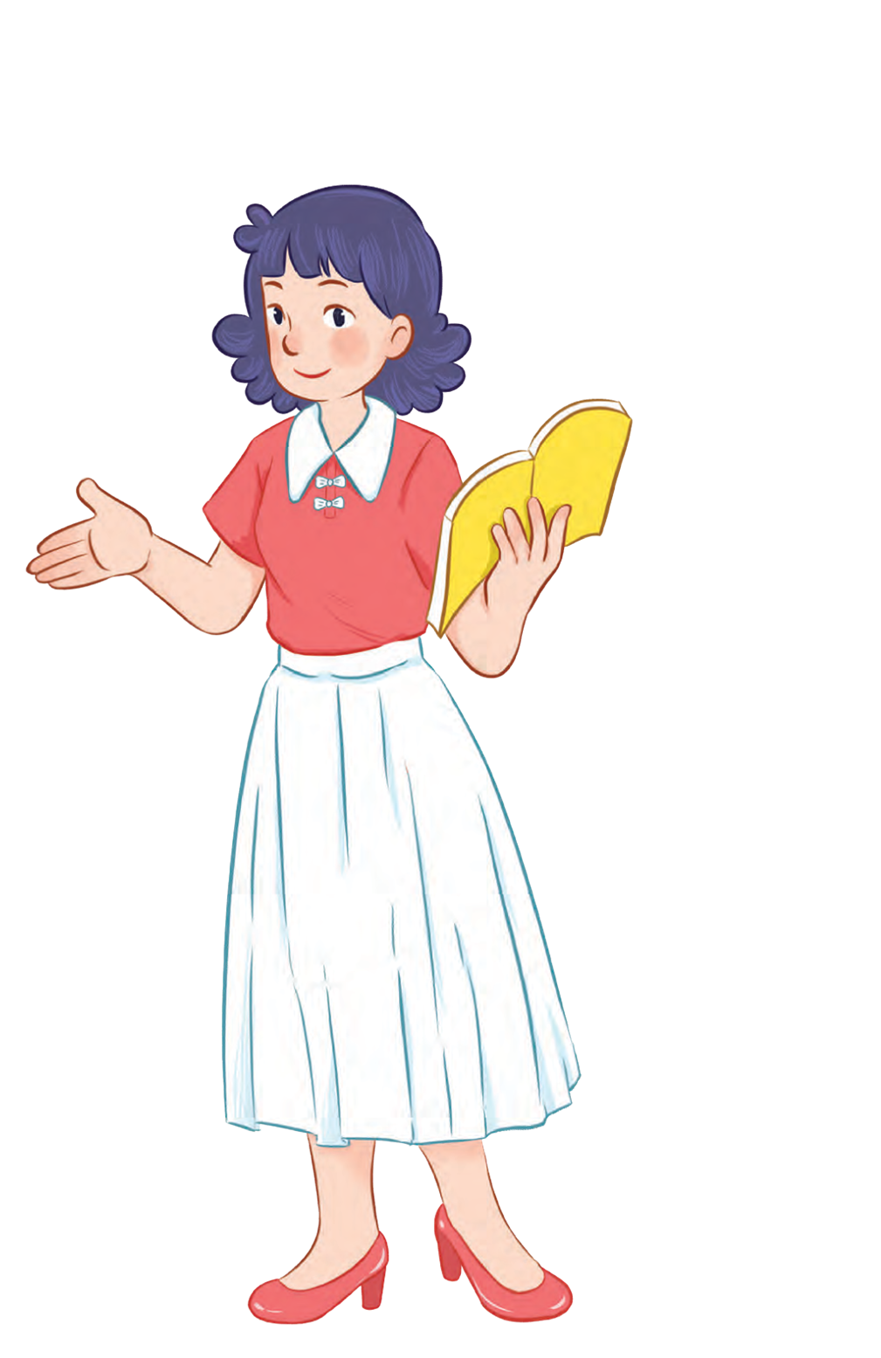



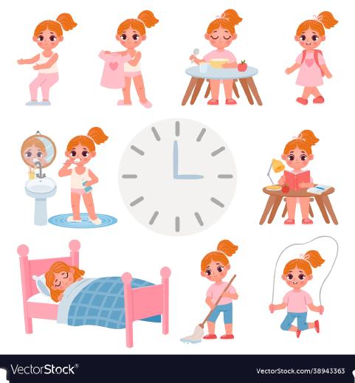


Unit 2
Time and
daily routine
MsPham
0936082789
Lesson 3 – Period 1

Slide 2

Warm up

Slide 3


MsPham
0936082789
MsPham
0936082789
Review

Slide 4

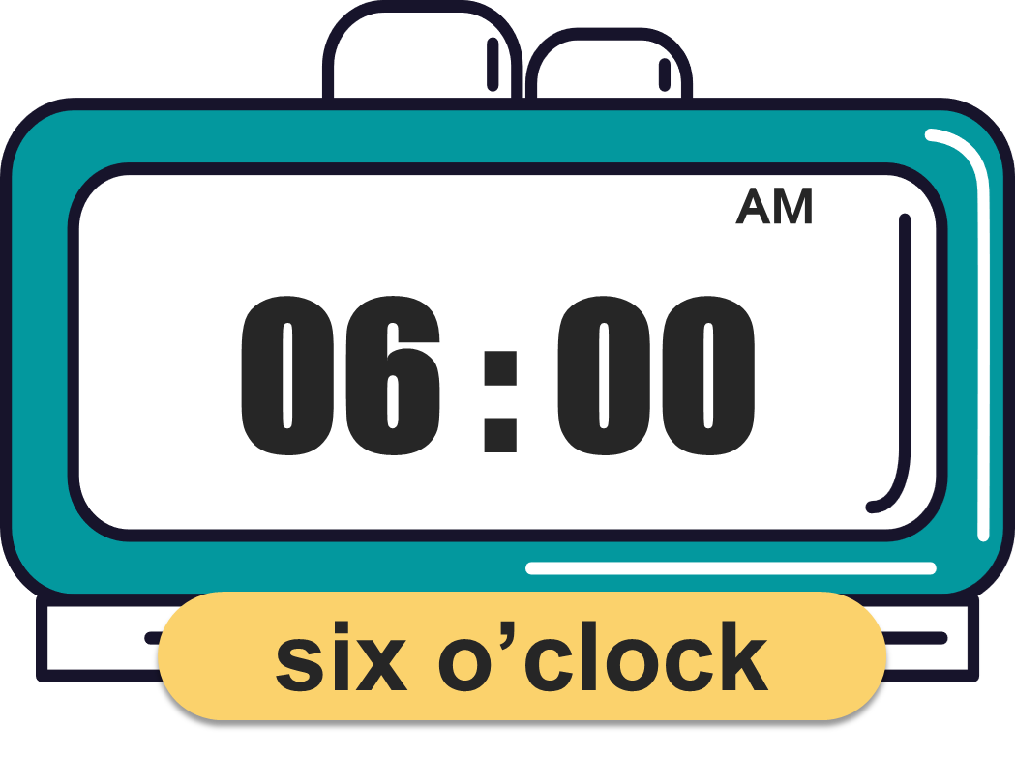
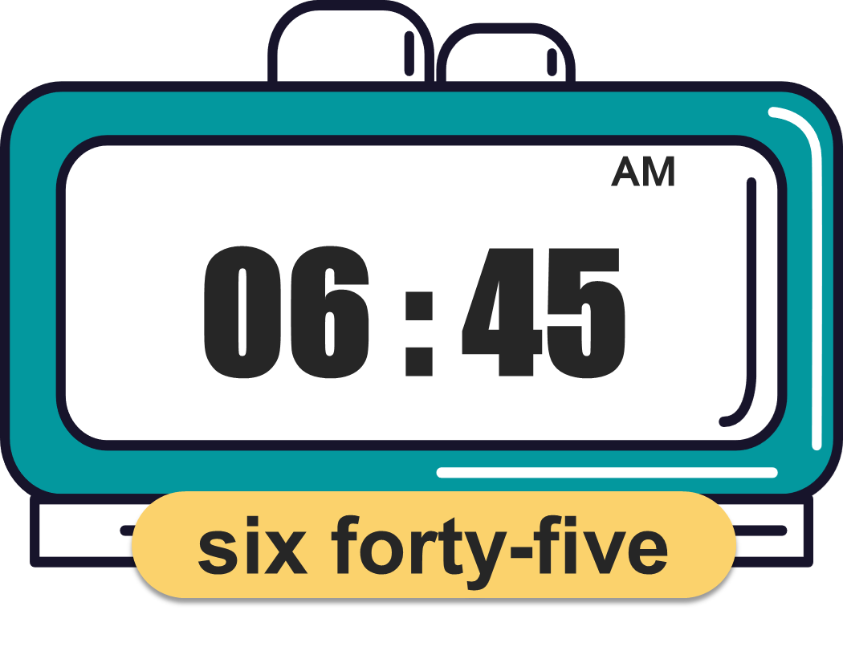
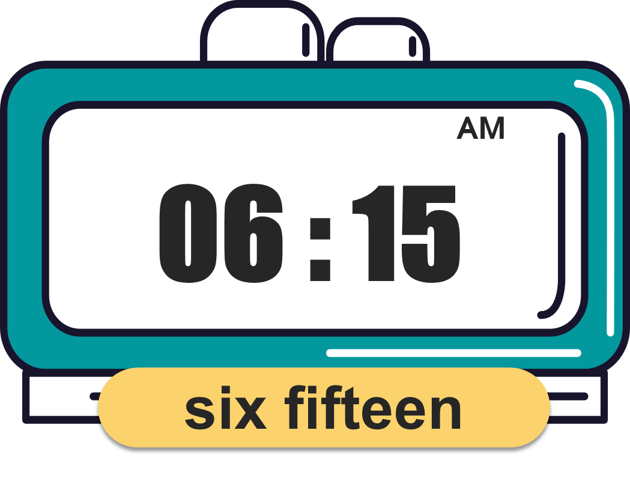
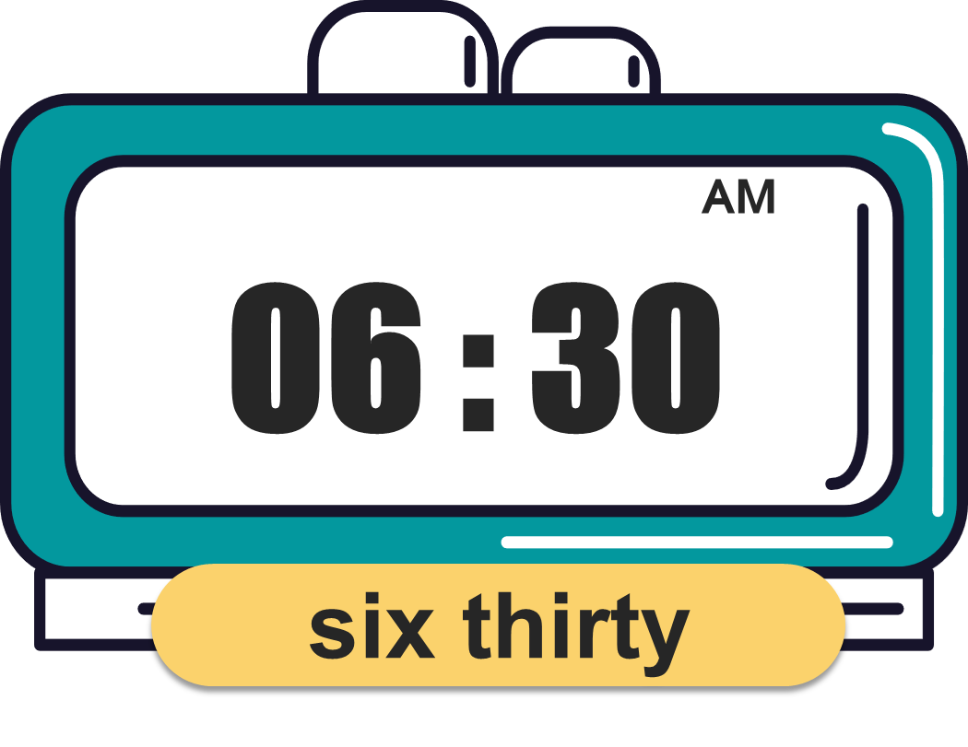
What time is it?
(Mấy giờ rồi?)
MsPham
0936082789
It’s _________.
(____)
MsPham
0936082789

Slide 5




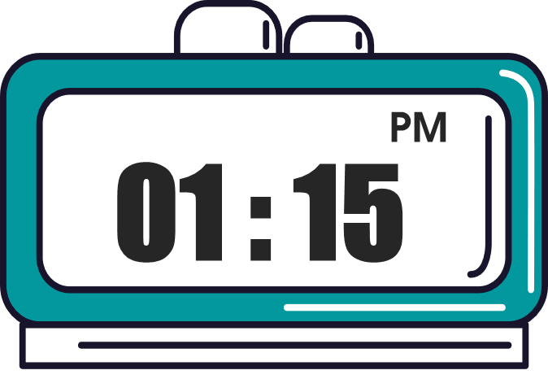




What time do you _______?
I ________ at ________.
MsPham
0936082789
get up
go to bed
have breakfast
go to school

Slide 6
MsPham
0936082789
MsPham
0936082789
Phonics

Slide 7


Slide 8
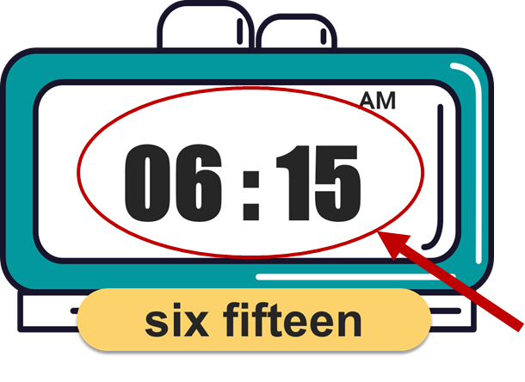

Phonics
time
t
/t/
/taɪm/
get up
/ɡet ʌp/
fifteen
/ˌfɪfˈtiːn/
Notes:
https://www.youtube.com/watch?v=8z3E7OM43gY&list=PL8_ETpRL2xNbJTjsq6q8ex0yMu7g61wrf

Slide 10
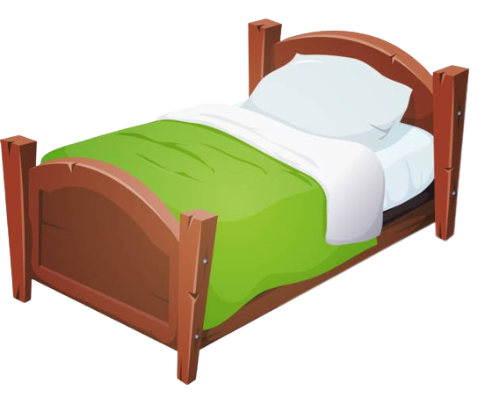


Phonics
bed
d
/d/
/bed/
read
/riːd/
friend
/frend/
Notes:
https://www.youtube.com/watch?v=8z3E7OM43gY&list=PL8_ETpRL2xNbJTjsq6q8ex0yMu7g61wrf

Slide 11
MsPham
0936082789
MsPham
0936082789
Practice

Slide 12

1
Listen and repeat.
t
get
What time do you get up?
d
bed
What time do you go to bed?

Slide 13

2
Listen and circle.
1.
I ________ at six thirty.
a. get up b. chat with my friends c. read a book
2.
I ________ at five forty-five.
a. go out b. watch TV with my dad c. go to bed

Slide 14

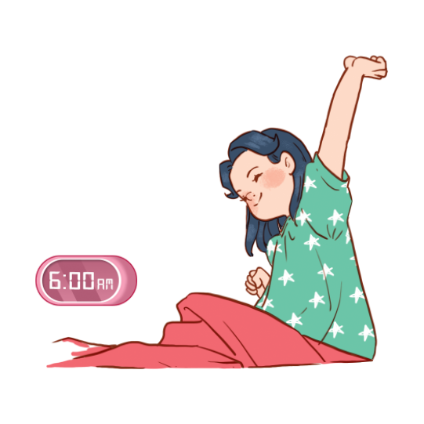
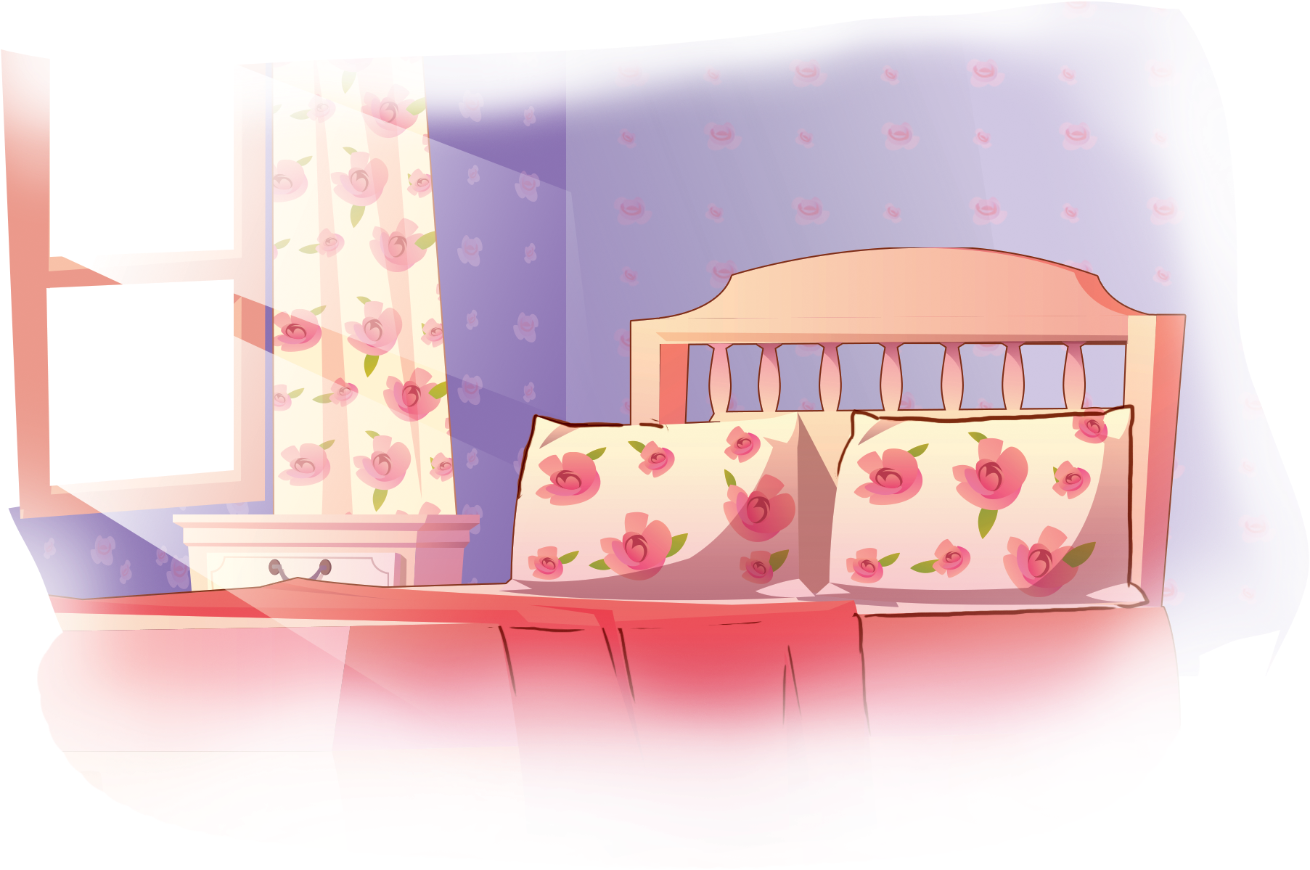
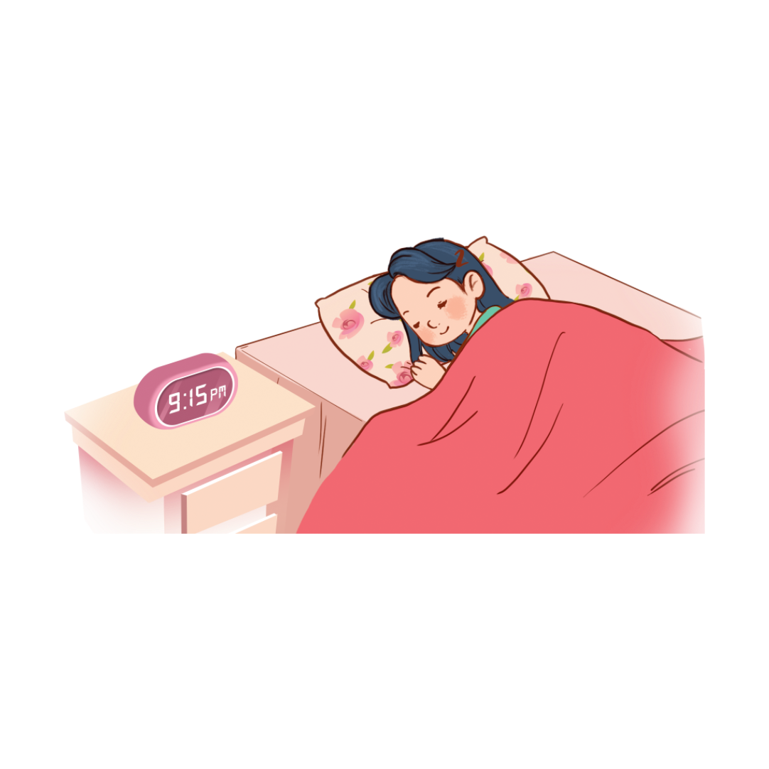
3
Let’s chant.
Get up, get up
Get up, get up
Get up, get up
Get up, get up
I get up at six o’clock.
I get up at six o’clock.
I get up at six o’clock.
I get up at six o’clock.
I get up at six o’clock.
I get up at six o’clock.
I get up at six o’clock.
I get up at six o’clock.
Go to bed, go to bed
Go to bed, go to bed
Go to bed, go to bed
Go to bed, go to bed
I go to bed at nine fifteen.
I go to bed at nine fifteen.
I go to bed at nine fifteen.
I go to bed at nine fifteen.
I go to bed at nine fifteen.
I go to bed at nine fifteen.
I go to bed at nine fifteen.
I go to bed at nine fifteen.
Hide

Slide 15

3
Let’s chant.
Get up, get up
Get up, get up
I get up at six o’clock.
I get up at six o’clock.
I get up at six o’clock.
I get up at six o’clock.
Go to bed, go to bed
Go to bed, go to bed
I go to bed at nine fifteen.
I go to bed at nine fifteen.
I go to bed at nine fifteen.
I go to bed at nine fifteen.

Slide 16
MsPham
0936082789
Thank you!

