Slide 1
Let’s chant
a a a America
a a a Australia
b b b Britain
v v v Viet nam

Slide 2
Unit 1
My friends
Lesson 2 - Period 1

Slide 3
1
Look, listen and repeat.

Slide 4


Look and guess.

Slide 5

Japan

Slide 6

Malaysia

Slide 7

Singapore

Slide 8

Thailand

Slide 9
2
Listen, point and say.

Slide 10
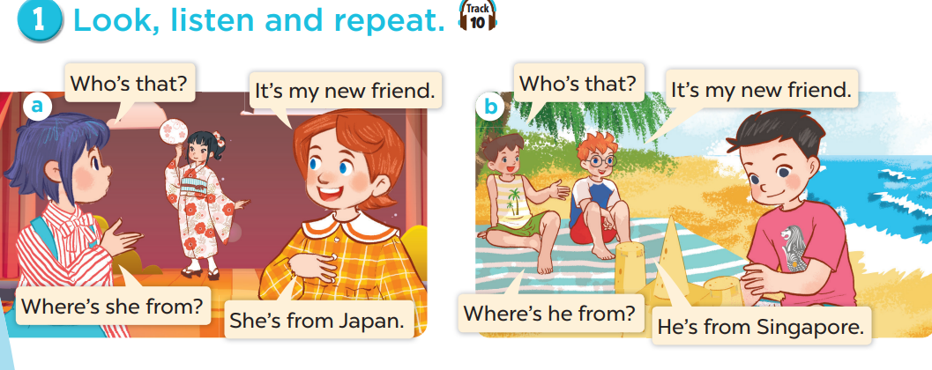
Look and think.
Notes:
Draw pupils' attention to the words HE and SHE. Ask them to think of the differences.

Slide 11



Where’s he from?
He’s from Singapore.

Slide 12

Where’s she from?
She’s from Thailand.

