Slide 1



13
Our house
LESSON 3 PERIOD 5

Slide 2
TABLE OF CONTENTS
Activity 4
Review and warm up
01.
02.
Activity 5
Activity 6
03.
04.
Listen and circle
Game
Look, complete and read
Let’s sing
Fun corner
Extra stuff
05.
06.
Game
Links

Slide 3
01.
Warm up & review

Slide 4

2
5
7
4
1
8
3
6
Notes:
Students compete in teams to earn carrots. The team getting more carrots is the winner.
Click the number to go to the question

Slide 5

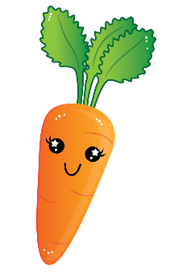


=
-
=
Notes:
There’s a bomb and an egg. Number with the egg is the lucky number.

Slide 6

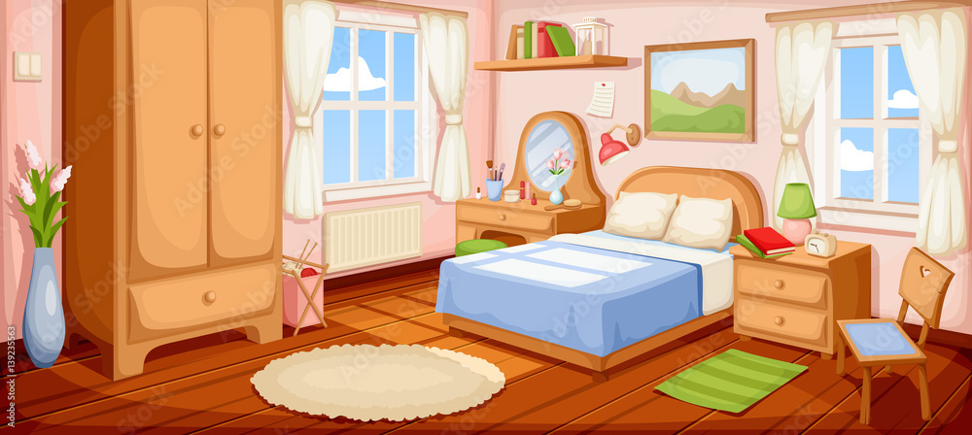



Where is the bedroom?
It’s here!
Notes:
Teacher says the first sentence. Student replies using the new structure. Click the rabbit to go back to question slide.
https://stock.adobe.com/images/id/139235563?as_audience=srp&as_campaign=Freepik&get_facets=1&order=relevance&safe_search=1&as_content=api&k=bedroom&as_camptype=test-apibanner3-b&tduid=084872d8d0bb09678f1874f5c5b99d1c&as_channel=affiliate&as_campclass=redirect&as_source=arvato

Slide 7
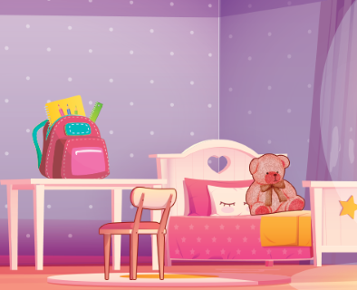

Where is the bed?
You have an egg!
It’s there!
Notes:
Teacher says the first sentence. Student replies using the new structure. Click the rabbit to go back to question slide.

Slide 8
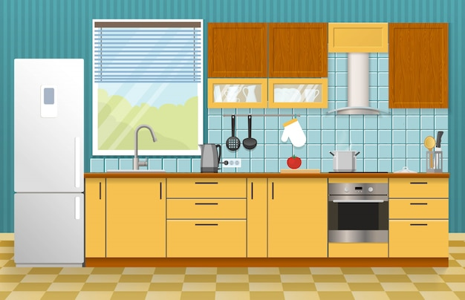
Where is the kitchen?
It’s here!
It’s here!
Notes:
Teacher says the first sentence. Student replies using the new structure. Click the rabbit to go back to question slide.
https://www.freepik.com/free-vector/kitchen-interior-concept_9399298.htm#query=kitchen&position=38&from_view=search

Slide 9

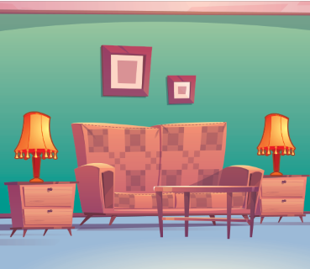
Where are the lamps?
Good luck next time!
They are in the living room.
Notes:
Teacher says the first sentence. Student replies using the new structure. Click the rabbit to go back to question slide.

Slide 10
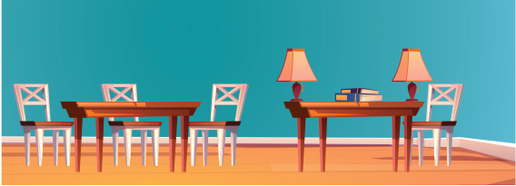
Where are the books?
They are on the table.
Notes:
Teacher says the first sentence. Student replies using the new structure. Click the rabbit to go back to question slide.

Slide 11
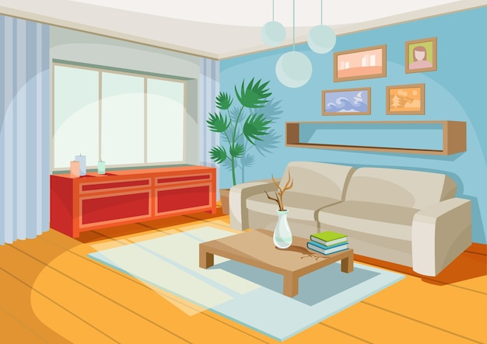
Where is the living room?
It’s here!
Notes:
Teacher says the first sentence. Student replies using the new structure. Click the rabbit to go back to question slide.

Slide 12
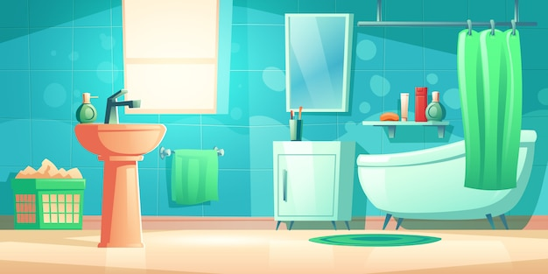
Where is the bathroom?
It’s there!
Notes:
Teacher says the first sentence. Student replies using the new structure. Click the rabbit to go back to question slide.

Slide 13
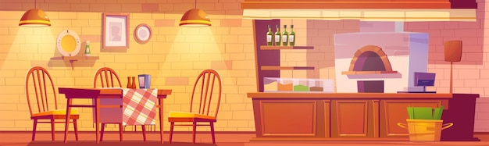
Where are the table?
It’s in the kitchen.
Notes:
Teacher says the first sentence. Student replies using the new structure. Click the rabbit to go back to question slide.

Slide 14
02.
Activity 1
Listen and repeat

Slide 15
/aʊ/
ou
h
se
Wow, it’s a big house!

Slide 16
/aʊ/
ow
br
n
Wow, it’s a brown house!

Slide 17
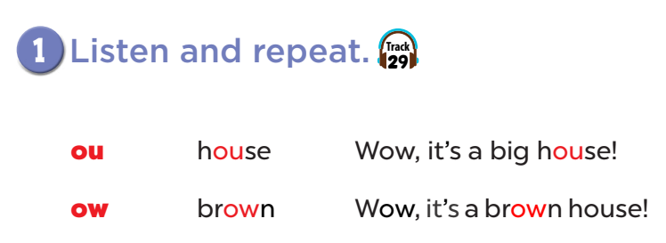


Slide 18
03.
Activity 2
Listen and circle

Slide 19
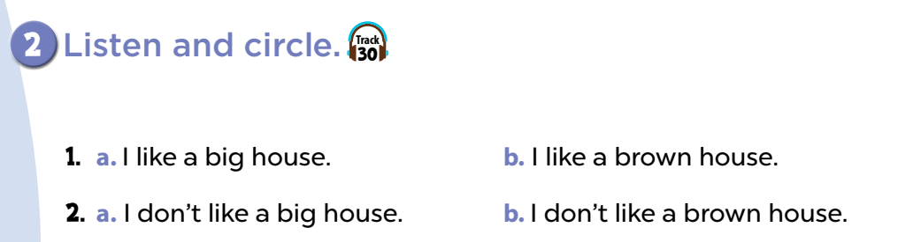

Slide 20
04.
Activity
Let’s chant

Slide 21
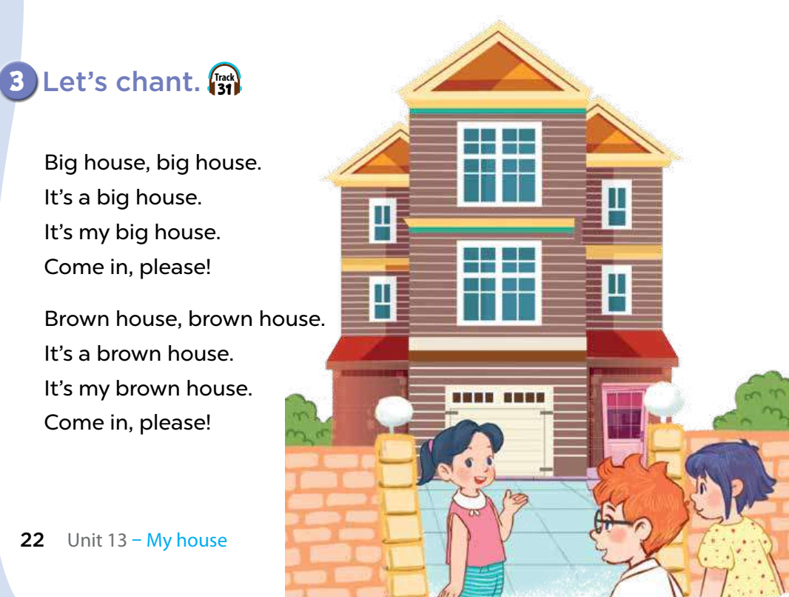

Slide 22
05
Fun corner
Let’s have some fun!

Slide 23
06.
Extra stuffs

