Slide 1



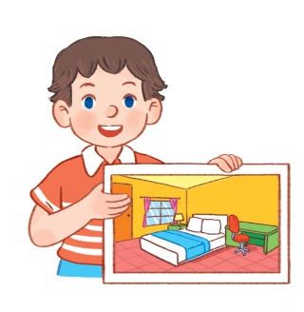

14
My bedroom
LESSON 2 - Period 4

Slide 2



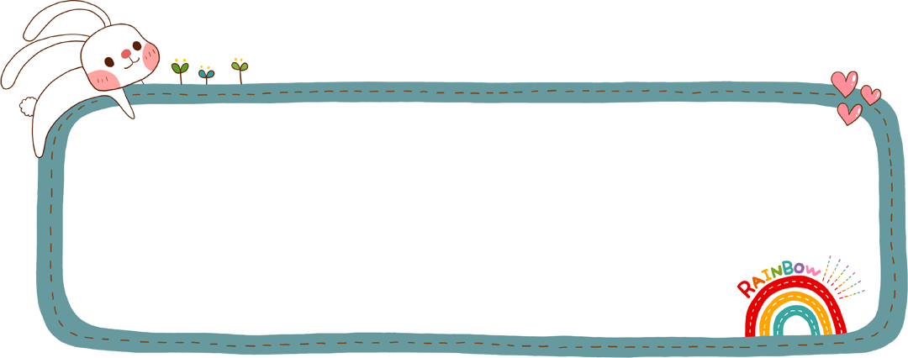




1. Warm up & review
Notes:
Revising the previous vocabulary.

Slide 3
Game: Bricks down
Notes:
Revising the previous vocabulary.

Slide 4


BRICKS DOWN
Notes:
Game: Bricks down

Slide 5

windows
Notes:
Key: windows

Slide 6
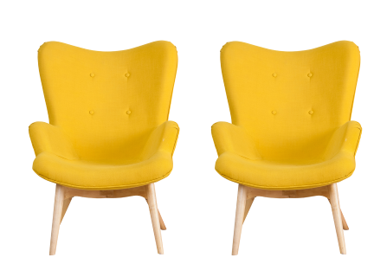
chairs
Notes:
Key: chairs

Slide 7

doors
Notes:
Key: doors

Slide 8
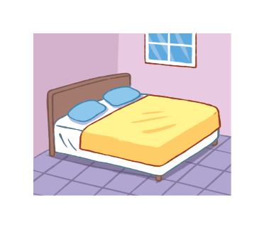
bed
Notes:
Key: bed

Slide 9
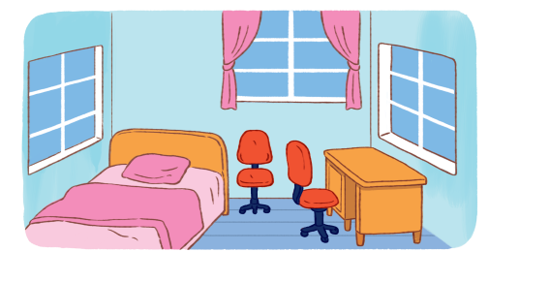
chair/desk
Notes:
Key: desk

Slide 10
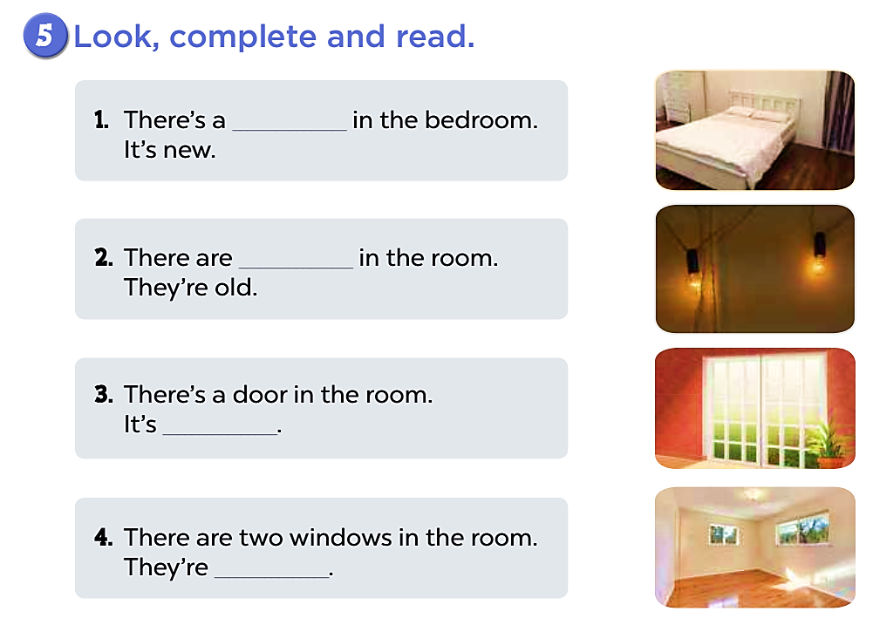
lamps
Notes:
Key: lamps

Slide 11
2. Listen and number
Notes:
Step 1: Have pupils look at the pictures and ask them some questions such as What is this? and What are these? You may explain that they can see a bed in Pictures a and b, but that the bed in Picture a is big and the bed in Picture b is small. Ask them to talk about the chairs in Pictures c and d. Check comprehension.
Step 2: Play the recording all the way through so that pupils can get familiar with the characters’ voices. Then play the recording for them to listen and number the pictures.
Step 3: Let them swap and check the answers before checking as a class. Correct the answers as necessary.
Step 4: If time allows, play the recording, sentence by sentence, for the class to listen and repeat in chorus. Correct pronunciation if necessary.

Slide 12
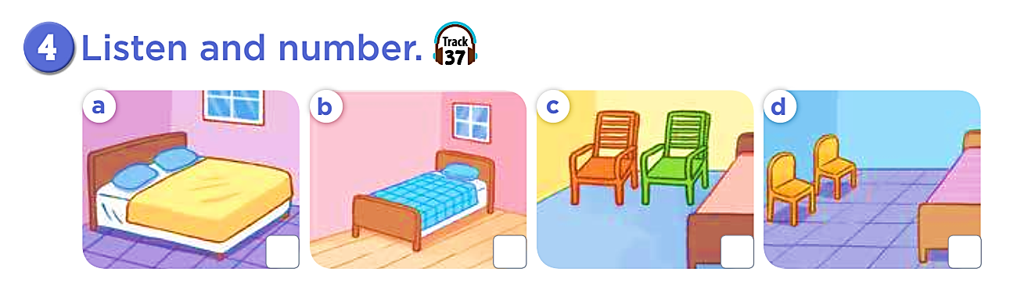

Notes:
Key: 1. b 2. a 3. c 4. d
1. There’s a bed in my bedroom. It’s small.
2. There’s a bed in my bedroom. It’s big.
3. There are two chairs in my bedroom. They’re big.
4. There are two chairs in my bedroom. They’re small.

Slide 13
2
1
3
4
Notes:
Key: 1. b 2. a 3. c 4. d
1. There’s a bed in my bedroom. It’s small.
2. There’s a bed in my bedroom. It’s big.
3. There are two chairs in my bedroom. They’re big.
4. There are two chairs in my bedroom. They’re small.

Slide 14
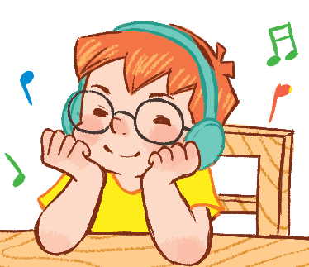
Game: Listen and choose
A or B

Slide 15
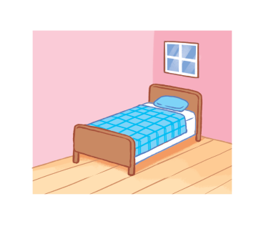
1
A
B
Notes:
Key: A

Slide 16
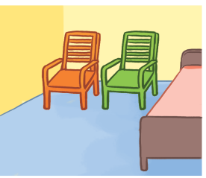
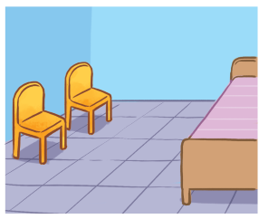
2
A
B
Notes:
Key: B

Slide 17
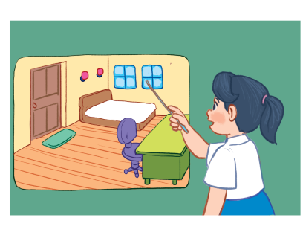
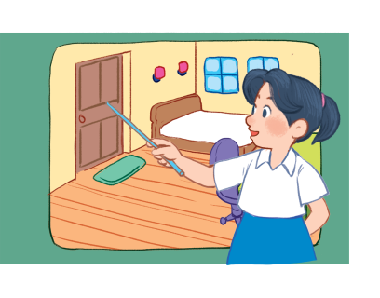
3
A
B
Notes:
Key: B

Slide 18
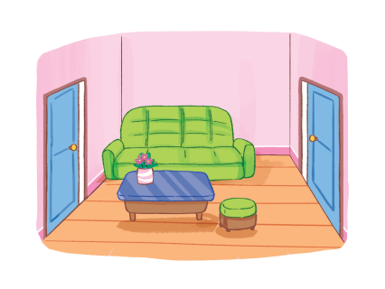
4
A
B
Notes:
Key: A

Slide 19
5
A
B
Notes:
Key: A

Slide 20
6
A
B
Notes:
Key: B

Slide 21
3. Look, complete and read
Notes:
Step 1: Have pupils read the first gapped sentence. Ask them: What is missing from sentence 1? (e.g. the thing in the bedroom). Then have them look at the picture. Ask: What’s this? (e.g. It’s a bed.). Ask pupils what word they should use to fill the gap (e.g. bed). Check comprehension. Step 2: Give pupils a time limit to read the other gapped sentences, look at the pictures, and fill in the gaps independently. Go around the classroom and give further support to pupils who find it difficult to do the task. Step 3: Ask pupils to swap and check their answers. Correct the answers. Step 4: Invite a few pupils to read the completed texts aloud in front of the class.

Slide 22
bed
two
lamps
Notes:
Key: 1. bed 2. two lamps 3. big 4. small

Slide 23
big
small
Notes:
Key: 1. bed 2. two lamps 3. big 4. small

Slide 24
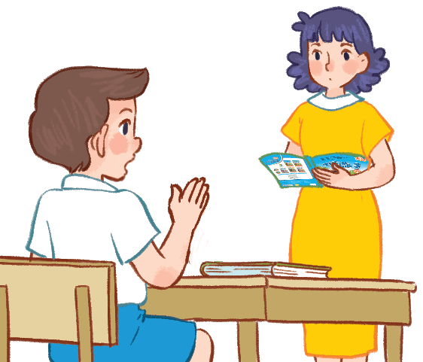
Correct
these
sentences
Notes:
Mini game: Sentence Correction Game
- Divide class into 4 groups.
- Ask pupils to look at the pictures and read the sentences carefully. Then set time in 5 seconds for pupils to identify and point (or circle) the incorrect word. Then ask them to say the correct one.

Slide 25


1. There’s a bed in the bedroom. It’s big.
+2
+2

Slide 26

2. There are two windows in the room.
+4
+4

Slide 27

3. There is a desk in the living room.
+3
+3

Slide 28
4. There is a lamp in the bedroom.
+2
+2

Slide 29
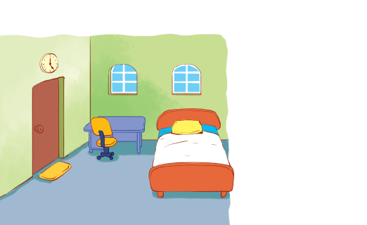

5. There are two chairs in the bedroom.
+3
+3

Slide 30
6. There’s a bed in the room. It’s small.
+2
+2

Slide 31

7.The door is there.
+3
+3

Slide 32
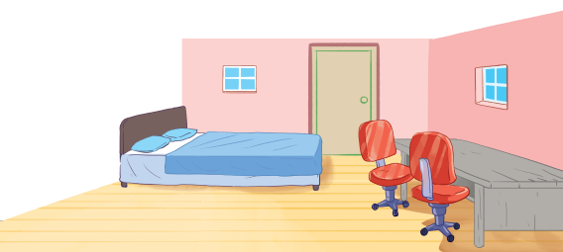
8.There are two doors in the bedroom.
+4
+4

Slide 33
4. Let’s sing!
Notes:
Step 1: Have pupils read the first verse of the lyrics. Then have them say its main idea. Draw their attention to the thing in the bedroom (e.g. bed) and how it is described (e.g. new). Check comprehension and give feedback.
Step 2: Have pupils listen to the whole verse, drawing their attention to the pronunciation, the rhythm and the melody. Then let pupils listen to the verse and practise singing it, line by line first while clapping their hands.
Step 3: Repeat Steps 1 and 2 with the second verse. Draw pupils’ attention to the things in the bedroom (e.g. Two windows) and how they are described (e.g. small).
Step 4: When pupils are familiar with the tune and melody, ask them to sing the whole song and clap their hands. You may get groups of pupils to sit face to face to practise singing and clapping their hands.
Step 5: Invite a few groups to the front of the class to sing the song. The class may sing along and clap hands to reinforce the activity.

Slide 34
LET’S MAKE
YOUR SONG!

Slide 35
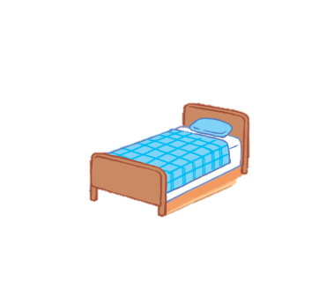

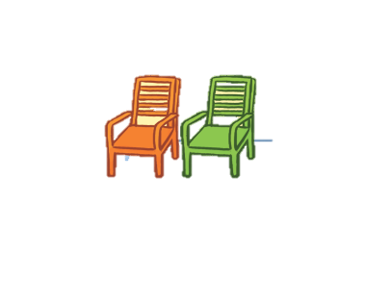
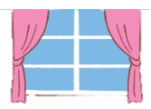
Let’s
decorate
your dream
bedroom!
Notes:
Option 3: Let’s decorate your bedroom!
- Ask pupils to work in pairs/ in group of four.
- Each pupil will draw things in his/her bedroom. Then introduce this picture to their friends.

Slide 36
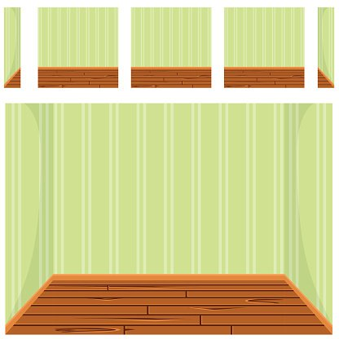

Slide 37
There’s a bed in my bedroom. It’s big.

Slide 38
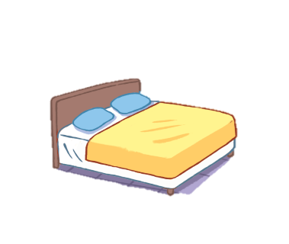


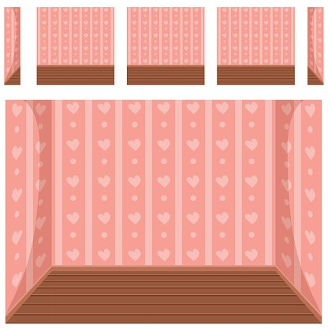
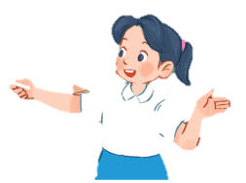

Slide 39
There are two chairs in my bedroom.

Slide 40

Goodbye!

