Slide 2


WELCOME
To Our Class

Slide 3
Unit 3: At the seaside
Lesson 1 – Period 1

Slide 4
TABLE OF CONTENTS
  Warm-up & Review
  Activity 1: Listen and repeat.
  Activity 2: Point and say.
  Fun corner & Wrap-up

Slide 5
01
Warm-up & Review
Game: Sing and complete

Slide 6

Where’s Kate?
She’s in the yard.
Is she ____ a bike?
Yes, __ is. Yes, __ is.
Where’s Ken?
He’s in the yard.
Is he riding a ___?
No, __ isn’t. No, __ isn’t.
riding
she
she
bike
he
he

Slide 7
Where’s Kate?
She’s in the yard.
Is she ____ a bike?
Yes, __ is. Yes, __ is.
Where’s Ken?
He’s in the yard.
Is he riding a ___?
No, __ isn’t. No, __ isn’t.
riding
she
she
bike
he
he

Slide 8



Unit
02
Activity 1
Listen and repeat.

Slide 9



Unit
1. Listen and repeat.
seaside

Slide 10


Unit
1. Listen and repeat.
sail
sand
sea

Slide 11
Unit
1. Listen and repeat.
sail
sand
seaside
sea

Slide 12



Let’s guess!
What’s the picture?
sand
Notes:
Click the picture 3 times for pupils to guess.
Click the word to hear the sound.

Slide 13

Let’s guess!
What’s the picture?
sea
Notes:
Click the picture 3 times for pupils to guess
Click the word to hear the sound

Slide 14
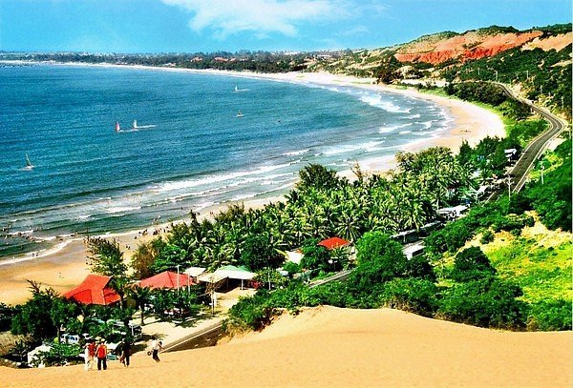
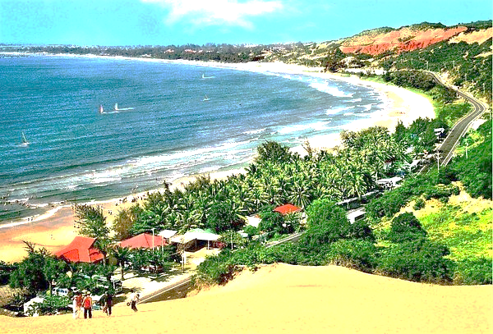
What’s the picture?
seaside
Notes:
Click the picture 3 times for pupils to guess
Click the word to hear the sound

Slide 15
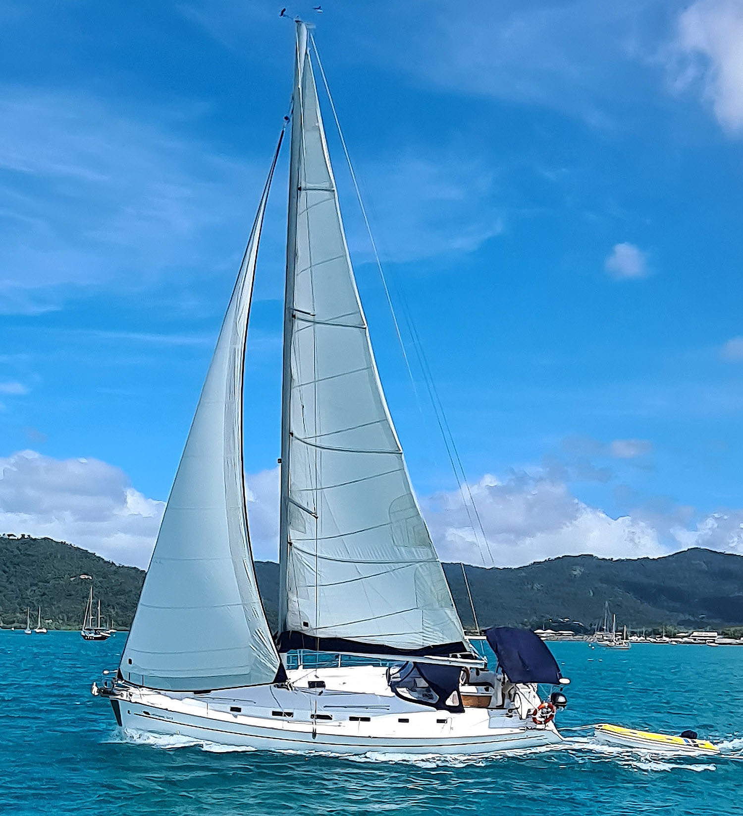
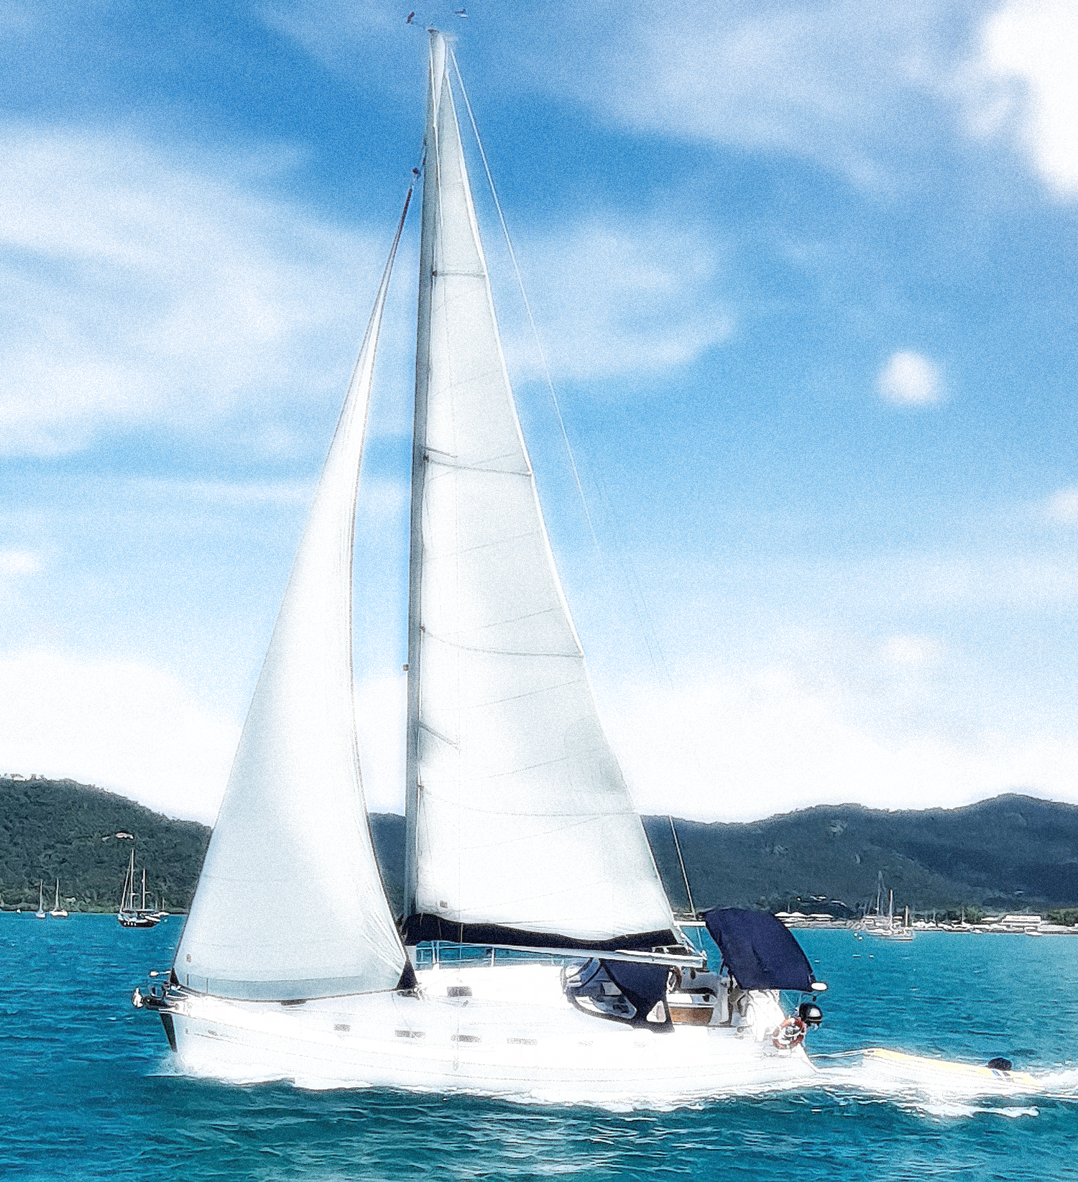

What’s the picture?
sail
Notes:
Click the picture 3 times for pupils to guess
Click the word to hear the sound

Slide 16
Unit
03
Activity 2
Point and say.

Slide 17


Unit
s
Point and say.
seaside
Notes:
Click letter S to hear the sound
Click to see the picture and the word
Click the word to hear the sound

Slide 18

Unit
s
Point and say.
sail
Notes:
Click letter S to hear the sound
Click to see the picture and the word
Click the word to hear the sound

Slide 19

Unit
Point and say.
s
sea
Notes:
Click letter S to hear the sound
Click to see the picture and the word
Click the word to hear the sound

Slide 20
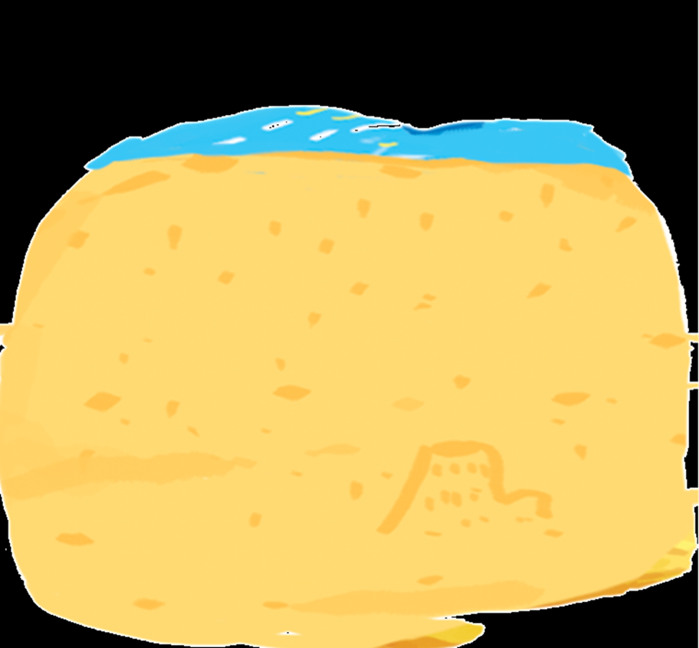
Unit
s
Point and say.
sand
Notes:
Click letter S to hear the sound
Click to see the picture and the word
Click the word to hear the sound

Slide 21
Unit
s
Point and say.
seaside
sail
sea
sand

Slide 22

Unit
Point and say.
GROUP WORK

Slide 23

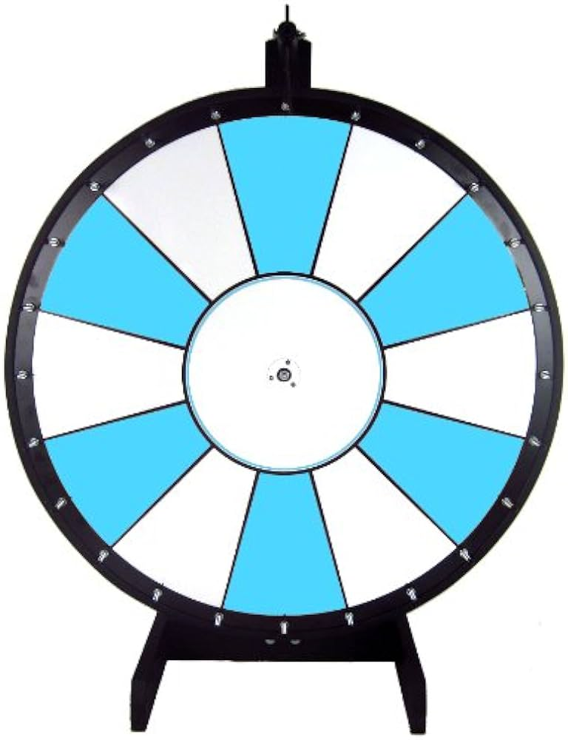





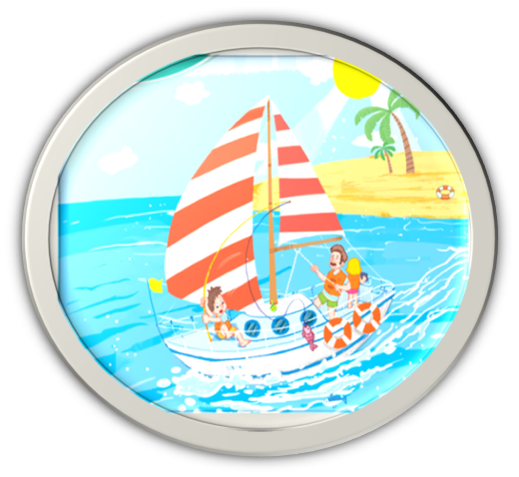
Unit
Point and say.
Notes:
Click the hand to spin and stop the wheel

Slide 24
04
Fun corner & Wrap-up
Game: Pelmanism

Slide 25








Game: Pelmanism
sand
seaside
sea
sail
Notes:
Click to open or cover the pictures and the words

Slide 26


Slide 27
GOODBYE!
See you next time!

Slide 28
Website: hoclieu.vn
Fanpage: https://www.facebook.com/tienganhglobalsuccess.vn/

