Slide 2

Review 1
Period 3

Slide 3




Slide 4










Class Rules

Slide 5



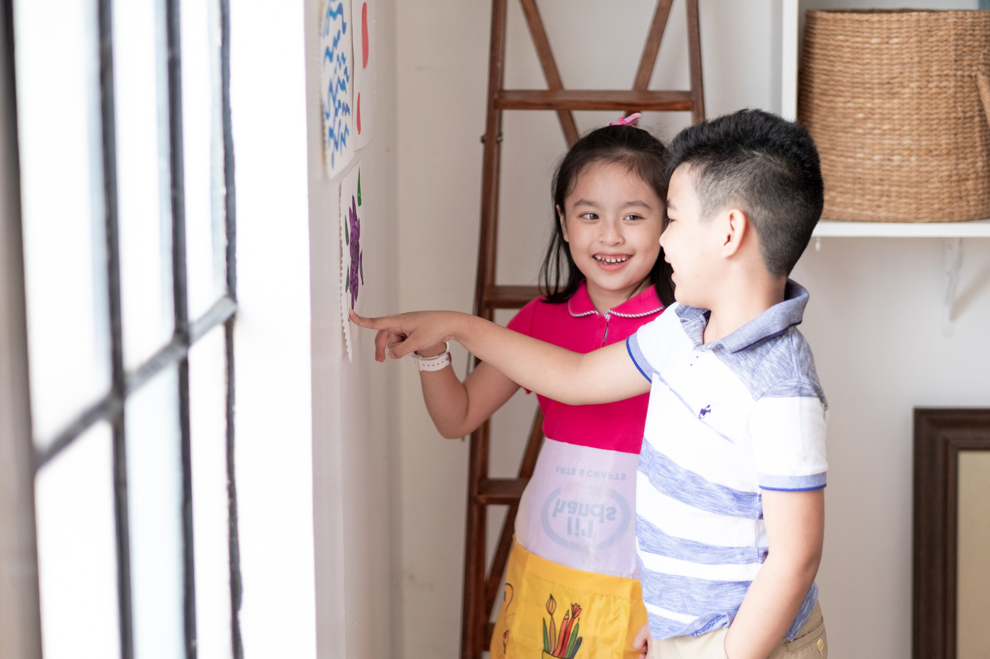



Rule 1
Listen to
your friend
talking in front.

Slide 6






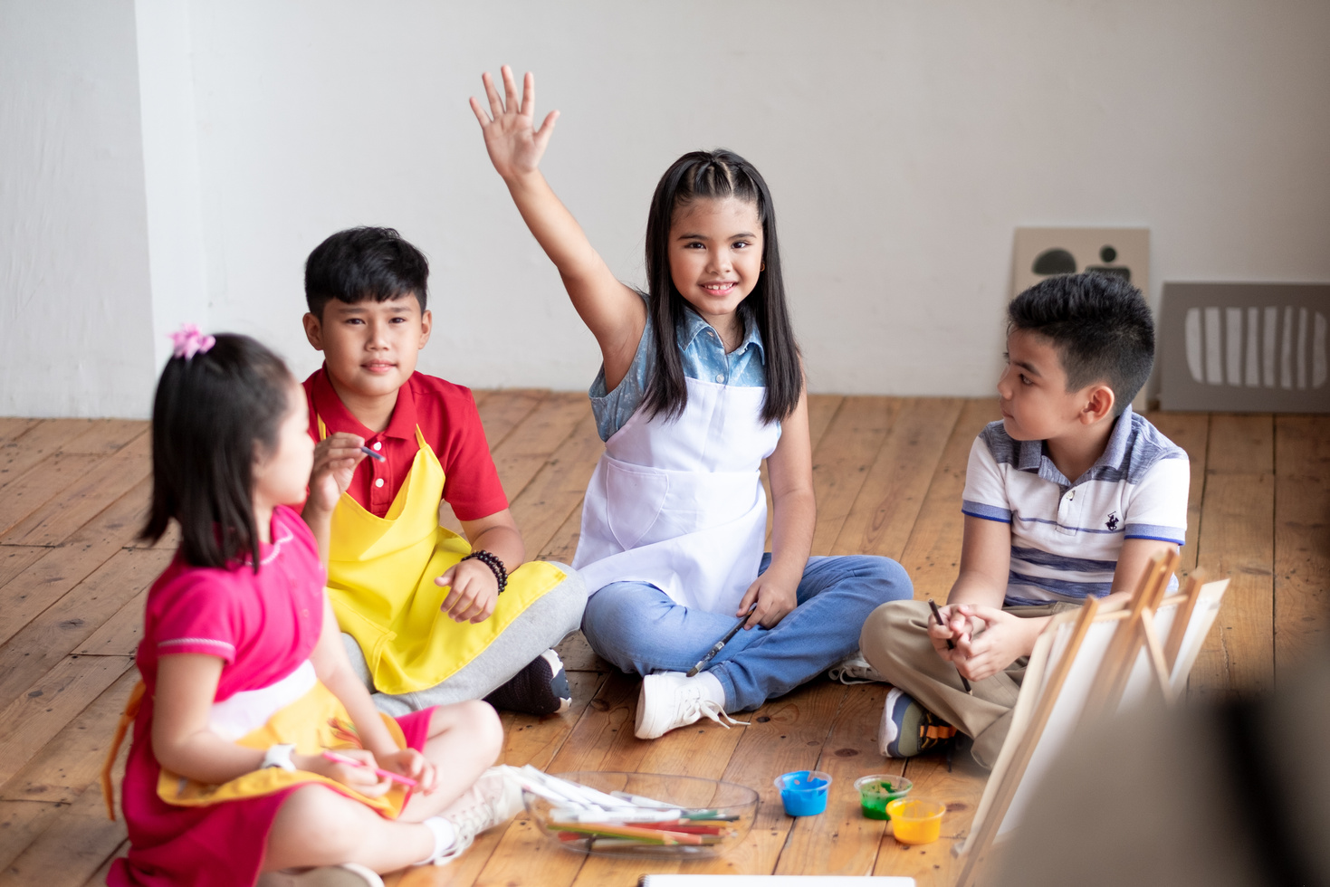

Rule 2
Raise your hand
if you have a question.

Slide 7




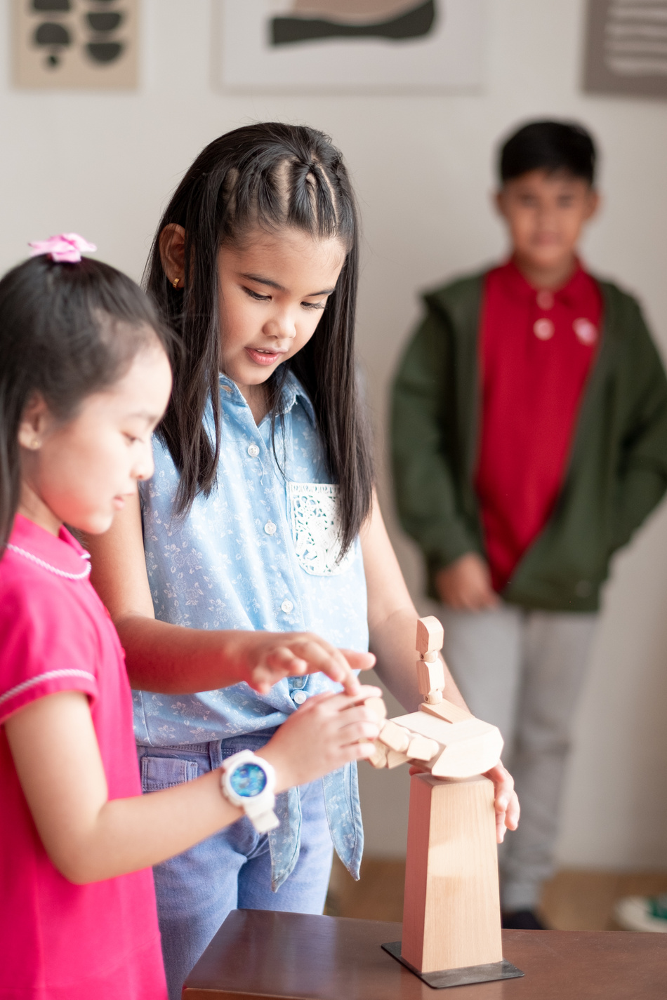


Rule 3
Wait for
your turn.

Slide 8







Review 1
1. Warm-up/ Review
2. Activity 4: Read and tick.
3. Activity 5: Guess, read and circle. Then say.
4. Activity 6: Write the words.

Slide 9
Review 1
01
Warm-up/ Review

Slide 10
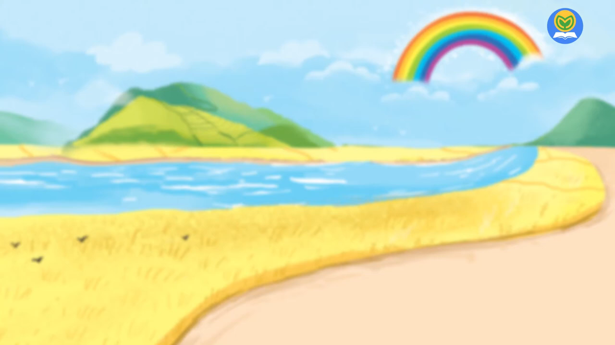
WARM-UP & REVIEW
Let’s sing

Slide 11


WARM-UP & REVIEW
Let’s sing!
What can you see?
What can you see?
What can you see?
What can you see?
I can see a rainbow.
I can see a rainbow.
I can see a rainbow.
I can see a rainbow.
A rainbow in the sky.
A rainbow in the sky.
A rainbow in the sky.
A rainbow in the sky.
What can you see?
What can you see?
What can you see?
What can you see?
I can see a river.
I can see a river.
I can see a river.
I can see a river.
A river near the road.
A river near the road.
A river near the road.
A river near the road.

Slide 12
02
Activity 4
Read and tick.

Slide 13









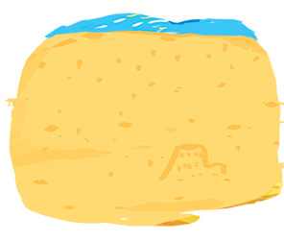


Review 1
Read and tick.
1
Let’s look at the river!
2
A: Is she flying a kite?
B: Yes, she is.
3
A: What can you see?
B: I can see a road.

Slide 14


Review 1
Read and tick.
1
Let’s look at the river!


Slide 15


Review 1
Read and tick.
A: Is she flying a kite?
B: Yes, she is.
2


Slide 16


Review 1
Read and tick.
A: What can you see?
B: I can see a road.
3


Slide 17
Review 1
03
Activity 5
Guess, read and circle. Then say.

Slide 18






Review 1
Guess, read and circle. Then say.
1
2
3

Slide 19



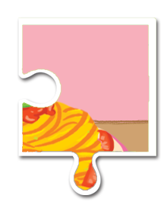
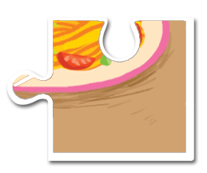
1
a.
The pizza is yummy.
b.
The pasta is yummy.

Slide 20





2
a.
I can see a sail.
b.
I can see a rainbow.

Slide 21





3
a.
Let’s look at the sea!
b.
Let’s look at the road!

Slide 22
Review 1
04
Activity 6
Write the words.

Slide 23
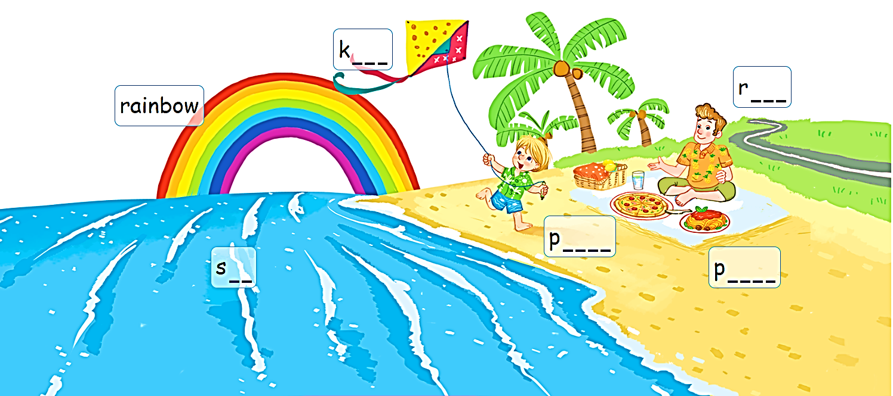
Review 1
6. Write the words.

Slide 24

Review 1
6. Write the words.
k_ _ _
k i t e

Slide 25

Review 1
6. Write the words.
s _ _
s e a

Slide 26

Review 1
6. Write the words.
p_ _ _ _
p i z z a

Slide 27

Review 1
6. Write the words.
p_ _ _ _
p a s t a

Slide 28
05
Fun corner & wrap-up
Game: ’’Yes or No’’

Slide 29
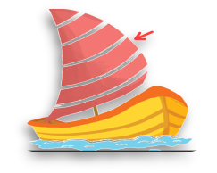
Game: ’’Yes or No’’
Question 1
Answers
A
Let’s look at the sea!
B
Let’s look at the sail!
Let’s look at the sand.
C

Slide 30

Game: ’’Yes or No’’
Question 2
Answers
He’s flying a kite.
A
He’s running.
B
C
He’s riding a bike.

Slide 31

Game: ’’Yes or No’’
Question 3
Answers
The pizza is yummy.
A
B
The pasta is yummy.
The popcorn is yummy.
C

Slide 32
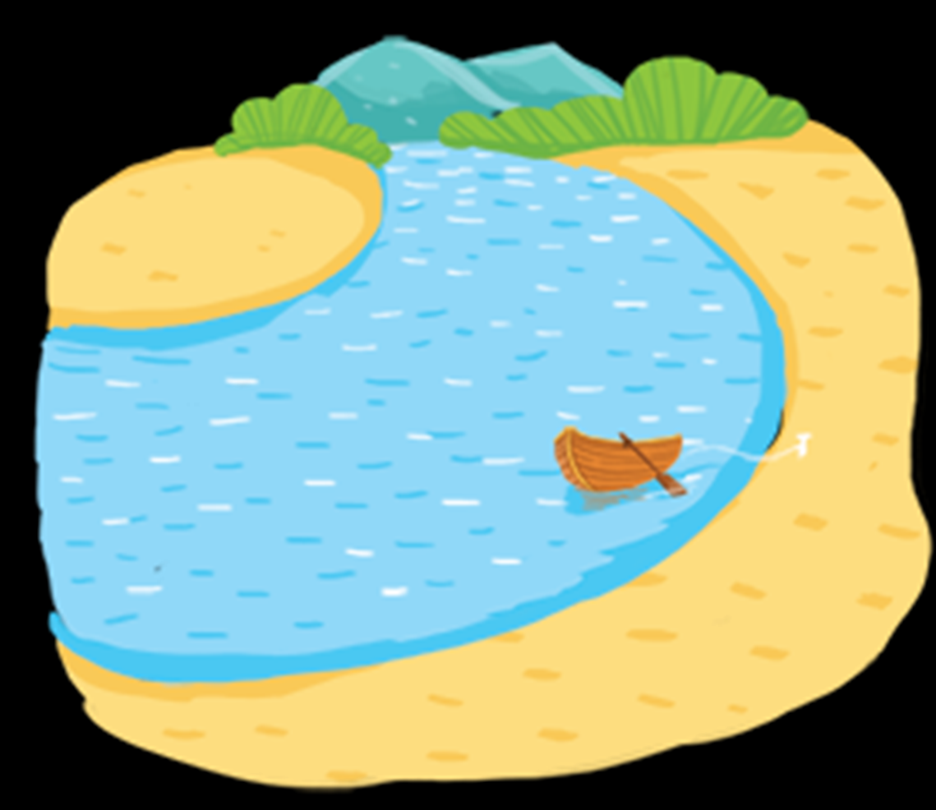
Game: ’’Yes or No’’
Question 4
Answers
A
I can see a river.
B
I can see a kite.
I can see a road.
C

Slide 33



Slide 34



Slide 35
Website: hoclieu.vn
Fanpage: facebook.com/www.tienganhglobalsuccess.vn

