Slide 2
Unit 5: In the classroom
Lesson 1 – Period 1

Slide 3
Table of contents
1. Warm-up and Review
2. Activity 1: Listen and repeat.
3. Activity 2: Point and say.
4. Fun corner and Wrap-up

Slide 4



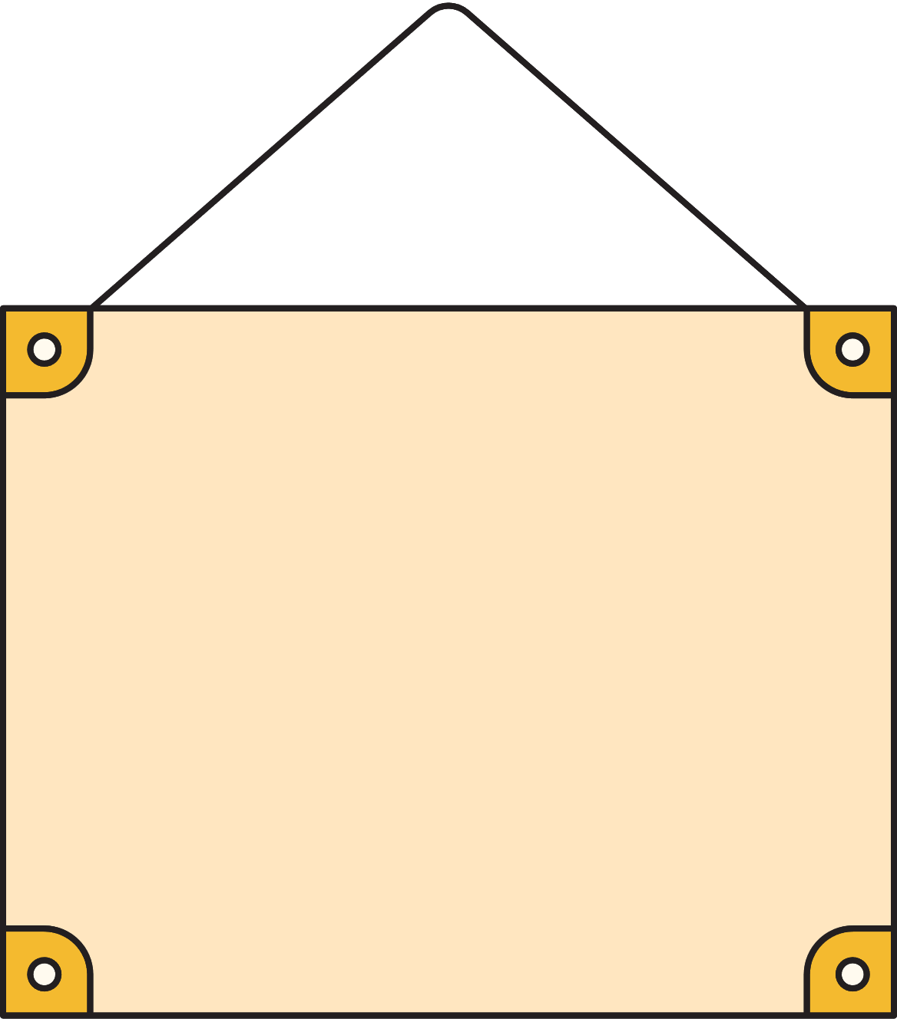
01
Warm-up & Review
Game: Crossword puzzle

Slide 5







6
R
2
O
S
3
5
R
A
I
N
B
O
W
A
4
S
A
N
D
1
R
I
V
E
R
L
A
Score

Slide 6












SCORE
Team 1
Team 2
Winner
1
2
Notes:
Click Team 1/ 2 to get point (presents)

Slide 7
Congratulations!
Team 1

Slide 8
Congratulation!
Team 2

Slide 9
02
Activity 1
Listen and repeat.

Slide 10









Unit
1. Listen and repeat.

Slide 11

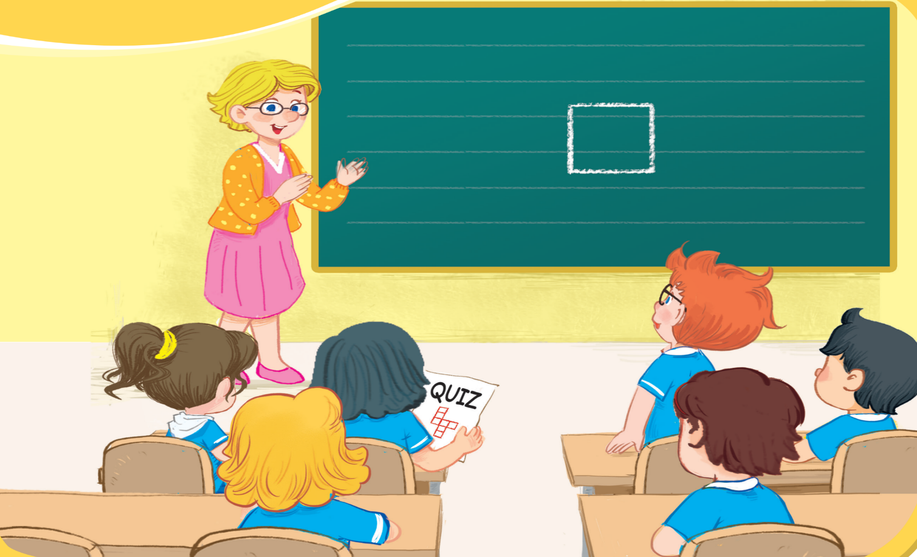




Unit
1. Listen and repeat.
question
square
quiz

Slide 12
Look and say aloud.
q
question

Slide 13

Look and say aloud.
q
square

Slide 14
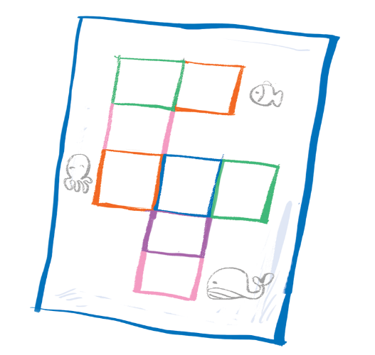
Look and say aloud.
q
quizz

Slide 15
03
Activity 2
Point and say.

Slide 16

Unit
2. Point and say.
question
square
quiz

Slide 17
04
Fun corner and Wrap-up

Slide 18
Game: Whispers

Slide 19


q
Notes:
Click the hot-air balloon to see the picture
Click the picture to hear the sound

Slide 20
q
Notes:
Click the hot-air balloon to see the picture
Click the picture to hear the sound

Slide 21
q
Notes:
Click the hot-air balloon to see the picture
Click the picture to hear the sound

Slide 22


Slide 23

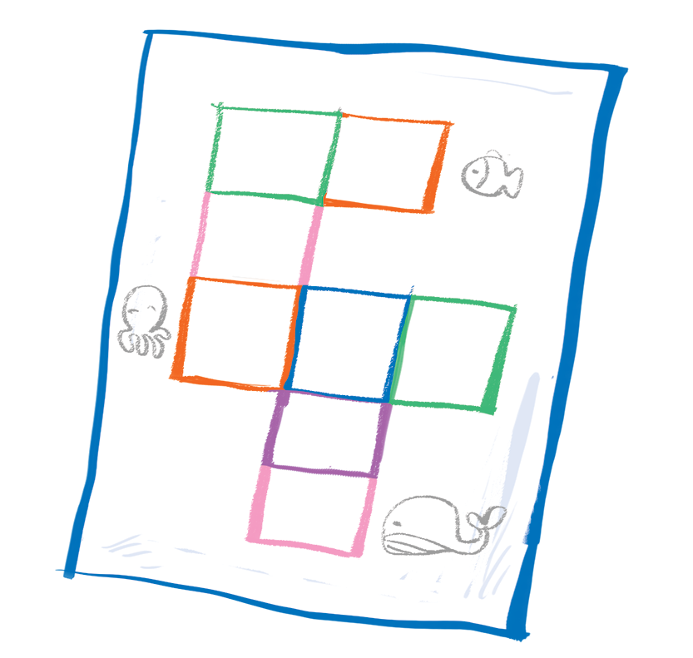
Time to say goodbye!
q

Slide 24


Slide 25
Website: hoclieu.vn
Fanpage: https://www.facebook.com/tienganhglobalsuccess.vn/

