Slide 2

Unit 9
Our outdoor activities
Lesson 1 - Period 2

Slide 3

Table of contents
01
Warm-up and Review
02
Activity 4. Listen and tick or cross.
03
Activity 5. Read and complete.
04
Activity 6. Let’s play.
05
Fun corner and Wrap-up

Slide 4


01
Warm-up and Review

Slide 5
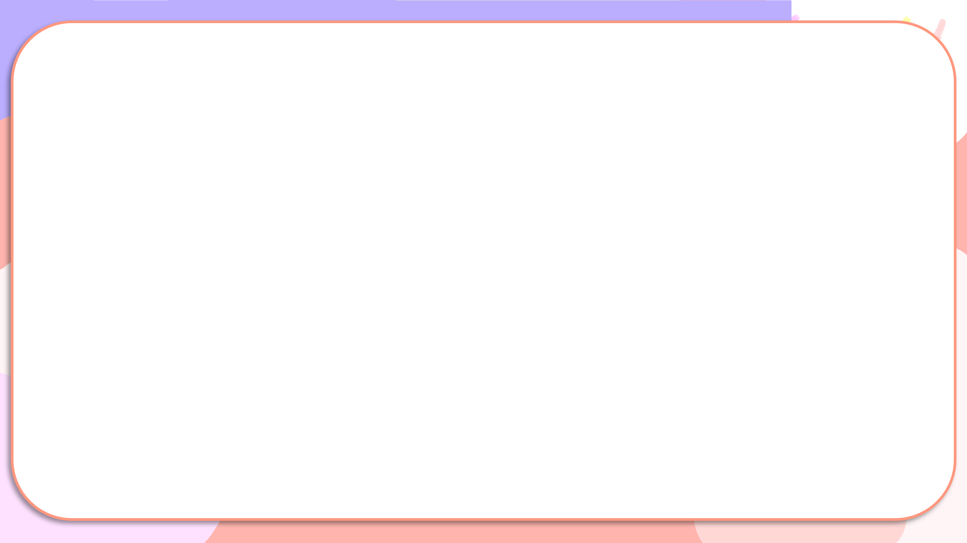

Were you at the ____ yesterday?
Yes, we were.
No, we weren’t.

Slide 6


Secret boxes
Game

Slide 7

Secret boxes
Game
Team 1
Team 2

Slide 8








Team 1
Team 2
Notes:
Nháy choột vào hộp để xuất hiện hình ảnh, mỗi lần nháy là 1 hình ảnh hiện ra và hình ảnh trước sẽ bi biến mất.
GV ghi điểm cho HS bằng cách nháy vào tên team. Mỗi lần nháy 1 ngôi sao xuất hiện.

Slide 9
02
Activity 4.
Listen and tick or cross.

Slide 10

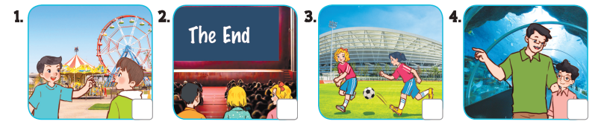
Listen and tick or cross.

Slide 11

Listen and tick or cross.
✓

Slide 12
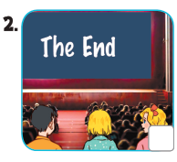
Listen and tick or cross.
✗

Slide 13
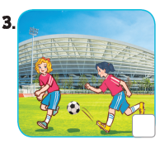
Listen and tick or cross.
✗

Slide 14

Listen and tick or cross.
✓

Slide 15
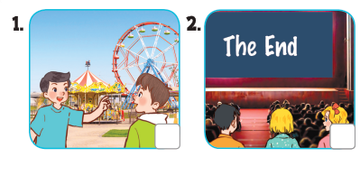



Listen and tick or cross.

Slide 16
03
Activity 5.
Read and complete.

Slide 17
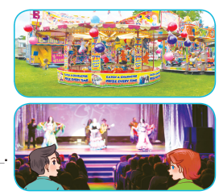

Read and complete.

Slide 18
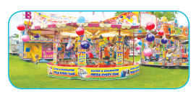
Read and complete.
1. A: Were you and Linh at the _______ last weekend?
B: Yes, ________.
funfair
we were

Slide 19

Read and complete.
2. A: Were you at the cinema last Saturday?
B: No, _________. We were at the ______.
we weren’t
theatre

Slide 20

Read and complete.
3. A: Where were you and Ben last Sunday?
B: ________ at the sports centre.
We were

Slide 21

Read and complete.
4. A: Where were you and Mary yesterday?
B: ____________________.
We were at the aquarium

Slide 22
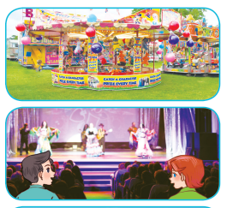

funfair
1. A: Were you and Linh at the _______ last weekend?
B: Yes, ________.
we were
2. A: Were you at the cinema last Saturday?
B: No, _________. We were at the ______.
we weren’t
theatre
3. A: Where were you and Ben last Sunday?
B: ________ at the sports centre.
We were
4. A: Where were you and Mary yesterday?
B: ____________________.
We were at the aquarium

Slide 23
04
Activity 6. Let’s play.

Slide 24
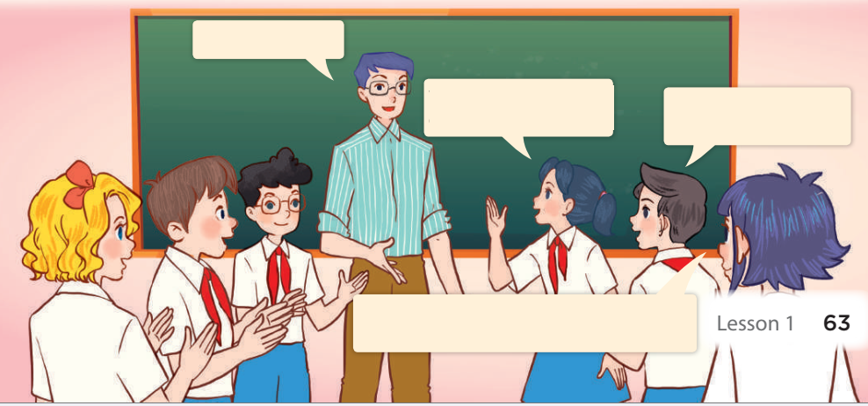
Memory game
at the campsite
We were at the campsite yesterday.
They were at the campsite yesterday.
They were at the campsite yesterday, and we were at the campsite, too.

Slide 25
05
Fun corner and Wrap-up

Slide 26



Throw a dice
Game

Slide 27
Throw a dice
Game
Team 1
Team 2

Slide 28
Website: hoclieu.vn
Fanpage: https://www.facebook.com/tienganhglobalsuccess.vn/

