Slide 1



Slide 2







9
Colours
LESSON 1
Period 2

Slide 3



CLASSROOM RULES

Slide 4
Put your hands On my desk. Who’s the best? It’s me!

Slide 5





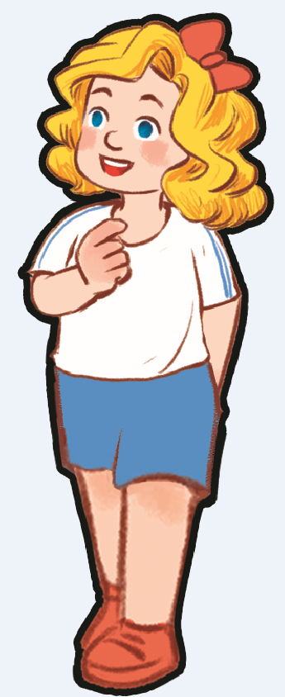


Let’s go to the top. There are 5 stops. Are you ready?

Slide 6

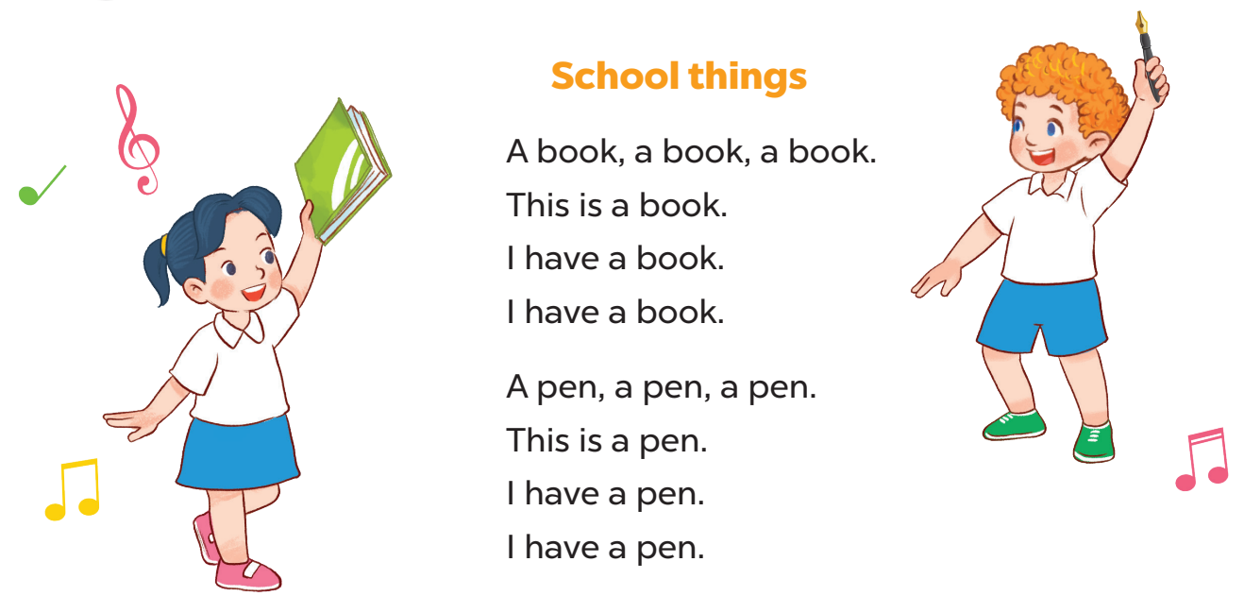

Sing a song
Ok! Now sing a song to the 1st stop! 1..2..3..Go!
Are you ready for the trip? We start from here.

Slide 7
Let’s play the guessing game to the next stop.

Slide 8


What colour is it?
blue

Slide 9

What colour is it?
brown

Slide 10

What colour is it ?
red

Slide 11


What colour is it?
yellow

Slide 12

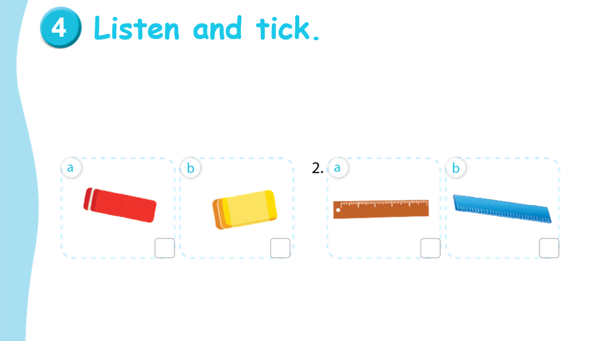
Look at this activity. Let’s do it together to get to the next stop!

Slide 13


Look and answer the question.
Notes:
Giáo viên làm mẫu với câu hỏi:
-What’s this?
What colour is it?
Gọi Hs trả lời
Mời 2 hs lên bảng làm mẫu: chỉ vào tranh hỏi và trả lời

Slide 14
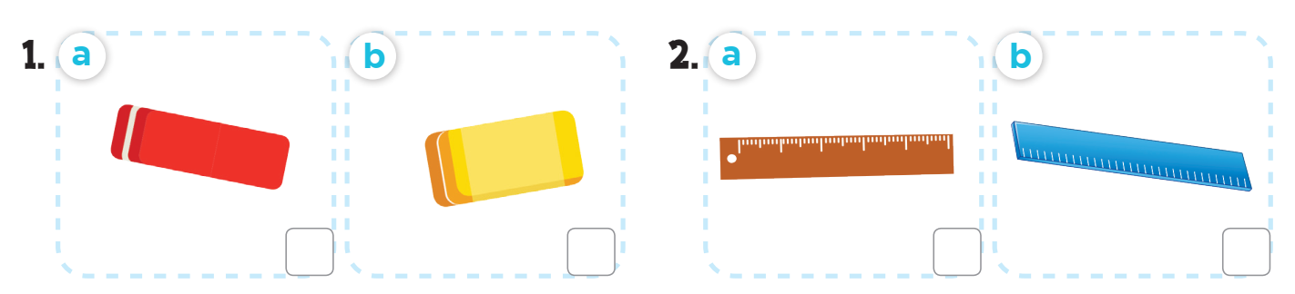
Listen and tick.

Slide 15

Let’s check!

Slide 16







Spin and choose a school thing
1 point
5 points
SPIN
3 points
2 points
10 points
End game
tekhnologic
Notes:
- Divide the class into groups of 2 (boys and girls). Each team takes turn to choose a school thing. They need to read the sentence and say the missing word(s) with the picture to get points.
- The group with more points at the end of the game will be the winner.

Slide 17

Read and complete.
What colour is ________?
it
It’s blue.

Slide 18


Read and complete.
colour
What ________ is it?
It’s red.

Slide 19

Read and complete.
What colour is it?
___________brown.
It’s

Slide 20

Read and complete.
What colour is it?
yellow
It’s _________.

Slide 21

Read and complete.
What _______ is it?
colour
It’s blue.

Slide 22

Read and complete.
What colour is it?
brown
It’s ________.

Slide 23
One – Stand up! Two – Turn around! Three – Clap your hands! Four – Say Hurray! It’s time to say goodbye. Goodbye, children! Goodbye, teacher!

Slide 24

Website: sachmem.vn
Fanpage: www.facebook.com/sachmem.vn

