Slide 2

Our school Rooms
Lesson 1 - Period 2

Slide 3




Table of contents
01
02
03
04
Let’s sing.
Warm-up & Review
05
Listen and tick or cross.
Fun corner & Wrap-up
Read and complete.

Slide 4


01
Warm-up
& Review

Slide 5


school
Remove

Slide 6

library
Remove

Slide 7

computer room
Remove

Slide 8
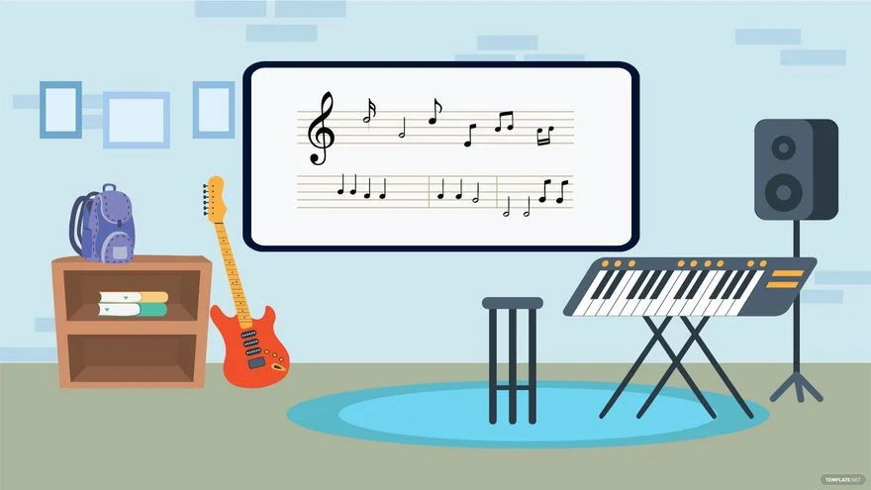
music room
Remove

Slide 9
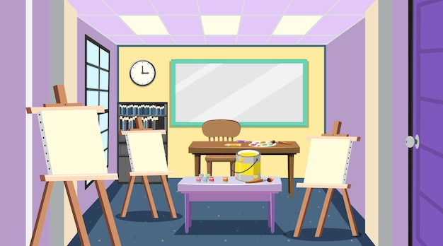
art room
Remove

Slide 10



Our school rooms
computer room
music room
library
art room

Slide 11


02
Listen and tick or cross.

Slide 12

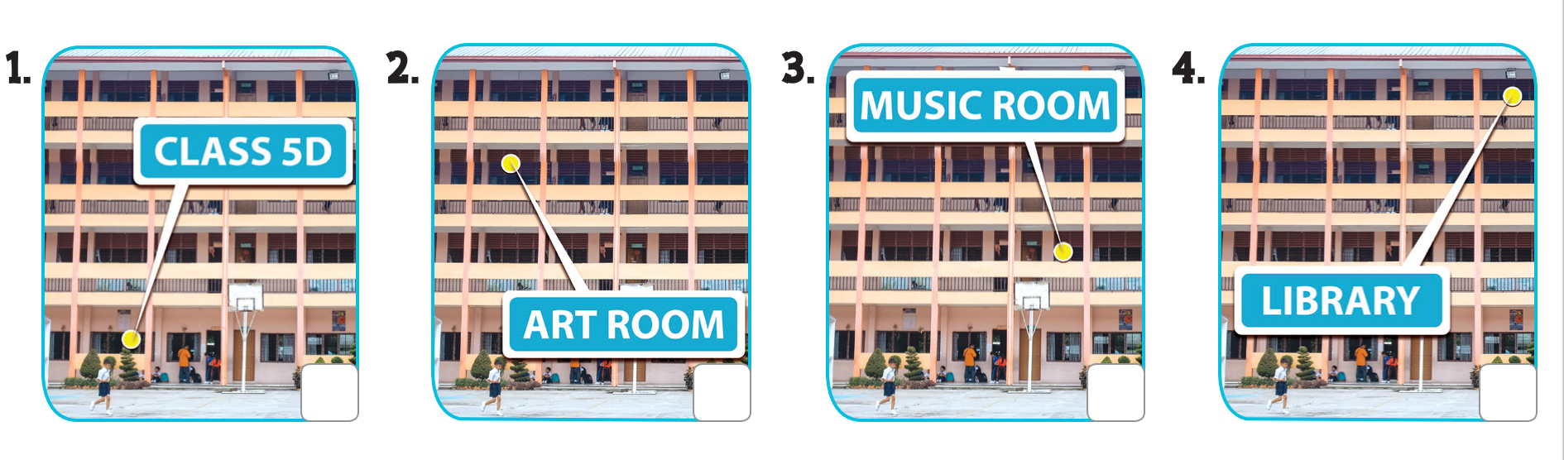


Where’s Class 5D?
Where’s the art room?
Listen and tick or cross.
Where’s the music room?
Where’s the library?

Slide 13

03
Read and complete.

Slide 14

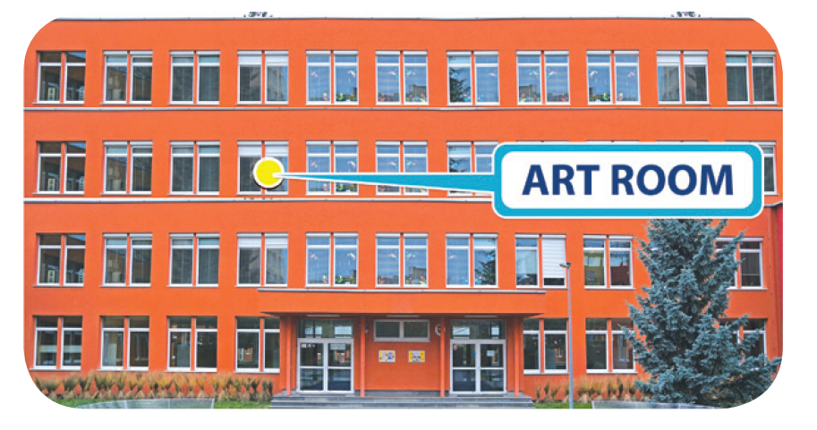
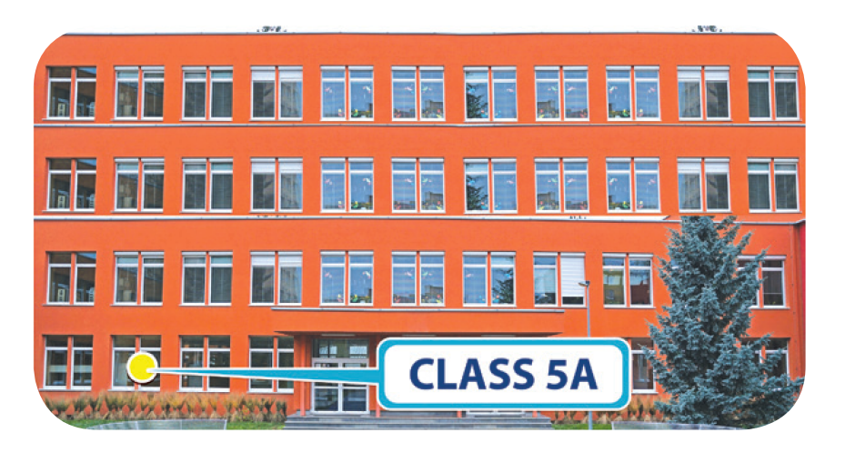

Read and complete.
1. A: Where’s the computer room?
B: It’s on the _______ floor.
2. A: Where’s the art room?
B: It’s on the _________ floor.
3. A: ________ class 5A?
B: It’s on the ____________.
4. A: Where’s the _________?
B: It’s on the __________.

Slide 15
first
1. A: Where’s the computer room?
B: It’s on the ______ floor.

Slide 16
second
2. A: Where’s the art room?
B: It’s on the _________ floor.

Slide 17
Where’s
3. A: __________ class 5A?
B: It’s on the ________________.
ground floor

Slide 18
library
4. A: Where’s the ________ ?
B: It’s on the ____________.
third floor

Slide 19



04
Let’s sing.

Slide 20
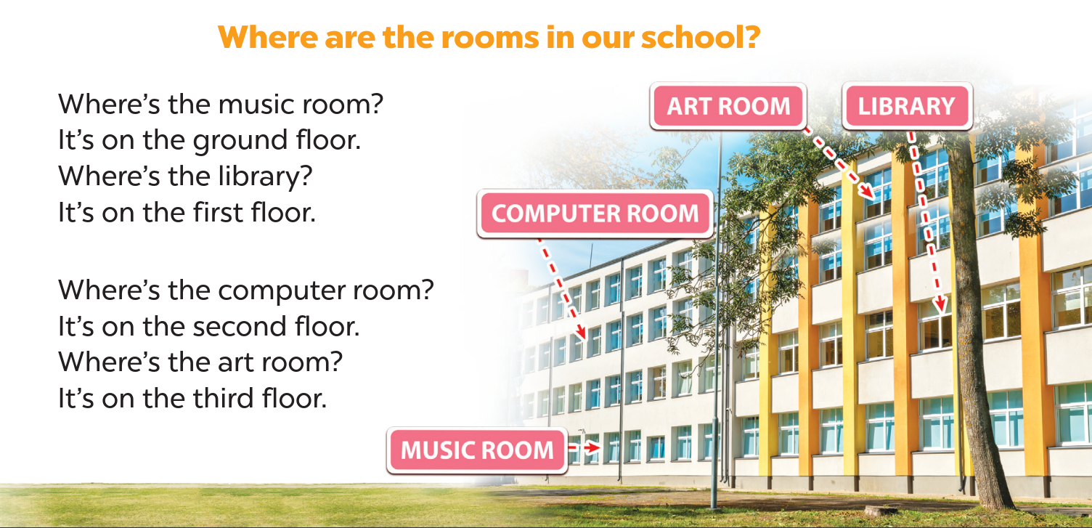

Slide 21
05
Fun corner & Wrap-up

Slide 22







School tour

Slide 23

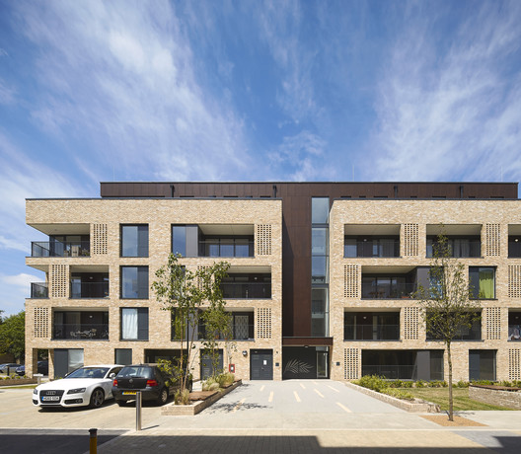
Where’s the _______ ?
library
It’s on the ___________
ground floor

Slide 24
Where’s Class 5E?
It’s on the ground floor.
CLASS 5E

Slide 25
Where’s the ________ ?
art room
_________
It’s on the __________
third floor

Slide 26

Where’s the ______________ ?
computer room
It’s on the ____________
second floor

Slide 27
Where’s Class 5A?
It’s on the ____________
second floor.
CLASS 5A

Slide 28
Where’s the music room?
It’s on the ____________
third floor.
It’s on the
third floor.
MUSIC ROOM

Slide 29
Website: hoclieu.vn
Fanpage: https://www.facebook.com/tienganhglobalsuccess.vn/

