Slide 2

Our school rooms
Lesson 2 - Period 3

Slide 3




Table of contents
01
02
03
04
Let's talk.
Warm-up & Review
05
Look, listen and repeat.
Fun corner & Wrap-up
Listen, point and say.

Slide 4


01
Warm-up
& Review

Slide 5

LUCKY CANDY HOUSE
NEXT
6
5
4
3
2
1
Notes:
Students show the question.

Slide 6

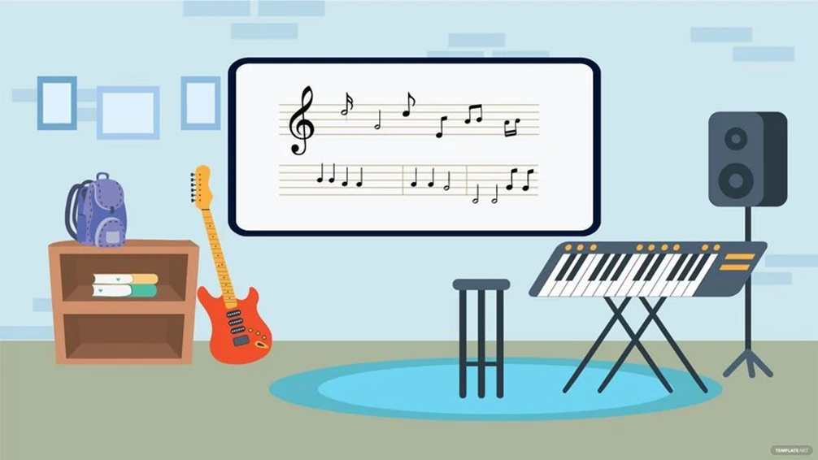






music room
Where’s the …………………… ?
It’s on the ………………….
second floor.

Slide 7


computer room
Where’s the …………………………………………. ?
It’s on the …………….
first floor.

Slide 8
Where’s Class 5A?
It’s on the ……………….
ground floor.
Class 5A

Slide 9
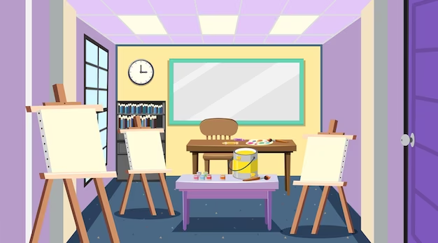
art room
Where’s the ……………… ?
It’s on the ………………….
second floor.

Slide 10
Where’s Class 5B?
It’s on the ………………….
ground floor.
Class 5B

Slide 11

library
Where’s the …………… ?
It’s on the ………………….
second floor.

Slide 12



02
Look, listen and repeat.

Slide 13
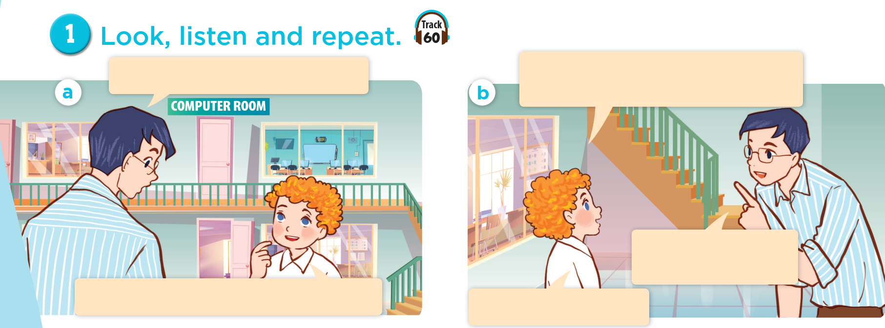
Who are they?
Where are they?

Slide 14

Look, listen and repeat.
What are you looking for, Bill?
Could you tell me the way to the computer room, please?
Go upstairs. It’s on the first floor.
I’m looking for the computer room.
^{Thank you, Mr Long.}

Slide 15
03
Listen, point and say.

Slide 16

Listen and repeat.

Slide 17

go upstairs

Slide 18

go downstairs

Slide 19
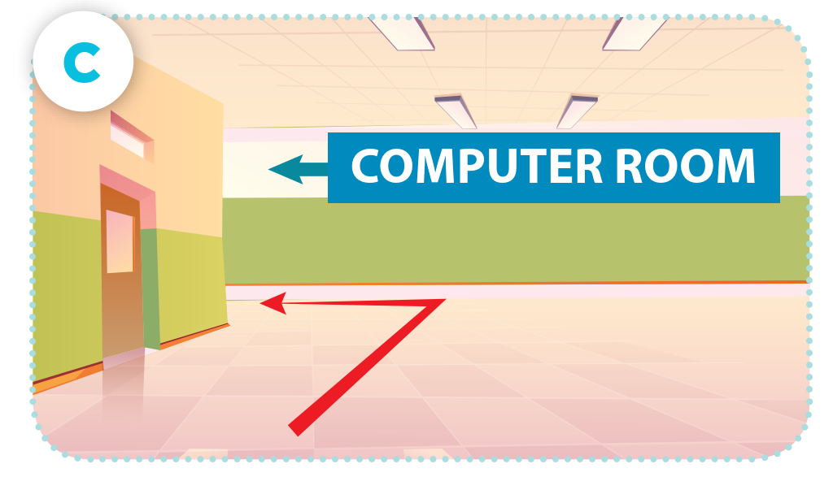
go along the corridor and turn left

Slide 20
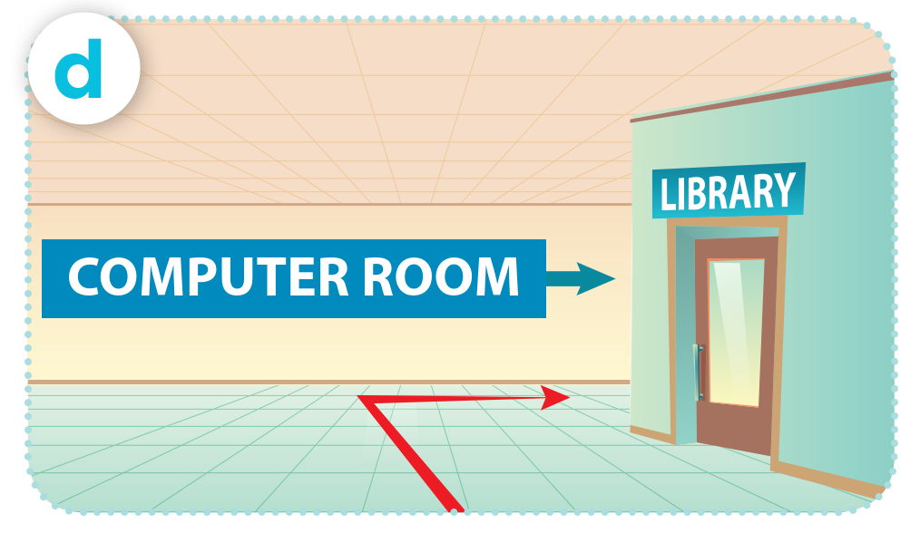
go past the library and turn right

Slide 21
Could you tell me the way to the computer room, please?
Go upstairs.

Slide 22
Could you tell me the way to the computer room, please?
Go downstairs.

Slide 23
Could you tell me the way to the computer room, please?
Go along the corridor and turn left.

Slide 24
Could you tell me the way to the computer room, please?
Go past the library and turn right.

Slide 25
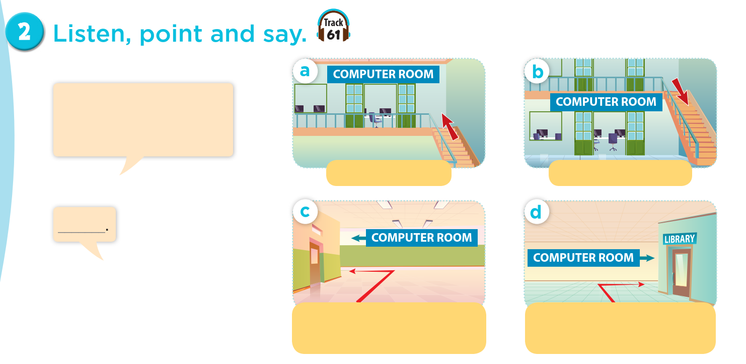
Listen, point and say.
Could you tell me the way to the computer room, please?
go upstairs
go downstairs
go along the corridor and turn left
go past the library and turn right

Slide 26
Act it out.
Could you tell me the way to the computer room, please?
go upstairs
go downstairs
go along the corridor and turn left
go past the library and turn right

Slide 27
04
Let’s talk.

Slide 28
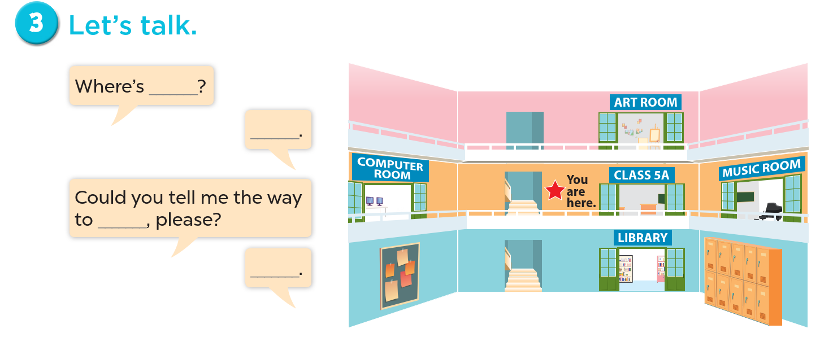

Slide 29
05
Fun corner & Wrap-up

Slide 30
Madagasca Game

Slide 31
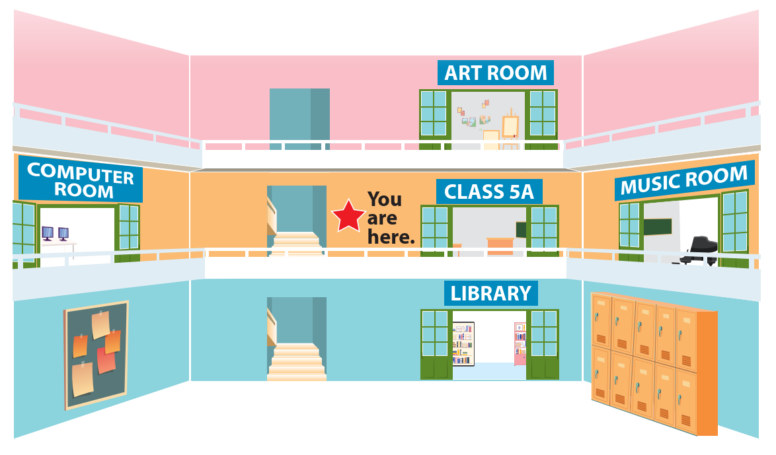
Could you tell me the way to the computer room, please?
Go along the corridor and turn left.

Slide 32



Pick a crate!

Slide 33
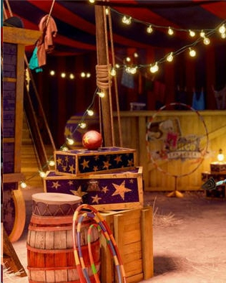
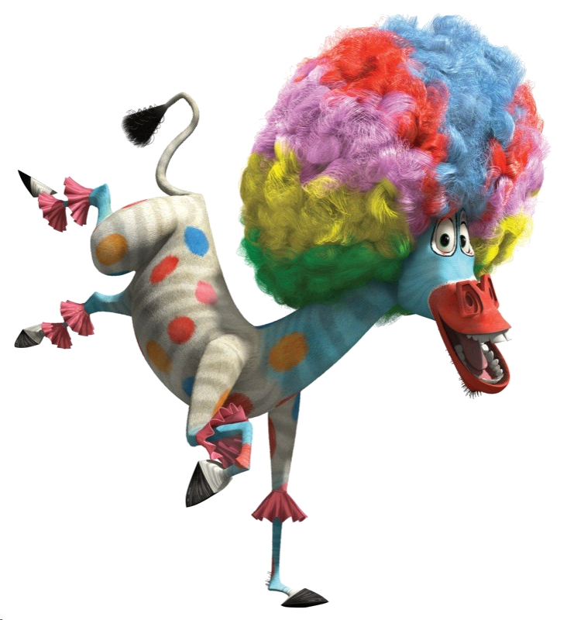

add 5 points

Slide 34


Steal 3 points.

Slide 35


Everyone lose 5 points

Slide 36
Could you tell me the way to the library, please?
Go downstairs and turn left.

Slide 37
Pick a crate!

Slide 38
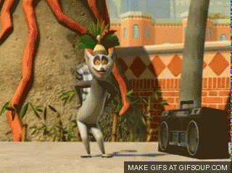
You like to move it!
10 points

Slide 39






6 points

Slide 40
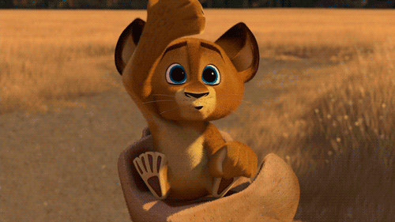
Steal 3 points.

Slide 41
Could you tell me the way to the music room, please?
Go past Class 5A and turn right.

Slide 42
Pick a crate!

Slide 43

Lose 5 points.

Slide 44
2 points

Slide 45
5 points
You like to move it!

Slide 46
Could you tell me the way to the art room, please?
Go upstairs and turn left.

Slide 47
Pick a crate!

Slide 48
Lose 2 points.

Slide 49
5 points

Slide 50
Steal 3 points.

Slide 51

Could you tell me the way to Class 5B, please?
CLASS 5B
Go downstairs and turn right.

Slide 52
Pick a crate!

Slide 53
Lose 5 points.

Slide 54
Steal 3 points.

Slide 55
4 points

Slide 56
Website: hoclieu.vn
Fanpage: https://www.facebook.com/tienganhglobalsuccess.vn/

