Slide 2











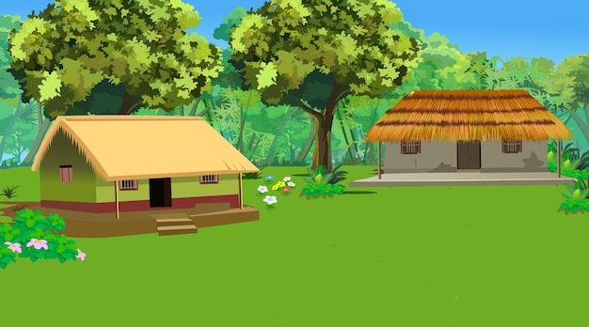
Unit
Lesson 1 - Period 1

Slide 3

Table of contents
1. Warm-up and Review
2. Activity 1: Listen and repeat.
3. Activity 2: Point and say.
4. Fun corner and Wrap-up

Slide 4
01
Warm-up
and
Review

Slide 5


Pass
me
the
jam
, please.
Here
you
are.
,please
jam
the
Pass
me
Here
you
are.

Slide 6
Pass
me
the
juice
, please.
Here
you
are.
,please
juice
the
Pass
me
Here
you
are.

Slide 7
Pass
me
the
jelly
, please.
Here
you
are.
,please
jelly
the
Pass
me
Here
you
are.

Slide 8


Slide 9
02
Activity 1
Listen and repeat.

Slide 10
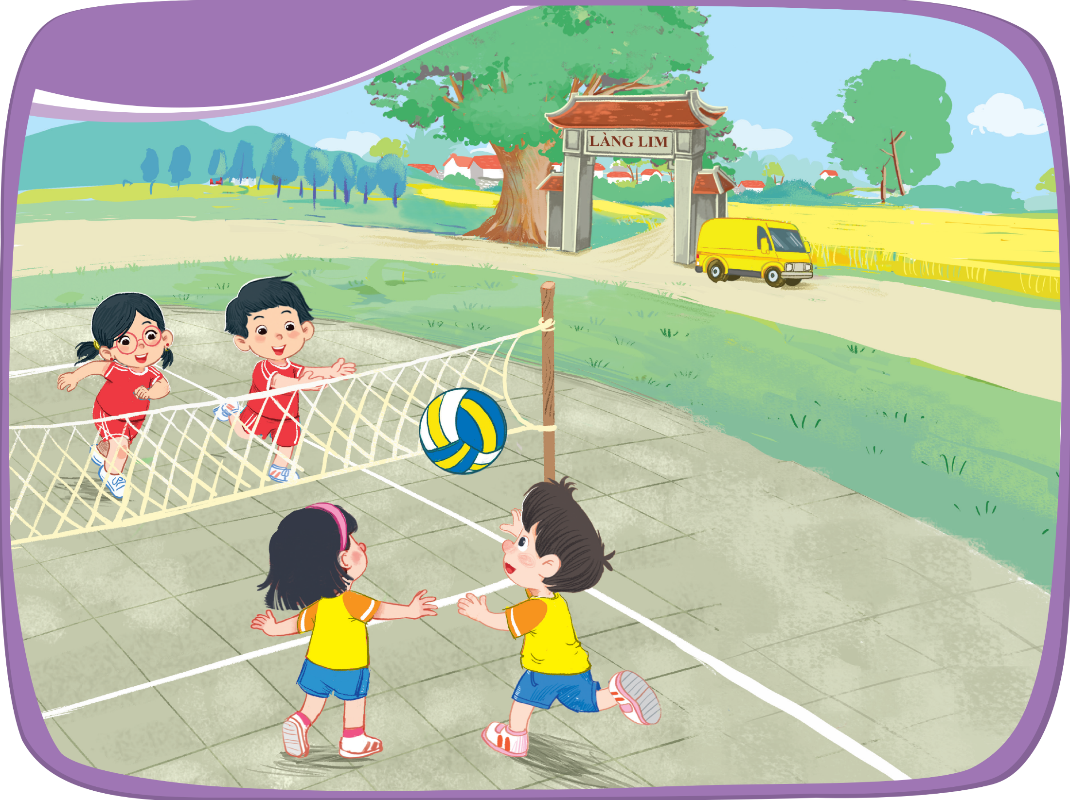




Listen and repeat.
village
van
volleyball

Slide 11



village
volleyball
van
v

Slide 12
03
Activity 2
Point and say.

Slide 13



Point and say.
village
van
volleyball

Slide 14
04
Fun corner
and
Wrap-up

Slide 15



Slide 16




Red words
Green words
START
Notes:
Chia 2 đội chơi.
Chọn 1 thẻ từ bất kì. Nếu HS đọc đúng thì GV thưởng 1 huy hiệu, nếu đọc sai thì bấm ngược lại huy hiệu để thu hồi và nhường lại lượt chơi cho đội bạn.

Slide 17




Excellent
Notes:
Chia 2 đội chơi.
Chọn 1 thẻ từ bất kỳ. Nếu hs đọc đúng thì GV thưởng 1 huy hiệu, nếu đọc sai thì bấm ngược lại huy hiệu để thu hồi và nhường lại lượt chơi cho đội bạn.
Đội nào thu thập đủ 6 huy hiệu trước sẽ chiến thắng. GV click vào hình boy hoặc girl để chúc mừng.

Slide 18

village

Slide 19
juice

Slide 20
jam

Slide 21
volleyball

Slide 22
ball

Slide 23
van

Slide 24
jelly

Slide 25

Time to say goodbye!
v

Slide 26
Website: hoclieu.vn
Fanpage: https://www.facebook.com/tienganhglobalsuccess.vn/

