Slide 1



Slide 2
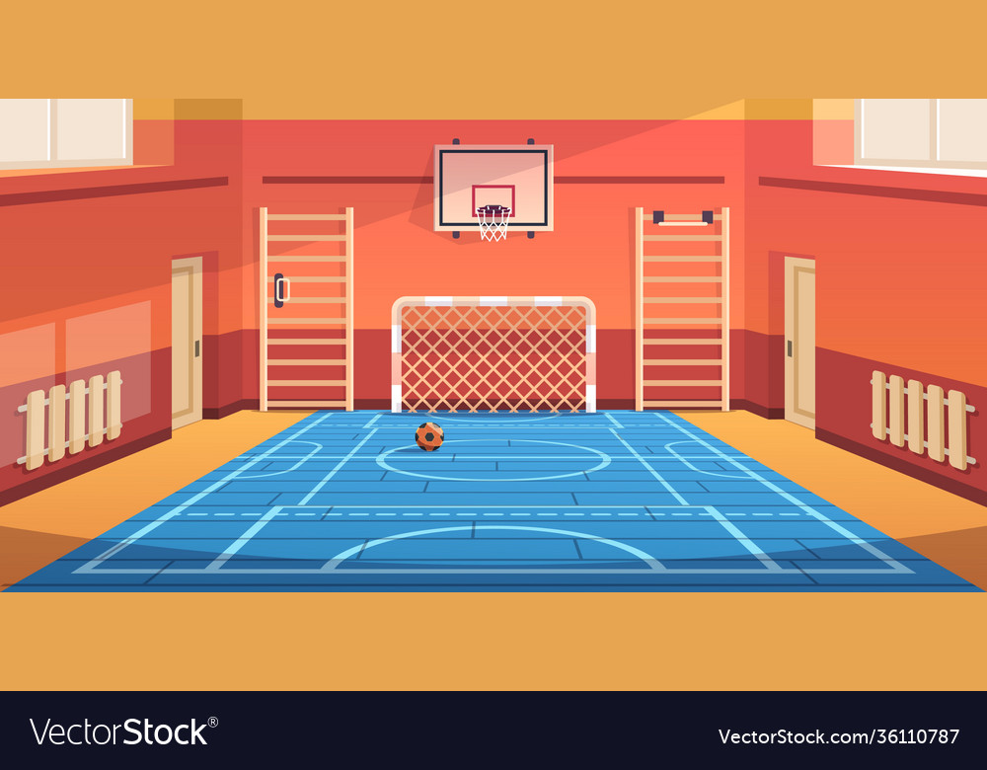



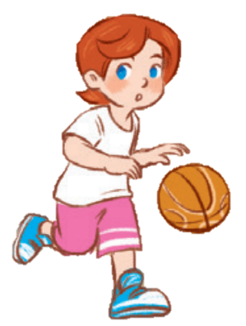

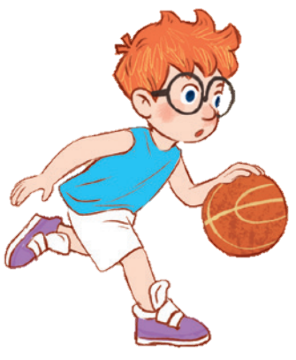
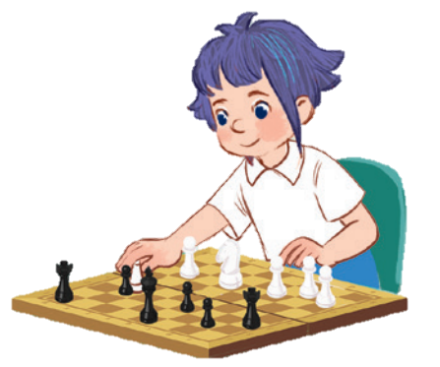
10
Period 2

Slide 3
Contents
1
5
Fun corner and wrap-up
Warm-up and review
4
2
3
Let’s sing.
Listen and tick.
Look, complete and read.

Slide 4

Warm-up and review

Slide 5
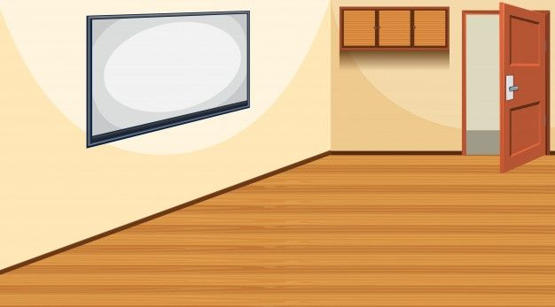
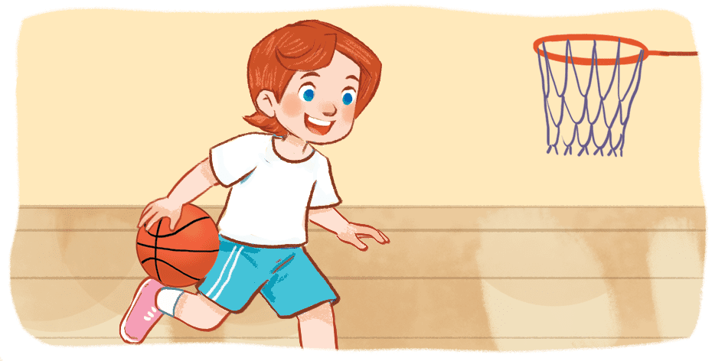
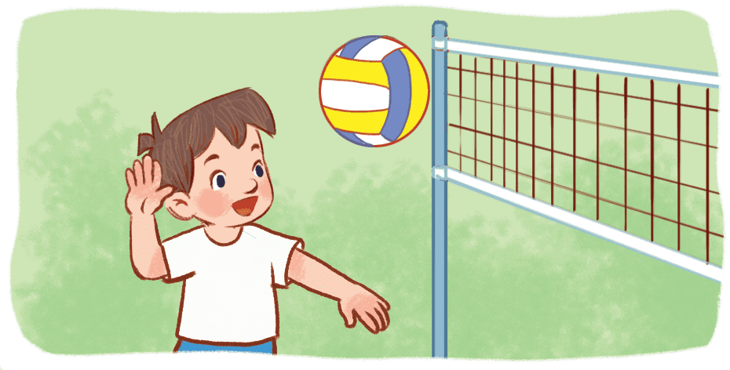
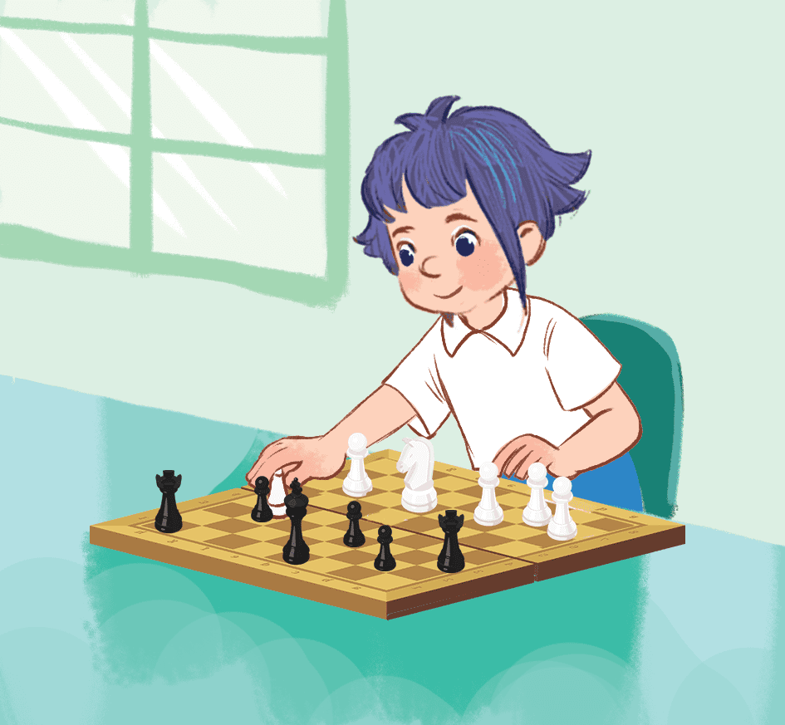
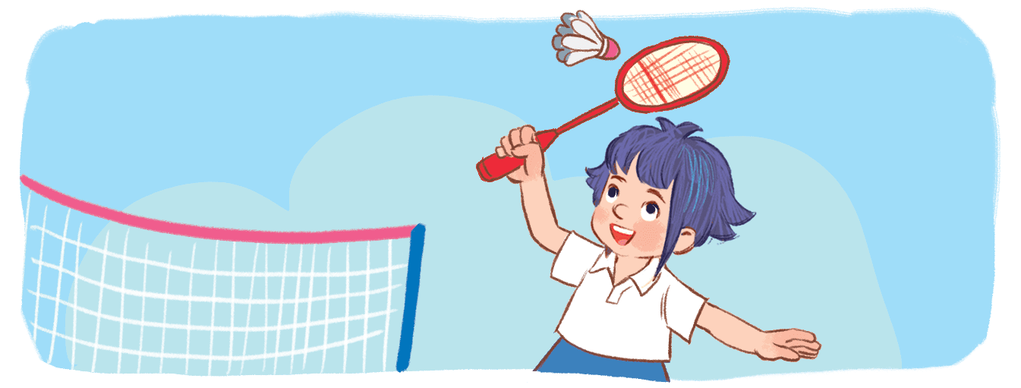


TEAM B
TEAM A
Notes:
Game: Act and Guess
- Teacher divides the class into 2 teams (Boys and Girls)
- 1 pupil of each team comes to the board and does actions for their team to guess the names of the break time activities and sticks the right pictures.
- The first team to stick 4 correct pictures in the right order is the winner.

Slide 6
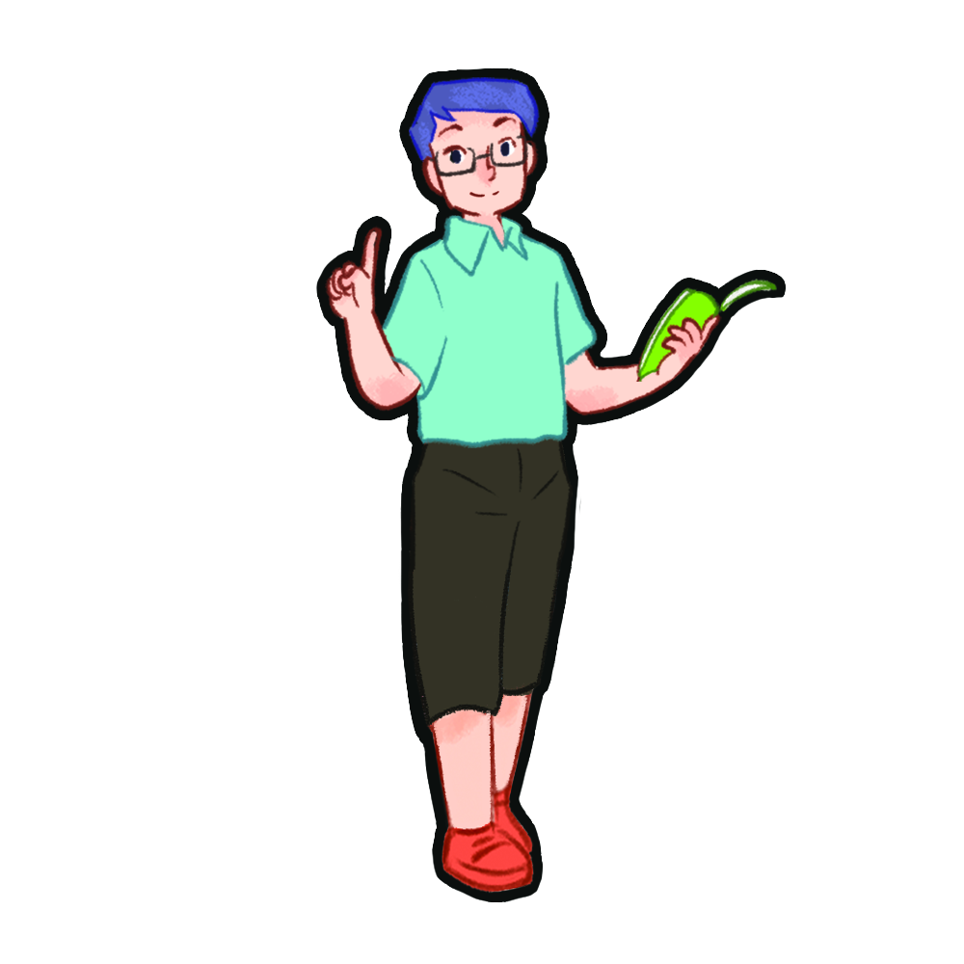
Listen and tick.

Slide 7

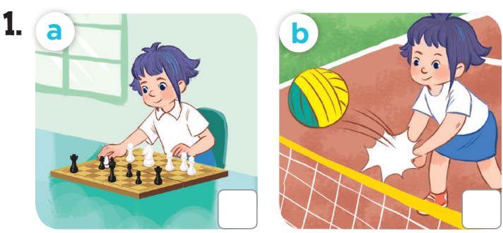

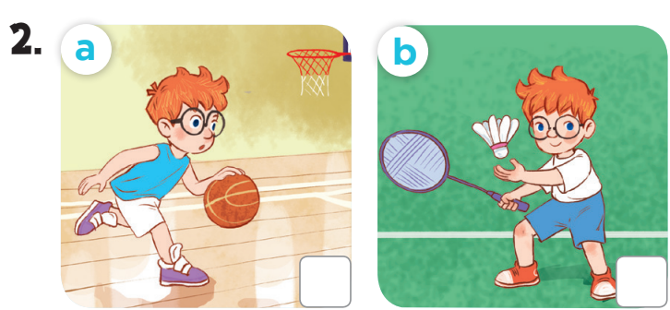


Slide 8
Look, complete and read.

Slide 9
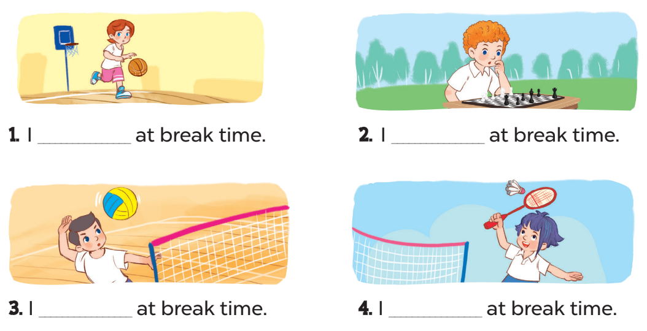
play basketball
play chess
play volleyball
play badminton

Slide 10
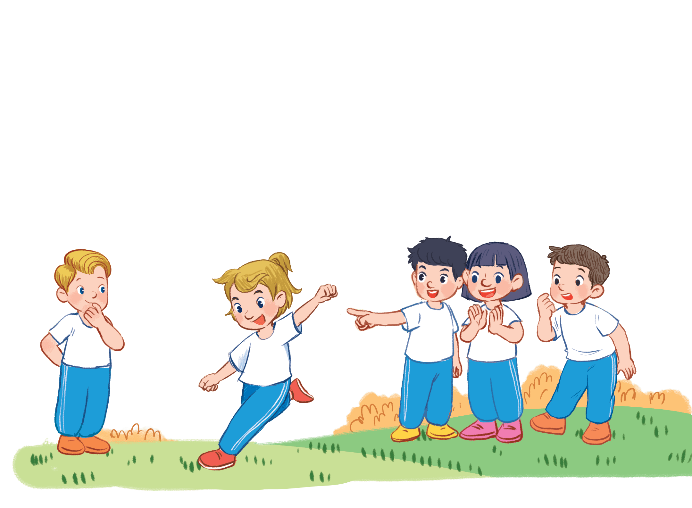
Game time
Notes:
Game: Matching
Teacher divides the class into 2 teams.
Pupils from each team take turns to choose the matching pictures and sentences to talk about break time activities.
Each matching pair and will get 1 point.

Slide 11
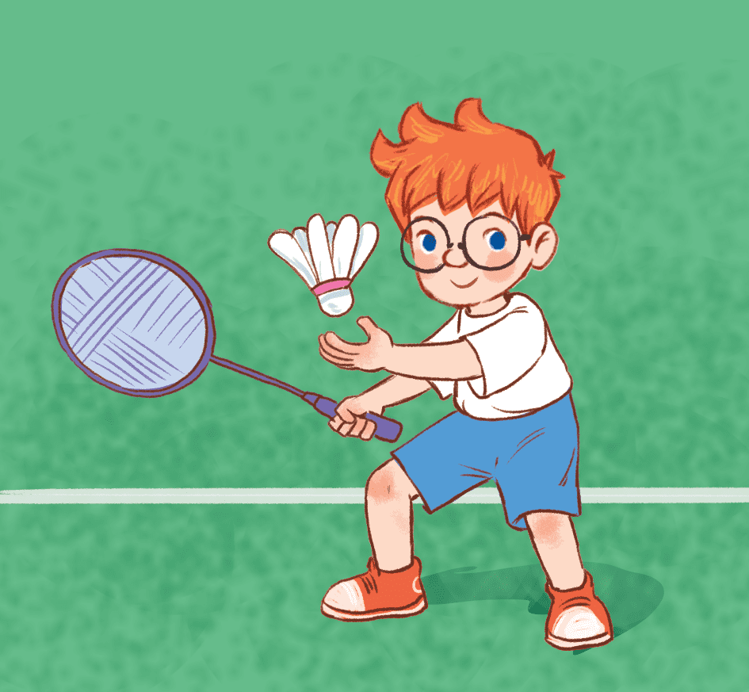

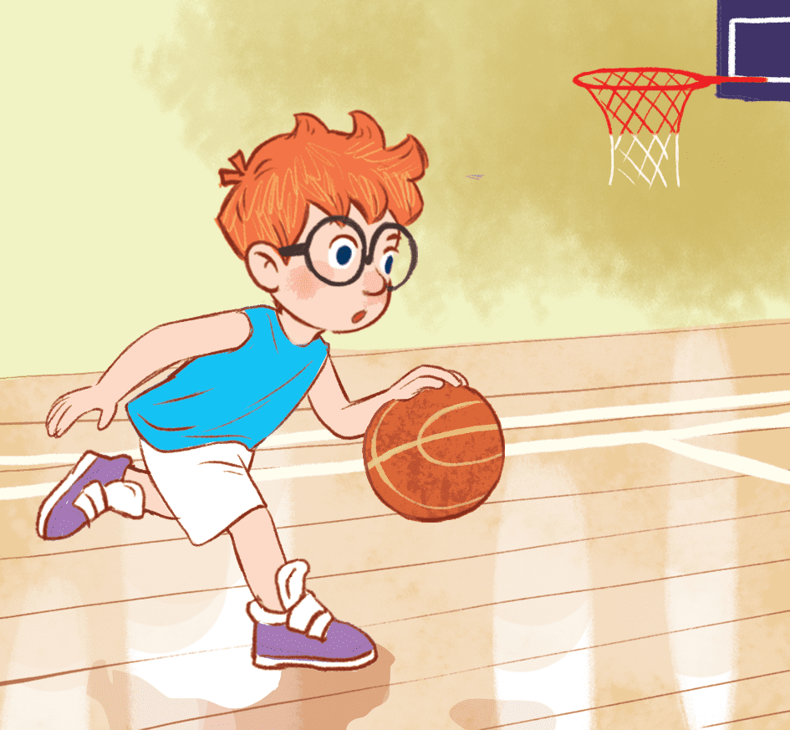

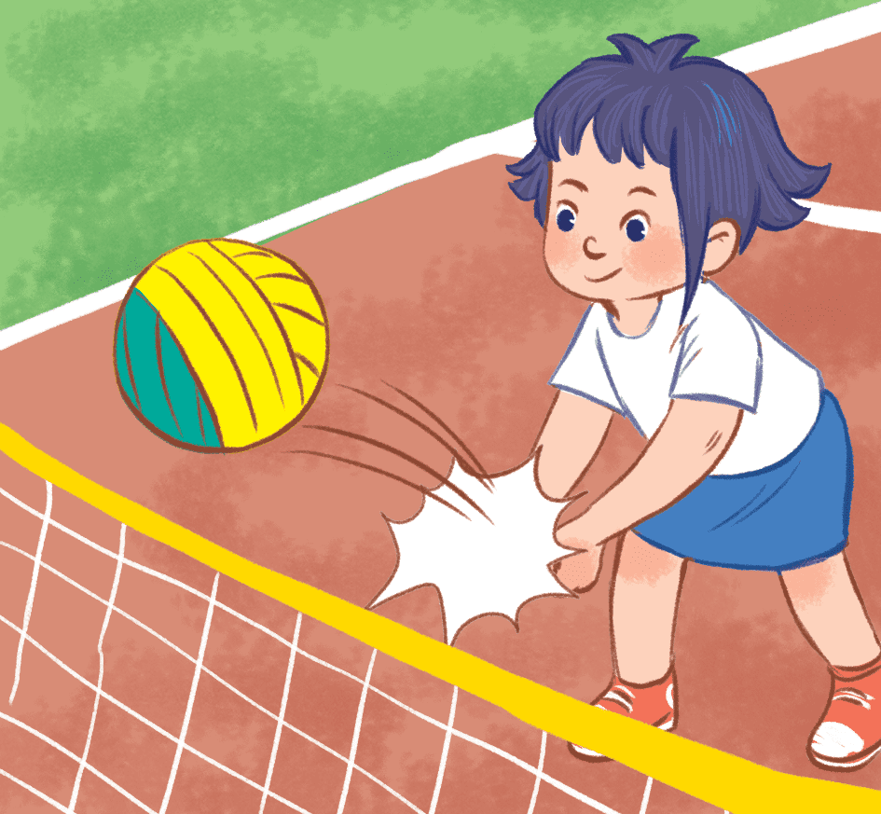
1
2
3
I play volleyball at break time.
4
5
6
I run at break time.
I play chess at break time.
I play basketball at break time.
9
7
11
I play badminton at break time.
12
10
8
I play football at break time.
Notes:
- Click the numbers to show, click the red circle signs to hide the pictures and sentences.

Slide 12
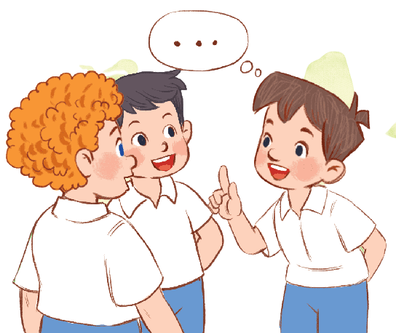
Let’s sing.

Slide 13
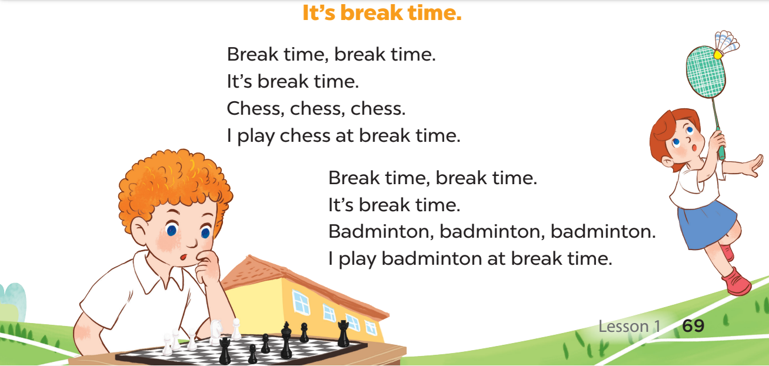

Slide 15
Fun corner and
Wrap-up
Notes:
Game: Guessing
- Teacher divides the class into groups of 4 or 5.
- Teacher calls members of 1 group to come to the board and write their answers (break time activities) on the small boards.
- Have members of the group on the board make sentences, then ask members of other groups to guess YES or NO.
The groups will get points for their correct answers.

Slide 16



play volleyball
play basketball
play chess
play badminton
I play volleyball at break time.
Yes.
+1
play volleyball

Slide 17
play volleyball
I play chess at break time.
play basketball
play chess
play badminton
No.
play chess
+1
play basketball
play volleyball
play chess

Slide 18


play
basketball
play
chess
play
volleyball
play
badminton
I ………. at break time.
Notes:
Teacher shows 4 pictures of break time activities on the board and asks pupils to use the model structure to make sentences.

Slide 19

Website: sachmem.vn
Fanpage: www.facebook.com/sachmem.vn

