Slide 1


Slide 2




Rearrange the letters to make words. Then say.
2. Let’s play.

Slide 3




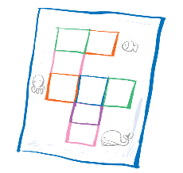
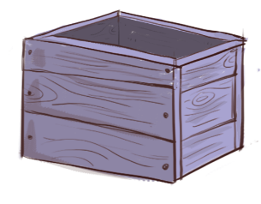
Rearrange the letters to make words. Then say.
1.
aqsuer
2.
ofx
3.
uziq
4.
xbo

Slide 4

1.
aqsuer
square

Slide 5
ofx
2.
fox

Slide 6
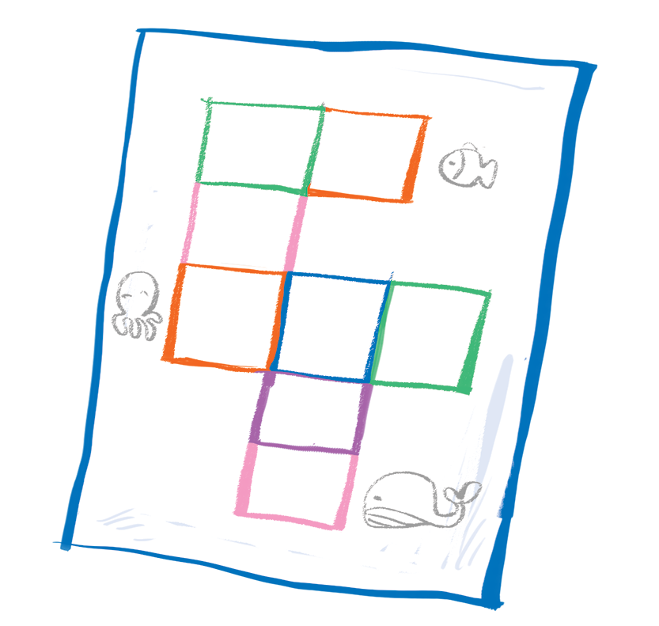
3.
uziq
quiz

Slide 7
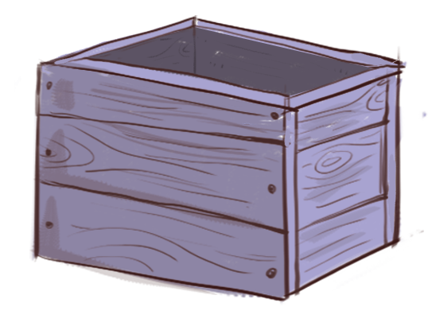
xbo
4.
box

Slide 8



Let’s play.
Bingo
quiz
rainbow
square
box
road
fox
ox
sail
question

Slide 9




Website: hoclieu.vn
Fanpage: facebook.com/www.tienganhglobalsuccess.vn

