Slide 1
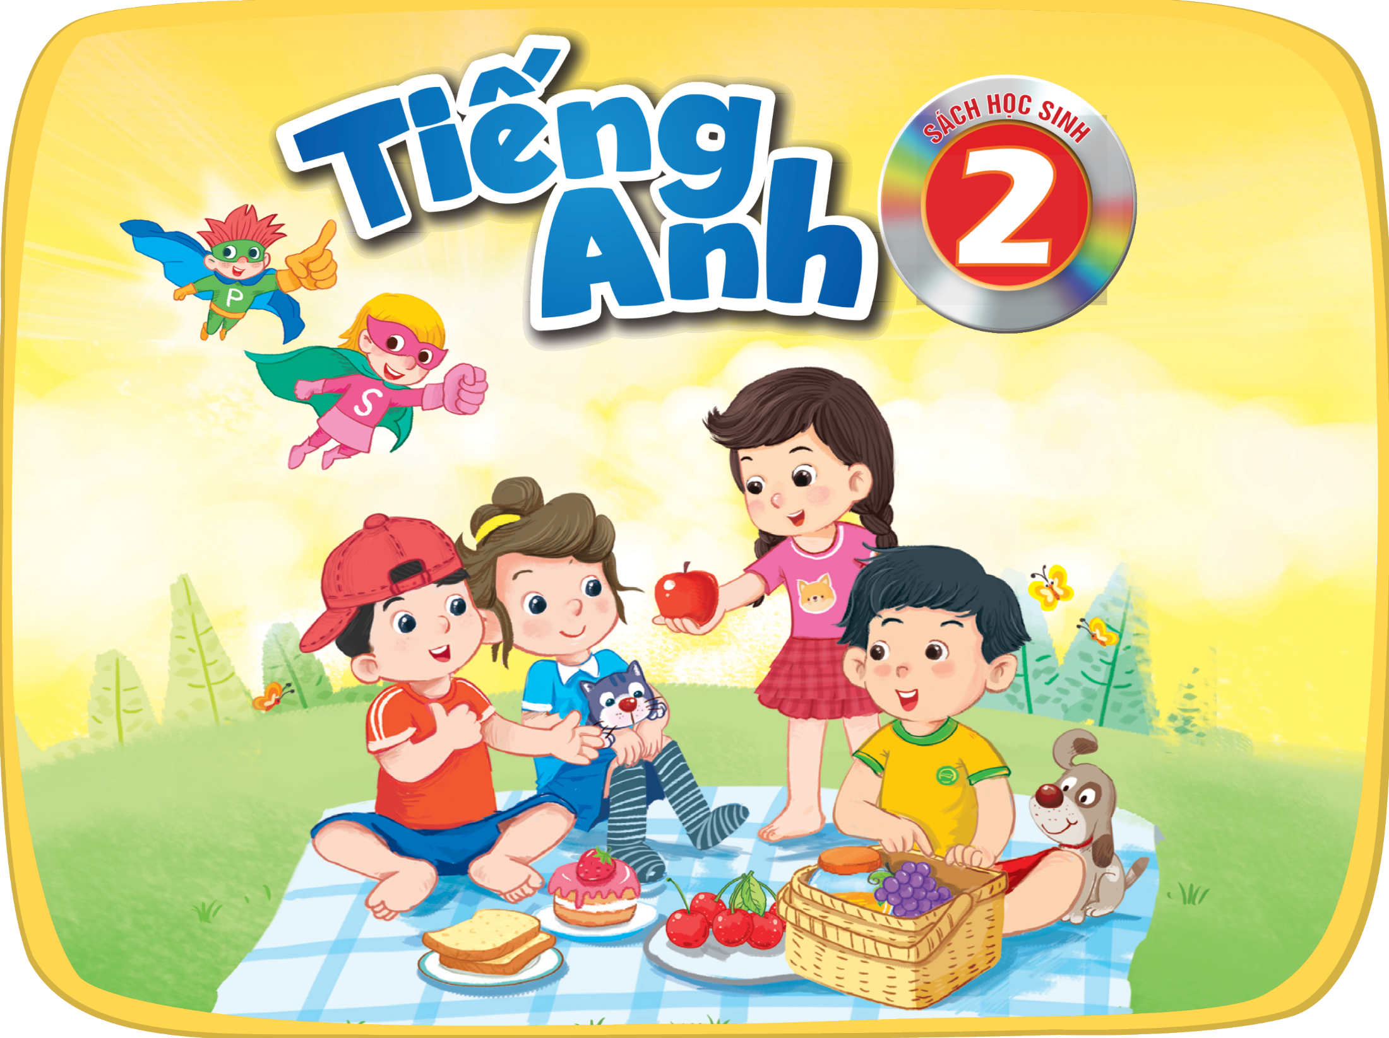

Slide 2





3. Guess and write. Then say.
4. Let’s play.

Slide 3

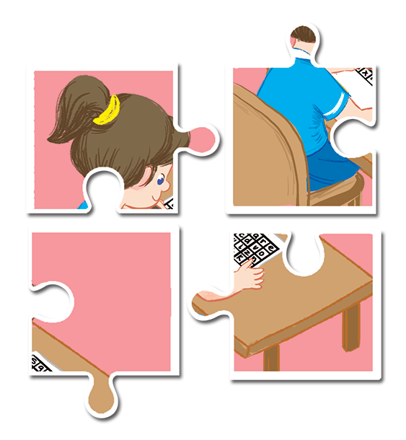
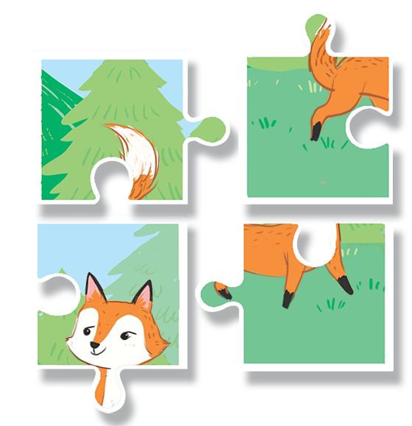
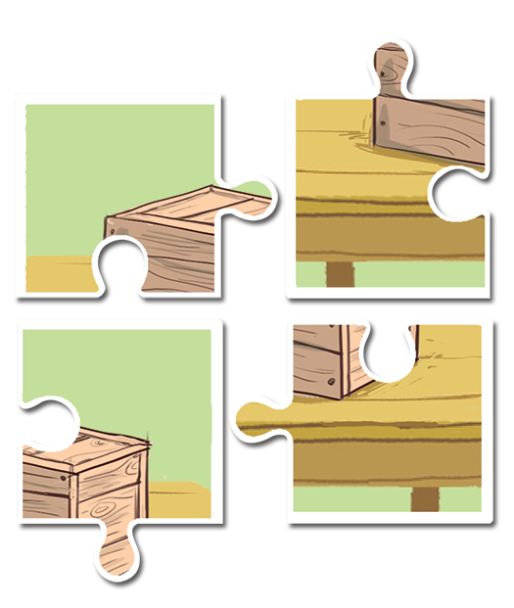
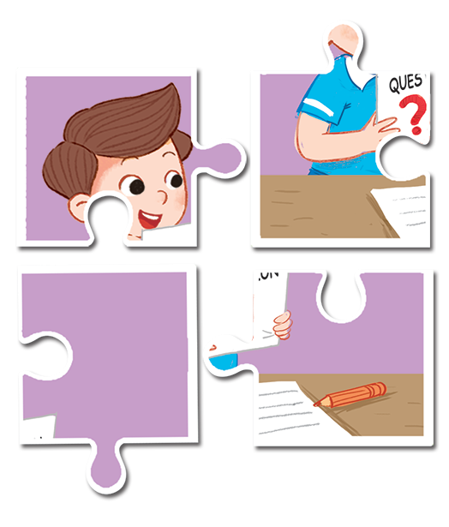
Guess and write. Then say.
1
2
3
4

Slide 4
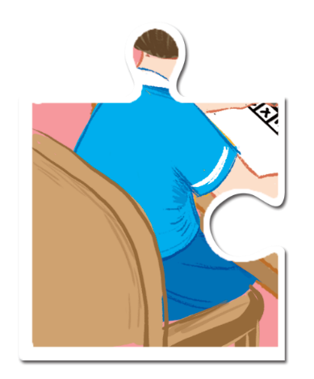
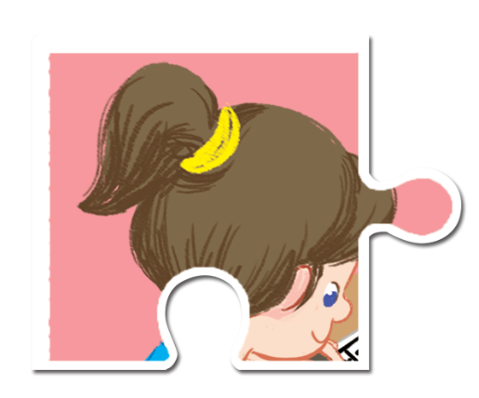

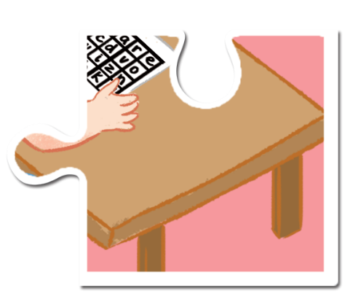

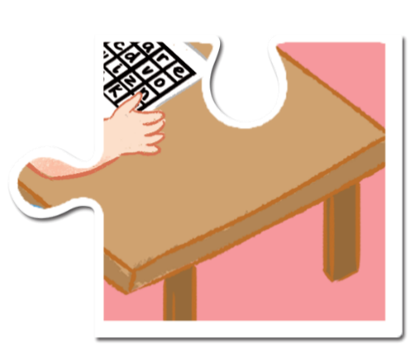
1
A: What’s she doing?
B: She’s doing a .
quiz

Slide 5




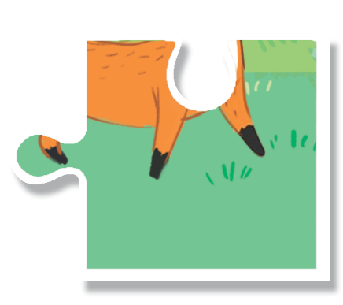
2
A: Is there a ?
fox
B: Yes, there is.

Slide 6

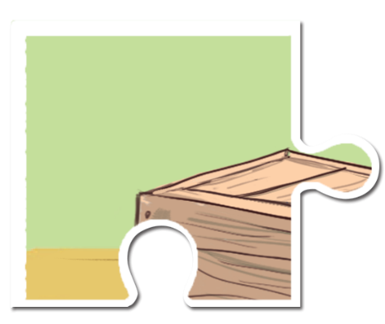
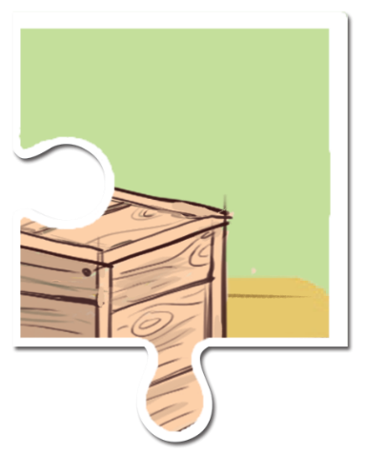

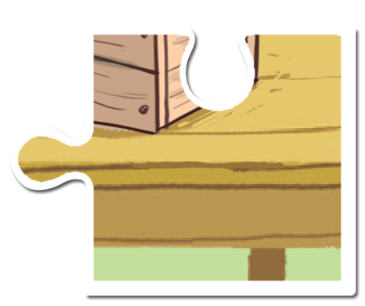
3
A: Is there a ?
box
B: Yes, there is.

Slide 7




4
A: What’s he doing?
B: He’s answering a .
question

Slide 8
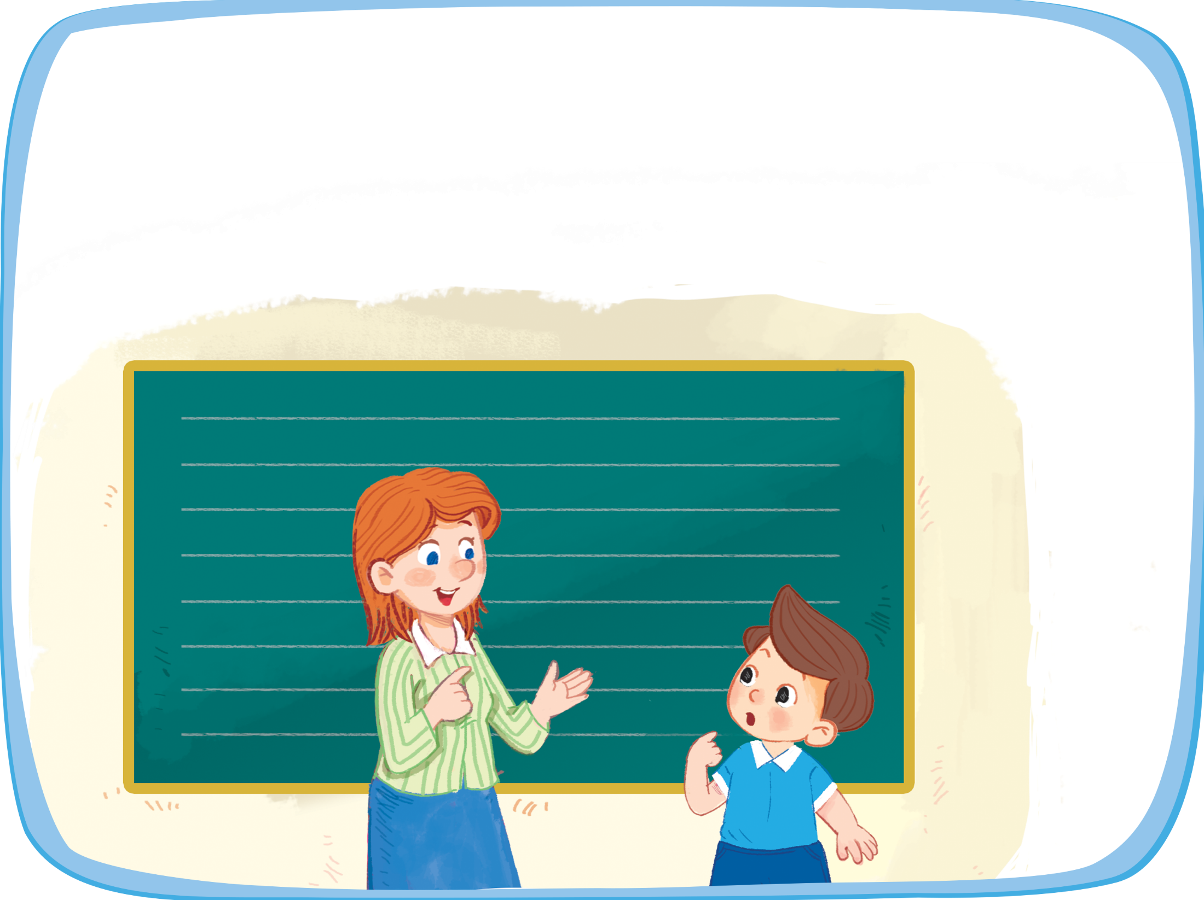



Let’s play.
Spelling bee
quiz
q-u-i-z

Slide 9




Website: hoclieu.vn
Fanpage: facebook.com/www.tienganhglobalsuccess.vn

