Slide 1







Unit 8
IN OUR CLASSROOM
Lesson 1 – Period 1

Slide 2





/
TABLE OF CONTENTS
Warm-up & Review
Look, listen and repeat.
Listen, point and say.
Let’s talk.
Fun corner & Wrap-up

Slide 3




01
Warm-up & Review

Slide 4






KIM’S GAME
Remember and say!
START
FINISH

Slide 5
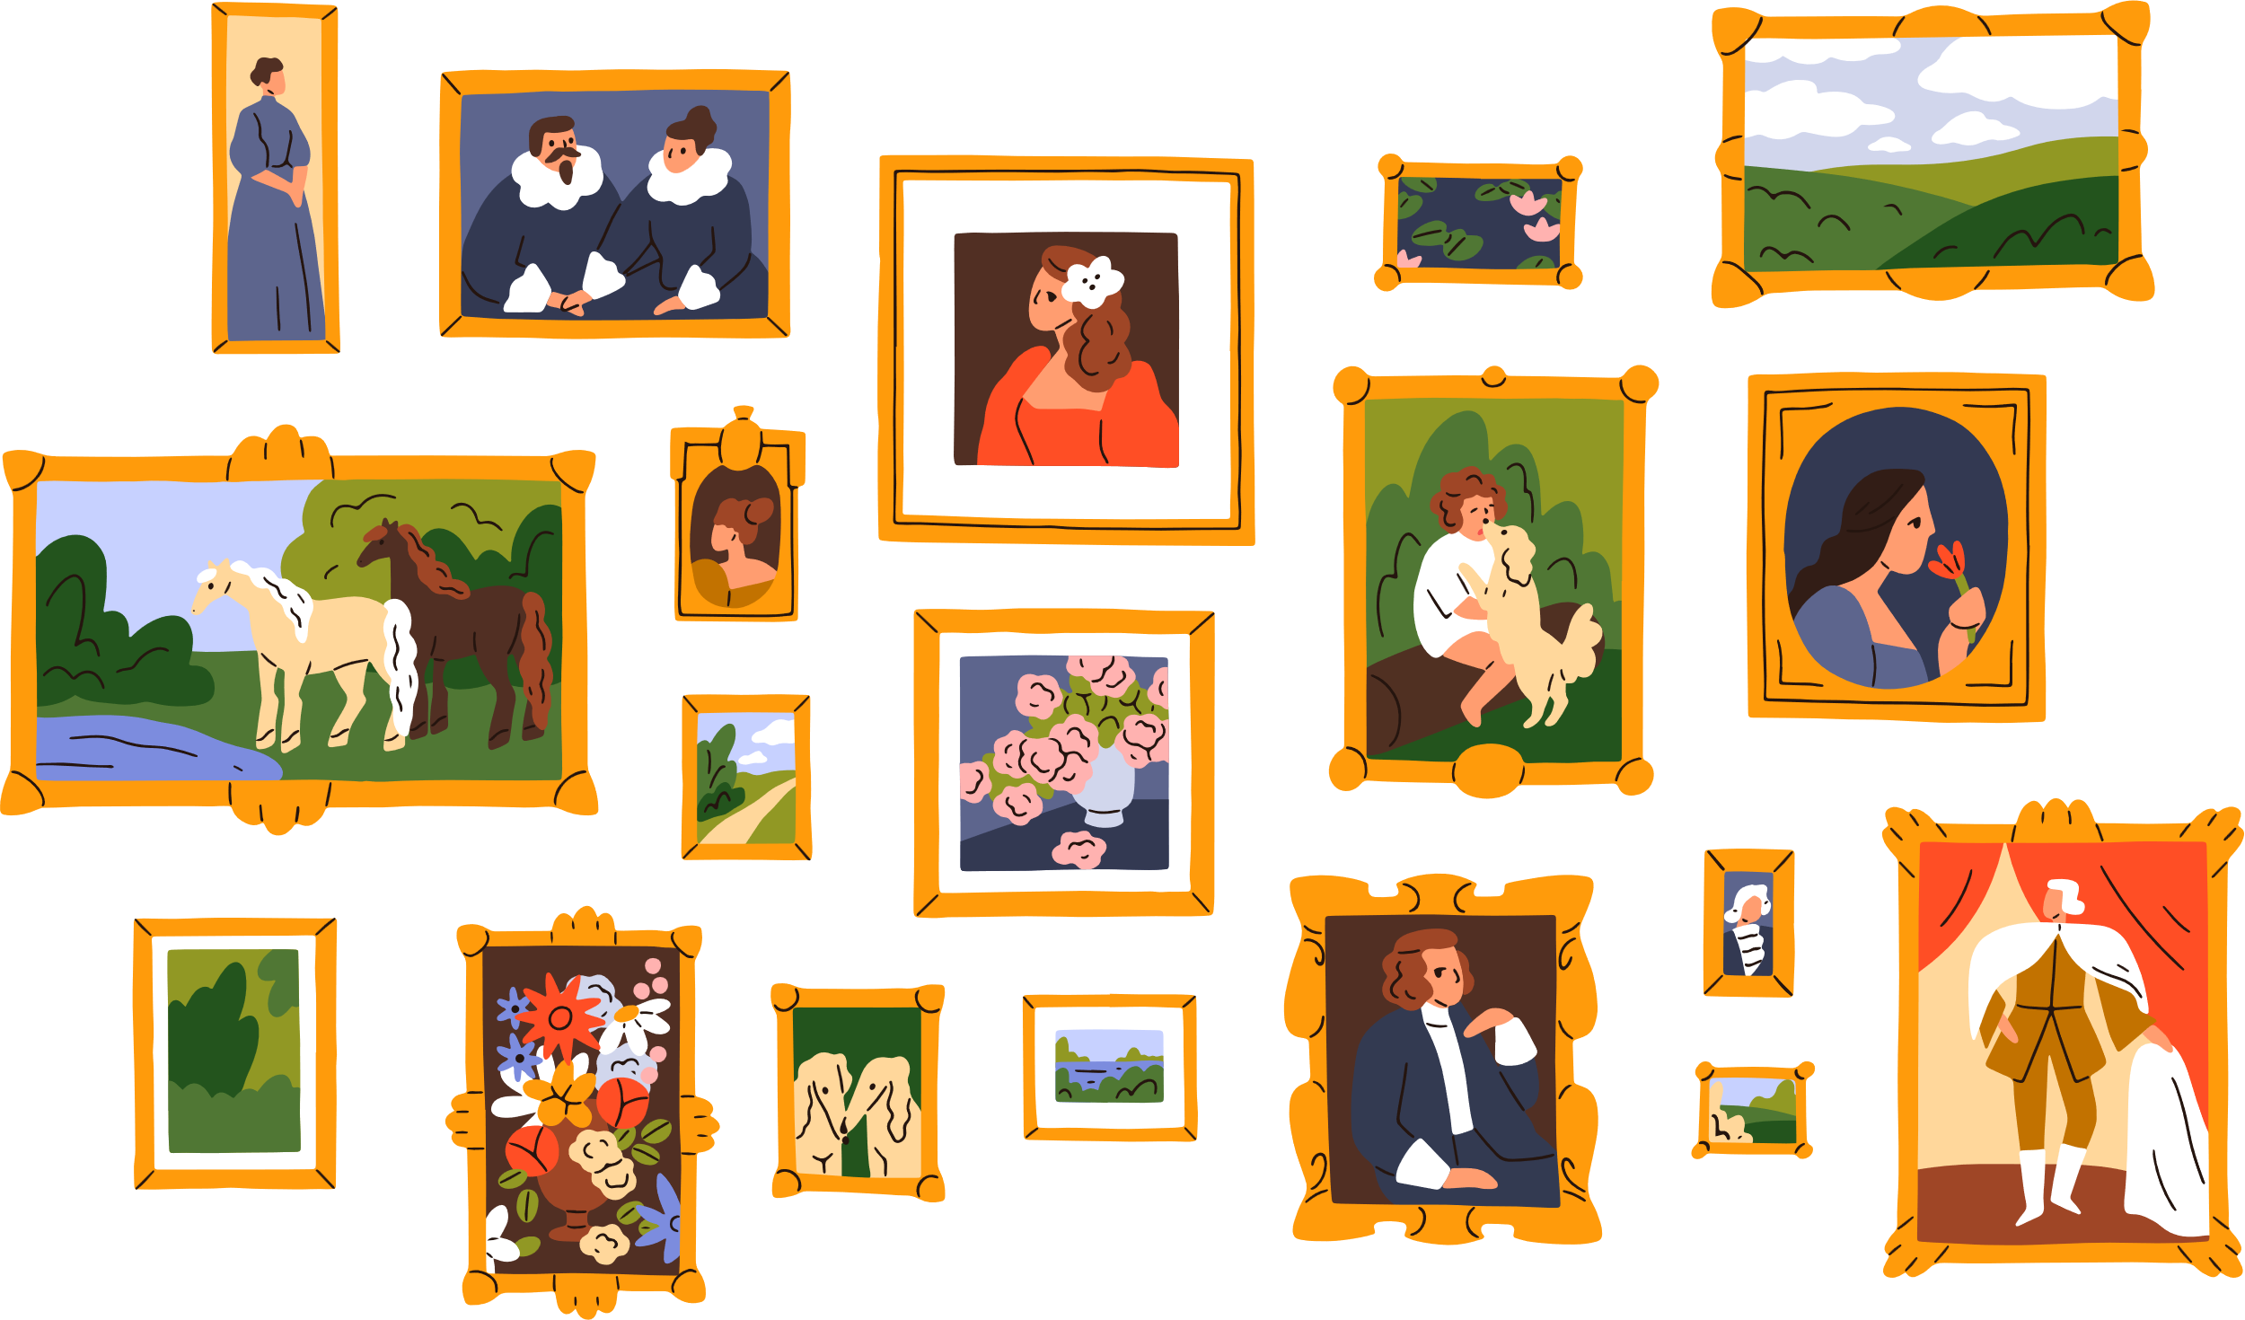




KIM’S GAME
START
FINISH

Slide 6











Slide 7
02
Look, listen and repeat.

Slide 8



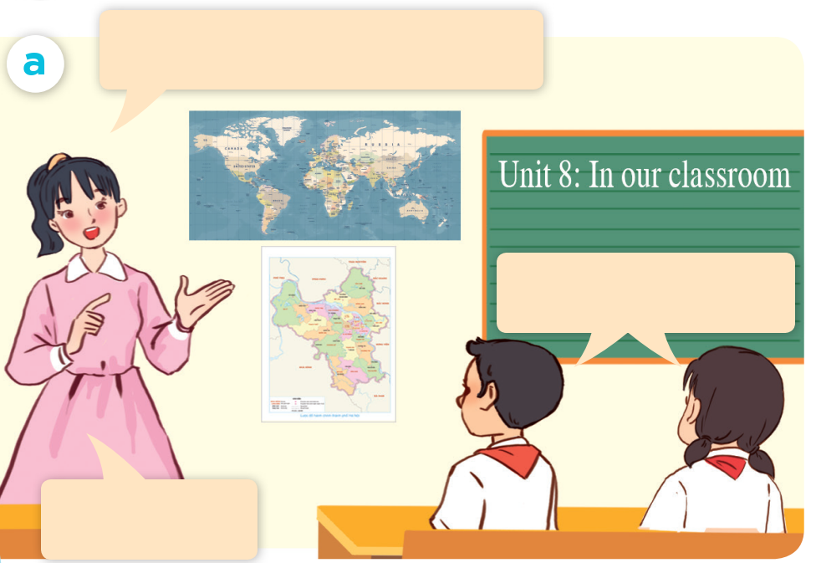

LOOK AND SAY.

Slide 9
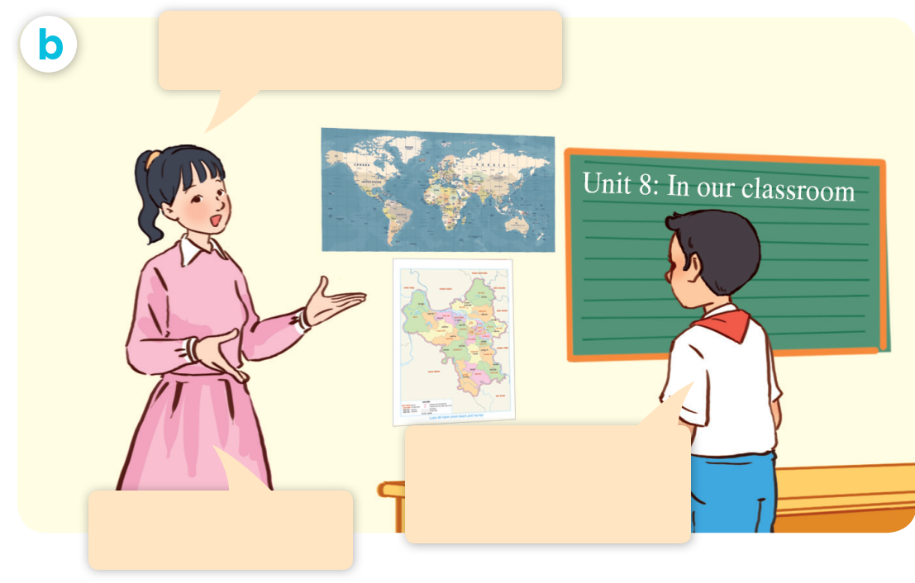
LOOK AND SAY.

Slide 10

LISTEN AND POINT.

Slide 11
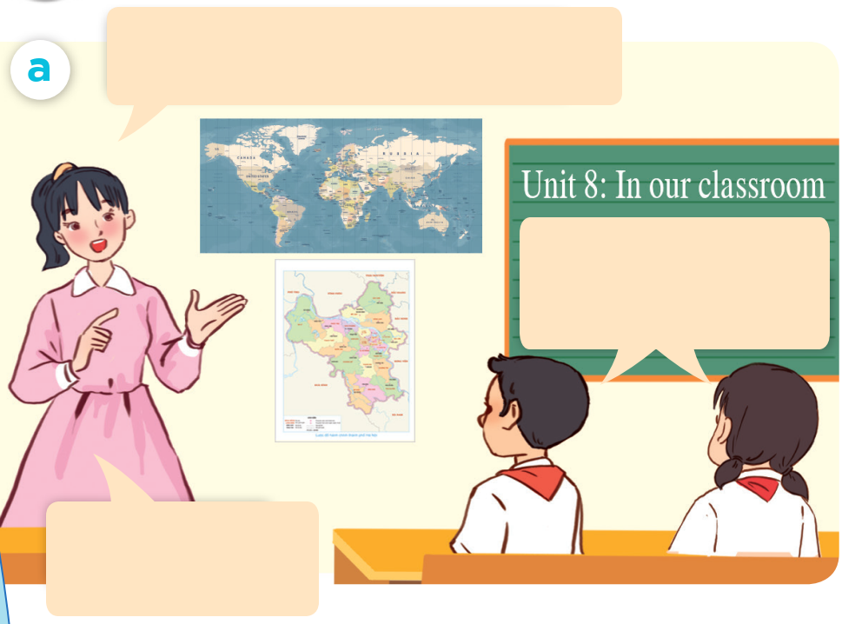
LISTEN AND REPEAT.
Class, what are these?
They are maps.
Well done.

Slide 12
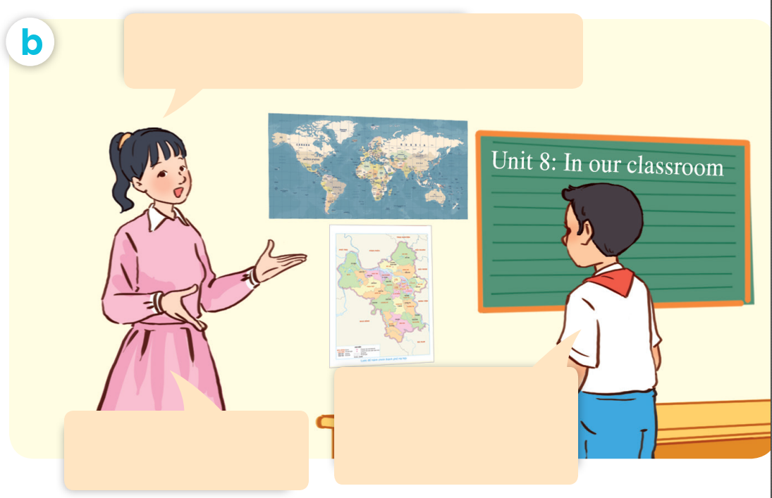
LISTEN AND REPEAT.
Where are the maps ?
They’re beside the board.
That’s right.

Slide 13
LISTEN AND REPEAT.
Where are the maps?
Class, what are these?
They are maps.
Well done.
They’re beside the board.
That’s right.

Slide 14
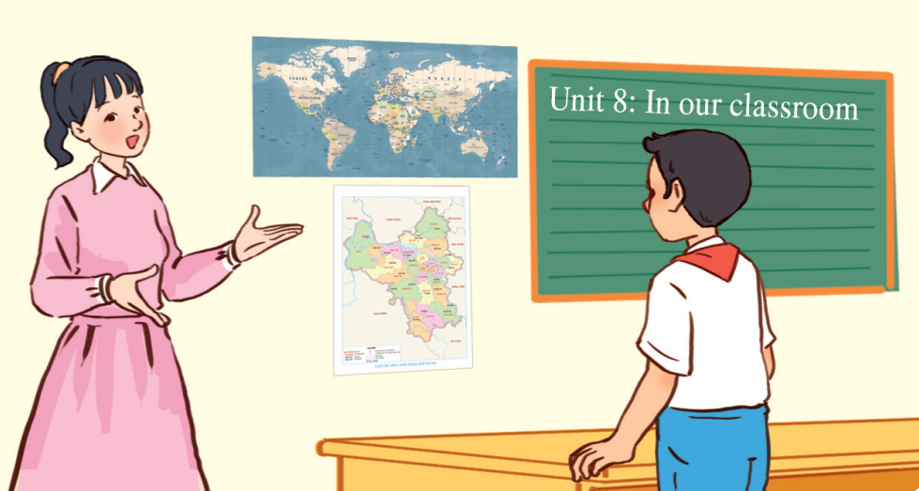

LISTEN AND REPEAT.
Where are the maps?
They’re beside the board.

Slide 15
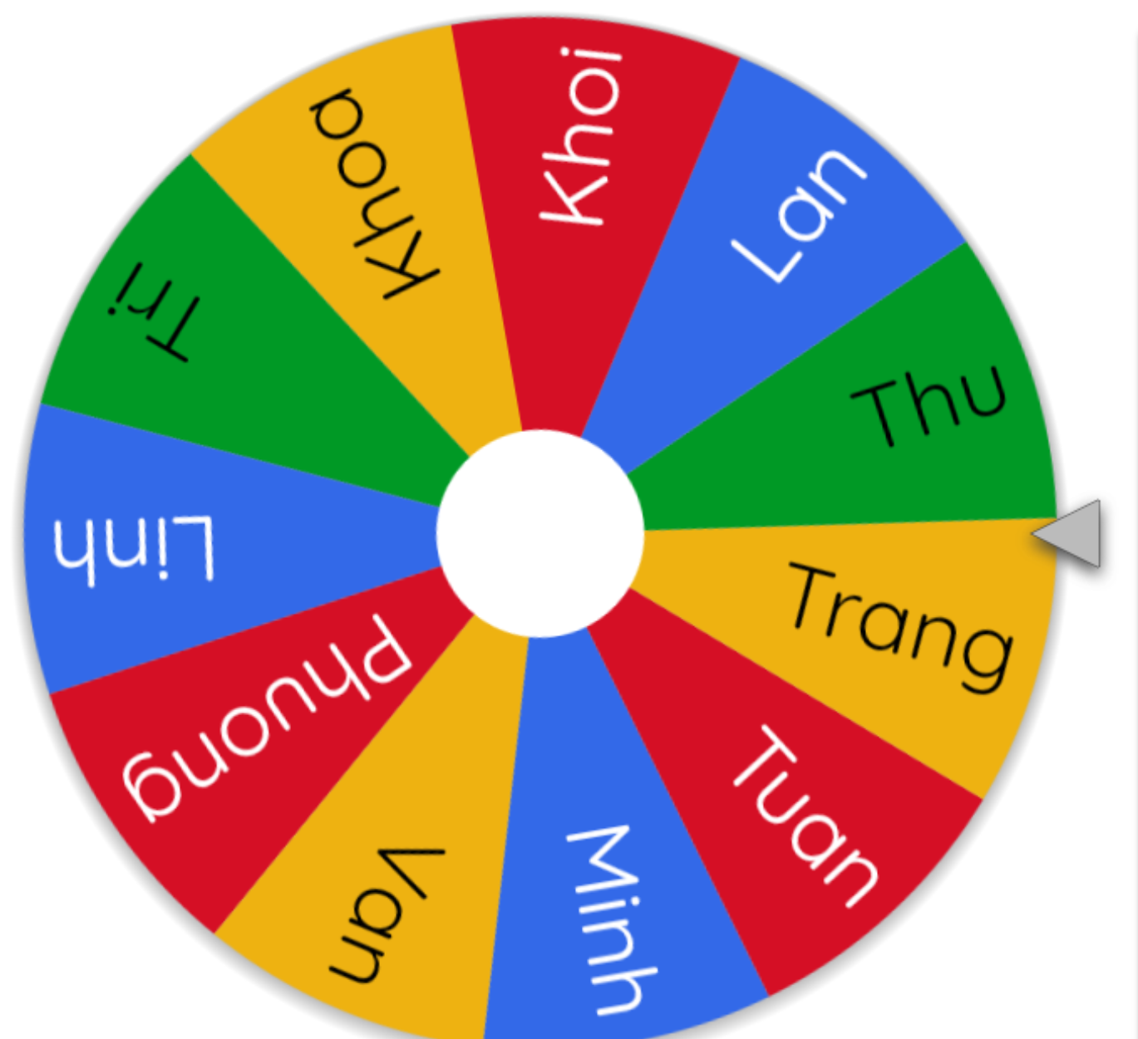
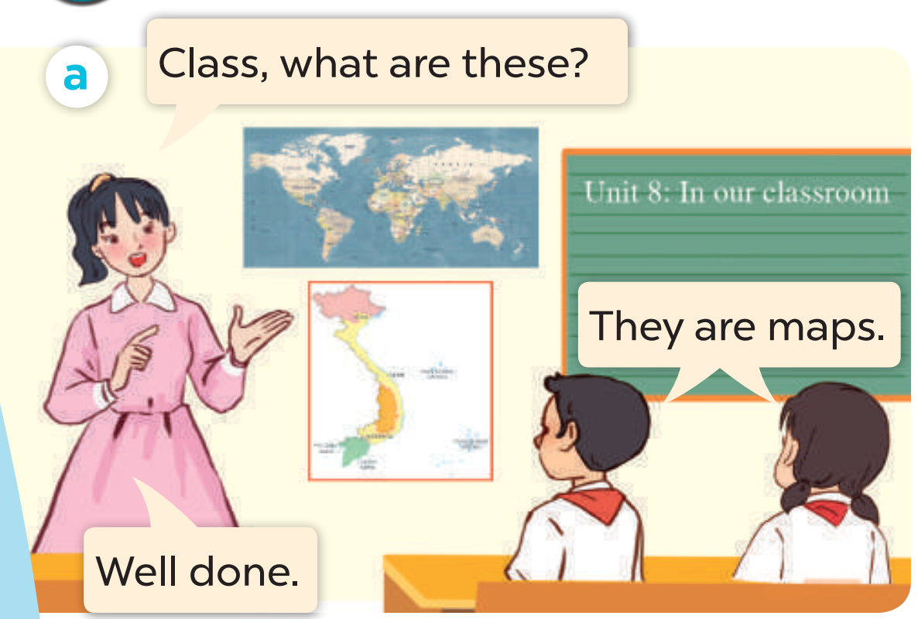
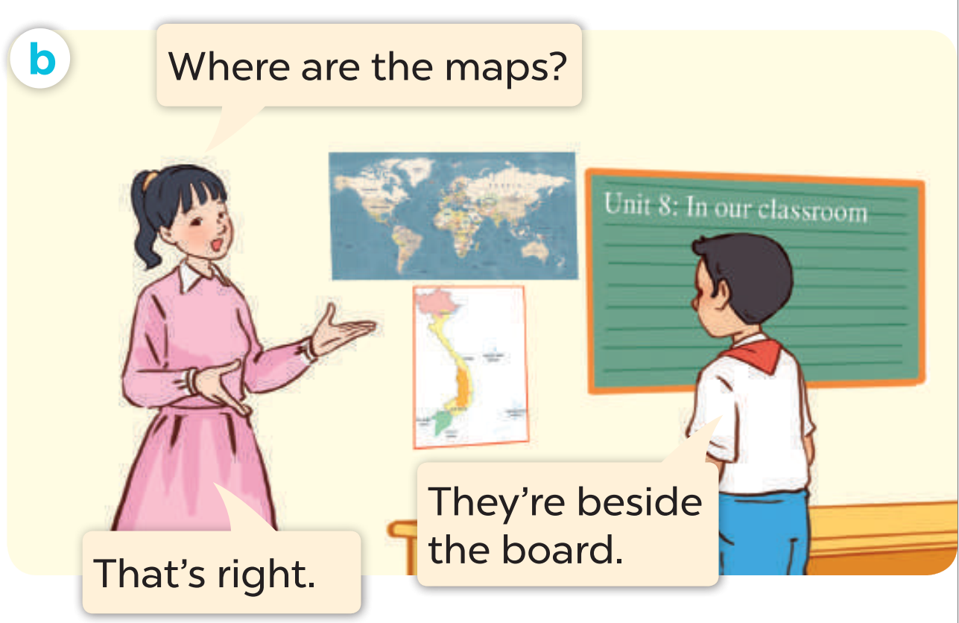
ASK AND ANSWER.

Slide 17
03
Listen, point and say.

Slide 18





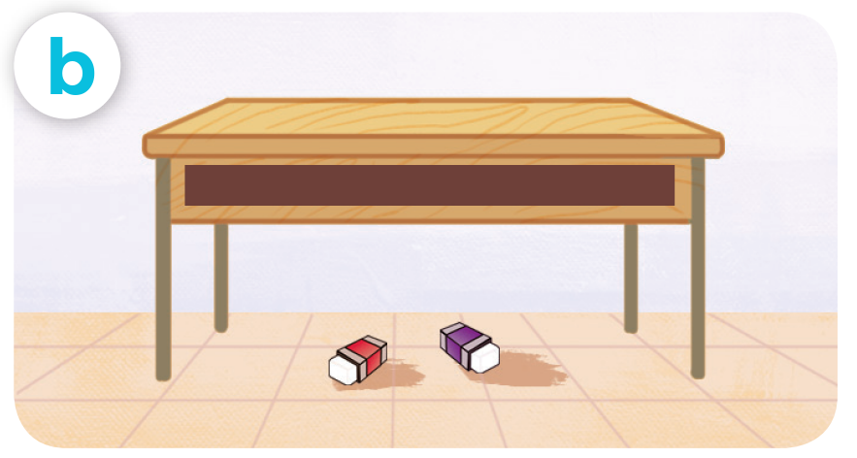
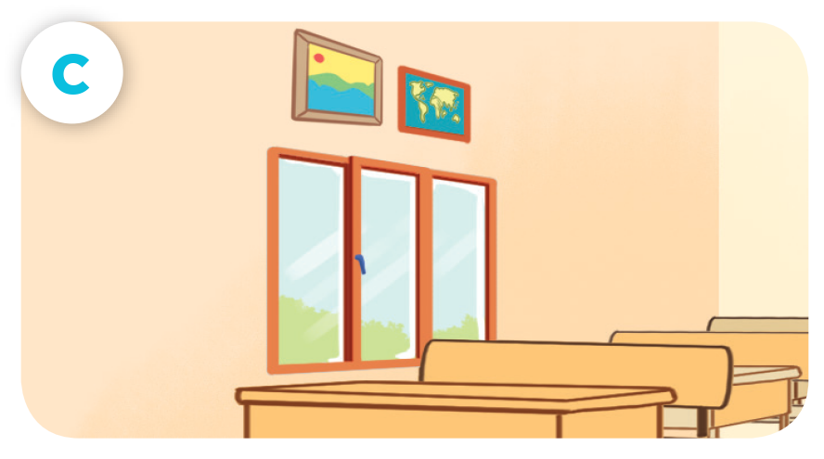

LOOK AND SAY
pencils / beside / book
erasers / under / desk
pictures / above / window
pens / in front of / clock

Slide 19





LISTEN AND REPEAT.
pencils / beside / book

Slide 20
LISTEN AND REPEAT.
erasers / under / desk

Slide 21
LISTEN AND REPEAT.
pictures / above / window

Slide 22
LISTEN AND REPEAT.
pens / in front of / clock

Slide 23






LISTEN AND REPEAT.
Where are the pencils?
pencils / beside / book
They’re beside
the book.

Slide 24

LISTEN AND REPEAT.
Where are the erasers?
erasers / under / desk
They’re under
the desk.

Slide 25


LISTEN AND REPEAT.
Where are the pictures?
pictures / above / window
They’re above
the window.

Slide 26
LISTEN AND REPEAT.
Where are the pens?
pens / in front of / clock
They’re in front of
the clock.

Slide 27


ASK AND ANSWER
pencils / beside / book
erasers / under / desk
pictures / above / window
pens / in front of / clock

Slide 28
ASK AND ANSWER
pencils / beside / book
erasers / under / desk
pictures / above / window
pens / in front of / clock

Slide 30
04
Let’s talk.

Slide 31


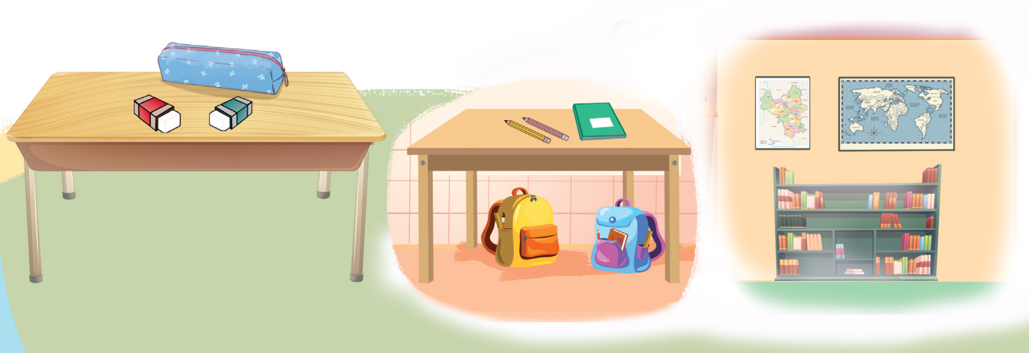
LOOK AND SAY.

Slide 32
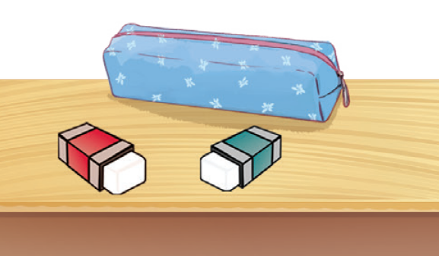
ASK AND ANSWER.
Where are
the erasers?
They’re beside the pencil case.

Slide 33
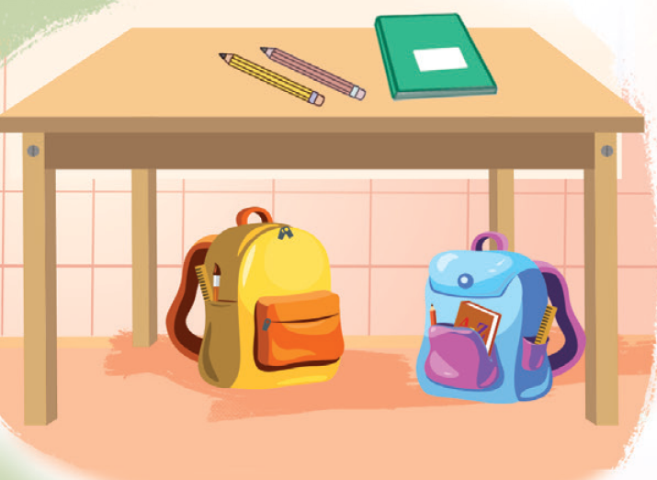

ASK AND ANSWER.
Where are the bags?
They’re under the desk.

Slide 34
ASK AND ANSWER.
Where are the pencils?
They’re beside the notebook.

Slide 35
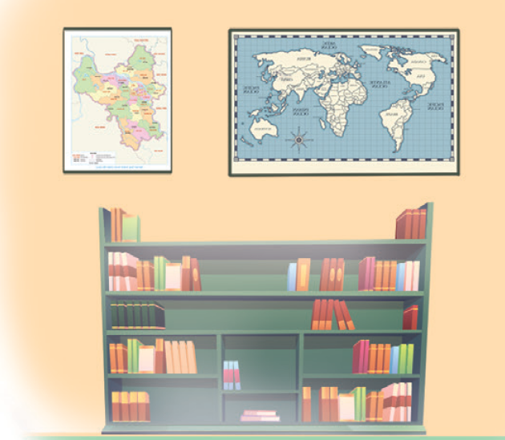
ASK AND ANSWER.
Where are the maps?
They’re above the bookcase.

Slide 36


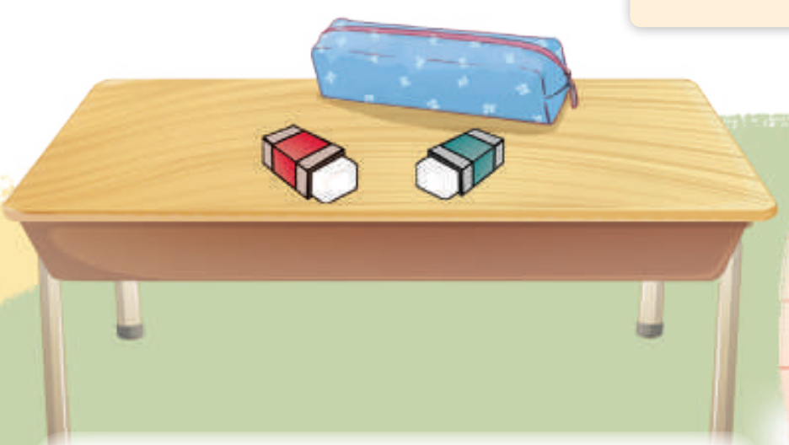
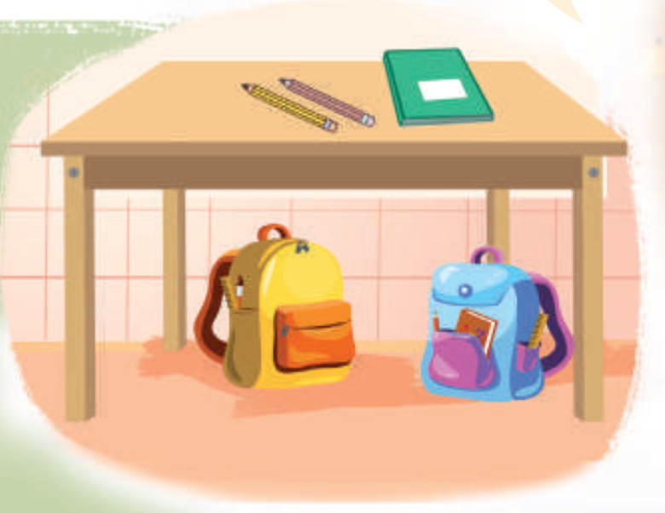

WORK in PAIRS
Ask and answer.

Slide 38






See you
next time!

Slide 39
Website: hoclieu.vn
Fanpage: https://www.facebook.com/tienganhglobalsuccess.vn/

