Slide 2







Unit 8
IN OUR CLASSROOM
Lesson 2 – Period 4

Slide 3





/
TABLE OF CONTENTS
Warm-up & Review
Listen and tick.
Read and complete.
Let’s play.
Fun corner & Wrap-up

Slide 4




01
Warm-up & Review

Slide 5





Game
FLOWER PICKING!

Slide 6







Group 1
Group 2
Notes:
Click the box to give scores to groups.
Click numbers to link to the Question slide.
Click star to end the game.

Slide 7



A: Whose glue is this?
Trung
It’s Trung’s.
B: ________
Notes:
GV nháy vào biểu tượng ngôi sao để về slide tính điểm cho đội trả lời đúng

Slide 8



pencil sharpener
A:Whose ____________ is this?
Thoa
It’s Thoa’s.
B: _______

Slide 9



crayon
A: Whose _____ is this?
David
It’s David’s.
B: _________

Slide 10



pencil case
A:Whose ________ is this?
Peter
It’s Peter’s.
B: _________

Slide 11



set square
A: Whose ________ is this?
Thu
It’s Thu’s.
B: _______

Slide 12


ruler
A: Whose ____ is this?
Hoai
It’s Hoai’s.
B: _________

Slide 13




Good job!

Slide 14





Swap your books!

Slide 15





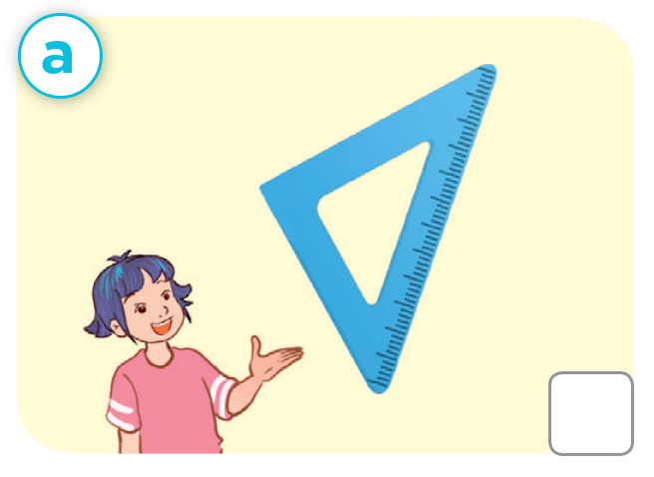
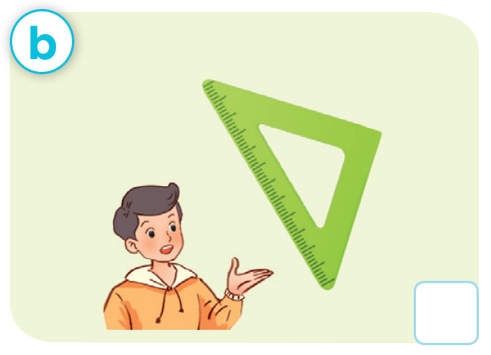
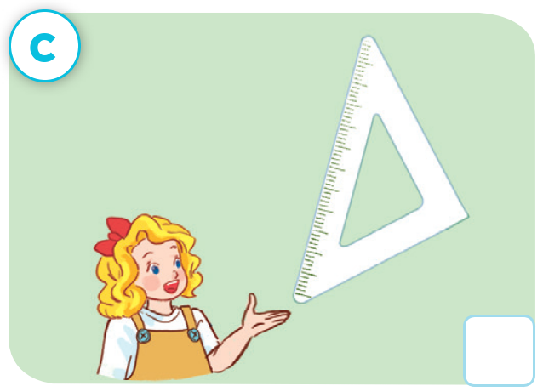


Let’s check!
✓

Slide 16
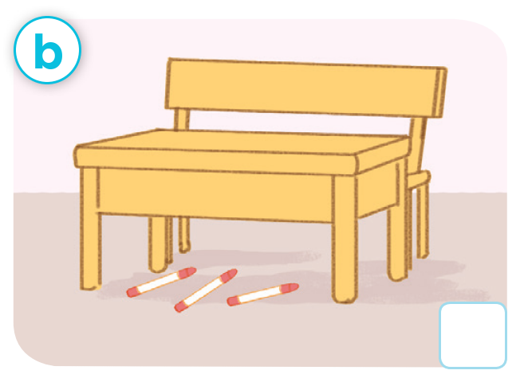


Make a new conversation.

Slide 17
Make a new conversation.

Slide 18











Slide 19
03
Read and complete.

Slide 20




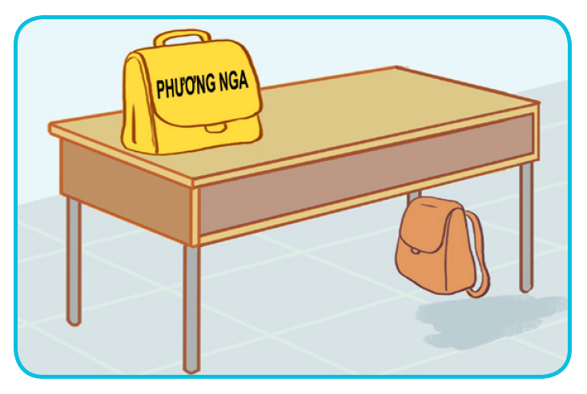
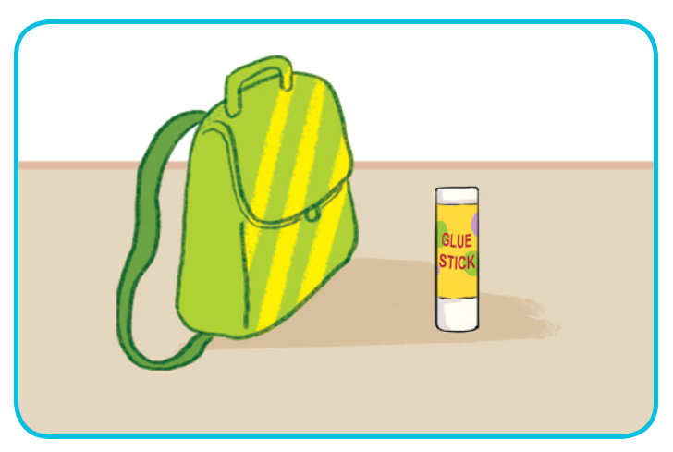
Look and say

Slide 21


Look and guess.
1. A: Excuse me, whose school bag is this?
B: _____ Phuong Nga’s.
A: And where’s my school bag?
B: Look! It’s there, ______ the desk.
A: Thank you.

Slide 22

Look and guess.
2. A: Is this your glue stick?
B: No, it isn’t.
A: ________________ glue stick is this?
B: It’s Tom’s.
A: _____________ my glue stick?
B: It’s there, beside the ________________.

Slide 23
Read and complete.
1. A: Excuse me, whose school bag is this?
B: ____ Phuong Nga’s.
A: And where’s my school bag?
B: Look! It’s there, ______ the desk.
A: Thank you.
It’s
under

Slide 24
Read and complete.
2. A: Is this your glue stick?
B: No, it isn’t.
A: ________ glue stick is this?
B: It’s Tom’s.
A: ______ my glue stick?
B: It’s there, beside the ___________.

Slide 25
SWAP YOUR BOOKS!

Slide 26
Let’s check!
2. A: Is this your glue stick?
B: No, it isn’t.
A: ________ glue stick is this?
B: It’s Tom’s.
A: _________ my glue stick?
B: It’s there, beside the ____________.
Whose
Where’s
school bag

Slide 28
04
Let’s play.

Slide 29
Website: hoclieu.vn
Fanpage: https://www.facebook.com/tienganhglobalsuccess.vn/

