Slide 1



Slide 2





8
Period 1

Slide 3



①
Warm-up and review
Contents
②
Look, listen and repeat.
③
Listen, point and say.
④
Let’s talk.
⑤
Fun corner and wrap-up

Slide 4


①
Warm-up and review

Slide 5



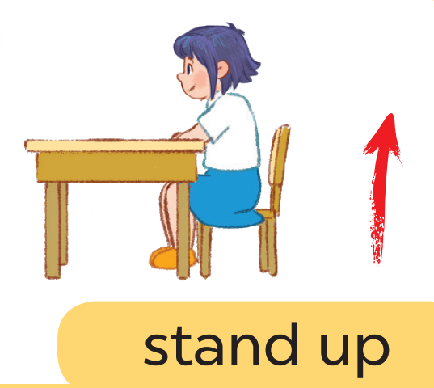


Game: Listen and choose

Slide 6
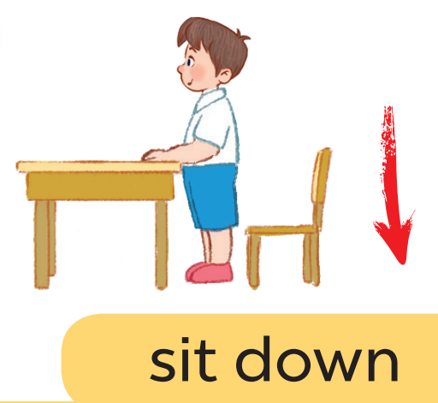
Game: Listen and choose

Slide 7
Game: Listen and choose

Slide 8
Game: Listen and choose

Slide 9
Game: Listen and choose

Slide 10
Game: Listen and choose

Slide 11
Game: Listen and choose

Slide 12
Game: Listen and choose

Slide 13
②
Look, listen and repeat.

Slide 14
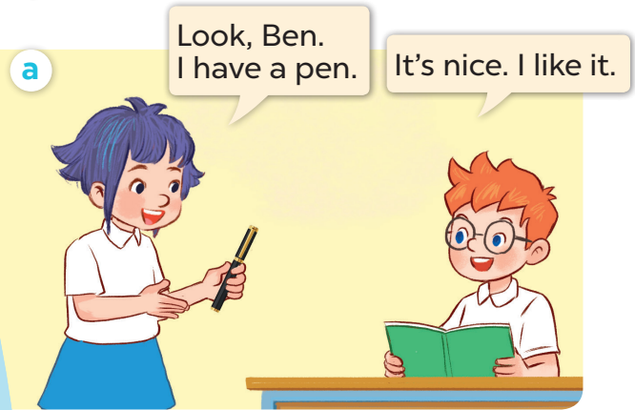
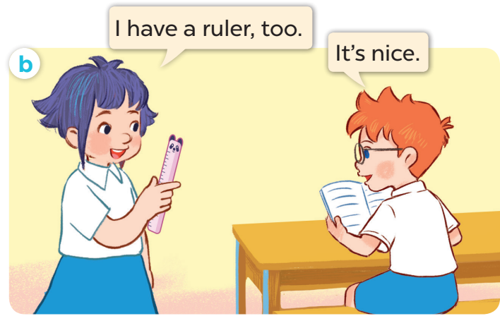

Slide 15
③
Listen, point and say.

Slide 16
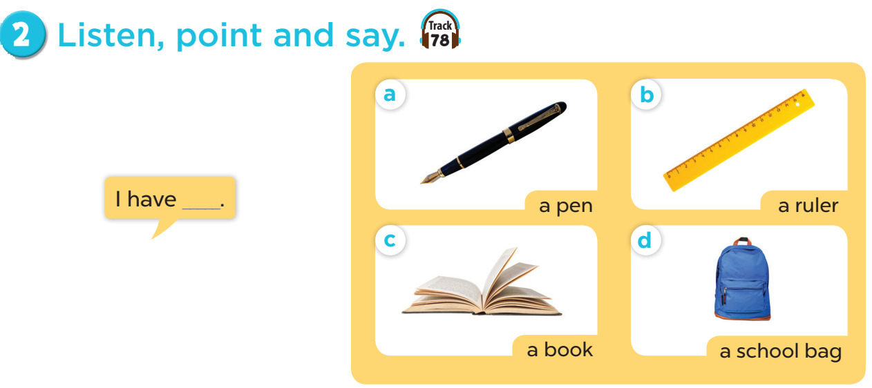

Slide 17


Slide 18

Website: sachmem.vn
Fanpage: www.facebook.com/sachmem.vn

