Slide 1
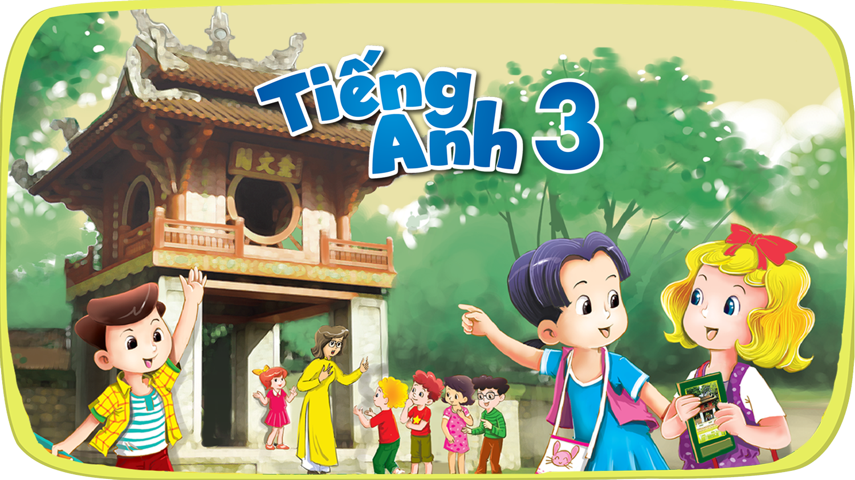


Slide 2



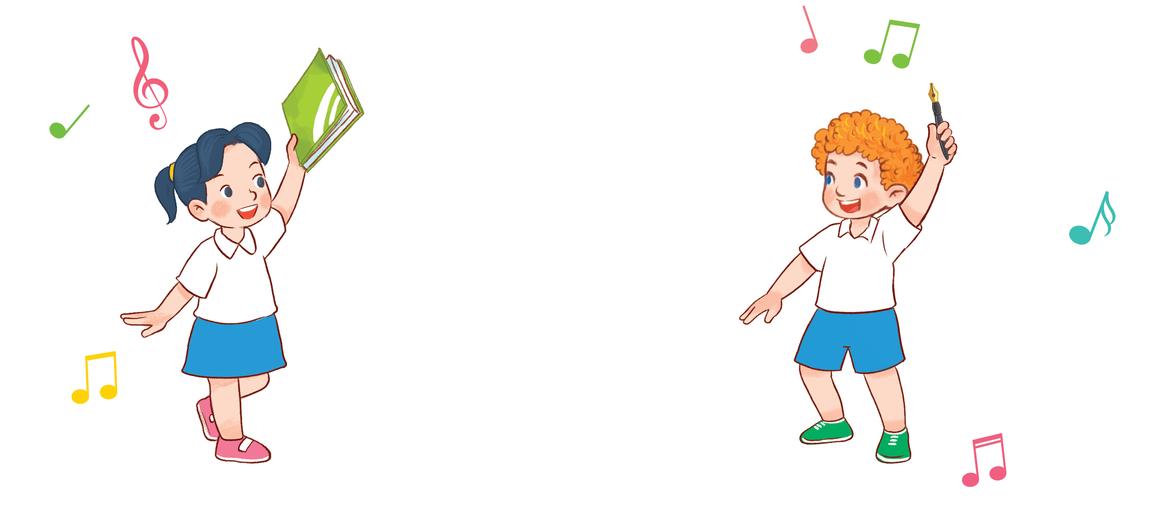

8
2
Period 3

Slide 3
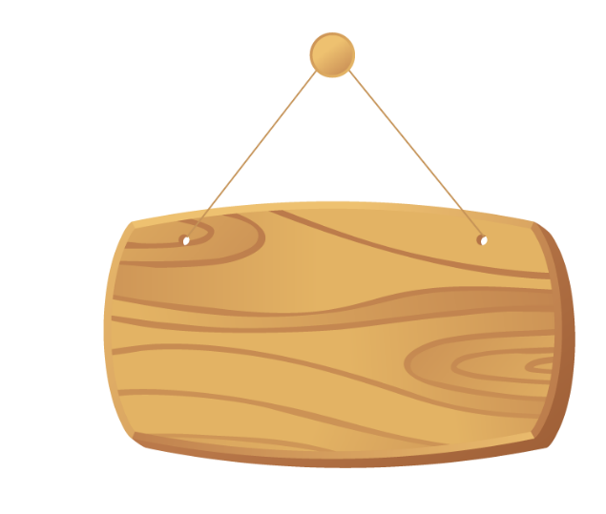

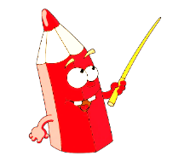
①
Warm-up and review
Contents
②
Look, listen and repeat.
③
Listen, point and say.
④
Let’s talk.
⑤
Fun corner and wrap-up

Slide 4


①
Warm-up and review

Slide 5

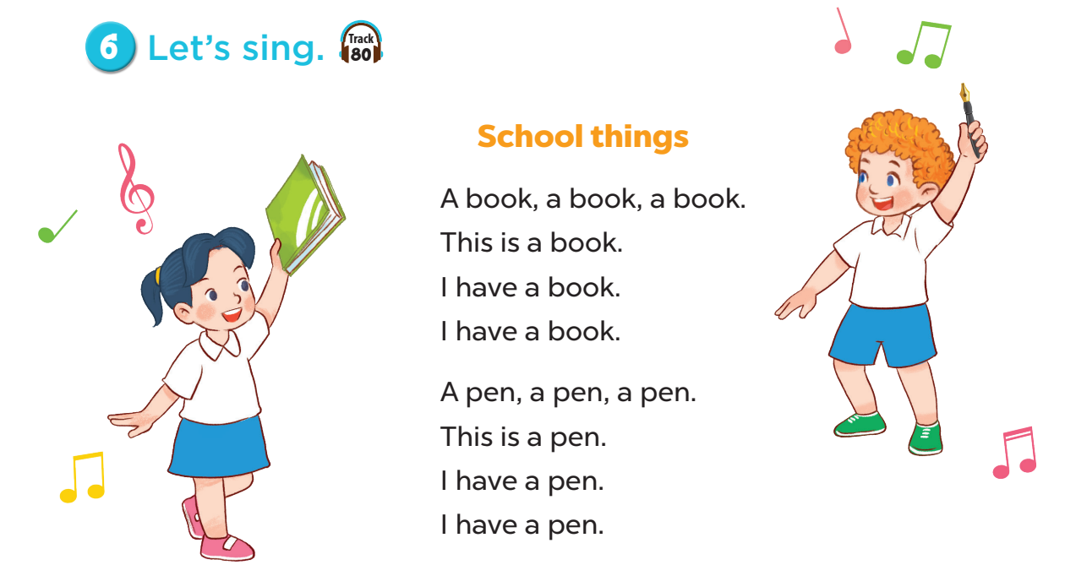
Notes:
Sing the song School things of Unit 8, page 57.
- Ask pupils to sing the song.
- Invite some of them to the board to role play and do action, the rest of the pupils will sing.
- Ask pupils to sing this song with some words covered. When they finish singing, check the lyrics.

Slide 6
②
Look, listen and repeat.

Slide 7
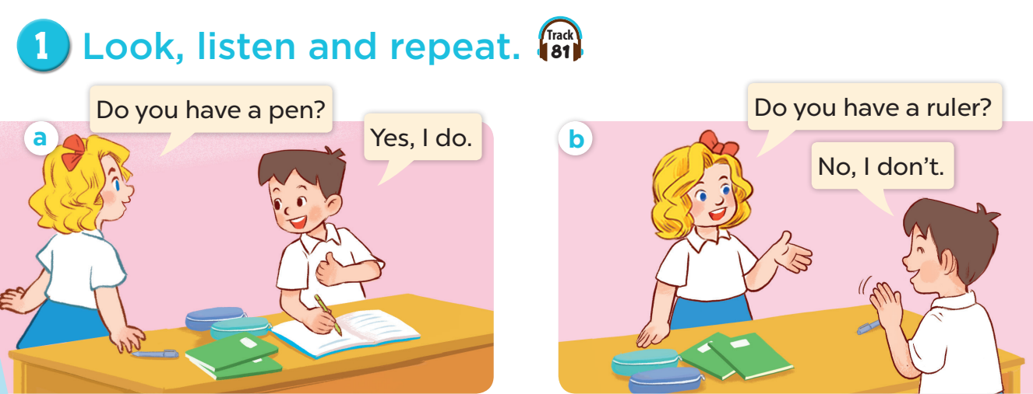

Slide 8
③
Listen, point and say.

Slide 9
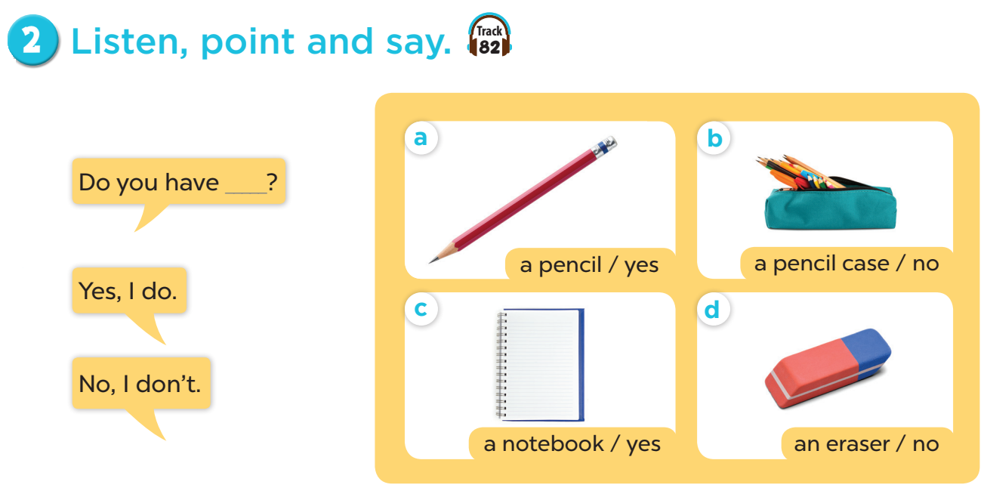

Slide 10


Slide 11




LUCKY WHEEL
30
20
1
2
3
40
10
Stop
SPIN
50
80
4
5
6
60
70
7
8
9
Next activity
Notes:
Game: LUCKY WHEEL
- Divide the class into four groups.
- Each group takes turns to pick a number.
- Look at the picture cue and answer the question on the slide.

Slide 12

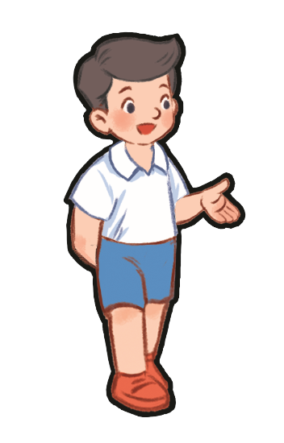
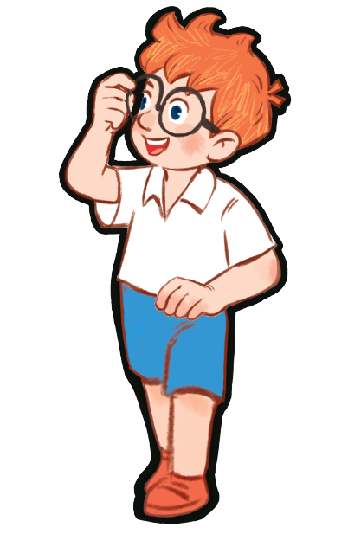
Do you have a pen?
☑
Yes, I do.
…………
Notes:
Game: Do you have…?

Slide 13
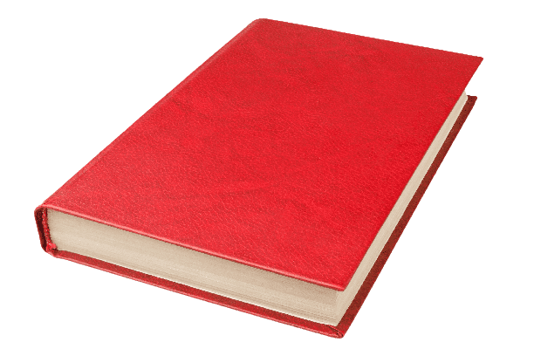
Do you have a book?

No, I don’t.
…………
Notes:
Game: Do you have…?

Slide 14
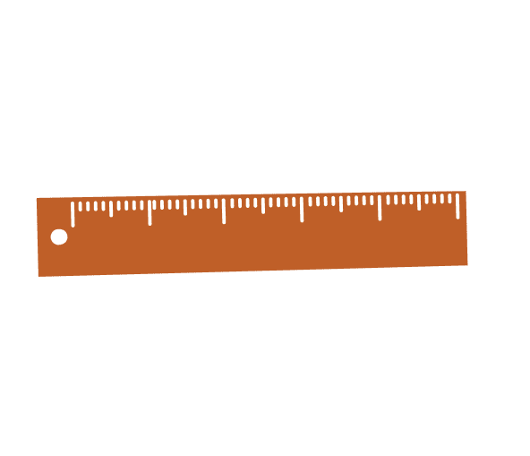
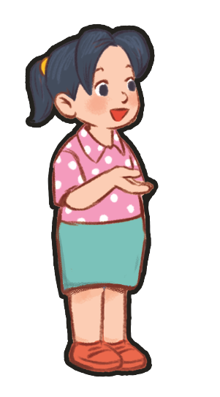
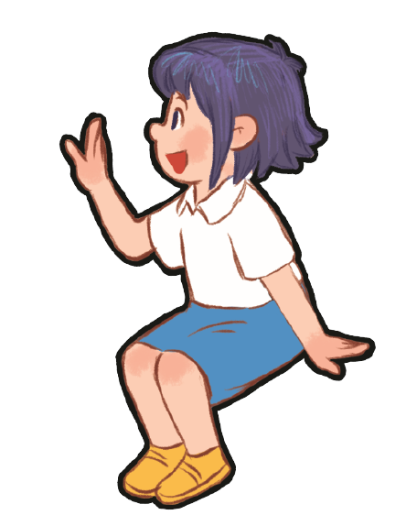
Do you have a ruler?

No, I don’t.
…………
Notes:
Game: Do you have…?

Slide 15

Do you have a pencil?
☑
Yes, I do.
…………
Notes:
Game: Do you have…?

Slide 16
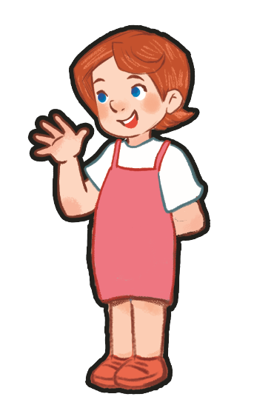
Do you have a ruler?
☑
Yes, I do.
…………
Notes:
Game: Do you have…?

Slide 17
Do you have a pen?

No, I don’t.
…………
Notes:
Game: Do you have…?

Slide 18
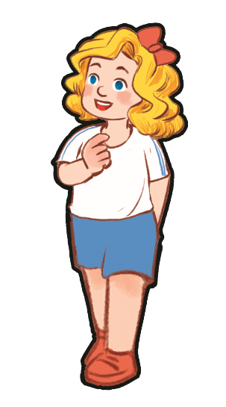
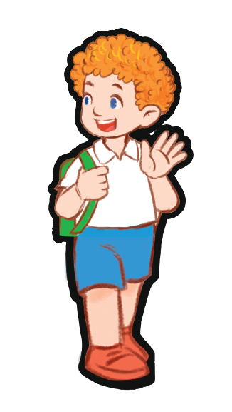
Do you have a book?

No, I don’t.
…………
Notes:
Game: Do you have…?

Slide 19
Do you have a pencil?

No, I don’t.
…………
Notes:
Game: Do you have…?

Slide 20
Do you have a ruler?
☑
Yes, I do.
…………
Notes:
Game: Do you have…?

Slide 21
④
Let’s talk.

Slide 22
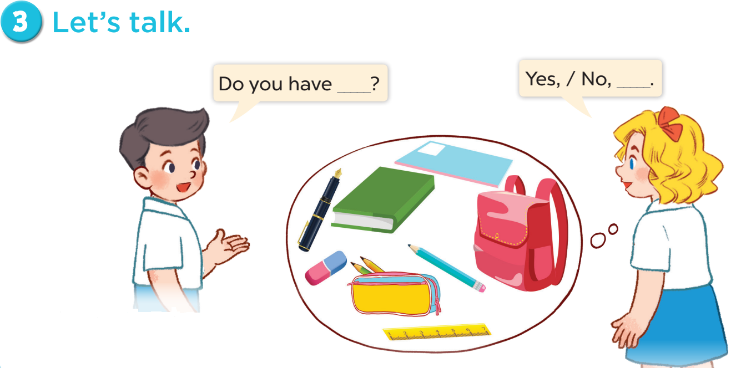

Slide 23
⑤
Fun corner and wrap-up
Notes:
Teacher tells pupils to put their school things on the desk.
Ask them: Do you have a pen/book/ruler…?
If they have that item, say: Yes, I do. If not, then say: No, I don’t.

Slide 24
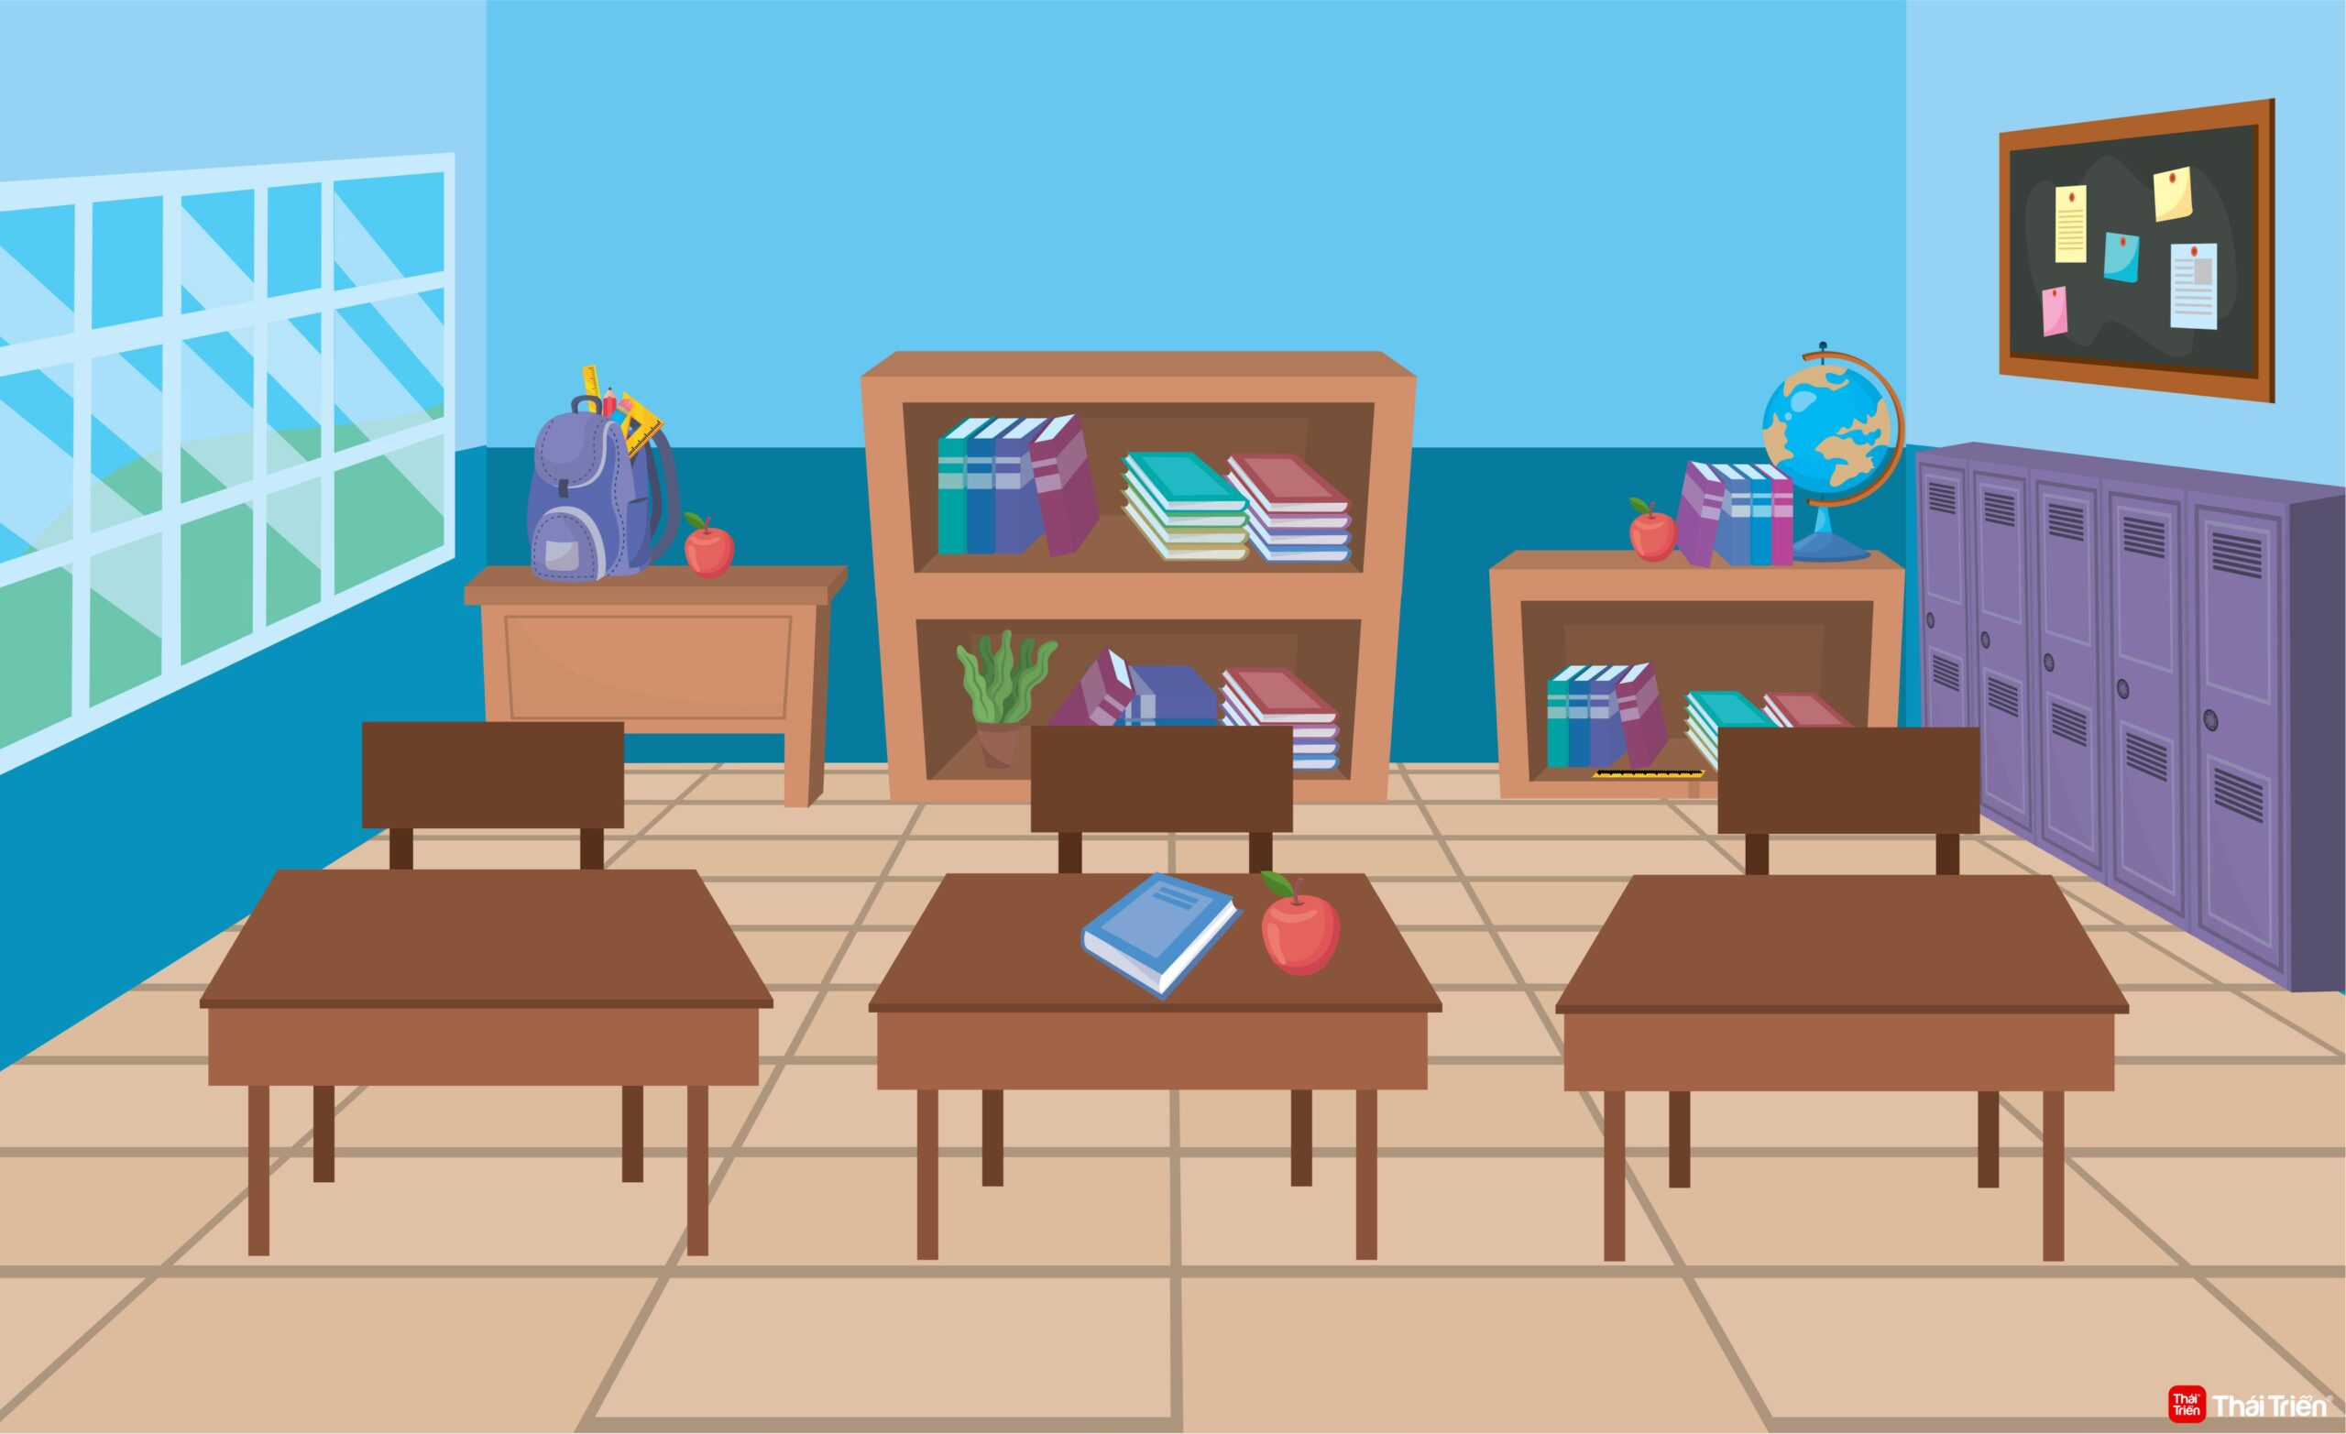
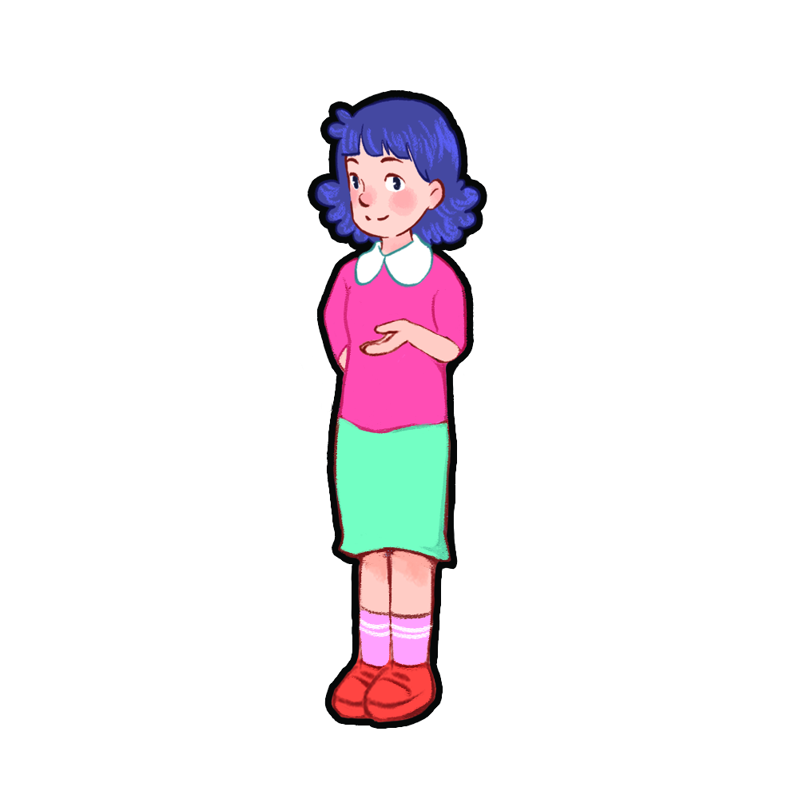
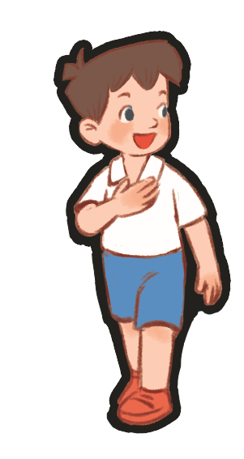

Do you have a ruler?
No, I don’t.
Yes, I do.
Yes, I do.

Slide 25

Website: sachmem.vn
Fanpage: www.facebook.com/sachmem.vn

