Slide 1


Slide 2



19
The animal world
LESSON 2 - PERIOD 4

Slide 3
Table of contents
01
02
Listen and circle.
Warm-up
Look, complete and read.
03
04
Let’s play.
05
Fun time

Slide 4
1
Warm-up

Slide 5


TEAM 1
TEAM 2
TEAM 3
x
x
x
click
to play
Notes:
- Click the team names to add points (flower)
- Click x to delete flowers

Slide 6












= 1 point
= -1 point
= 2 points

Slide 7
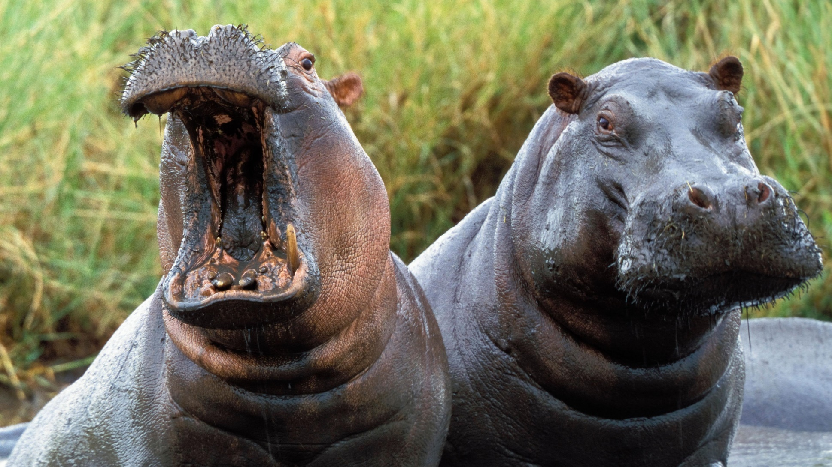

What are these animals?
They’re hippos.
Notes:
click house to go back

Slide 8


What are these animals?
They’re lions.

Slide 9

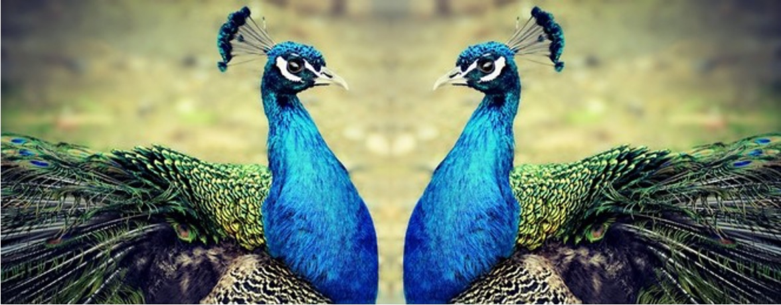
What are these animals?
They’re peacocks.

Slide 10
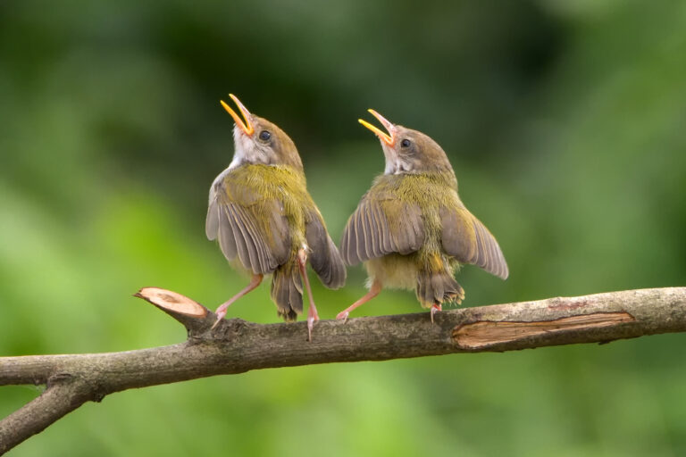
Why do you like birds?
Because they sing merrily.

Slide 11
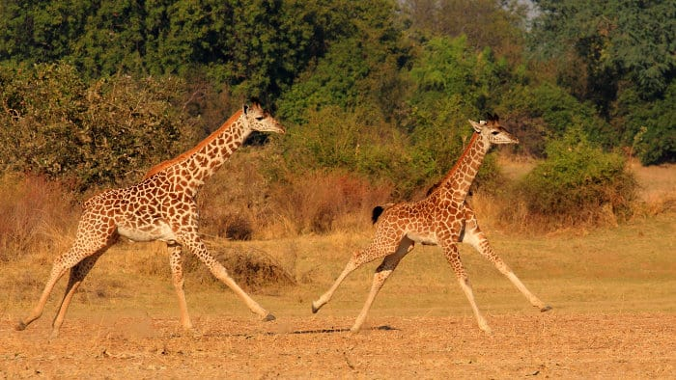
Why do you like giraffes?
Because they run quickly.

Slide 12
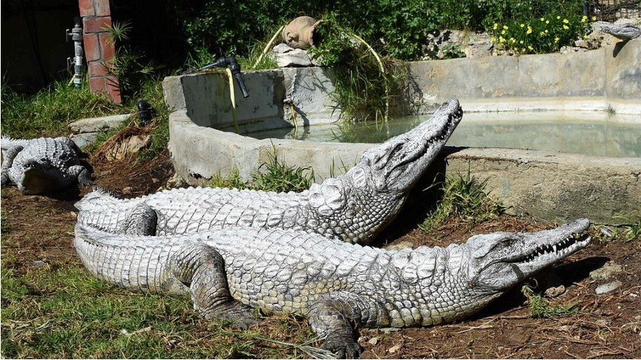
What are these animals?
They’re crocodiles.

Slide 13
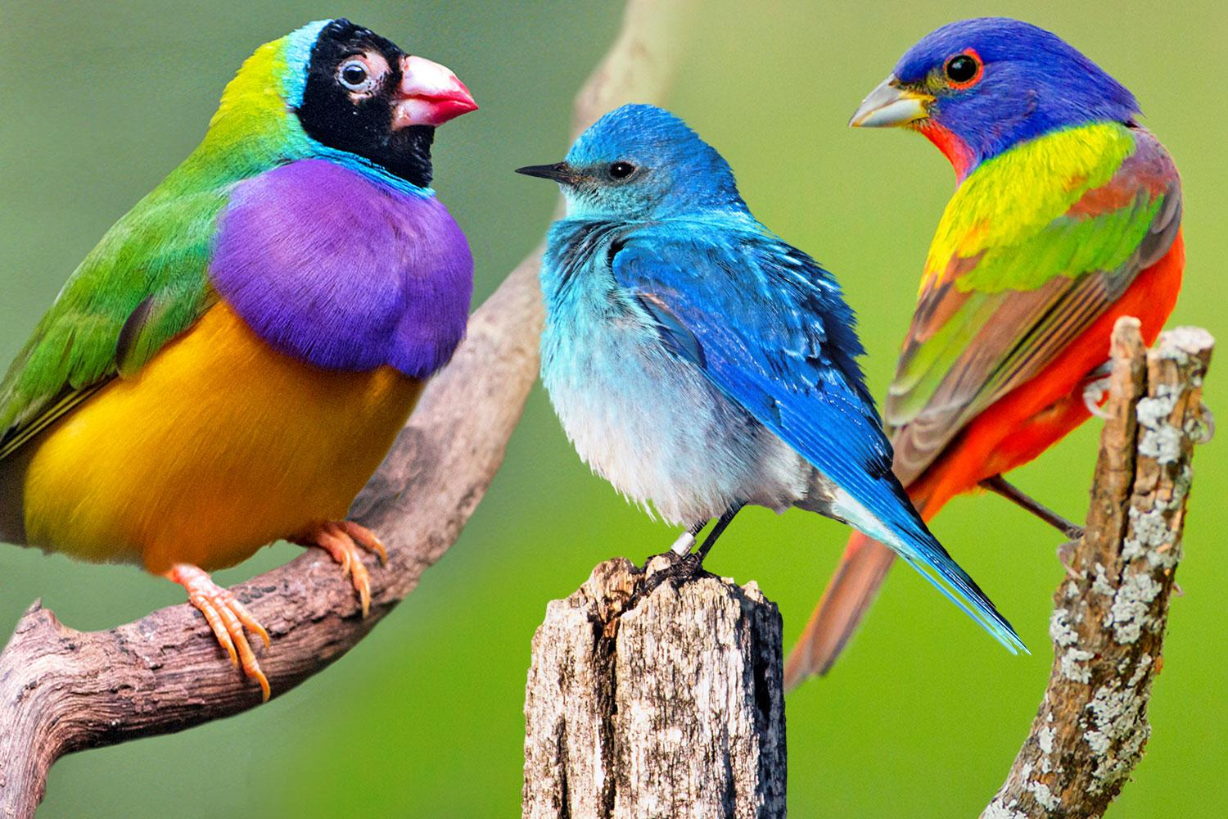
What are these animals?
They’re birds.

Slide 14
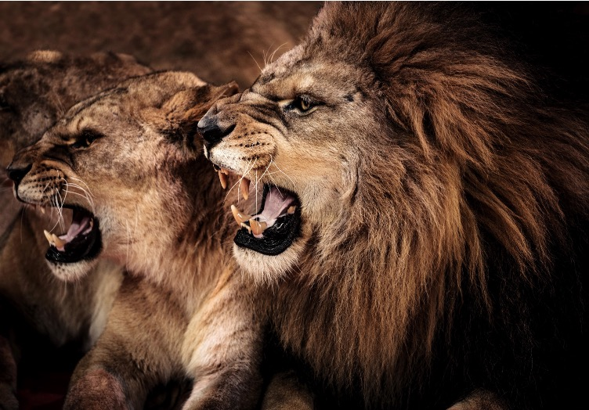
Why do you like lions?
Because they roar loudly.

Slide 15
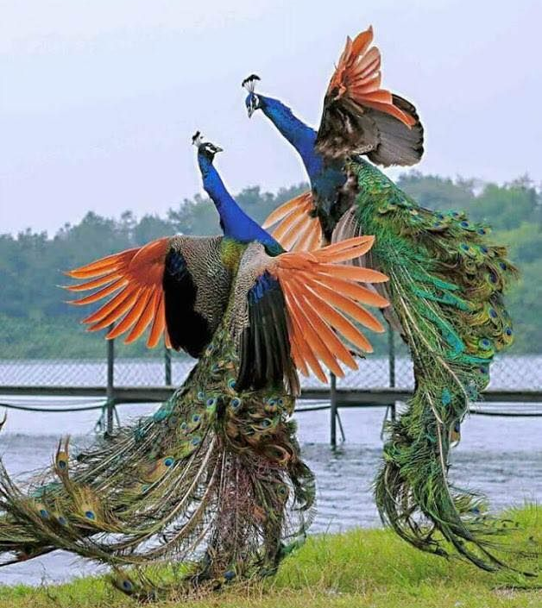
Why do you like peacocks?
Because they dance beautifully.

Slide 16
2
Listen and circle.

Slide 17


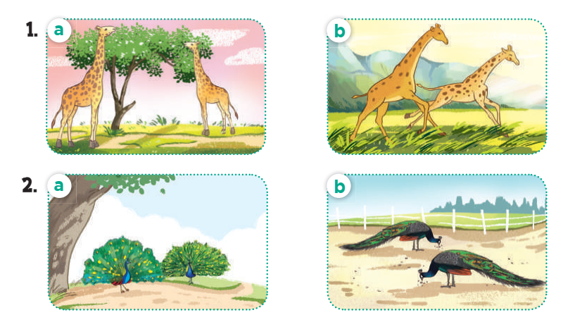

Slide 18
3
Look, complete and read.

Slide 19
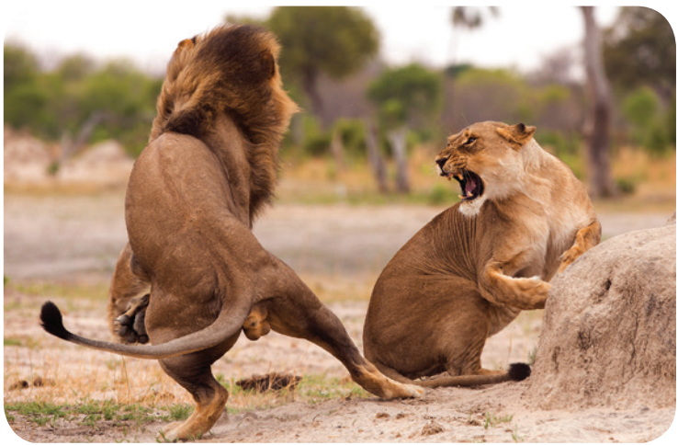
Look, complete and read.
A: What are these
animals?
B: They’re ______.
I like them.
A: Why do you like
lions?
B: _______ they roar loudly.
lions
Because

Slide 20
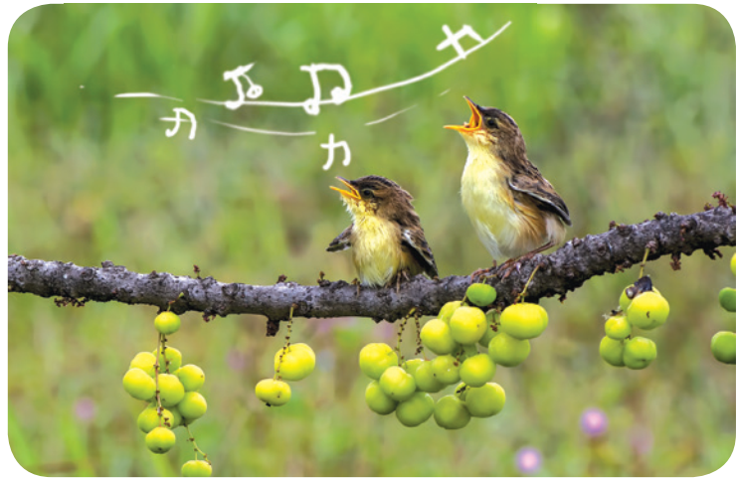
Look, complete and read.
A: What are those
_______?
B: They’re birds.
I like them.
A: _______ do you
like birds?
B: Because they ___________.
animals
Why
sing merrily

Slide 21
4
Let’s play.

Slide 22
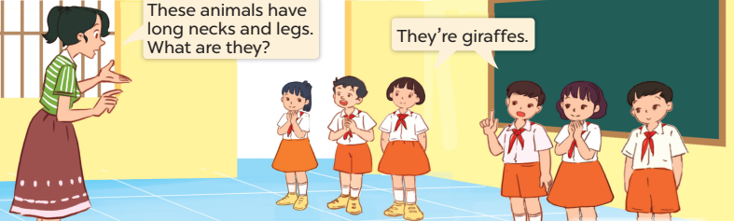
Guessing animals

Slide 23
5
Fun time

Slide 24



Why do you like …?
Because …
Lions/
roar loudly
+2 pts
Lions/ brave
+3 pts
TEAM 1
TEAM 2
+
Peacocks/ dance beautifully
+4 pts
Birds/
sing merrily – 3 pts
+
SPIN
-
-
Hippos/
have short legs
+1 pt
Hippos/ strong
- 5pts
Giraffes/
run quickly
+7 pts
Crocodiles/ have sharp teeth
– 2 pts
tekhnologic
Notes:
Divide the class into 2 teams
Teacher/ student clicks on the SPIN button to run the wheel; then clicks again to stop the wheel.
Students ask and answer with the model sentence using the given word on the wheel .
If they have got the correct answer, they get points for their team.

Slide 25

Website: hoclieu.vn
Fanpage: facebook.com/www.tienganhglobalsuccess.vn
Website: sachmem.vn; hoclieu.vn
Fanpage: www.facebook.com/sachmem.vn

