Slide 2

WARM UP
Sing “The morning routines?” song
UNIT 9 – LESSON 3
Notes:
Sing a warm-up song: The morning routines song.
https://www.youtube.com/watch?v=VlkJRzAwgd0

Slide 3


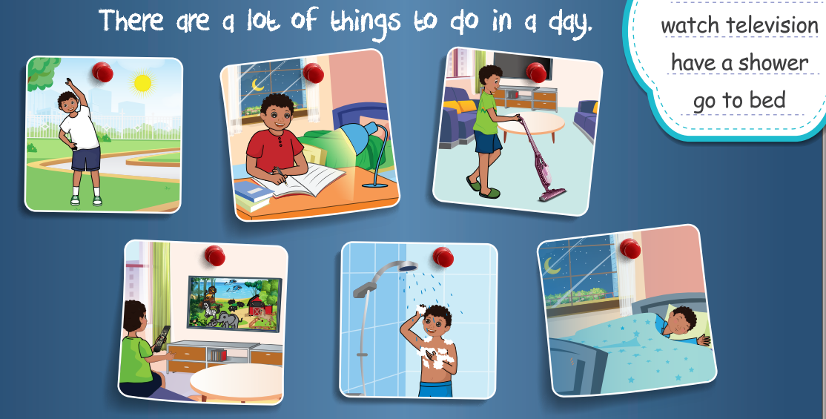
UNIT 9 – DAILY ROUTINES
Lesson 3
Period 1
UNIT 9 – LESSON 3

Slide 4

1
Listen and repeat.
UNIT 9 – LESSON 3
Notes:
Ask students to look at the picture in activity 1, introduce the activities the boy often do in a day.

Slide 5
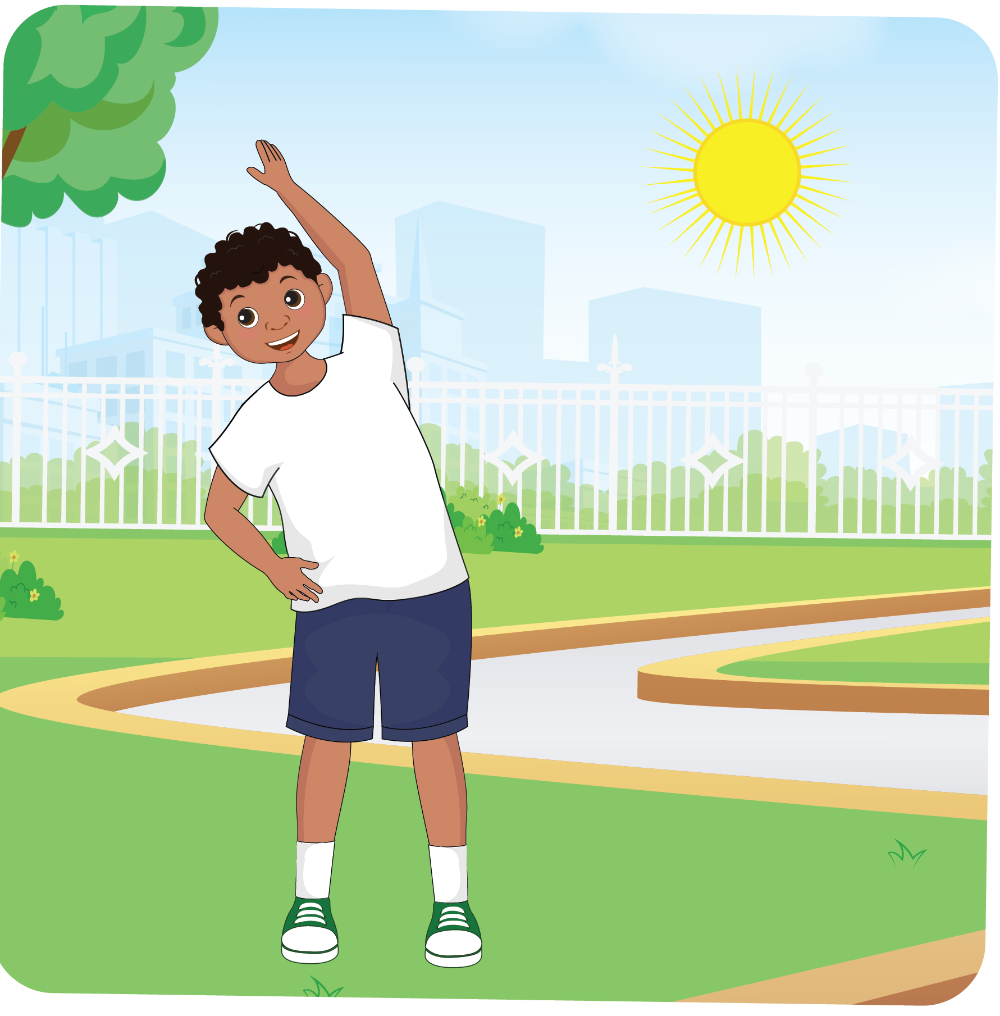

1
Listen and repeat.
UNIT 9 – LESSON 3
Notes:
Play the audio CD (CD2 Track 22) for students to listen to the twice.
Play the audio for students to listen and repeat, teach the new words: do exercise, do homework, do housework, watch television, have a shower, go to bed, explain the meaning.

Slide 6


1
Listen and repeat.
UNIT 9 – LESSON 3
Notes:
Play the audio CD (CD2 Track 22) for students to listen to the twice.
Play the audio for students to listen and repeat, teach the new words: do exercise, do homework, do housework, watch television, have a shower, go to bed, explain the meaning.

Slide 7
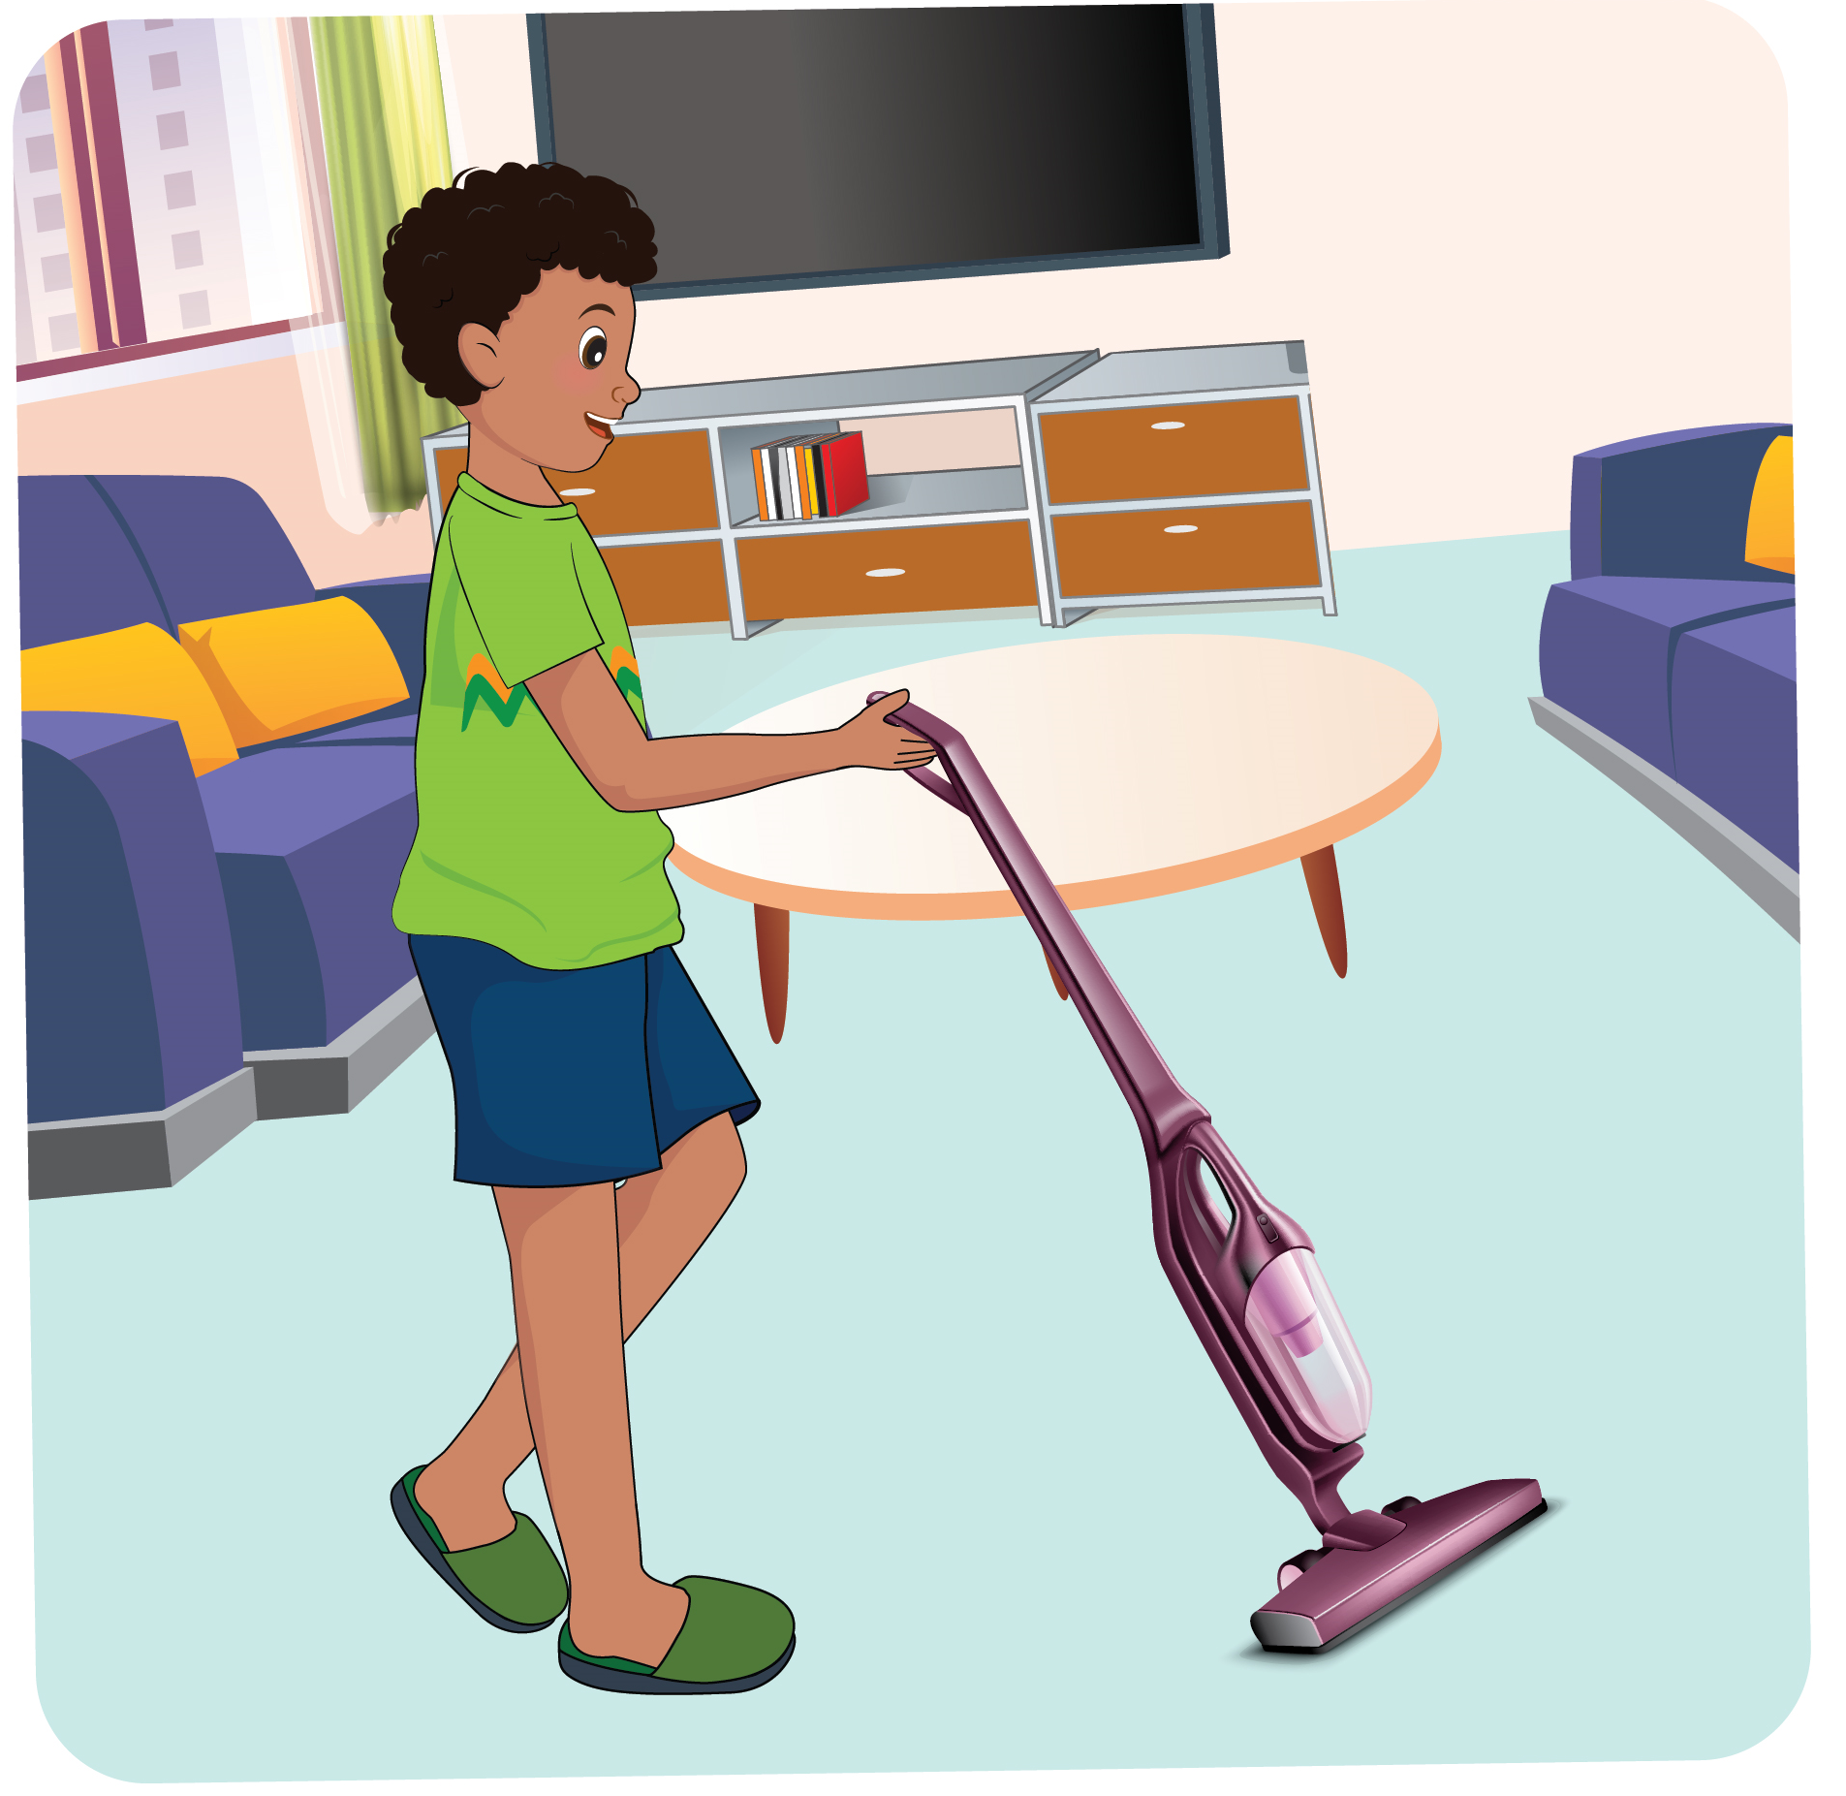

1
Listen and repeat.
UNIT 9 – LESSON 3
Notes:
Play the audio CD (CD2 Track 22) for students to listen to the twice.
Play the audio for students to listen and repeat, teach the new words: do exercise, do homework, do housework, watch television, have a shower, go to bed, explain the meaning.

Slide 8
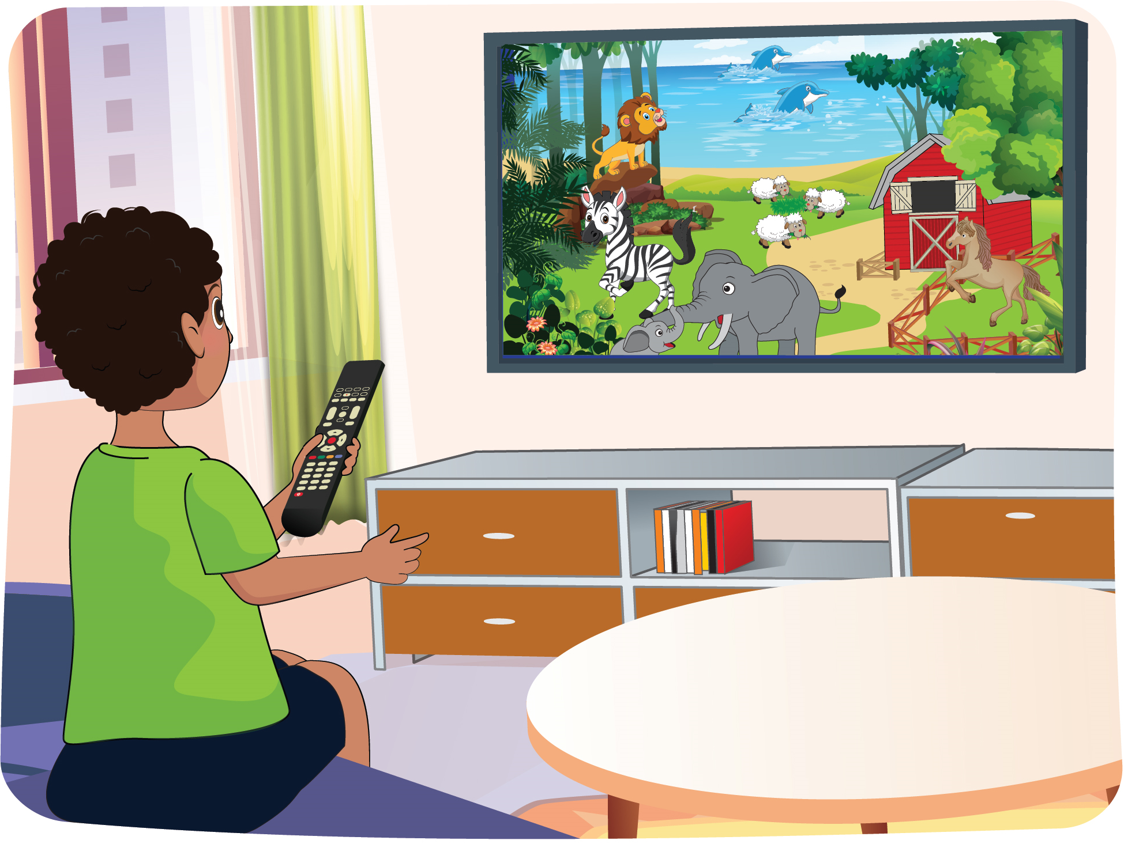

1
Listen and repeat.
UNIT 9 – LESSON 3
Notes:
Play the audio CD (CD2 Track 22) for students to listen to the twice.
Play the audio for students to listen and repeat, teach the new words: do exercise, do homework, do housework, watch television, have a shower, go to bed, explain the meaning.

Slide 9
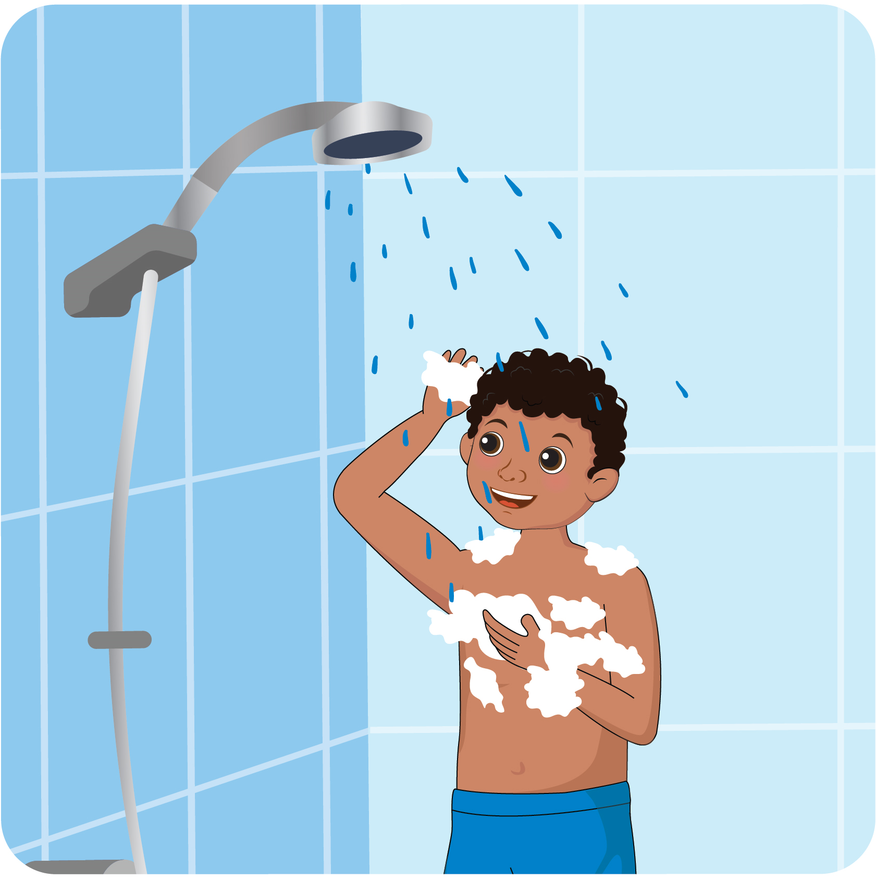

1
Listen and repeat.
UNIT 9 – LESSON 3
Notes:
Play the audio CD (CD2 Track 22) for students to listen to the twice.
Play the audio for students to listen and repeat, teach the new words: do exercise, do homework, do housework, watch television, have a shower, go to bed, explain the meaning.

Slide 10
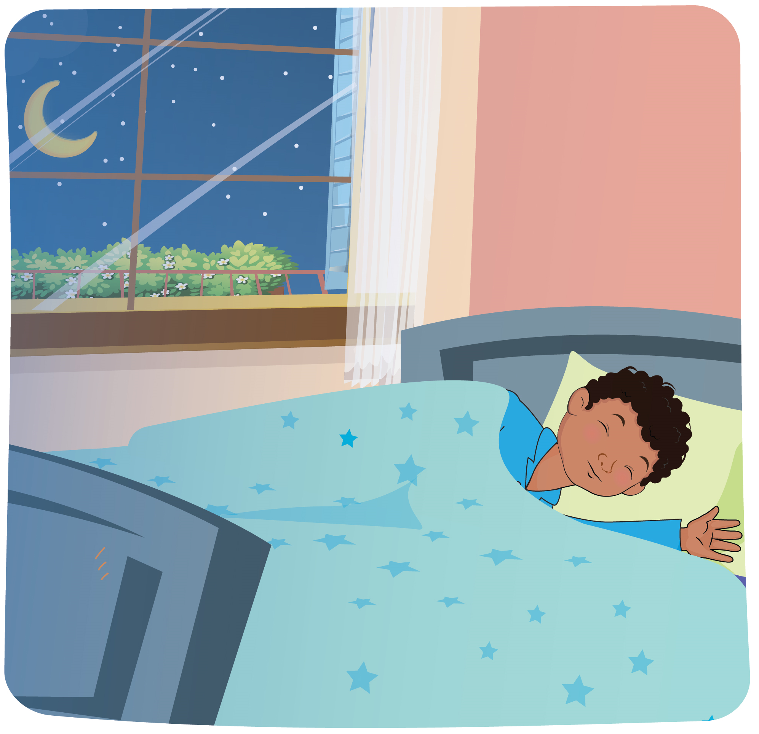

1
Listen and repeat.
UNIT 9 – LESSON 3
Notes:
Play the audio CD (CD2 Track 22) for students to listen to the twice.
Play the audio for students to listen and repeat, teach the new words: do exercise, do homework, do housework, watch television, have a shower, go to bed, explain the meaning.

Slide 11

1
Listen and repeat.
UNIT 9 – LESSON 3
Notes:
Correct students’ pronunciation mistakes and instruct students to say using proper intonation.
Ask students to work in pairs: one student points, one student reads.

Slide 12
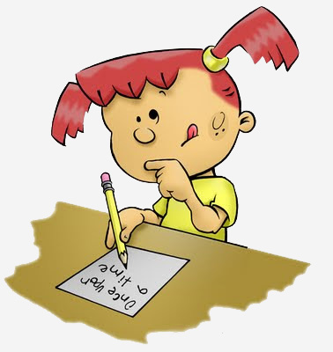
GAME: Make a sentence.
UNIT 9 – LESSON 3
Notes:
Ask students to work in group.
Each turn, one student from each group go to the board, pick one flashcard about daily activity. The others raise their hands to get their group’s turn, this group will make a sentence with the phrase.
Teacher gives points for the correct sentences.

Slide 13
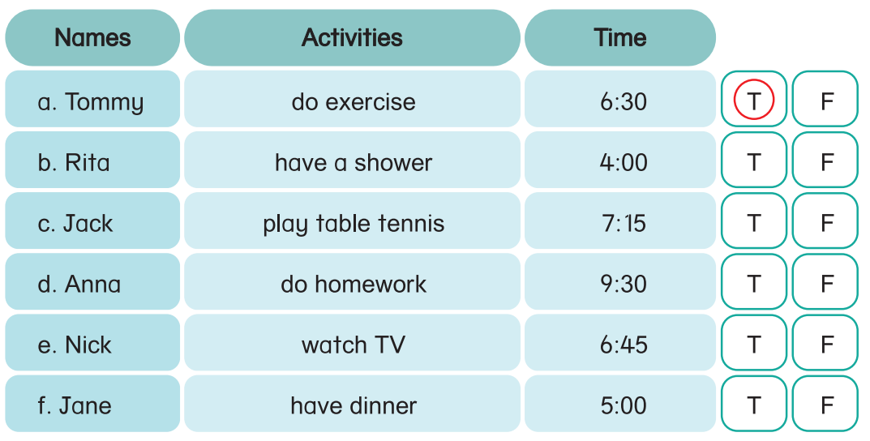
2
Listen and circle T (True) or F (False).
T
UNIT 9 – LESSON 3
Notes:
Focus students on Activity 2.
Ask students say the names in the table correctly, read aloud the activities and recognize the time.
Tell student that they are going listen 6 people’s daily activities, then circle T if the sentences describe people’s activities correctly compared to the audio. Otherwise, students circle F.
Play the audio CD (CD2 track 23) for students to listen once.
Draw students’ attention to the example. Then explain.
Play the audio for students to listen and circle.
Ask some students to give their answers.
Check and give correct answers.

Slide 14
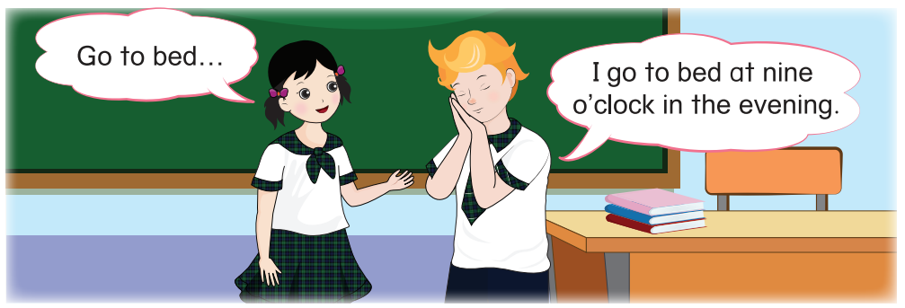
3
Read and complete.
UNIT 9 – LESSON 3
Notes:
Ask students to look at the picture in Activity 3. Focus on Tommy and Ha Linh. Ask students what they are doing.
Introduce the context: Ha Linh says a phrase “go to bed” and then Tommy makes a sentence with this phrase “I go to bed at nine o’clock in the evening”.
Ask student to read the sample verb phrase and the sentence.
Tell students that they are going work in pairs, each student takes turns to give a verb phrase and the other listens to this verb phrase, does the action while saying the sentence using this phrase.
Ask students to look at the pictures, read and write the words in the blanks to complete the sentences.
Give time for students to work in pairs.
Invite some students to go to the board, say aloud the verb phrases, the others raise their hands to do the actions and make the sentences.
Give feedback.

Slide 15


Thursday, Jannuary 1st 2024
Unit 9: DAILY ROUTINES
Lesson 3. Period 1
Vocabulary
do exercise
do homework
do housework
watch television
have a shower
go to bed
UNIT 9 – LESSON 3
Notes:
Review all the words they have learned by using flashcards.
Count the stars.
Give compliments.

Slide 16


