Slide 1



Slide 2
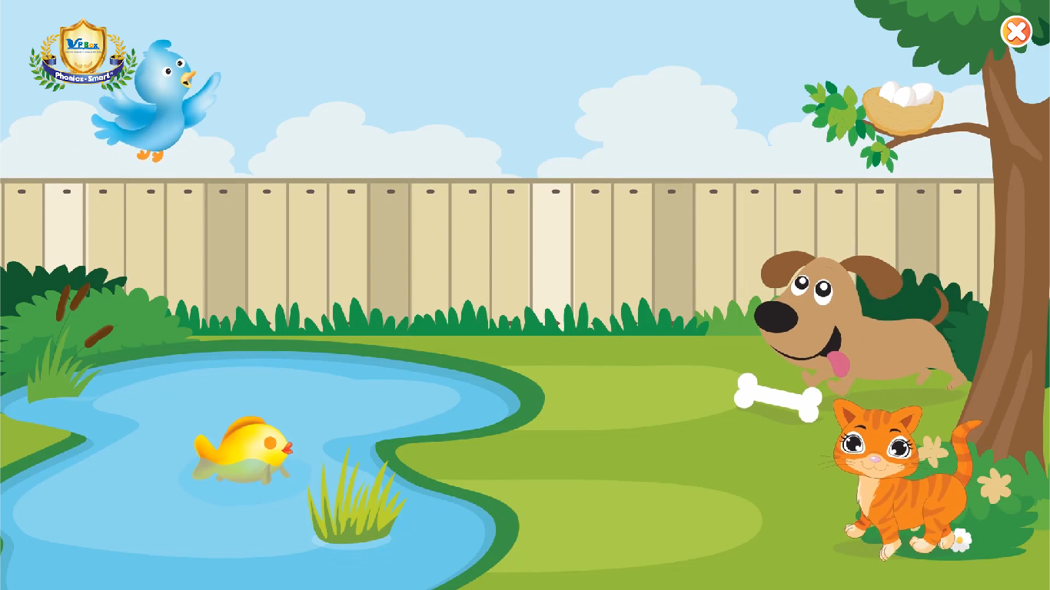

Notes:
T says “ Hello, everyone. How are you? How’s the weather? Is it sunny? Great! Now, let’s sing a song with me.”
Warm up: Sing “Animal song” – “Excellent! You sing very well.”
Divide class into 2 groups (optional) – “Today, we will have 2 groups – Group 1 and Group 2. You are Group 1, you are Group 2.”
(Chèn bài animal song)

Slide 3


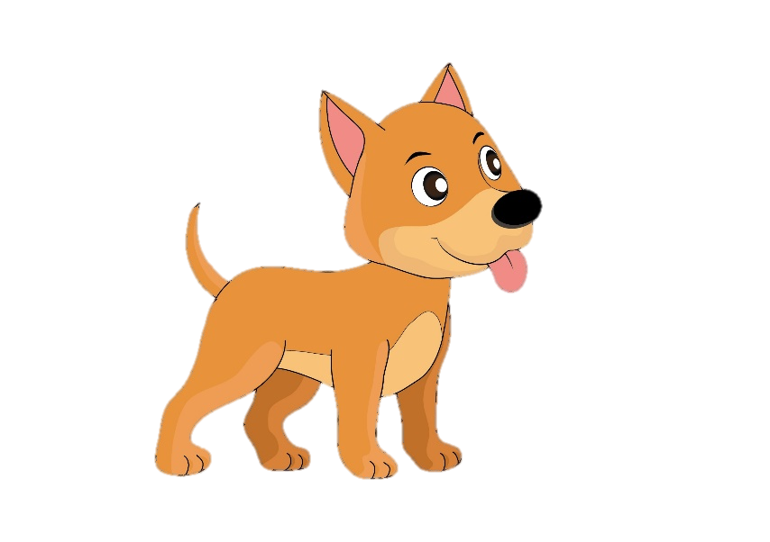
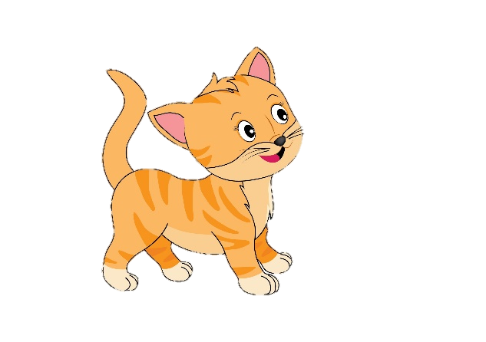
Game: Counting game
HOW MANY DOGS?
Notes:
Counting game
T says “I have got a lot of animals. Let’s count them with me.”
Work in groups
T asks “Group 1, how many dogs are there?”
Sts answer (each group has 1 turn)
T shows the answer – “Good job! One flower for group 1.”
With one correct answer, each group will have 1 flower.

Slide 4
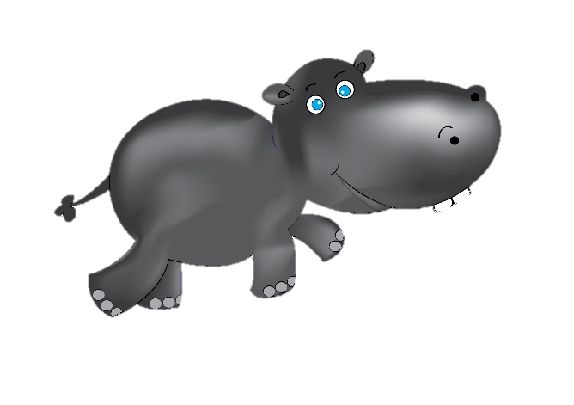
Game: Counting game
HOW MANY HIPPOS?
Notes:
T asks “Group 2, how many hippos are there?”
T shows the answer – “Good job! One flower for group 2.”

Slide 5
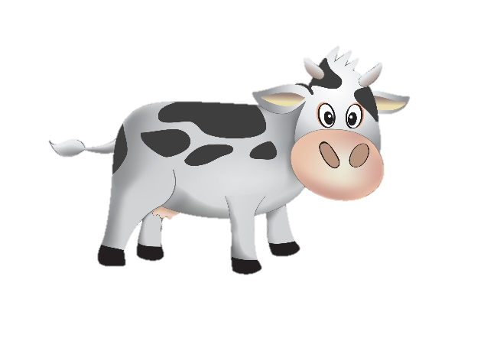
Game: Counting game
HOW MANY COWS?
Notes:
T asks “Group 1, how many cows are there?”
T shows the answer – “Good job! One flower for group 1.”

Slide 6
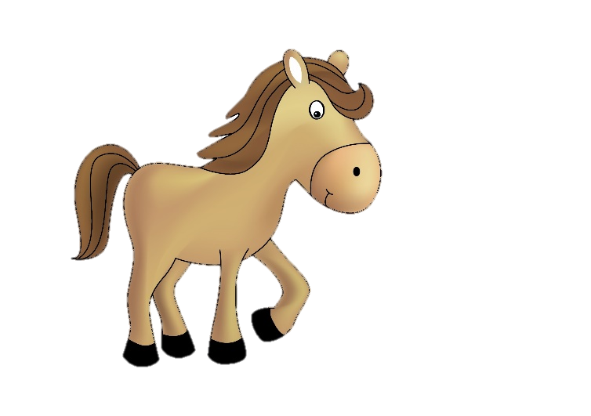
Game: Counting game
HOW MANY HORSES?
Notes:
T asks “Group 2, how many horses are there?”
T shows the answer – “Good job! One flower for group 2.”

Slide 7

Notes:
“Excellent, class! Let’s move to our lesson today.”

Slide 8



Unit 8
Lesson 4
Notes:
1. Introduce new lesson “Today, we will learn Unit 8 – Lesson 4. We will learn 2 new things. What are they? Now, look and listen.”

Slide 9


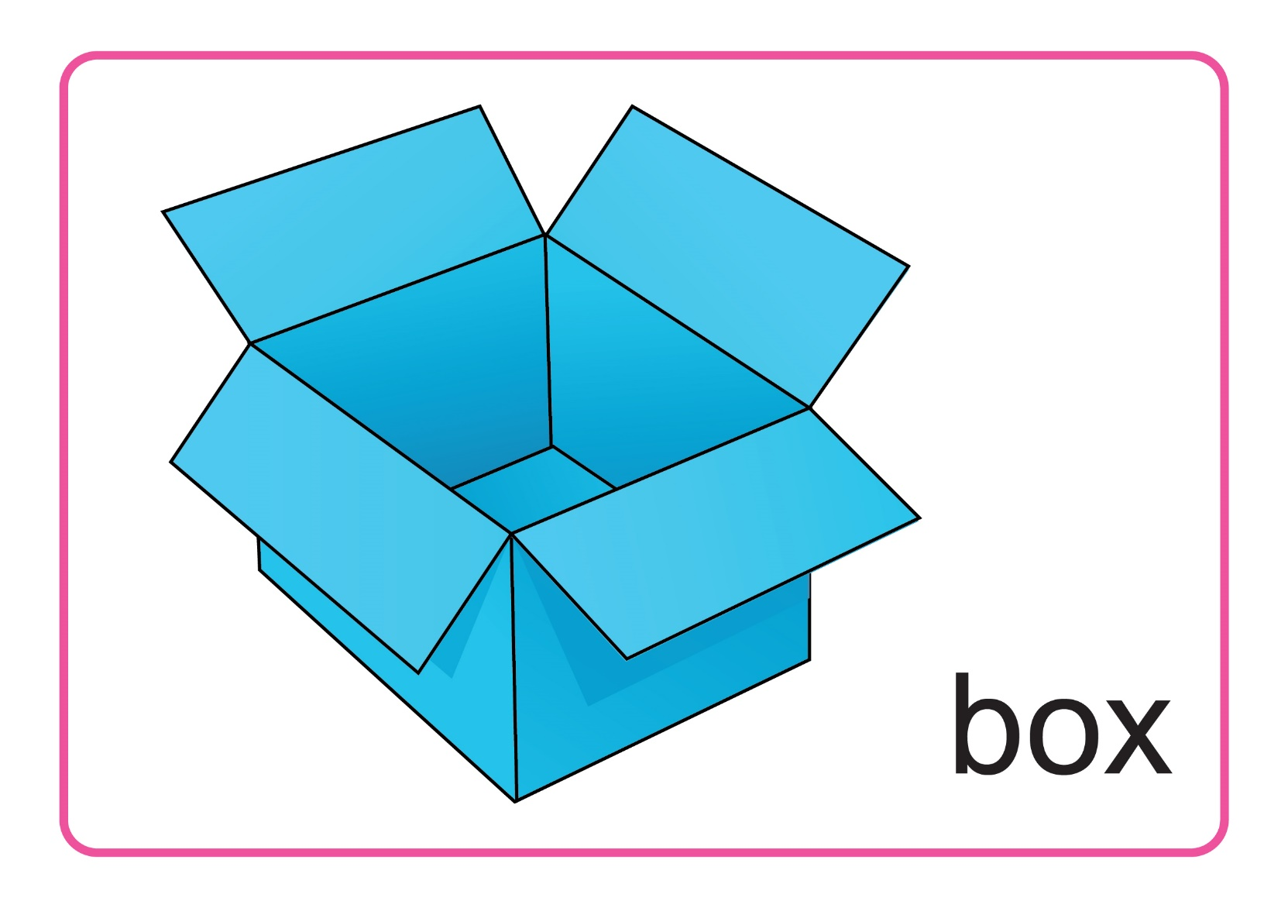
Unit 8:
Lesson 4:
H h
1. Listen and repeat.
Notes:
Introduce picture “Class, what is it? OK! Now, listen 3 times”
Ask sts to listen 3 times
Ask sts to listen and repeat (class, group, individual) - “Listen and repeat. Class! Group 1, please! Group 2, please! You, you and you!
T can use body language to describe the word. - “Look at me and listen. Box! Class, what is it? Good!”
Click to make the word “box” disappear – Ask “What is it?”
T can use body language to check sts’ understanding - “Look and tell me what it is.”

Slide 10


Unit 8:
Lesson 4:
H h
1. Listen and repeat.
Notes:
Introduce picture “Class, what is it? OK! Now, listen 3 times”
Ask sts to listen 3 times
Ask sts to listen and repeat (class, group, individual) - “Listen and repeat. Class! Group 1, please! Group 2, please! You, you and you!
T can use body language to describe the word. - “Look at me and listen. Tree! Class, what is it? Good!”
Click to make the word “tree” disappear – Ask “What is it?”
T can use body language to check sts’ understanding - “Look and tell me what it is.”

Slide 11
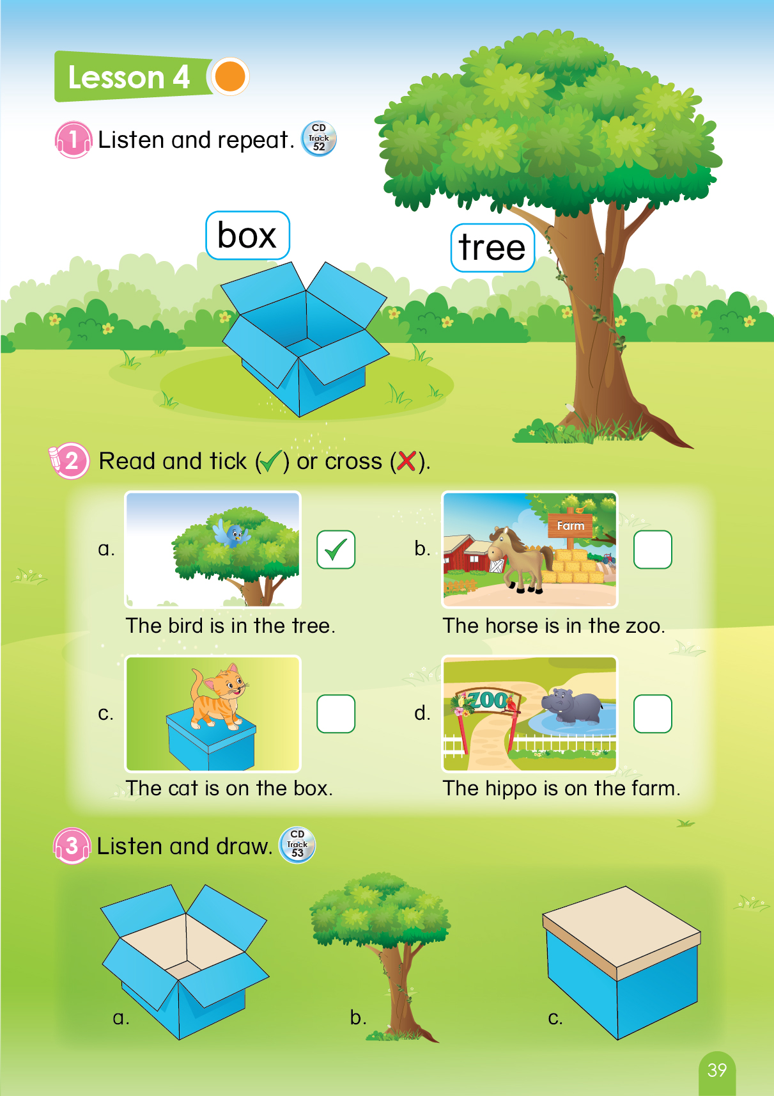
Page 39
Notes:
Book using – Look, point and say
1. T says “Class, open your book page 39. Let’s look, point and tell me what it is.”
2. T points at the picture and asks “What is it?”
3. T gives 1 flower to each group -“Great! One flower for each group.”

Slide 12


Unit 8:
Lesson 4:
H h
1. Listen and repeat.
Game: What is it?
Notes:
Game: What is it?
T says “ I have got a lot of pictures. Please, tell me what it is?”
T says “Now, look the picture and tell me what it is.”
T shows the picture and asks “What is it? Great!”
Review: Show these pictures quickly and ask “Class, I will show all pictures faster. Please, tell me what it is.”

Slide 13

Notes:
“Well done. One flower for each group. Let’s move to next part.”

Slide 14

Unit 8:
Lesson 4:
H h
1. Listen and repeat.
2. Read and tick () or cross ().
Page 39
Notes:
T says “ Let’s read and tick or cross.”
Show the example, point at the bird and ask “What is it? Where is it?”
T says “So, we tick or cross, class?” and shows the answer. – “Yes. We tick.”

Slide 15

Unit 8:
Lesson 4:
H h
2. Read and tick () or cross ().



Page 39
Notes:
Book using – Read and tick or cross
T asks sts to open their book and do task. – “Now, open your book page 39. Let’s read and tick or cross.”
T points at the pictures and says “ What is it? Where is it? Yes. So we tick or cross? Right. We tick/cross.”
Sts answer and T shows the correct answer.

Slide 16
Notes:
“Good job. Now, Let’s draw with me.”

Slide 17


Unit 8:
Lesson 4:
H h
1. Listen and repeat.
2. Read and tick () or cross ().
3. Listen and draw.
Notes:
T asks “Class, what is it? Great.”
T says “Now, let’s listen and draw.”

Slide 18
Unit 8:
Lesson 4:
H h
3. Listen and draw.
Notes:
“We have 3 things. We will listen and draw. For example, if you hear ‘The bird is on the box.’, you will draw the bird on the box. Are you ready? Let’s listen.”

Slide 19
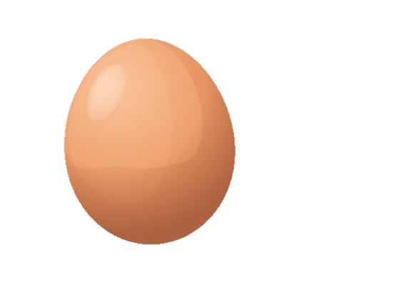
Unit 8:
Lesson 4:
H h
3. Listen and draw.
Notes:
T shows the picture and asks “What is it?”
T asks sts to listen 2 times and draw – “Now, listen 2 times and draw.”
T asks sts to listen again and asks “What will we draw? Put it where?”
T shows the answer. “Well done. The egg is in the box. We draw the egg in the box.”

Slide 20

Unit 8:
Lesson 4:
H h
3. Listen and draw.
Notes:
T shows the picture and asks “What is it?”
T asks sts listen 2 times and draw – “Now, listen 2 times and draw.”
T asks sts listen again and asks “What will we draw? Put it where?”
T shows the answer. “Well done. The apple is in the tree. We draw the apple in the tree.”

Slide 21

Unit 8:
Lesson 4:
H h
3. Listen and draw.
Notes:
T shows the picture and ask “What is it?”
T asks sts to listen 2 times and draw – “Now, listen 2 times and draw.”
T asks sts to listen again and ask “What will we draw? Put it where?”
T shows the answer. “Well done. The duck is on the box. We draw the duck on the box.”

Slide 22



Unit 8:
Lesson 4:
H h
3. Listen and draw.
Notes:
1. T shows again all the answers. “Have you finished? Great!”

Slide 23
Unit 8:
Lesson 4:
H h
1. Listen and repeat.
2. Read and tick () or cross ().
3. Listen and draw.
Notes:
Sum up – Ask “Look at these pictures again, what is it? Good!”
Count the flowers of each groups – “Let’s count your flowers.”
Group having more flowers will be the winner. – “So the winner is group …. Group …, you also good, too.”
Say goodbye “ Now, let’s say ‘Goodbye egg, Goodbye elephant”. Now, Goodbye class.”

Slide 24


