Slide 2
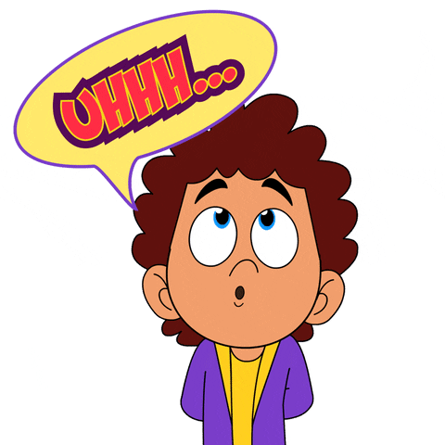
WARM UP
Guessing Game
UNIT 9 – LESSON 3
Notes:
“Guessing game”
Ask students to play in groups. Each turn, one student from each group go to the board, teacher shows this student a picture about vocabulary they learnt in previous lesson. This student acts out to describe the word/phrase they get. The others look and guess the word/phrase.
Teacher gives 1 point for each correct answer.

Slide 3
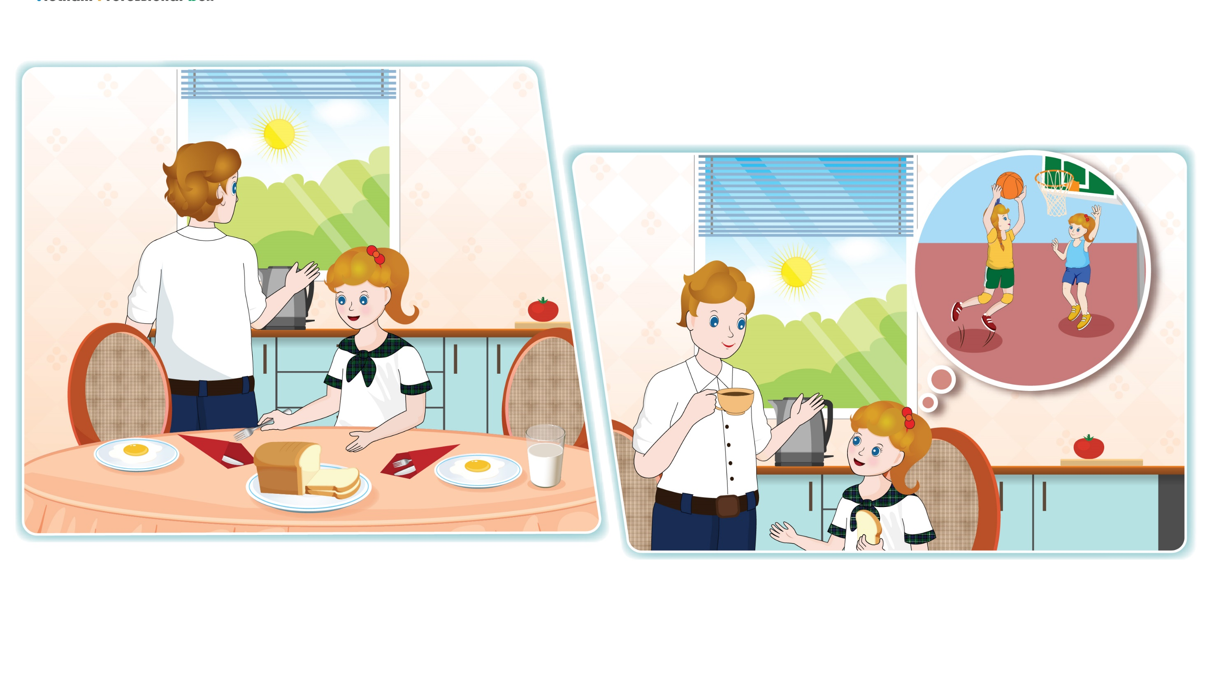
UNIT 9 – DAILY ROUTINES
Lesson 3
Period 2
UNIT 9 – LESSON 3

Slide 4

4
Listen and read.
UNIT 9 – LESSON 3
Notes:
Focus students on the 2 pictures in Activity 4, P.g.83, recognize the the people in the story, what they are talking about.

Slide 5

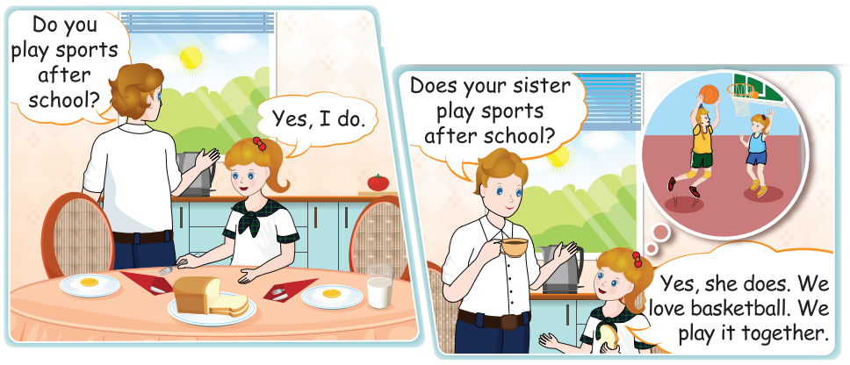
4
Listen and read.
UNIT 9 – LESSON 3
Notes:
Introduce the context: Lucy and her father are talking about Lucy’s daily activities in the kitchen.
Play the audio CD (CD2 Track 24) twice to listen the story.

Slide 6
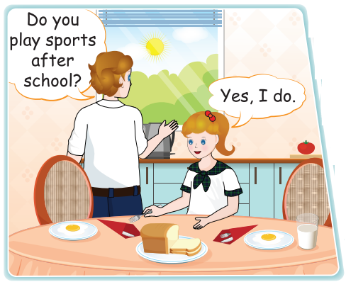
4
Listen and read.
Do you play sports after school?
- Yes, I do
Do you + [verb phrase] + [time]?
- Yes, I do./ No, I don’t.
UNIT 9 – LESSON 3
Notes:
Ask some questions to check their understanding if needed.
Introduce the sentence structure to ask and answer about someone’s daily routines/activities:
* Do you + [verb phrase] + [time]?
- Yes, I do./ No, I don’t.
* Does he/she/… + [verb phrase] + [time]?
- Yes, he/she/… does./ No, he/she/… doesn’t.
Get students to listen and repeat sentence by sentence.

Slide 7
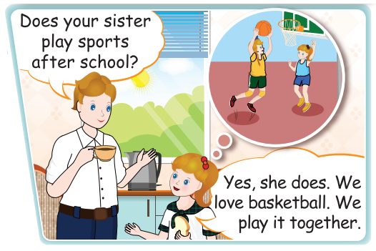
4
Listen and read.
Does your sister plays sports after school?
- Yes, she does.
Does he/she/… + [verb phrase] + [time]?
- Yes, he/she/… does.
No, I\he/she/… doesn’t.
UNIT 9 – LESSON 3
Notes:
Ask some questions to check their understanding if needed.
Introduce the sentence structure to ask and answer about someone’s daily routines/activities:
* Do you + [verb phrase] + [time]?
- Yes, I do./ No, I don’t.
* Does he/she/… + [verb phrase] + [time]?
- Yes, he/she/… does./ No, he/she/… doesn’t.
Get students to listen and repeat sentence by sentence.

Slide 8
4
Listen and read.
UNIT 9 – LESSON 3
Notes:
Have students practice in pairs/groups.
Ask some pairs to practice this conversation in front of the class and correct their pronunciation.

Slide 9
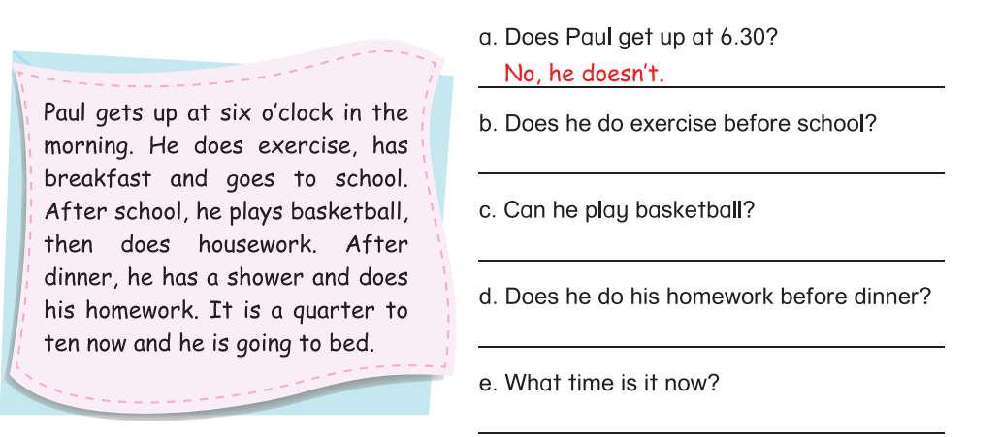
5
Read and write True or False.
Yes, he does.
Yes, he can.
No, he doesn’t.
It’s a quarter to ten.
UNIT 9 – LESSON 3
Notes:
Tell students that they are going read the text and questions about Paul’s daily routines, then write the answer in the blanks.
Get students to look at the text and ask them to read the text in silence, underline the key information in each sentence.
Help students with the word they don’t know the meaning.
Model the task with question a. Explain.
Give students time to do the task individually.
Get students to check the answers in pairs
Call some students to go to the board and write the answers.
Check the answers with the whole class.

Slide 10
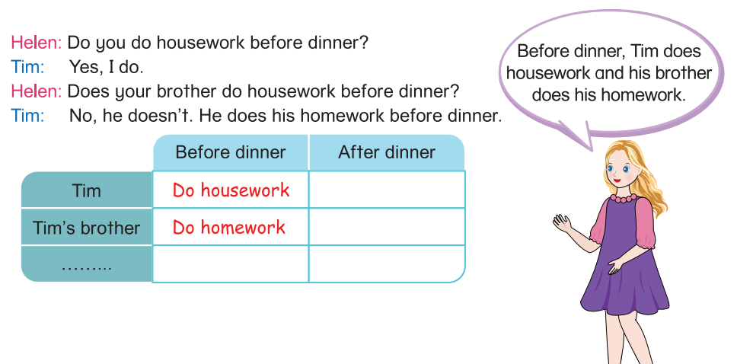
6
Ask and answer. Talk about your friend.
UNIT 9 – LESSON 3

Slide 11
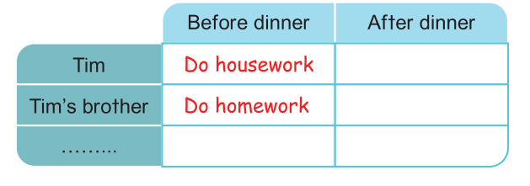
6
Ask and answer. Talk about your friend.
What do Tim and his brother do before dinner?
UNIT 9 – LESSON 3
Notes:
Get students’ attention on the table. Help students recognize the information of Tim and his brother. Ask students what Tim and his brother do before dinner.

Slide 12
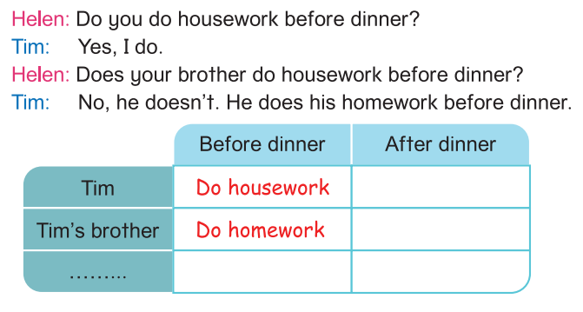
6
Ask and answer. Talk about your friend.
UNIT 9 – LESSON 3
Notes:
Ask students to read the conversation between Helen and Tim.
Ask students to walk in groups of 4, ask and answer about daily routines. Then take note the information in the table.
Give students time to do the task.

Slide 13
6
Ask and answer. Talk about your friend.
UNIT 9 – LESSON 3
Notes:
Focus students on the picture of Helen and read aloud Helen’s bubble.
Ask students to look at their tables, talk about someone’s daily routines that they took note in the table.
Invite some students to talk in front of class.

Slide 14


… Day … Month …. Date … Year
Unit 9: DAILY ROUTINES
Lesson 3. Period 1
Structure
* Do you + [verb phrase] + [time]?
- Yes, I do./ No, I don’t.
* Does he/she/… + [verb phrase] + [time]?
- Yes, he/she/… does./ No, he/she/…
UNIT 9 – LESSON 3
Notes:
Review all the structures
Count the stars.
Give compliments.

Slide 15
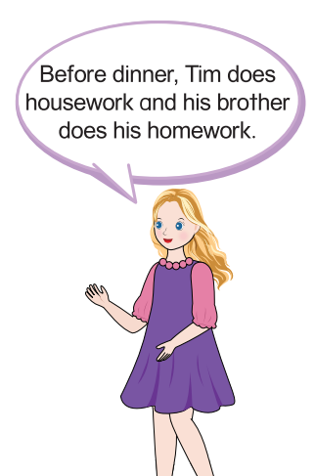
WRAP UP
* Do you + [verb phrase] + [time]?
- Yes, I do./ No, I don’t.
* Does he/she/… + [verb phrase] + [time]?
- Yes, he/she/… does./ No, he/she/…
UNIT 9 – LESSON 3

Slide 16


