Slide 1


Slide 2



Slide 3




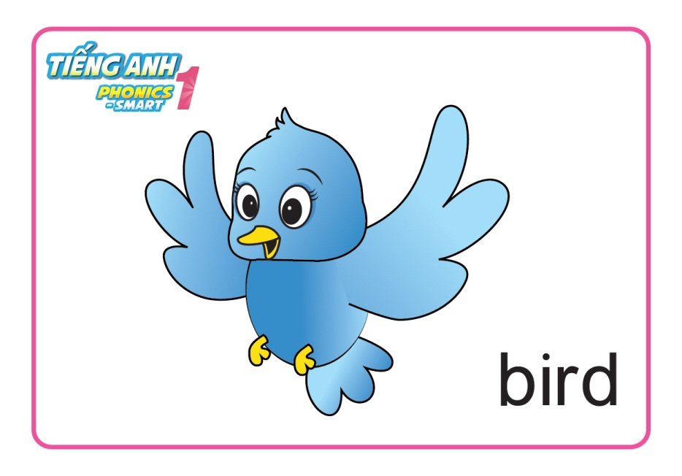

Let’s review

Slide 4
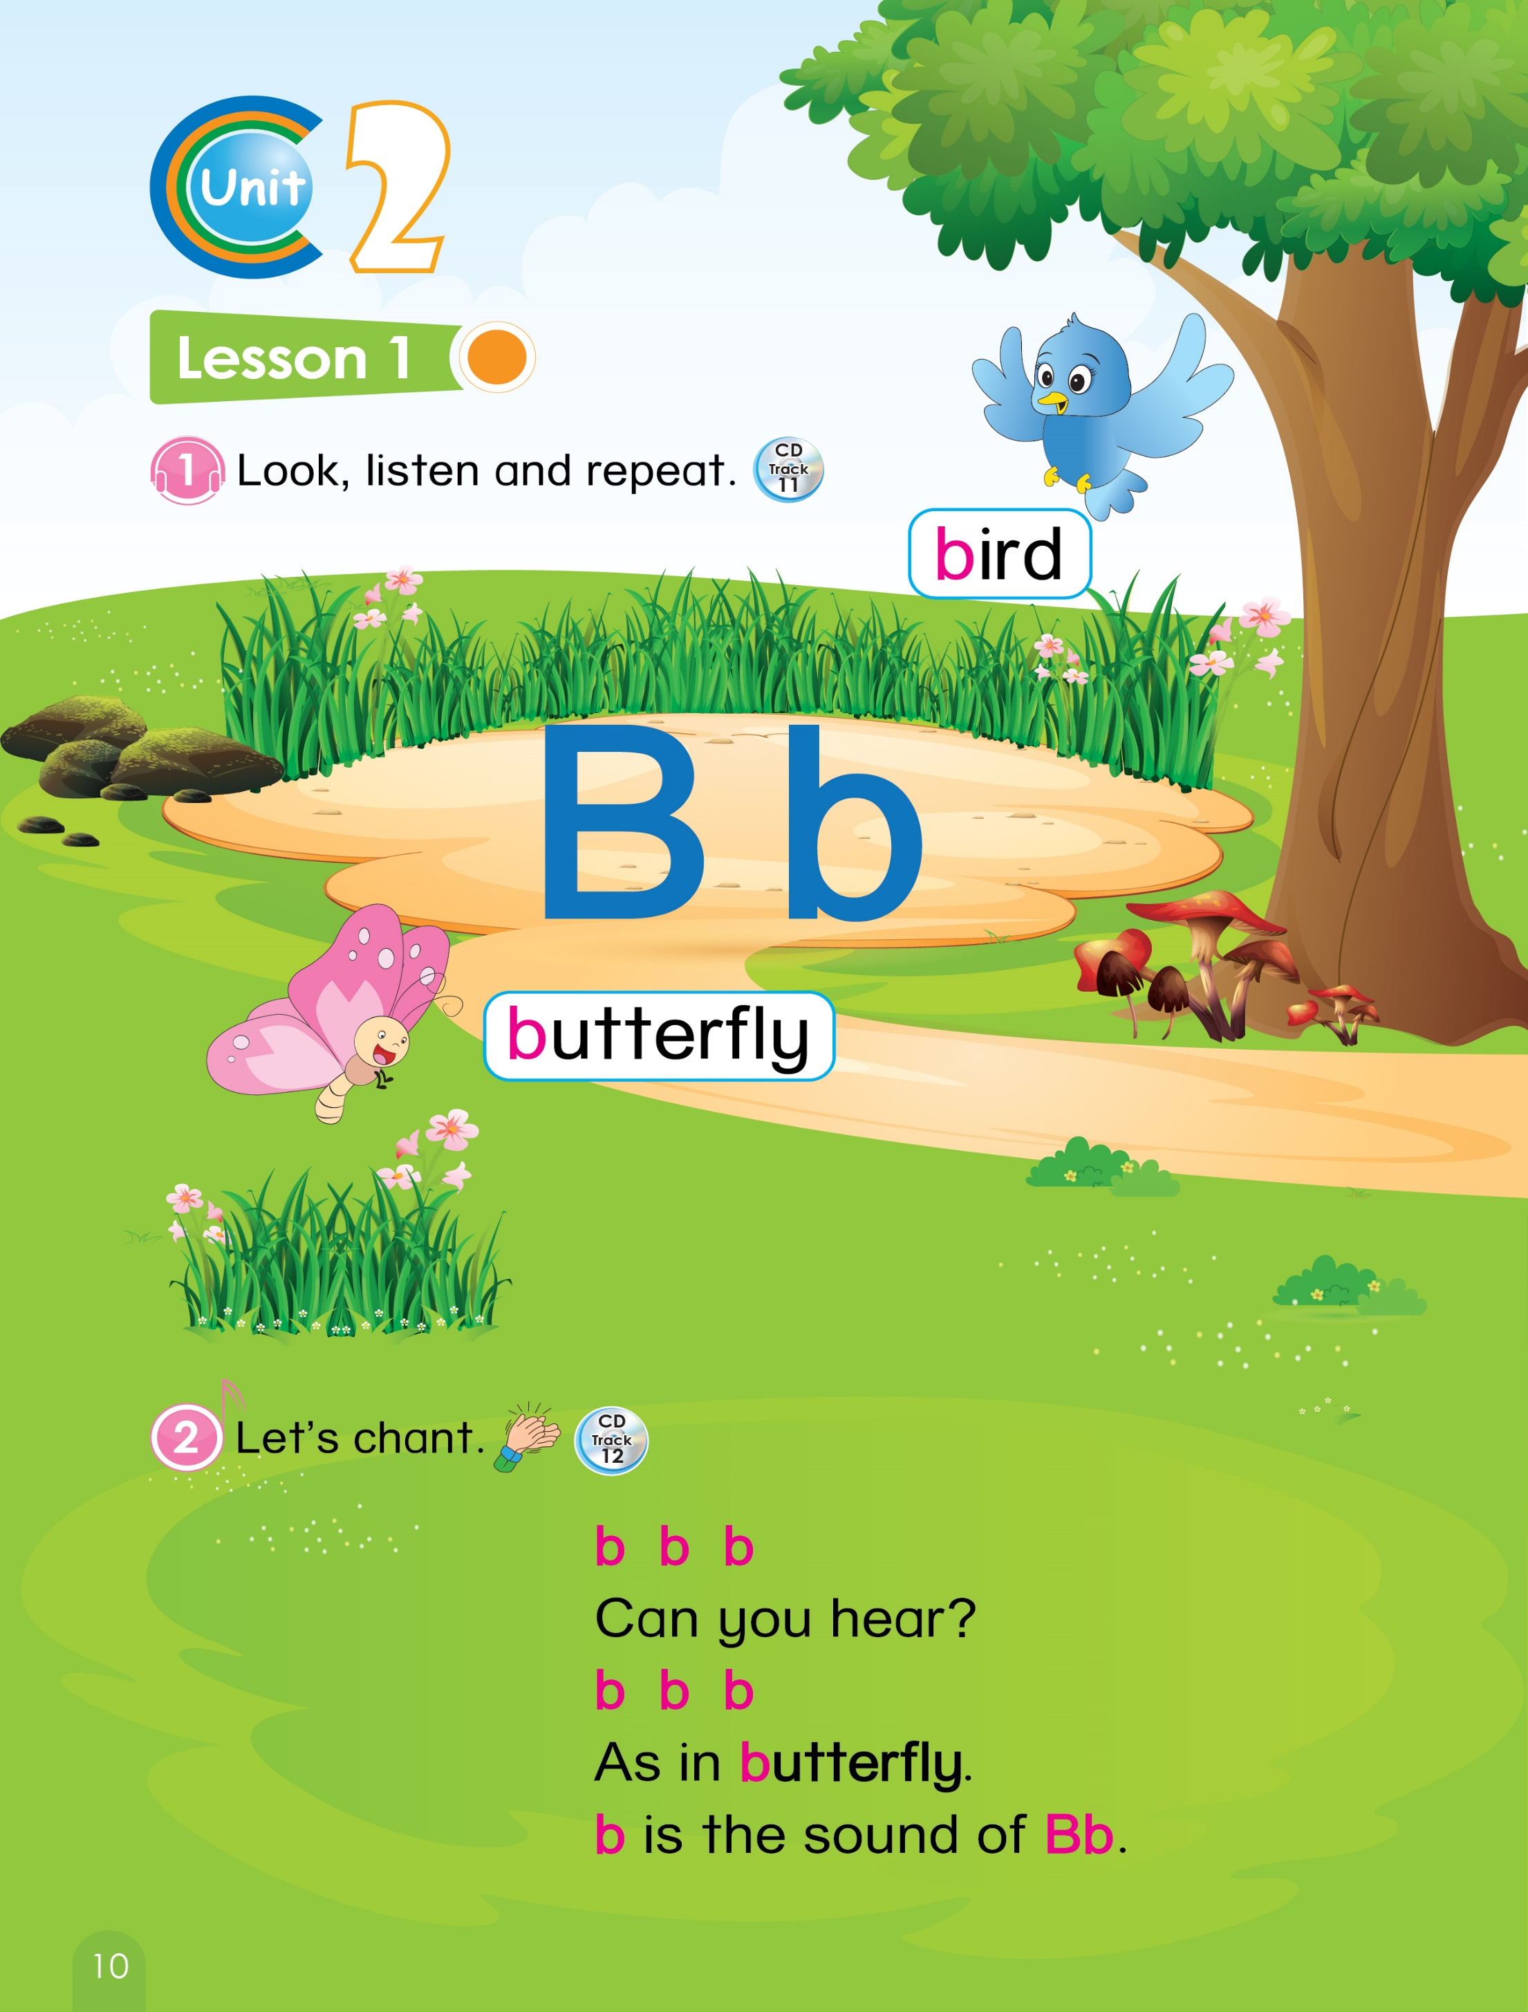
Let’s sing

Slide 5



Unit 2
Lesson 2

Slide 6
Unit 2:
Lesson 2
1. Look, listen and repeat.
Look! It is a bird.
Look! It is a butterfly.
Notes:
- Click on sentence 1 “Look! It is a bird.” and sentence 2 “Look! It is a butterfly.” Have students listen only.
- Ask students to repeat as a class, in groups, and individually
- Instruct students to say the sentences with actions.

Slide 7

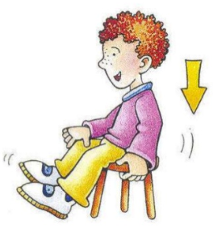


Unit 2:
Lesson 2
1. Look, listen and repeat.
GAME
JUMP UP or SIT DOWN?
Look! It is a ________ .
Look! It is a ________ .
Notes:
Explain the rules to students: ‘When I point to the bird, you have to say the sentence and sit down. But when I point to the butterfly, you have to say the sentence and jump up.’

Slide 8

Unit 2:
Lesson 2
1. Look, listen and repeat.
GAME
JUMP UP or SIT DOWN?
Look! It is a ________ .
Notes:
Explain the rules to students: ‘When you see the bird, you have to say the sentence and sit down. But when you see the butterfly, you have to say the sentence and jump up.’

Slide 9

Notes:
Explain the rules to students: ‘When I point to the bird, you have to say the sentence and sit down. But when I point to the butterfly, you have to say the sentence and jump up.’

Slide 10
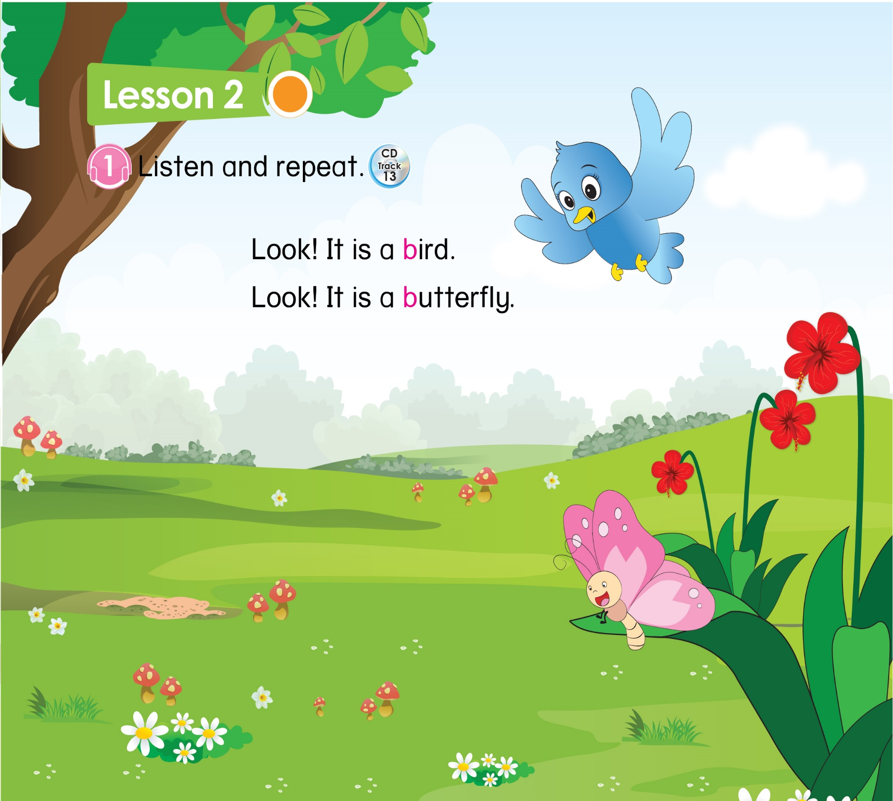
Listen, point and repeat
Notes:
Ask Ss to open page 11, listen, point to the book and say.

Slide 11
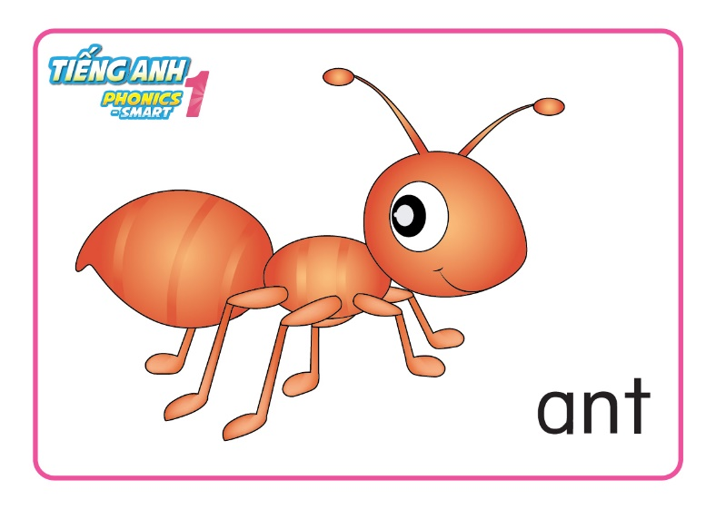
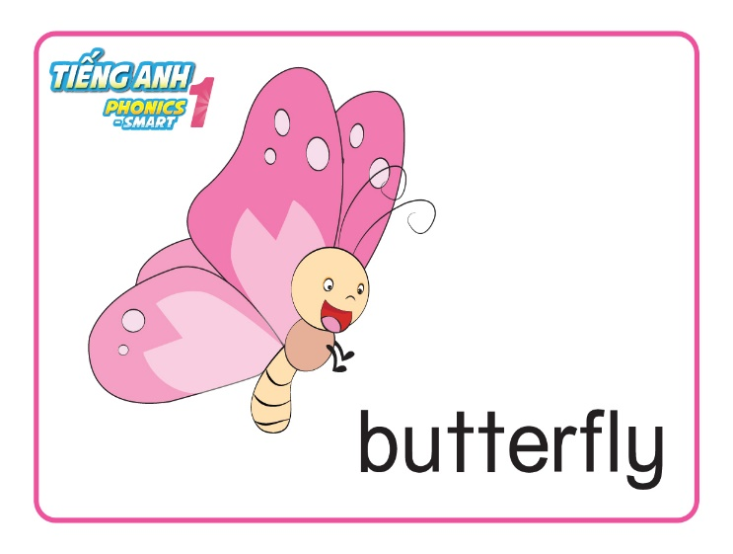


Unit 2:
Lesson 2
1. Look, listen and repeat.
2. Listen, circle and say
Notes:
Review: Ant, apple, bird, butterfly

Slide 12

Unit 2:
Lesson 2
1. Look, listen and repeat.
2. Listen, circle and say
Notes:
Ask Ss to open the book page 11, look at part 2
Do an example with word Ant

Slide 13
Unit 2:
Lesson 2
1. Look, listen and repeat.
2. Listen, circle and say
Notes:
Audio: It is a bird

Slide 14
Unit 2:
Lesson 2
1. Look, listen and repeat.
2. Listen, circle and say
Notes:
Audio: It is a butterfly

Slide 15

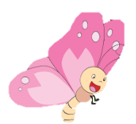

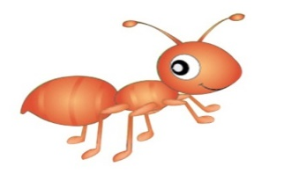

Unit 2:
Lesson 2
1. Look, listen and repeat.
2. Listen, circle and say.
WHISPER GAME
Notes:
Have Ss play the game WHISPER GAME
Words to play: ant, apple, bird, butterfly.
Explain the rules:
Tell the first student of each team a word (ant/apple/bird/butterfly).
He/she has to put it in a sentence and say the sentence quietly and whispers it to the next person, i.e. It is an ant/an apple/a bird/a butterfly.
- Students in a team continue doing that until the sentence reaches the last person who has to come to the board and say aloud the correct sentence.

Slide 16

Unit 2:
Lesson 2
1. Look, listen and repeat.
Look! It is a ________ .
2. Listen, circle and say

Slide 17


CÔNG TY CỔ PHẦN PHÁT TRIỂN GIÁO DỤC
VIỆT NAM VPBOX
Hà Nội
Biệt thự G2&G28, Làng Quốc Tế Thăng Long,
Quận Cầu Giấy, Hà Nội.
ĐT: (024) 3 3793 2405
phonics.hanoi@vpbox.edu.vn
Thành Phố Hồ Chí Minh
Số 29 Mai Thị Lựu, Quận 1, TP. HCM.
ĐT: (028) 3 820 5934
phonics.hcm@vpbox.edu.vn
www.vpbox.edu.vn

