Slide 1


Slide 2



Slide 3

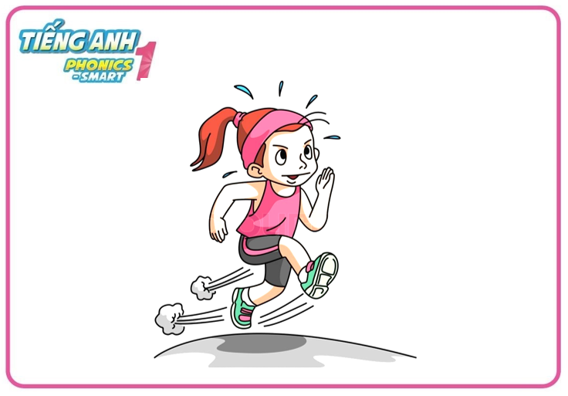


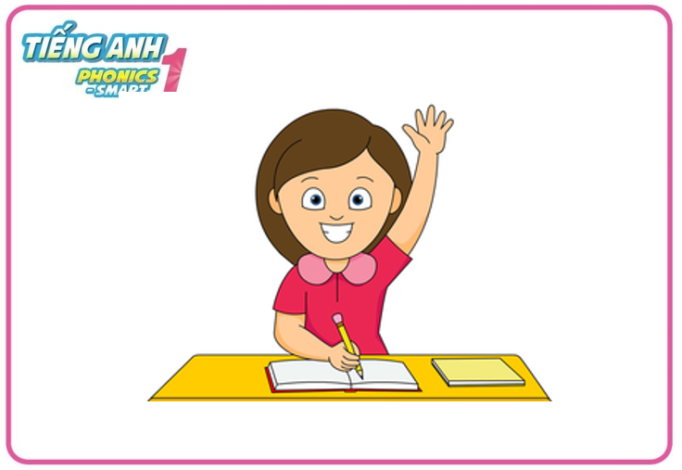
Warm - up
Game: Fast as you can
Notes:
-Let’s do 4 actions: run, walk, jump and raise your hands first.
- Teacher says the actions one by one, Ss do the correct action fast as they can.

Slide 4
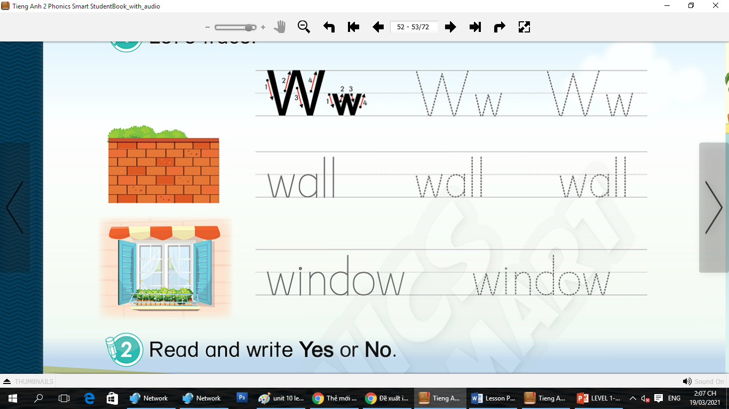
Unit 10: Lesson 3 Ww

Slide 5



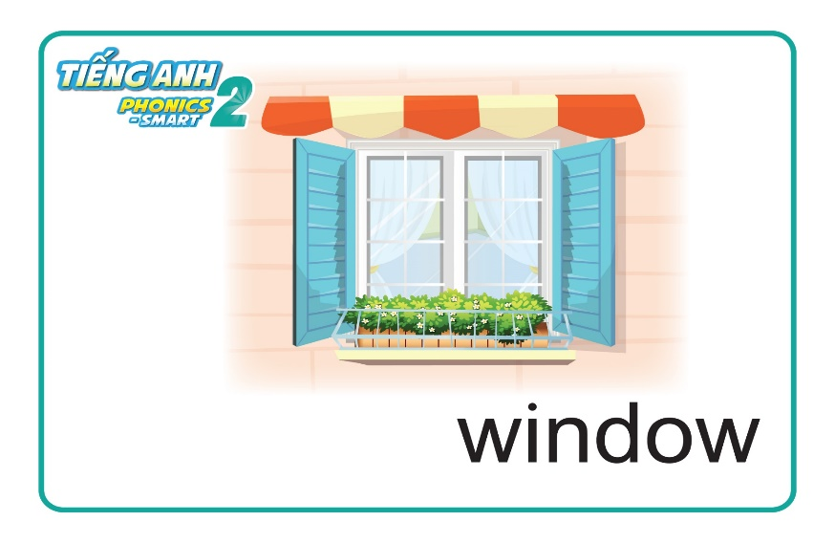
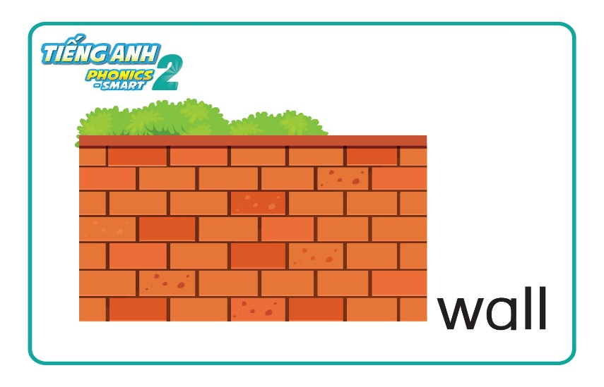
Unit 10: Lesson 3 Ww
Revision

Slide 6
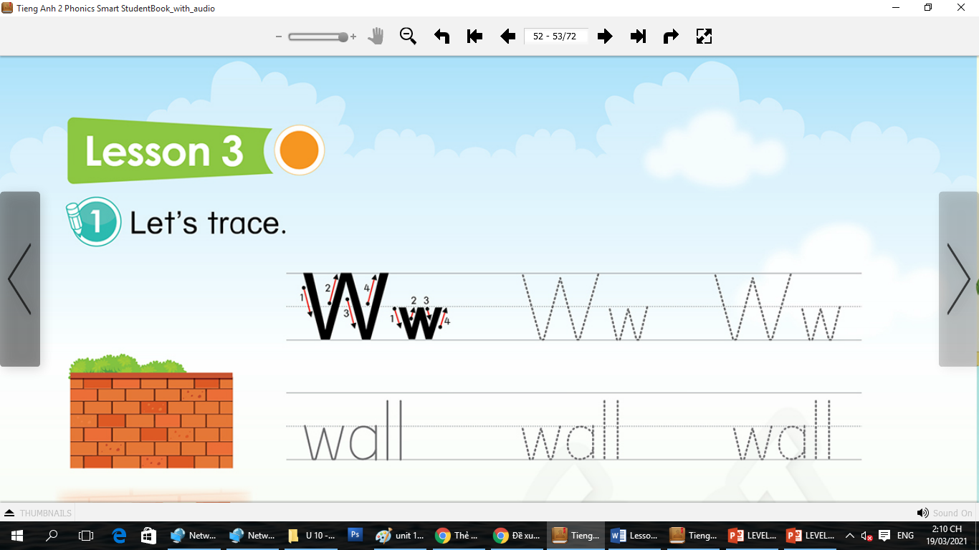
Unit 10: Lesson 3 Ww
1. Trace the letters.
Notes:
- Have Ss watch the video and do actions.

Slide 7
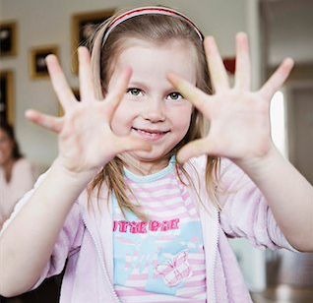

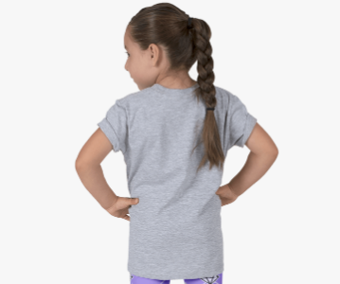
Unit 10: Lesson 3 Ww
1. Trace the letters.
Let’s write letter Ww: in the air, in your palms and on your friend’s back

Slide 8

Unit 10: Lesson 3 Ww
1. Trace the letters.
Let’s write letter Ww on your board
W
W
W
W

Slide 9
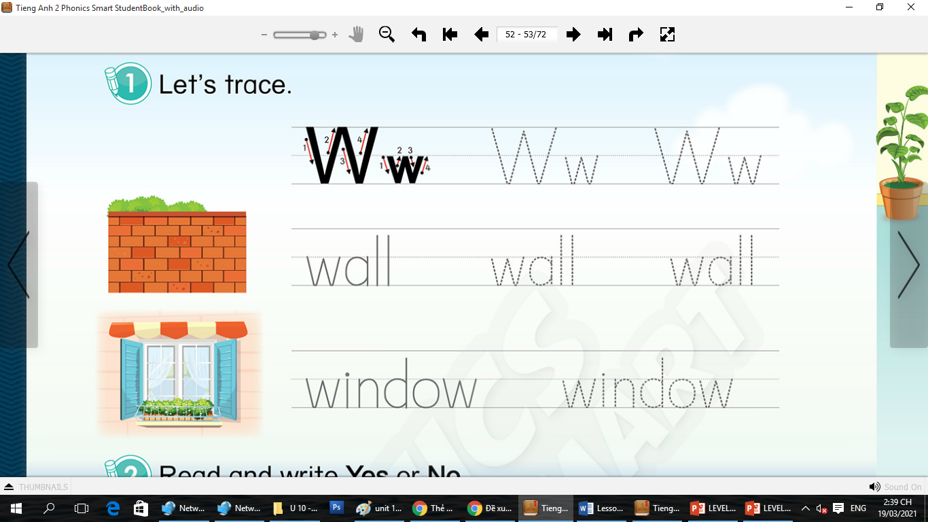
Unit 10: Lesson 3 Ww
1. Trace the letters.
Open your book - page 46
Notes:
Hướng dẫn HS sử dụng sách.

Slide 10
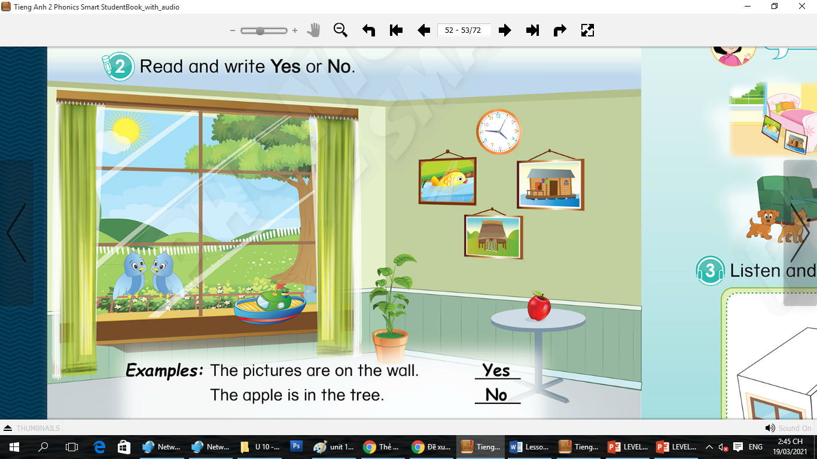
Unit 10: Lesson 3 Ww
1. Trace the letters.
2. Read and write Yes or No.

Slide 11
Unit 10: Lesson 3 Ww
2. Read and write Yes or No.
Ex: The pictures are on the wall
Yes
The apple is in the tree
No

Slide 12
Unit 10: Lesson 3 Ww
2. Read and write Yes or No.
Yes
a. The clock is on the wall

Slide 13
Unit 10: Lesson 3 Ww
2. Read and write Yes or No.
b. The birds are at the window
Yes

Slide 14
Unit 10: Lesson 3 Ww
2. Read and write Yes or No.
No
c. The boat is on the table

Slide 15



Game: Counting game
HOW MANY APPLES ARE ON THE TABLE?
Notes:
Counting game
T says “Look at the picture and answer the question”
Work in groups
T asks “Group 1, how many apples are on the table?”
Sts answer (each group has 1 turn)
T shows the answer – “Good job! One flower for group 1.”
With one correct answer, each group will have 1 flower.

Slide 16

THERE ARE 5 APPLES ON THE TABLES.
Notes:
Counting game
T says “Look at the picture and answer the question”
Work in groups
T asks “Group 1, how many apples are on the table?”
Sts answer (each group has 1 turn)
T shows the answer – “Good job! One flower for group 1.”
With one correct answer, each group will have 1 flower.

Slide 17



Game: Counting game
WHAT NUMBER IS ON THE BALL?
Notes:
T asks “Group 2, what number is on the ball?”
T shows the answer – “Good job! One flower for group .....”

Slide 18
12- TWELVE
Notes:
T asks “Group 2, what number is on the ball?”
T shows the answer – “Good job! One flower for group .....”

Slide 19

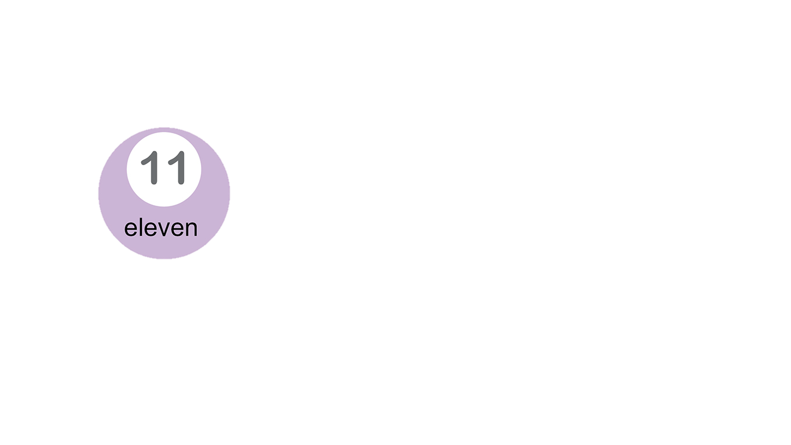
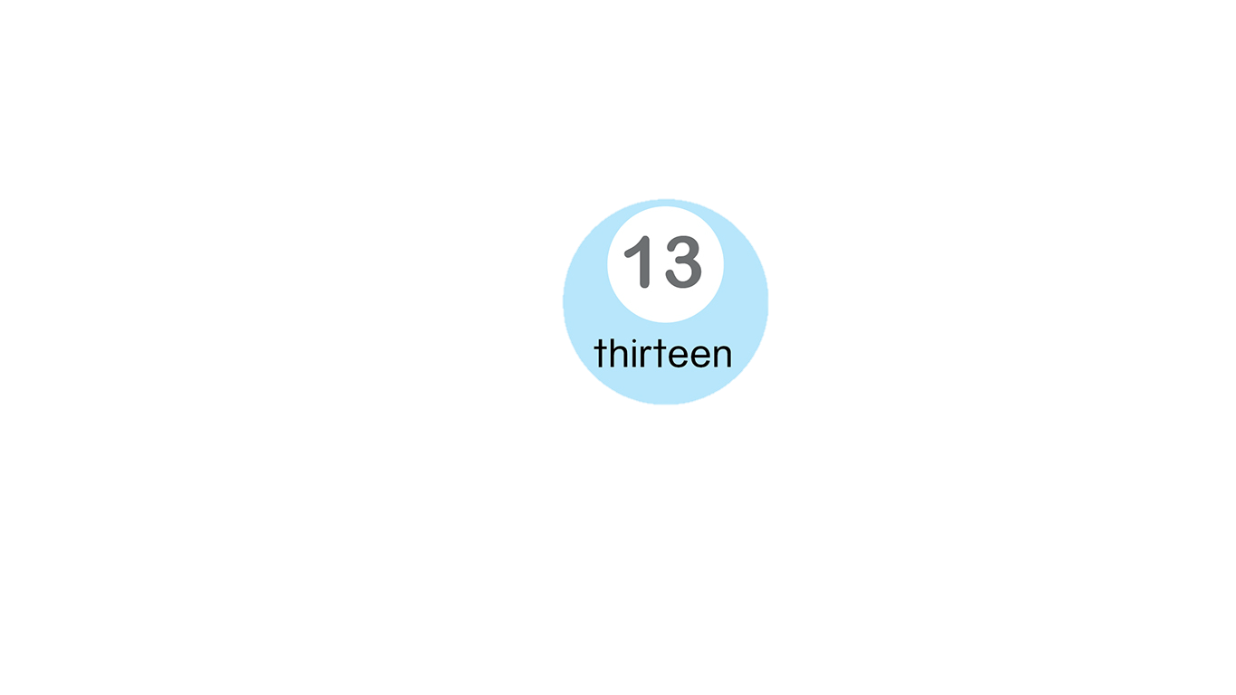
Game: Counting game
HOW MANY CLOCKS?
Notes:
T asks “Group 1, How many clocks are there?”
T shows the answer – “Good job! One flower for group .....”

Slide 20
7 CLOCKS
Notes:
T asks “Group 1, How many clocks are there?”
T shows the answer – “Good job! One flower for group .....”

Slide 21

Game: Counting game
HOW MANY BIG BOATS ARE THERE?
Notes:
T asks “Group 2, how many big boats are there?”
T shows the answer – “Good job! One flower for group .....”

Slide 22
Game: Counting game
2 BIG BOATS
Notes:
T asks “Group 2, how many big boats are there?”
T shows the answer – “Good job! One flower for group .....”

Slide 23


CÔNG TY CỔ PHẦN PHÁT TRIỂN GIÁO DỤC
VIỆT NAM VPBOX
Hà Nội
Biệt thự G2&G28, Làng Quốc Tế Thăng Long,
Quận Cầu Giấy, Hà Nội.
ĐT: (024) 3 3793 2405
phonics.hanoi@vpbox.edu.vn
Thành Phố Hồ Chí Minh
Số 29 Mai Thị Lựu, Quận 1, TP. HCM.
ĐT: (028) 3 820 5934
phonics.hcm@vpbox.edu.vn
www.vpbox.edu.vn

