Slide 1


Slide 3

TEAM DIVISION
Team 1
Team 2
Team 3
Team 4
Unit 12 – Lesson 1
Notes:
Divide class into 4 teams

Slide 4


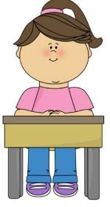

CLASSROOM RULES
1. Be quiet!
2. Listen!
3. Sit nicely!
4. Raise your hand to speak!
Unit 12 – Lesson 1
Notes:
Set the rules in class.

Slide 5

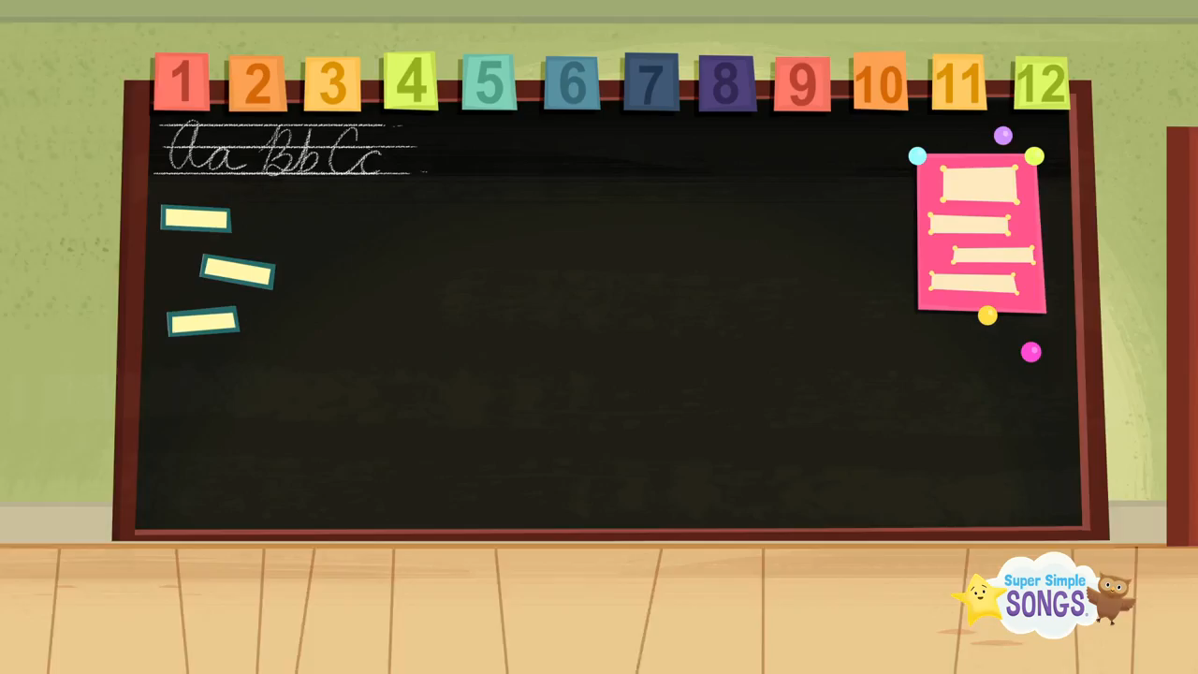
WARM UP
“Hello”
Unit 10 – Lesson 2
Unit 10 – Lesson 2
Unit 12– Lesson 1
Notes:
Play the song “Hello”
https://www.youtube.com/watch?v=tVlcKp3bWH8&ab_channel=SuperSimpleSongs-KidsSongs

Slide 6



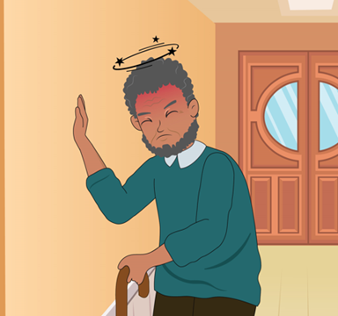
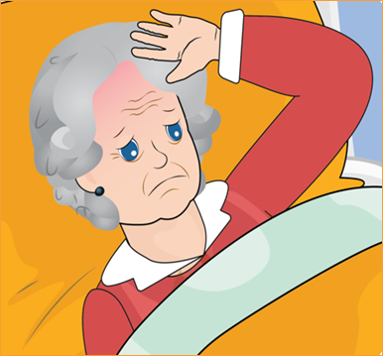
REVISION
hot
cold
sleepy
dizzy
tired
Unit 10 – Lesson 2
Unit 12 – Lesson 1
Notes:
Remind students the words they learnt in previous lesson by flashcards and book.

Slide 7
WHERE IS MY SKATEBOARD?
START
Unit 12– Lesson 1

Slide 8

I feel sleepy.
FALSE
TRUE
Unit 12 – Lesson 1
Notes:
Explain that you are going to give instructions. Give a question with an illustration, students must choose the skateboard with the correct answer.
Model the activity, e.g. I feel sleepy. The skateboard has the correct answer is True.
Play game until the last question. Whoever has more correct answers is the winner.

Slide 9
I feel tired.
TRUE
FALSE
Unit 12 – Lesson 1

Slide 10

I feel cold.
TRUE
FALSE
Unit 12 – Lesson 1

Slide 11
I feel hot.
FALSE
TRUE
Unit 12 – Lesson 1

Slide 12
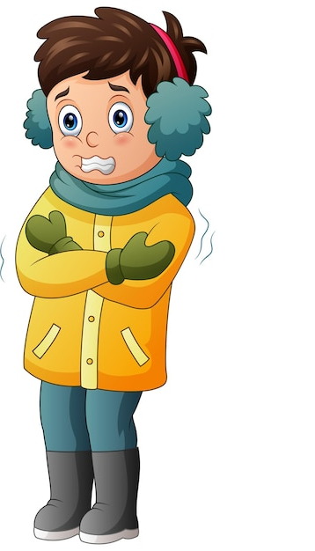
I feel cold.
FALSE
TRUE
Unit 12 – Lesson 1

Slide 13
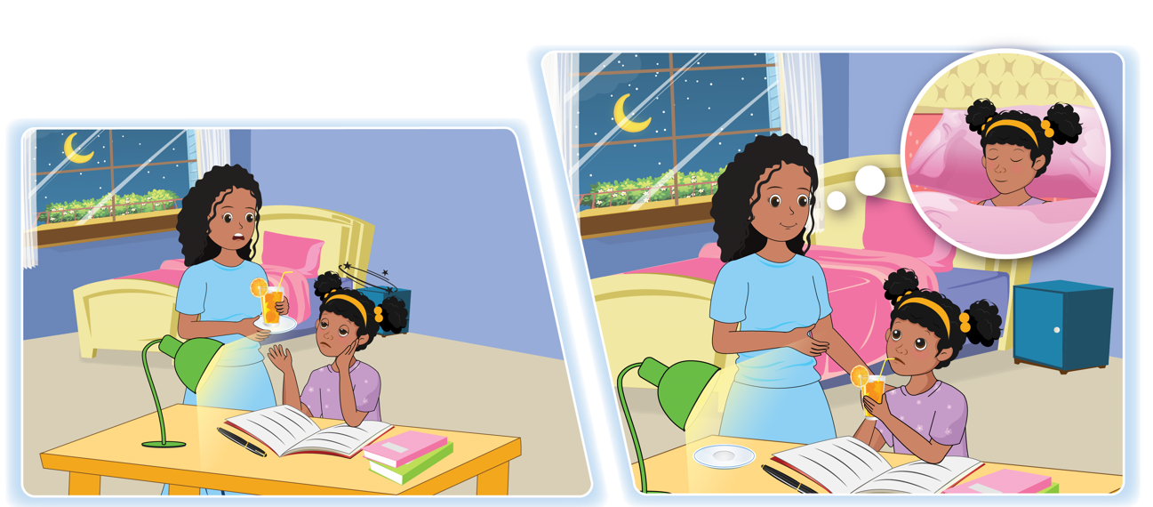

UNIT 12 – HEALTH
Period 2
Unit 10 – Lesson 2
Unit 12 – Lesson 1

Slide 14

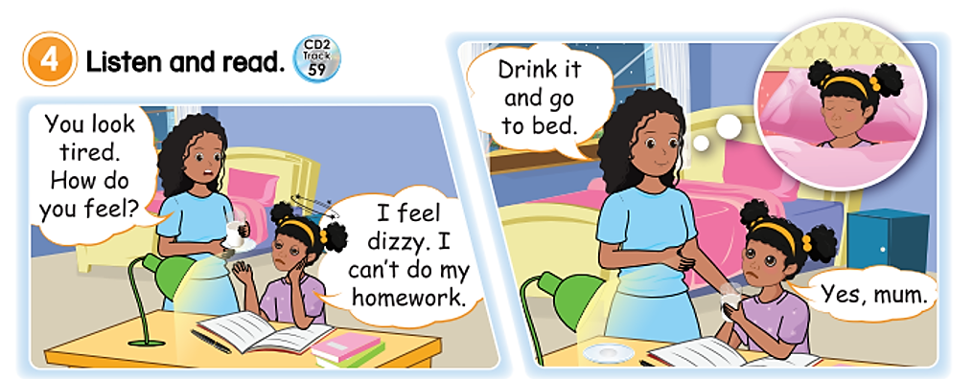
4
Listen and read.
Unit 10 – Lesson 2
Unit 12 – Lesson 1
Notes:
Ask students to look at the picture in the book (or show it on the screen): “Now whole class, look at this picture and answer my questions”
T: How many people are there in the picture?
T: Who is sitting at the table? Who is next to Rita? Is Rita good?
Ask students to look at the screen and listen to the audio CD (Track 59) twice.
Ask students to listen to and repeat each line before reading it all together. Play the audio (Track 59) for them to listen and say along.
Pair up the class to practice role-playing, encouraging them to do actions when they say their lines.

Slide 15
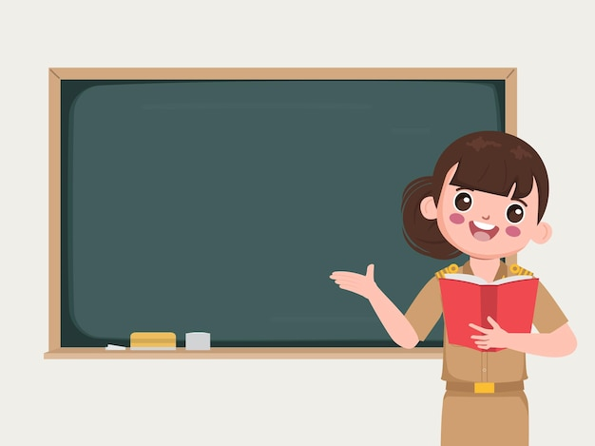
4
Listen and read.
1. How do you feel?
=> I feel + adj
2. I want to/ don’t want to + Verb
3. I can/ can’t + Verb
Unit 10 – Lesson 2
Unit 12 – Lesson 1
Notes:
Focus students' attention on the structures How do you feel? => I feel + adj..., to ask about people’s feelings.

Slide 16

Pair work
4
Listen and read.
Role play
Unit 10 – Lesson 2
Unit 12 – Lesson 1
Notes:
Pair up the class to practise role-playing, encouraging them to do actions when they say their lines.

Slide 17
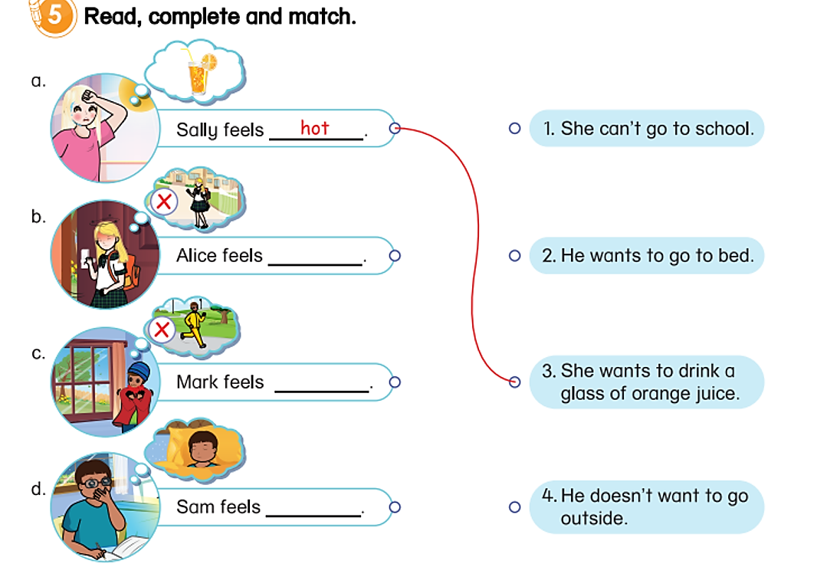
5
Read, complete and match.
Unit 12 – Lesson 1
Notes:
Point to the table and ask students “How many names can you see?” and let students answer.
Review words about people’s feelings (hot, cold, dizzy, sleepy, tired))
Lead-in: Now, we are going to look at the pictures, read, complete and match.
Tell students that they will look at the sentences, read the sentence, and fill in the blanks. Then match the pictures.
Do an example with the first sentence. Explain the sample
Give students the time to do this task individually.

Slide 18
5
Read, complete and match.
dizzy
cold
sleepy
Unit 12 – Lesson 1
Notes:
Point to the table and ask students “How many names can you see?” and let students answer.
Review words about people’s feelings (hot, cold, dizzy, sleepy, tired))
Lead-in: Now, we are going to look at the pictures, read, complete and match.
Tell students that they will look at the sentences, read the sentence, and fill in the blanks. Then match the pictures.
Do an example with the first sentence. Explain the sample
Give students the time to do this task individually.

Slide 19


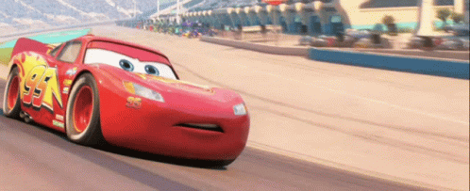

Unit 12 – Lesson 1

Slide 20





4
3
2
1
4
3
2
1
Unit 10 – Lesson 2
Unit 12 – Lesson 1
Notes:
Divide the class into two teams.
Each turn, students work in teams, look at the picture, the questions and the options, then answer.
When they have the correct answer, their car will move one step. The team who answers four questions correctly first is the winner.s

Slide 21

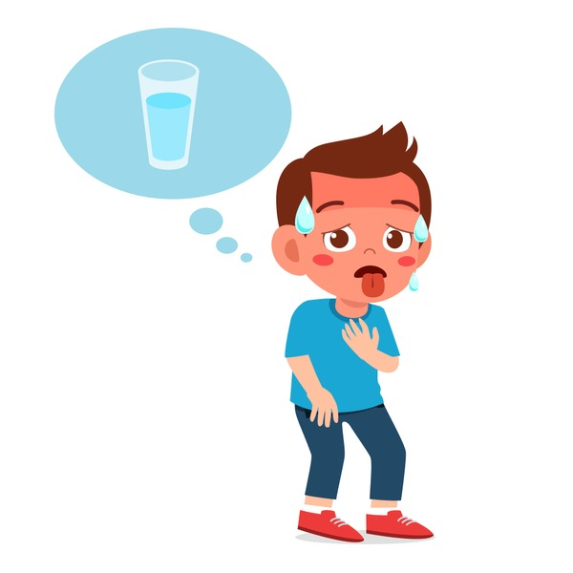





He feels hot and he wants to….
A
drink water
B
ice skate
C
go to bed
Unit 10 – Lesson 2
Unit 12 – Lesson 1
Notes:
Divide the class into two teams.
Each turn, students work in teams, look at the picture, the questions and the options, then answer.
When they have the correct answer, their car will move one step. The person who answers four questions correctly first is the winner

Slide 22



I feel cold and I don’t want to……
A
go to bed
B
go outside
C
go to school
Unit 12 – Lesson 1
Notes:
Divide the class into two teams.
Each turn, students work in teams, look at the picture, the questions and the options, then answer.
When they have the correct answer, their car will move one step. The person who answers four questions correctly first is the winner

Slide 23



She feels dizzy and she can’t…
A
sleep
B
go to school
C
draw
Unit 12 – Lesson 1
Notes:
Divide the class into two teams.
Each turn, students work in teams, look at the picture, the questions and the options, then answer.
When they have the correct answer, their car will move one step. The person who answers four questions correctly first is the winner

Slide 24


I feel sleepy and I can’t…
A
do my homework
B
do to bed
C
drink water
Unit 12 – Lesson 1
Notes:
Divide the class into two teams.
Each turn, students work in teams, look at the picture, the questions and the options, then answer.
When they have the correct answer, their car will move one step. The person who answers four questions correctly first is the winner

Slide 25

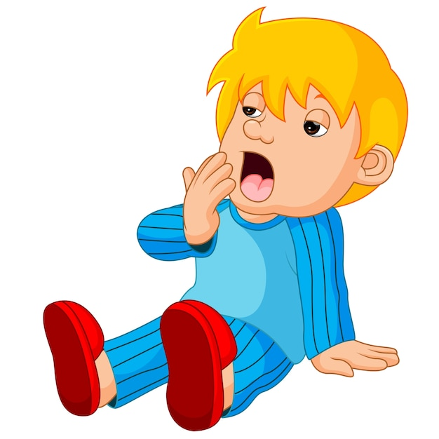
He feels sleepy and he
wants to …
A
go outside
B
drink water
C
go to bed
Unit 12– Lesson 1
Notes:
Divide the class into two teams.
Each turn, students work in teams, look at the picture, the questions and the options, then answer.
When they have the correct answer, their car will move one step. The person who answers four questions correctly first is the winner

Slide 26

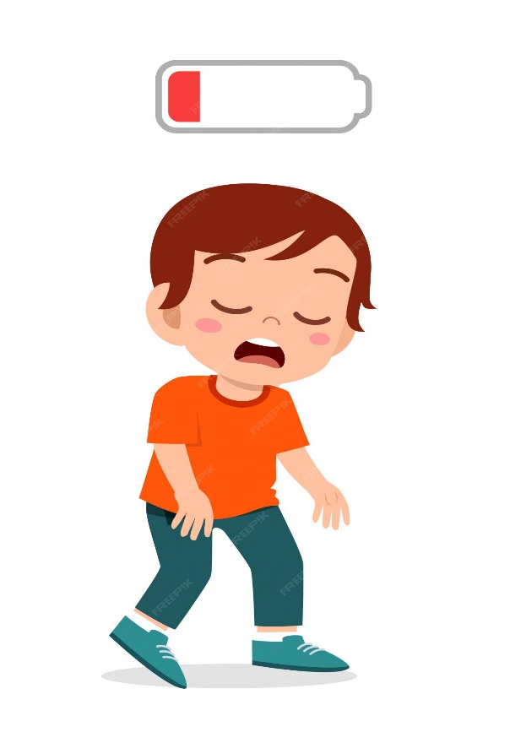
I feel tired and I don’t want to…
A
drance
B
drink water
C
do my homework
Unit 12– Lesson 1
Notes:
Divide the class into two teams.
Each turn, students work in teams, look at the picture, the questions and the options, then answer.
When they have the correct answer, their car will move one step. The person who answers four questions correctly first is the winner

Slide 27

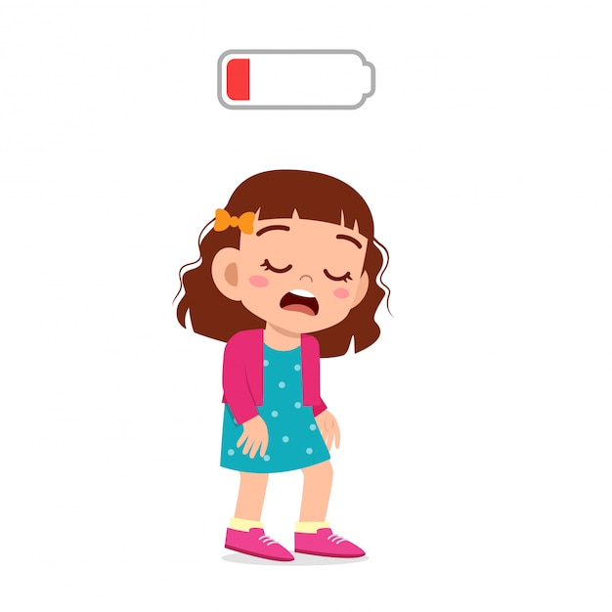
She feels tired and she wants to...
A
drink milk
B
go to bed
C
go outside
Unit 12 – Lesson 1
Notes:
Divide the class into two teams.
Each turn, students work in teams, look at the picture, the questions and the options, then answer.
When they have the correct answer, their car will move one step. The person who answers four questions correctly first is the winner

Slide 28

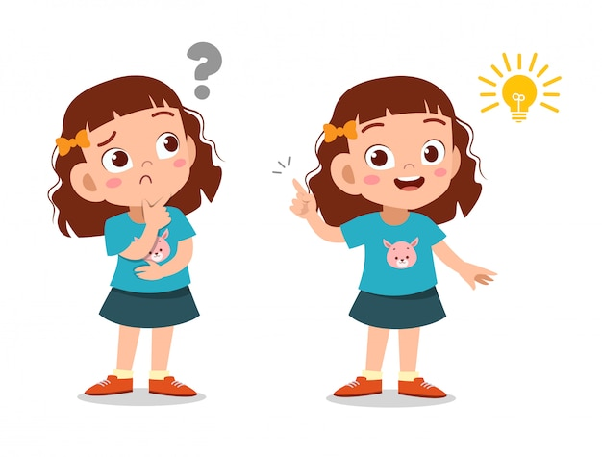
I feel good and I want to …
A
do my homework
B
help my mom
C
go swimming
Unit 12– Lesson 1
Notes:
Divide the class into two teams.
Each turn, students work in teams, look at the picture, the questions and the options, then answer.
When they have the correct answer, their car will move one step. The person who answers four questions correctly first is the winner

Slide 29
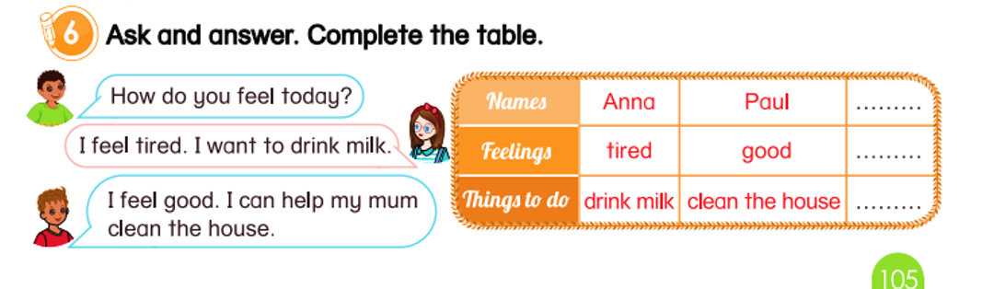
6
Ask and answer. Complete the table.
Unit 12 - Lesson 1
Notes:
Tell students that they are going to practice the structure that they have learnt.
Divide the class into groups of three.
Ask students to introduce their names and talk about their feelings and what they want to do.
Ask student to complete the table.
Give students time to do the task.
Call some groups to perform in front of the class.

Slide 30

6
Ask and answer. Complete the table.
PERFORMANCE TIME
Unit 12 – Lesson 1
Notes:
Call some groups to perform in front of the class
Give compliments.

Slide 31


… Day … Month …. Date … Year
Unit 12: Health
Lesson 1. Period 2
Vocabulary
Hot
Cold
Dizzy
Tired
Sleepy
Structure
I can’t go to school.
I can go outside.
I want to drink milk.
I don’t want to go bed.
Unit 12 – Lesson 1
Notes:
Review all the words they have learned by using flashcards.
Count the stars.
Give compliments.

Slide 32


CÔNG TY CỔ PHẦN PHÁT TRIỂN GIÁO DỤC
VIỆT NAM VPBOX
Hà Nội
Tầng 2, Nhà A, Nhà Khách La Thành, số 226 Vạn Phúc, P.Liễu Giai,
Quận Ba Đình, Hà Nội.
ĐT: (024) 3 3793 2405
phonics.hanoi@vpbox.edu.vn
Thành Phố Hồ Chí Minh
Số 270A, Lý Thường Kiệt, P.14, Quận 10.
ĐT: (028) 3 820 5934
phonics.hcm@vpbox.edu.vn
www.vpbox.edu.vn
https://phonics-smart.edu.vn

