Slide 1


Slide 3

TEAM DIVISION
Team 1
Team 2
Team 3
Team 4
Unit 12– Lesson 3
Notes:
Divide class into 4 teams

Slide 4
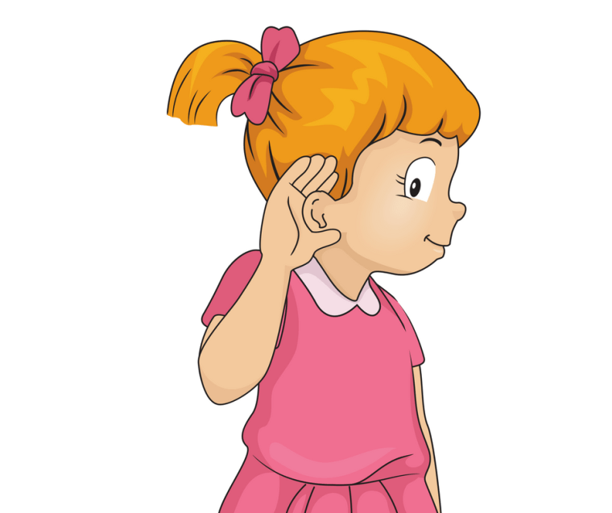

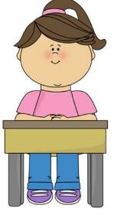

CLASSROOM RULES
1. Be quiet!
2. Listen!
3. Sit nicely!
4. Raise your hand to speak!
Unit 12 – Lesson 3
Notes:
Set the classroom rules

Slide 5
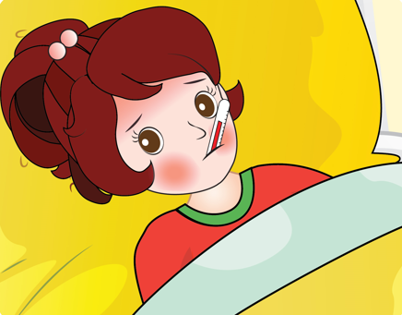
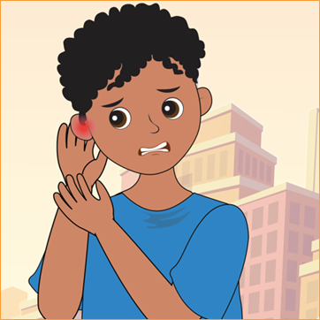

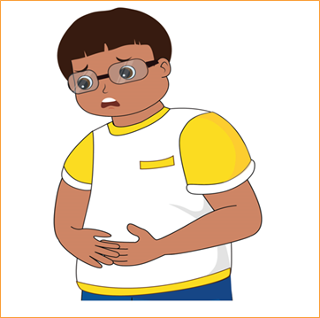
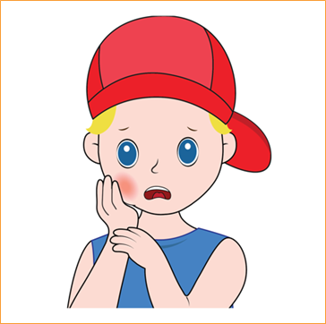

REVISION
Unit 12 – Lesson 3
Notes:
Review the old words.

Slide 6





















CONGRATULATIONS RABBIT TEAM
CONGRATULATIONS TIGER TEAM
5
5
4
4
3
3
2
2
WHO IS TALLER?
1
1
Notes:
Divide the class into two teams: Tiger and Rabbit.
Each turn, students work in groups, look at the question and answer. When they have a correct answer, they will go one step. Which group gives five correct answer first will be the winner.

Slide 7

RABBIT TEAM
My tooth hurts. I can not eat anything.
toothache
Notes:
Divide the class into two teams: Tiger and Rabbit.
Each turn, students work in groups, look at the question and answer. When they have a correct answer, they will go one step. Which group gives five correct answer first will be the winner.

Slide 8
RABBIT TEAM
My head hurts. I can not do my homework.
headache

Slide 9
RABBIT TEAM
My stomach hurts. I do not want to eat anything.
stomachache

Slide 10
RABBIT TEAM
He has a…..
cough

Slide 11
RABBIT TEAM
She’s got a………
temperature

Slide 12
TIGER TEAM
He has got….
a stomachache

Slide 13
TIGER TEAM
I have got an…
earache

Slide 14

TIGER TEAM
I have got a….
I want to take a rest.
headache

Slide 15
TIGER TEAM
My ear hurts. I can not listen well.
Earache.

Slide 16

TIGER TEAM
She is………….
tired

Slide 17
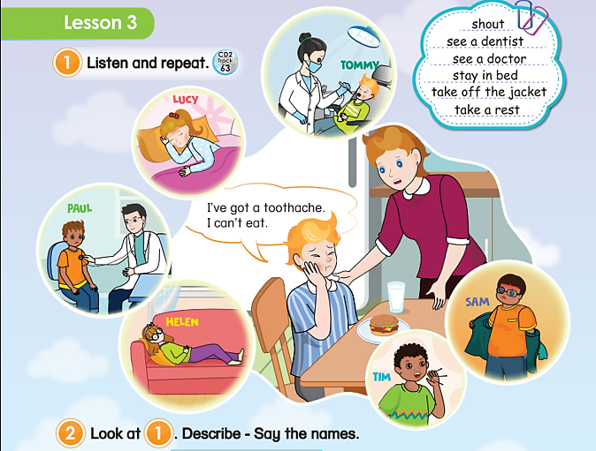
UNIT 12 – HEALTH
Lesson 3
Period 1
Unit 12– Lesson 3

Slide 18

1
Listen and repeat.
Unit 12 – Lesson 3
Notes:
Ask students to look at the picture in the book (or show it on the screen): “Where are the people? What’s wrong with Tommy?
Ask students to look at the screen and listen to the audio CD (Track 63) twice.
Ask students to listen and repeat word by word (shout, see a dentist, see a doctor, stay in bed, take a rest, take off the jacket)
Ask students to open the book on page 108, part 1, look, listen and repeat.

Slide 19
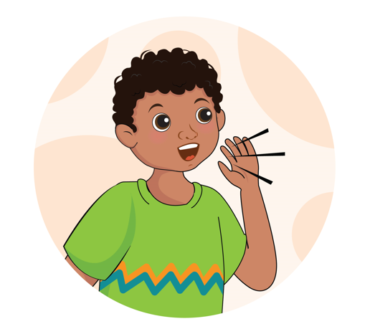
1
Listen and repeat.
shout
Unit 12 – Lesson 3
Notes:
Teach the new words: shout, see a dentist, see a doctor, stay in bed, take a rest, take off the jacket

Slide 20
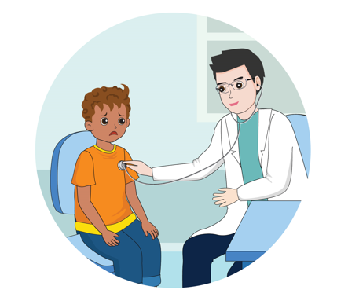
1
Listen and repeat.
see a doctor
Unit 12 – Lesson 3
Notes:
Teach the new words: shout, see a dentist, see a doctor, stay in bed, take a rest, take off the jacket

Slide 21
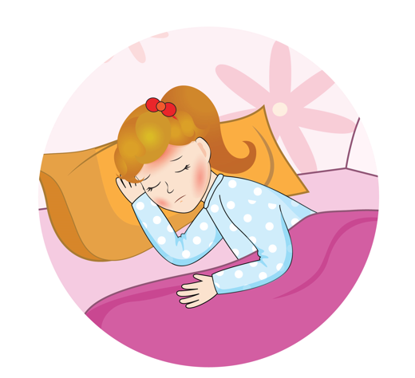
1
Listen and repeat.
stay in bed
Unit 12 – Lesson 3
Notes:
Teach the new words: shout, see a dentist, see a doctor, stay in bed, take a rest, take off the jacket

Slide 22
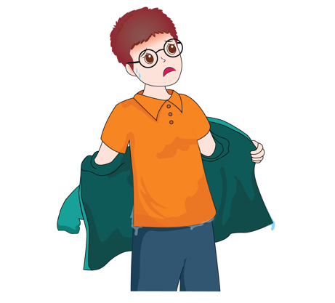
1
Listen and repeat.
take off the jacket
Unit 12 – Lesson 3
Notes:
Teach the new words: shout, see a dentist, see a doctor, stay in bed, take a rest, take off the jacket

Slide 23
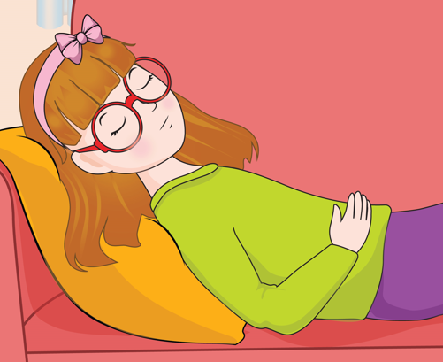
1
Listen and repeat.
take a rest
Unit 12 – Lesson 3
Notes:
Teach the new words: shout, see a dentist, see a doctor, stay in bed, take a rest, take off the jacket

Slide 24


1
Listen and repeat.
stay in bed
take a rest
take off the jacket
see a doctor
shout
Unit 12 – Lesson 3
Notes:
Work in pairs: one student points, one student reads.
Use flashcards to practice by raising them high and low. If raising them high, students read aloud and if raising them low, students read softly.
Correct students’ pronunciation mistakes and instructs students to say using proper intonation.

Slide 25

3
7
1
5
6
2
4
LUCKY STAR
Notes:
Students play this game individually.
Students raise hands to answer. Invite the fastest student. Give one star if they have correct answer.
There are seven stars. Students choose a star and ask the question behind a star. Each star has a different point.

Slide 26




Star 1 : question
You are given 3 stars
shout
GO HOME
Notes:
If students have the correct answer, click the present to open it.

Slide 27

Star 2 : question
You are given 1 star.
take off the jacket
GO HOME
Notes:
If students have the correct answer, click the present to open it.

Slide 28
Star 3 : question
You are given 3 stars.
stay in bed
GO HOME
Notes:
If students have the correct answer, click the present to open it.

Slide 29
Star 4 : question
You are given 2 stars.
take a rest
GO HOME
Notes:
If students have the correct answer, click the present to open it.

Slide 30
You are given 1 star.
GO HOME
Notes:
If students have the correct answer, click the present to open it.

Slide 31
Star 5 : question
You are given 2 stars.
see a doctor
GO HOME
Notes:
If students have the correct answer, click the present to open it.

Slide 32
You are given 10 star.
GO HOME
Notes:
If students have the correct answer, click the present to open it.

Slide 33
Sing a Song
GO HOME
Notes:
If students have the correct answer, click the present to open it.

Slide 34

2
Look at . Describe and say names.
1
This child is seeing a dentist.
=> He’s Tommy.
Unit 12 – Lesson 3
Notes:
Use the software/ PowerPoint/ Book and show the pictures of part 2.
Tells students that they are going to play a game in pairs in which students take turns to describe the actions of the characters in Activity 1. The other students guess who is being mentioned.
Ask students to read the example and elicit the phrases and the names of the characters.
Give pairs of students time to play the game.
Invite some pairs go to the board and say.

Slide 35
2
Look at . Describe and say names.
1
This child is staying in bed.
=> She’s Lucy.
Unit 12 – Lesson 3
Notes:
Use the software/ PowerPoint/ Book and show the pictures of part 2.
Tells students that they are going to play a game in pairs in which students take turns to describe the actions of the characters in Activity 1. The other students guess who is being mentioned.
Ask students to read the example and elicit the phrases and the names of the characters.
Give pairs of students time to play the game.
Invite some pairs go to the board and say.

Slide 36

2
Look at . Describe and say names.
1
This child is seeing a doctor.
=> She’s Paul.
Unit 12 – Lesson 3
Notes:
Use the software/ PowerPoint/ Book and show the pictures of part 2.
Tells students that they are going to play a game in pairs in which students take turns to describe the actions of the characters in Activity 1. The other students guess who is being mentioned.
Ask students to read the example and elicit the phrases and the names of the characters.
Give pairs of students time to play the game.
Invite some pairs go to the board and say.

Slide 37

2
Look at . Describe and say names.
1
This child is taking a rest.
=> She’s Helen.
Unit 12 – Lesson 3
Notes:
Use the software/ PowerPoint/ Book and show the pictures of part 2.
Tells students that they are going to play a game in pairs in which students take turns to describe the actions of the characters in Activity 1. The other students guess who is being mentioned.
Ask students to read the example and elicit the phrases and the names of the characters.
Give pairs of students time to play the game.
Invite some pairs go to the board and say.

Slide 38

2
Look at . Describe and say names.
1
This child is taking off the jacket.
=> He’s Sam.
Unit 12 – Lesson 3
Notes:
Use the software/ PowerPoint/ Book and show the pictures of part 2.
Tells students that they are going to play a game in pairs in which students take turns to describe the actions of the characters in Activity 1. The other students guess who is being mentioned.
Ask students to read the example and elicit the phrases and the names of the characters.
Give pairs of students time to play the game.
Invite some pairs go to the board and say.

Slide 39

2
Look at . Describe and say names.
1
This child is shouting.
=> He’s Tim.
Unit 12 – Lesson 3
Notes:
Use the software/ PowerPoint/ Book and show the pictures of part 2.
Tells students that they are going to play a game in pairs in which students take turns to describe the actions of the characters in Activity 1. The other students guess who is being mentioned.
Ask students to read the example and elicit the phrases and the names of the characters.
Give pairs of students time to play the game.
Invite some pairs go to the board and say.

Slide 40
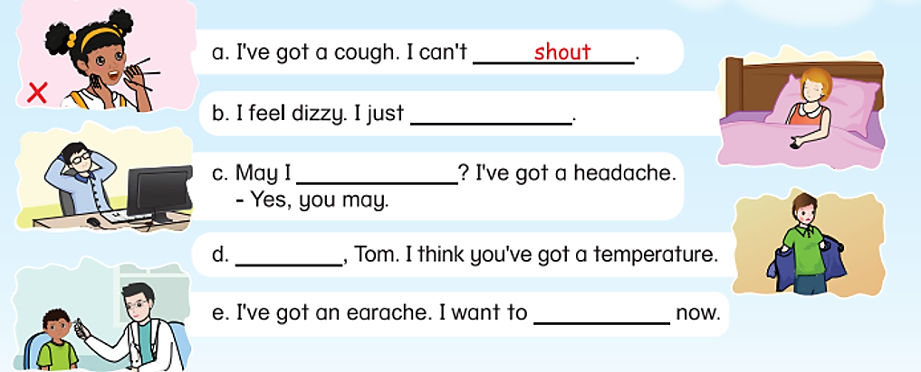
3
Read and complete.
Unit 12 – Lesson 3
Notes:
Use the software/ PPT/ Book page and show the pictures in Activity 3. “Now, look at the picture and answer my question: What can you see? Now, you are going to read the sentences about activities. Let’s read carefully, circle and match.”
Ask students to open their books page 108, Activity 3. Tell students that they are going to look at the pictures, read and complete.
Ask the students to read the sentences and underline the key words.
Let students read the first sentence and Sentence a. Explain.
Give students 2 minutes to do the task individually.
Let students check their answers in pairs before checking as a class.
Ask some students to read the sentences aloud.

Slide 41
3
Read and complete.
stay in bed
take a rest
take off
the jacket
see a doctor
Unit 12 – Lesson 3
Notes:
Use the software/ PPT/ Book page and show the pictures in Activity 3. “Now, look at the picture and answer my question: What can you see? Now, you are going to read the sentences about activities. Let’s read carefully, circle and match.”
Ask students to open their books page 108, Activity 3. Tell students that they are going to look at the pictures, read and complete.
Ask the students to read the sentences and underline the key words.
Let students read the first sentence and Sentence a. Explain.
Give students 2 minutes to do the task individually.
Let students check their answers in pairs before checking as a class.
Ask some students to read the sentences aloud.

Slide 42


… Day … Month …. Date … Year
Unit 12: Health
Lesson 3. Period 1
Vocabulary
see a doctor
shout
stay in bed
take off the jacket
take a rest
Unit 12 – Lesson 3
Notes:
Review all the words they have learned by using flashcards.
Count the stars.
Give compliments.

Slide 43
WRAP UP
Unit 12 – Lesson 3
Notes:
Review the words and the structure

Slide 44


CÔNG TY CỔ PHẦN PHÁT TRIỂN GIÁO DỤC
VIỆT NAM VPBOX
Hà Nội
Tầng 2, Nhà A, Nhà Khách La Thành, số 226 Vạn Phúc, P.Liễu Giai,
Quận Ba Đình, Hà Nội.
ĐT: (024) 3 3793 2405
phonics.hanoi@vpbox.edu.vn
Thành Phố Hồ Chí Minh
Số 270A, Lý Thường Kiệt, P.14, Quận 10.
ĐT: (028) 3 820 5934
phonics.hcm@vpbox.edu.vn
www.vpbox.edu.vn
https://phonics-smart.edu.vn

