Slide 1


Slide 3

TEAM DIVISION
Team 1
Team 2
Team 3
Team 4
Notes:
Divide class into 4 teams

Slide 4
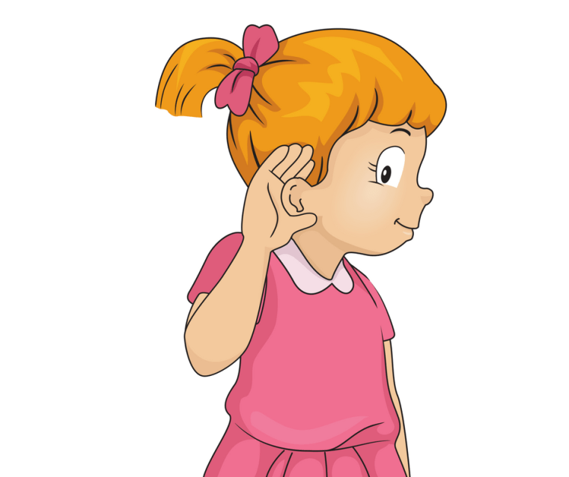



CLASSROOM RULES
1. Be quiet!
2. Listen!
3. Sit nicely!
4. Raise your hand to speak!
Notes:
Set the classroom rules

Slide 5

WARM UP
Sing “The animals” song
UNIT 9 – LESSON 1
Notes:
Sing a warm up song: Time song

Slide 6
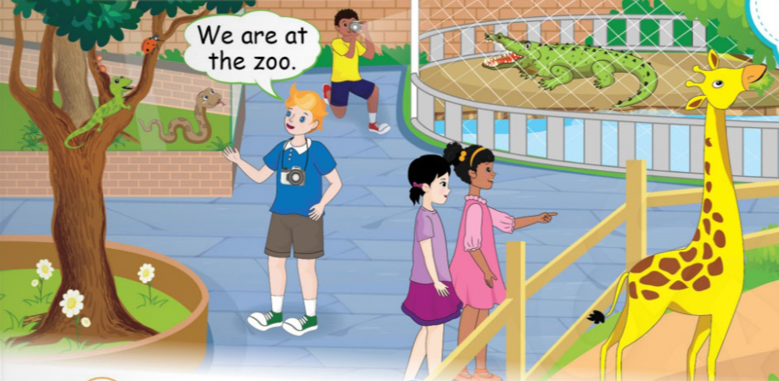
UNIT 13 – ANIMALS
Lesson 1
Period 1
UNIT 13 – LESSON 1

Slide 7

1
Listen and repeat.
UNIT 13 – LESSON 1
Notes:
Have students look at the three pictures on their books or show the picture on the screen.
Ask students where the children are.
Thell students that they are at the zoo and ask them to name of the animals they know.

Slide 8
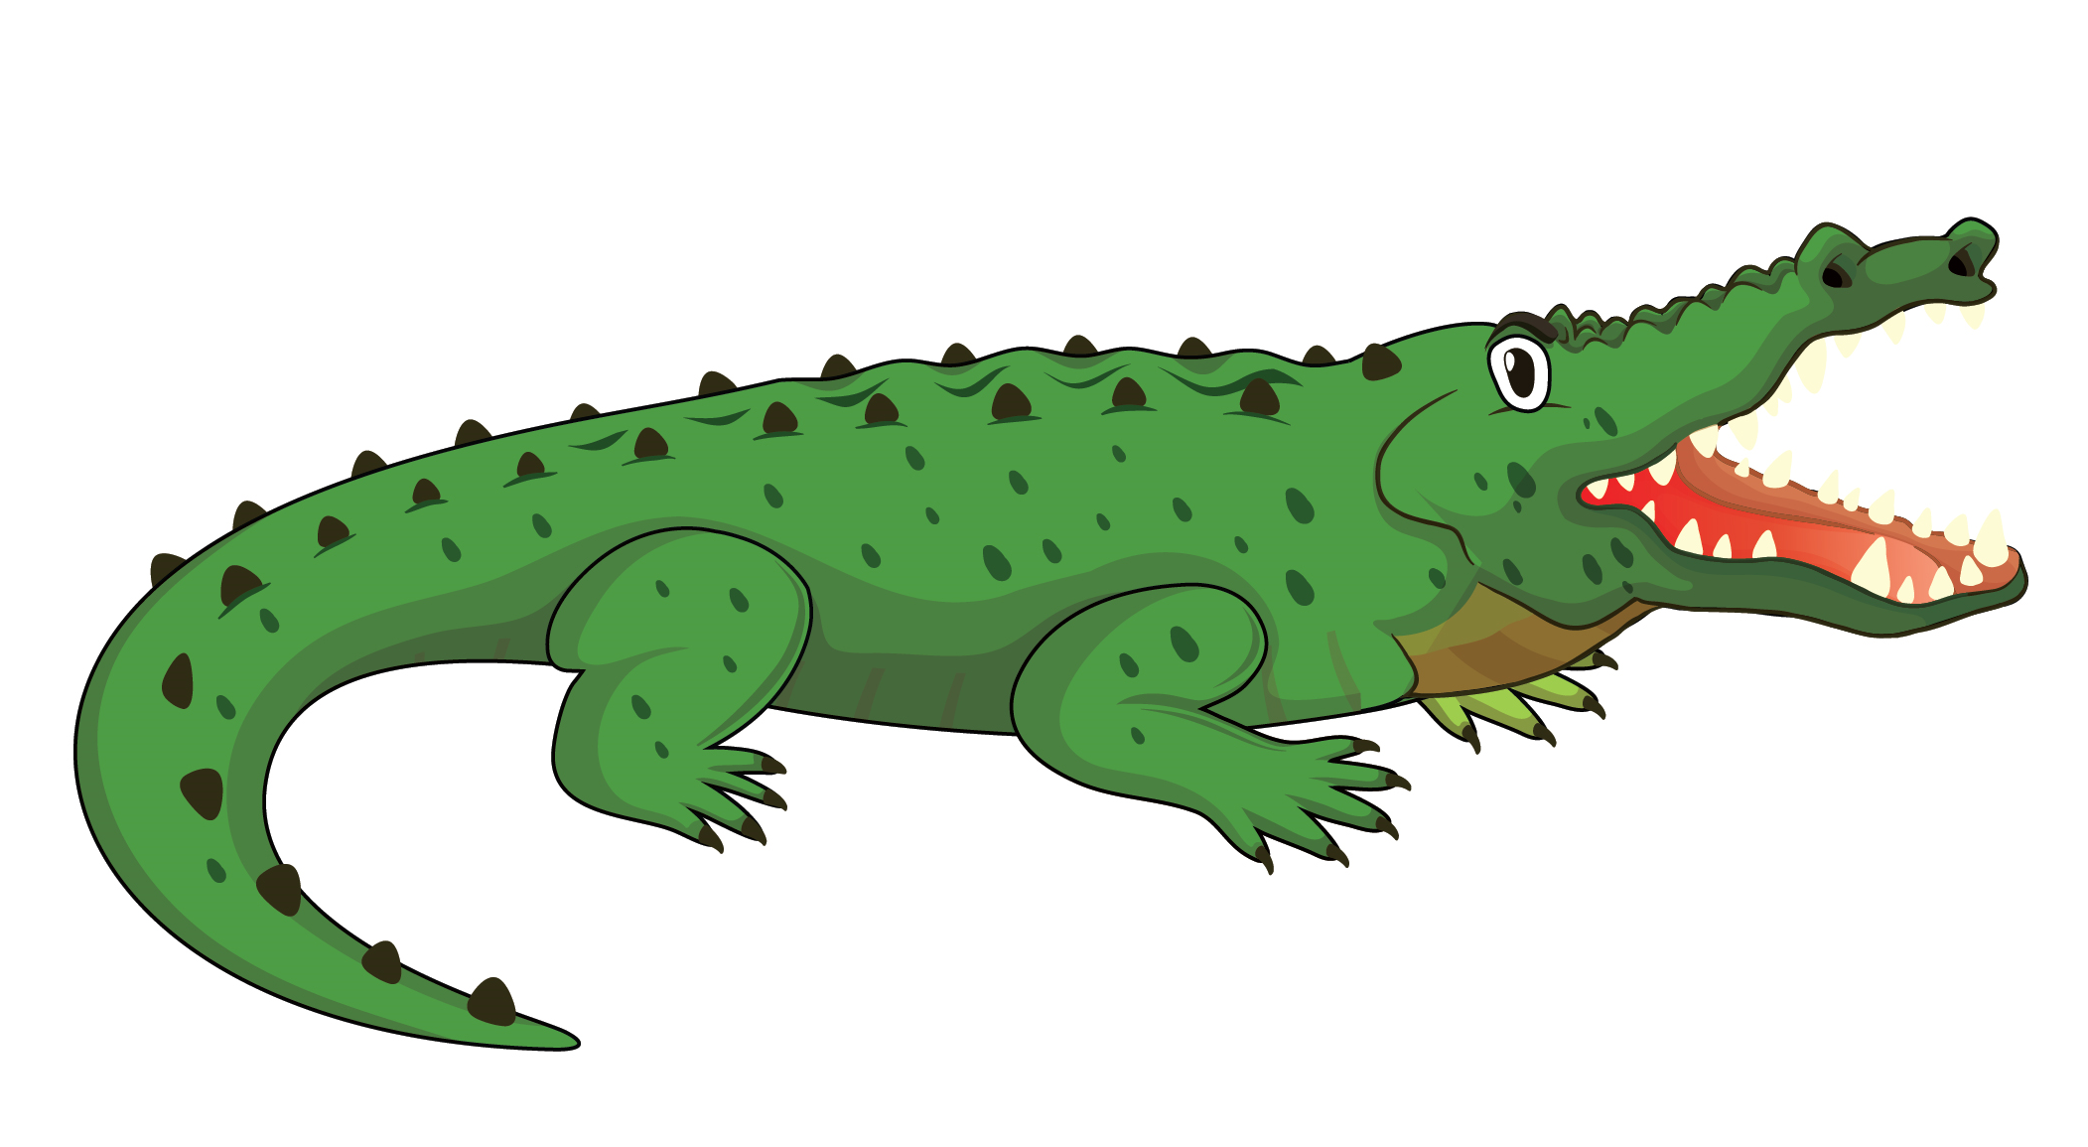

1
Listen and repeat.
UNIT 13 – LESSON 1
Notes:
Teach students the new words about animals and their food.
Play the audio (CD2 Track 72) for students to listen the words.
Play the audio a gain for students to listen and repeat in pairs, whole class, groups and/or individually.

Slide 9


1
Listen and repeat.
UNIT 13 – LESSON 1
Notes:
Teach students the new words about animals and their food.
Play the audio (CD2 Track 72) for students to listen the words.
Play the audio a gain for students to listen and repeat in pairs, whole class, groups and/or individually.

Slide 10
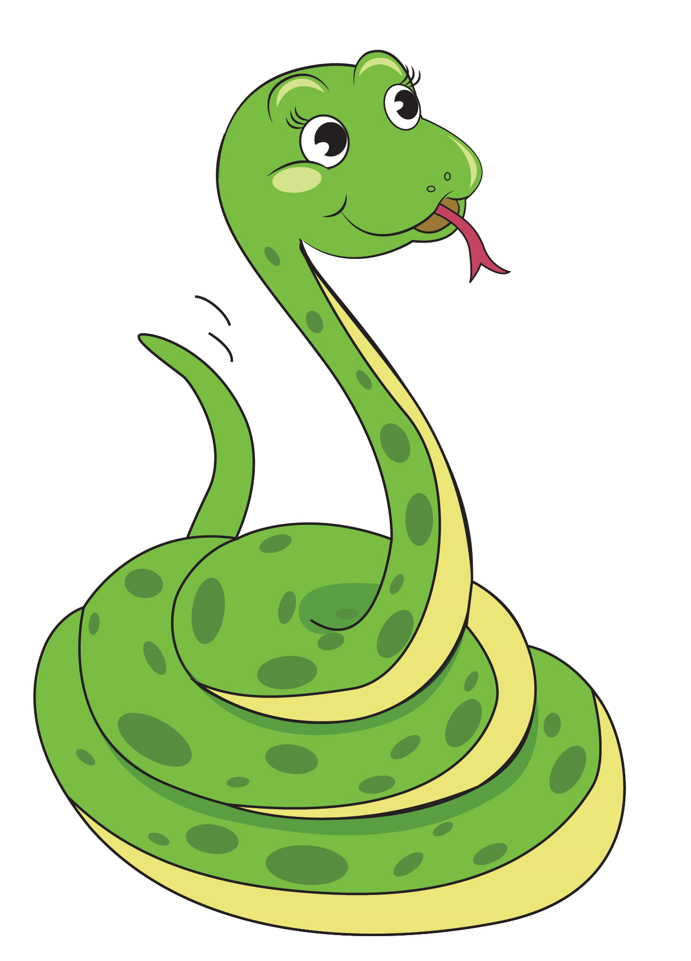

1
Listen and repeat.
UNIT 13 – LESSON 1
Notes:
Teach students the new words about animals and their food.
Play the audio (CD2 Track 72) for students to listen the words.
Play the audio a gain for students to listen and repeat in pairs, whole class, groups and/or individually.

Slide 11


1
Listen and repeat.
UNIT 13 – LESSON 1
Notes:
Teach students the new words about animals and their food.
Play the audio (CD2 Track 72) for students to listen the words.
Play the audio a gain for students to listen and repeat in pairs, whole class, groups and/or individually.

Slide 12
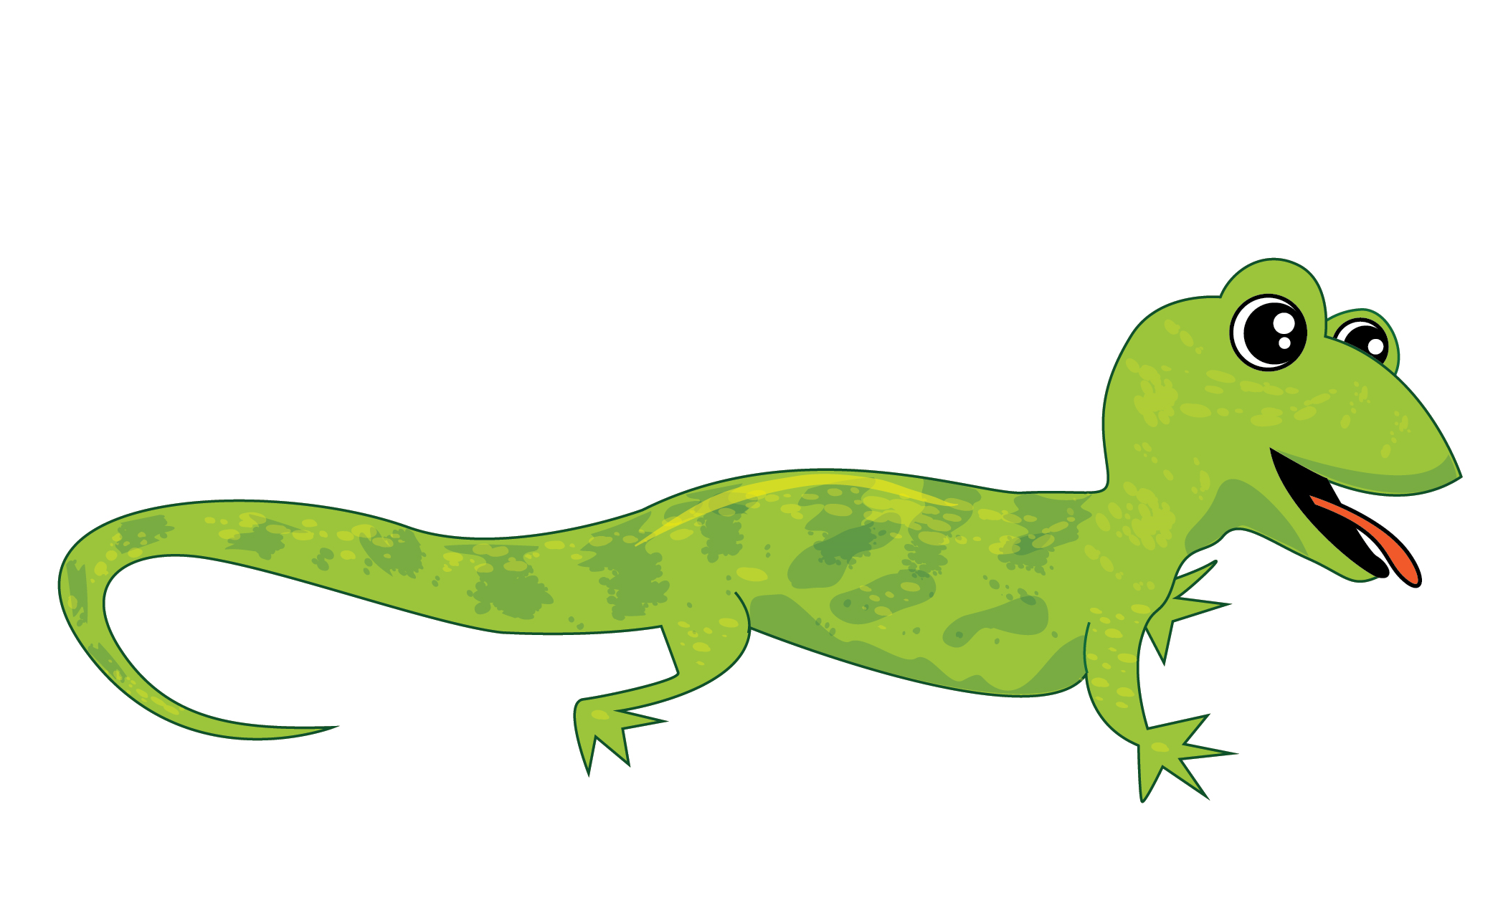

1
Listen and repeat.
UNIT 13 – LESSON 1
Notes:
Teach students the new words about animals and their food.
Play the audio (CD2 Track 72) for students to listen the words.
Play the audio a gain for students to listen and repeat in pairs, whole class, groups and/or individually.

Slide 13
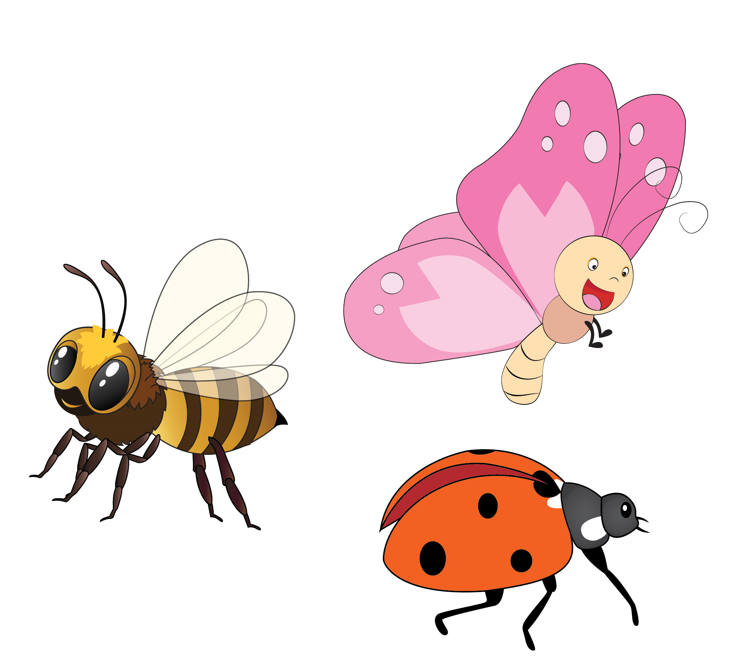

1
Listen and repeat.
UNIT 13 – LESSON 1
Notes:
Teach students the new words about animals and their food.
Play the audio (CD2 Track 72) for students to listen the words.
Play the audio a gain for students to listen and repeat in pairs, whole class, groups and/or individually.

Slide 14
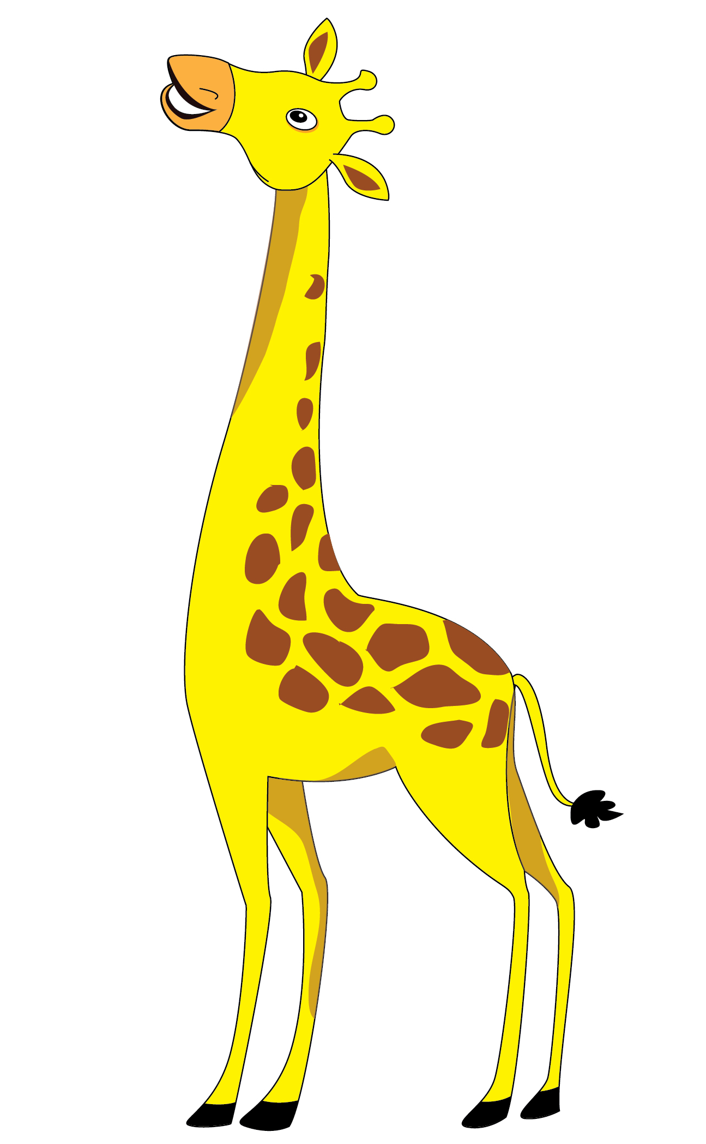

1
Listen and repeat.
UNIT 13 – LESSON 1
Notes:
Teach students the new words about animals and their food.
Play the audio (CD2 Track 72) for students to listen the words.
Play the audio a gain for students to listen and repeat in pairs, whole class, groups and/or individually.

Slide 15
1
Listen and repeat.
UNIT 13 – LESSON 1
Notes:
Ask students to practice in pairs, one points at the pictures, one says the words.

Slide 16

PLAY GAME
Magic box
UNIT 13 – LESSON 1
Notes:
Game: Magic box.
Teacher prepares a box and the pieces of paper. With each piece of paper, teacher write a name of an animal. In the game, teach play the music while the students are passing the box. When the music stops, who keeps the box will pick a piece of paper, reads aloud the word and say this animal’s favourite food. Teacher checks the answers with the whole class and give stars for the correct answers.

Slide 17
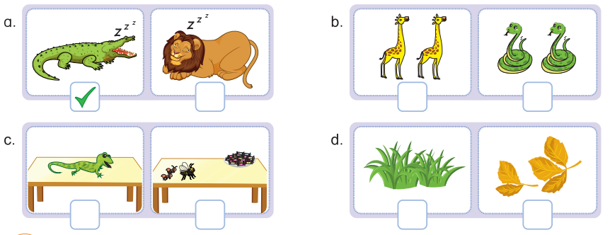
2
Listen and tick.
✓
✓
✓
UNIT 13 – LESSON 1
Notes:
Focus students on Activity 2. Ask students to look at the pictures, name the animals and their food.
Tell students that they are going to listen to the audio, look and tick the correct answers.
Model the task with the pictures in a. Explain.
Give students time to do the task individually.
Let students check their answers in pairs before checking as a class.
play the audio again for students to listen and repeat.

Slide 18
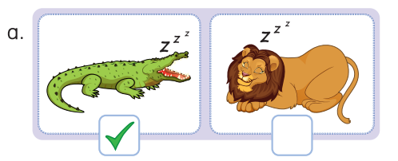
2
Listen and tick.
UNIT 13 – LESSON 1
Notes:
play the audio again for students to listen and repeat.

Slide 19
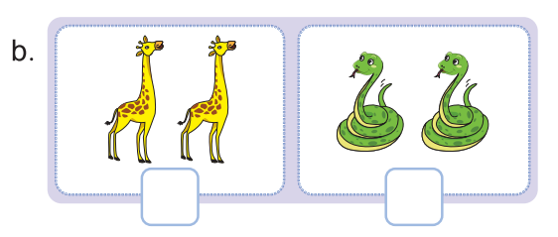
2
Listen and tick.
✓
UNIT 13 – LESSON 1
Notes:
play the audio again for students to listen and repeat.

Slide 20
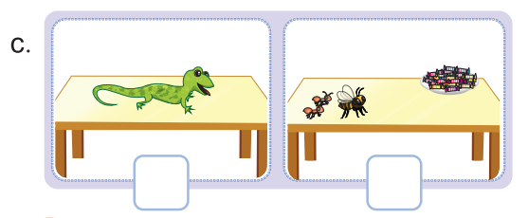
2
Listen and tick.
✓
UNIT 13 – LESSON 1
Notes:
play the audio again for students to listen and repeat.

Slide 21
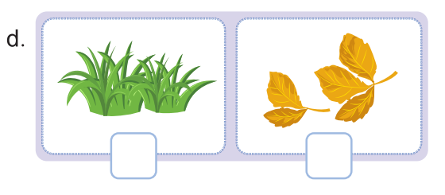
2
Listen and tick.
✓
UNIT 13 – LESSON 1
Notes:
play the audio again for students to listen and repeat.

Slide 22
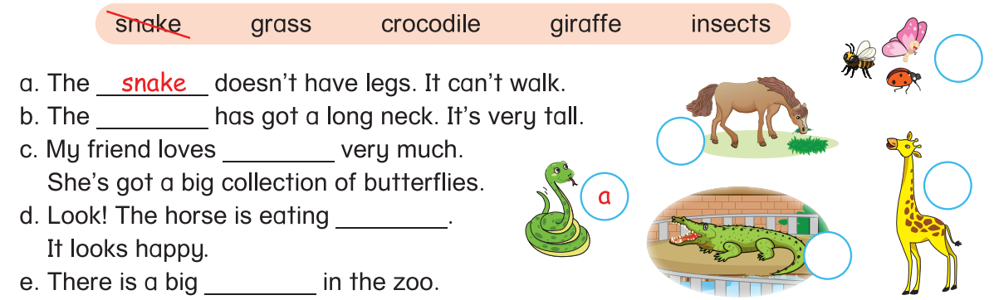
3
Read and complete. Match.
UNIT 13 – LESSON 1
Notes:
Tell students that they are going to reorder the words to make complete sentences.
Note to students that each sentence starts with the word with the first letter which is capitalized and the sentence ends with the word followed by a dot.
Model the task with Sentence a. Explain.

Slide 23
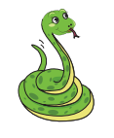
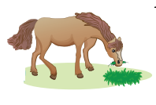
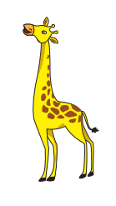

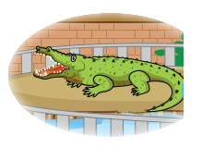
3
Read and complete. Match.
grass
snake
horse
giraffe
crocodile
insects
UNIT 13 – LESSON 1
Notes:
Focus students on the Activity 3, look at the animals and say the names of animals.

Slide 24
3
Read and complete. Match.
c
giraffe
insects
d
b
e
grass
crocodile
UNIT 13 – LESSON 1
Notes:
Ask students to read the given words aloud.
Guide the students to read and understand the meaning of the sentences.
Tell students that they are going to look at the words, read the sentences, fill in the blanks and match the sentences with the correct pictures.
Model the task with Sentence a. Explain.
Give students time to do the task individually.
Let students check their answers in pairs before checking as a class.
Correct the answers with the whole class.
Call some students to read the sentences loudly.

Slide 25


… Day … Month …. Date … Year
Unit 13: ANIAMLS
Lesson 1. Period 1
Vocabulary
crocodile
giraffe
lizard
Snake
Insects
Grass
leafhouse
UNIT 13 – LESSON 1
Notes:
Review all the words they have learned by using flashcards.
Count the stars.
Give compliments.

Slide 26
WRAP UP
UNIT 13 – LESSON 1
Notes:
Ask students to practice in pairs, one points at the pictures, one says the words.

Slide 27


CÔNG TY CỔ PHẦN PHÁT TRIỂN GIÁO DỤC
VIỆT NAM VPBOX
Hà Nội
Tầng 2, Nhà A, Nhà Khách La Thành, số 226 Vạn Phúc, P.Liễu Giai,
Quận Ba Đình, Hà Nội.
ĐT: (024) 3 3793 2405
phonics.hanoi@vpbox.edu.vn
Thành Phố Hồ Chí Minh
Số 270A, Lý Thường Kiệt, P.14, Quận 10.
ĐT: (028) 3 820 5934
phonics.hcm@vpbox.edu.vn
www.vpbox.edu.vn
https://phonics-smart.edu.vn

