Slide 1


Slide 3

TEAM DIVISION
Team 1
Team 2
Team 3
Team 4
Notes:
Divide class into 4 teams

Slide 4
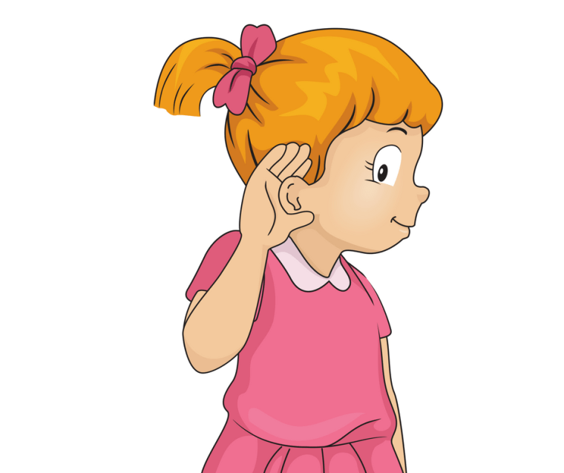



CLASSROOM RULES
1. Be quiet!
2. Listen!
3. Sit nicely!
4. Raise your hand to speak!
Notes:
Set the classroom rules

Slide 5

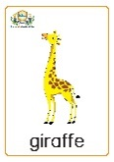
WARM UP
“Pass the flashcards” game
UNIT 9 – LESSON 3
Notes:
Pass the flashcard game.
Prepare the flashcards of animals. Each turn, teacher plays the music while students pass the flashcards. When the music stops, who is holding the flashcard will make a sentence, using the structure: I like [name of animals] because they are [adjective].

Slide 6
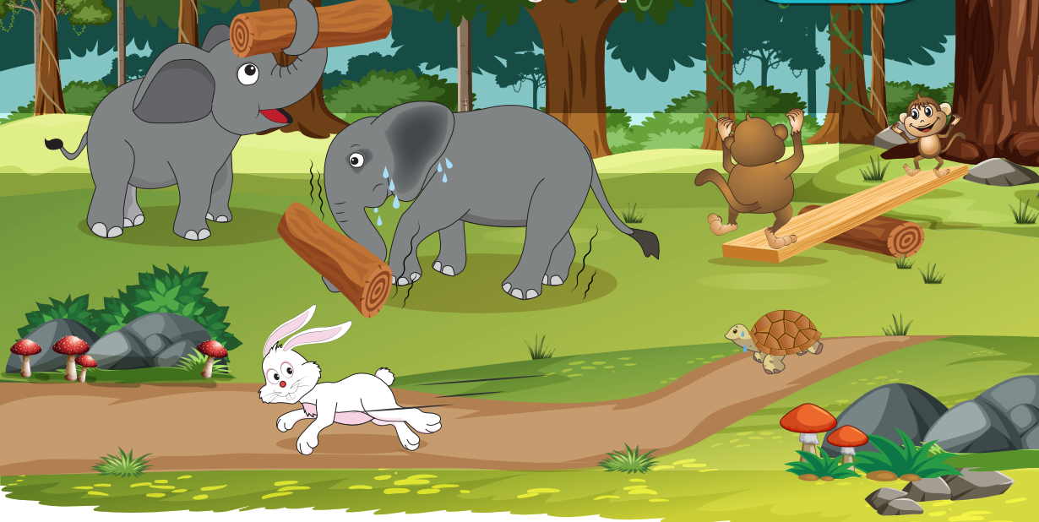
UNIT 10 – ANIMALS
Lesson 3
Period 1
UNIT 13 – LESSON 3

Slide 7


1
Listen and repeat.
UNIT 13 – LESSON 3
Notes:
Focus students on the picture and ask some questions to help them recognize the picture background: What are the animals? What are they doing?
Collect students’ answers and give feedback.
Let students read the context sentence.

Slide 8
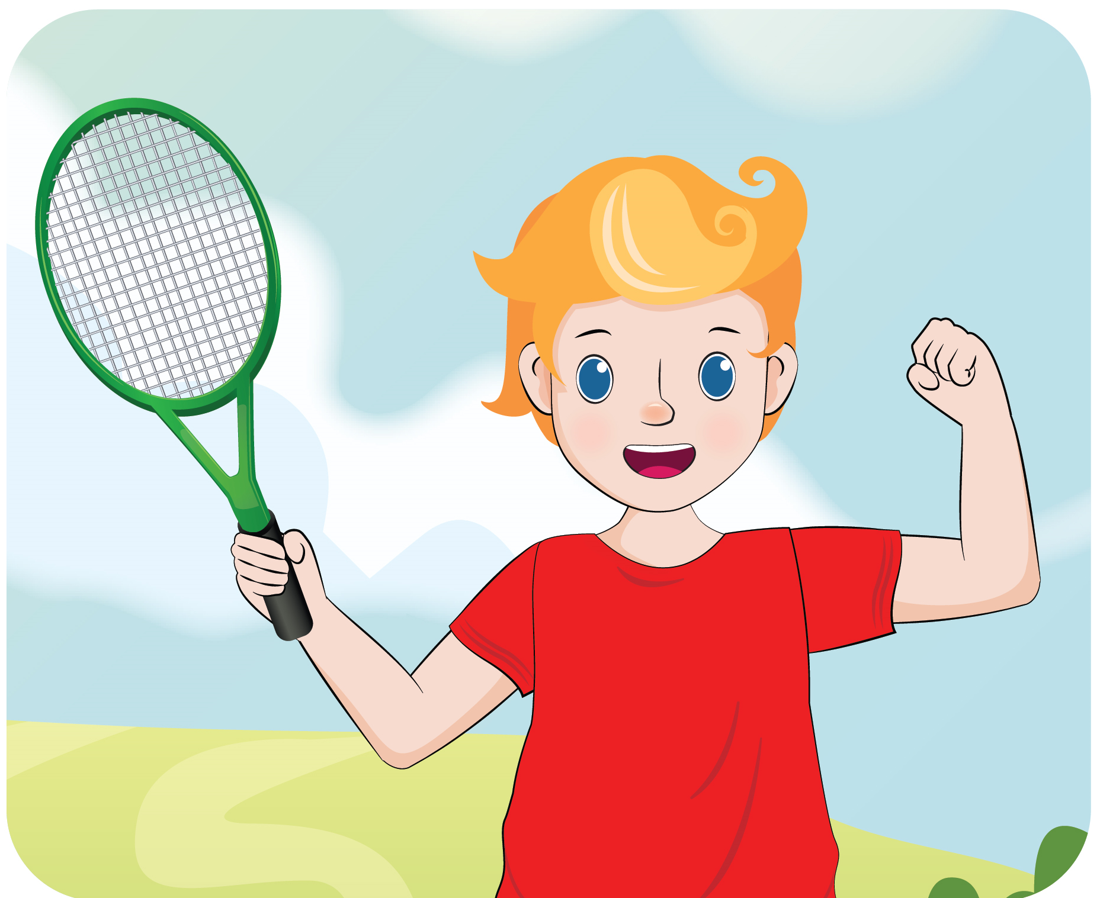

1
Listen and repeat.
UNIT 13 – LESSON 3
Notes:
Teach the new words by asking how each animal is doing.
Play the audio CD (CD2 Track 78) for students to listen to the twice.
Play the audio for students to listen and repeat the new words.
Correct students’ pronunciation mistakes and instruct students to say using proper intonation.

Slide 9
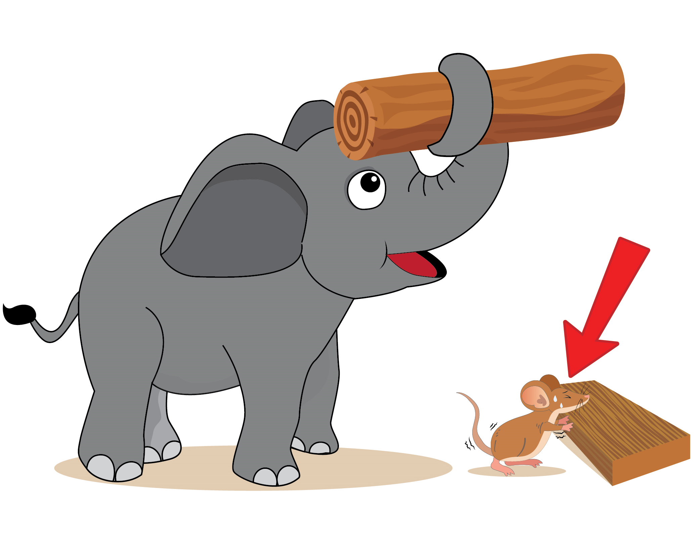

1
Listen and repeat.
UNIT 13 – LESSON 3
Notes:
Teach the new words by asking how each animal is doing.
Play the audio CD (CD2 Track 78) for students to listen to the twice.
Play the audio for students to listen and repeat the new words.
Correct students’ pronunciation mistakes and instruct students to say using proper intonation.

Slide 10
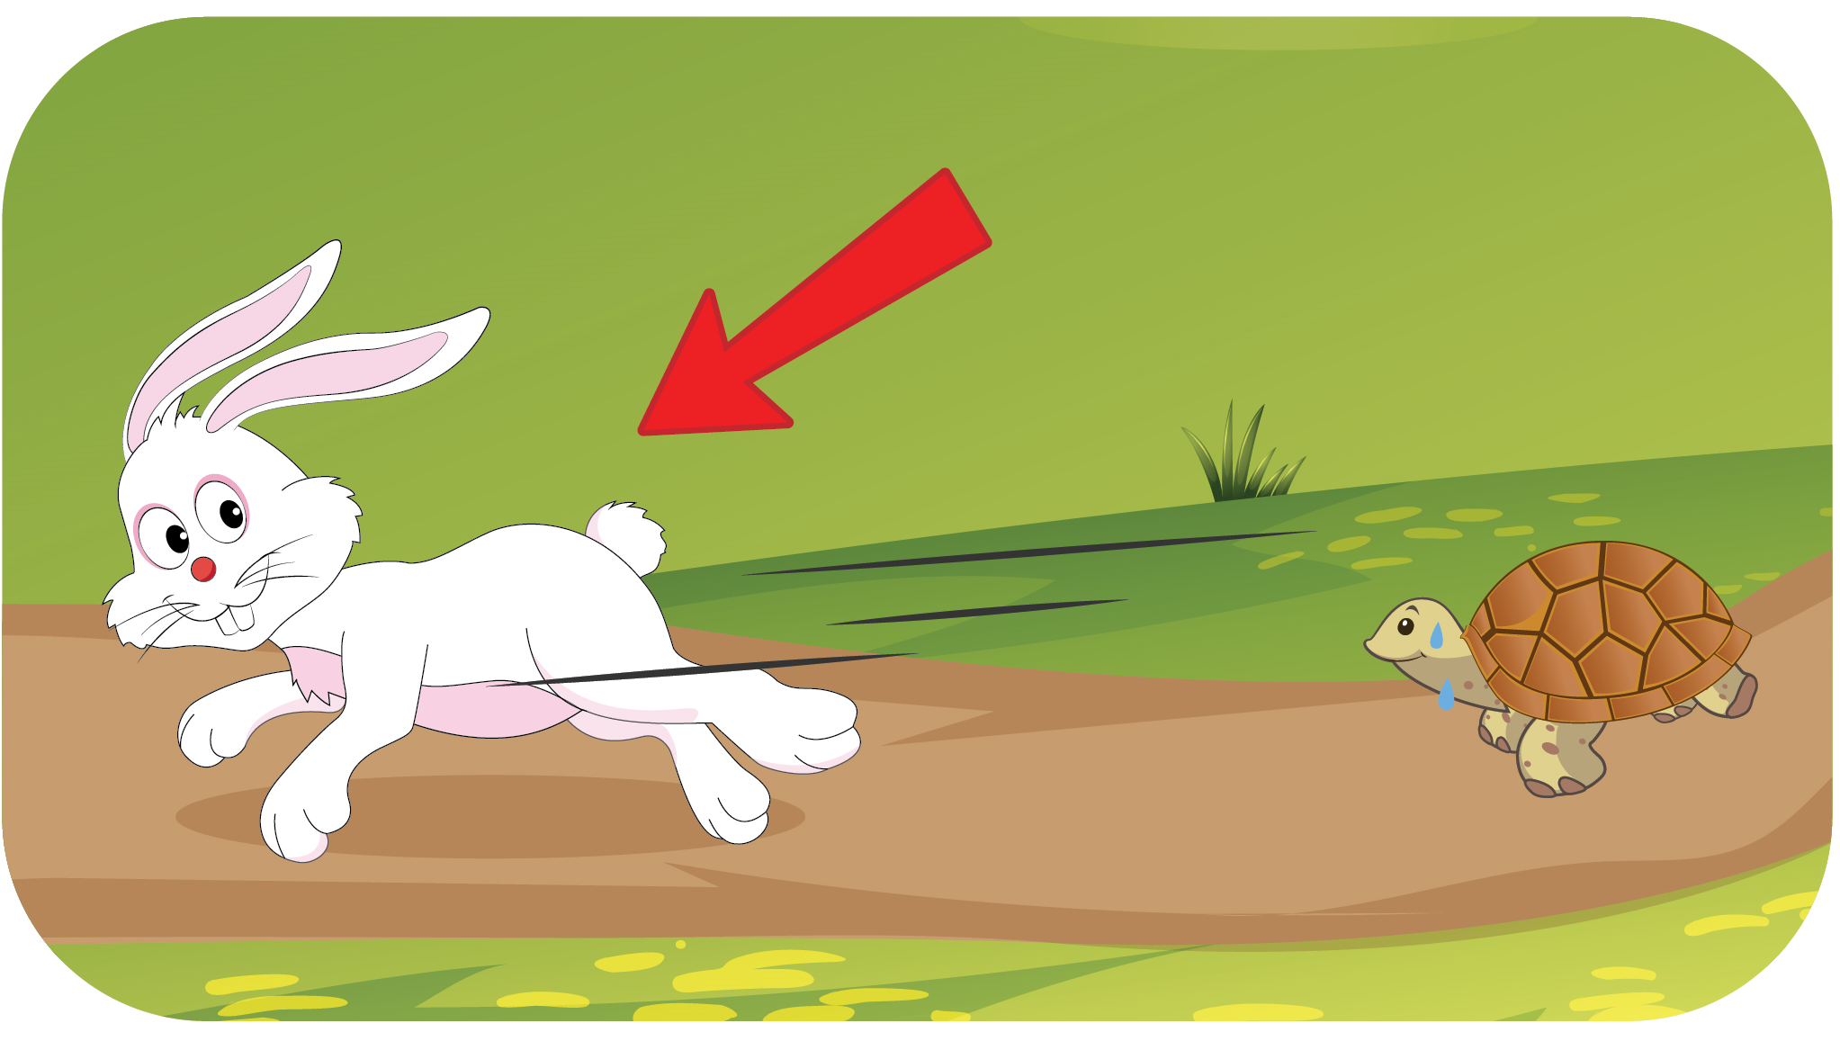

1
Listen and repeat.
UNIT 13 – LESSON 3
Notes:
Teach the new words by asking how each animal is doing.
Play the audio CD (CD2 Track 78) for students to listen to the twice.
Play the audio for students to listen and repeat the new words.
Correct students’ pronunciation mistakes and instruct students to say using proper intonation.

Slide 11
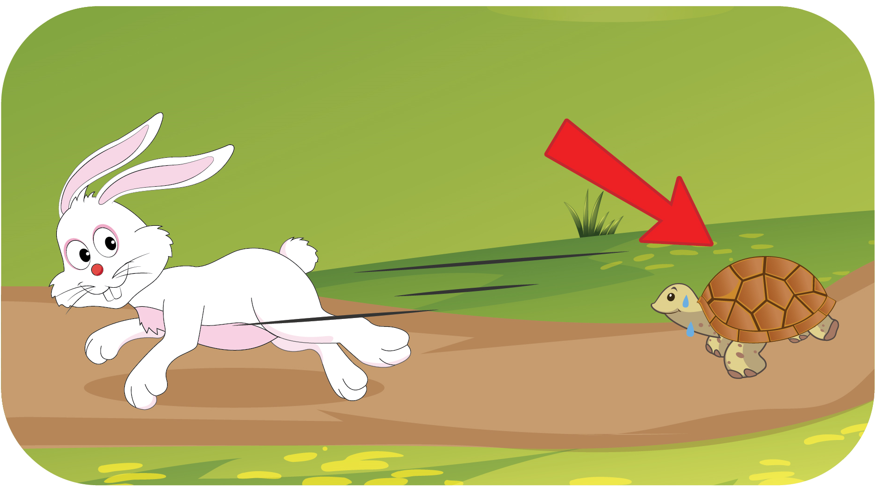

1
Listen and repeat.
UNIT 13 – LESSON 3
Notes:
Teach the new words by asking how each animal is doing.
Play the audio CD (CD2 Track 78) for students to listen to the twice.
Play the audio for students to listen and repeat the new words.
Correct students’ pronunciation mistakes and instruct students to say using proper intonation.

Slide 12
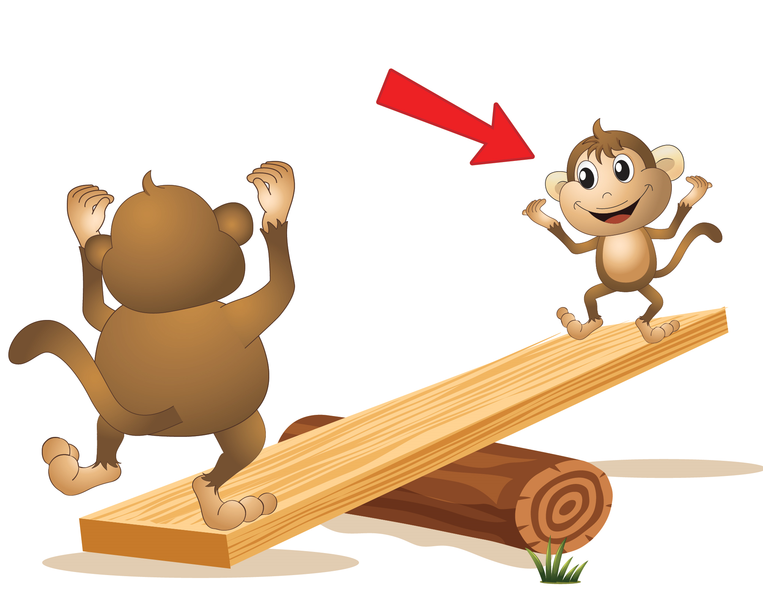

1
Listen and repeat.
UNIT 13 – LESSON 3
Notes:
Teach the new words by asking how each animal is doing.
Play the audio CD (CD2 Track 78) for students to listen to the twice.
Play the audio for students to listen and repeat the new words.
Correct students’ pronunciation mistakes and instruct students to say using proper intonation.

Slide 13
1
Listen and repeat.
UNIT 13 – LESSON 3
Notes:
Ask students to work in pairs: one student points, one student reads.

Slide 14

GAME: Slap the board!
UNIT 13 – LESSON 3
Notes:
Guessing game.
Ask students to work in groups.
Each turn, one student from each group go to the board, pick one flashcard and use body language to describe this word. The others raise their hands to get their group’s turn to answer.
Teacher gives points for the correct answers.

Slide 15
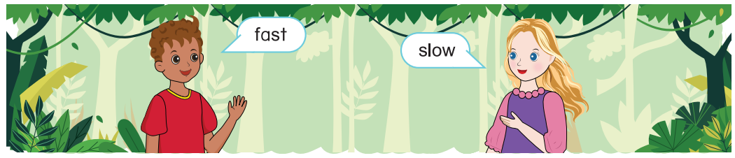
2
Let’ play: Find the opposite words.
UNIT 13 – LESSON 3
Notes:
Focus students on Activity 2.
Tell students that they are going to play an interesting game to find pairs of opposite words.
Ask students to play in two groups. One student from each group says a learnt word, another student from the other group listens to the word, then say aloud the opposite word. With each correct answer, the group get one point. The group with more points will be the winner.
Model the task for students to follow. The teacher says the word fast then call one student to find the opposite word.
Give students time to play the game.
Check the answers with the whole class.

Slide 16
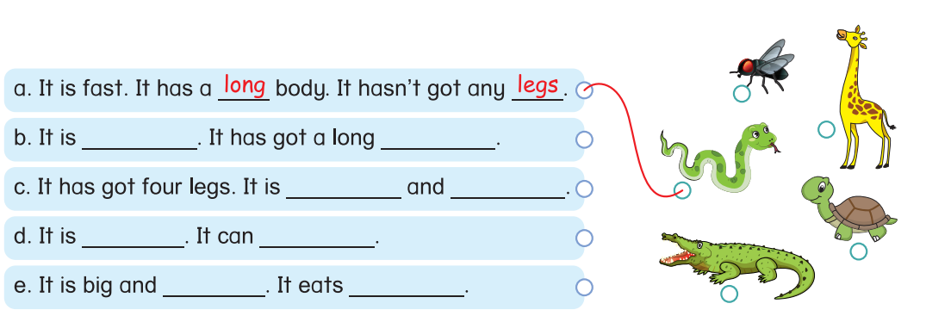
3
Listen and write. Match.
tall
neck
short
slow
light
fly
strong
meat
UNIT 13 – LESSON 3
Notes:
Ask students to look at the picture of animals in Activity 3 and name the animals.
Tell students that they are going to listen to the sentences, complete them, then guess what animal that the sentences talking about by matching each sentence with the correct animal.
Ask student to read the sentences, guess the answers if they can.
Play the audio and do the first sentence to model the task. Explain.
Play the audio for students to listen and do the task.
Ask students to share the answers in pairs.
Invite some students to give their answers and read aloud the sentences.
Give feedback.

Slide 17


… Day … Month …. Date … Year
Unit 13: ANIMALS
Lesson 3. Period 1
Vocabulary
strong
weak
fast
slow
light
UNIT 13 – LESSON 3
Notes:
Review all the words they have learned by using flashcards.
Count the stars.
Give compliments.

Slide 18
WRAP UP
UNIT 13 – LESSON 3
Notes:
Ask students to work in pairs: one student points, one student reads.

Slide 19


CÔNG TY CỔ PHẦN PHÁT TRIỂN GIÁO DỤC
VIỆT NAM VPBOX
Hà Nội
Tầng 2, Nhà A, Nhà Khách La Thành, số 226 Vạn Phúc, P.Liễu Giai,
Quận Ba Đình, Hà Nội.
ĐT: (024) 3 3793 2405
phonics.hanoi@vpbox.edu.vn
Thành Phố Hồ Chí Minh
Số 270A, Lý Thường Kiệt, P.14, Quận 10.
ĐT: (028) 3 820 5934
phonics.hcm@vpbox.edu.vn
www.vpbox.edu.vn
https://phonics-smart.edu.vn

