Slide 1


Slide 3

TEAM DIVISION
Team 1
Team 2
Team 3
Team 4
Notes:
Divide class into 4 teams

Slide 4




CLASSROOM RULES
1. Be quiet!
2. Listen!
3. Sit nicely!
4. Raise your hand to speak!
UNIT 14 – LESSON 2
Notes:
Set the classroom rules

Slide 5

WARM UP
Sing “Beach Holiday” song
UNIT 5 – LESON 1
Notes:
Play a warm-up song: Beach Holiday

Slide 6
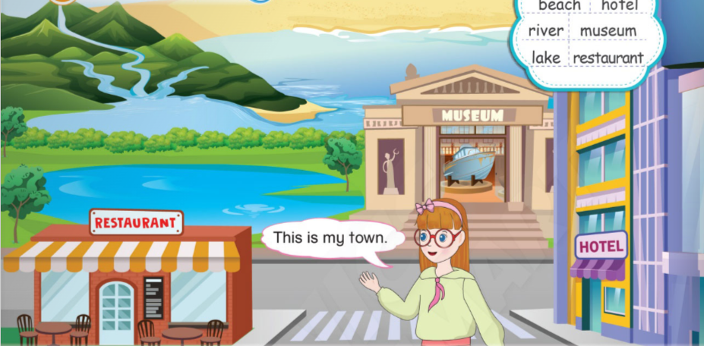
UNIT 14 – TRAVELLING
Lesson 2
Period 1

Slide 7
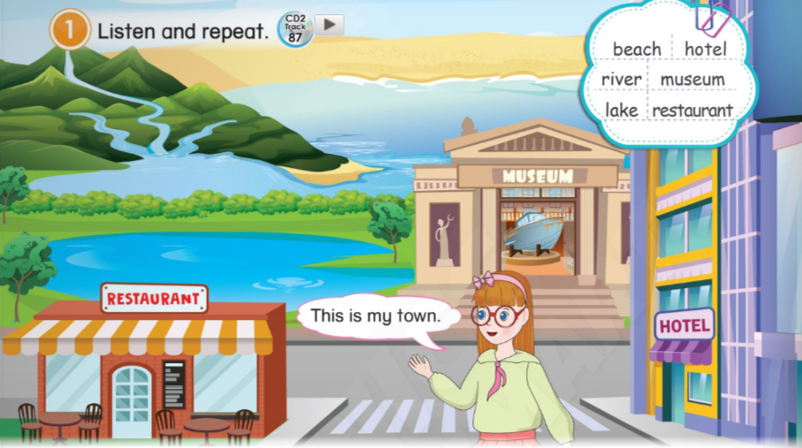
1
Listen and repeat.
UNIT 14 – LESSON 2
Notes:
-Ask students to look at the picture in the book (or show it on the screen): “Now class, look at the picture and answer my questions. What do you see in the picture? Is there a restaurant near your house?”
-Introduce the context: Helen is introducing her hometown.
-Teach the new words: beach, hotel, river, museum, lake, restaurant.
-Point at the picture and elicit the places by asking some questions: “Is it a hotel? Is it a restaurant? What is it?”

Slide 8







1
Listen and repeat.
This is my town.
UNIT 14 – LESSON 2
Notes:
-Ask students to look at the screen and listen to the audio CD (Track 87) twice.

Slide 9
1
Listen and repeat.
This is my town.
UNIT 14 – LESSON 2
Notes:
-Ask students to open the book on page 124, Activity 1. Listen and repeat.
-Do choral and individual repetition and check students’ pronunciation.
-Point at each picture randomly and ask students to say the words in chorus and individually.
-Correct students’ pronunciation mistakes and instructs students to say using proper intonation.

Slide 10
1
Listen and repeat.
UNIT 14 – LESSON 2
Notes:
-Ask students to open the book on page 124, Activity 1. Listen and repeat.
-Do choral and individual repetition and check students’ pronunciation.
-Point at each picture randomly and ask students to say the words in chorus and individually.
-Correct students’ pronunciation mistakes and instructs students to say using proper intonation.

Slide 11
1
Listen and repeat.
UNIT 14 – LESSON 2
Notes:
-Ask students to open the book on page 124, Activity 1. Listen and repeat.
-Do choral and individual repetition and check students’ pronunciation.
-Point at each picture randomly and ask students to say the words in chorus and individually.
-Correct students’ pronunciation mistakes and instructs students to say using proper intonation.

Slide 12

Unscramble the words
UNIT 14 – LESSON 2
Notes:
-Show the slides of the pictures and the letters to make the words.
-Each turn, students work in groups, look at the picture, the letters, then raise hand to get turn.
-Invite the fastest hand to go to the board and write the answer.
Students get one point for each correct answer.

Slide 13
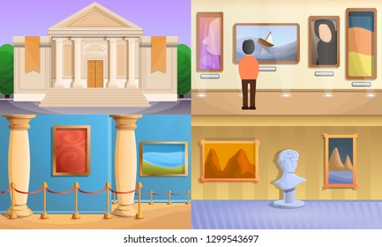
u e m u s m
museum
UNIT 14 – LESSON 2

Slide 14

c a h e b
beach
UNIT 14 – LESSON 2

Slide 15

a t e l r a l f w
waterfall
UNIT 14 – LESSON 2

Slide 16

s u n r a t r t a e
restaurant
UNIT 14 – LESSON 2

Slide 17

e v r i r
river
UNIT 14 – LESSON 2

Slide 18

o t h l e
hotel
UNIT 14 – LESSON 2

Slide 19

a c o h c
coach
UNIT 14 – LESSON 2

Slide 20

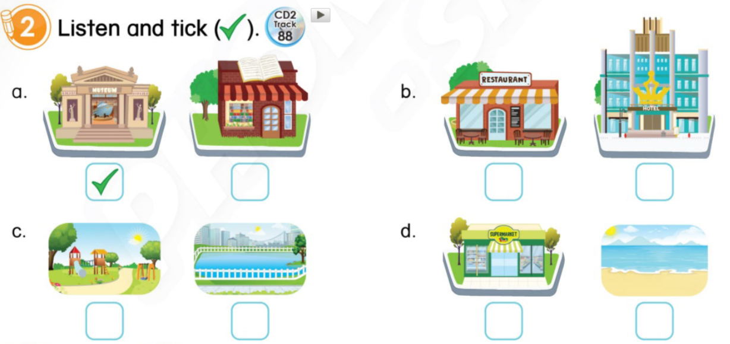
2
Listen and stick ( ).
UNIT 14 – LESSON 2
Notes:
-Use the software/ PowerPoint/ Book and show the pictures in Activity 2. “Hi class, look at the pictures. Is it a museum? Is it a restaurant? What is it?” Let students give answers.
-Tell students that they are going to listen to the audio and tick the correct boxes under the pictures.

Slide 21

2
Listen and stick ( ).
UNIT 14 – LESSON 2
Notes:
-Play the CD (Track 88) twice for students to listen.
-Model the task with the first dialogue. Explain.
-Play the audio again for students to do the task.
-Remind students to use their pencils to tick the boxes.
-Ask students to do the task individually and share their answers with their friends.
-Check and give correct answers.
-Invite some students to say the words aloud and check their pronunciation.

Slide 22
3
Look at . Read and complete.
1
UNIT 14 – LESSON 2
Notes:
-Review about the words in ① (beach, hotel, river, museum, lake, restaurant).
-Tell students that they are going to look at the picture in activity 1, read the sentences and fill in the blanks with the suitable word from the Word Box.

Slide 23
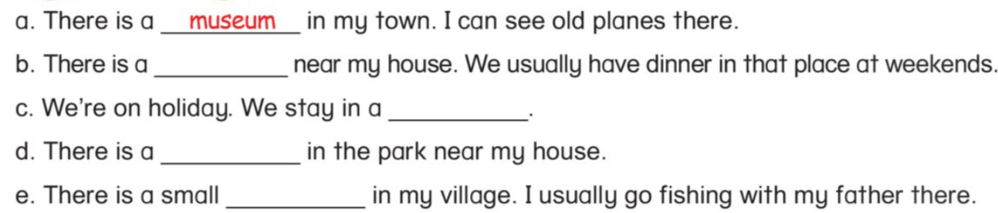
3
Look at . Read and complete.
1
restaurant
hotel
lake
river
UNIT 14 – LESSON 2
Notes:
-Have the students look at sentence a and read aloud. Explain.
-Give students time to do the task individually.
-Get students to work in pairs, then students take turns to read the sentences.
-Call some students to give their answers.
-Check and give correct answers.

Slide 24


… Day … Month …. Date … Year
Unit 14: Travelling
Lesson 2. Period 1
Vocabulary
beach
river
lake
hotel
museum
restaurant
UNIT 14 – LESSON 2
Notes:
Review all the words they have learned by using flashcards.
Count the stars.
Give compliments.

Slide 25
WRAP UP
UNIT 14 – LESSON 2

Slide 26


CÔNG TY CỔ PHẦN PHÁT TRIỂN GIÁO DỤC
VIỆT NAM VPBOX
Hà Nội
Tầng 2, Nhà A, Nhà Khách La Thành, số 226 Vạn Phúc, P.Liễu Giai,
Quận Ba Đình, Hà Nội.
ĐT: (024) 3 3793 2405
phonics.hanoi@vpbox.edu.vn
Thành Phố Hồ Chí Minh
Số 270A, Lý Thường Kiệt, P.14, Quận 10.
ĐT: (028) 3 820 5934
phonics.hcm@vpbox.edu.vn
www.vpbox.edu.vn
https://phonics-smart.edu.vn

