Slide 1


Slide 3

TEAM DIVISION
Team 1
Team 2
Team 3
Team 4
Notes:
Divide class into 4 teams

Slide 4




CLASSROOM RULES
1. Be quiet!
2. Listen!
3. Sit nicely!
4. Raise your hand to speak!
UNIT 14 – LESSON 3
Notes:
Set the classroom rules

Slide 5

GAME
UNIT 14 – LESSON 3
Notes:
+ Stick the flashcards of places learnt in Lesson 1 and Lesson 2 on the board.
+ Put them in random positions for students to practise memorizing the name of places.
+ Invite two students to come to the board each time. One asks questions and the other answer it.

Slide 6
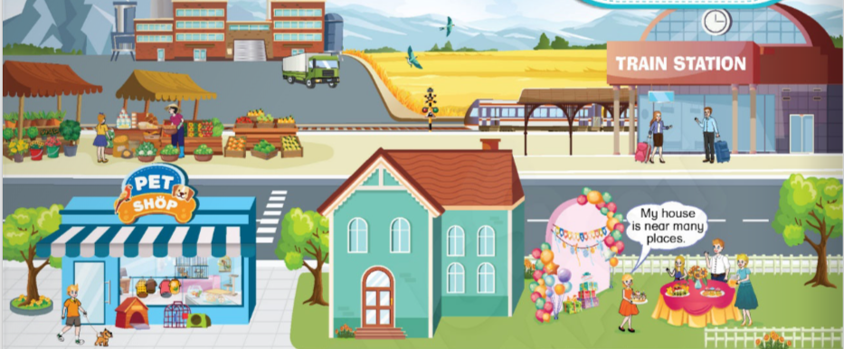
UNIT 14 – TRAVELLING
Lesson 3
Period 2

Slide 7

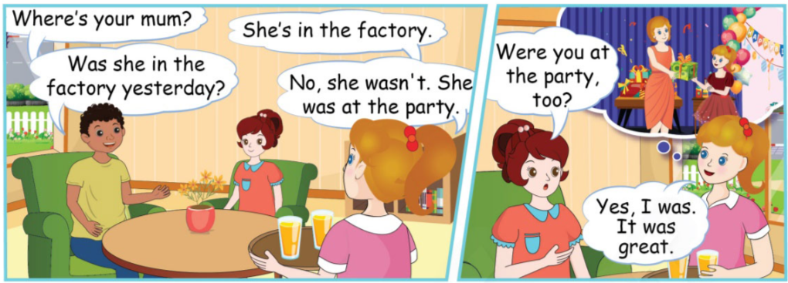
4
Listen and read.
UNIT 14 – LESSON 3
Notes:
-Ask students to look at the picture in the book (or show it on the screen): “Now class, look at the picture. Who are they? (Tim, Pat and Lucy), Where are they? (at Lucy’s house), What are they talking about? (Lucy’s mum).”
-Introduce: Tin and Pat are at Lucy’s house. Tim is asking about Lucy’s mum.
-Ask students to look at the screen and listen to the audio CD (Track 91) twice.

Slide 8
4
Listen and read.
New structure
Use: ask and answer questions about the place where someone was in the past.
Q: Were/Was + they/he/she…+ in/on/at + a/an/the + [place]?
A: Yes, they/he/she … were/was.
No, they/he/she … weren’t/wasn’t.
UNIT 14 – LESSON 3
Notes:
-Introduce the structure to ask and answer the questions about the place where someone was in the past:
Q: Were/Was + they/he/she…+ in/on/at + a/an/the + [place]?
A: Yes, they/he/she … were/was.
No, they/he/she … weren’t/wasn’t.

Slide 9
4
Listen and read.
UNIT 14 – LESSON 3
Notes:
-Play the audio again, then get students to listen to and repeat each sentence.
-While repeating each sentence, students point at the speech bubbles respectively.
-Give students time to act out the situation in groups of three. Invite some groups to perform in front of class.
Correct students’ pronunciation mistakes and instructs students to say using proper intonation.

Slide 10
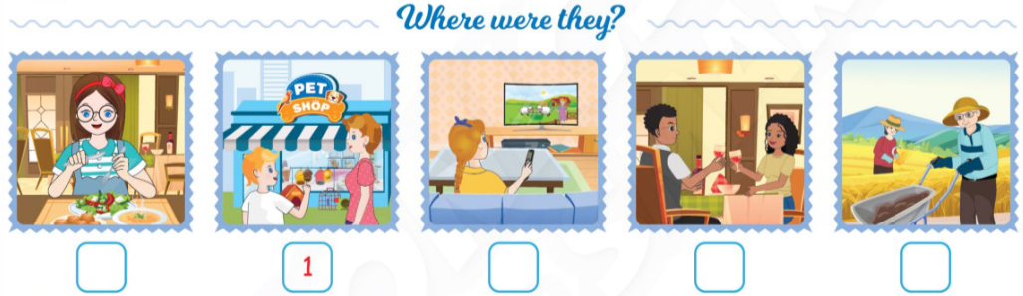
5
Listen and number.
UNIT 14 – LESSON 3
Notes:
-Have students look at the pictures and ask: “Is the girl eating in the restaurant? Where are Tommy and his mother?”.
-Tell students that they are going to listen to five dialogues and number the pictures in the correct order they hear.
-Play the audio and pause after the first dialogue, then draw students’ attention to number 1 under the second picture. Explain.

Slide 11
5
Listen and number.
4
3
2
5
UNIT 14 – LESSON 3
Notes:
-Play the audio CD (Track 92) for students to listen and do the task.
-Ask students to work in pairs and share their answers with their partners.
-Check and correct their answers.

Slide 12
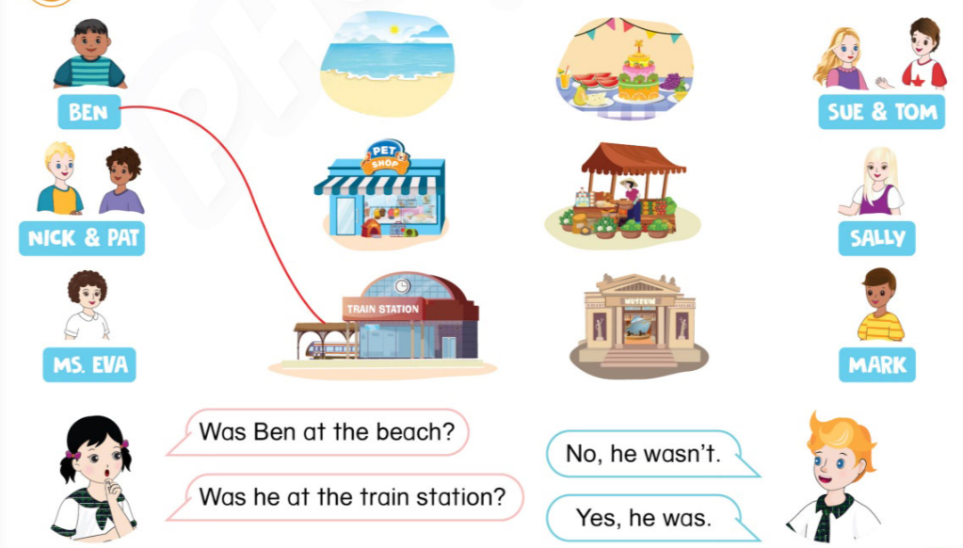






6
Draw lines. Ask and answer.
UNIT 14 – LESSON 3
Notes:
-Tell students that they are going to practise more with the structure they have learnt.
-Have students look at the pictures and ask: “Now class, look at the picture! What is it? Is it a train station?”.
-Draw students’ attention to the sample dialogue. Model the task and explain.
-Ask students to draw lines from the characters to the places individually. Explain that students imagine the characters were at the places in the past (according to the lines).
-Tell students that they are going to work in pairs to ask and answer the questions about the place where someone was in the past.
-Ask students to read the sample dialogues several times.
-Give students time to do the task in pairs. Go around to offer help it necessary.
-Ask some students to make the dialogues in front of the class. Give feedback.

Slide 13

GAME: Spin the Bottle
UNIT 14 – LESSON 3
Notes:
-Sit students in a circle with a bottle in the middle.
-The teacher spins the bottle.
-When it stops spinning the student it is pointing to has to answer a question by “Yes, they/he/she … were/was. / No, they/he/she … weren’t/wasn’t.”
-If the answer is “No”, correct the answer by using the structure: “He/she/they…+ was/were + in/on/at + a/an/the + [place].”
-If the answer is correct then that student can spin the bottle.

Slide 14

GAME: Spin the Bottle
Were the boys in front of the factory?
UNIT 14 – LESSON 3

Slide 15

GAME: Spin the Bottle
Were the students at the museum yesterday?
UNIT 14 – LESSON 3

Slide 16

GAME: Spin the Bottle
Were Kate and her mum at the market?
UNIT 14 – LESSON 3

Slide 17

GAME: Spin the Bottle
Were Nat and his family at the village in holiday?
UNIT 14 – LESSON 3

Slide 18
GAME: Spin the Bottle
Were they at the restaurant?
UNIT 14 – LESSON 3

Slide 19

UNIT 14 – LESSON 2

Slide 20


… Day … Month …. Date … Year
Unit 14: Travelling
Lesson 3. Period 2
Structure:
Q: Were/Was + they/he/she…+ in/on/at + a/an/the + [place]?
A: Yes, they/he/she … were/was.
No, they/he/she … weren’t/wasn’t.
UNIT 14 – LESSON 3
Notes:
Review all the words they have learnt by using flashcards.
Count the stars.
Give compliments.

Slide 21


CÔNG TY CỔ PHẦN PHÁT TRIỂN GIÁO DỤC
VIỆT NAM VPBOX
Hà Nội
Tầng 2, Nhà A, Nhà Khách La Thành, số 226 Vạn Phúc, P.Liễu Giai,
Quận Ba Đình, Hà Nội.
ĐT: (024) 3 3793 2405
phonics.hanoi@vpbox.edu.vn
Thành Phố Hồ Chí Minh
Số 270A, Lý Thường Kiệt, P.14, Quận 10.
ĐT: (028) 3 820 5934
phonics.hcm@vpbox.edu.vn
www.vpbox.edu.vn
https://phonics-smart.edu.vn

