Slide 1


Slide 2

TEAM DIVISION
Team 1
Team 2
Team 3
Team 4
Notes:
Divide class into 4 teams

Slide 3
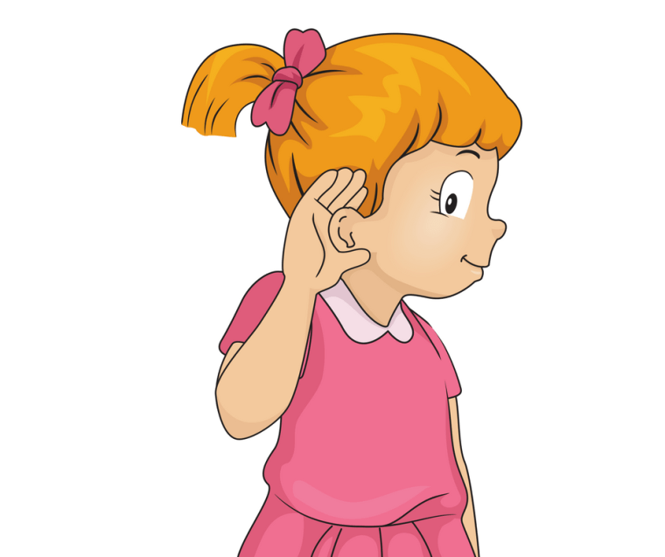

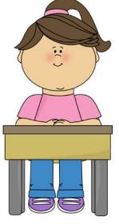

CLASSROOM RULES
1. Be quiet!
2. Listen!
3. Sit nicely!
4. Raise your hand to speak!
Notes:
Classroom rules

Slide 4

REVIEW
Last summer vacation, I went to Da Nang with my family. It was sunny but not very hot. My parents sat in the sun and talked. My younger sister and I went swimming...
Notes:
Review the previous lesson by talking about students travel in summer/holidays.

Slide 5
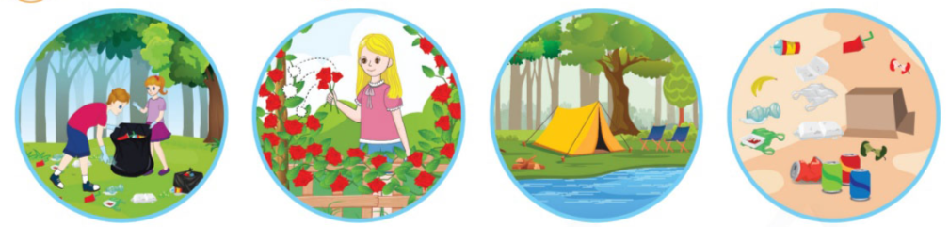
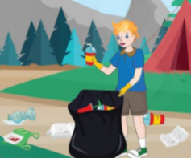
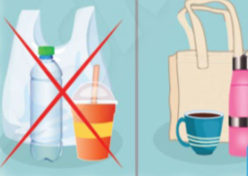
UNIT 14 – TRAVELLING
Learn more
Care about the environment

Slide 6

1
Listen and repeat.
What are they doing?
What is it?
Notes:
-Ask students that they are going to learn words about the environment.
-Ask students to look at the picture and say: “What are they doing? What is it?”, then let them answer.

Slide 7

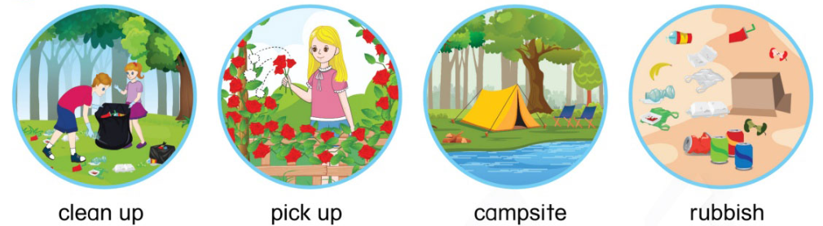
1
Listen and repeat.
Notes:
-Teach the new words: clean up, pick up, campsite, rubbish.
-Play the audio CD (track 95) for students to listen and repeat twice.

Slide 8
1
Listen and repeat.
Notes:
-Do choral and individual repetition.
-Point at each item pictured randomly and ask students to say the phrases in chorus and individually. Check theirs’ pronunciation.
Use flashcard or conduct a game to practise the language items more.

Slide 9
1
Listen and repeat.
Notes:
-Do choral and individual repetition.
-Point at each item pictured randomly and ask students to say the phrases in chorus and individually. Check theirs’ pronunciation.
Use flashcard or conduct a game to practise the language items more.

Slide 10
1
Listen and repeat.
Notes:
-Teach the new words: clean up, pick up, campsite, rubbish.
-Play the audio CD (track 95) for students to listen and repeat twice.

Slide 11


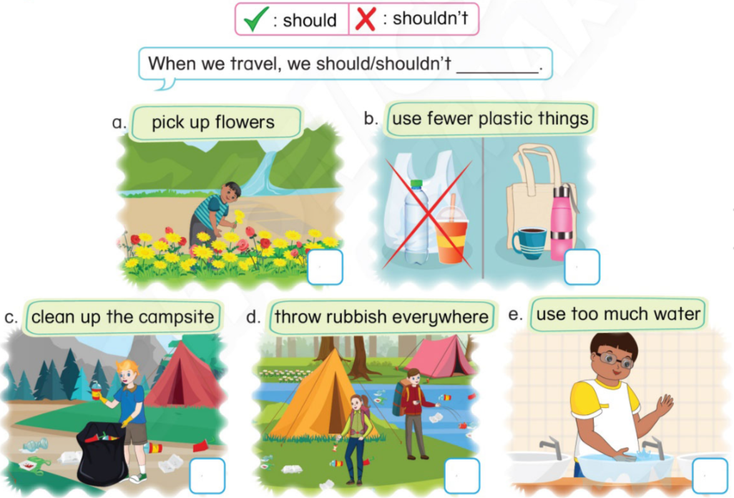
2
Tick ( ) or cross ( ). Say.
Notes:
-Tell students that they are going to look at the pictures and tick the activity they should do and cross the activity they shouldn’t do to protect the environment, then say the sentences aloud.
-Have the class look at the pictures and ask: “What is the boy doing? Is he picking up flowers? What are they doing? Should we pick up flowers?”.
-Ask some students to read verb phrases correctly.

Slide 12
2
Tick ( ) or cross ( ). Say.
What is the boy doing?
Is he picking up flowers?
Should we pick up flowers?
When we travel, we shouldn’t pick up flower.
Notes:
-Model the task with Picture a and explain.
-Invite some students to say the sentence aloud: When we travel, we shouldn’t pick up flowers.

Slide 13
2
Tick ( ) or cross ( ). Say.
When we travel,
we should use fewer plastic things.
When we travel,
we should clean up the campsite.
Notes:
-Have students to do the task in pairs. Go around and offer help if necessary.
-Get students to swap and check their answers before checking as a class.
-Invite some students to say their sentences and give feedback.

Slide 14
2
Tick ( ) or cross ( ). Say.
When we travel,
we shouldn’t throw rubbish everywhere.
When we travel,
we shouldn’t use to much water.
Notes:
-Have students to do the task in pairs. Go around and offer help if necessary.
-Get students to swap and check their answers before checking as a class.
-Invite some students to say their sentences and give feedback.

Slide 15
3
Let’s share.
What do you usually do to protect the environment when you travel?
Where do you usually travel?
Notes:
-Tell students thet they are going to talk about the place they usually travel to and the activities they do to protect the environment.
-Get students’ attention and ask some questions: “Where do you usually travel? What do you usually do to protect the environment when you travel?”.

Slide 16

3
Let’s share.
When we travel, ....
We should/shouldn’t...
Notes:
-Ask students to work in groups and share about their travelling activities.
-Give students time to practise speaking.
-Invite some students to share in front of the class. Give feedback.

Slide 17
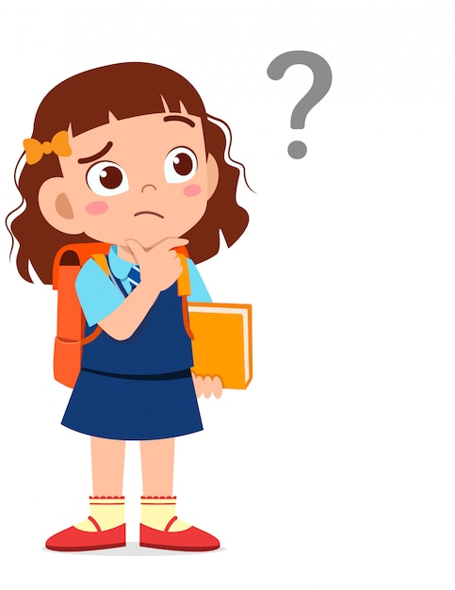
3
Let’s share.
Should we protect the environment when we travel? What should we do?
VALUE
We should protect the environment when we travel.
Notes:
Draw students’ attention to the value of the lesson. Check their understanding by asking questions: “Should we protect the environment when we travel? What should we do?”.

Slide 18


… Day … Month …. Date … Year
Unit 14: Travelling
Learn more
Vocabulary:
- clean up
- pick up
- campsite
- rubbish
Notes:
Review all the words they have learnt by using flashcards.
Count the stars.
Give compliments.

Slide 19
WRAP UP
When we travel,
we shouldn’t throw rubbish everywhere.

Slide 20


CÔNG TY CỔ PHẦN PHÁT TRIỂN GIÁO DỤC
VIỆT NAM VPBOX
Hà Nội
Tầng 2, Nhà A, Nhà Khách La Thành, số 226 Vạn Phúc, P.Liễu Giai,
Quận Ba Đình, Hà Nội.
ĐT: (024) 3 3793 2405
phonics.hanoi@vpbox.edu.vn
Thành Phố Hồ Chí Minh
Số 270A, Lý Thường Kiệt, P.14, Quận 10.
ĐT: (028) 3 820 5934
phonics.hcm@vpbox.edu.vn
www.vpbox.edu.vn
https://phonics-smart.edu.vn

