Slide 1


Slide 3

TEAM DIVISION
Team 1
Team 2
Team 3
Team 4
Notes:
Divide class into 4 teams

Slide 4




CLASSROOM RULES
1. Be quiet!
2. Listen!
3. Sit nicely!
4. Raise your hand to speak!
UNIT 8 – LESSON 1
Notes:
Set the classroom rules

Slide 5

WARM UP
Sing “This is the way we go to school” song
UNIT 5 – LESON 1
Notes:
Play a warm-up song: This is the way we go to school.

Slide 6
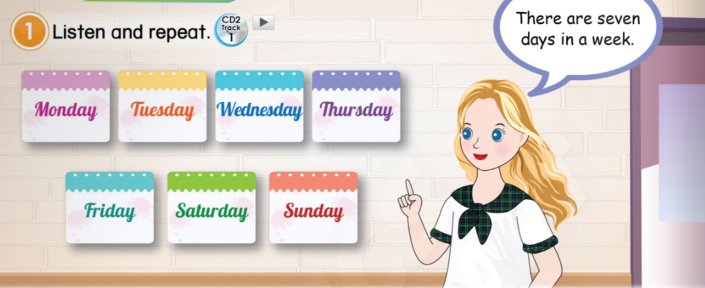
UNIT 8 – THE TIME
Lesson 1
Period 1
UNIT 5 – LESON 1

Slide 7








1
Listen and repeat.
There are seven days in a week.
UNIT 8 – LESSON 1

Slide 8
1
Listen and repeat.
There are seven days in a week.
UNIT 8 – LESSON 1

Slide 9
1
Listen and repeat.
UNIT 8 – LESSON 1

Slide 10
1
Listen and repeat.
UNIT 8 – LESSON 1

Slide 11
1
Listen and repeat.
UNIT 8 – LESSON 1

Slide 12
1
Listen and repeat.
There are seven days in a week.
UNIT 8 – LESSON 1

Slide 13
BINGO game
UNIT 8 – LESSON 1
Notes:
Stick the flashcards (paper, email, pen, map, treasure) on the board and revise all with students.
Divide class into 4 groups.
Each student takes turn to stand up and speak “Paper” – “Email” – “Pen” – “Map” – “Treasure”.
The last students in each group will speak a word and say BINGO. Note the time each group spends to finish the game. The group finishes the game in shortest time will be winner.

Slide 14




Bingo!
UNIT 8 – LESSON 1

Slide 15
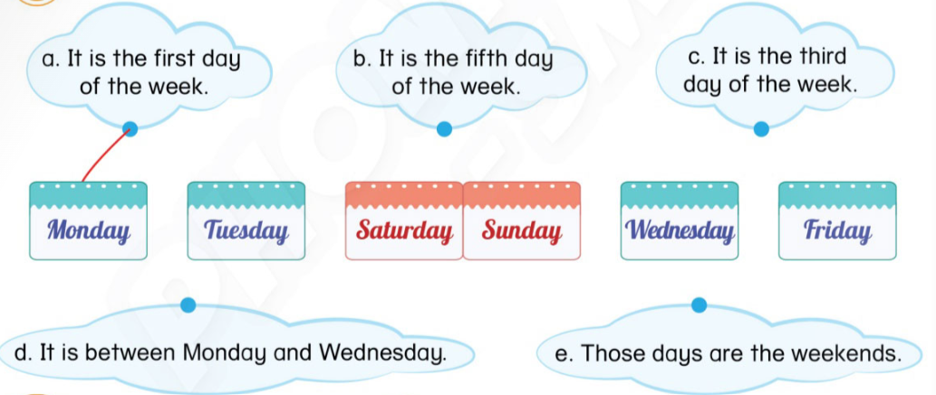
2
Read and draw lines.
UNIT 8 – LESSON 1

Slide 16
2
Read and draw lines.
UNIT 8 – LESSON 1

Slide 17
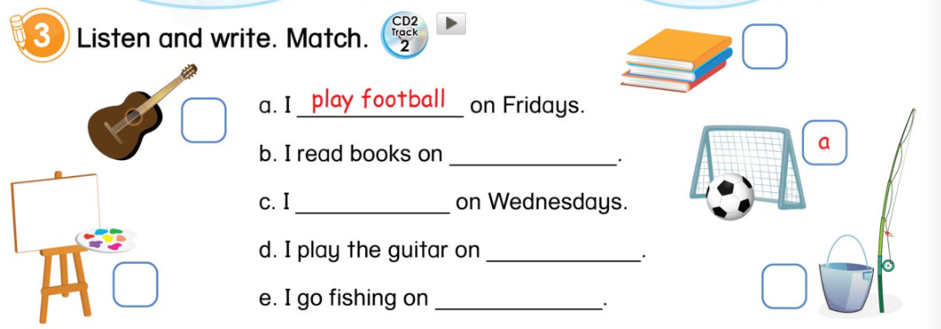
3
Listen and write. Match.
UNIT 8 – LESSON 1

Slide 18
3
Listen and write. Match.
b
d
Saturdays
paint
Tuesdays
c
e
Sundays
UNIT 8 – LESSON 1

Slide 19


… Day … Month …. Date … Year
Unit 8: The Time
Lesson 1. Period 1
Vocabulary
Monday
Tuesday
Wednesday
Thursday
Friday
Saturday
Sunday
UNIT 8 – LESSON 1
Notes:
Review all the words they have learned by using flashcards.
Count the stars.
Give compliments.

Slide 20
WRAP UP
UNIT 8 – LESSON 1

Slide 21


CÔNG TY CỔ PHẦN PHÁT TRIỂN GIÁO DỤC
VIỆT NAM VPBOX
Hà Nội
Tầng 2, Nhà A, Nhà Khách La Thành, số 226 Vạn Phúc, P.Liễu Giai,
Quận Ba Đình, Hà Nội.
ĐT: (024) 3 3793 2405
phonics.hanoi@vpbox.edu.vn
Thành Phố Hồ Chí Minh
Số 270A, Lý Thường Kiệt, P.14, Quận 10.
ĐT: (028) 3 820 5934
phonics.hcm@vpbox.edu.vn
www.vpbox.edu.vn
https://phonics-smart.edu.vn

