Slide 1


Slide 2

TEAM DIVISION
Team 1
Team 2
Team 3
Team 4
Notes:
Divide class into 4 teams

Slide 3
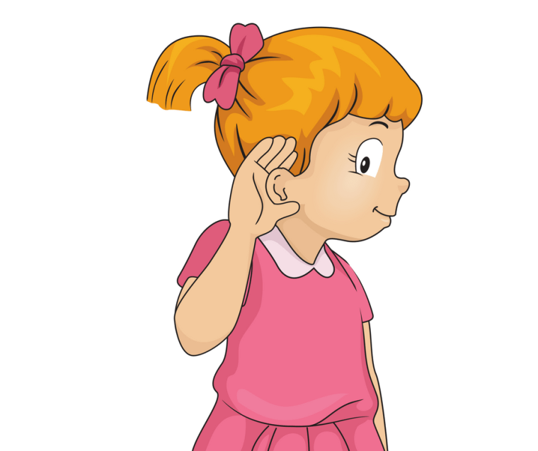

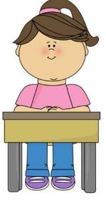

CLASSROOM RULES
1. Be quiet!
2. Listen!
3. Sit nicely!
4. Raise your hand to speak!
Notes:
Classroom rules

Slide 4

REVISION - GAME: Spelling
Notes:
Revise the vocabulary in the previous lessons by conducting a game. Rules:
- Have each student prepare a strip and write a word about days and months. Collect them.
- Divide the class into two groups. Call a student from each group to pick up a word and spell it. The rest of the class raise their hands to say the word spelled.
- One point/star is rewarded for the group with the correct spelling. Another one point/star is for the group saying the word correctly.

Slide 5
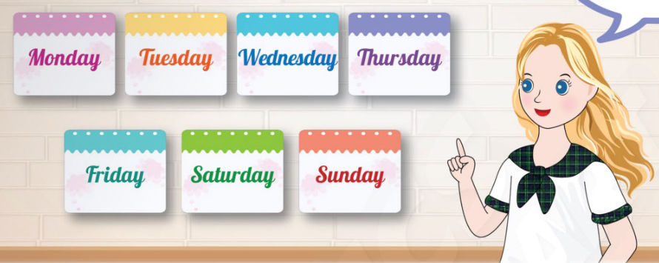
UNIT 6 – THE TIME
Phonics

Slide 6

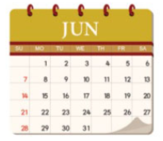
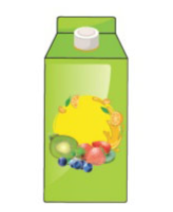

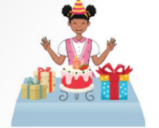
1
Listen and repeat.
/θ/
/ʤ/
third
birthday
June
juice
Notes:
-Use the software to show the pictures in part 1. “Now class, look at the picture. We are going to learn some words that have two new sound /θ/and /ʤ/. These are third, birthday, June, juice.”.
-Show the pictures for students to say the words.
-Ask students to look at the screen and listen to the audio CD (track 11) twice.
-Draw students’ attention to the red letter in each word. Help them to understand and recognize this by writing a word “third” on the board then underline and number each syllable in the word.
-Get students to focus on the sound /θ/ as in the words “third, birthday” and the sound /ʤ/ as in the words “June, juice”, then guide them how to pronounce these sounds correctly.

Slide 7
1
Listen and repeat.
/θ/
third
birthday
Notes:
Have students observe and mimic the position of the lips and the tongue when the sound /θ/ pronouced.
Play the audio CD2 Track 11 for students to listen and repeat.

Slide 8
1
Listen and repeat.
/ʤ/
June
juice
Notes:
Have students observe and mimic the position of the lips and the tongue when the sound /ʤ/ pronouced.
Play the audio CD2 Track 11 for students to listen and repeat.

Slide 9
1
Listen and repeat.
/θ/
/ʤ/
third
birthday
June
juice

Slide 10

1
Listen and repeat.
Who’s faster?
Notes:
Game: Who’s faster?
-Write pairs of words with sounds /θ/and /ʤ/ on the board (ex: third - juice).
-Say a sound (/θ/ or /ʤ/), students listen and say the word having that sound.
-The fastest student raises hand to answer.
-For each correct answer, that team will get 1 points/stars.
Ask the whole class to read aloud the words and correct students’ pronunciation.

Slide 11
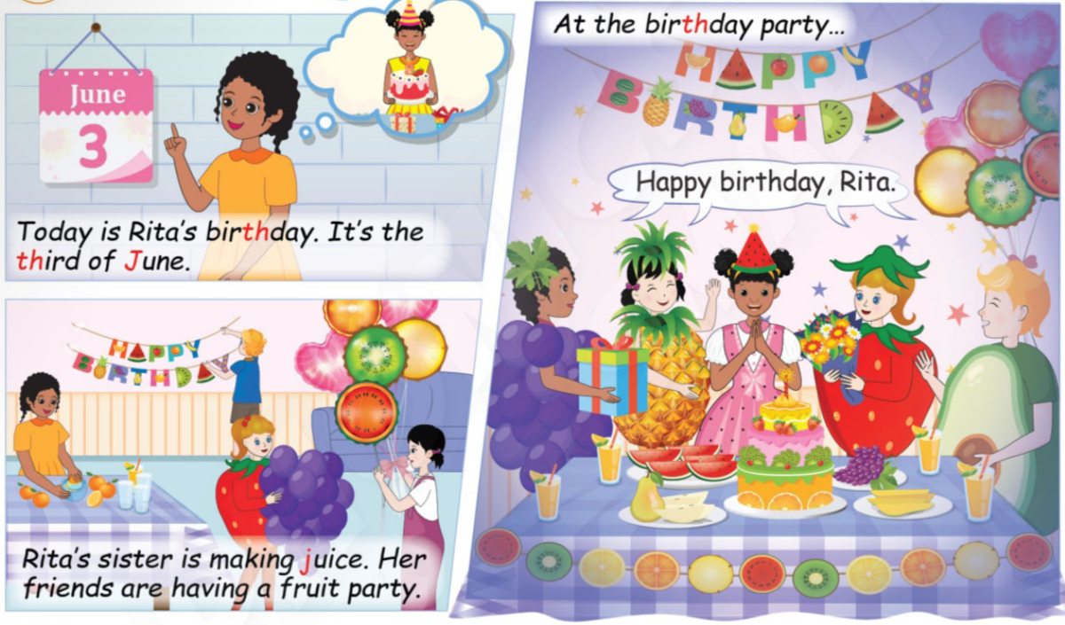
2
Listen and read.
Notes:
-Ask students “What’s the date today? What will happen on that date?” and let students answer.
-Tell students look at their book Activity 2 on page 74.
-Review learnt vocabularies: the sound /θ/, /ʤ/: and the words: third, birthday, June, juice.
-Tell students that they are going to listen.
-Play the software for the students to listen to the conversation from the audio CD (track 12) twice.

Slide 12
2
Listen and read.
Notes:
-Have students listen again, catch the language items they have learnt by claping the words with coloured letter.
-Ask some questions about the conversation to check students’ understanding.

Slide 13
2
Listen and read.
Notes:
-Have students listen again, catch the language items they have learnt by claping the words with coloured letter.
-Ask some questions about the conversation to check students’ understanding.

Slide 14
2
Listen and read.
Notes:
-Have students listen again, catch the language items they have learnt by claping the words with coloured letter.
-Ask some questions about the conversation to check students’ understanding.

Slide 15
2
Listen and read.
Notes:
-Let students work in pairs, open the book, take turn to read the story, the others listen and clap the focused words.
-Have students practice in pairs and do role play.
-Invite some students to read the story in front of class, the rest listen and clap.

Slide 16
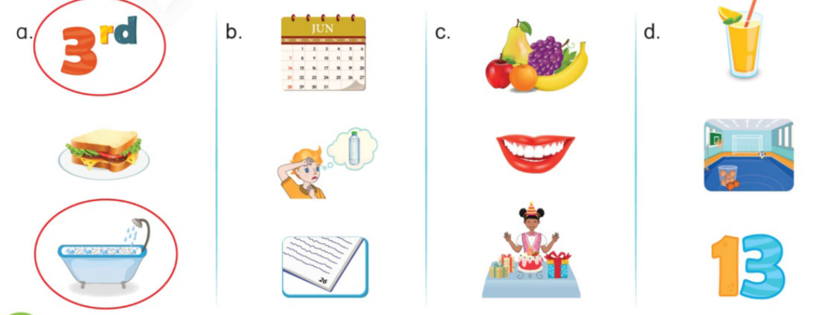
3
Listen and circle the pictures with the same sound.
Notes:
-Tell students that they are going to listen the sounds and the words, then circle the pictures having their names with the same sound they hear.
-Ask students to look at the pictures and name them (third, sandwich, bath - June, thirsty, page - fruit, mouth, birthday - juice, gym, thirteen).

Slide 17
3
Listen and circle.
Notes:
-Instruct students to listen and circle.
-Show students an example. (a) and explain.
-Teacher can write the three words on the board and select some students to underline the letter pronounced /θ/.
-Get students to work in pairs to look at the others pictures and say the words and the sounds.
-Ask students to listen and do the same with b, c, d then check the answers.

Slide 18
WRAP UP
/θ/
/ʤ/
third
birthday
June
juice
Notes:
Review all the words they have learnt by using flashcards.

Slide 19


… Day … Month …. Date … Year
Unit 4: The time
Phonics
Sounds:
/θ/: third, birthday
/ʤ/: June, juice
Notes:
Review all the words they have learnt by using flashcards.
Count the stars.
Give compliments.

Slide 20


CÔNG TY CỔ PHẦN PHÁT TRIỂN GIÁO DỤC
VIỆT NAM VPBOX
Hà Nội
Tầng 2, Nhà A, Nhà Khách La Thành, số 226 Vạn Phúc, P.Liễu Giai,
Quận Ba Đình, Hà Nội.
ĐT: (024) 3 3793 2405
phonics.hanoi@vpbox.edu.vn
Thành Phố Hồ Chí Minh
Số 270A, Lý Thường Kiệt, P.14, Quận 10.
ĐT: (028) 3 820 5934
phonics.hcm@vpbox.edu.vn
www.vpbox.edu.vn
https://phonics-smart.edu.vn

