Slide 1


Slide 2

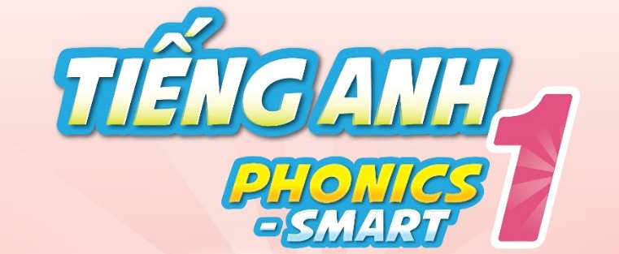

Slide 3
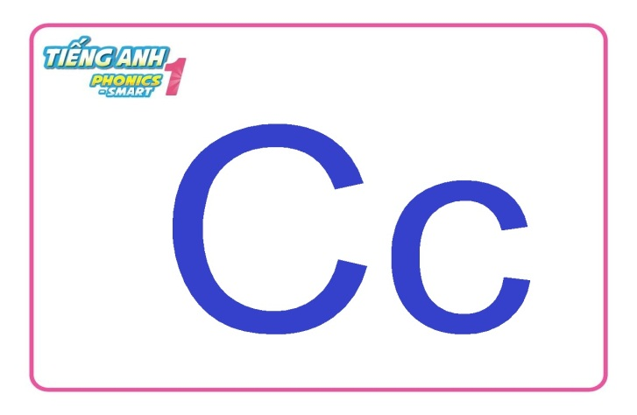
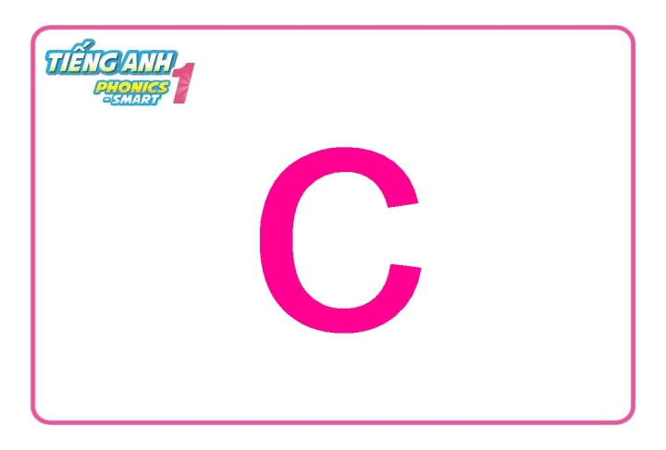
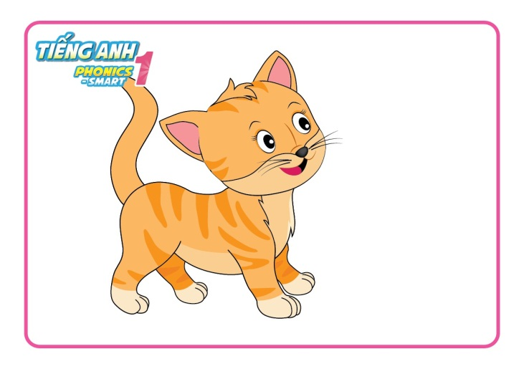
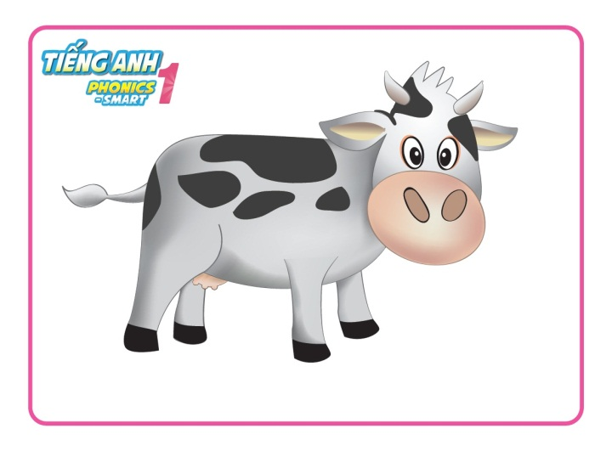
Review
Say and do actions.
Notes:
-

Slide 4
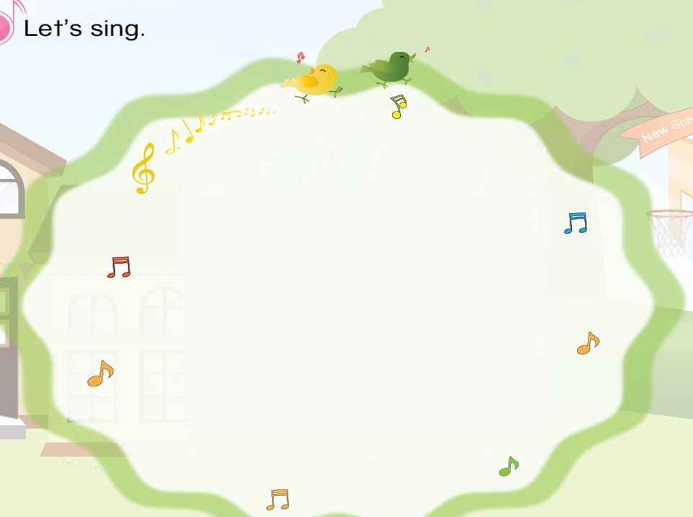

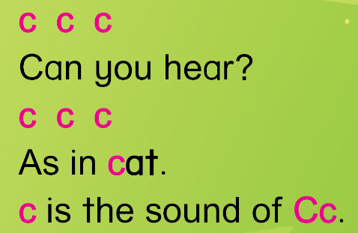

Slide 5
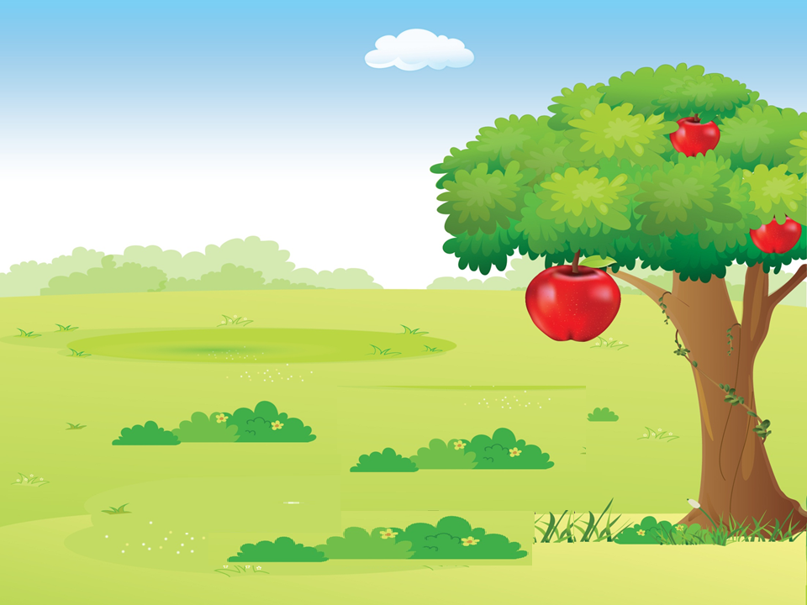

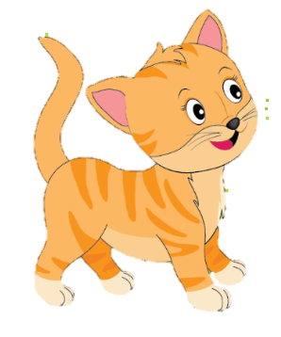
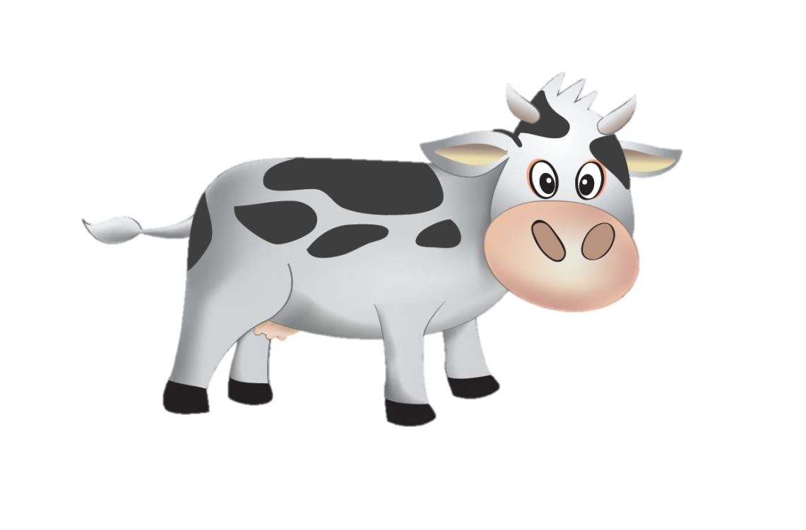
Unit 3
Lesson 2

Slide 6
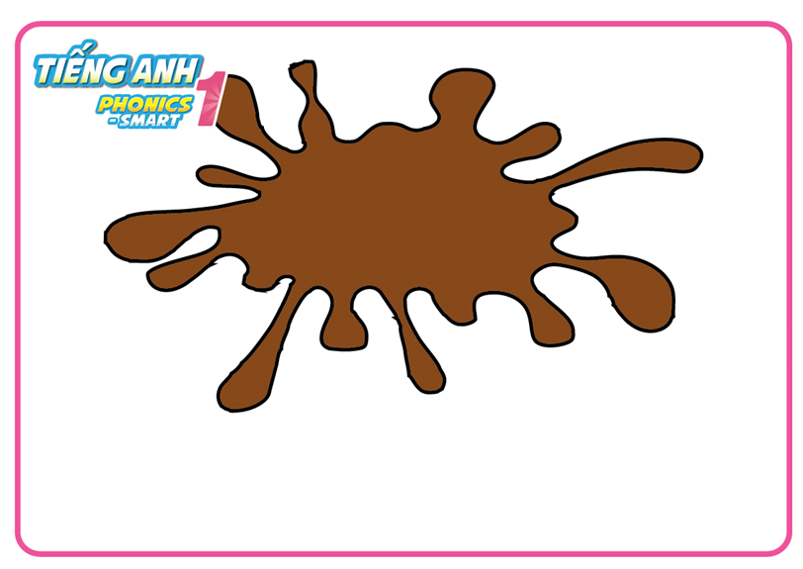
Unit 3:
C c
Lesson 2
1. Listen and repeat.
brown

Slide 7
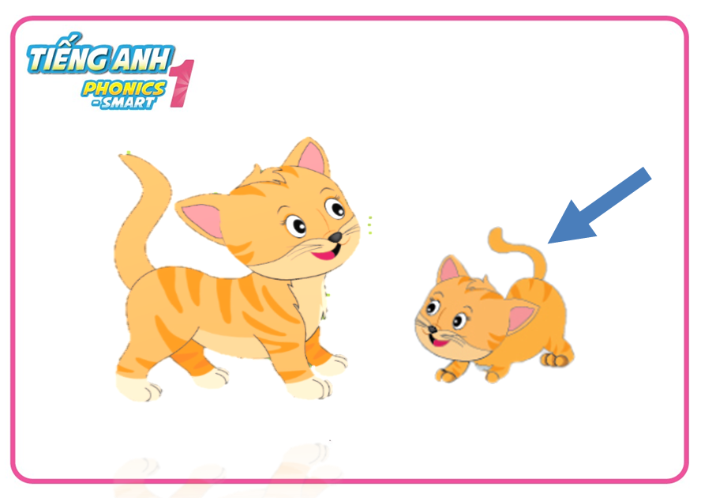
Unit 3:
C c
Lesson 2
1. Listen and repeat.
small

Slide 8
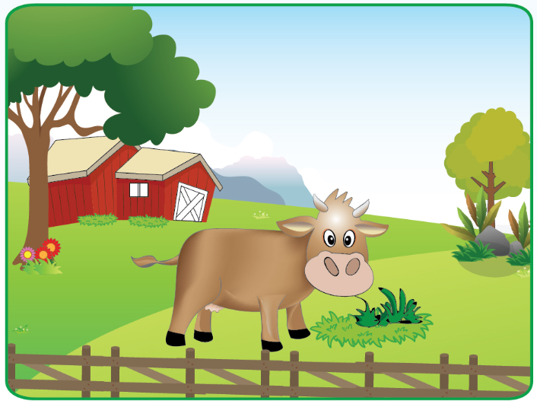
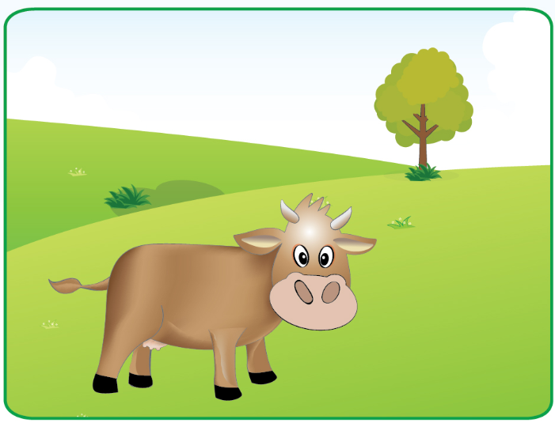
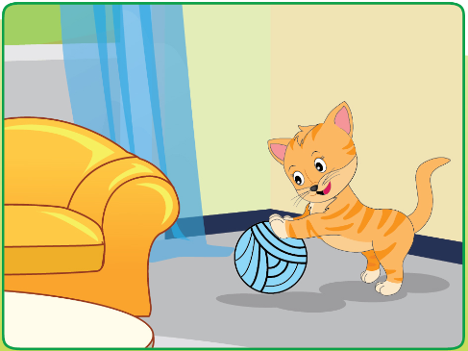
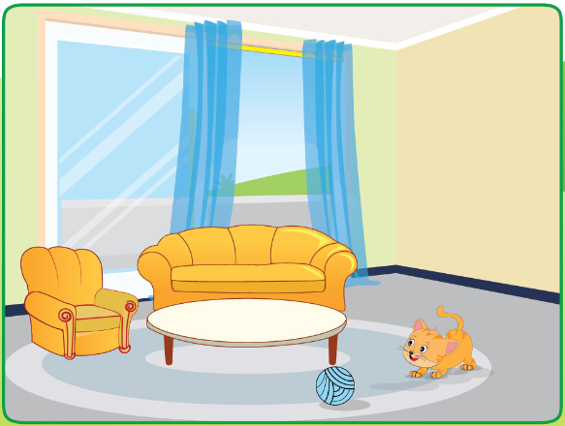
It is a cow.
It is brown.
It is a cat.
It is small.
Notes:
- Giới thiệu câu chuyện.

Slide 9
Unit 3:
C c
Lesson 2
1. Listen and repeat.
It is a cow.

Slide 10
Unit 3:
C c
Lesson 2
1. Listen and repeat.
It is brown.

Slide 11
Unit 3:
C c
Lesson 2
1. Listen and repeat.
It is a cat.

Slide 12
Unit 3:
C c
Lesson 2
1. Listen and repeat.
It is small.

Slide 13
It is a cow.
It is brown.
It is a cat.
It is small.
Notes:
- HD học sinh tự kể chuyện.

Slide 14
It is a cow.
It is brown.
It is a cat.
It is small.
Notes:
- HD học sinh tự kể chuyện.

Slide 15
It is a cow.
It is brown.
It is a cat.
It is small.
Notes:
- HD học sinh tự kể chuyện.

Slide 16
It is a cow.
It is brown.
It is a cat.
It is small.
Notes:
- HD học sinh tự kể chuyện.

Slide 17
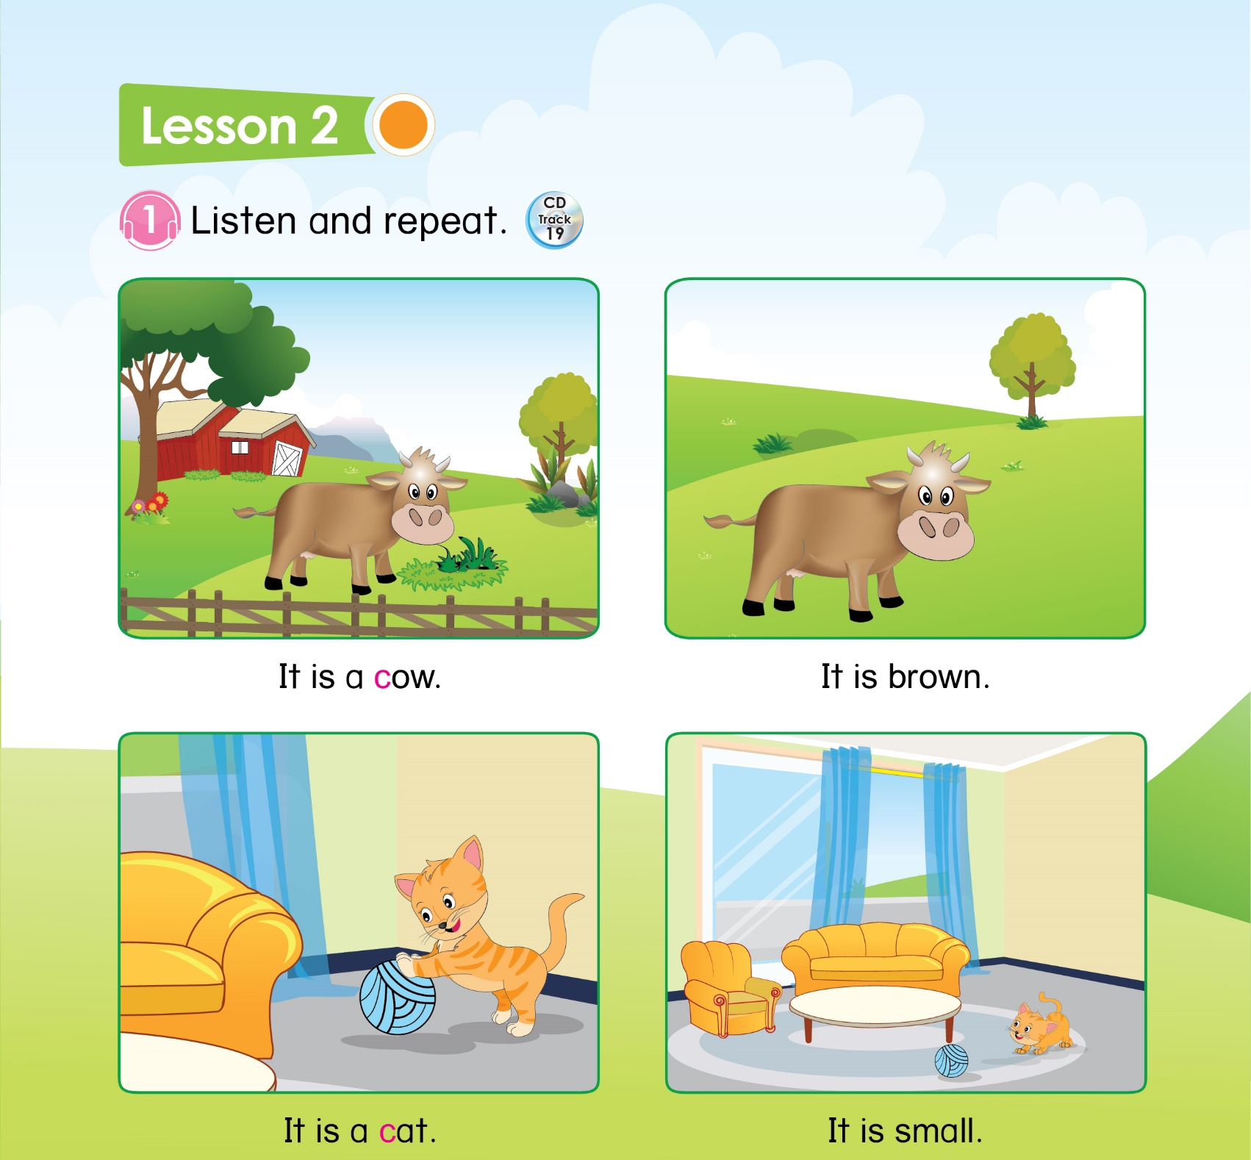

15
Notes:
- HD học sinh sử dụng SGK.

Slide 18
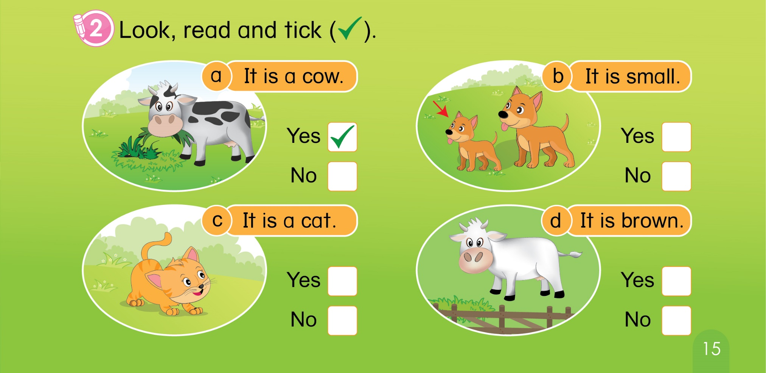
Unit 3:
C c
Lesson 2
1. Listen and repeat.
2. Look, read and tick.
15

Slide 19
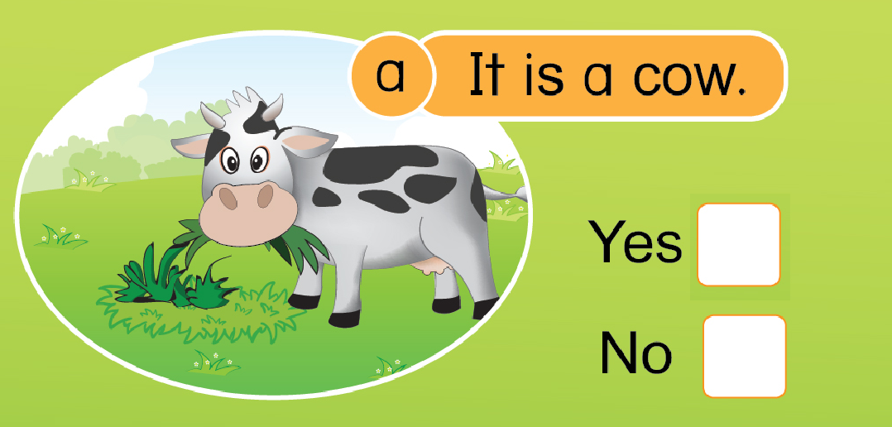

Unit 3:
C c
Lesson 2
1. Listen and repeat.
2. Look, read and tick.

Slide 20
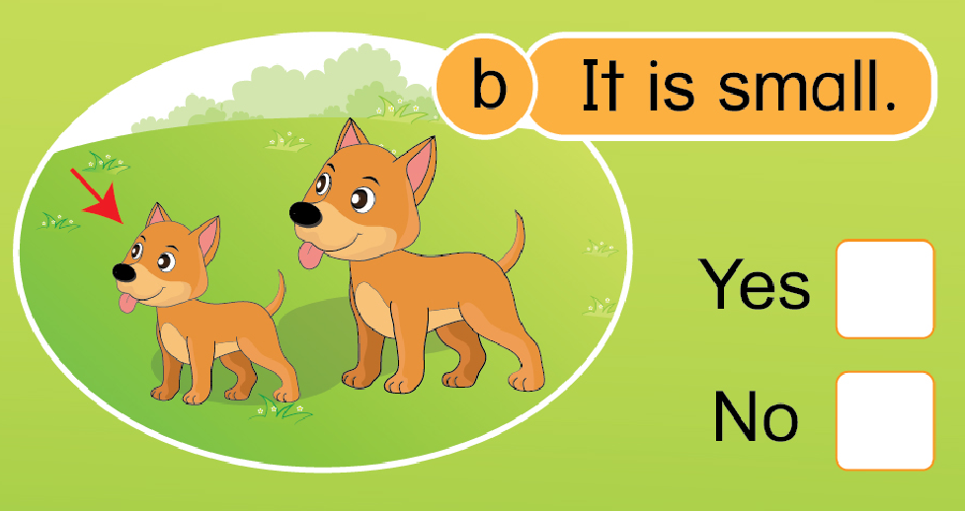
Unit 3:
C c
Lesson 2
1. Listen and repeat.
2. Look, read and tick.

Slide 21
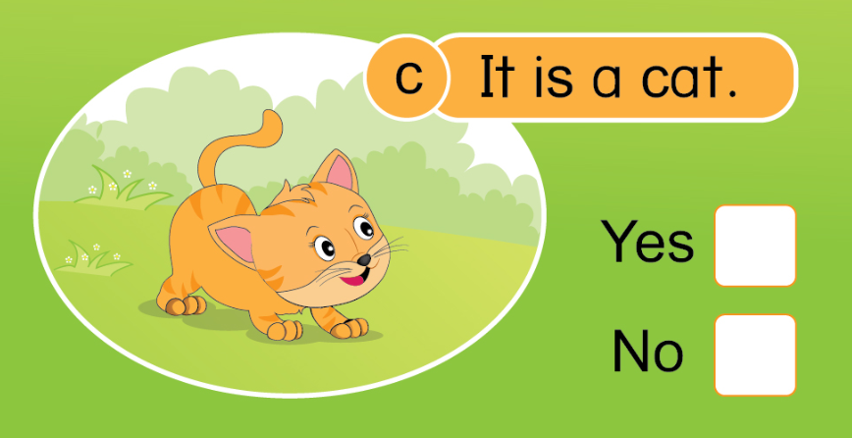

Unit 3:
C c
Lesson 2
1. Listen and repeat.
2. Look, read and tick.

Slide 22
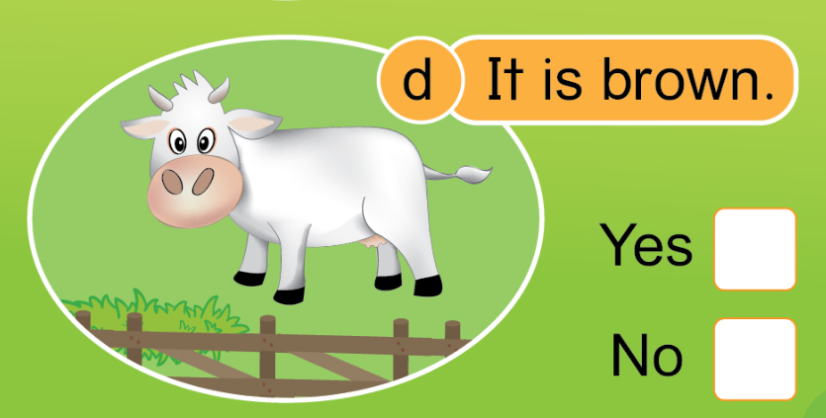
Unit 3:
C c
Lesson 2
1. Listen and repeat.
2. Look, read and tick.

Slide 23

Unit 3:
C c
Lesson 2
1. Listen and repeat.
2. Look, read and tick.
Notes:
- Tổng kết

Slide 24


