Slide 1

Unit 6: I like chicken
Lesson 3/period 2
Teacher: Nguyen Thi Thanh Nhan
School: Tien Thanh Primary school

Slide 2


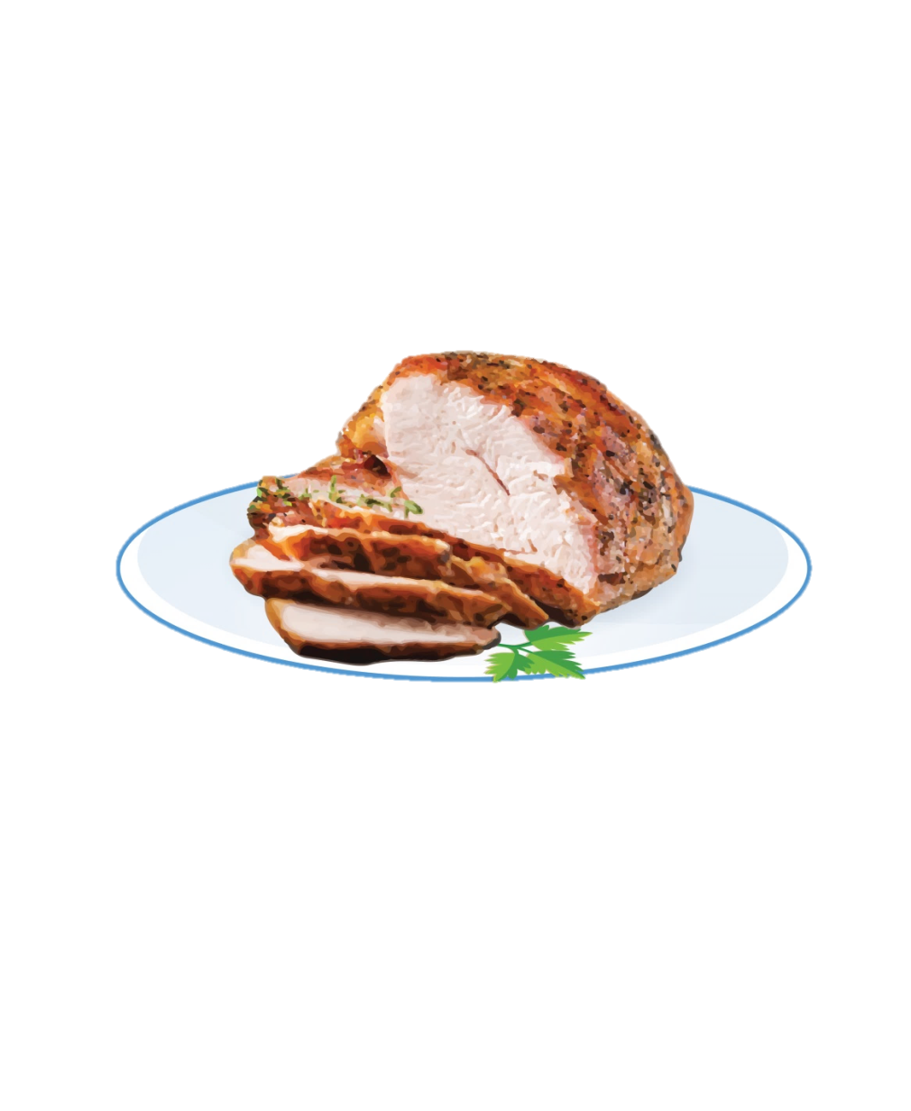

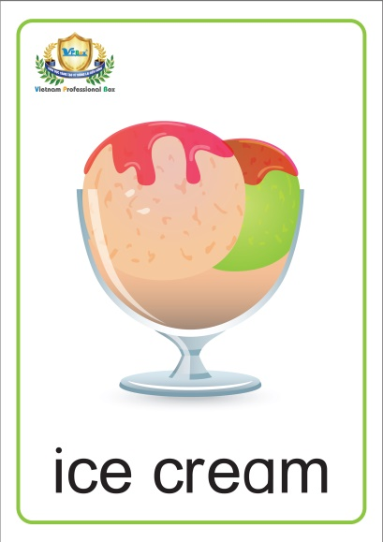
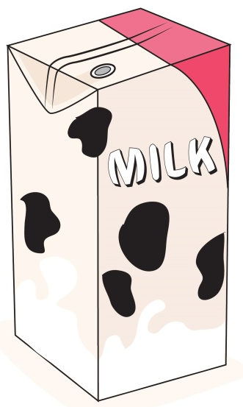

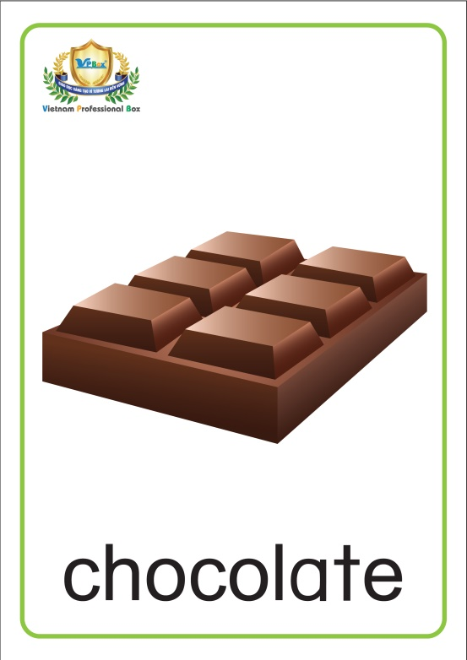

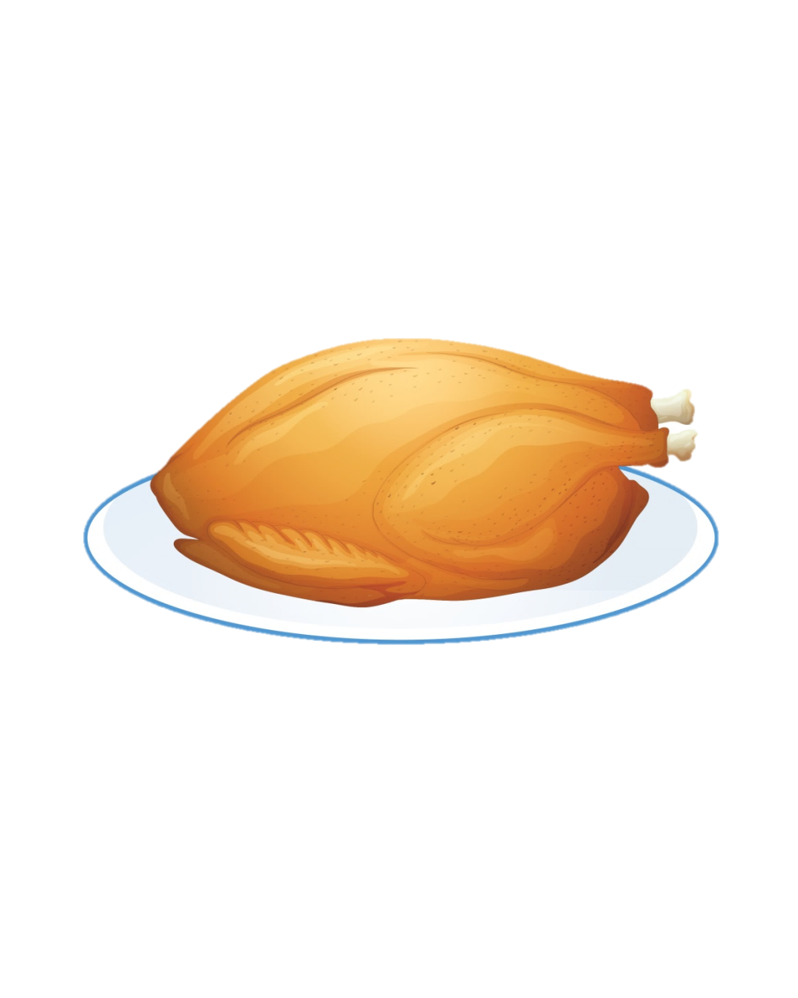
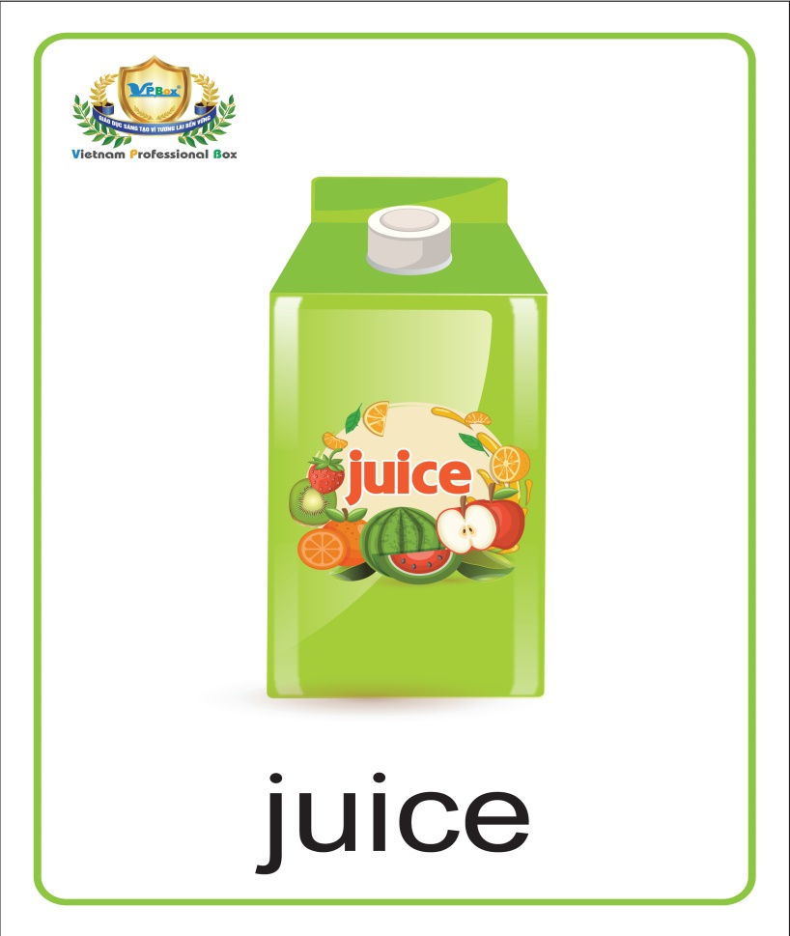

Slide 3
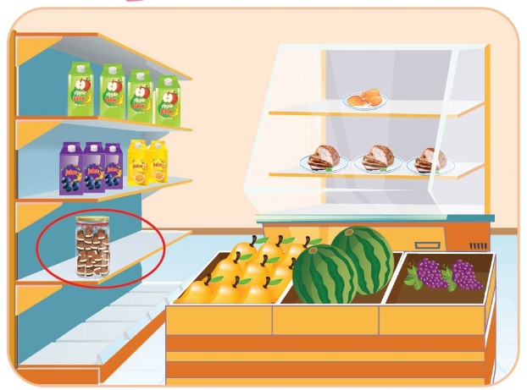


Lesson 3
Period 6

Slide 4


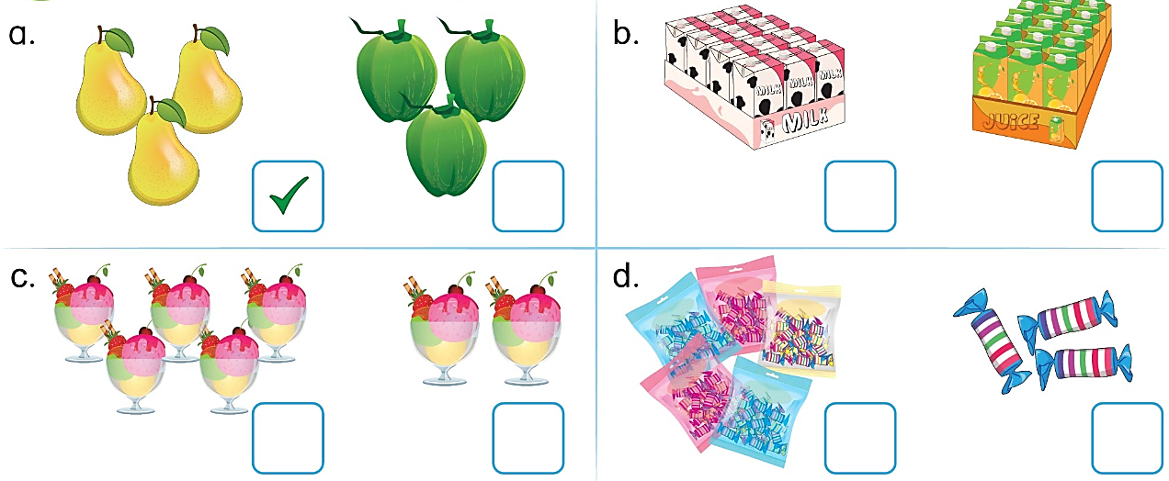


Slide 5

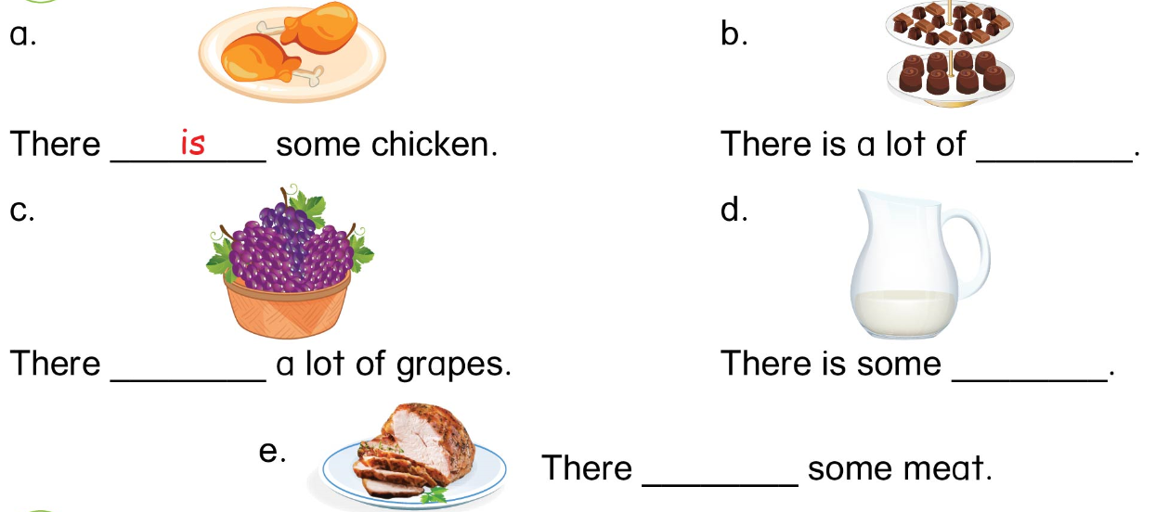
chocolate
are
milk
is

Slide 6

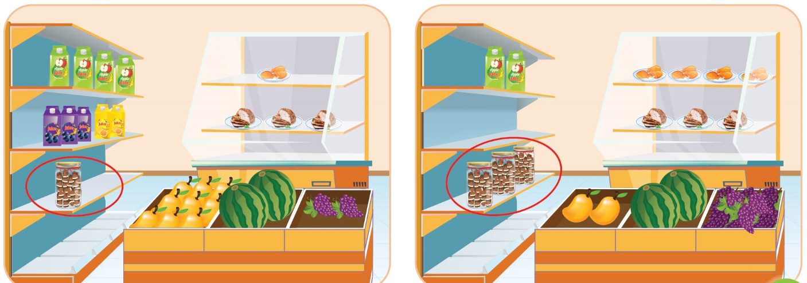

Slide 7
Sentence structure
There is some milk.
There are a lot of grapes.
There is a lot of / some
There are a lot of / some
+ uncountable nouns
+ countable nouns

Slide 8
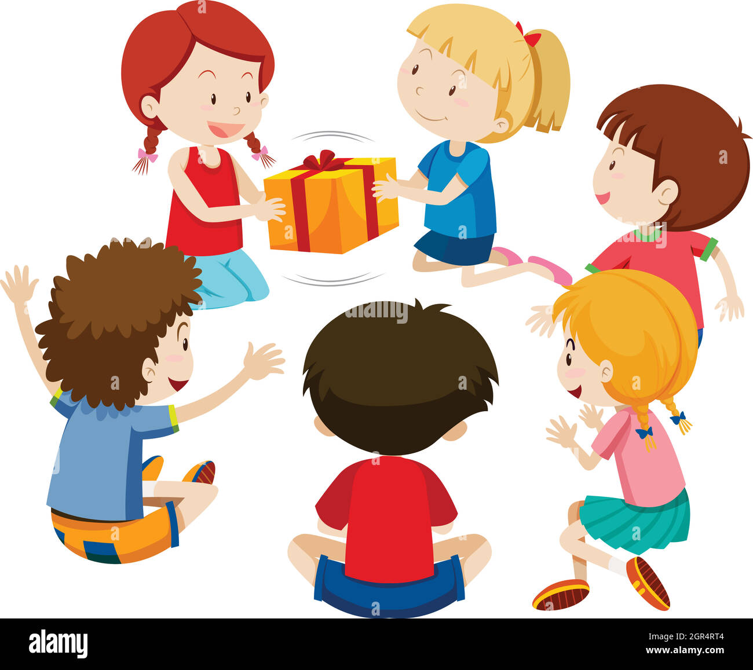
PASSING BOX

