Slide 1


Slide 2



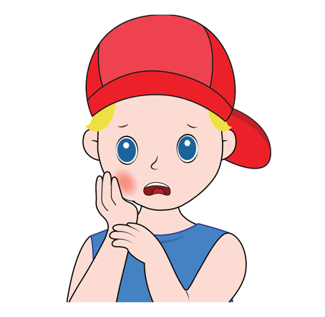
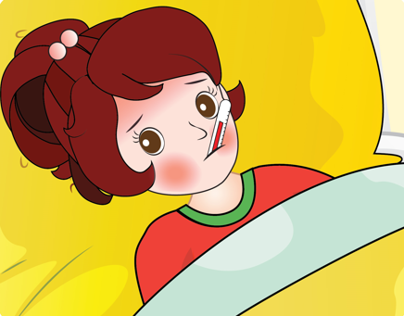
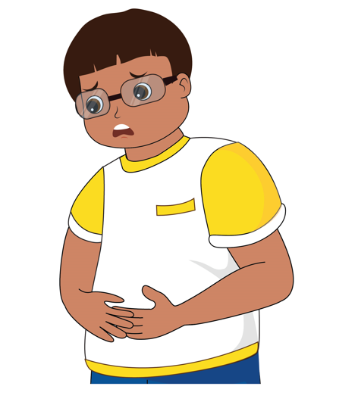
REVISION
cough
headache
earache
toothache
temperature
stomachache
Unit 12– Lesson 2
Notes:
Remind students the words they learnt in previous lesson by flashcards and book.

Slide 4


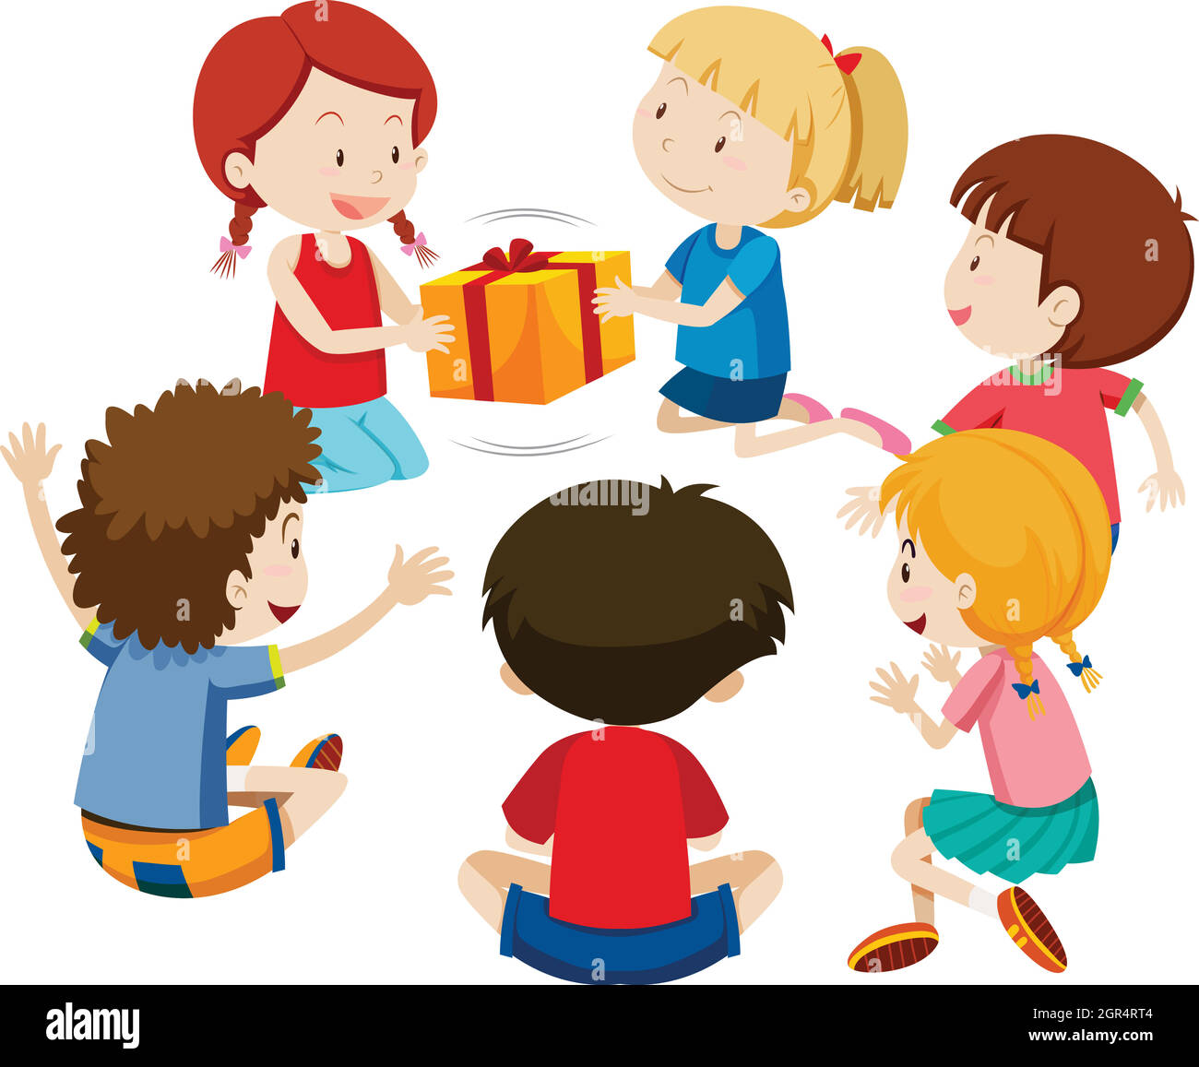
PASSING BOX

Slide 11
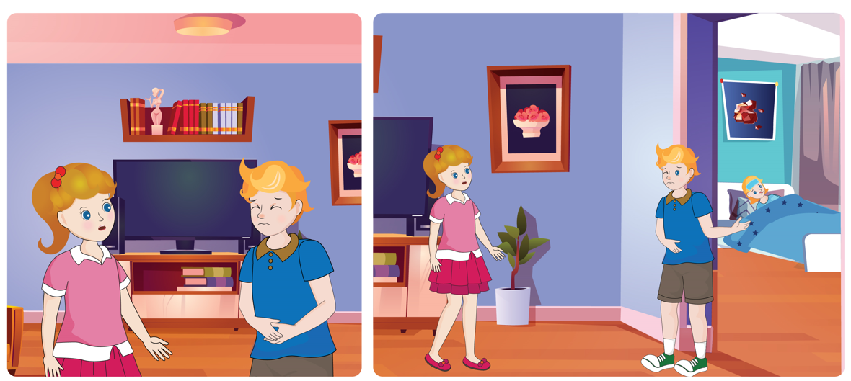

UNIT 12 – HEALTH
Lesson 2
Period 2
Unit 12– Lesson 2

Slide 12

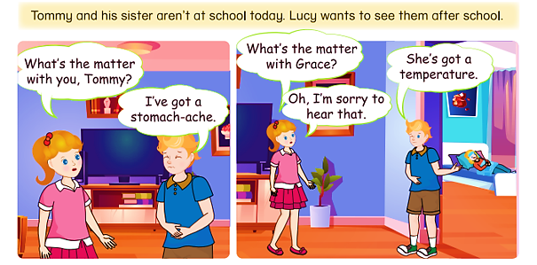
4
Listen and read.
Unit 12– Lesson 2
Notes:
Ask students to look at the picture in the book (or show it on the screen): “Now whole class, look at this picture and answer my questions”
at school? How does Tommy/ his sister feel?
Ask students to look at the screen and listen to the audio CD (Track 61) twice.
Focus students' attention on the structures What’s the matter with you/name? I’ve got a/an… He/she has got a/an….

Slide 13

4
Listen and read.
What’s the matter with you/name?
I’ve got a/an…
He/she has got a/an….
Unit 12– Lesson 2
Notes:
Focus students' attention on the structures What’s the matter with you/name? I’ve got a/an… He/she has got a/an….

Slide 14

Pair work
Pair work
Role play
Role play
Unit 12– Lesson 2

Slide 15
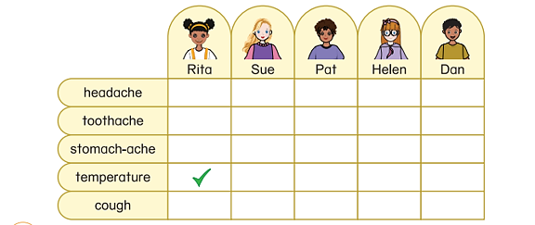
5
Listen and tick.
Unit 12 – Lesson 2

Slide 16


5
Listen and tick.
Unit 12 – Lesson 2
Notes:
Point to the table and ask students “How many pictures can you see?” and let students answer.
Review about the words in the pictures (. walk the dog, go to school, play chess, visit grandparents)
Give students three minutes to do this task individual.

Slide 17

FOOTBALL GAME

Slide 18
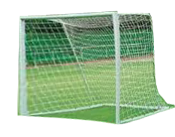

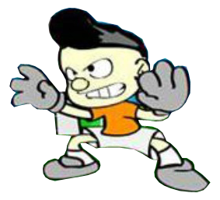



Ungoal
Goal
Make a choice
1
2
3
4
5
Unit 12 – Lesson 2
Notes:
Extra game: Football game
Show the slides of the pictures and the letters to make the words.
Each turn, students work in groups, choose a number, look at the picture and answer the question.
Teacher invite the fastest hand to read the word.
Students get one point for each correct answer.

Slide 19

goal
ungoal
1
back
Unit 12 – Lesson 2
Notes:
game: Football game
Show the slides of the pictures and the letters to make the words.
Each turn, students work in groups, choose a number, look at the picture and answer the question.
Teacher invite the fastest hand to read the word.
Students get one point for each correct answer.

Slide 20

goal
ungoal
2
back
Unit 12 – Lesson 2
Notes:
Extra game: Football game
Show the slides of the pictures and the letters to make the words.
Each turn, students work in groups, choose a number, look at the picture and answer the question.
Teacher invite the fastest hand to read the word.
Students get one point for each correct answer.

Slide 21

goal
ungoal
3
back
Unit 12 – Lesson 2
Notes:
Extra game: Football game
Show the slides of the pictures and the letters to make the words.
Each turn, students work in groups, choose a number, look at the picture and answer the question.
Teacher invite the fastest hand to read the word.
Students get one point for each correct answer.

Slide 22
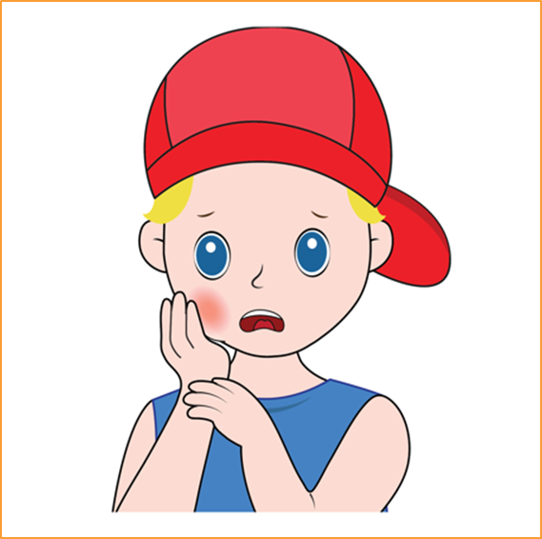
goal
ungoal
4
back
Unit 12 – Lesson 2
Notes:
Extra game: Football game
Show the slides of the pictures and the letters to make the words.
Each turn, students work in groups, choose a number, look at the picture and answer the question.
Teacher invite the fastest hand to read the word.
Students get one point for each correct answer.

Slide 23
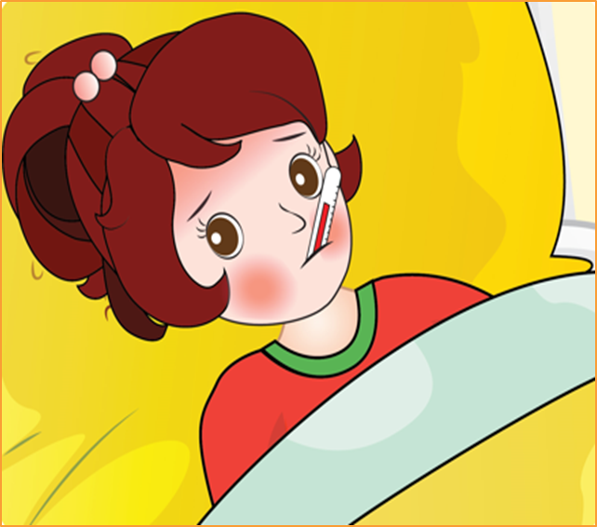
goal
ungoal
5
back
Unit 12 – Lesson 2
Notes:
Extra game: Football game
Show the slides of the pictures and the letters to make the words.
Each turn, students work in groups, choose a number, look at the picture and answer the question.
Teacher invite the fastest hand to read the word.
Students get one point for each correct answer.

Slide 24


Notes:
Extra game: “The mouse trap”
Students play individually. If student has a correct answer, he/ she will be given a sticker.
Explain that you are going to give instructions. Give a question with an illustration, students must choose the correct answer.
Model the activity, e.g. Show the question: The correct answer is What is the matter with you?

Slide 25







HEALTH
Notes:
Extra game: “The mouse trap”
Students play individually. If student has a correct answer, he/ she will be given a sticker.
Explain that you are going to give instructions. Give a question with an illustration, students must choose the correct answer.
Model the activity, e.g. Show the question: The correct answer is What is the matter with you?

Slide 26

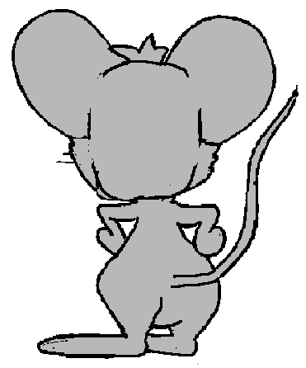

Click on the right answer to complete the sentence
were
are
is
GREAT!
NEXT
is
What ____ the matter with you?

Slide 27
Click on the right answer to complete the sentence
has
is
have
GREAT!
NEXT
He ____ got a stomachache.
has

Slide 28
Click on the right answer to complete the sentence
have
has
haves
GREAT!
NEXT
She____ hot an earache.
has

Slide 29
Click on the right answer to complete the sentence
having
has
have
GREAT!
NEXT
They____ got a temperature.
have

Slide 30
Click on the right answer to complete the sentence
have
has
having
GREAT!
NEXT
I ____ got a toothache.
have

Slide 31
Click on the right answer to complete the sentence
were
are
have
GREAT!
NEXT
We____ got a headache.
have

Slide 32
THANK YOU!

Slide 33
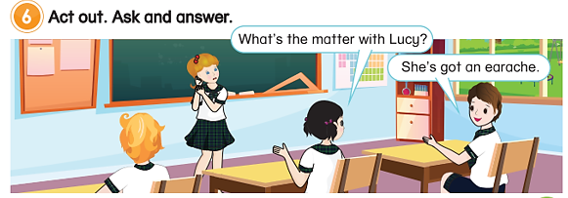
6
Act out. Ask and answer.
Tom doesn’t painting
on Saturdays. He goes skateboarding.
Unit 12 – Lesson 2
Notes:
Tell students that they are going to practice the structure they have learnt.
Divide the class into groups of three. One student acts out a health problem and two students ask and answer about their friend’s problem.
Give students time to do the task.
Call some groups to perform in front of the class.

Slide 34
6
Act out. Ask and answer.
LET’S ASK AND ANSWER
Tom doesn’t painting
on Saturdays. He goes skateboarding.
Unit 12 – Lesson 2
Notes:
Tell students that they are going to practice the structure they have learnt.
Divide the class into groups of three. One student acts out a health problem and two students ask and answer about their friend’s problem.
Give students time to do the task.
Call some groups to perform in front of the class.

Slide 35


… Day … Month …. Date … Year
Unit 12: Health
Lesson 2. Period 2
Vocabulary
earache
stomachache
temperature
headache
toothache
cough
Structure
I have got a cough.
She has got an earache.
Unit 12 – Lesson 2
Notes:
Review all the words they have learned by using flashcards.
Count the stars.
Give compliments.

Slide 36


CÔNG TY CỔ PHẦN PHÁT TRIỂN GIÁO DỤC
VIỆT NAM VPBOX
Hà Nội
Tầng 2, Nhà A, Nhà Khách La Thành, số 226 Vạn Phúc, P.Liễu Giai,
Quận Ba Đình, Hà Nội.
ĐT: (024) 3 3793 2405
phonics.hanoi@vpbox.edu.vn
Thành Phố Hồ Chí Minh
Số 270A, Lý Thường Kiệt, P.14, Quận 10.
ĐT: (028) 3 820 5934
phonics.hcm@vpbox.edu.vn
www.vpbox.edu.vn
https://phonics-smart.edu.vn

