Slide 1
Unit 13
Appearance
Lesson 3 - Period 5

Slide 2
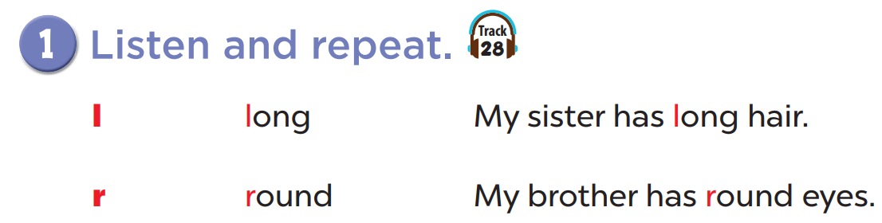


Slide 3
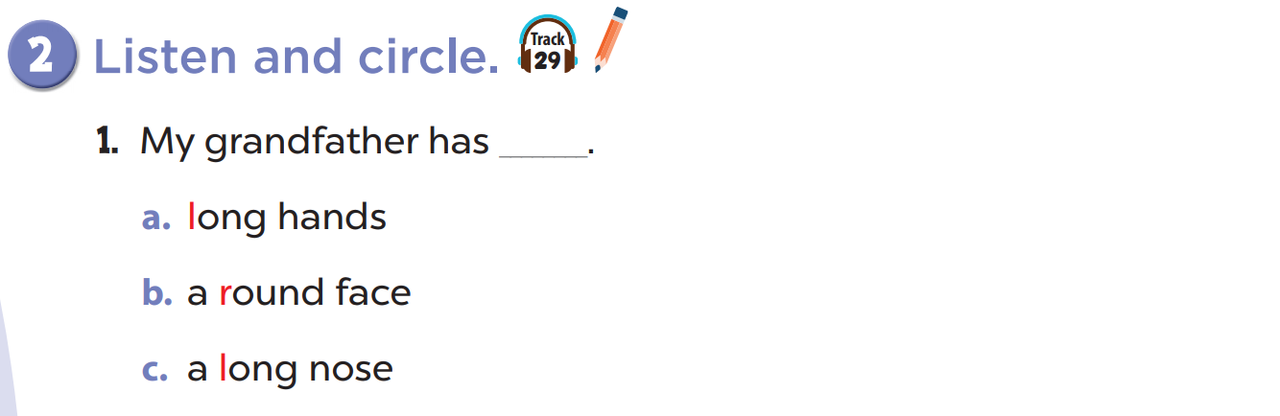
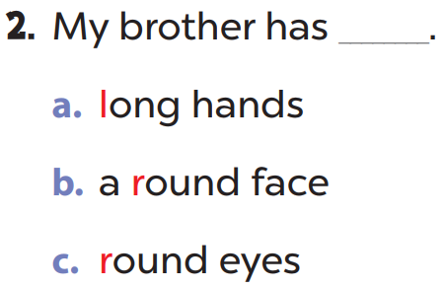

Slide 4
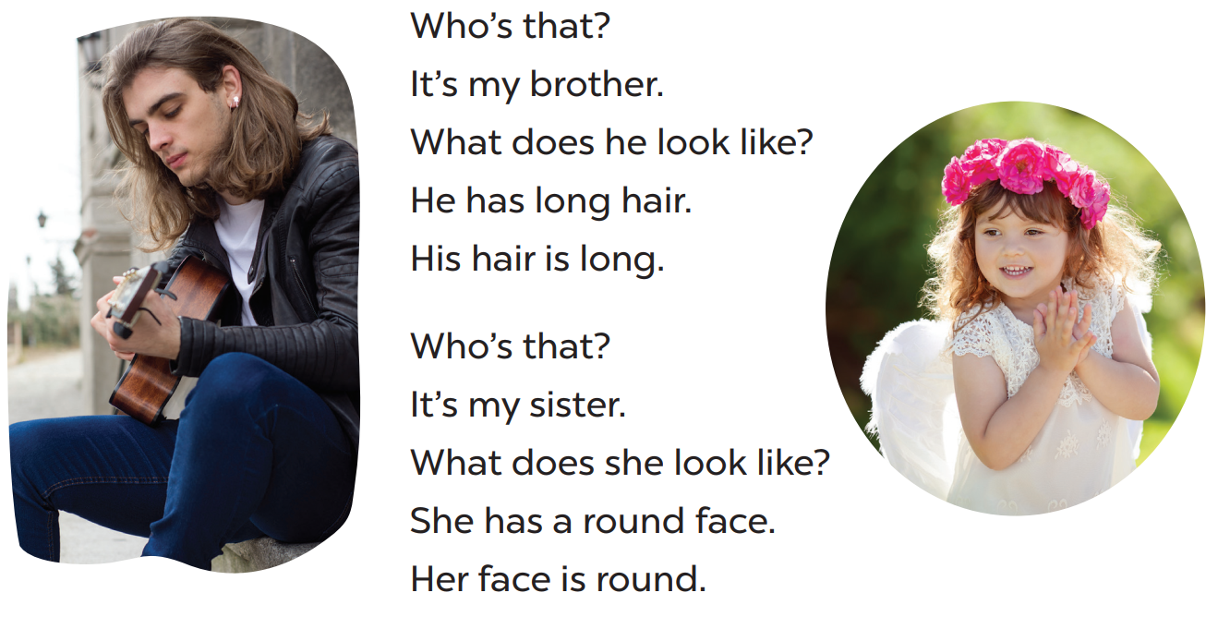
Read the lyrics.

Slide 5
Listen.

Slide 6
Fun corner
Listen and find the word with the given sounds.
Notes:
- Teacher plays the audio. Student listens and choose the number with the word containing the given sound.
- Teacher click on play / stop button to choose the point for that question.

Slide 7


Which word has the "L" sound?
He's
got
long
hair.
1
2
3
4



Slide 8
Which word has the "R" sound?
She's
got
a
round
face.
1
2
3
4
5



Slide 9
Which word has the "L" sound?
What
does
he
look
like?
1
2
3
4
5



Slide 10
Which word has the "L" sound?
He's
got
long
legs.
1
2
3
4



Slide 11
Which word has the "R" sound?
Ron
has
round
eyes.
1
2
3
4



Slide 12
Which word has the "R" sound?
Lucy
rides
a
bike.
1
2
3
4



Slide 13
Which word has the "L" sound?
It
looks
like
a
robot.
1
2
3
4
5



Slide 14
Which word has the "R" sound?
The
robot
has
round
eyes.
1
2
3
4
5



