Slide 1
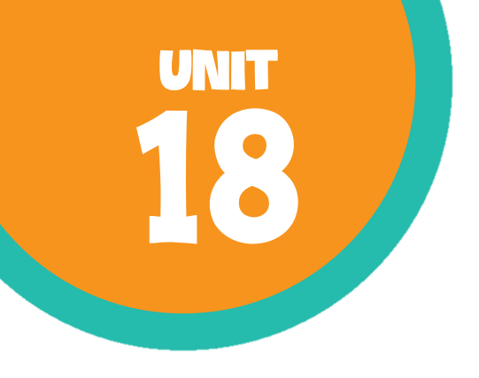
At the shopping centre Lesson 1 - Period 1

Slide 2

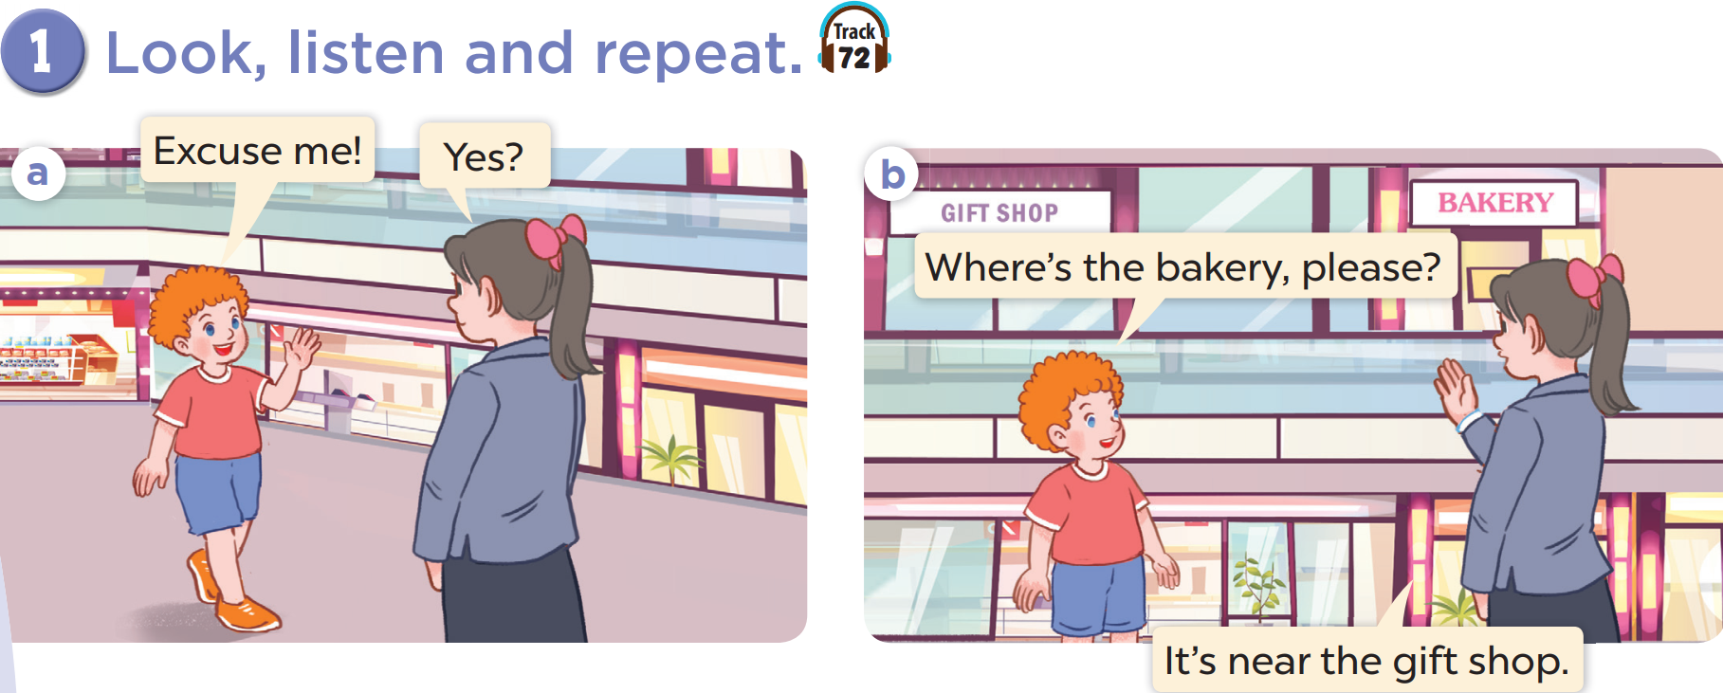






Slide 3
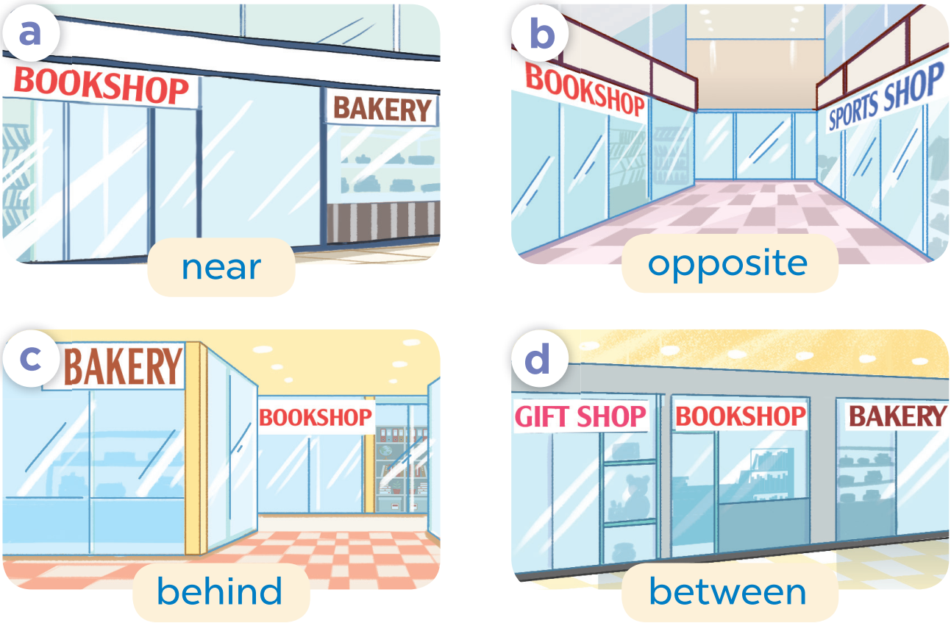
02
Listen, point and say.
Pupil’s book page 52

Slide 4
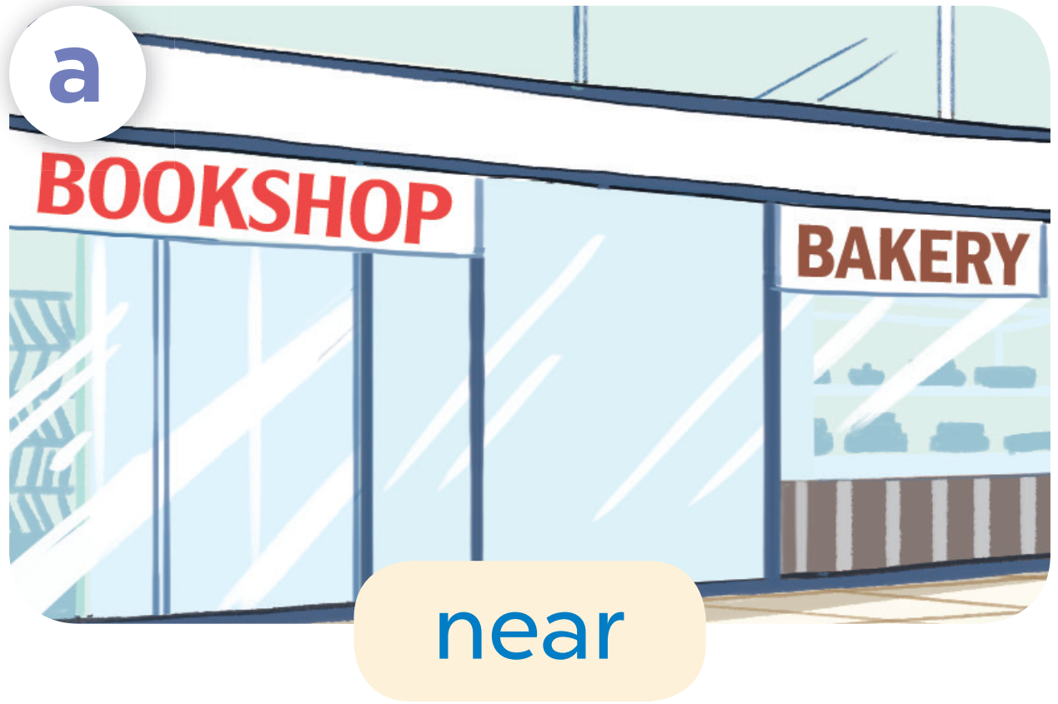
near

Slide 5
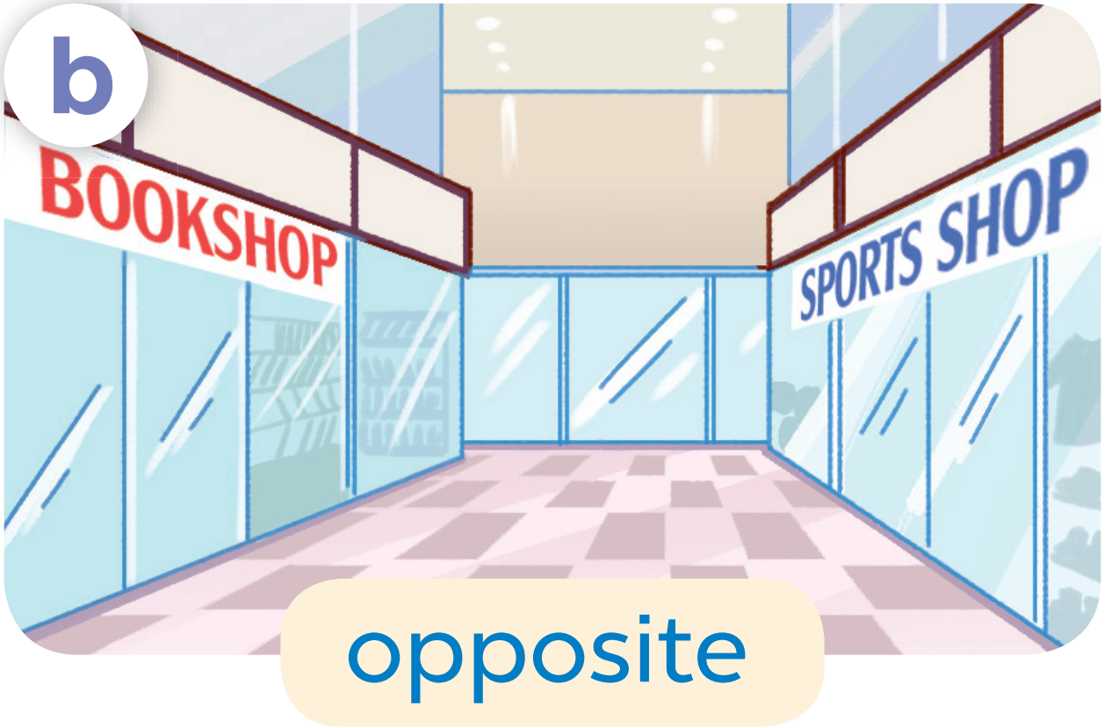
opposite

Slide 6
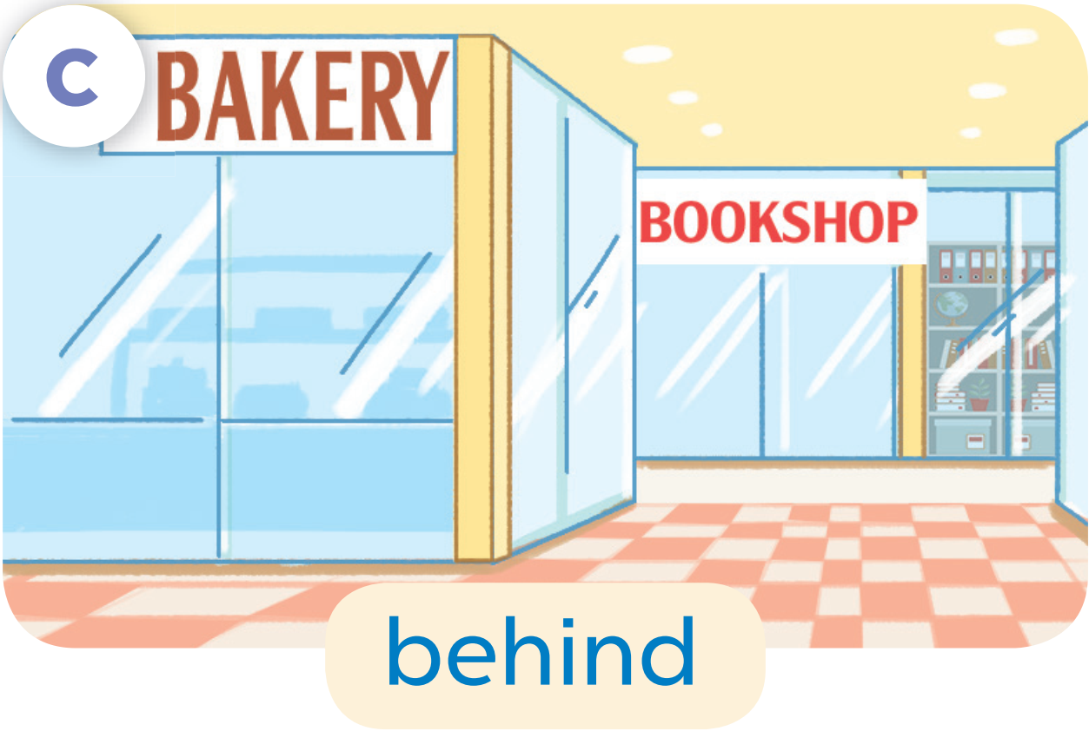
behind

Slide 7
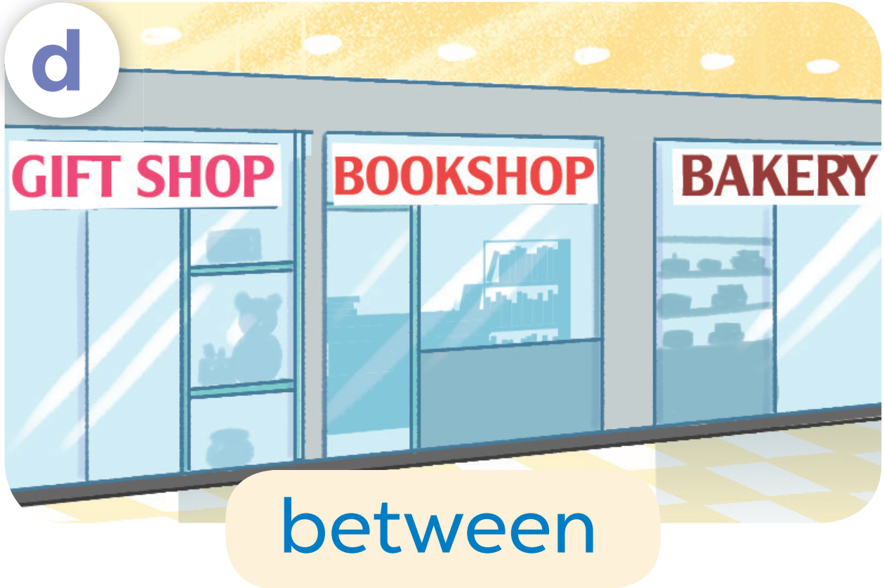
between

Slide 8
Let’s practise!

Slide 9
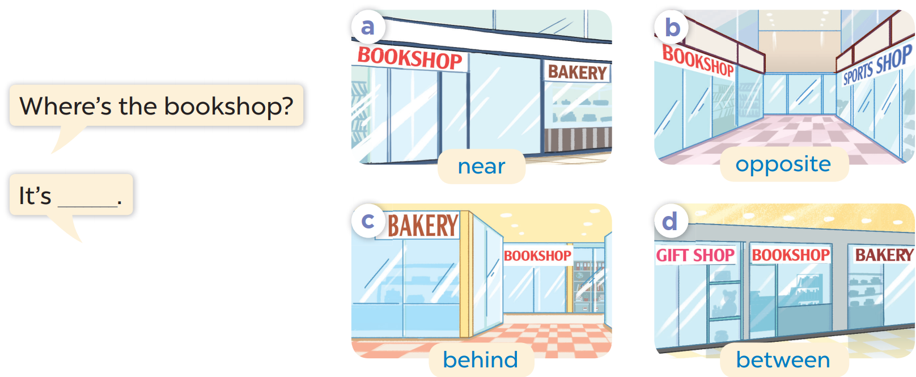


Slide 10
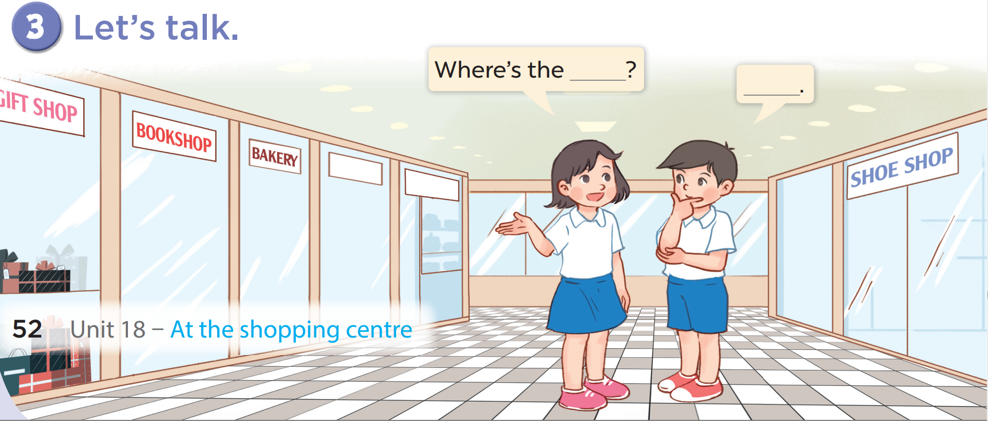

Slide 11
Fun corner

Slide 12



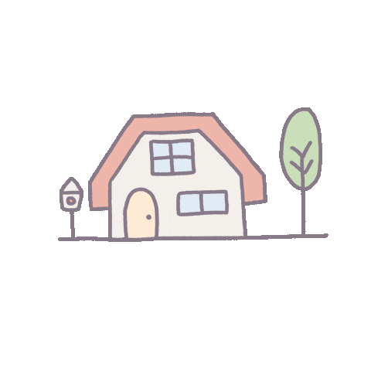
= 10 points
= - 20 points
= 50 points

Slide 13









TEAM 1
TEAM 2
TEAM 3

Slide 14
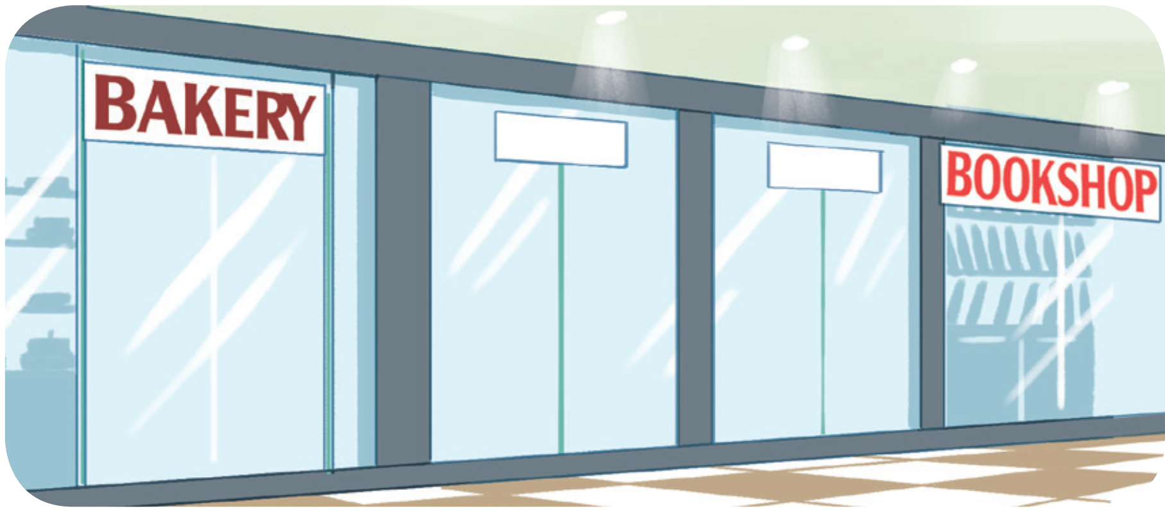
Where’s the bookshop?
It’s near the bakery.

Slide 15
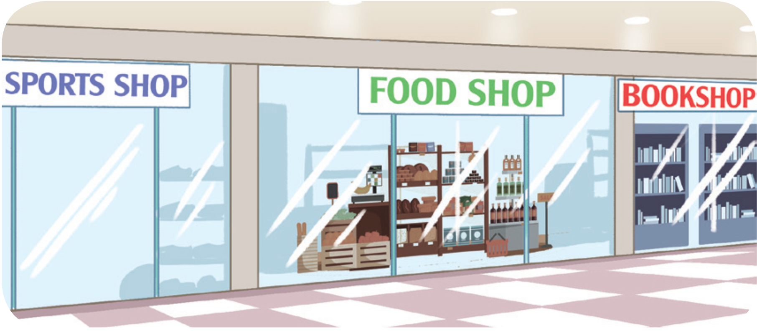
Where’s the food shop?
It’s between the sports shop and the bookshop.

Slide 16
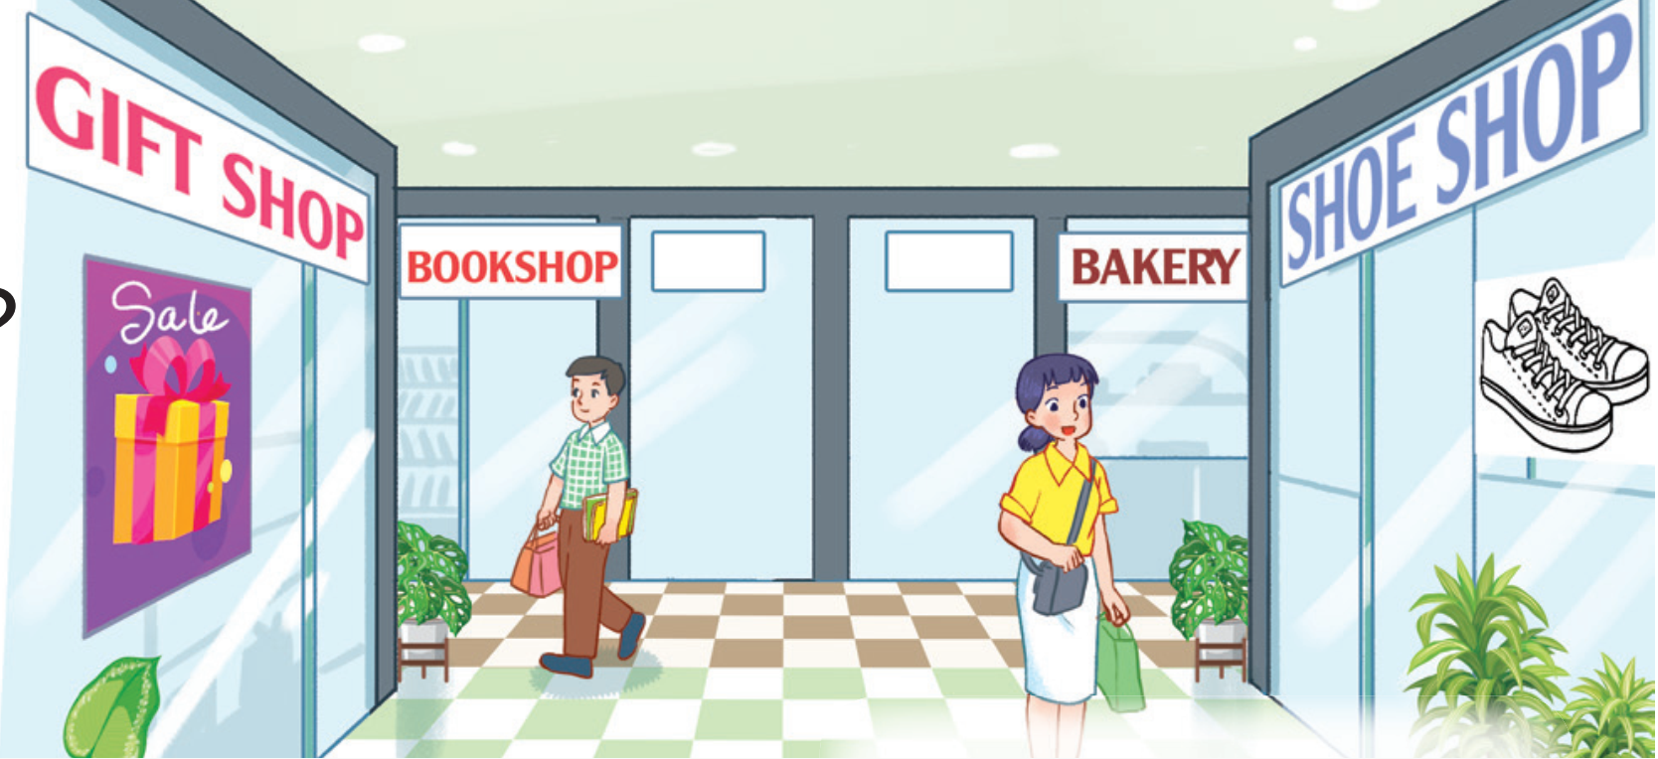
Where’s the shoe shop?
It’s opposite the gift shop.

Slide 17
Where’s the bakery?
It’s near the bookshop.

Slide 18
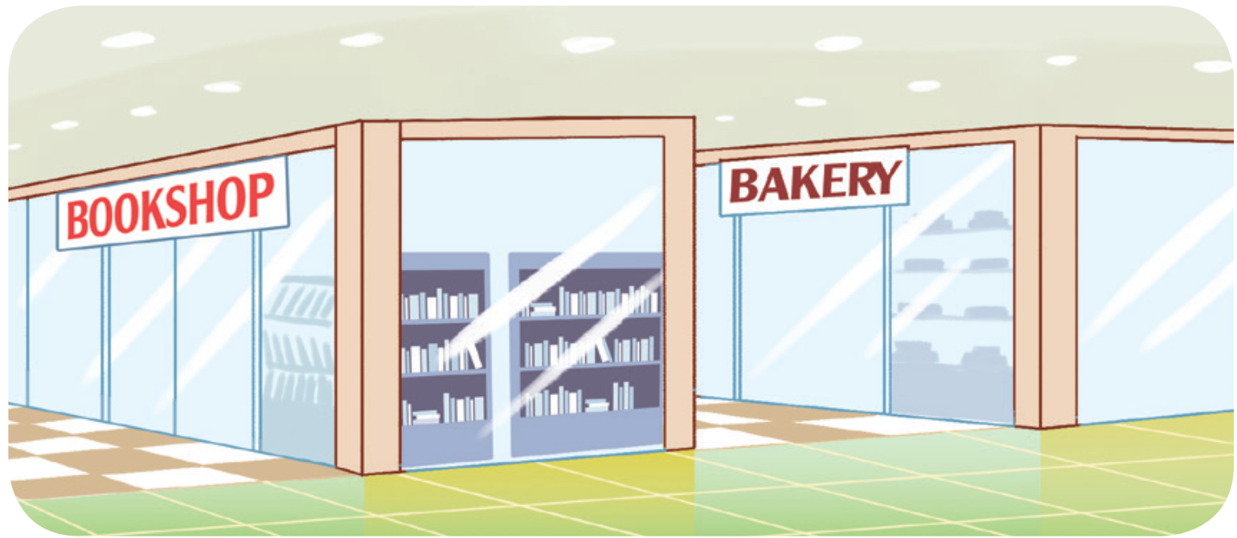
Where’s the bakery?
It’s behind the bookshop.

Slide 19
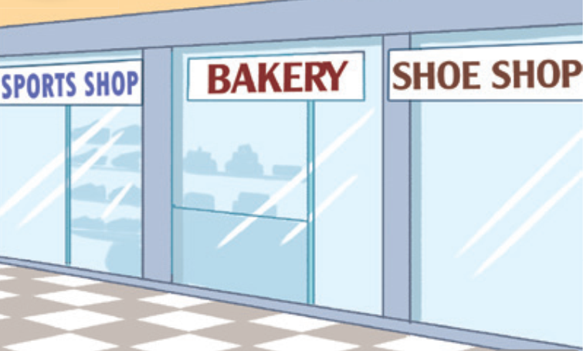
Where’s the bakery?
It’s between the sports shop and the shoe shop.

Slide 20
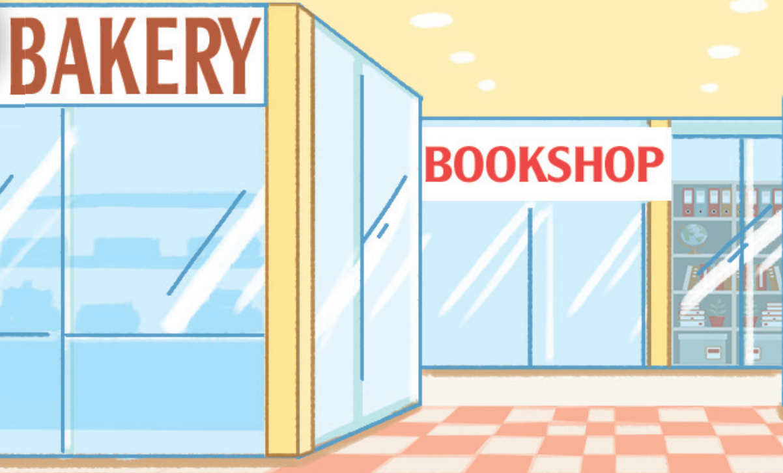
Where’s the bookshop?
It’s behind the bakery.

Slide 21
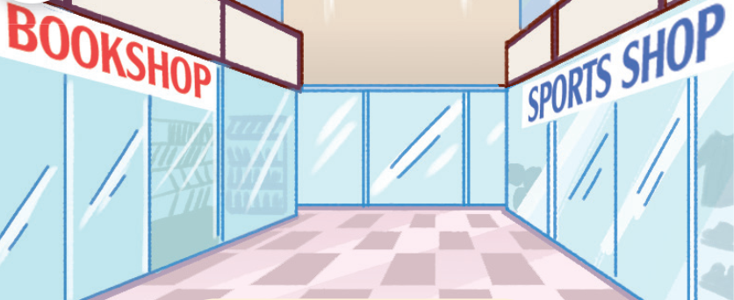
Where’s the sports shop?
It’s opposite the bookshop.

Slide 22
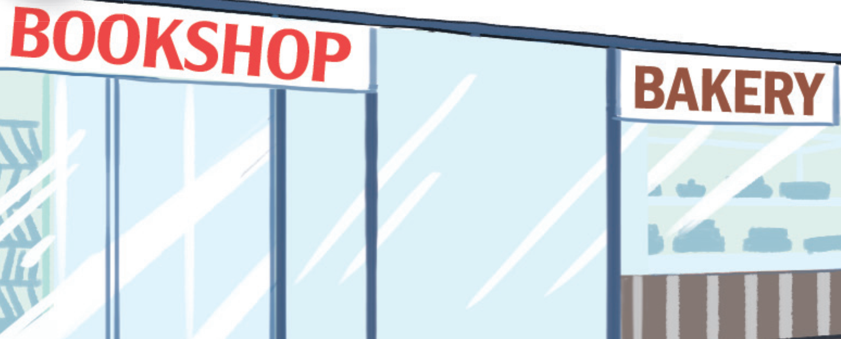
Where’s the bookshop?
It’s near the bakery.

