Slide 1


Slide 2



19
The animal world
LESSON 3 - PERIOD 6

Slide 3
Table of contents
01
Warm-up
02
Read and write the answers.
03
Let’s write.
04
Project
05
Fun corner

Slide 4
1
Warm-up

Slide 5

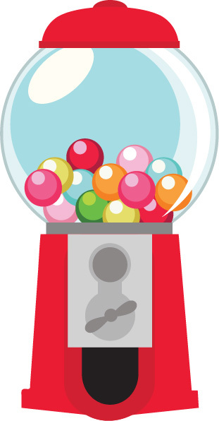


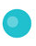
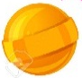

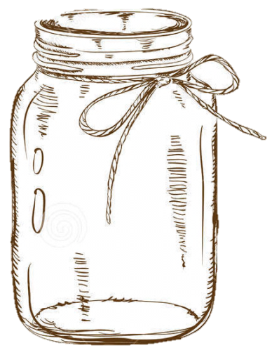
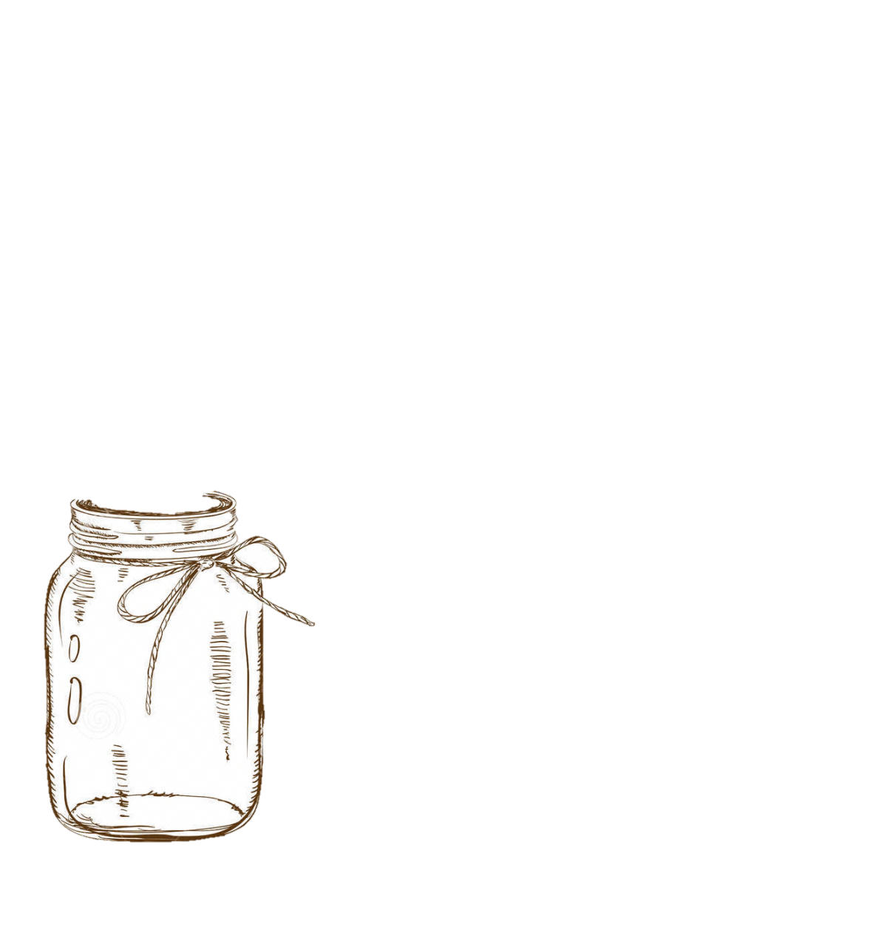
1
2
3
1
2
3
4
5
4
5
Notes:
Students compete in two groups, answer questions to get candy.
Students choose a number, teacher clicks on the number to go to the question.
If students answer correctly, teacher clicks back to this slide, clicks the play button with the color of that team to get candies into the jars.
Once finished, click the candy machine to go to the next slide.

Slide 6
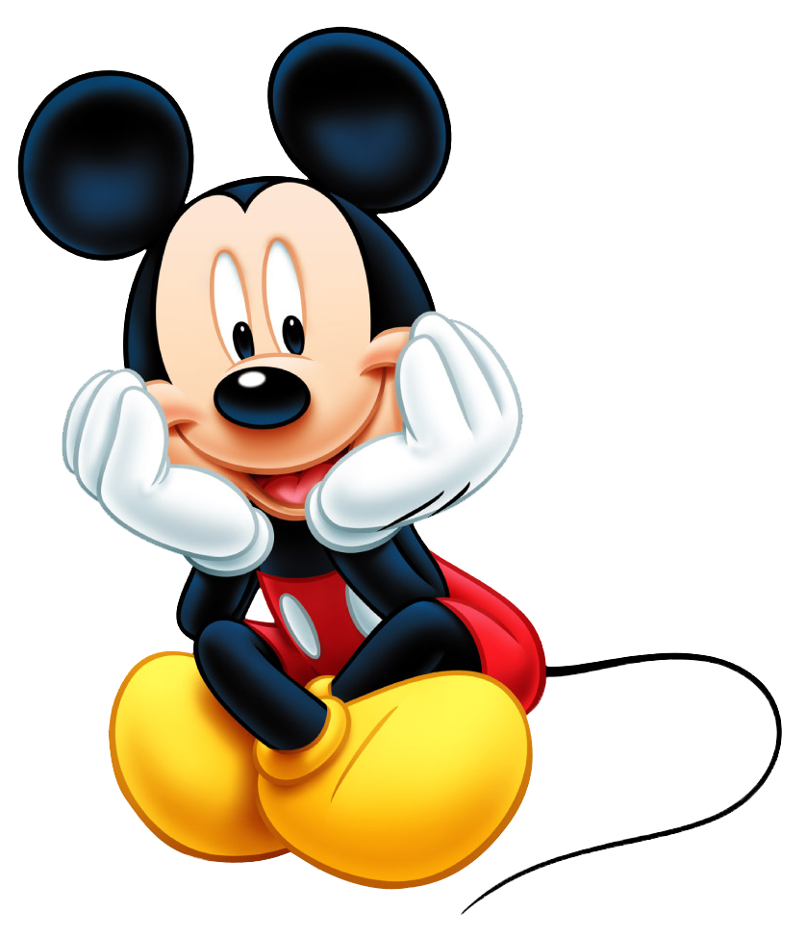







I like peacocks because ___.
they dance
beautifully
they roar
loudly
they sing
merrily

Slide 7
My sister likes lions
because ____.
they sing
merrily
they run
quickly
they roar
loudly

Slide 8
They have long legs and long necks, too. What are they?
Crocodiles
Giraffes
Hippos

Slide 9
They have short legs and big bodies. What are they?
Monkeys
Giraffes
Hippos

Slide 10
_____ do you like crocodiles?
What
Why
Where

Slide 11
______ dance beautifully.
Birds
Peacocks
Hippos

Slide 12
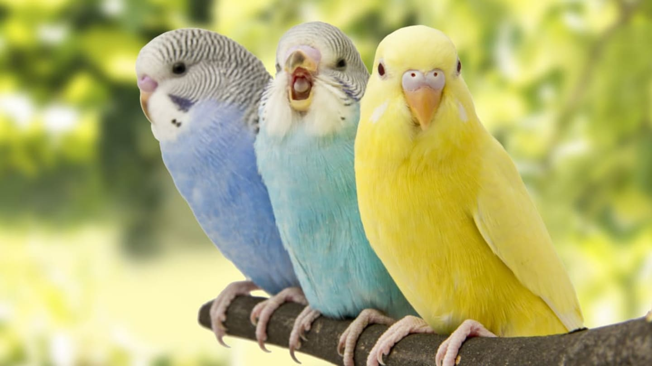
What are these animals??
Birds
Giraffes
Lions

Slide 13
They roar loudly. What are they?
Peacocks
Giraffes
Lions

Slide 14
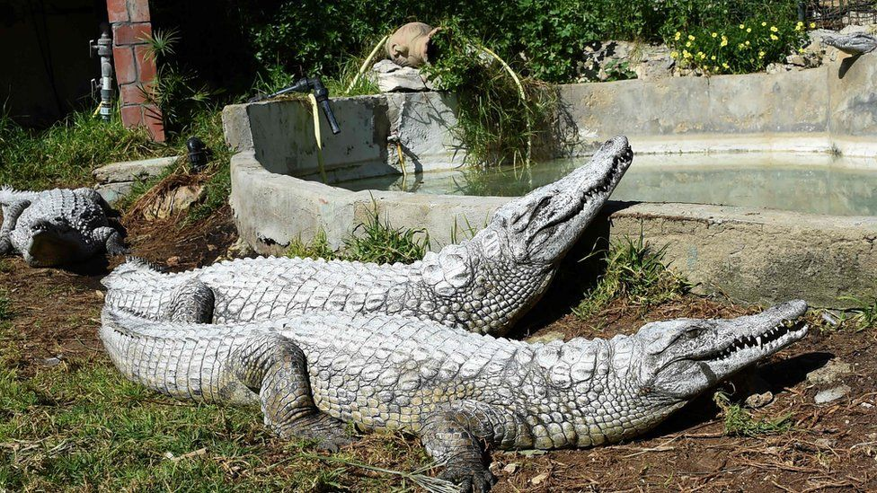
What are these animals?
Crocodiles
Birds
Hippos

Slide 15
I like birds ____ they sing merrily.
why
but
because

Slide 16
Read and write the answers.
2

Slide 17
Read and write the answers.
It is a nice day today. Ben and his friends are at the zoo because they want to see the animals. They like giraffes because they have long necks and legs. Giraffes can run very quickly. His friends like birds because they sing merrily. Ben loves peacocks because they dance beautifully.

Slide 18
Read and write the answers.
1. Where are Ben and his friends? _____________________________
2. What do they want to see? _____________________________
They are at the zoo.
  They want to see the animals.

Slide 19
Read and write the answers.
3. Why do they like giraffes? ______________________________ ______________________________
4. Why do his friends like birds? ______________________________
  Because they have long necks and legs. They can run very quickly.
  Because they sing merrily.

Slide 20
3
Let’s write.

Slide 21
Let’s write.
- What animals do you like to see and why?
- What animals does your brother / sister like to see and why?

Slide 22
Our favourite zoo animals
It is a sunny Sunday. My brother / sister and I are at the zoo _________________ ________________________________________________________________________________________________________________________________________________________________________________________________
because we want to
see the zoo animals. My brother likes the giraffes very much because they are beautiful with long legs. They can run very quickly. I like the peacocks because they have many colours. They can dance beautifully.

Slide 23
4
Project

Slide 24
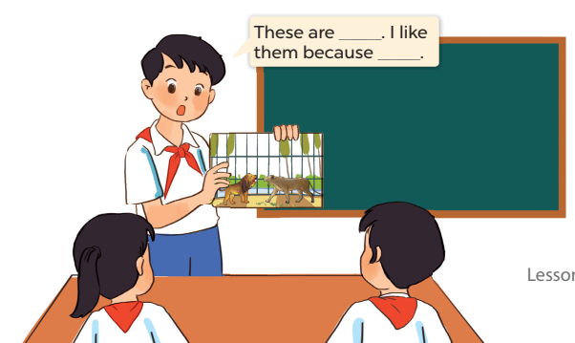

My favourite zoo animals

Slide 25
What is your favorite zoo animal?
They are
______
Because
____
What do they look like?
Why do
you like them?
What color are they?
They are
______

Slide 26

Website: hoclieu.vn
Fanpage: facebook.com/www.tienganhglobalsuccess.vn
Website: sachmem.vn; hoclieu.vn
Fanpage: www.facebook.com/sachmem.vn

