Slide 2






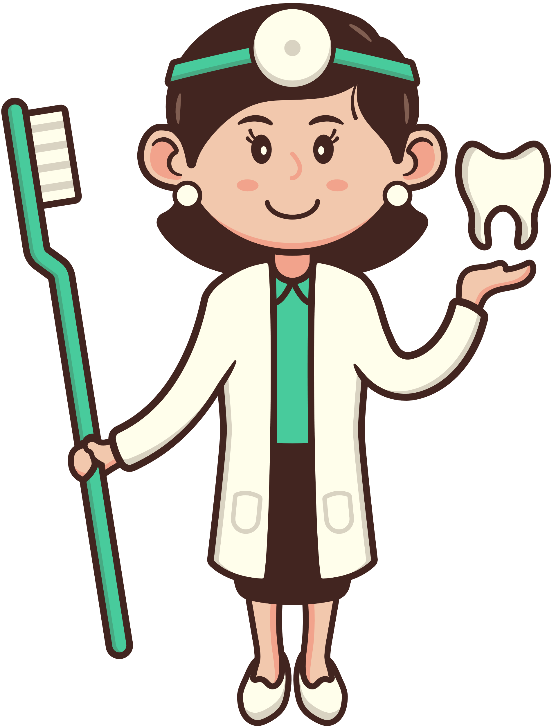


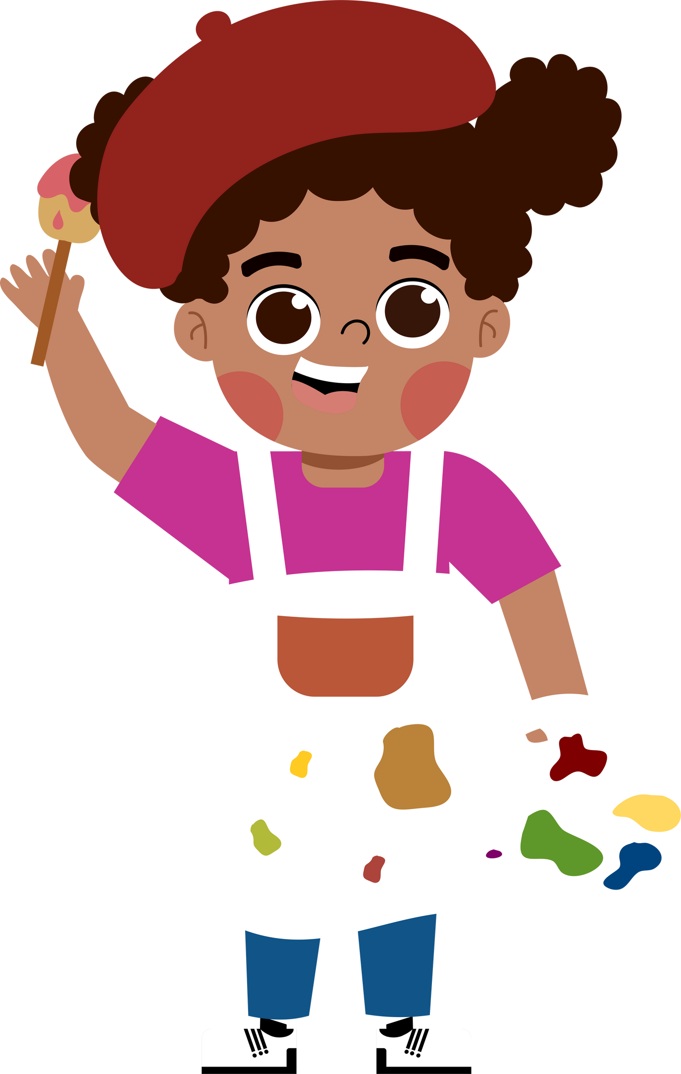
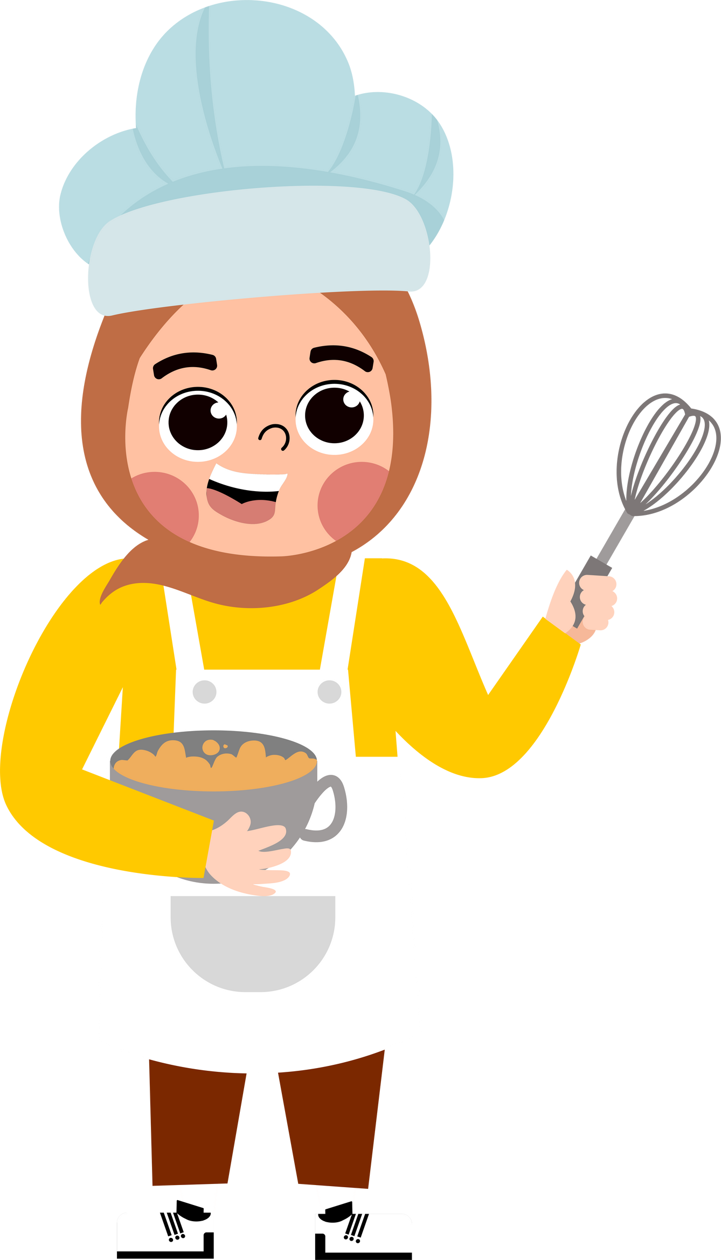
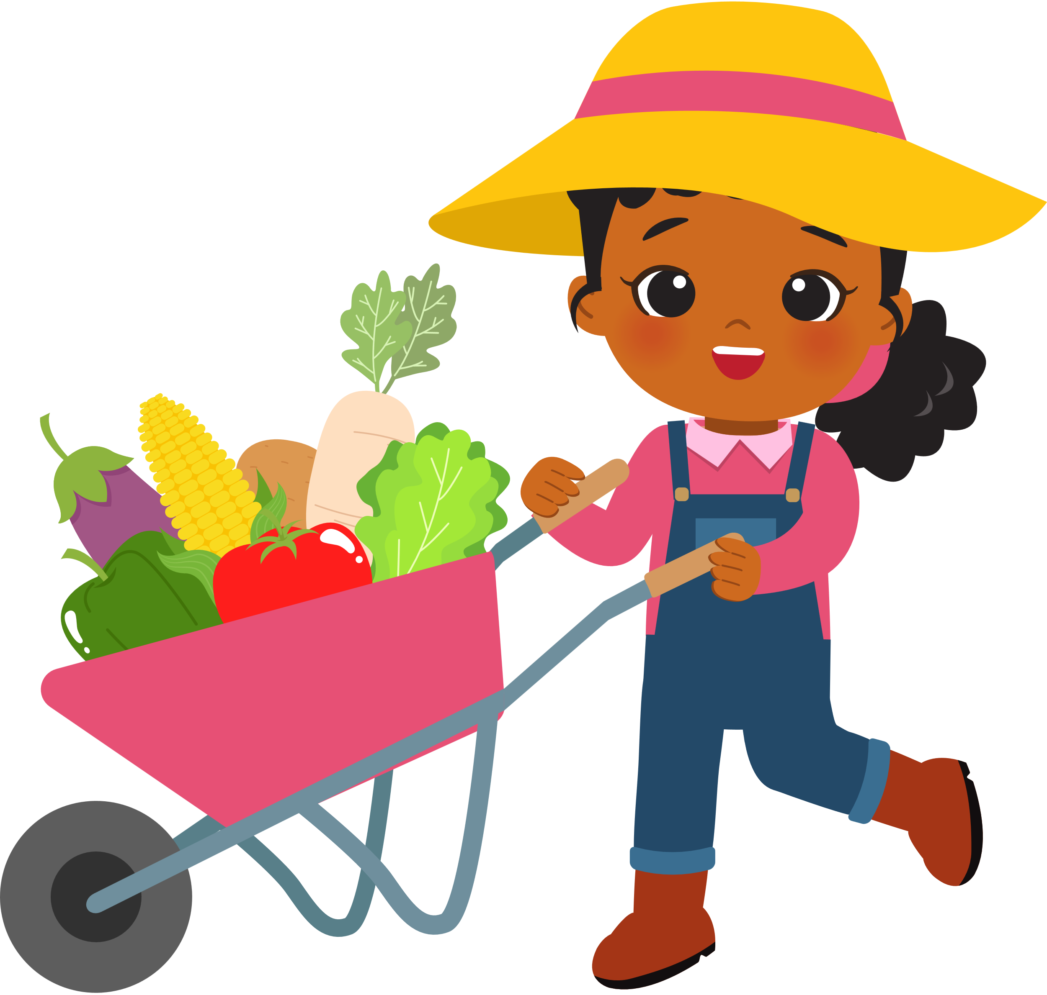

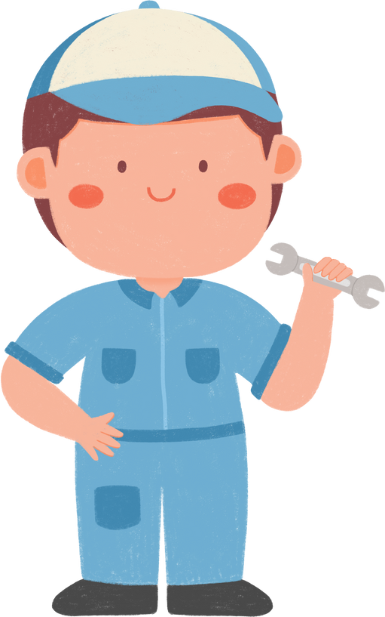
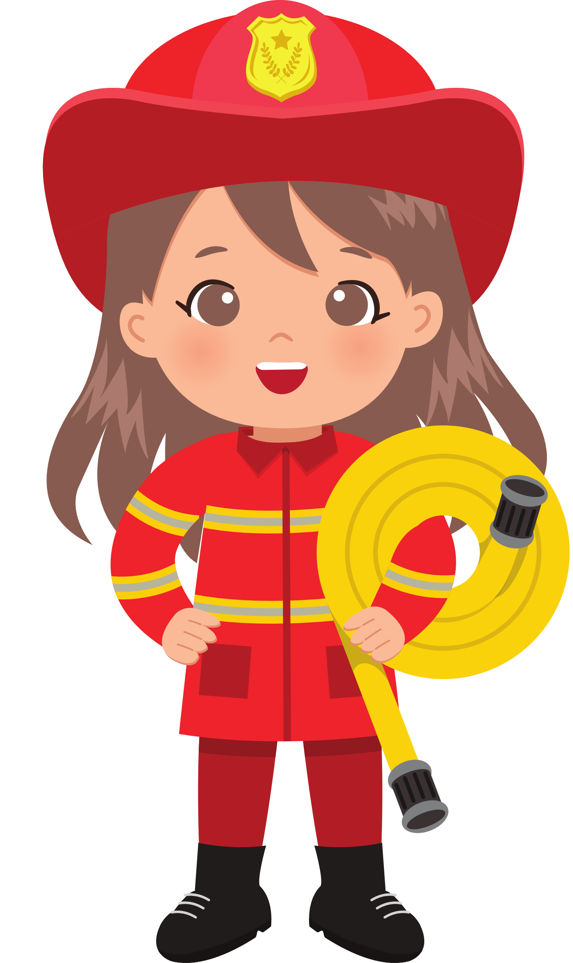
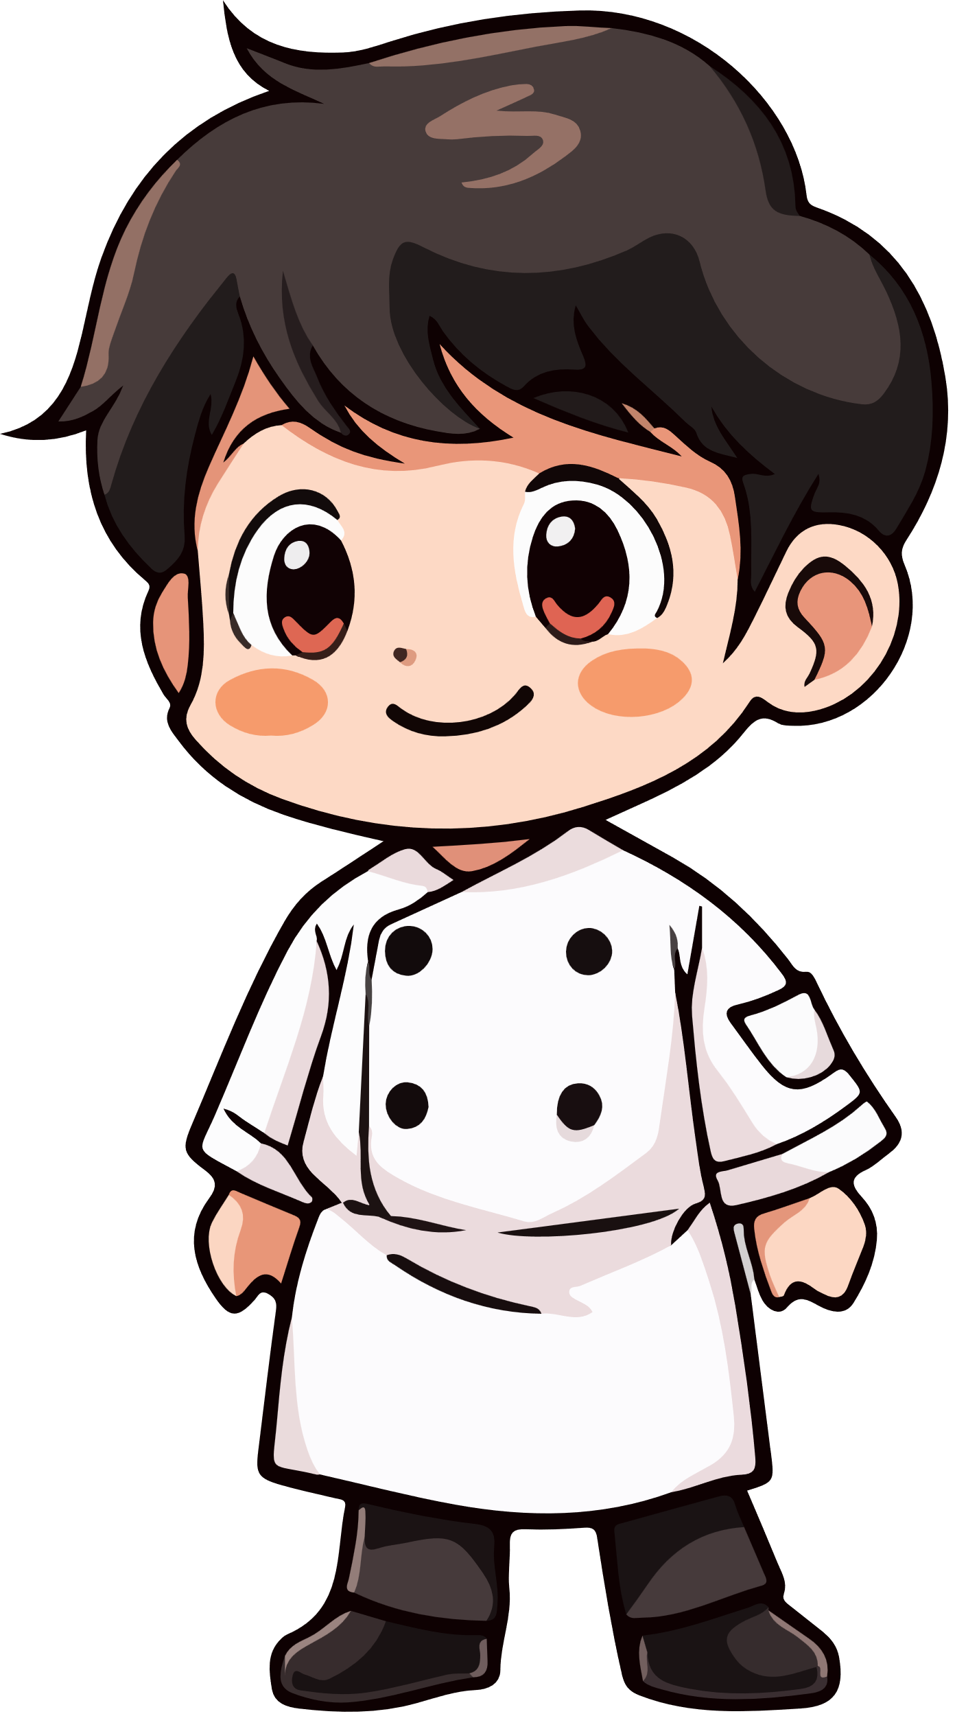


5
My future job
  Lesson 2 - Period 3
  Lesson 2 - Period 3

Slide 3





TABLE OF CONTENTs
  01. Warm-up
  02. Look, listen and repeat.
  03. Listen, point and say.
  04. Let’s talk.
  05. Fun corner and wrap-up

Slide 4




01.
Warm-up

Slide 5




Guessing game

Slide 6
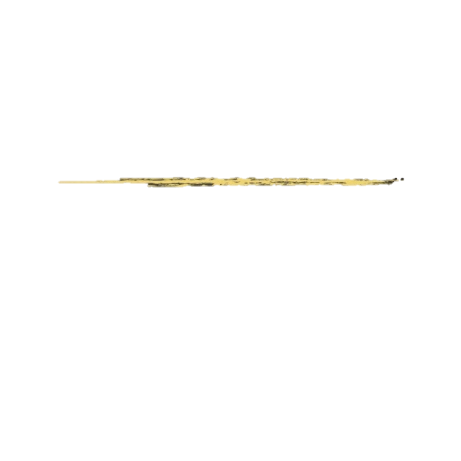

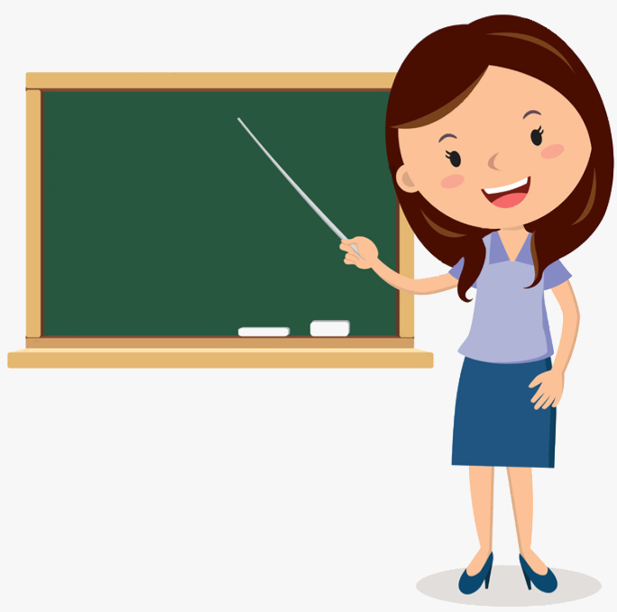

She loves children.
She works at school.
_ _ a c _ e_
t
e
h
r

Slide 7

He sometimes works in the office
and sometimes in the street.
c
a
_ o l _ _ e m _ n
p
i

Slide 8
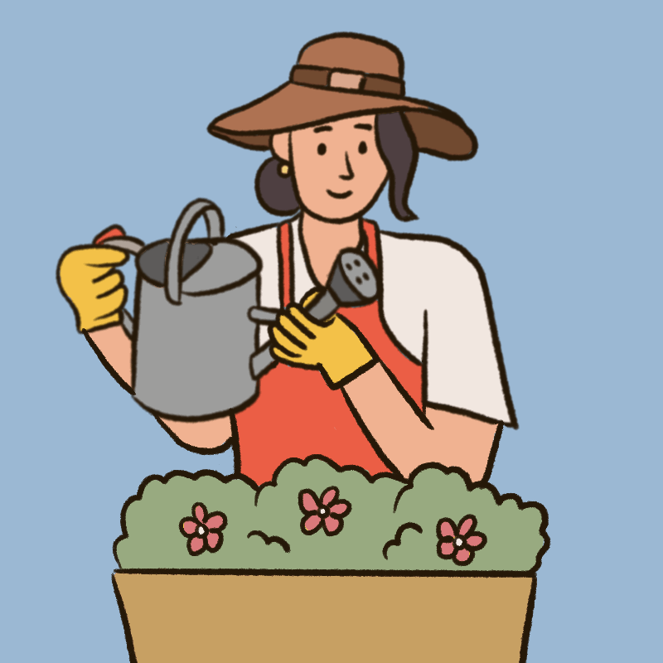
She loves plants and flowers.
a
e
r
g _ r d_ n e _

Slide 9
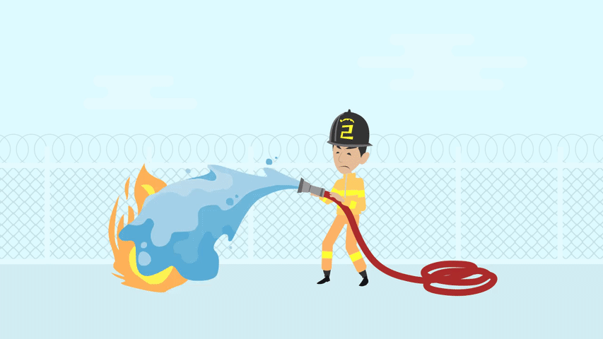
He is very brave. He can stop fire.
_ i r _ f i _ h t _ _
e
g
e
r
f

Slide 10
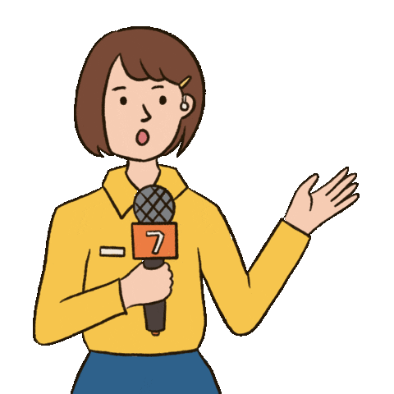
You can see her on TV or on the radio. She reports the news.
e
_ e p _ _ t _ r
r
o
r

Slide 11
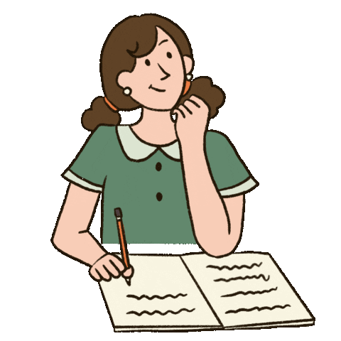
She loves reading stories and
writing new stories.
w
_ r _ _ e r
i
t

Slide 12

He helps sick people.
He works in the hospital.
d
c
_ o _ t o _
r

Slide 13
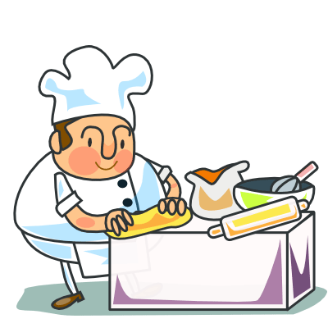
He works in the restaurant.
He loves cooking.
c
o
k
_ _ o _

Slide 14
02.
Look, listen and repeat.

Slide 15



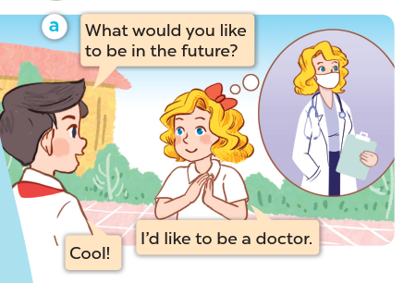


Listen and repeat.

Slide 16
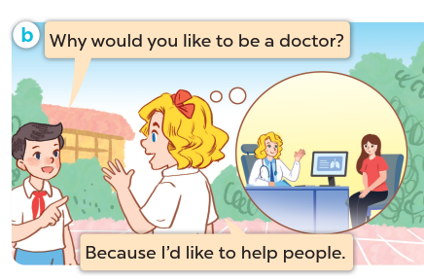
Listen and repeat.

Slide 17
03.
Listen, point and say.

Slide 18
New words

Slide 19


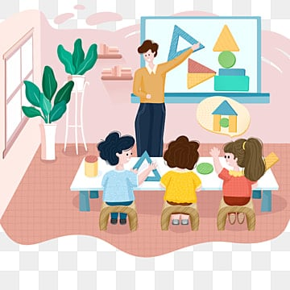

teach children

Slide 20
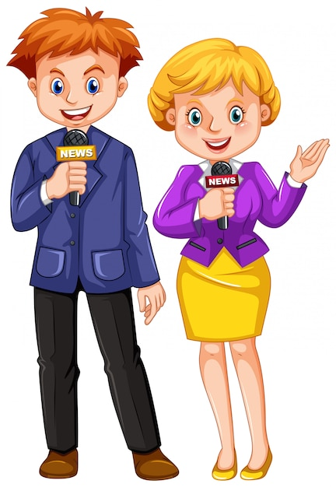
report the news

Slide 21
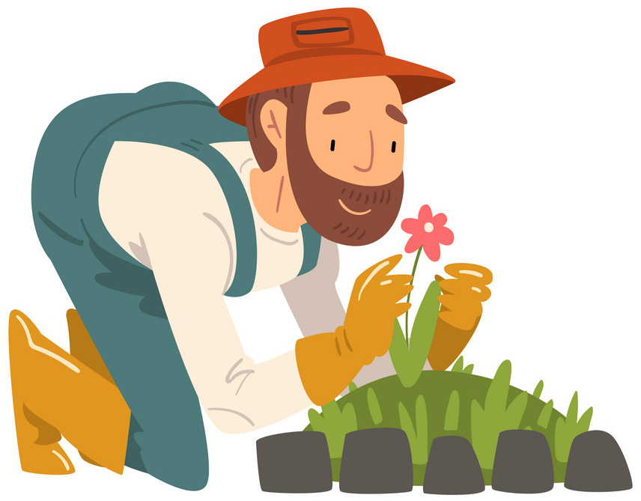
grow flowers

Slide 22

write stories

Slide 23
report the news
teach children
grow flowers
write stories

Slide 24
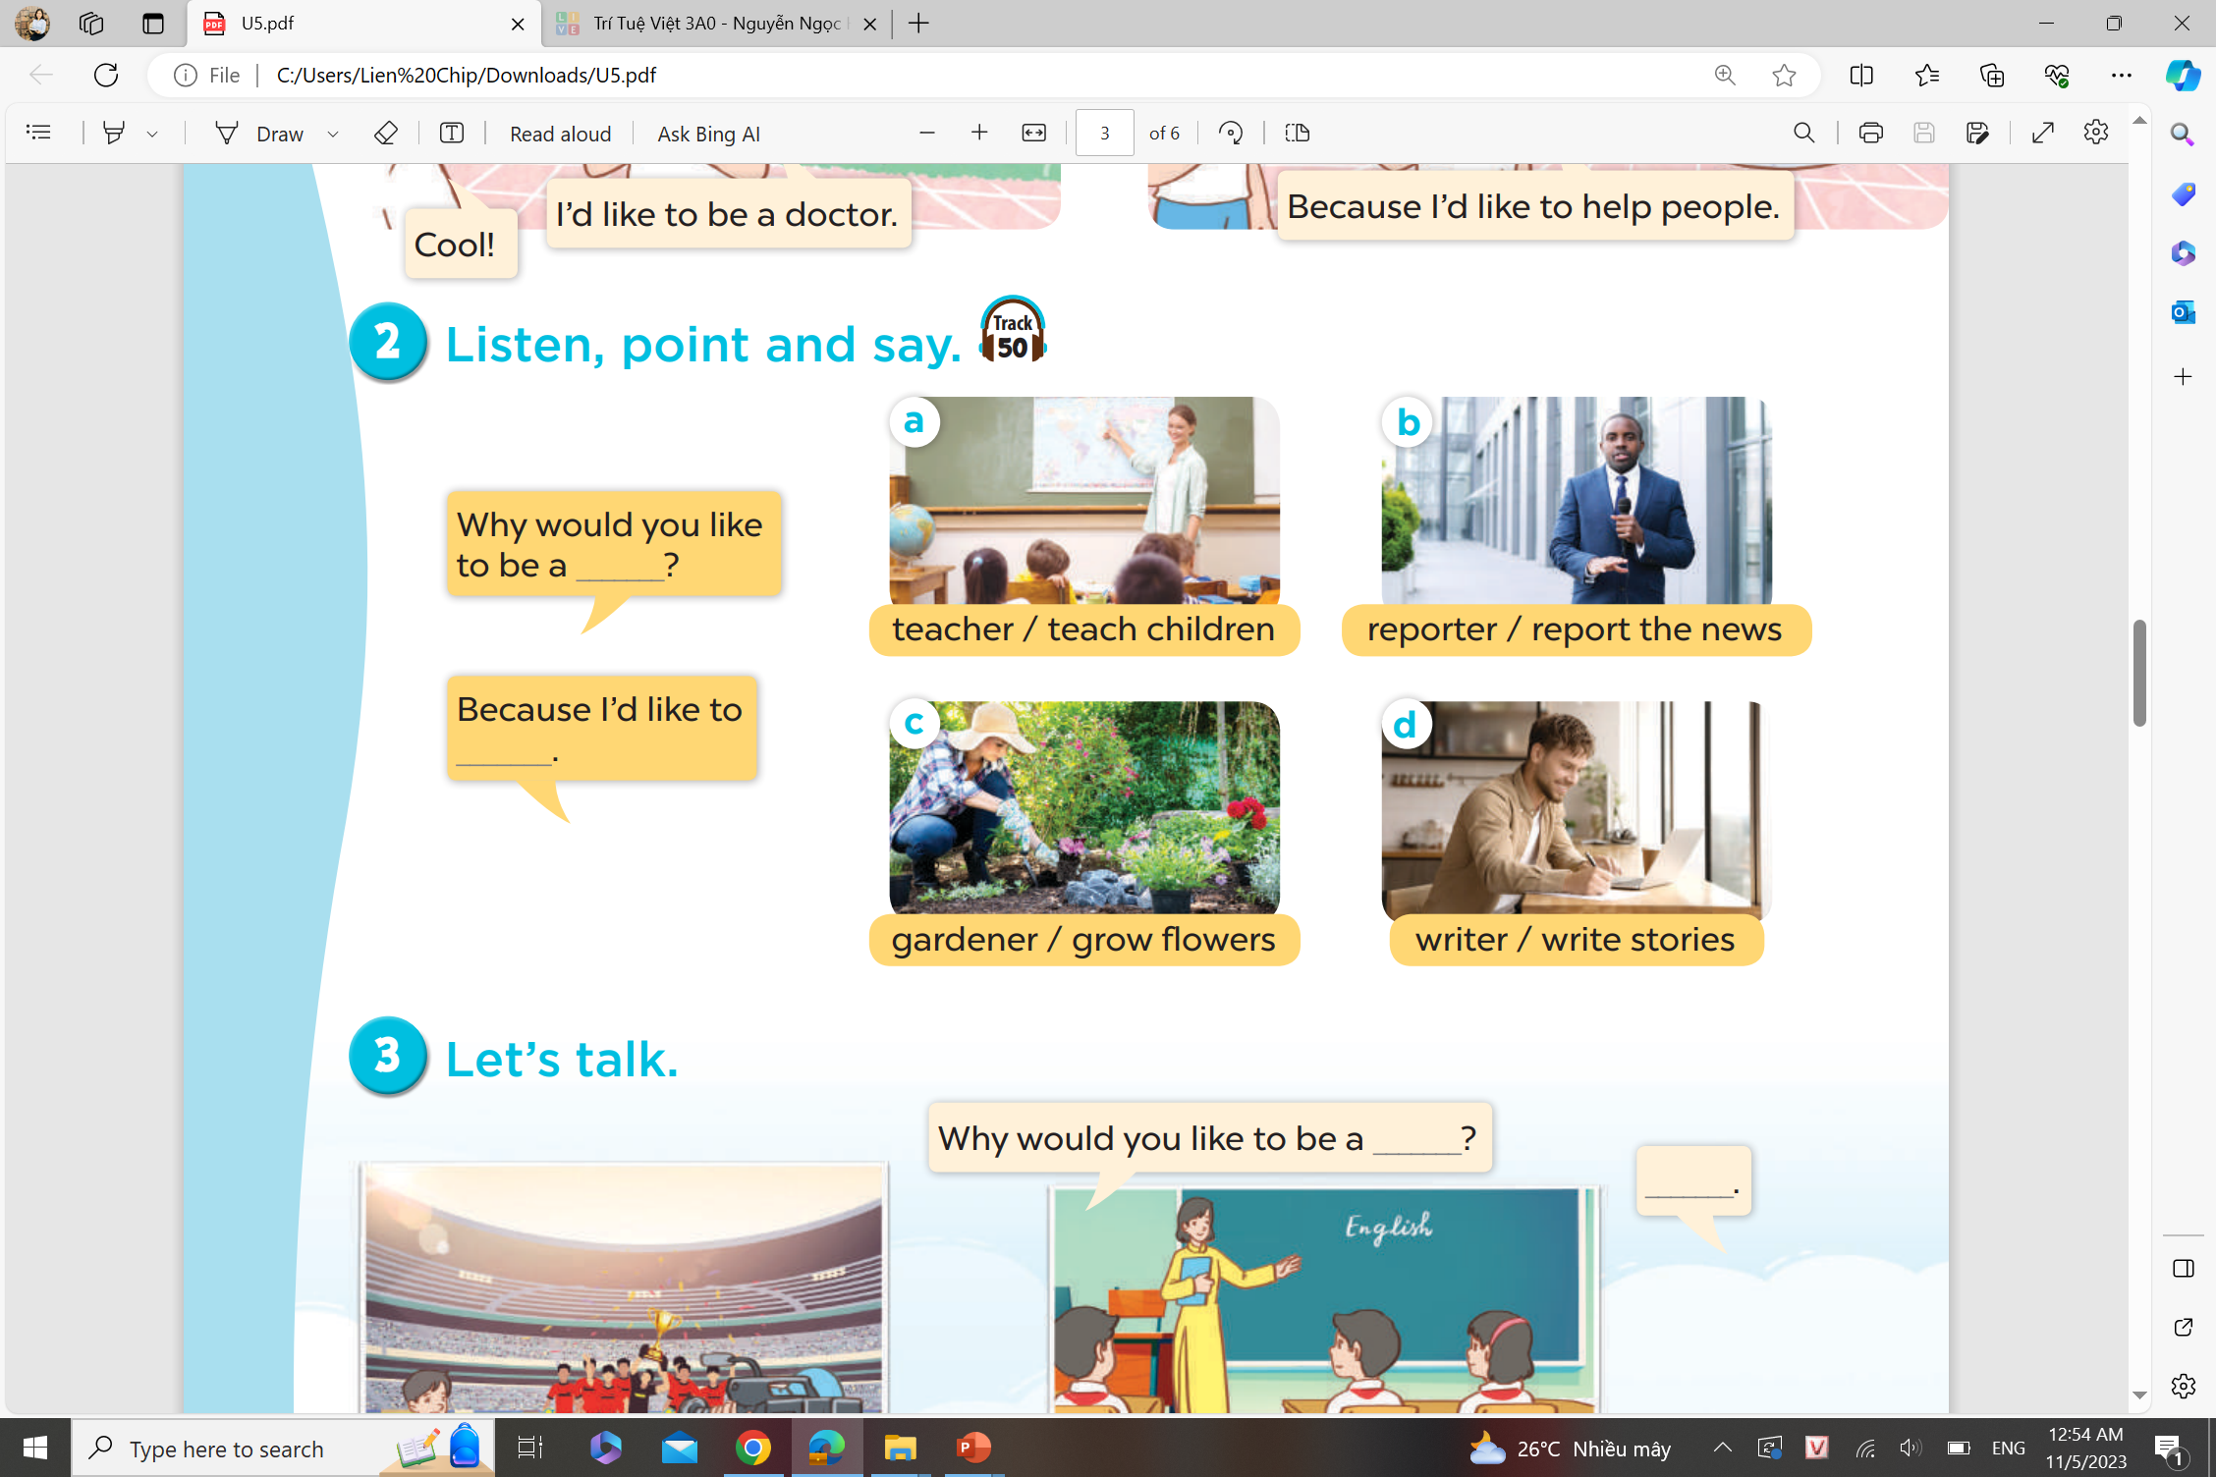
Listen and answer.

Slide 25
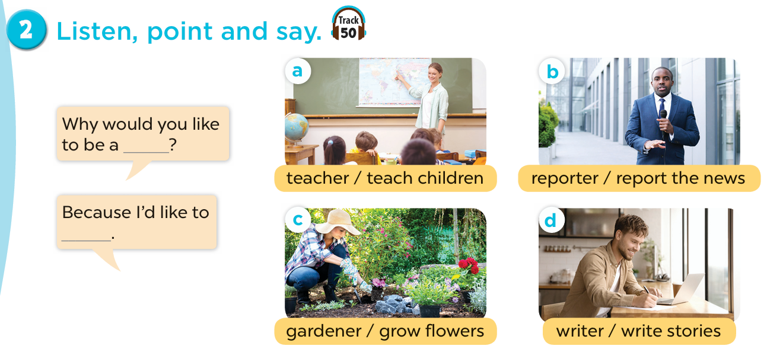

Slide 26
04.
Let’s talk.

Slide 27
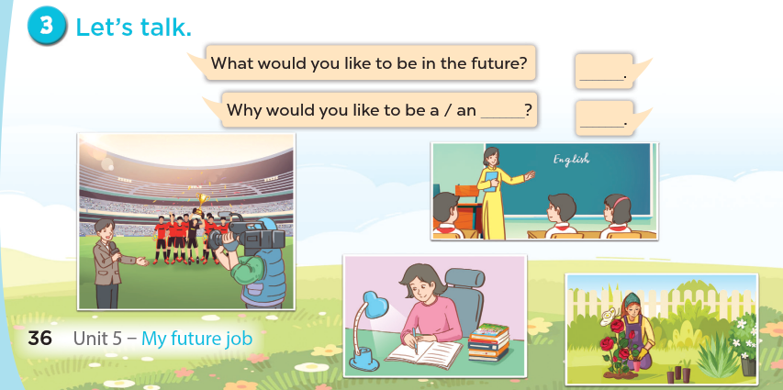

Slide 28
05.
Fun corner and wrap-up

Slide 29
Look and say.

Slide 30


What
.................. would you like to be
in the future?
A. Why
B. What
C. Because

Slide 31
A: Why would you like to be a gardener?
B: ...................... I like to grow flowers.
Because
A. What
B. When
C. Because

Slide 32
Why would you like to
be a ......................?
reporter
A. reporter
B. gardener
C. doctor

Slide 33
Why would you like to be a teacher?
- Because I ................... to teach children.
like
A. to like
B. likes
C. like

Slide 34
writer
Why would you like to be a ......................?
- Because I like to write new stories.
A. writer
B. cook
C. farmer

Slide 35
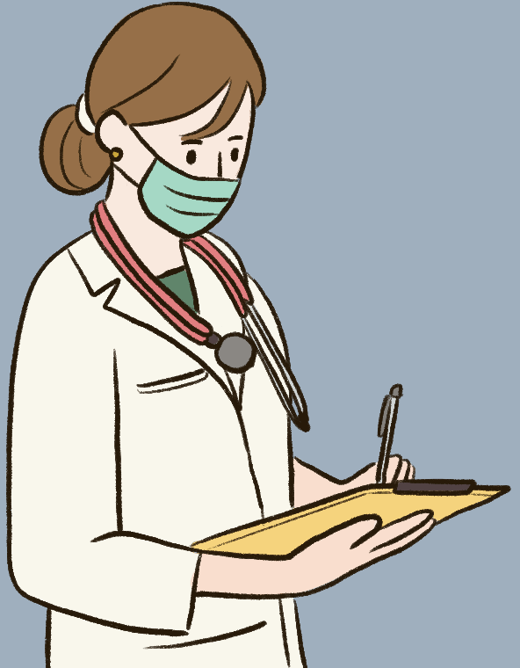
Why would you like to be a doctor?
- Because I like to ...............................
help sick people
A. teach children
B. help sick people
C. play football

Slide 36
A: Why would you like to be a ...................?
B: Because I like to cook.
cook
A. farmer
B. cook
C. dancer

Slide 37
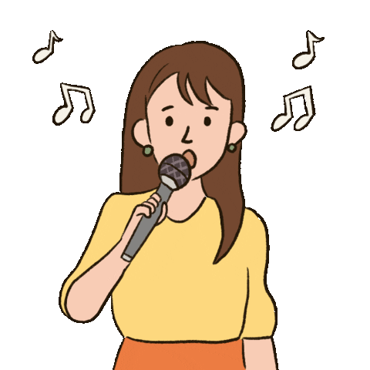
Why would you like to be a singer?
- Because I like to ....................
sing
A. help people
B. write stories
C. sing

Slide 38
Website: hoclieu.vn
Fanpage: https://www.facebook.com/tienganhglobalsuccess.vn/

