Slide 1



Slide 2




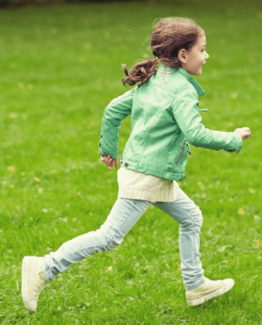


5
My hobbies
LESSON 2
Period 4

Slide 3
Content
1
5
Warm-up
Fun corner and Wrap-up
4
2
3
Let’s sing.
Listen and tick.
Look, complete and read.

Slide 4
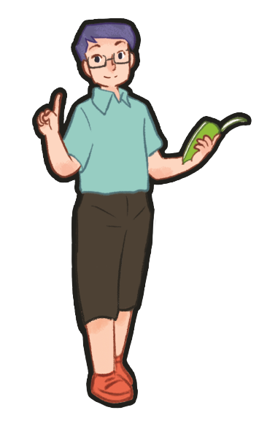
1
Warm-up
Game
Notes:
Review Numbers 1-10 and Alphabet

Slide 5
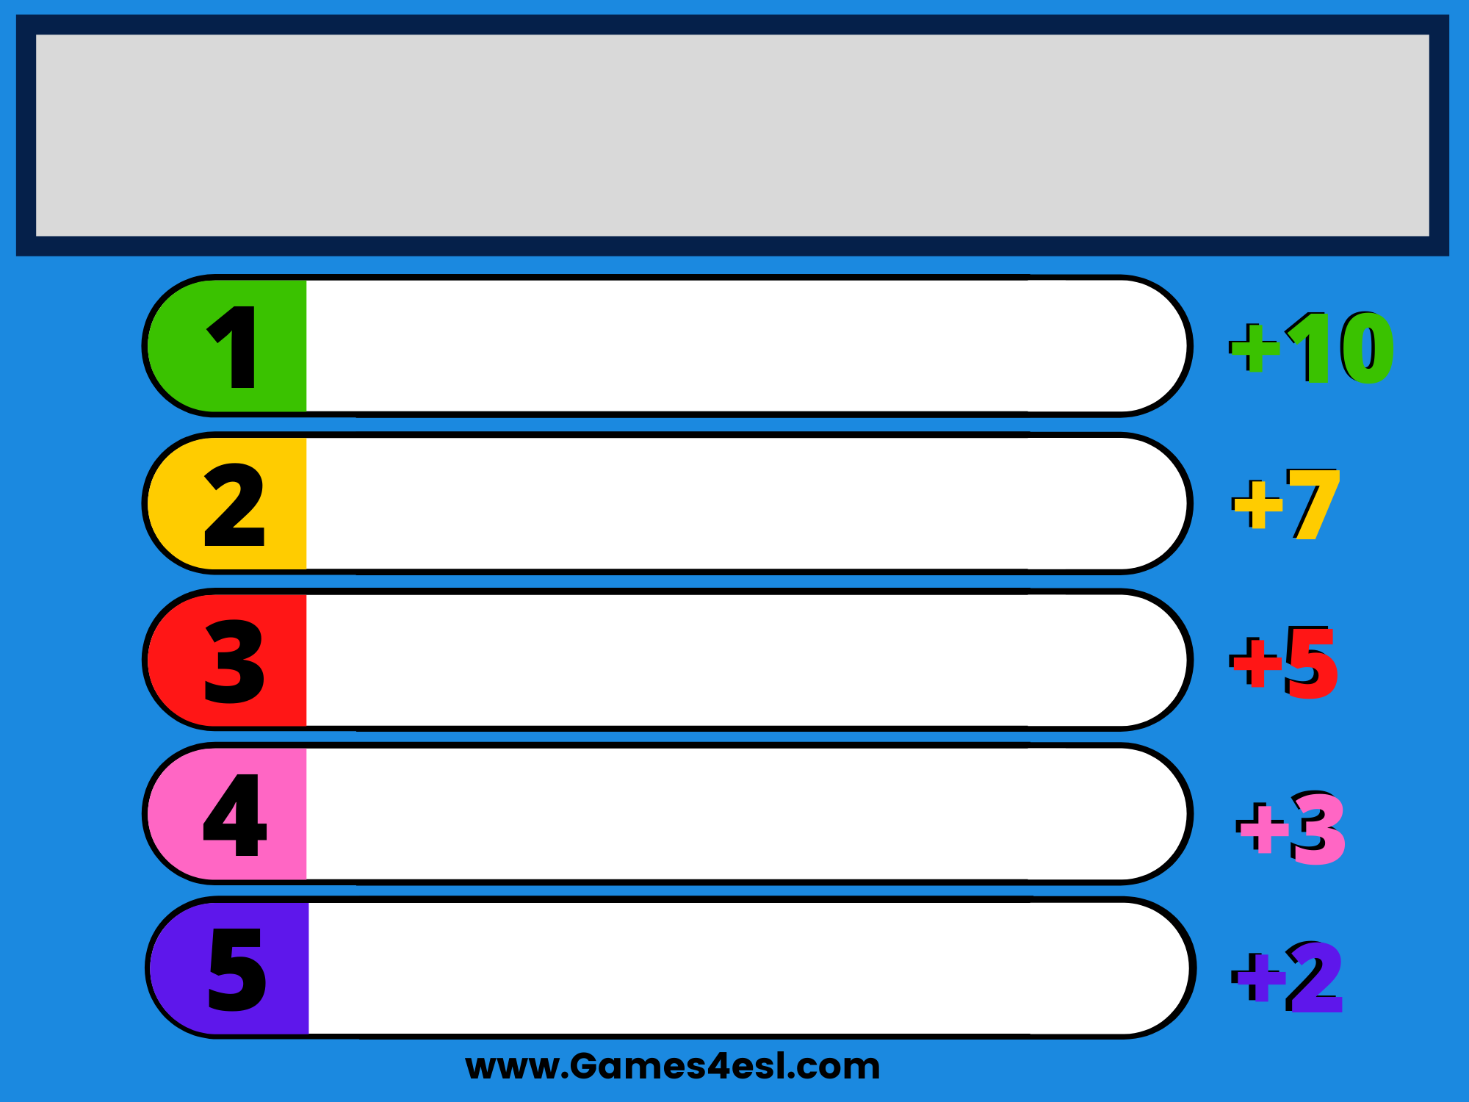
Hobbies people may have
cooking
painting
swimming
running
walking
Notes:
- The question has many possible answers.
- T lets the pupils in class write their answers (hobbies) on their board.
- When T shows answers, each answer of them will get each point.

Slide 6
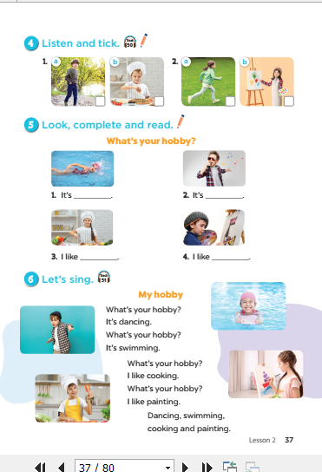
Notes:
T asks pupils to open their SB/ page 37.

Slide 7
2
Listen and tick.

Slide 8
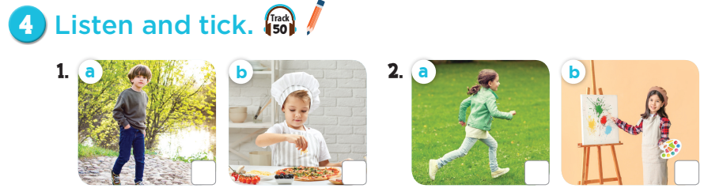

Notes:
Step 1: Draw pupils’ attention to Pictures 1a and 1b. Tell them about the activity. Elicit the
hobby in each picture. Play the recording of the first exchange. Play the recording again for
pupils to do the task. Play the recording a third time for pupils to check their answers.
Step 2: Repeat Step 1 for the second exchange.
Step 3: Tell pupils to swap books with a partner, then check answers as a class. Write the
correct answers on the board for pupils to correct their answers.
Step 4: Play the recording again for pupils to double-check their answers.
Extension: If time allows, play the recording sentence by sentence for the class to listen and
repeat in chorus. Correct their pronunciation where necessary.

Slide 9
✓
✓
Let’s check!
Notes:
Step 1: Draw pupils’ attention to Pictures 1a and 1b. Tell them about the activity. Elicit the
hobby in each picture. Play the recording of the first exchange. Play the recording again for
pupils to do the task. Play the recording a third time for pupils to check their answers.
Step 2: Repeat Step 1 for the second exchange.
Step 3: Tell pupils to swap books with a partner, then check answers as a class. Write the
correct answers on the board for pupils to correct their answers.
Step 4: Play the recording again for pupils to double-check their answers.
Extension: If time allows, play the recording sentence by sentence for the class to listen and
repeat in chorus. Correct their pronunciation where necessary.

Slide 10
3
Look, complete
and read.
Notes:
Review Numbers 1-10 and Alphabet

Slide 11
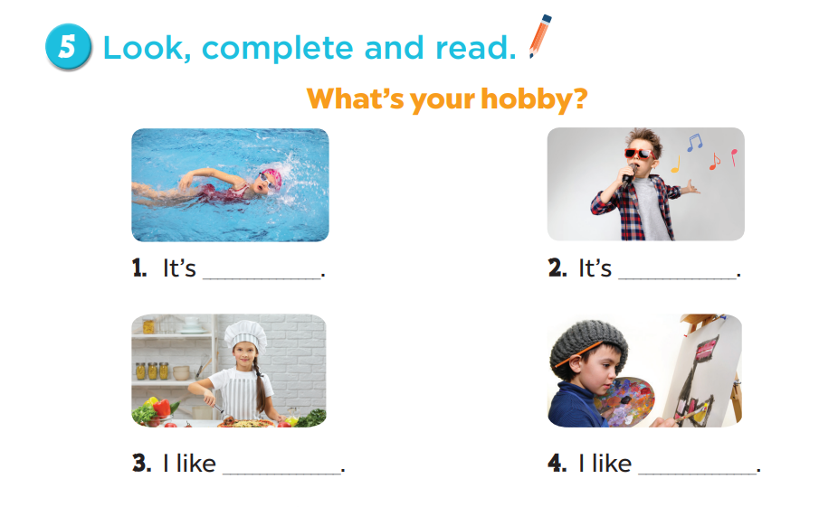
swimming
singing
cooking
painting
Notes:
Step 1: Have pupils look at the pictures. Have them identify the hobbies in the pictures.
Step 2: Have pupils look at the four incomplete sentences. Draw their attention to the missing
words in the sentences.
Step 3: Model with Picture 1. Have pupils look at the sentence. Ask them what is missing in the
answer (swimming). Then have them look at the picture and identify the hobby. Then have
them complete the gap (What’s your hobby? – It’s swimming.).
Step 4: Follow the same procedure with Pictures 2, 3 and 4.
Step 5: Have pupils complete the dialogues individually and ask a few pairs to read them
aloud.

Slide 12
Game time
Notes:
Review Numbers 1-10 and Alphabet

Slide 13
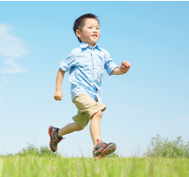
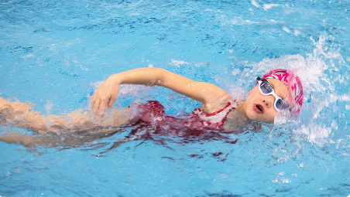
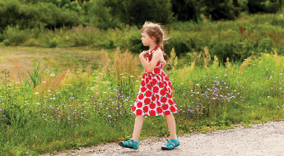
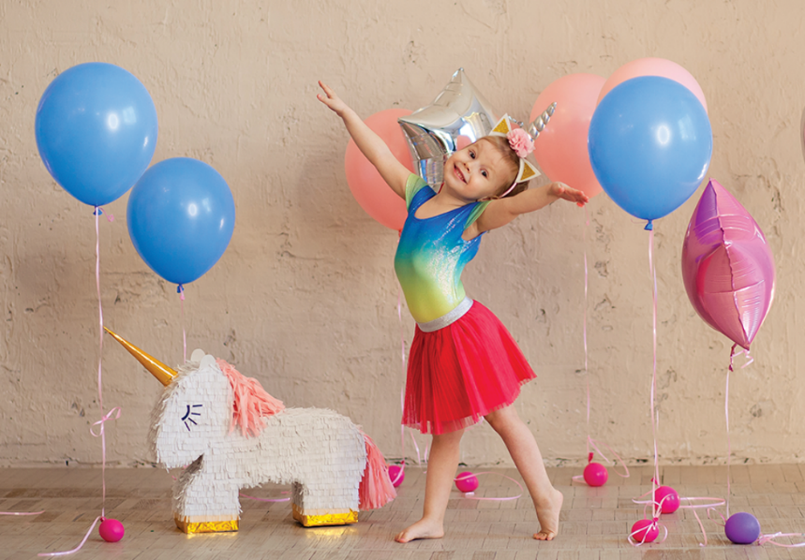
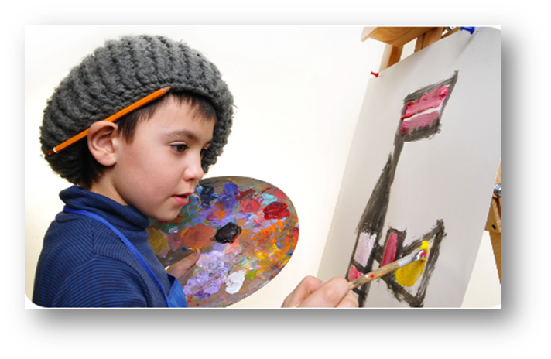



HOBBIES
Notes:
- T review words of hobbies by showing pictures.
- T divides class into 2 teams (Boys and Girls).
- T asks 1 pupil of each team come to the board and face to the others (they can’t see the pictures and questions on ppt at the beginning).
- When T says GO, 2 pupils will turn back, look at the screen, and say out loud the answers (A-B-C-D-E-F) as quickly as they can.
- The first one to say the letter and the word is the winner.

Slide 14
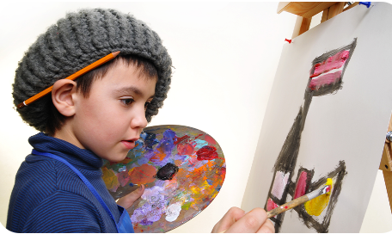


What’s your hobby?
A-walking
B-painting
C-running
D-dancing
E-cooking
F-swimming
Notes:
- T review words of hobbies by showing pictures.
- T divides class into 2 teams(Boys and Girls).
- T asks 1 pupil of each team come to the board and face to the others(they can’t see the pictures and questions on ppt at the beginning).
- When T says GO, 2 pupils will turn back, look at the screen, and say out loud the answers (A-B-C-D-E-F) as quickly as they can.
- The first one to say the letter and the word is the winner.

Slide 15
What’s your hobby?
A-swimming
B-running
C-dancing
D-singing
E-cooking
F-walking
Notes:
- T review words of hobbies by showing pictures.
- T divides class into 2 teams (Boys and Girls).
- T asks 1 pupil of each team come to the board and face to the others (they can’t see the pictures and questions on ppt at the beginning).
- When T says GO, 2 pupils will turn back, look at the screen, and say out loud the answers (A-B-C-D-E-F) as quickly as they can.
- The first one to say the letter and the word is the winner.

Slide 16
What’s your hobby?
A-painting
B-cooking
C-running
D-walking
E-dancing
F-singing
Notes:
- T review words of hobbies by showing pictures.
- T divides class into 2 teams (Boys and Girls).
- T asks 1 pupil of each team come to the board and face to the others(they can’t see the pictures and questions on ppt at the beginning).
- When T says GO, 2 pupils will turn back, look at the screen, and say out loud the answers (A-B-C-D-E-F) as quickly as they can.
- The first one to say the letter and the word is the winner.

Slide 17
What’s your hobby?
A-singing
B-drawing
C-painting
D-swimming
E-cooking
F-running
Notes:
- T review words of hobbies by showing pictures.
- T divides class into 2 teams (Boys and Girls).
- T asks 1 pupil of each team come to the board and face to the others (they can’t see the pictures and questions on ppt at the beginning).
- When T says GO, 2 pupils will turn back, look at the screen, and say out loud the answers (A-B-C-D-E-F) as quickly as they can.
- The first one to say the letter and the word is the winner.

Slide 18
What’s your hobby?
A-drawing
B-walking
C-running
D-cooking
E-singing
F-swimming
Notes:
- T review words of hobbies by showing pictures.
- T divides class into 2 teams (Boys and Girls).
- T asks 1 pupil of each team come to the board and face to the others (they can’t see the pictures and questions on ppt at the beginning).
- When T says GO, 2 pupils will turn back, look at the screen, and say out loud the answers (A-B-C-D-E-F) as quickly as they can.
- The first one to say the letter and the word is the winner.

Slide 19
What’s your hobby?
A-swimming
B-cooking
C-walking
D-running
E-dancing
F-painting
Notes:
- T review words of hobbies by showing pictures.
- T divides class into 2 teams (Boys and Girls).
- T asks 1 pupil of each team come to the board and face to the others (they can’t see the pictures and questions on ppt at the beginning).
- When T says GO, 2 pupils will turn back, look at the screen, and say out loud the answers (A-B-C-D-E-F) as quickly as they can.
- The first one to say the letter and the word is the winner.

Slide 20

What’s your hobby?
A-walking
B-swimming
C-running
D-cooking
E-singing
F-dancing
Notes:
- T review words of hobbies by showing pictures.
- T divides class into 2 teams (Boys and Girls).
- T asks 1 pupil of each team come to the board and face to the others (they can’t see the pictures and questions on ppt at the beginning).
- When T says GO, 2 pupils will turn back, look at the screen, and say out loud the answers (A-B-C-D-E-F) as quickly as they can.
- The first one to say the letter and the word is the winner.

Slide 21
4
Let’s sing.
Notes:
Step 1: Draw pupils’ attention to the title and lyrics of the song. Encourage them to point
at the pictures to reinforce their understanding.
Step 2: Play the recording all the way through. Encourage pupils to listen carefully to the
pronunciation and the melody.
Step 3: Play the recording line by line for pupils to listen and repeat. Correct their
pronunciation where necessary.
Step 4: Play the recording all the way through for pupils to sing along.
Step 5: Introduce actions for pupils to do while they sing along with the recording.

Slide 22
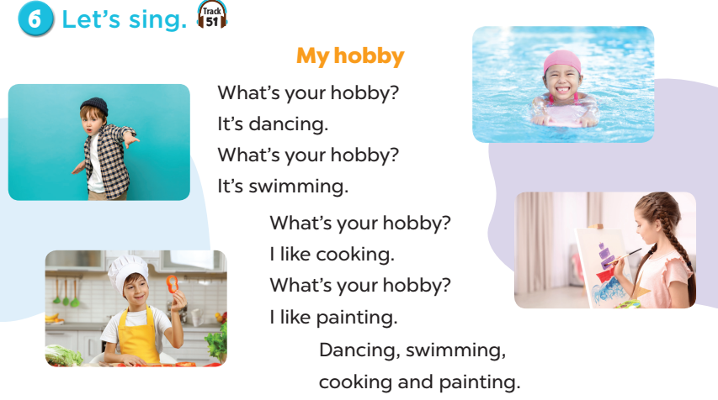
Notes:
Step 1: Draw pupils’ attention to the title and lyrics of the song. Encourage them to point
at the pictures to reinforce their understanding.
Step 2: Play the recording all the way through. Encourage pupils to listen carefully to the
pronunciation and the melody.
Step 3: Play the recording line by line for pupils to listen and repeat. Correct their
pronunciation where necessary.
Step 4: Play the recording all the way through for pupils to sing along.
Step 5: Introduce actions for pupils to do while they sing along with the recording.

Slide 23
Game: let’s sing!
Boys
Girls
Boys
Girls
Boys
Girls
Boys
Girls
All
Notes:
Game: Let’s sing!
Divide the class into 2 teams: Boys and girls.
Each team has to sing a verse of the song.
Then all they sing the last sentence.
The team can make it better will get points.

Slide 24
5
Fun corner
and
Wrap-up

Slide 25


G
S
G
E
S
N
U
I
G
M
E
A
Notes:
Guessing game:
- T lets the whole class look at the pictures and asks: What’s your hobby?
- The first one to answer will get the points.

Slide 26




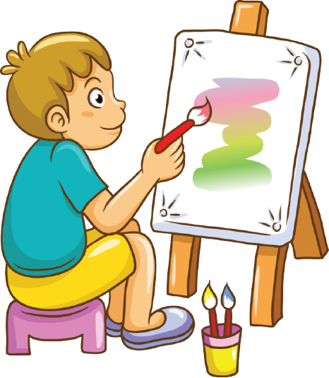




What’s your hobby?
Notes:
Guessing game:
- T lets the whole class look at the pictures and asks: What’s your hobby?
- The first one to answer will get the points.

Slide 27
It’s painting.

Slide 28
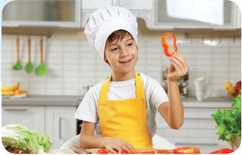
What’s your hobby?

Slide 29
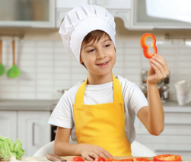
I like cooking.

Slide 30

What’s your hobby?

Slide 31
It’s running.

Slide 32

What’s your hobby?

Slide 33
I like walking.

Slide 34



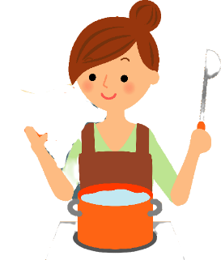

What’s your hobby?
I like _____________.
It’s ______________.
Notes:
T shows 4 pictures on the board and asks pupils to repeat. -> Wrap up.

Slide 35

Website: hoclieu.vn
Fanpage: facebook.com/www.tienganhglobalsuccess.vn

