Slide 1








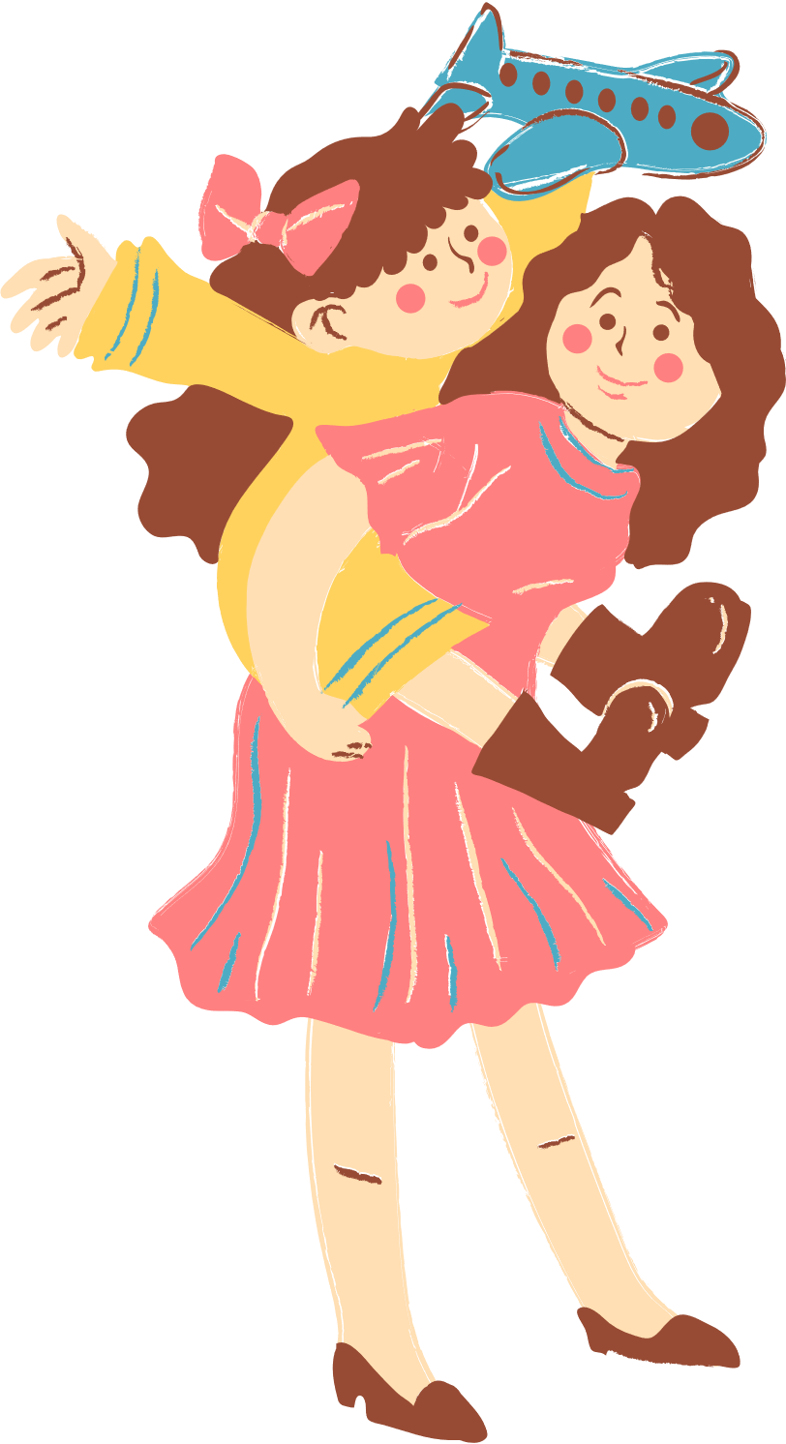
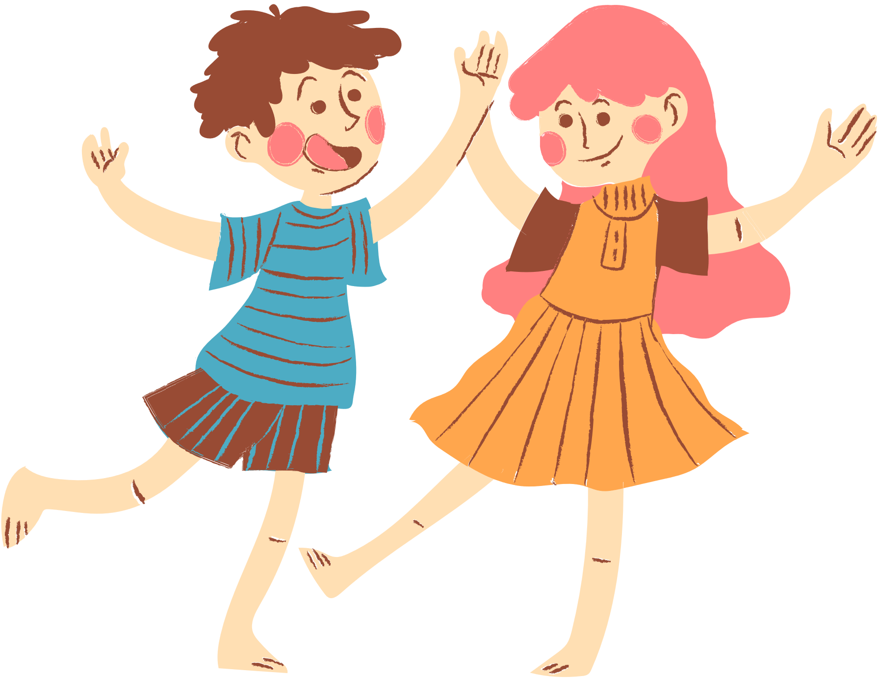
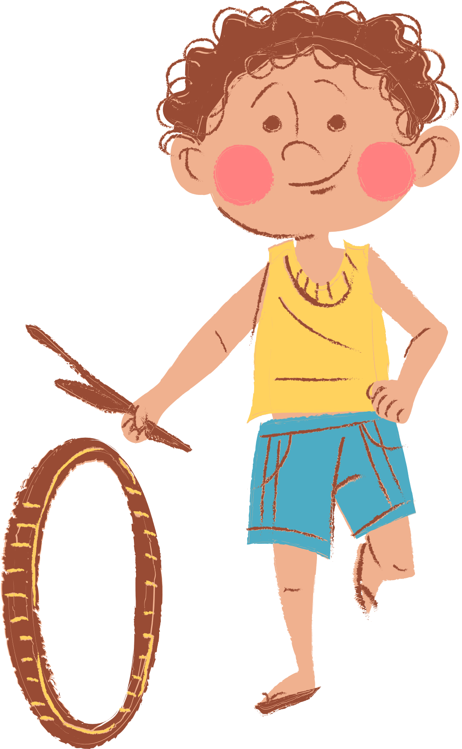
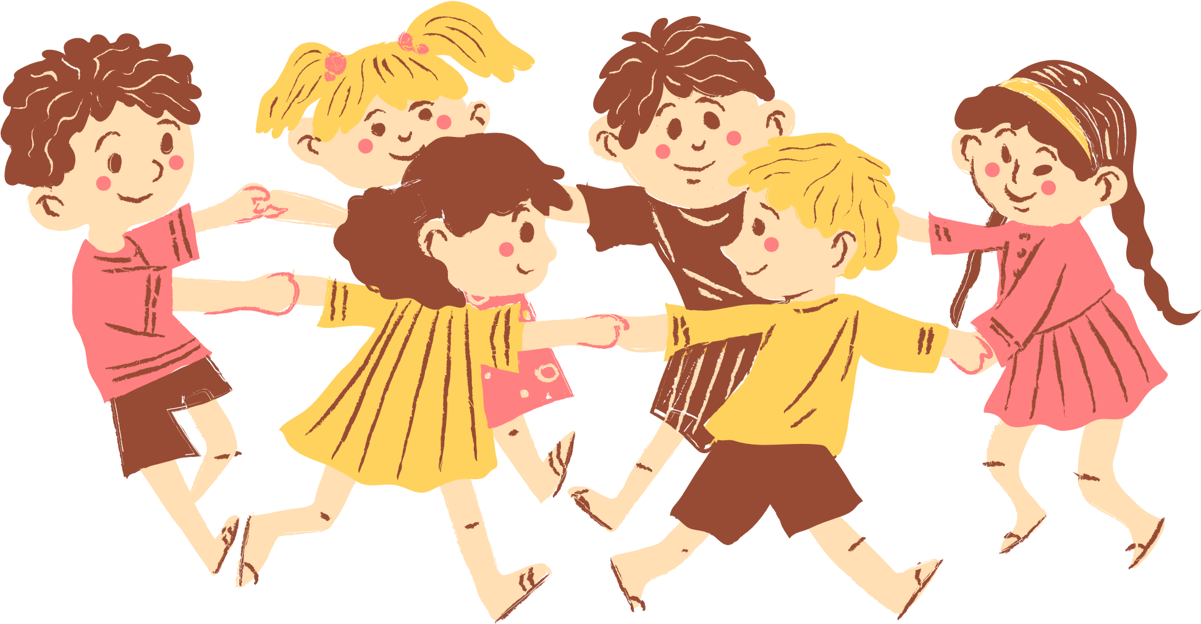
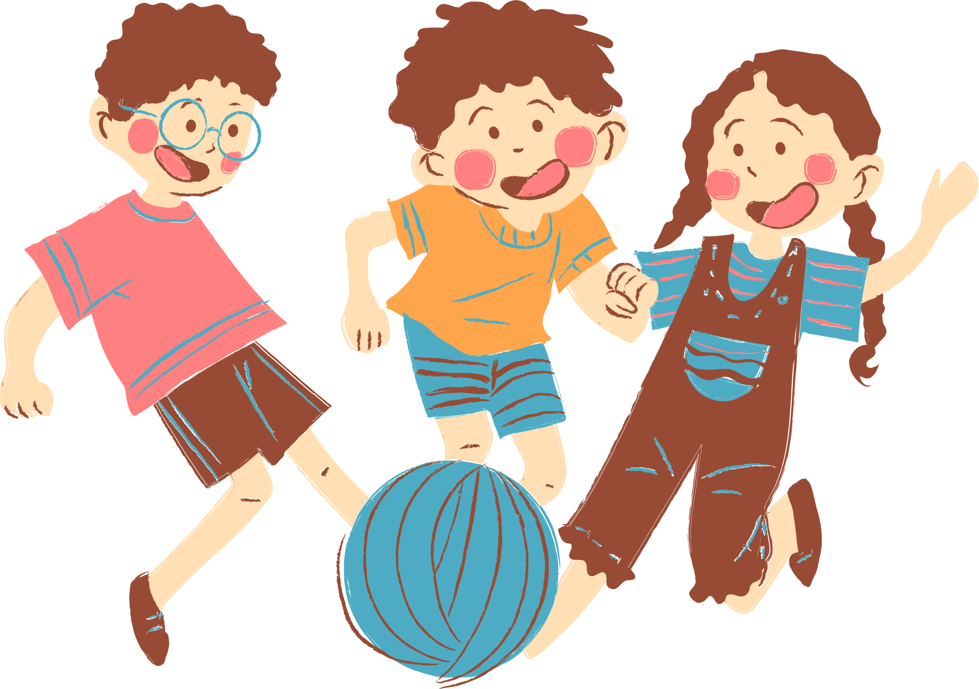
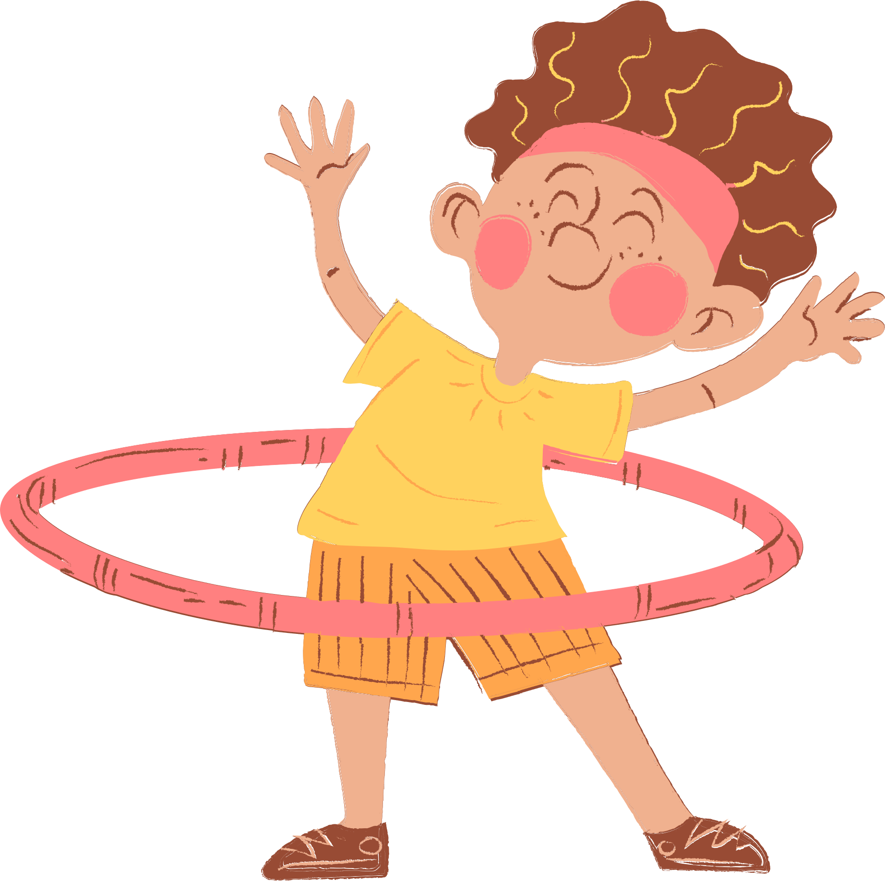
4
Our Free-time Activities

Slide 2






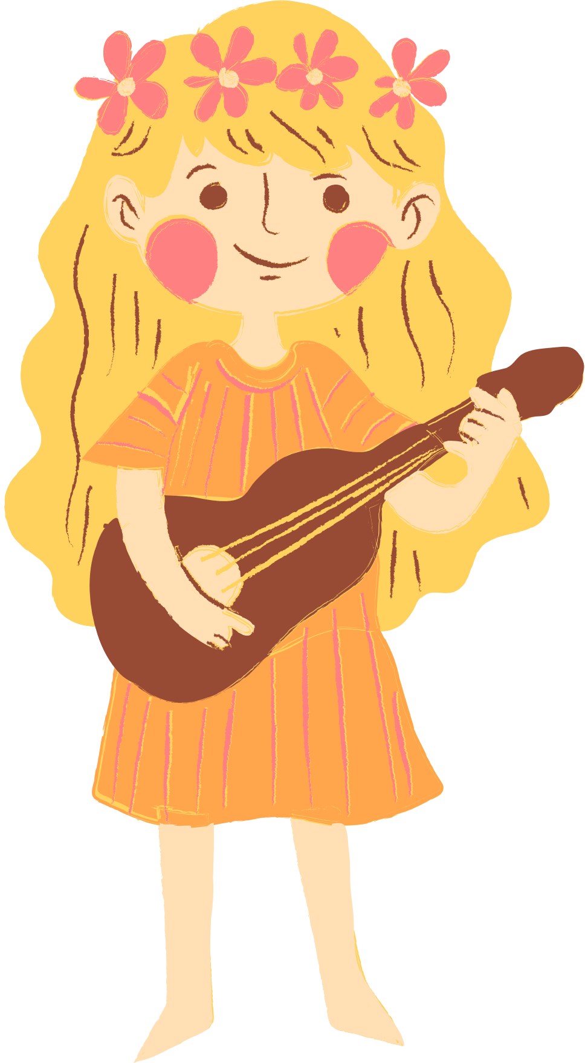
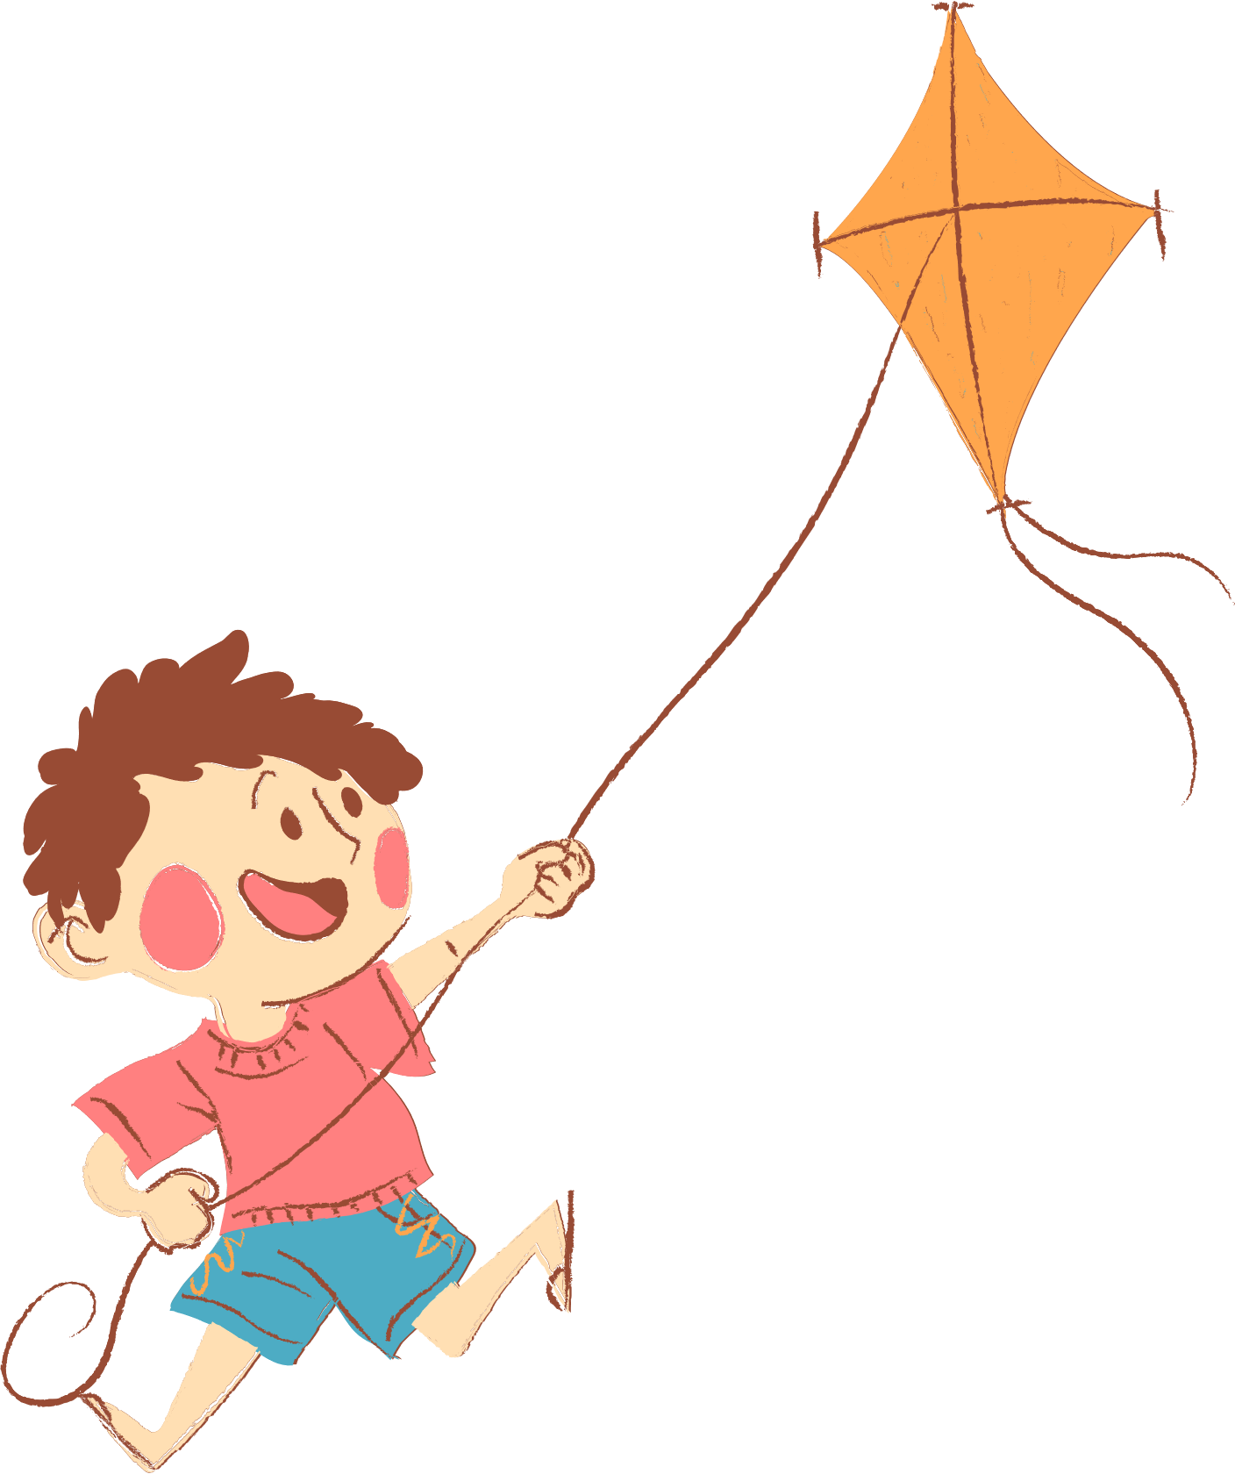
01. Review
02. Listen and number.
03. Read and complete.
04. Let’s play.
05. Fun time

Slide 3
01. Review

Slide 4

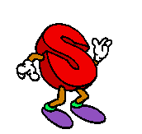
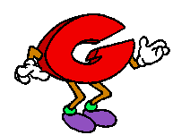
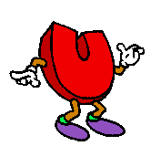
Can you

Slide 5
Look and guess what word is it.
1-open picture: 3 points
2-open pictures: 2 points
Picture left: 1 point

Slide 6

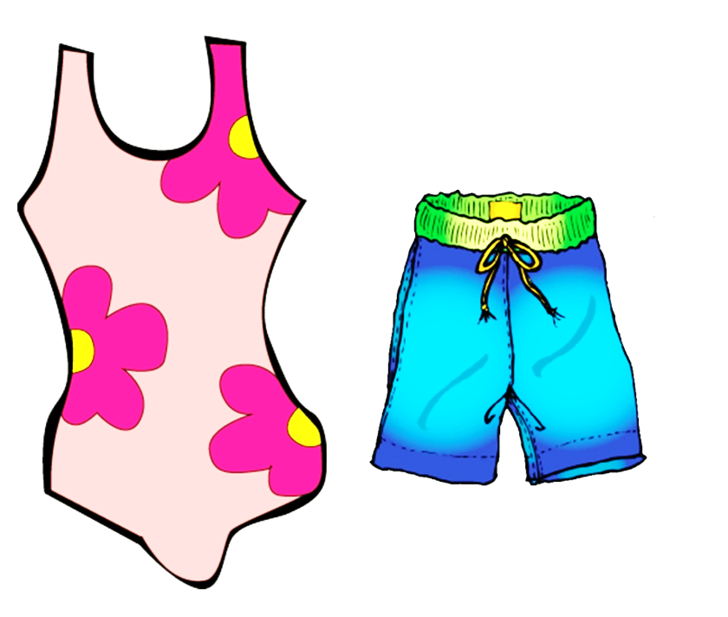
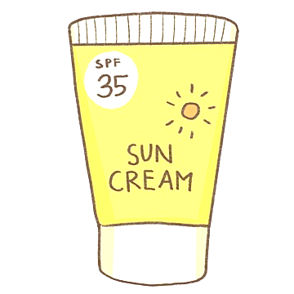

swim

Slide 7


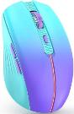
surf the Internet

Slide 8
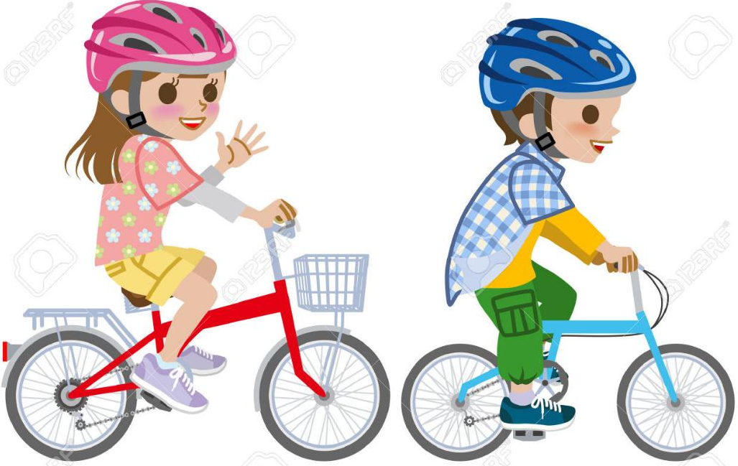
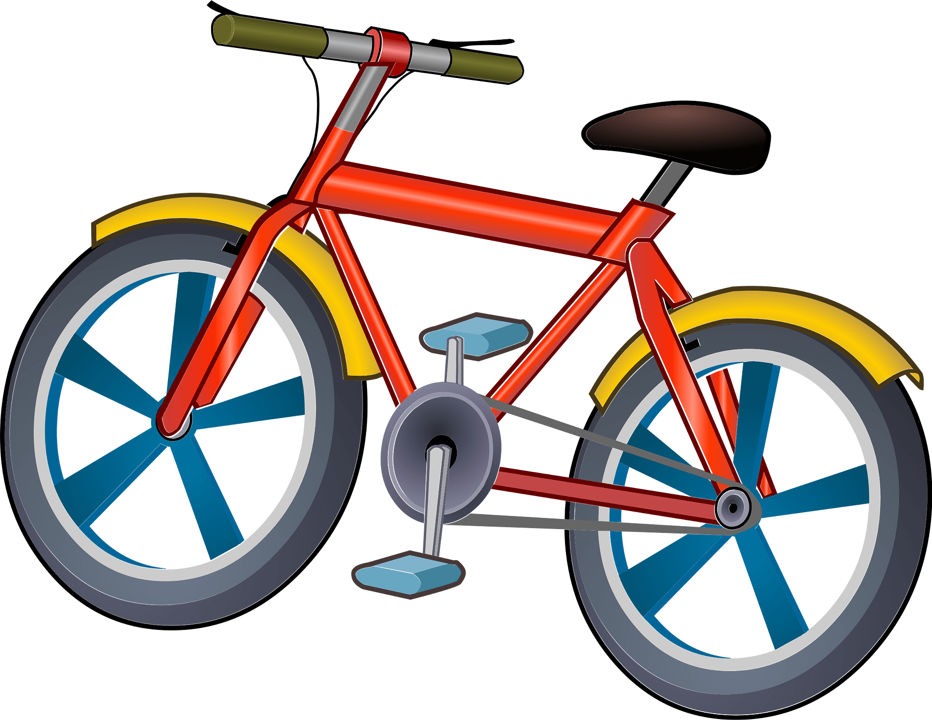

ride a bike

Slide 9
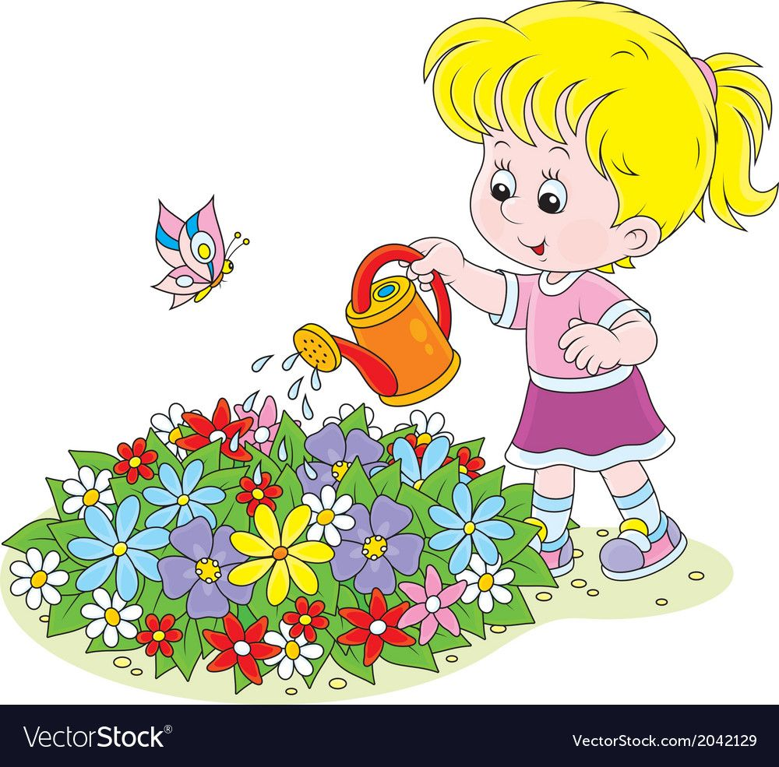


water the flowers

Slide 10
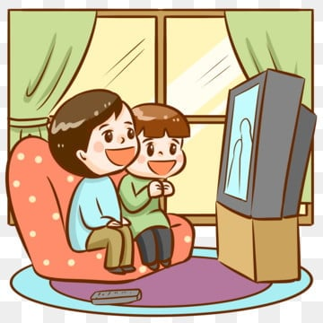


watch TV

Slide 11
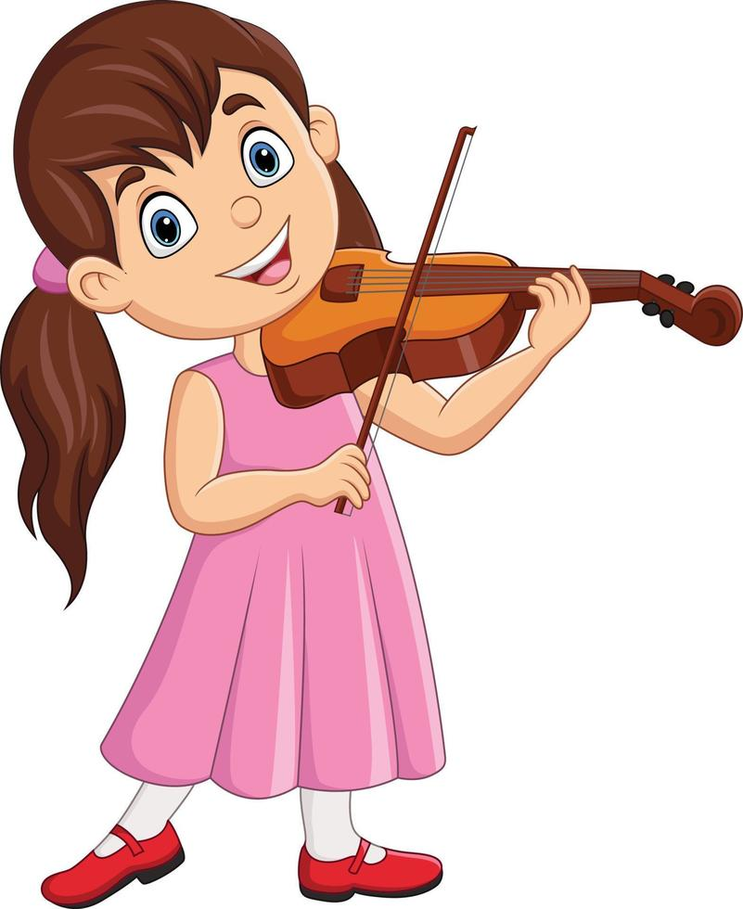

play the violin

Slide 12
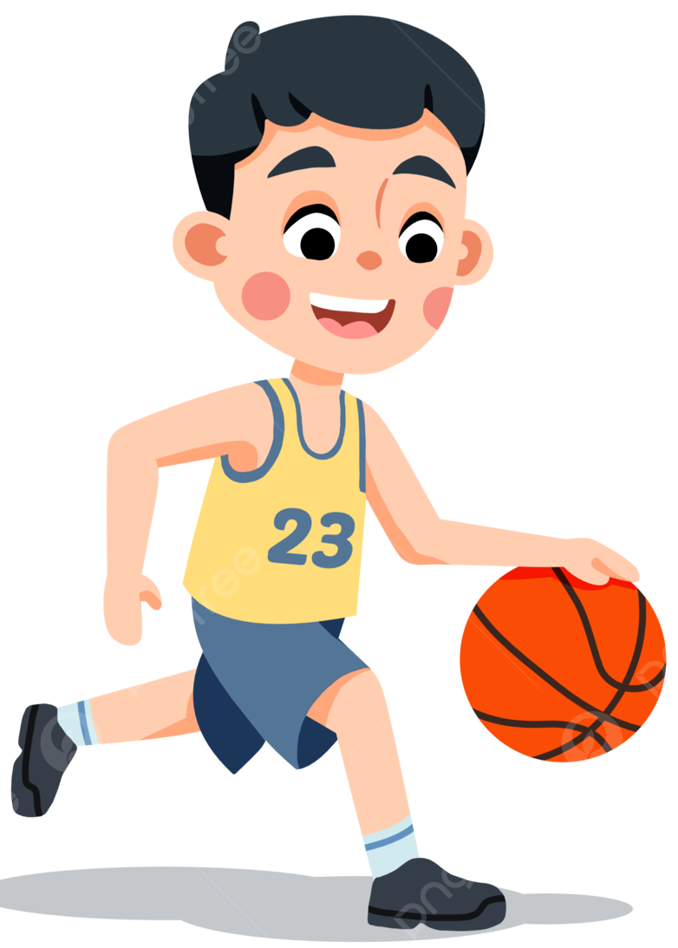
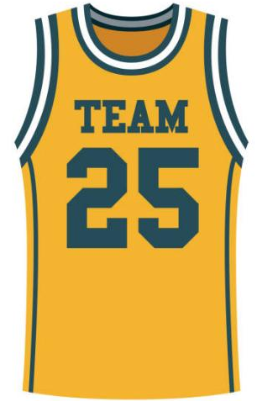

play basketball

Slide 13


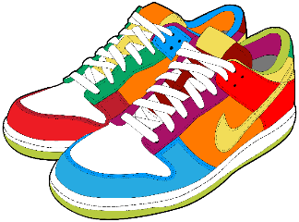
go for a walk

Slide 14
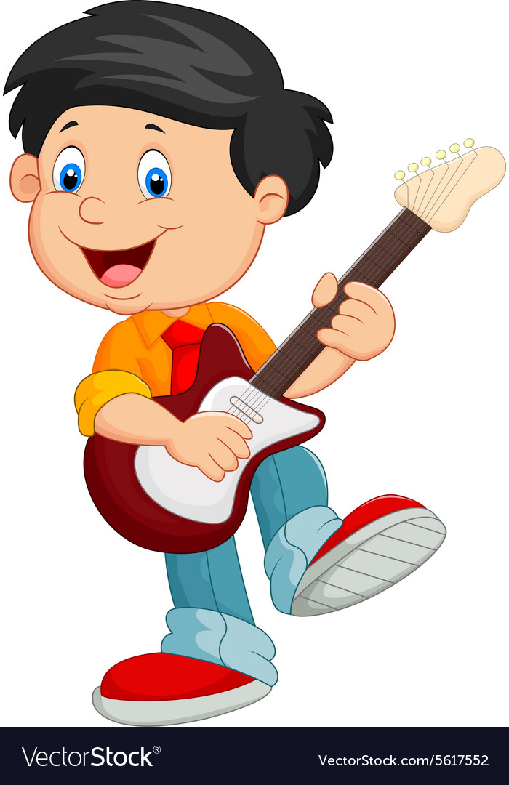
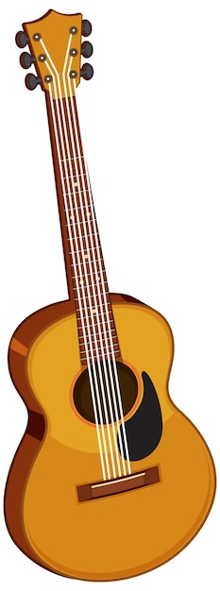

play the guitar

Slide 15
Let’s meet
my friends.
What do / don’t they like doing?

Slide 16
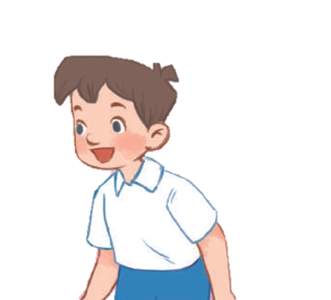


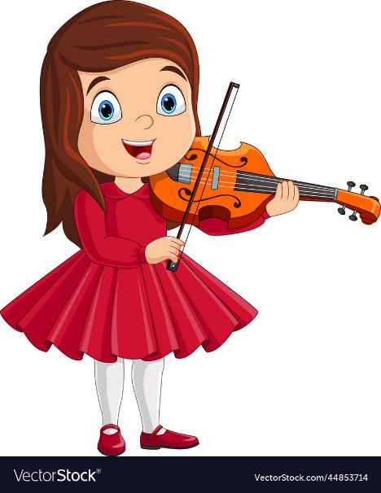
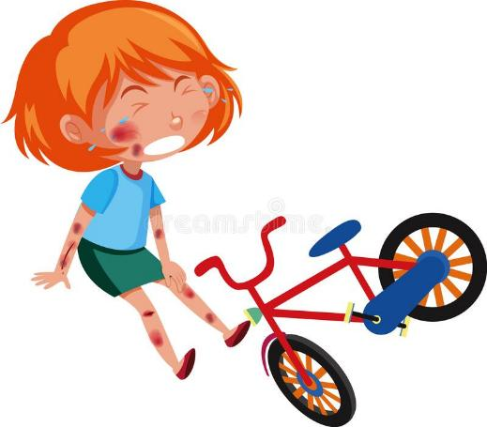


Do you like ………………. in your free time?
No, I don’t.
Yes, I do.
No, I don’t.

Slide 17

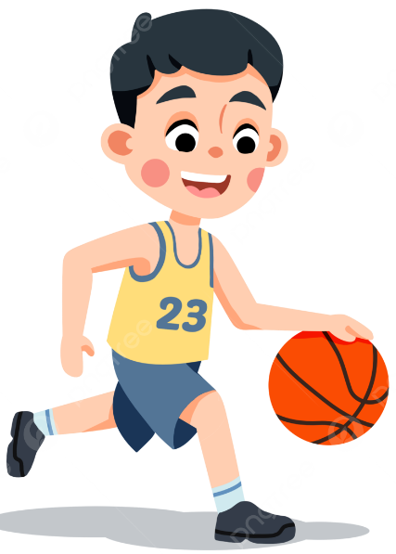
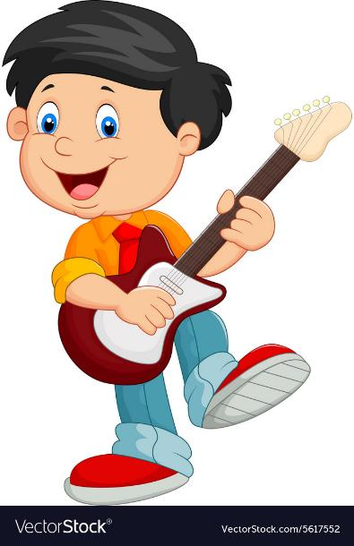

What do you like doing
in your free time?
I like ……………….

Slide 18
02. Listen and number.

Slide 19
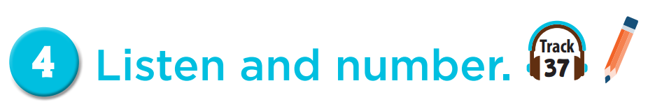

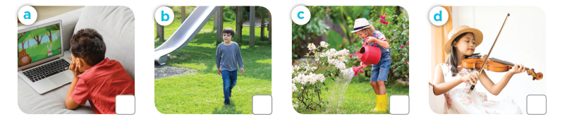
4
3
2
1

Slide 20
03. Read and complete.

Slide 21
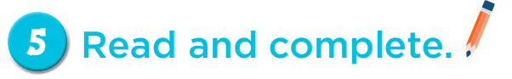
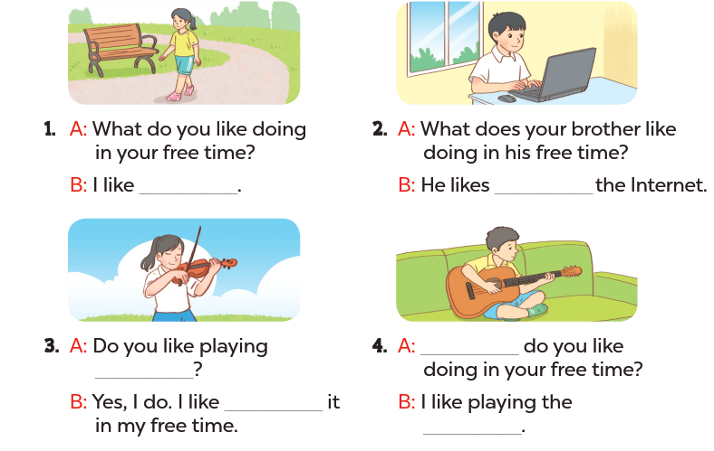
going for a walk
surfing
What
the violin
playing
guitar

Slide 22
04. Let’s play.

Slide 23
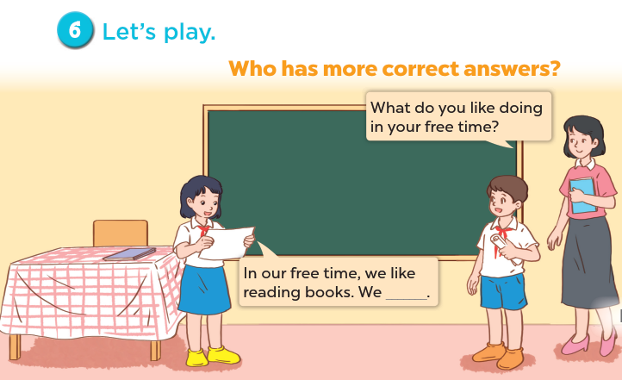

Slide 24
Share with friends.

Slide 25
05. Fun time

Slide 26



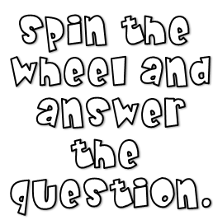




Slide 35

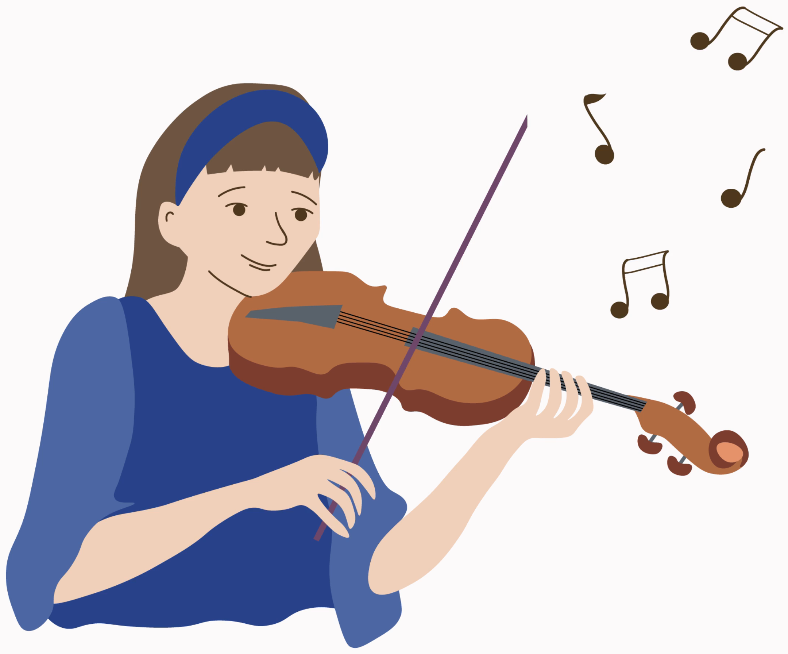

What do you like doing
in your free time?
I like playing the violin.

Slide 36
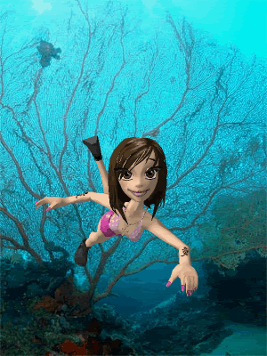
What do you like doing
in your free time?
I like swimming.

Slide 37
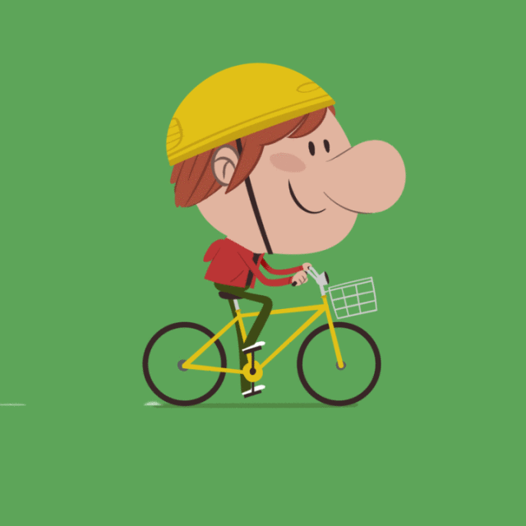
What do you like doing
in your free time?
I like riding a bike.

Slide 38


Slide 39
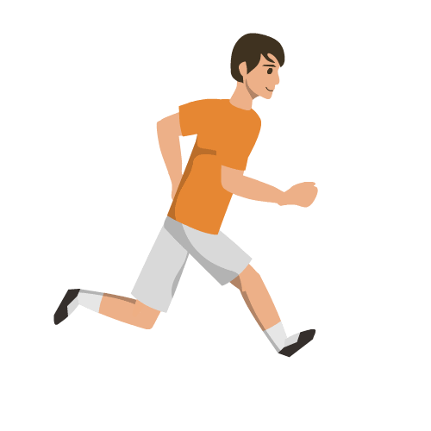
What do you like doing
in your free time?
I like running.

Slide 40

- 3 stars

Slide 41

What do you like doing
in your free time?
I like surfing the Internet.

Slide 42
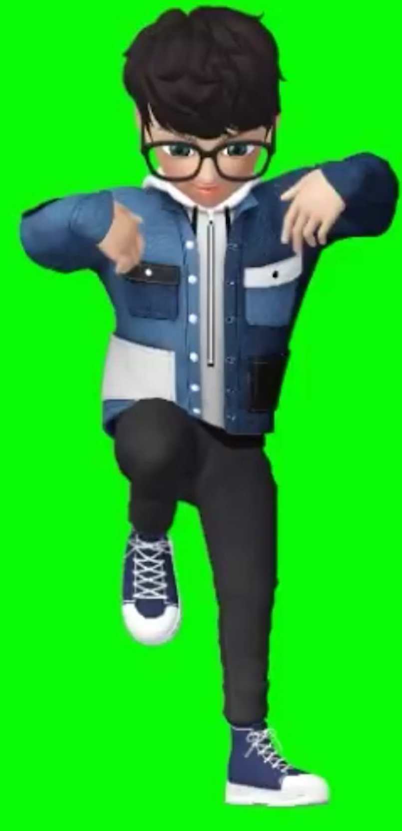

What do you like doing
in your free time?
I like dancing.

Slide 43
Website: hoclieu.vn
Fanpage: https://www.facebook.com/tienganhglobalsuccess.vn/

