Slide 1

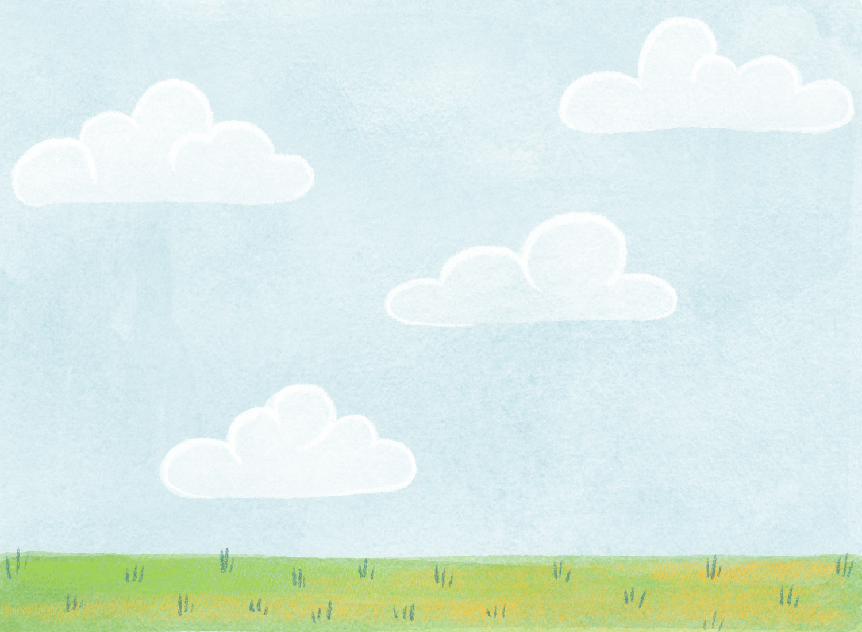






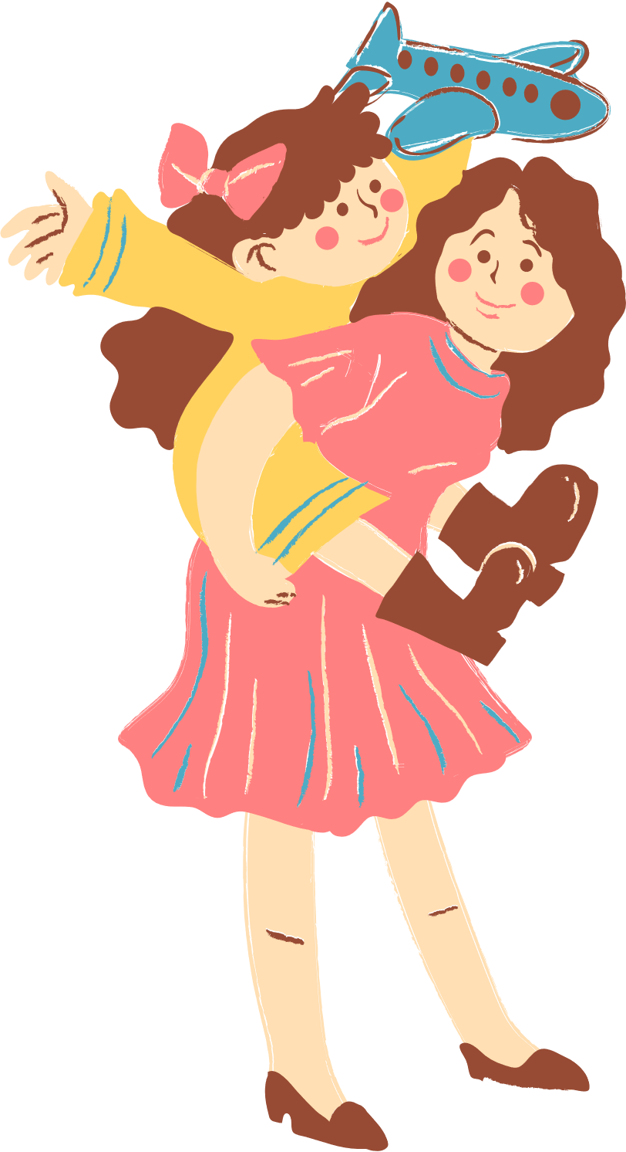
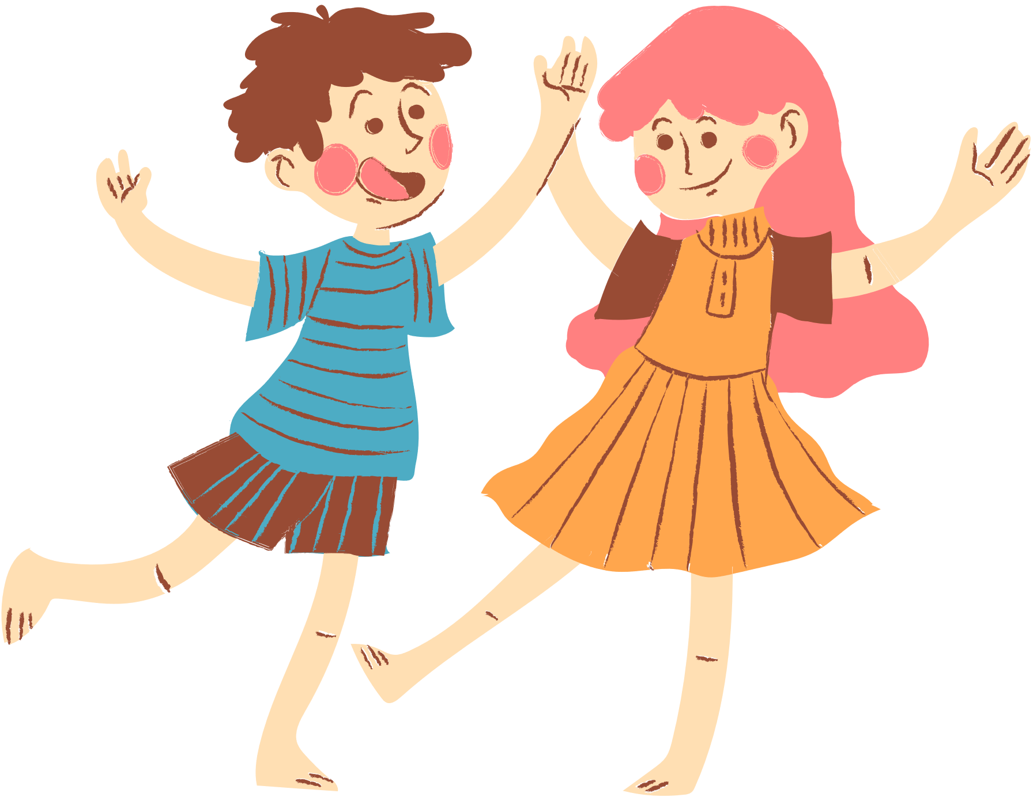
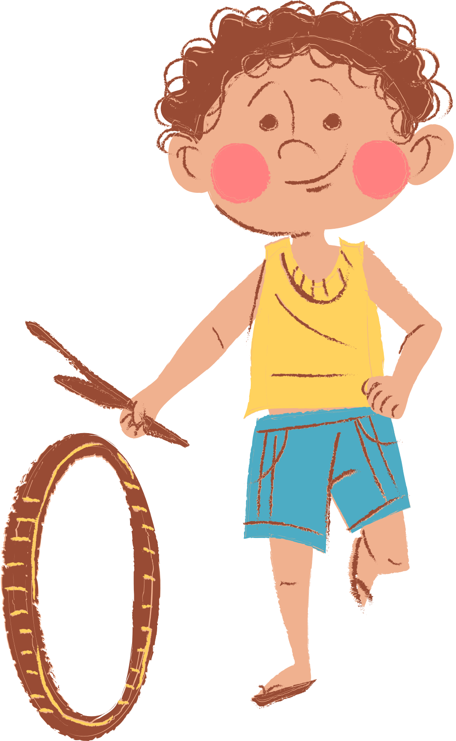
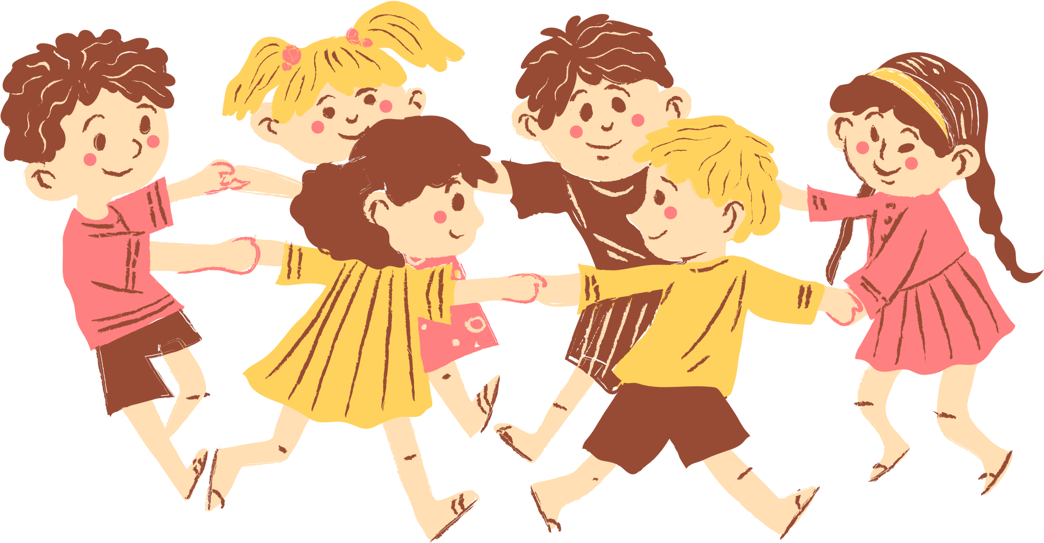
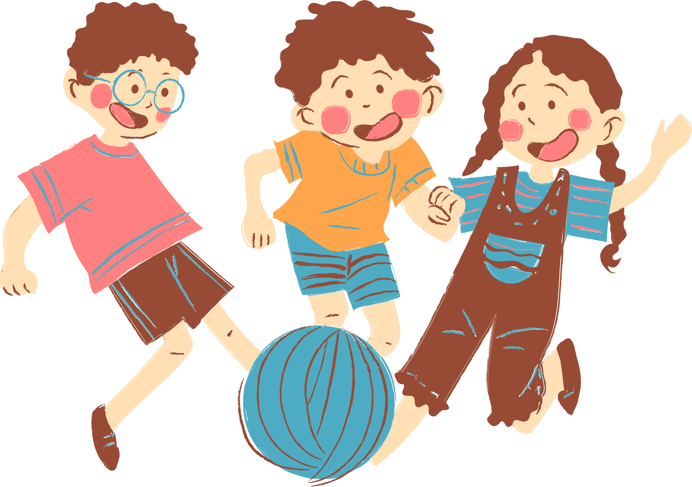
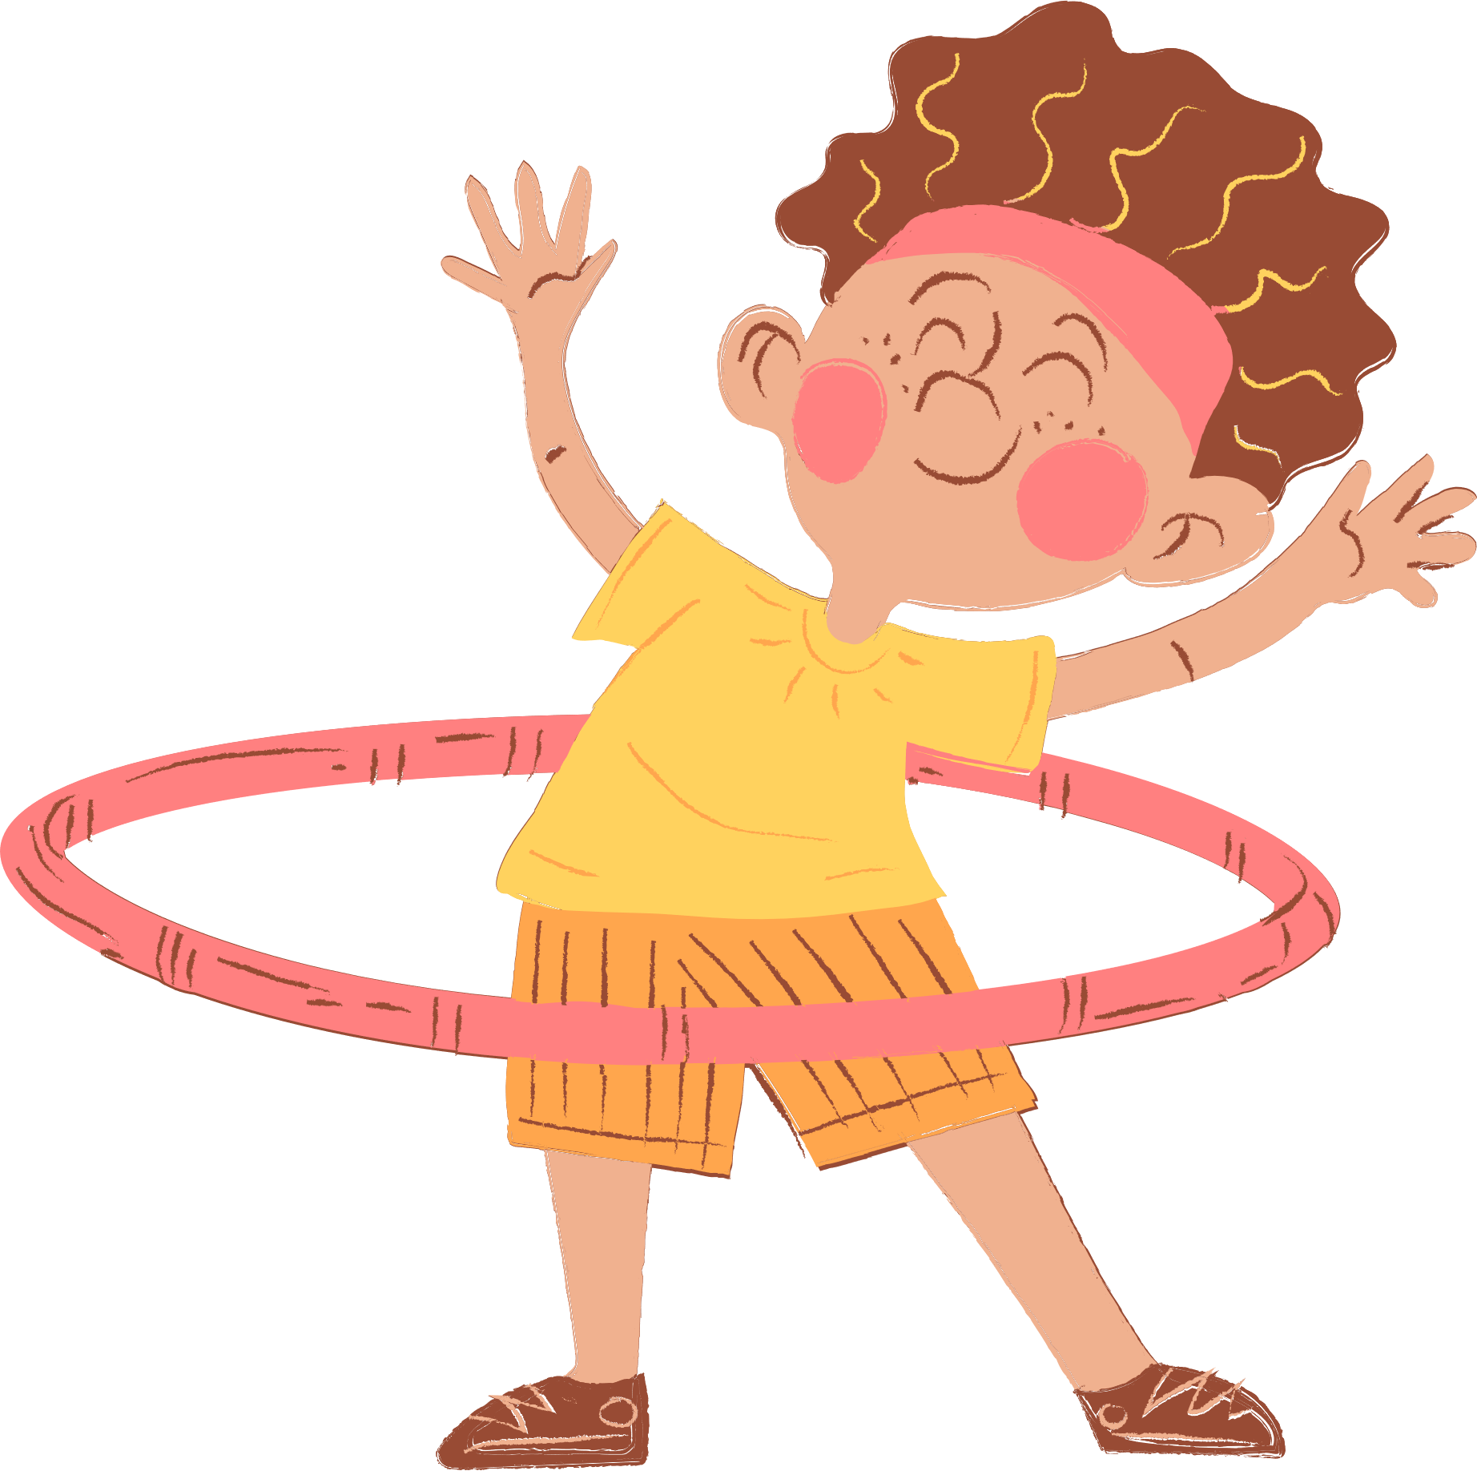
4
Our Free-time Activities

Slide 2






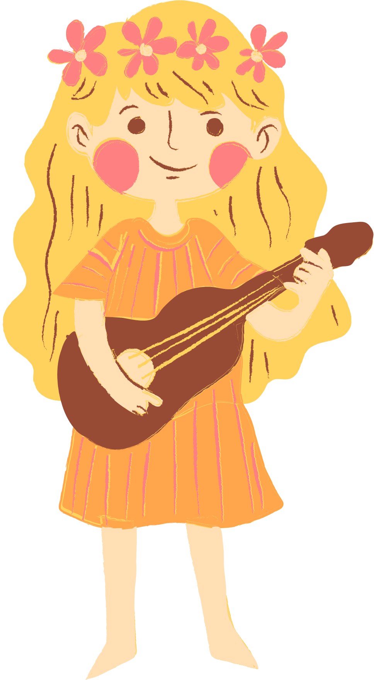
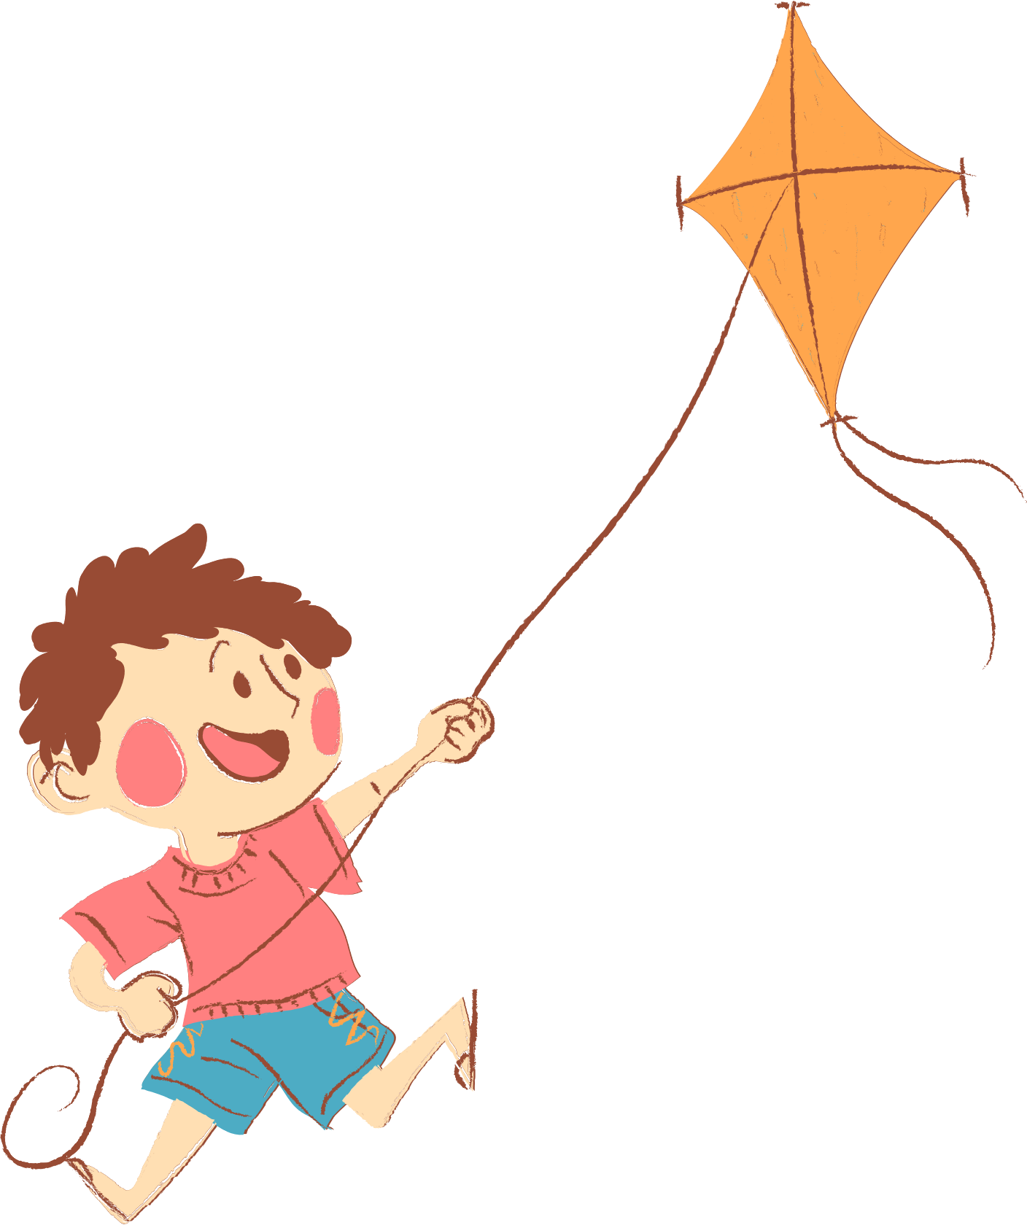
01. Review
02. Listen and tick.
03. Read and complete.
04. Let's sing.
05. Fun time

Slide 3
01. Review
Choose a number and say the activity.

Slide 4

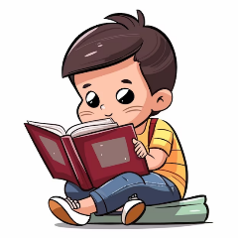
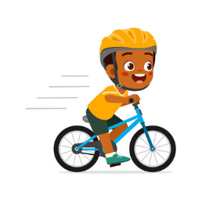
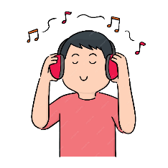
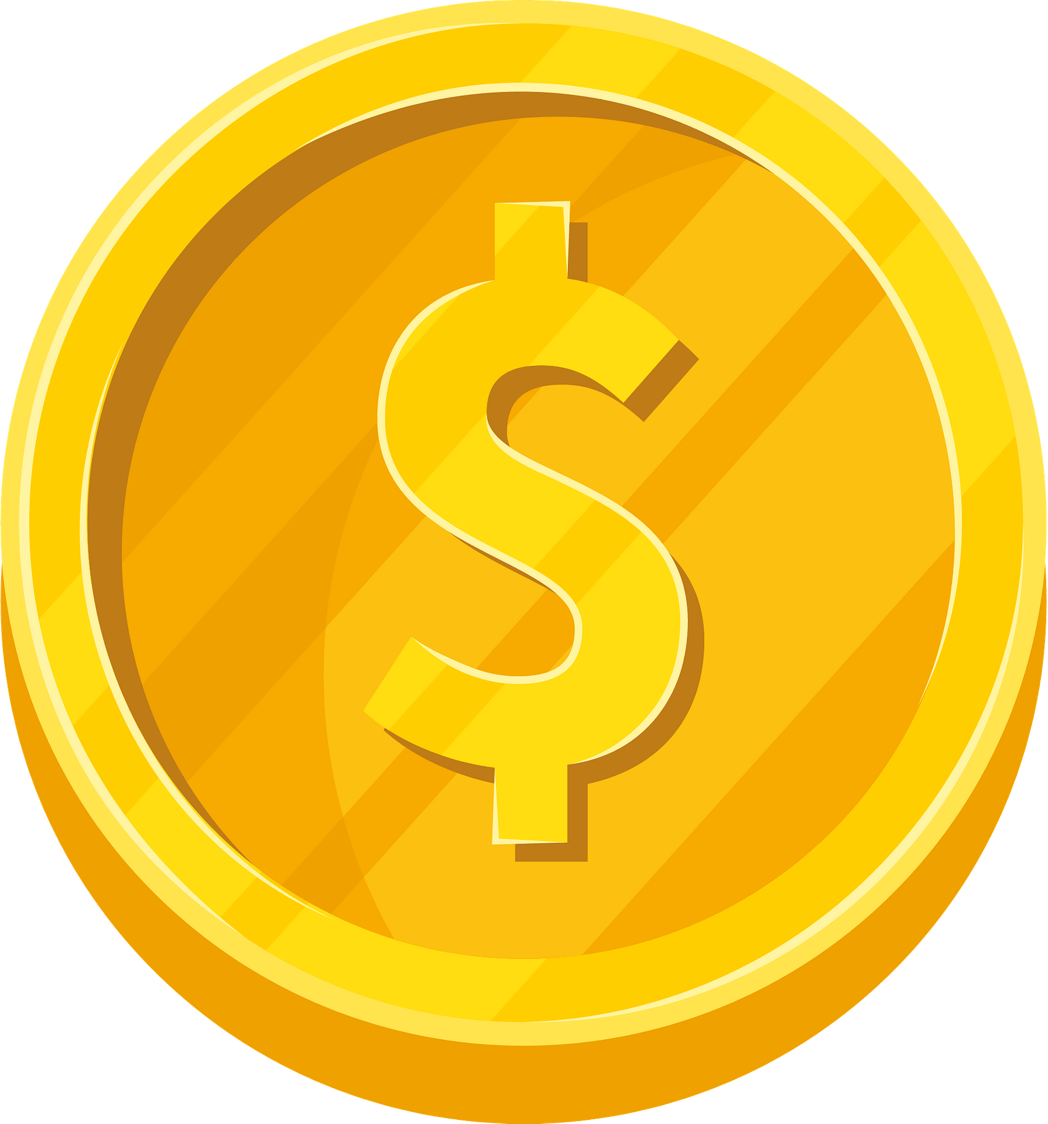

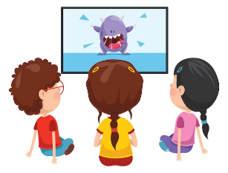

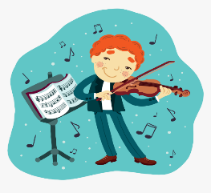
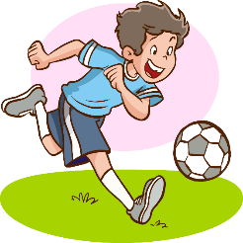
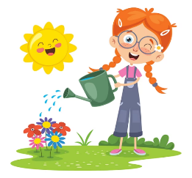
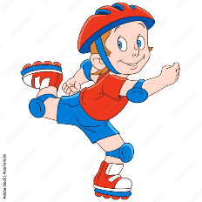
1
2
3
= +1 point
4
5
6
= lose 2 points
= rock, paper, scissors
(winner takes 2)
7
8
9
Notes:
- Divide the class into 3 teams.
- Pupils from each team choose a number (or throw sticky ball on the grid to choose the number), then have 2 pupils from each team ask and answer with the picture in that number.
- Pupils or teacher clicks on the month to reveal the icons indicating the points for that team.
- After 9 numbers, the team with the most points is the winner.

Slide 5
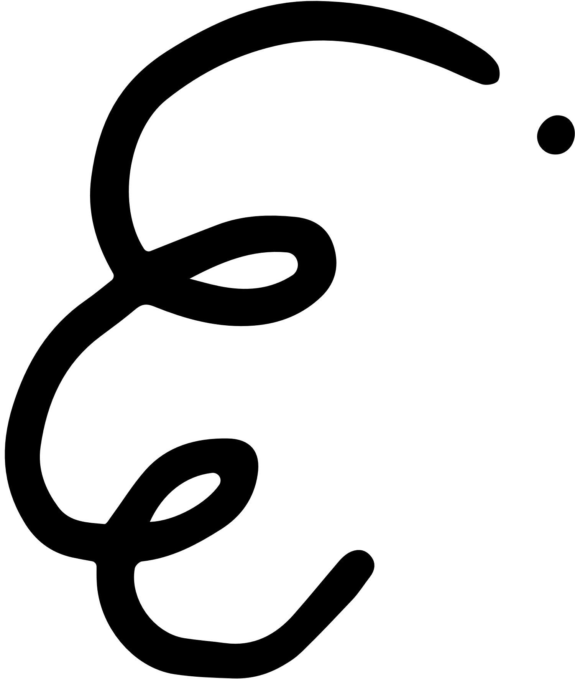

Adverbs of Frequency
always
✓✓✓✓
usually
✓✓✓
often
✓✓
sometimes
✓
never
✗

Slide 6



What do you do at the weekend?
Mon. | Tue. | Wed. | Thu. | Fri. | Sat. | Sun.
always
I always read stories.

Slide 7
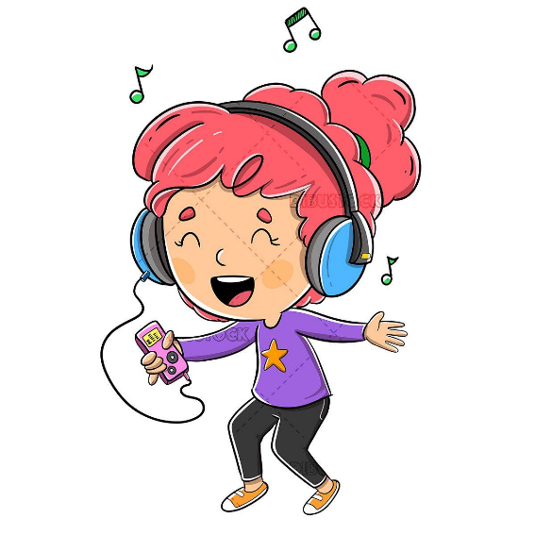
What do you do at the weekend?
Mon. | Tue. | Wed. | Thu. | Fri. | Sat. | Sun.
usually
I usually listen to music.

Slide 8

What do you do at the weekend?
Mon. | Tue. | Wed. | Thu. | Fri. | Sat. | Sun.
never
I never ride my bike.

Slide 9
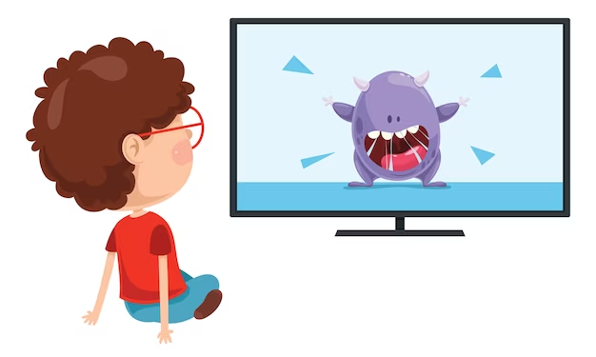
What do you do at the weekend?
Mon. | Tue. | Wed. | Thu. | Fri. | Sat. | Sun.
often
I often watch cartoons.

Slide 10
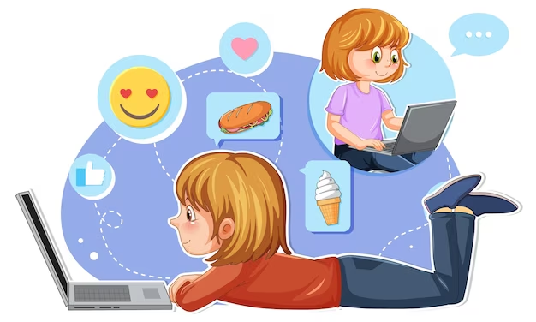
What do you do at the weekend?
Mon. | Tue. | Wed. | Thu. | Fri. | Sat. | Sun.
sometimes
I sometimes surf the Internet.

Slide 11
02.
Listen and tick.

Slide 12
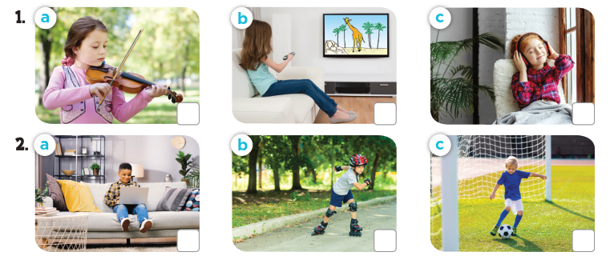
Look and answer
Notes:
Press the spacebar or down arrow to reveal the answer.
Press the X to go back to the letter slide (wrong answer), press the question box to go the reward slide (correct answer).

Slide 13
What do they do at the weekend?
Notes:
Press the spacebar or down arrow to reveal the answer.
Press the X to go back to the letter slide (wrong answer), press the question box to go the reward slide (correct answer).

Slide 14
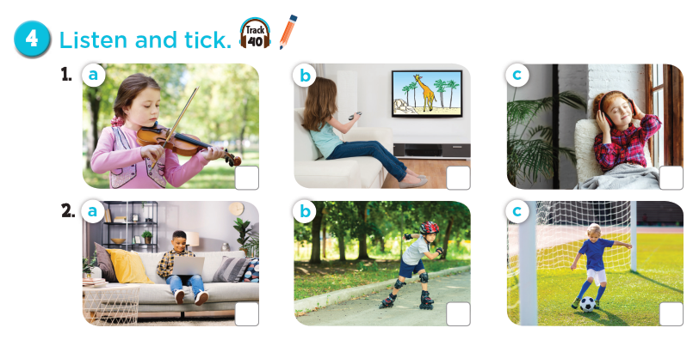

Notes:
Press the spacebar or down arrow to reveal the answer.
Press the X to go back to the letter slide (wrong answer), press the question box to go the reward slide (correct answer).

Slide 15

Let's check!
Notes:
Press the spacebar or down arrow to reveal the answer.
Press the X to go back to the letter slide (wrong answer), press the question box to go the reward slide (correct answer).

Slide 16
Listen and repeat!
Notes:
Press the spacebar or down arrow to reveal the answer.
Press the X to go back to the letter slide (wrong answer), press the question box to go the reward slide (correct answer).

Slide 17
03.
Read and complete.

Slide 18
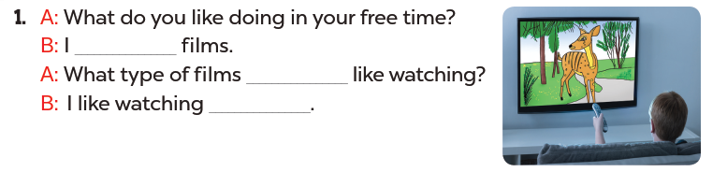
Read. What's the missing word?
like watching
do you
cartoons

Slide 19
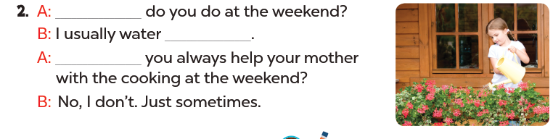
Read. What's the missing word?
What
the flowers
Do

Slide 20
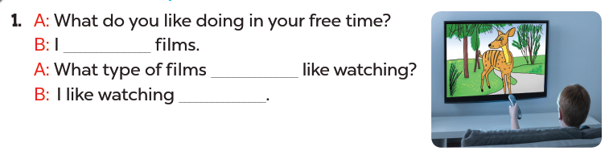
Read aloud.
like watching
do you
cartoons

Slide 21
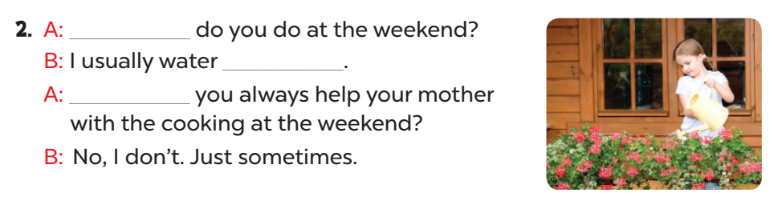
Act it out.
What
the flowers
Do

Slide 22
04.
Let's sing!

Slide 23
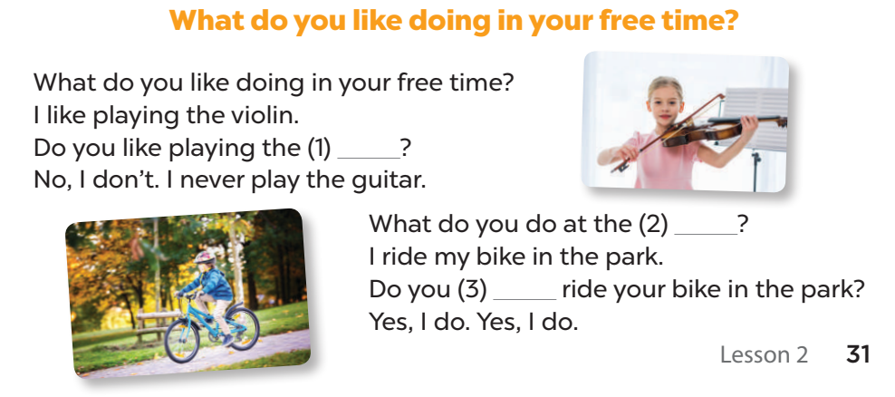
Listen and complete.
guitar
weekend
always

Slide 24
Let's sing.
guitar
weekend
always

Slide 25
05.
Fun time!

Slide 26

1
2
3
THE
FOOTBALL GAME
4
5
6
7
8
9

Slide 27
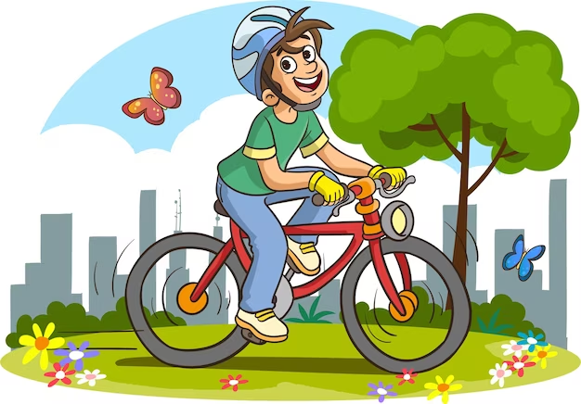
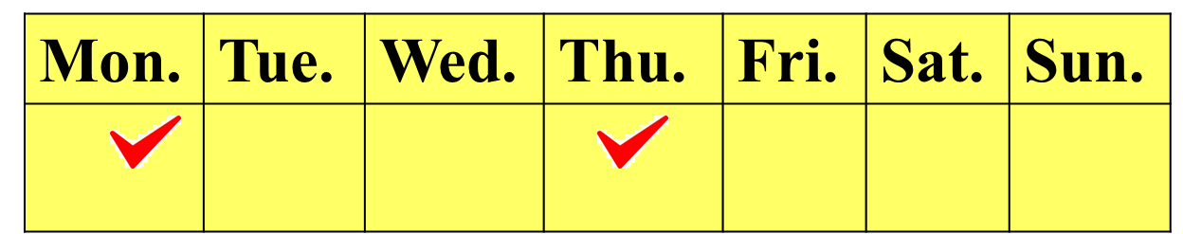
What do you at the weekend?
I sometimes ride a bike.

Slide 28
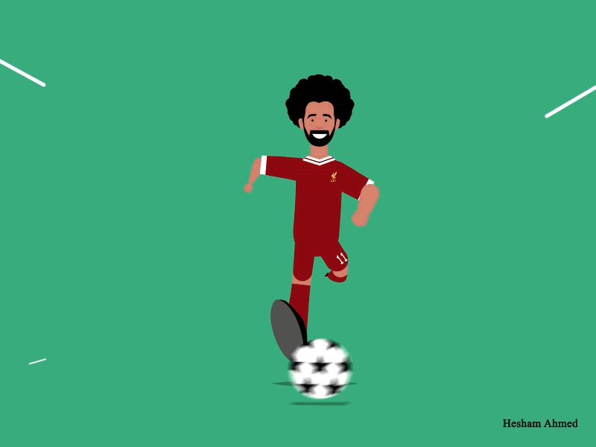
+ 3 points

Slide 29
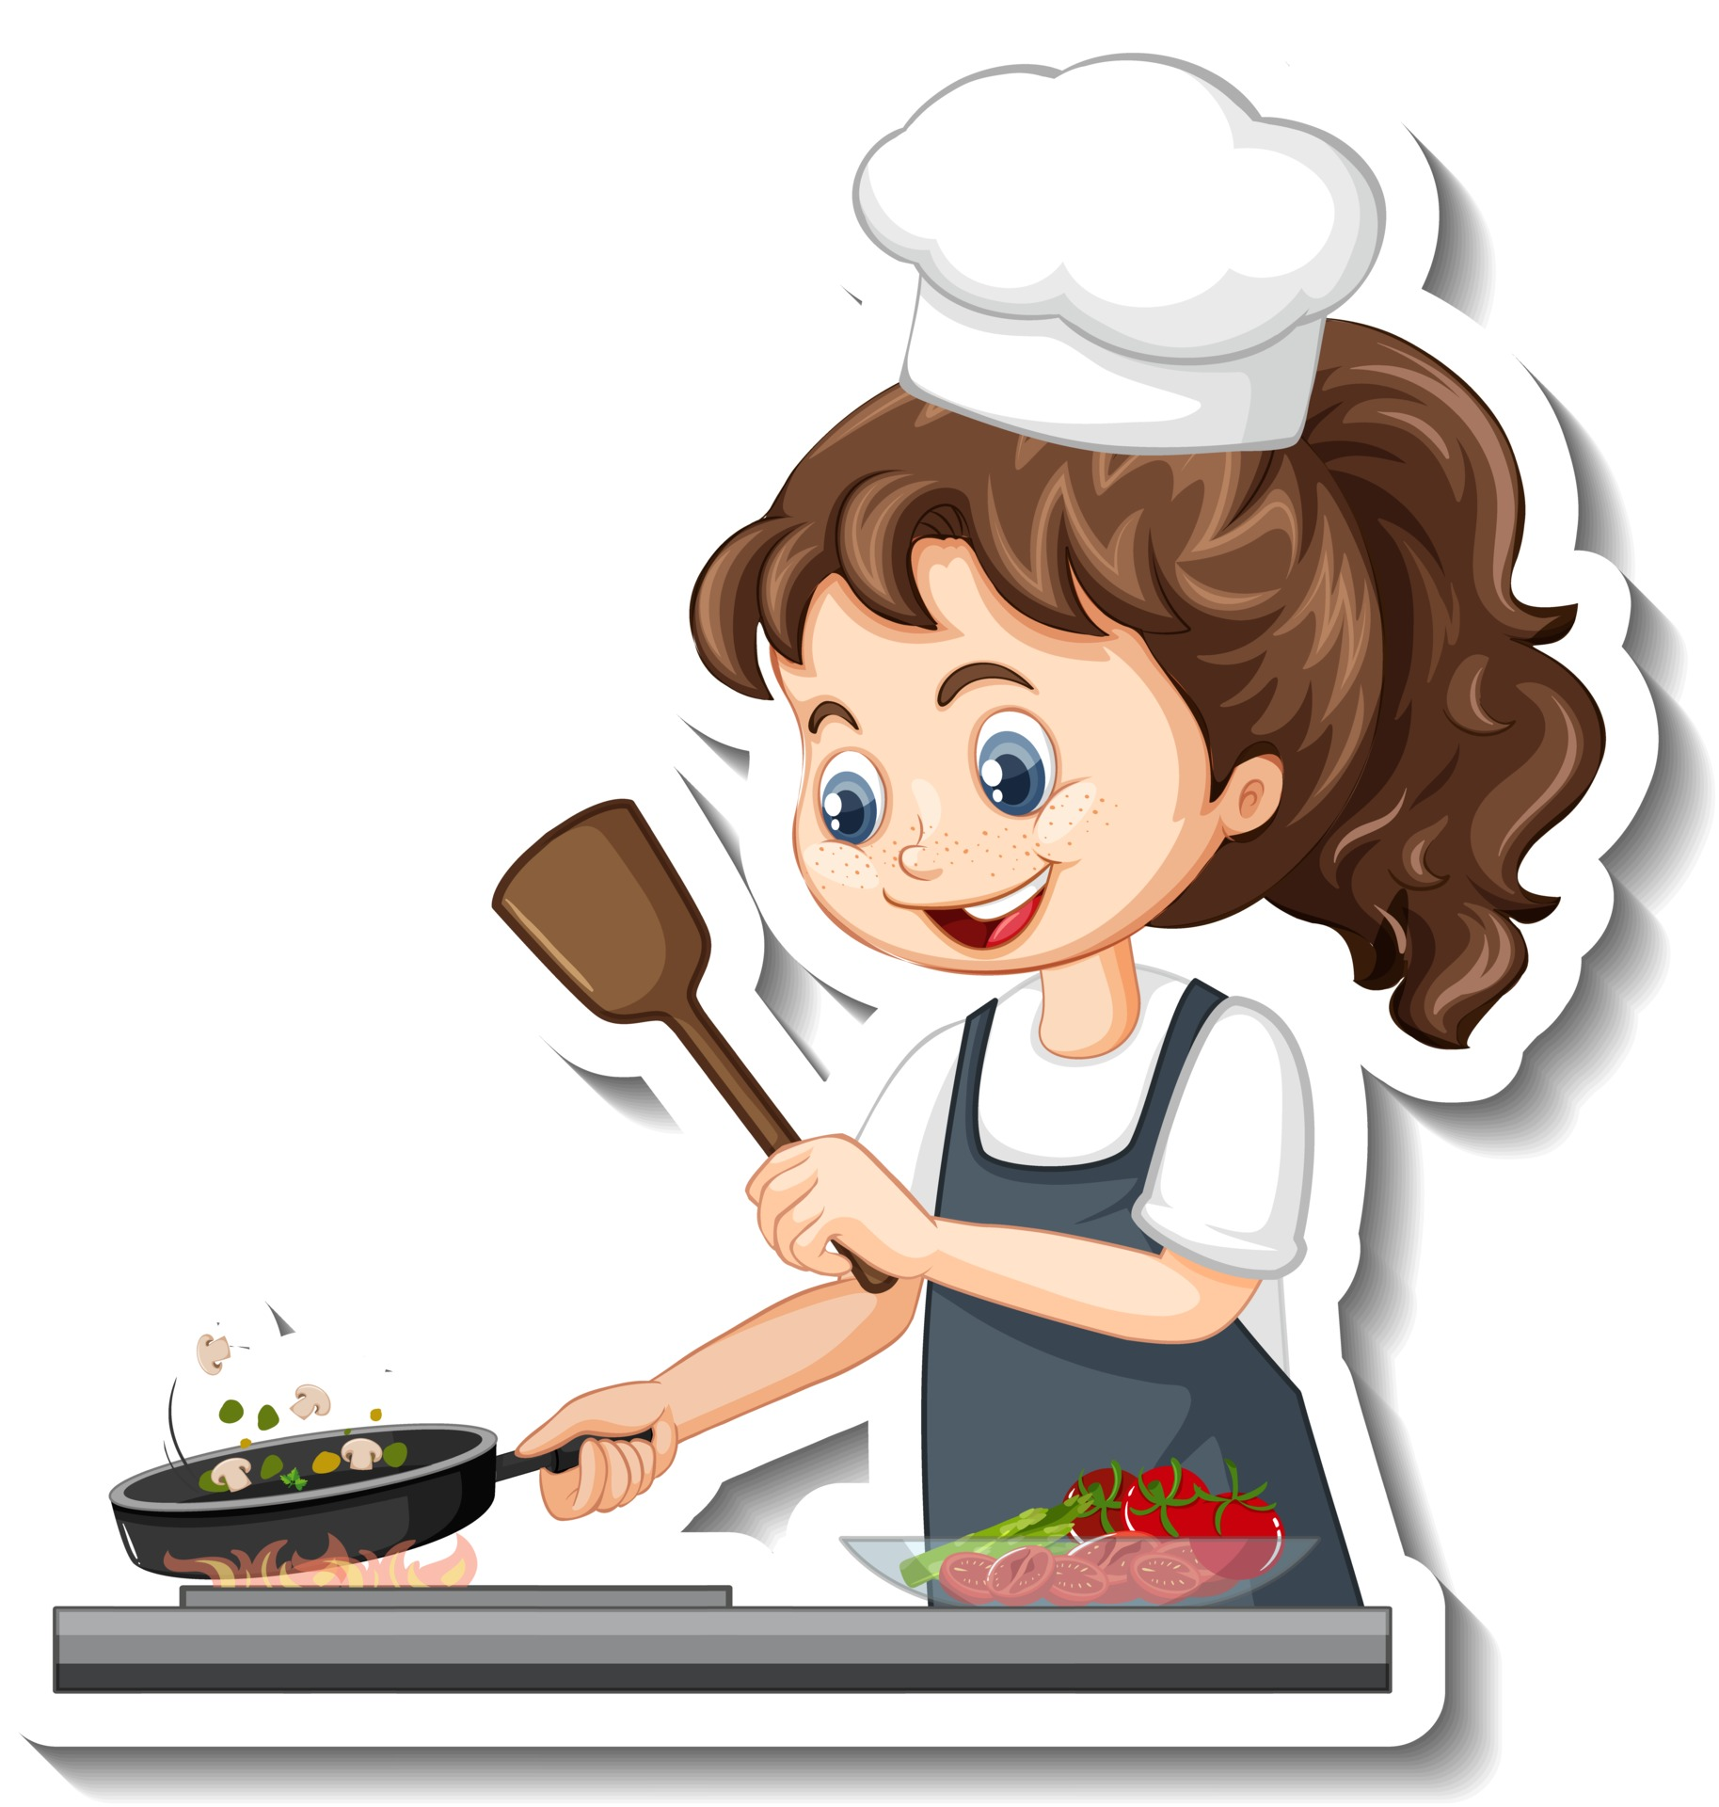
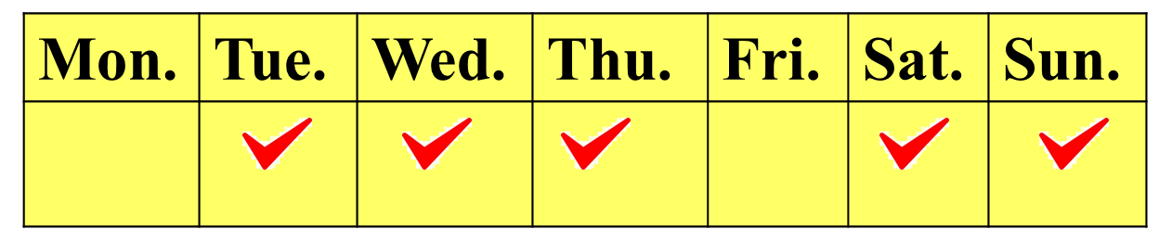
Do you always cook at the weekend?
No, I don't.

Slide 30
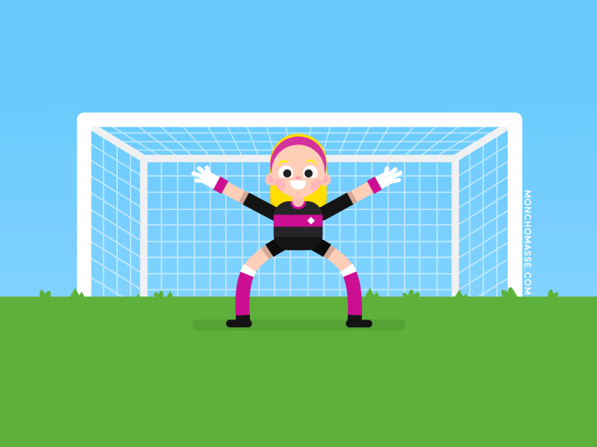
+ 5 points

Slide 31
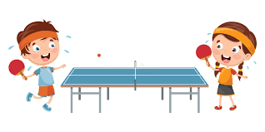
What do you like doing in your free time?
I like playing table tennis.

Slide 32
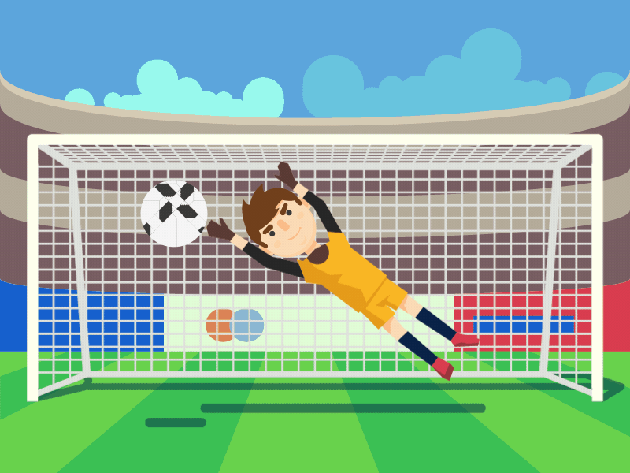
+ 2 points

Slide 33
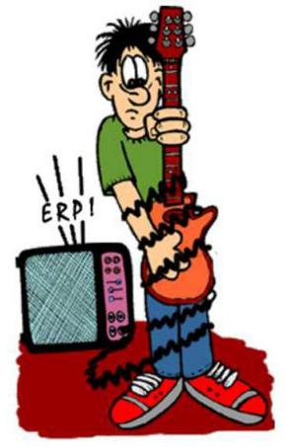
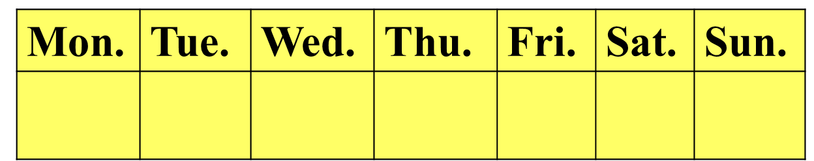
Do you like playing the guitar?
No, I don't.
I never play the guitar.

Slide 34
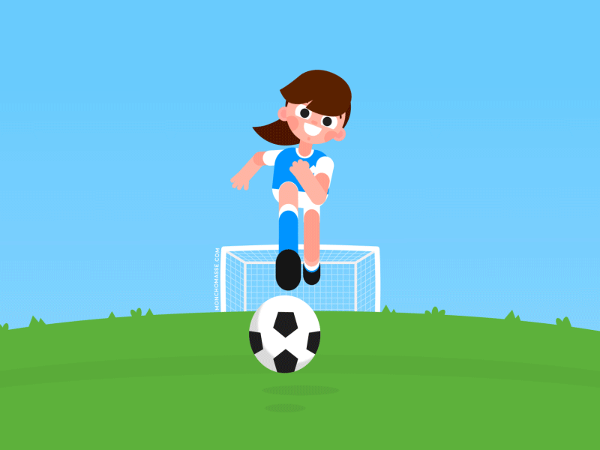
Take 2 points from another team

Slide 35

What
______ do you do at the weekend?
A. Who
B. When
C. What
I water the flower.

Slide 36
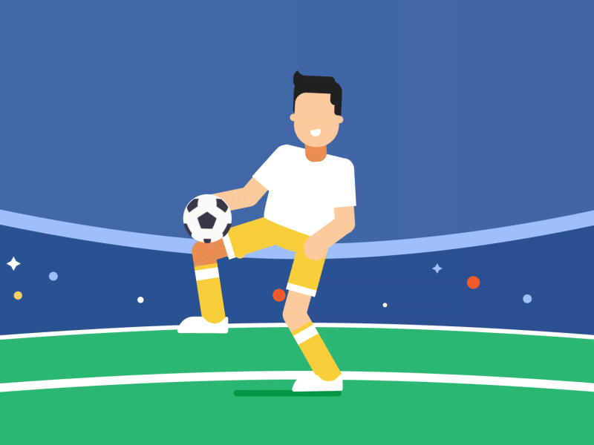
Change points with another team

Slide 37
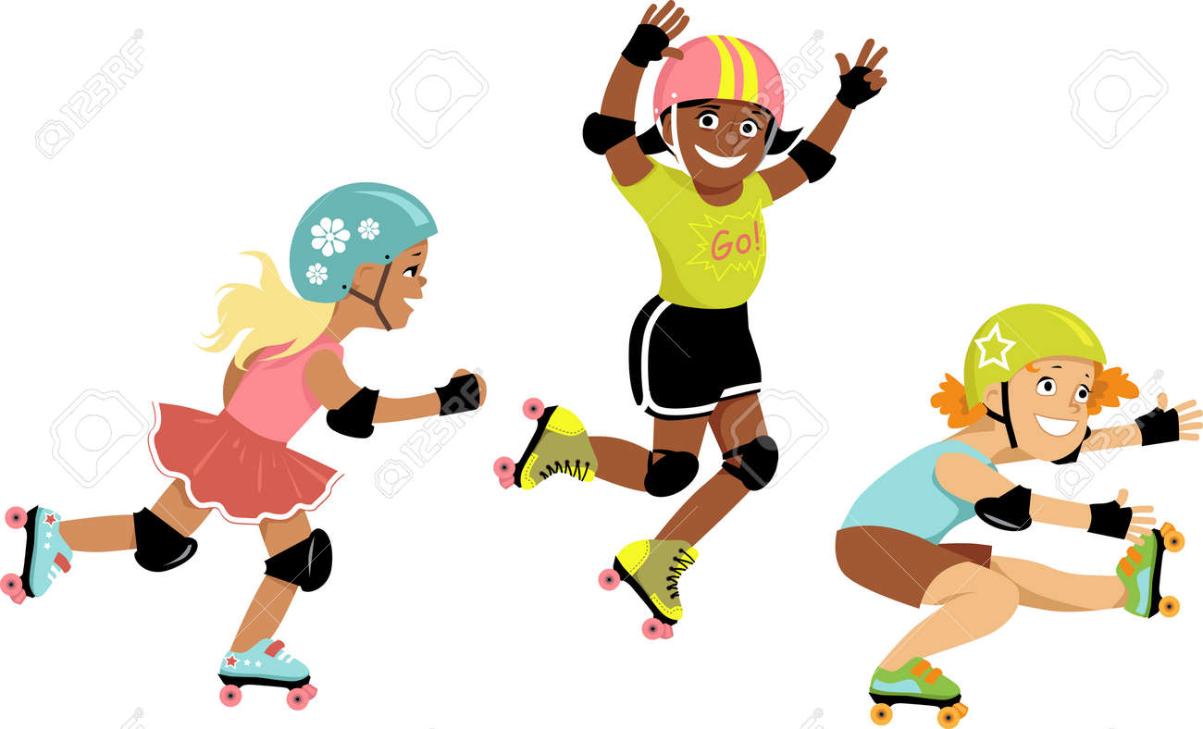
______ always roller skate
at the weekend?
Do you
Yes, I do.
I sometimes roller skate.

Slide 38
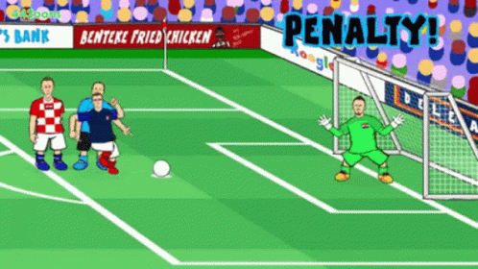
Oh no!
-3 points

Slide 39
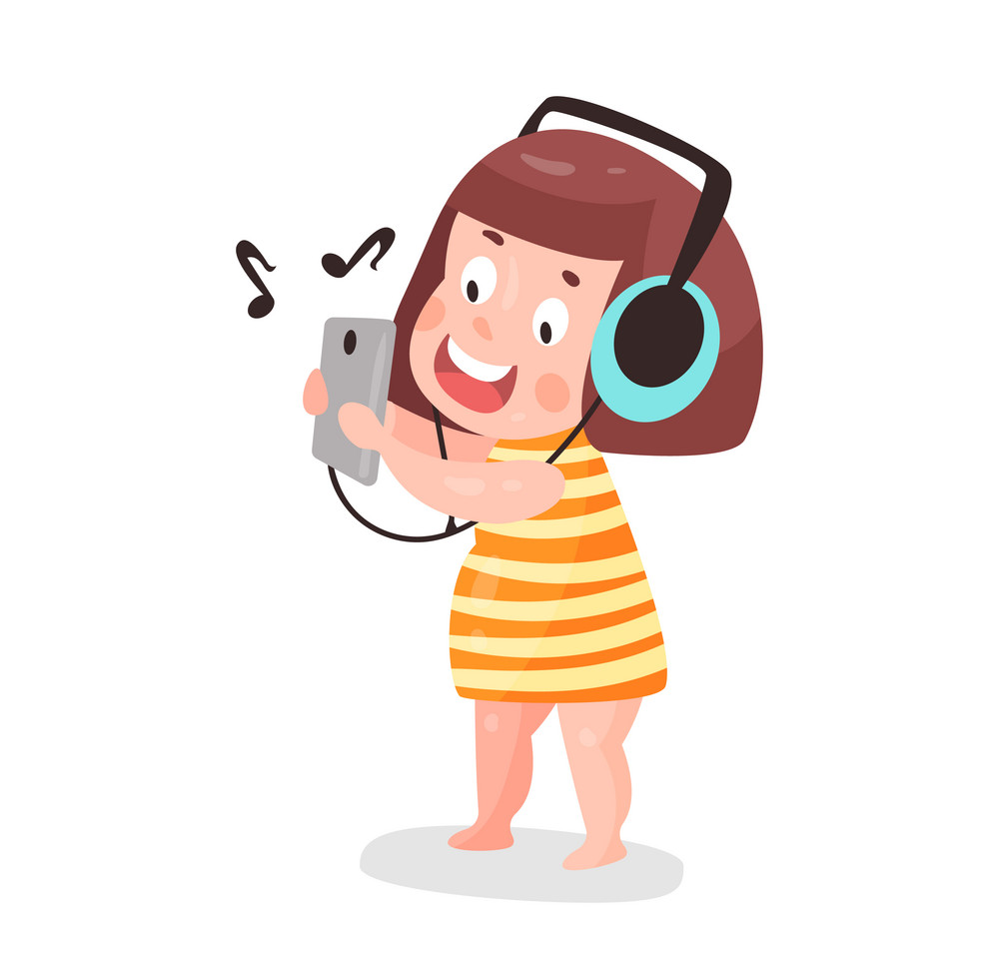
What are you doing?
I'm listening to music.

Slide 40
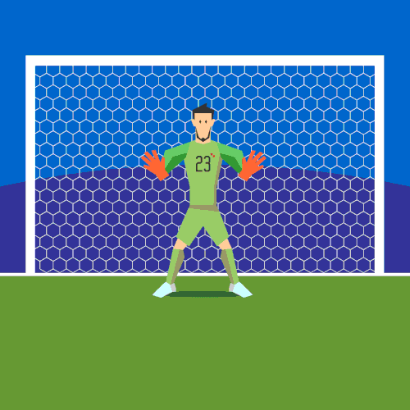
+ 4 points

Slide 41
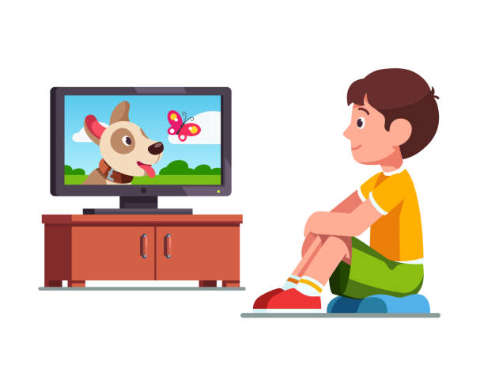
Do you like _____________ at the weekend?
watching cartoons
Yes, I do.

Slide 42
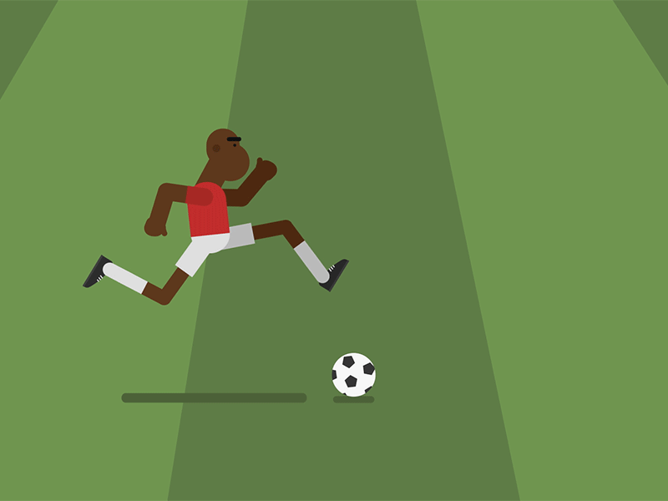
Too slow!
-2 points

Slide 43
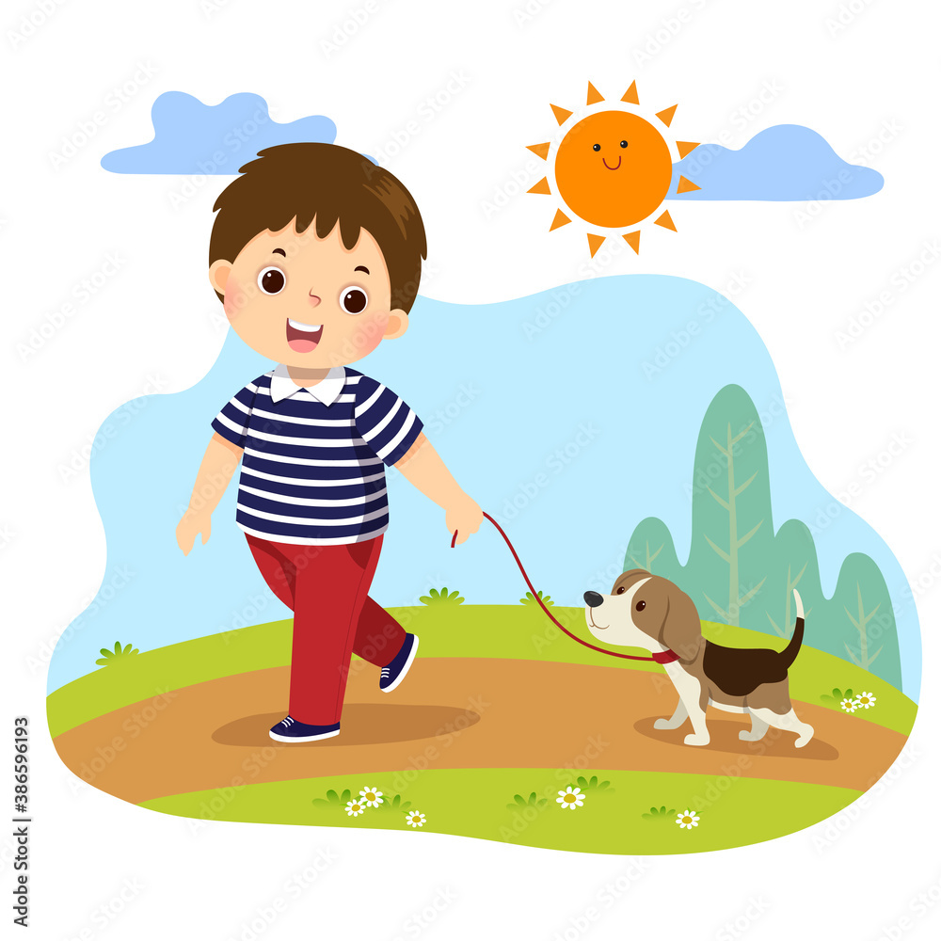
What do you at the weekend?
I _______ go for a walk.
usually

Slide 44
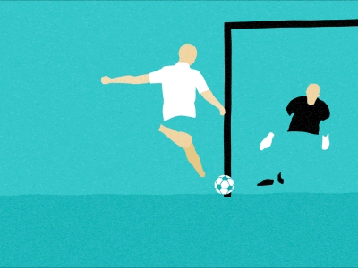
Oops!
-3 points

Slide 45
Website: hoclieu.vn
Fanpage: https://www.facebook.com/tienganhglobalsuccess.vn/

