Slide 1


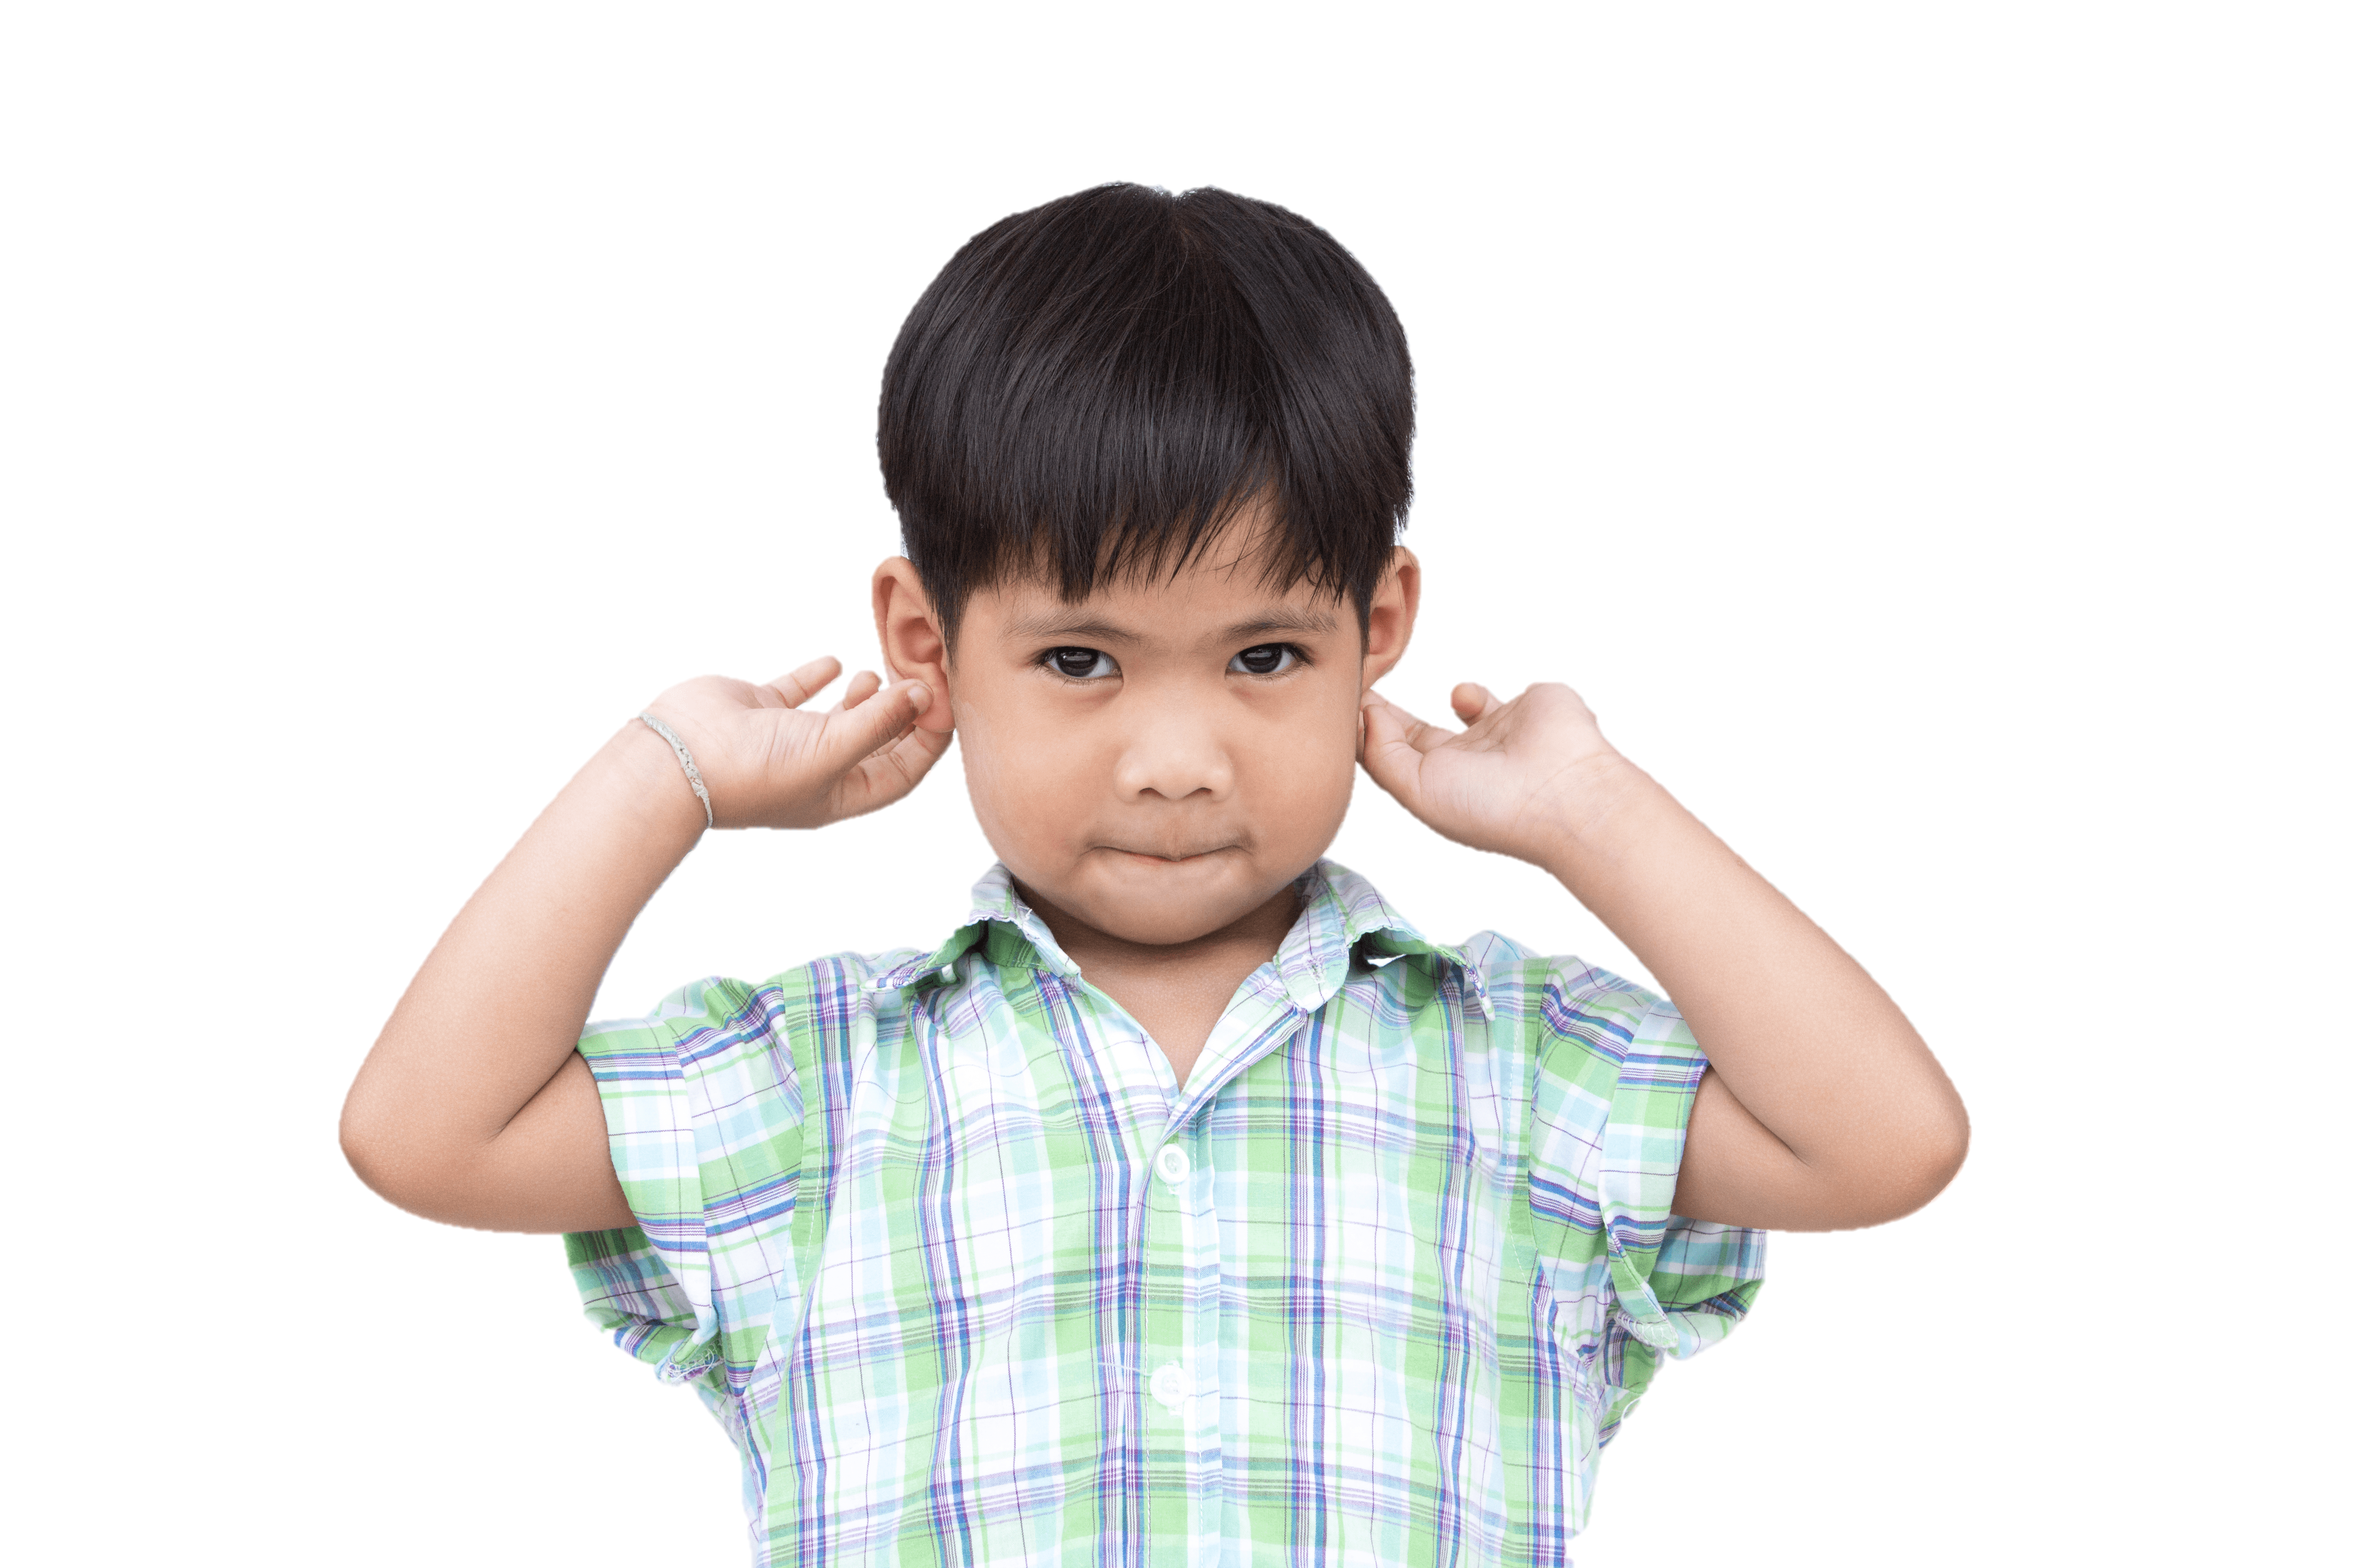
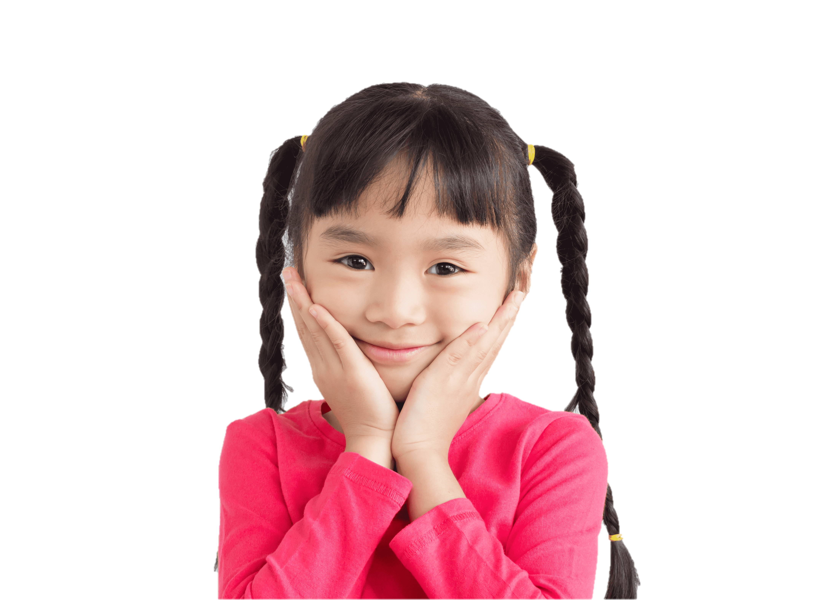

4
Our bodies
LESSON 2
Period 3

Slide 2
Contents
1
3
Warm-up and review
2
4
Look, listen and repeat.
Let’s talk.
Listen, point and say.
5
Fun corner and wrap-up

Slide 3
1
Warm-up and review

Slide 4



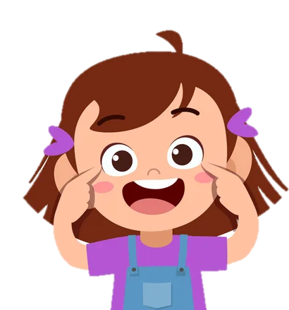



eyes
Notes:
Teacher: We use our ... to look. (Teacher pretends to wear glasses)
Pupils: eyes!

Slide 5
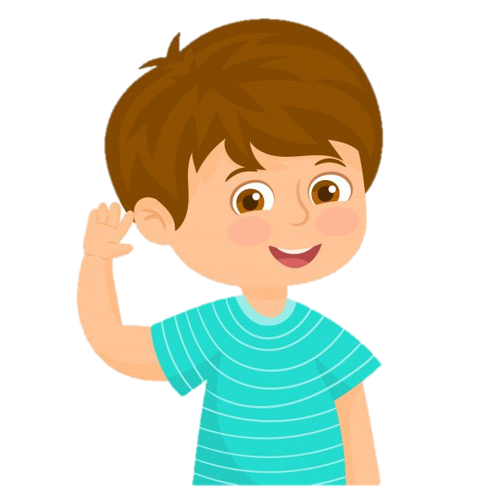
ears
Notes:
Teacher: We use our ... to listen. (Teacher pretends to listen to music)
Pupils: ears!

Slide 6
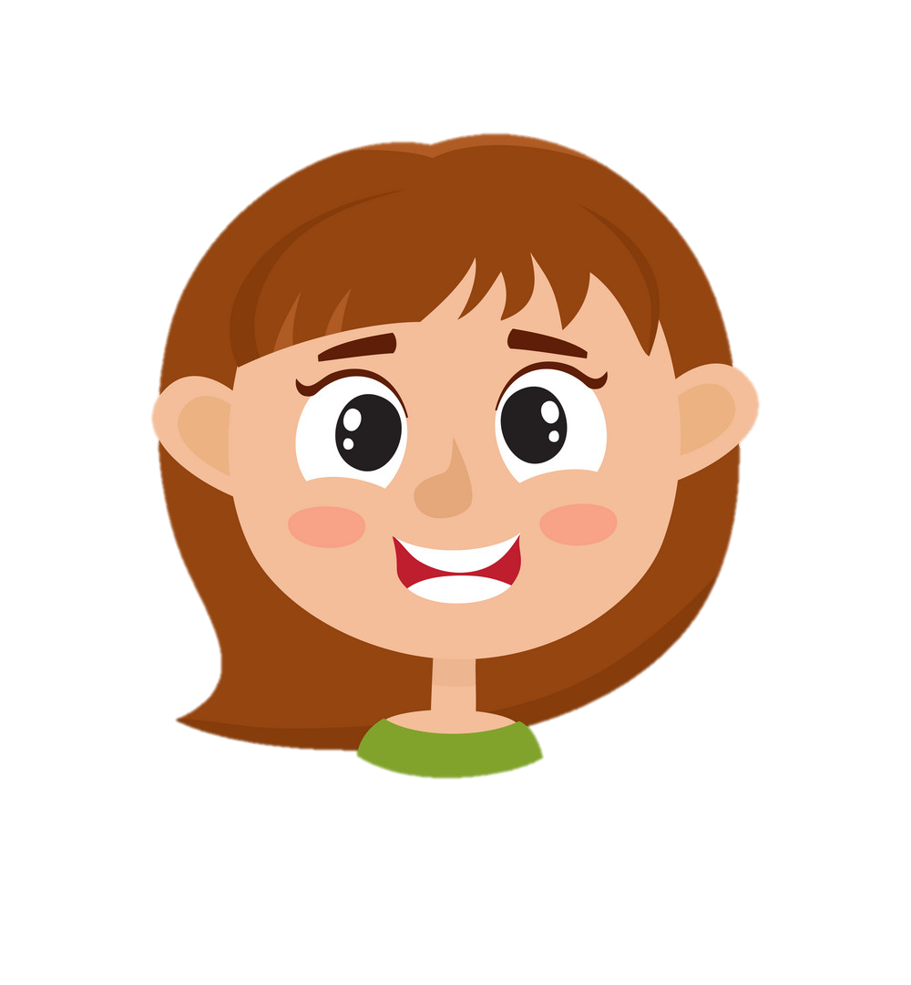
face
Notes:
Teacher: We put makeup on the ... (Teacher pretends to put on makeup)
Pupils: face!

Slide 7
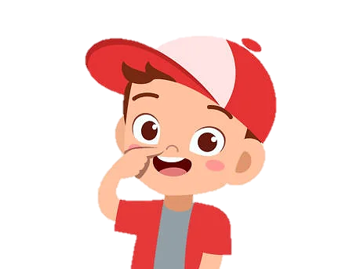
nose
Notes:
Teacher: We use the ... to smell. (Teacher pretends to smell somthing good)
Pupils: nose!

Slide 8
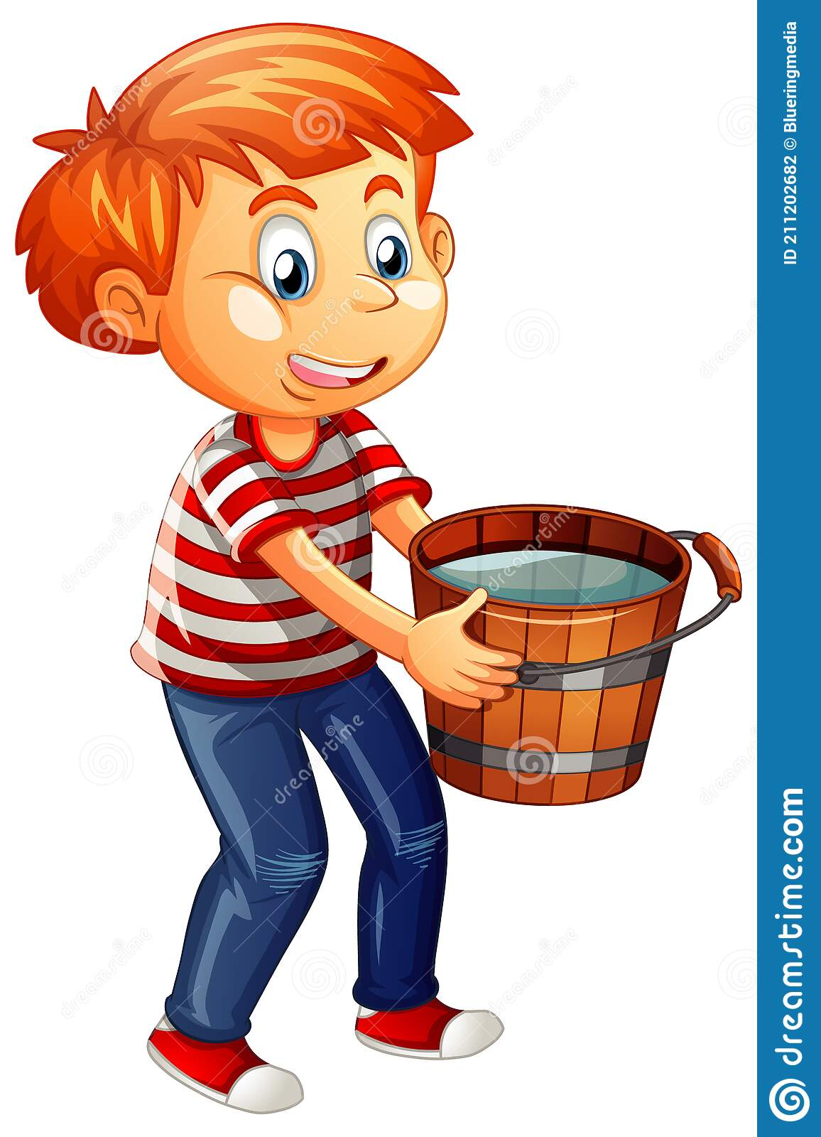
hands
Notes:
Teacher: We hold something with our ... (Teacher pretends to hold heavy thing)
Pupils: hands!

Slide 9
2
Look, listen and repeat.

Slide 10
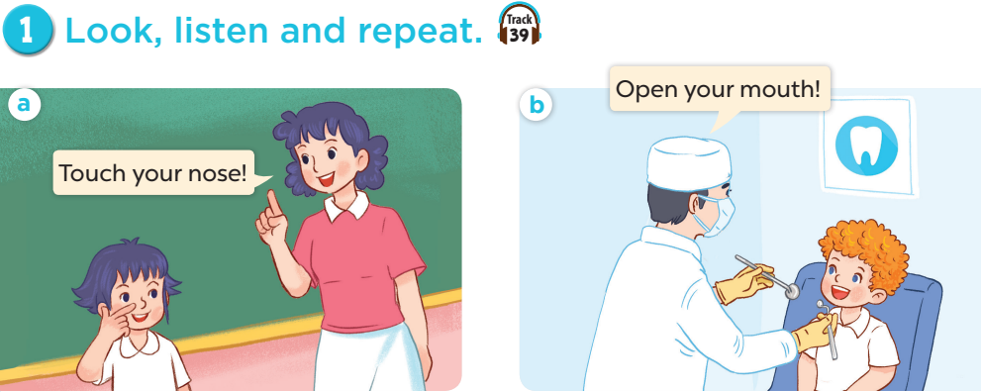

Slide 11
3
Listen, point and say.

Slide 12
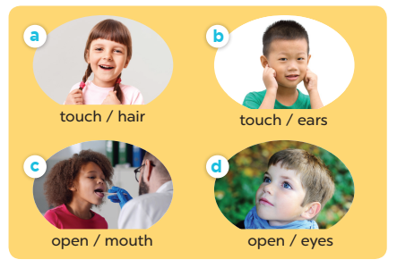



Slide 13
4
Let’s talk.

Slide 14
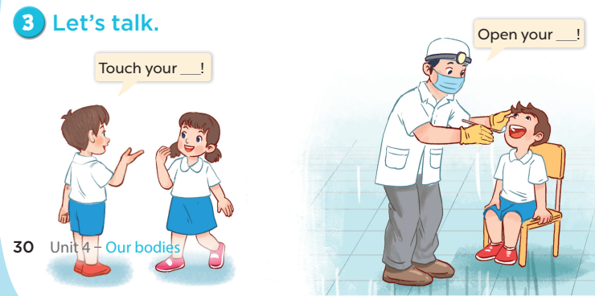

Slide 15
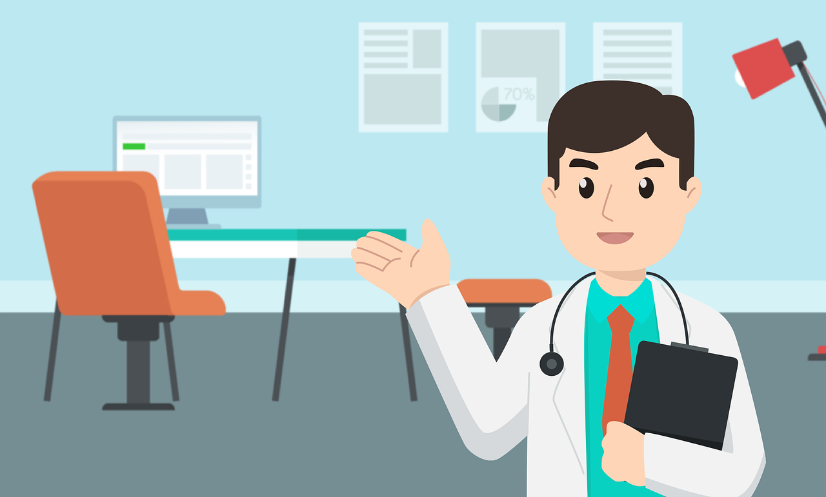
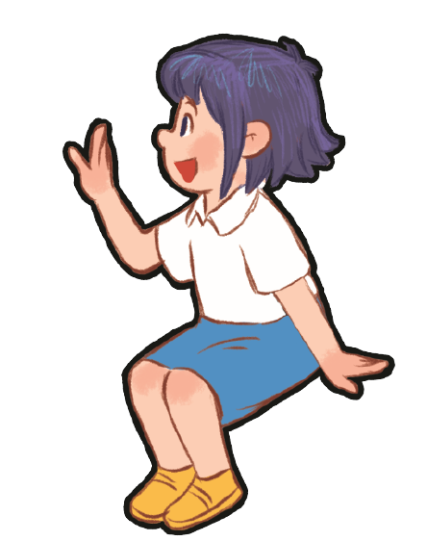
Notes:
Game: At the Doctor's Office
Step 1: Ask some volunteer pairs to role-play in front of class.
Step 2: One pupil is a doctor and the other is a patient, who will describe which body part hurts.
Step 3: When a patient says his/her ..... is hurt. The doctor has to listen carefully and touches that correct body part.

Slide 16
5
Fun corner and wrap-up

Slide 17


Let’s dance and touch!
Start
Notes:
Let’s dance and touch!
Step 1: The teacher starts the music and instructs pupils to dance around the room.
Step 2: The teacher stops the music and shows the next slide.
Step 3: Then pupils must find a partner and touch the appropriate body part on their’s friend body.

Slide 18
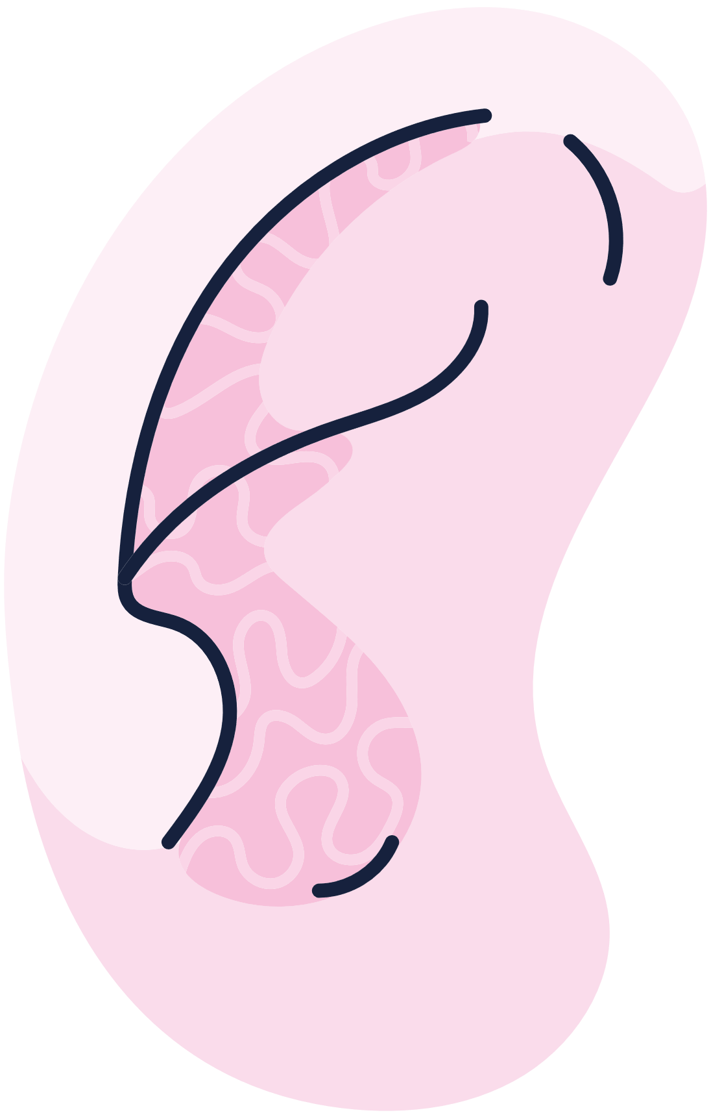
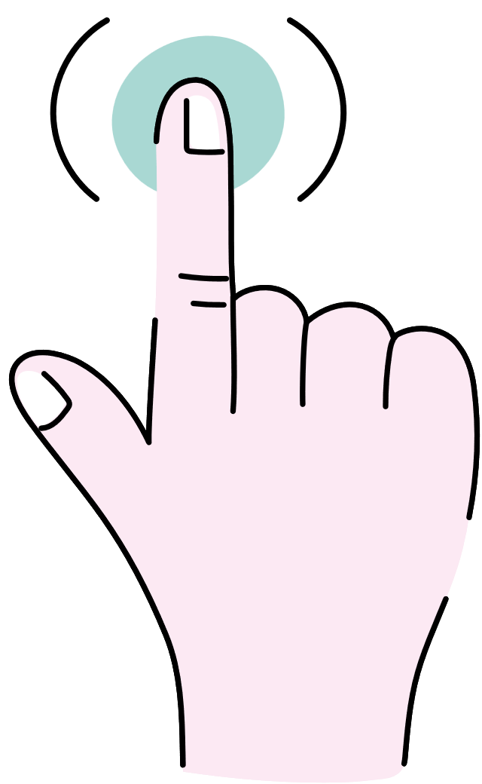
Can
you
touch ...?

Slide 19
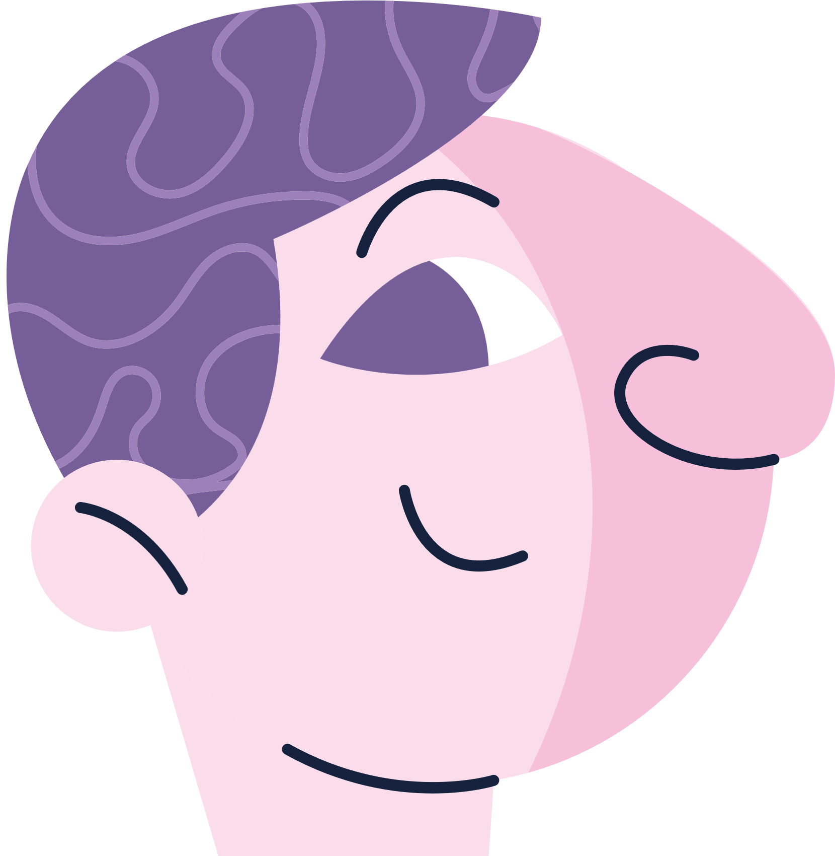
Can
you
touch ...?

Slide 20
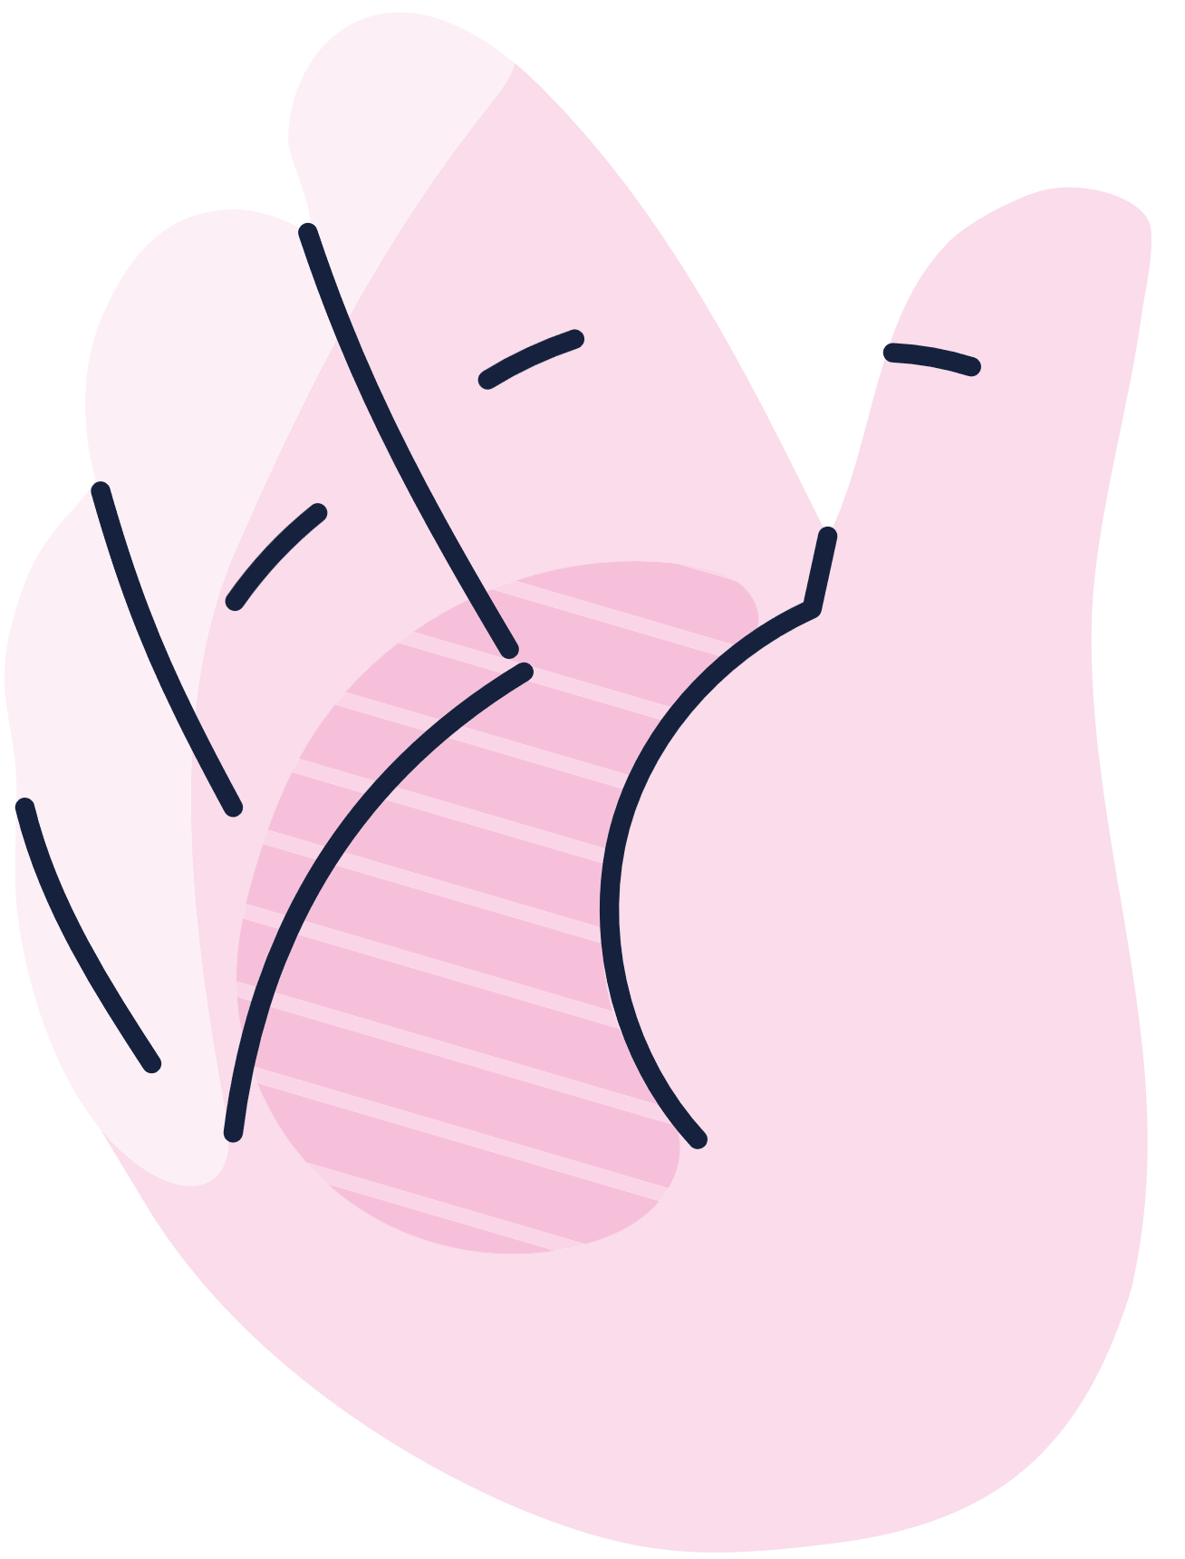
Can
you
touch ...?

Slide 21
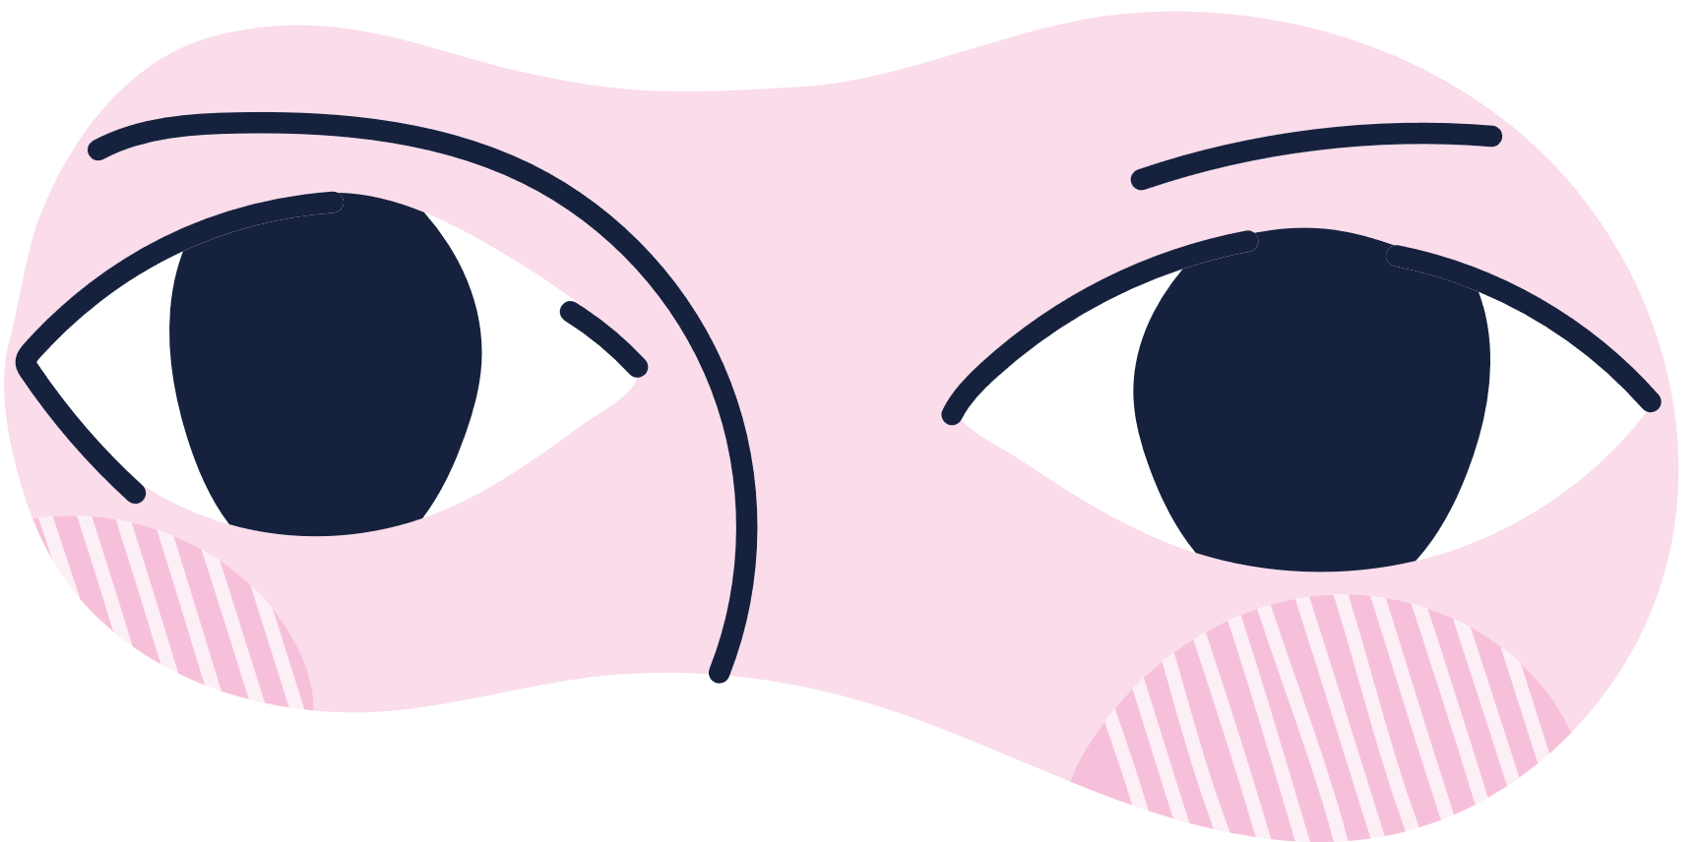
Can
you
touch ...?

Slide 22
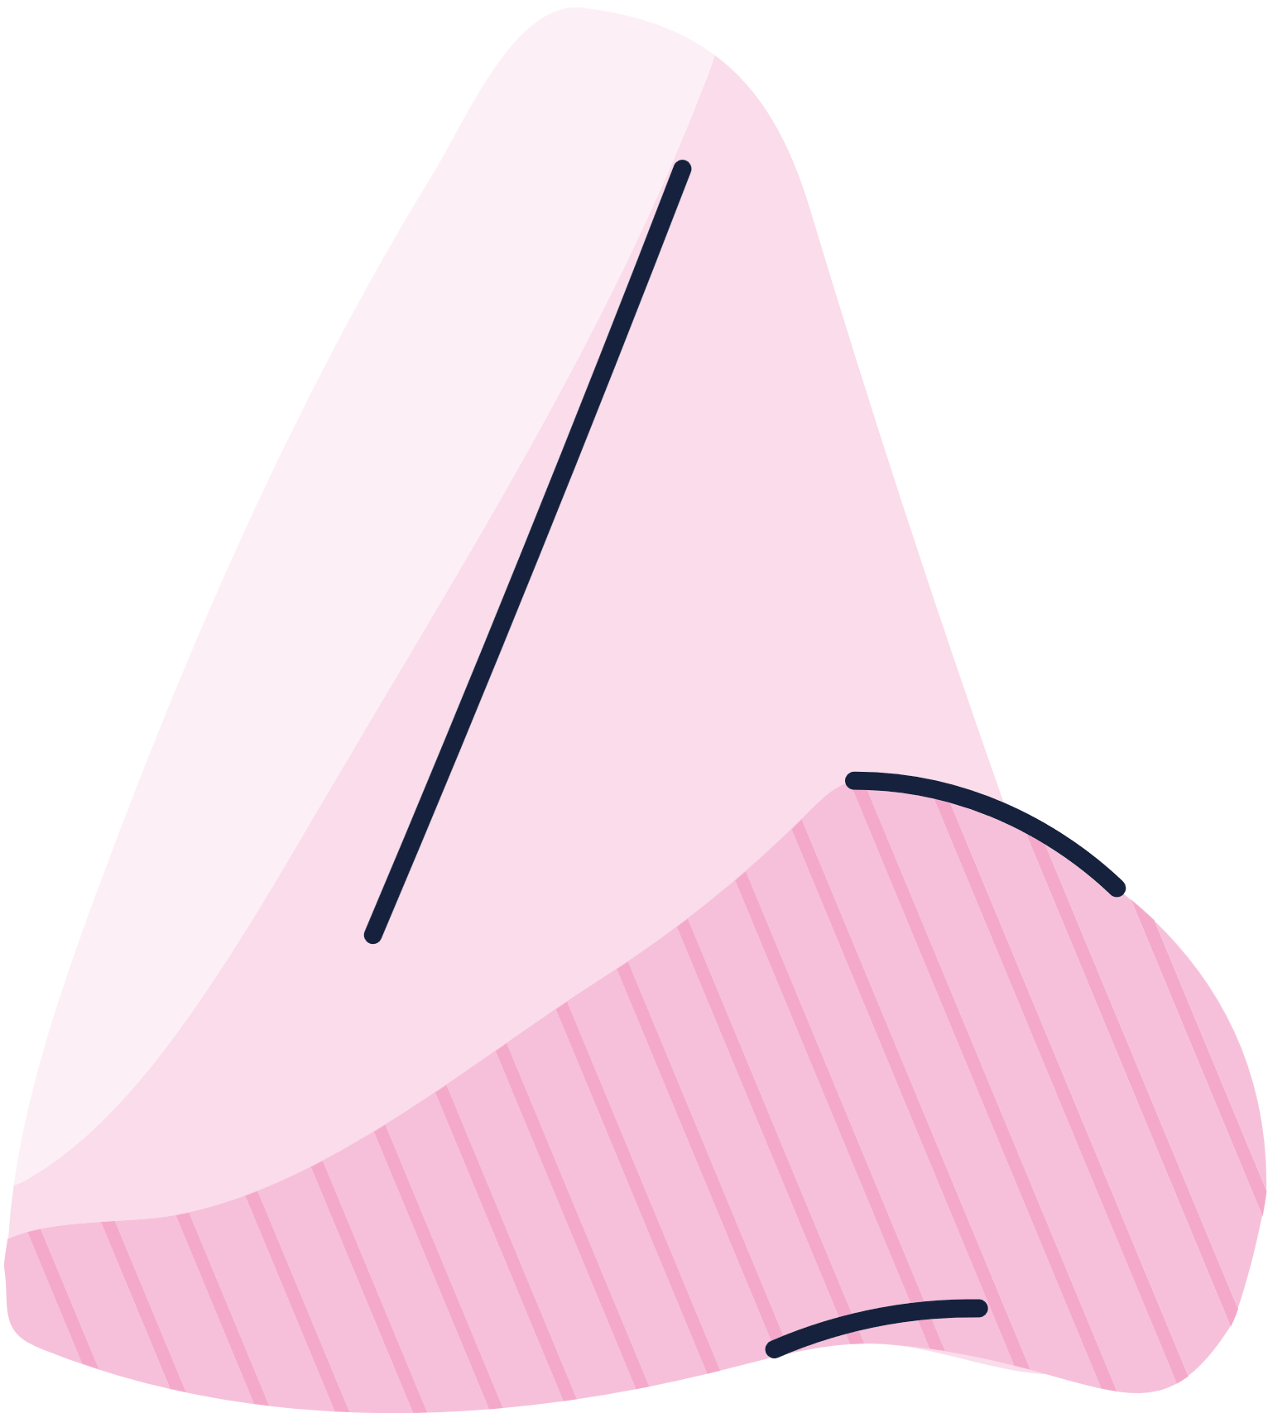
Can
you
touch ...?

