Slide 1





4
Our bodies
LESSON 2
Period 4

Slide 2
Contents
1
2
3
Warm-up and review
Listen and number.
4
Fun corner and wrap-up
Look, match and read.
5
Let’s play.
Notes:
eyes

Slide 3
1
Warm-up and review

Slide 4

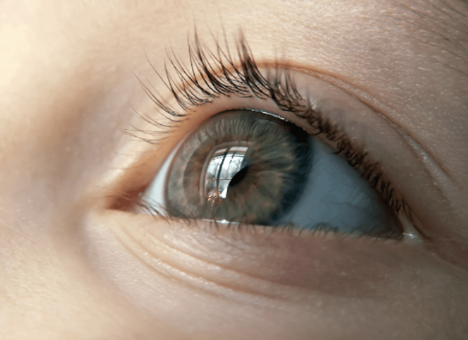
an eye
Notes:
Hidden Pictures Game
Step 1: Divide the class into 4 big groups.
Step 2: Each group takes turns to open a colored box and guess what the picture hidden behind it is.
The fastest group who answers correctly is the winner.

Slide 5

nose

Slide 6

a hand

Slide 7

mouth

Slide 8

a face

Slide 9
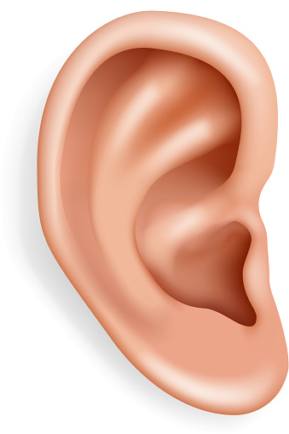
an ear

Slide 10
2
Listen and number.

Slide 11
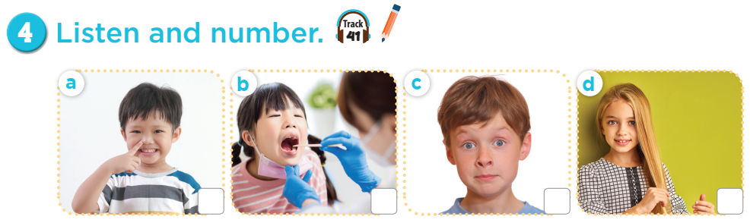
3
1
4
2

Slide 12


Notes:
Ask students to do the actions in the pictures.

Slide 13


Notes:
Ask students to do the actions in the pictures.

Slide 14
3
Look, match and read.

Slide 15
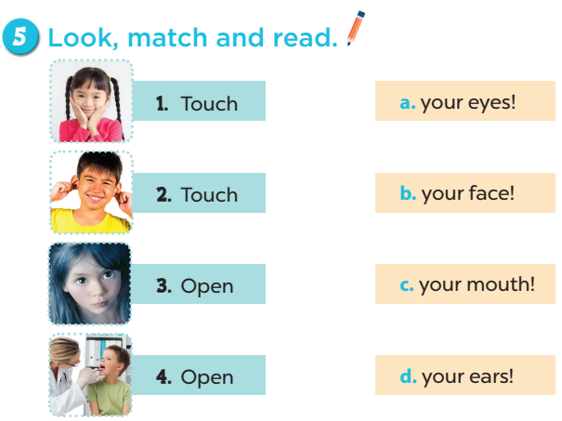
Notes:
Key: 1. b 2. d 3. a 4. c

Slide 16
4
Let’s play.

Slide 17
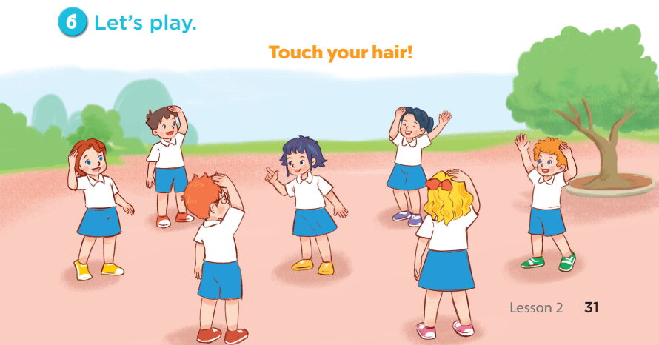

Slide 18
5
Fun corner and wrap-up

Slide 19
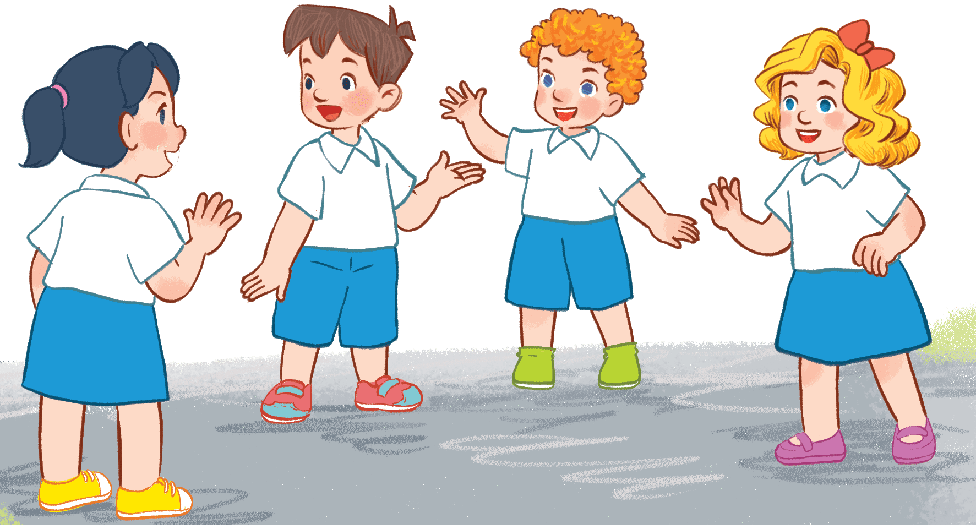
Listen and grab!!!
Listen and grab!!!
Notes:
Step 1: Pupils work in group of 4.
Step 2: Teacher gives out a set of mini flashcards to each group.
Step 3: Ask pupils listen carefully, then grab (as fast as they can) the correct flashcard that they heard.
The winner is the player with the most cards at the end of the game.

Slide 20
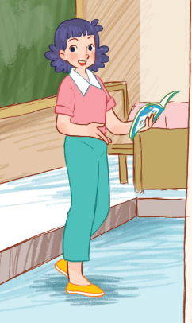
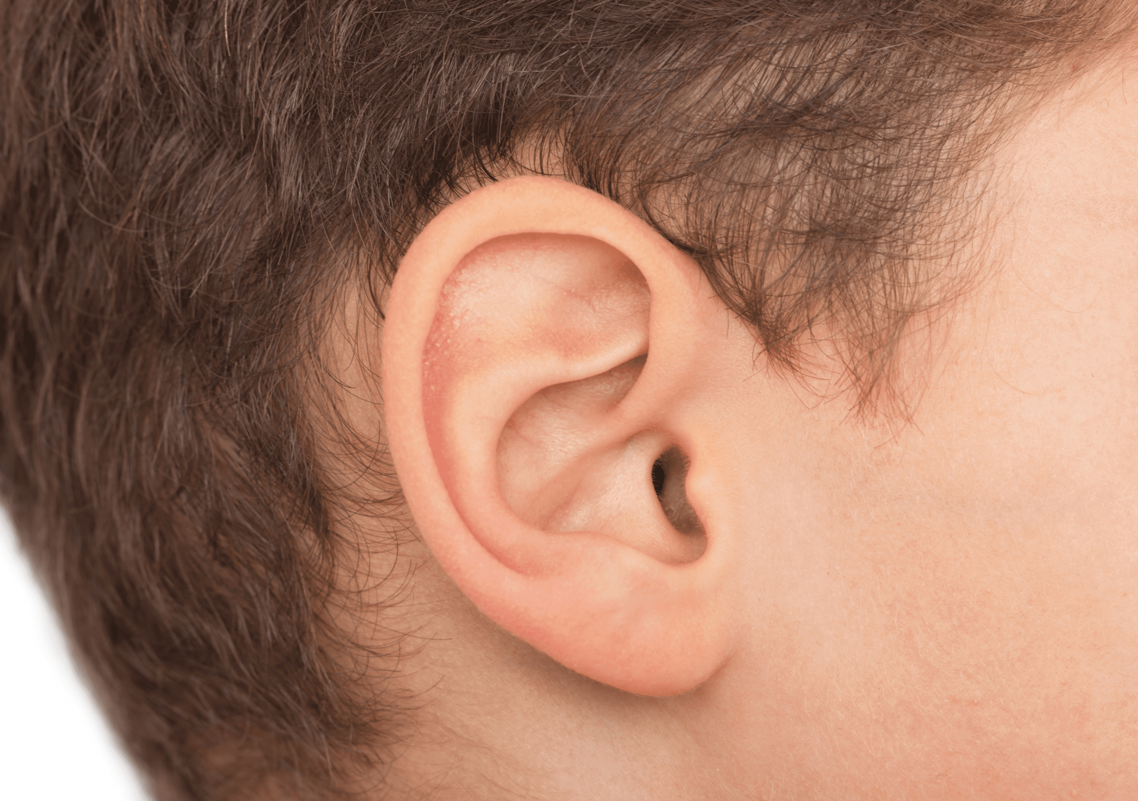
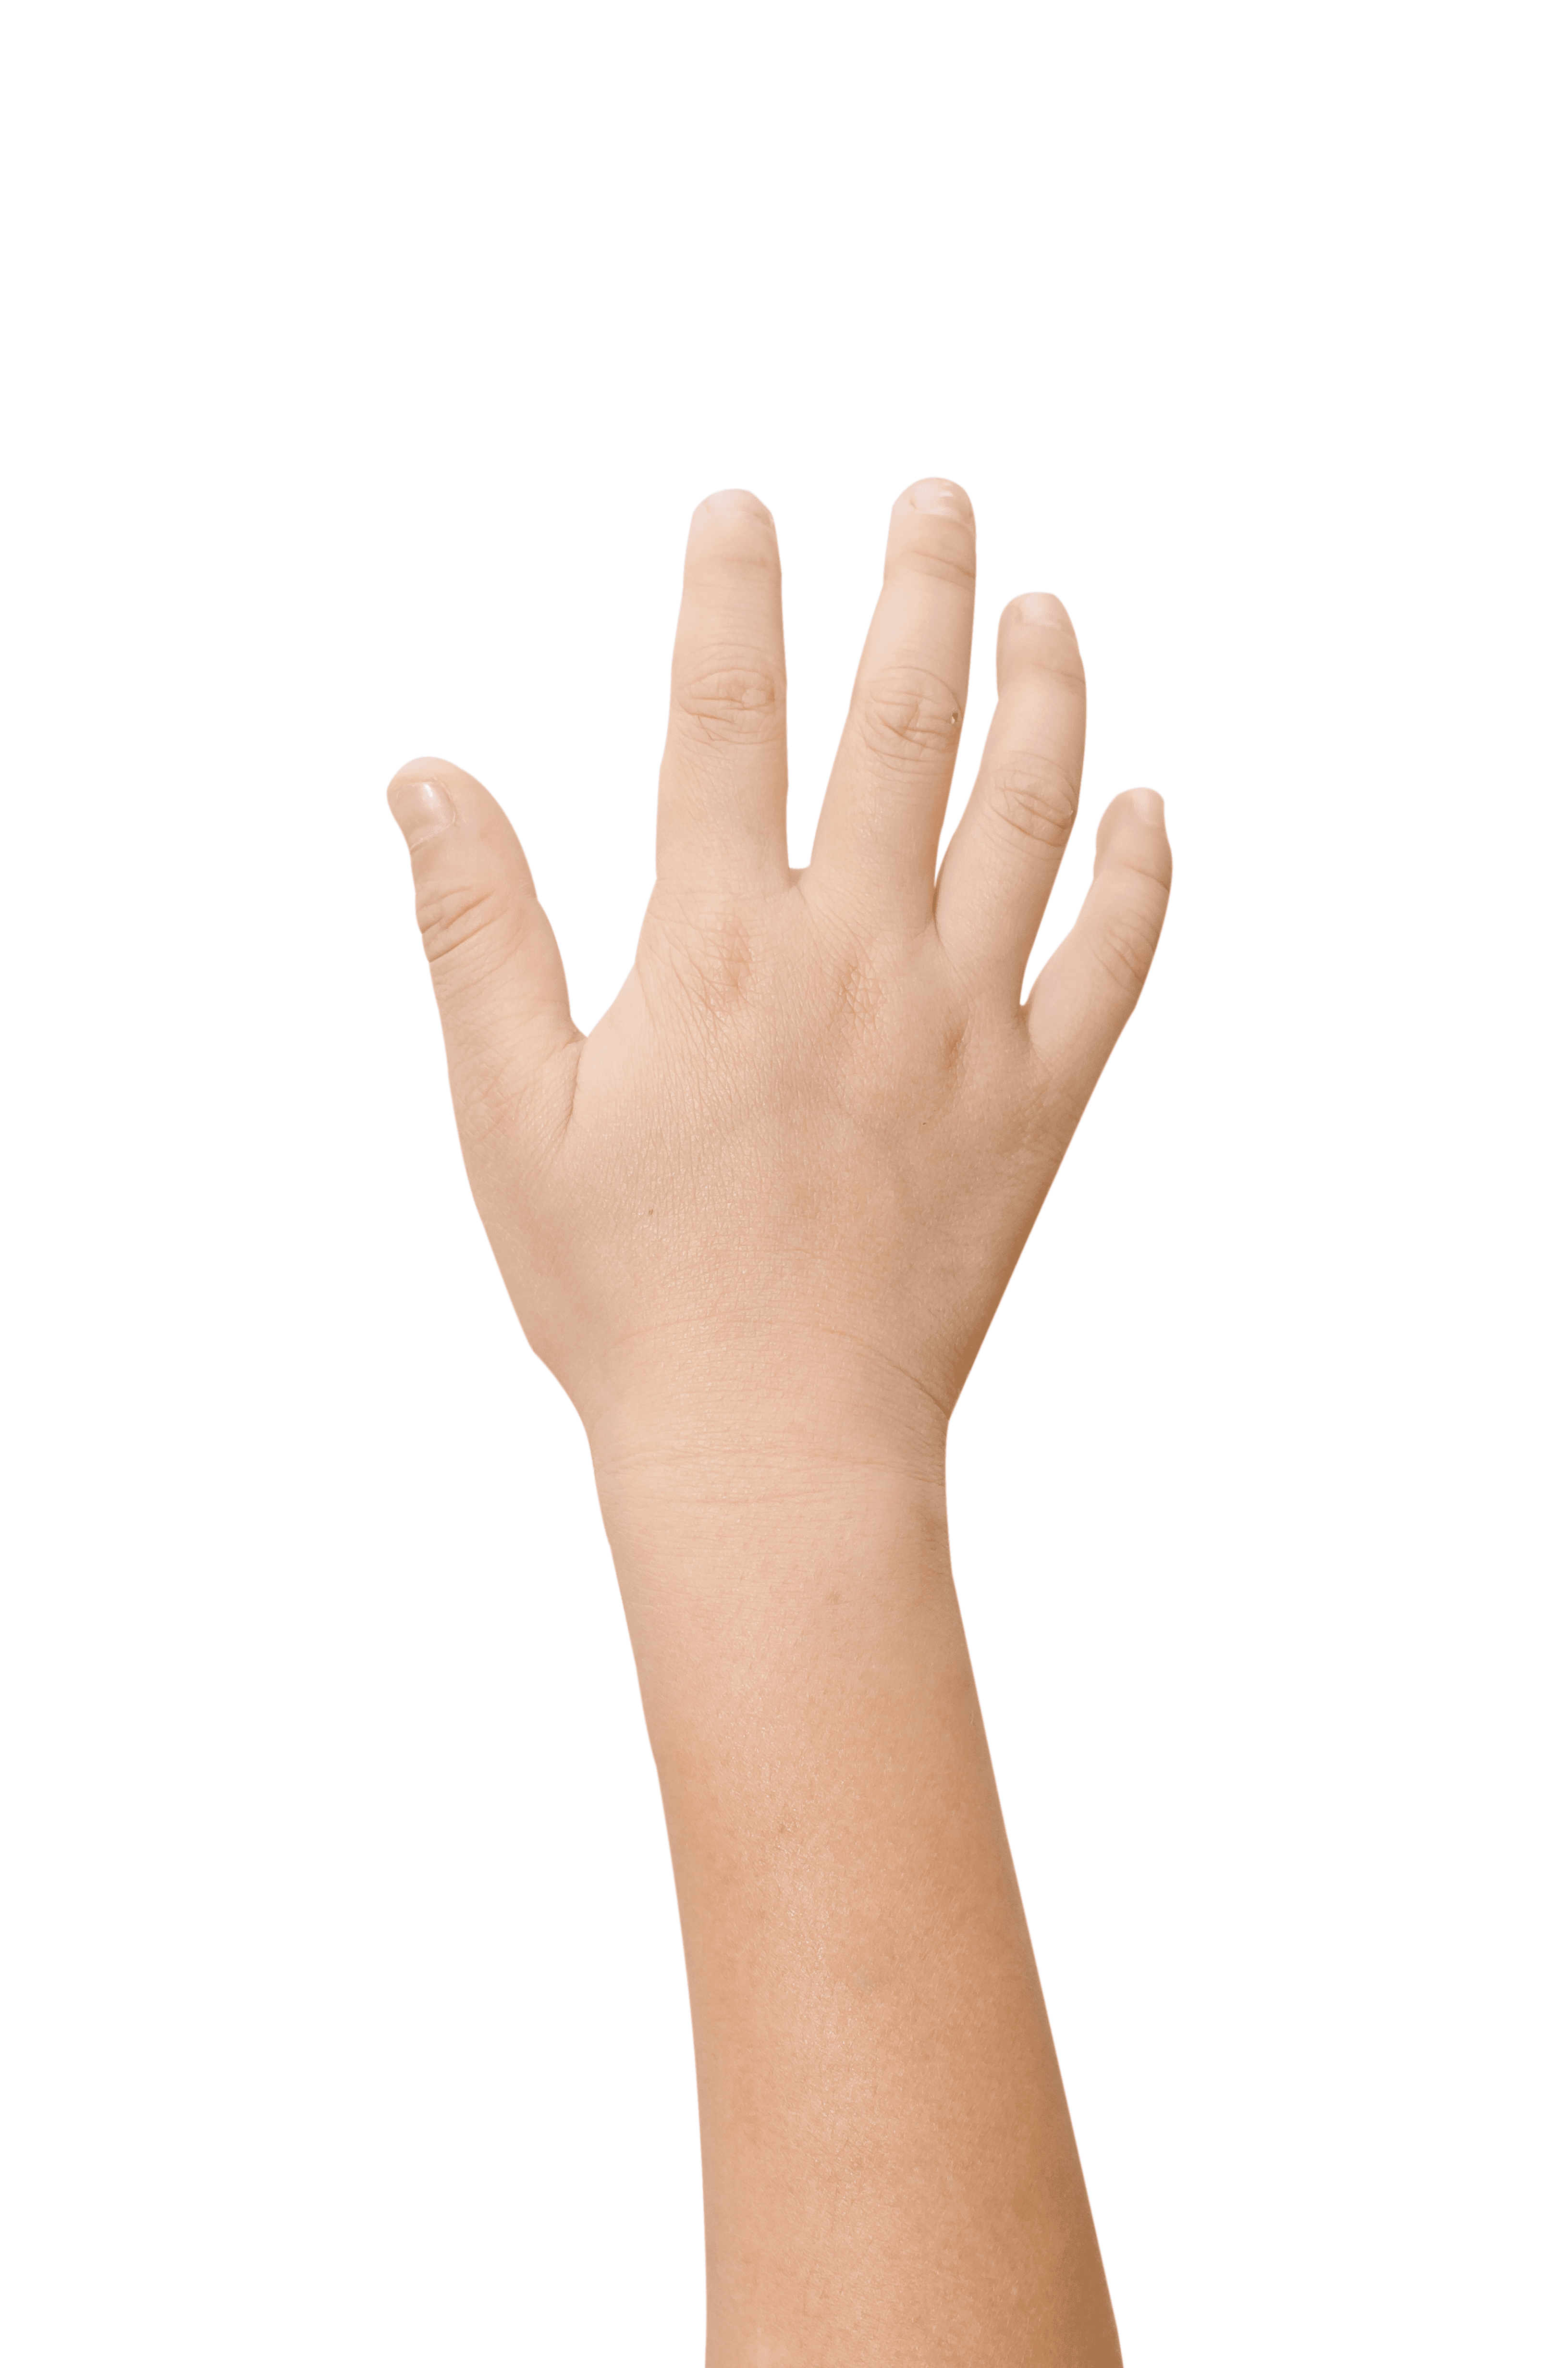
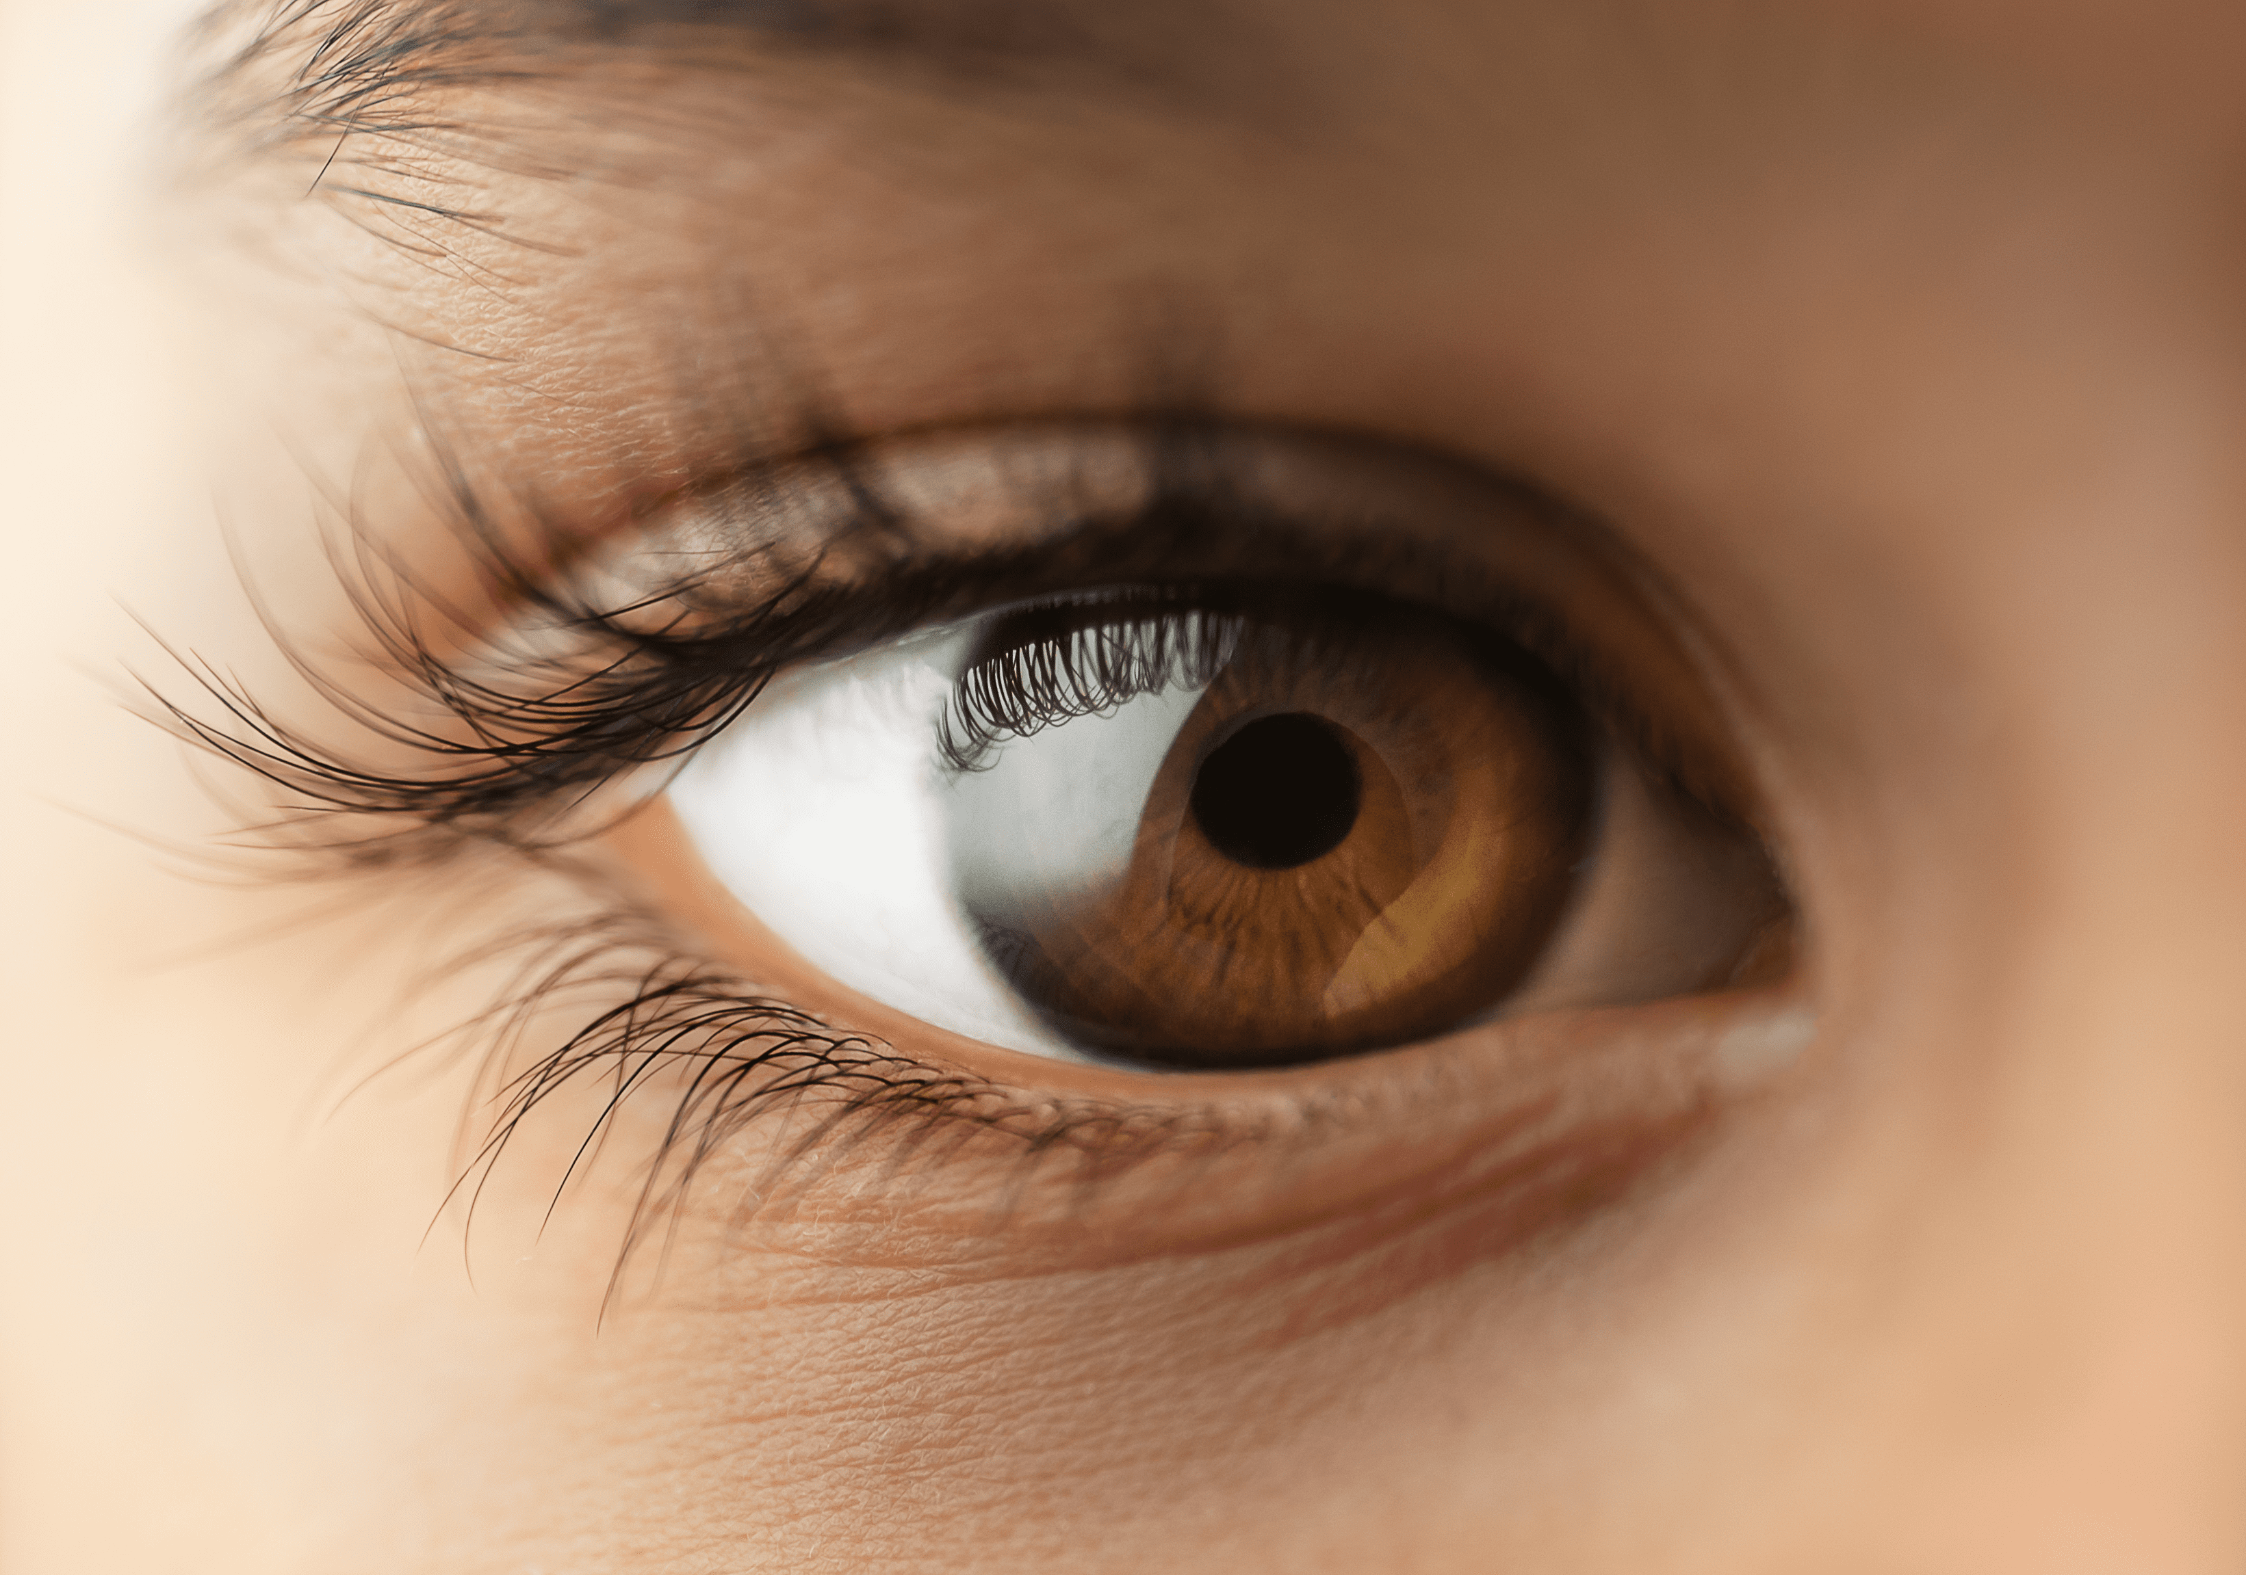

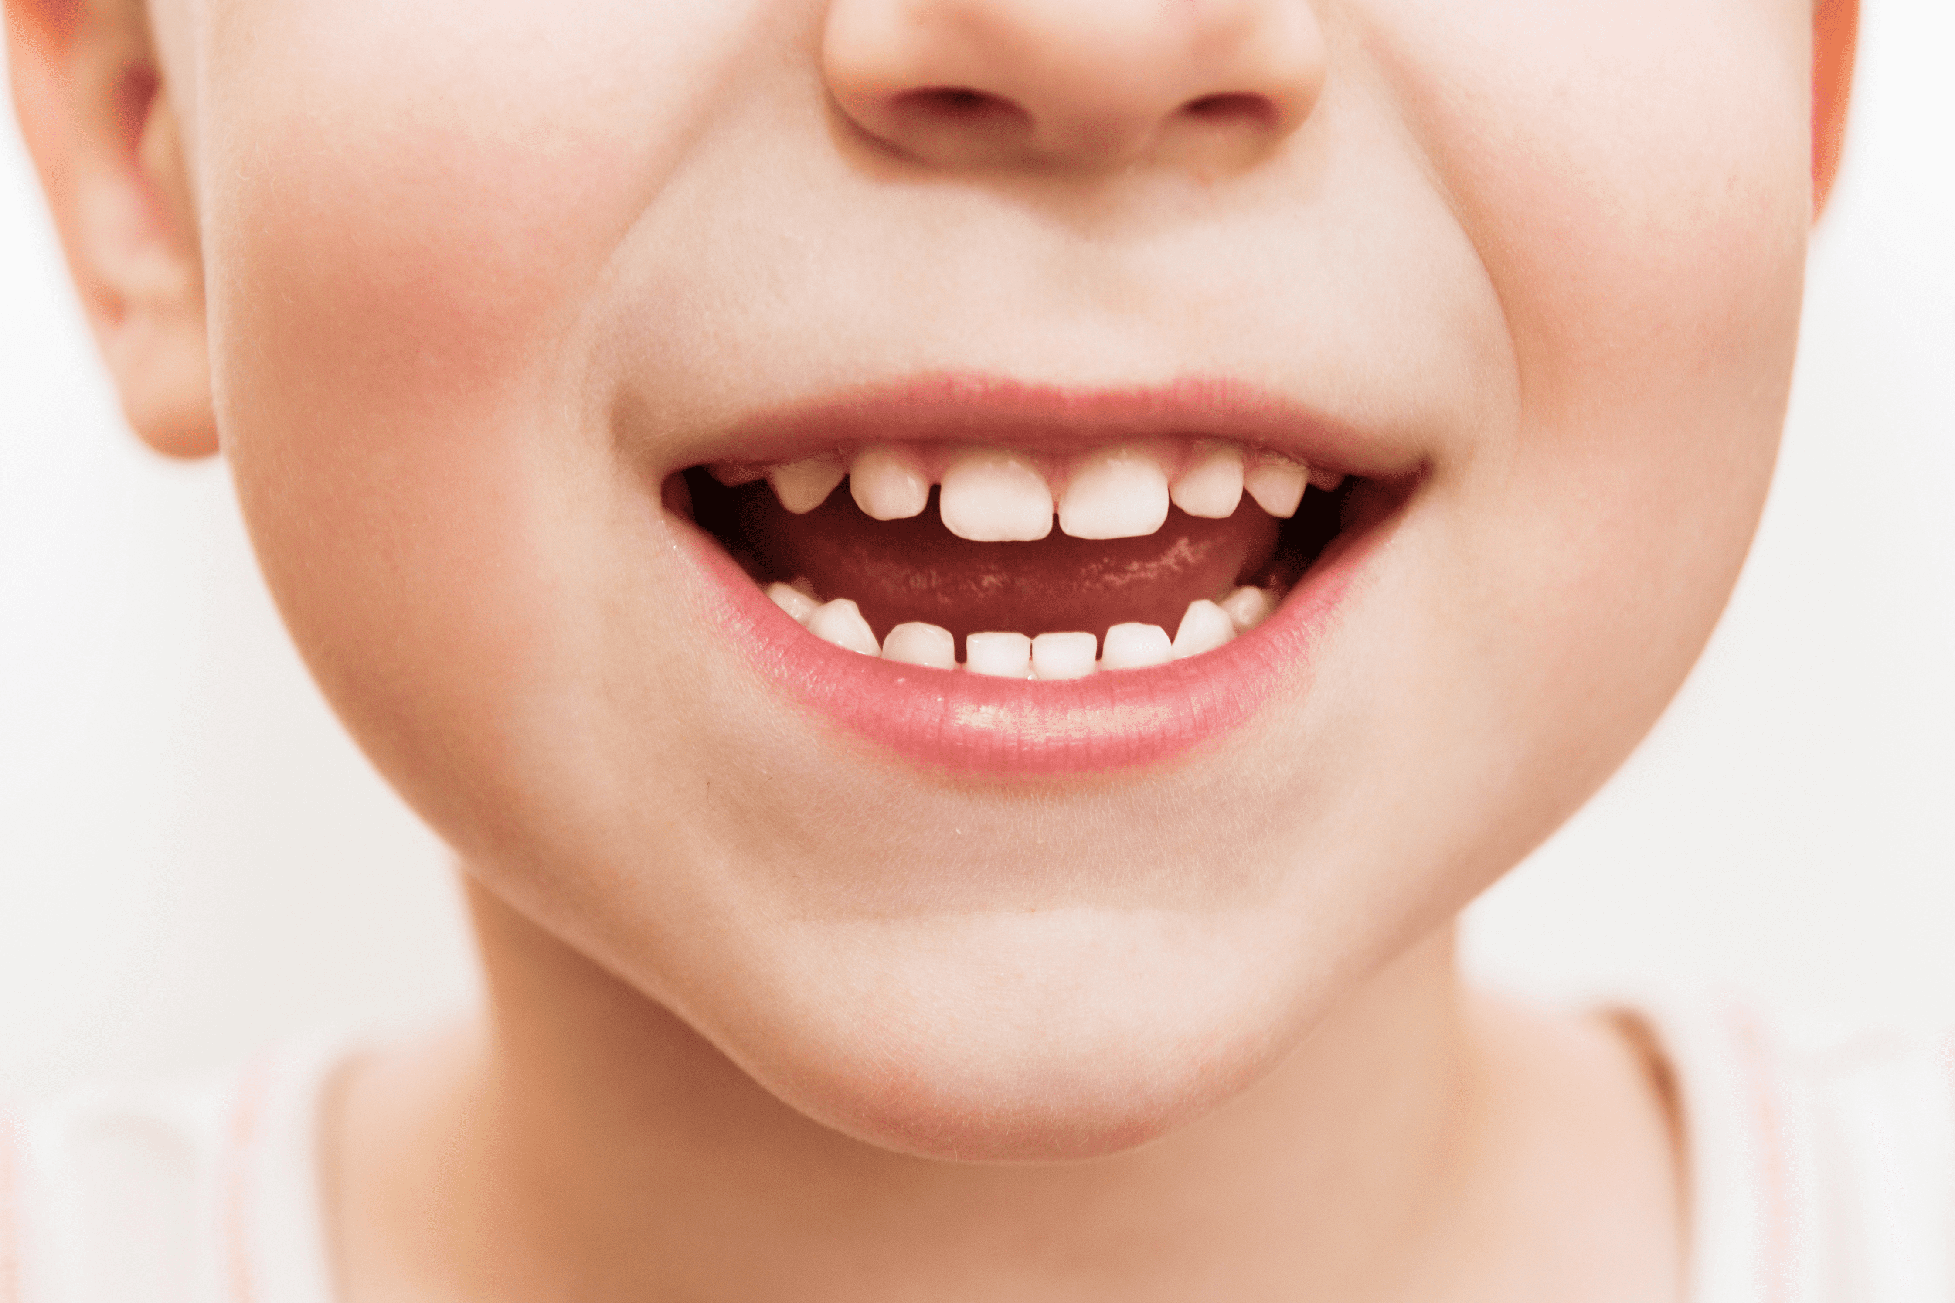
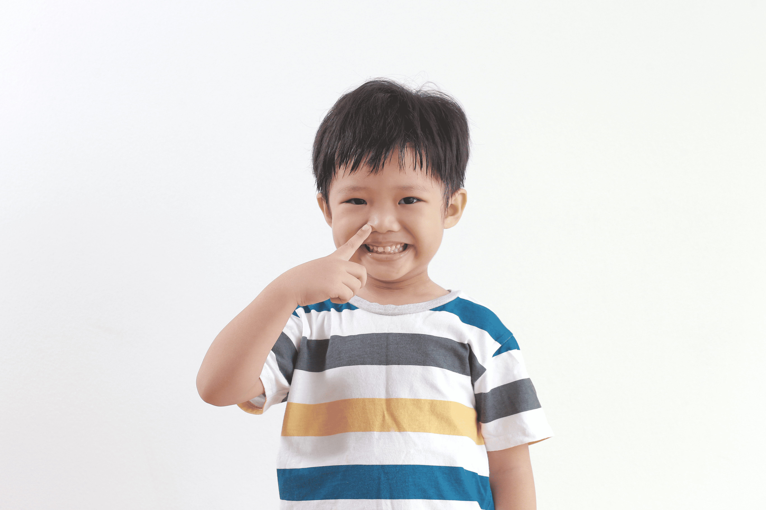
ear!

