Slide 1


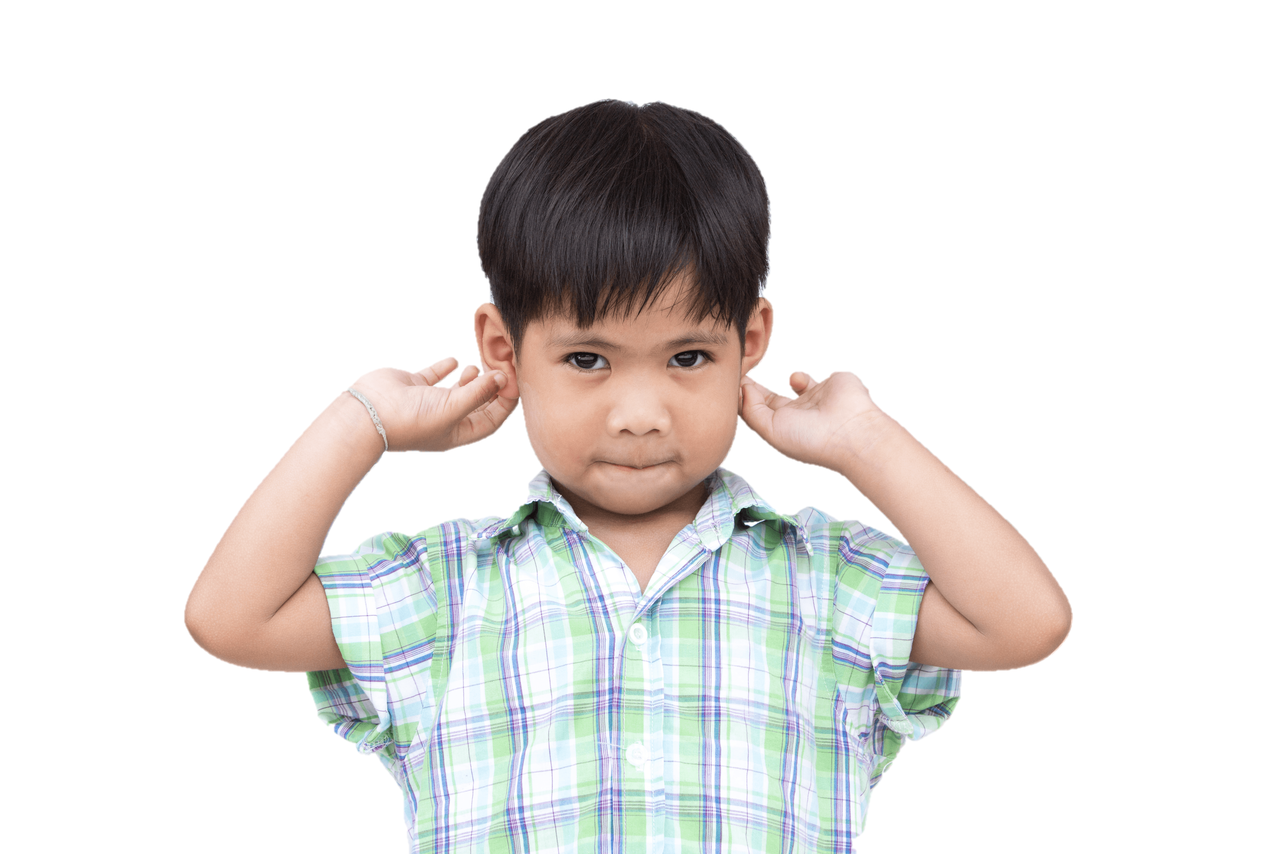
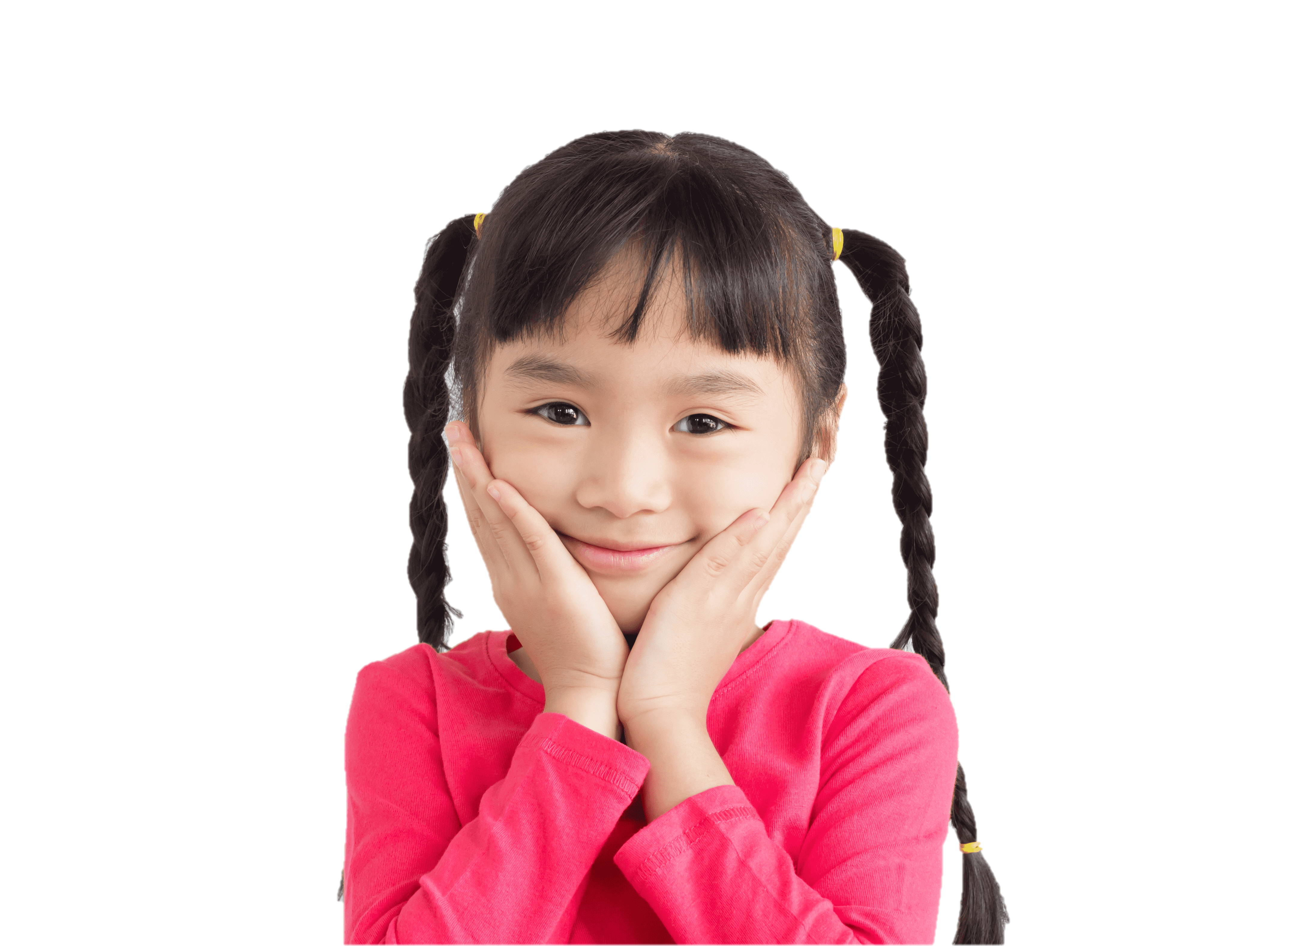

4
Our bodies
LESSON 3
Period 5

Slide 2
2
Listen and repeat.

Slide 3
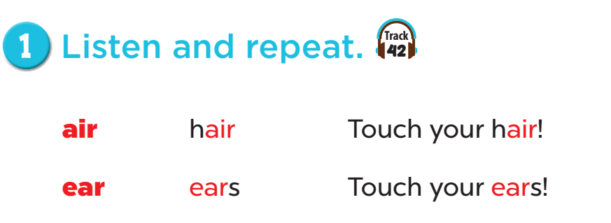


Slide 4
3
Listen and circle.

Slide 5
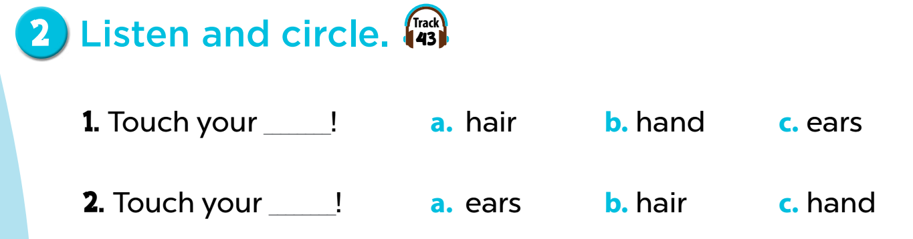
Notes:
Key: 1. c 2. b

Slide 6
4
Let’s chant.

Slide 7
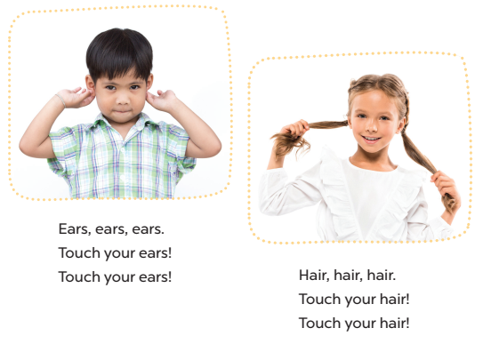

Slide 8
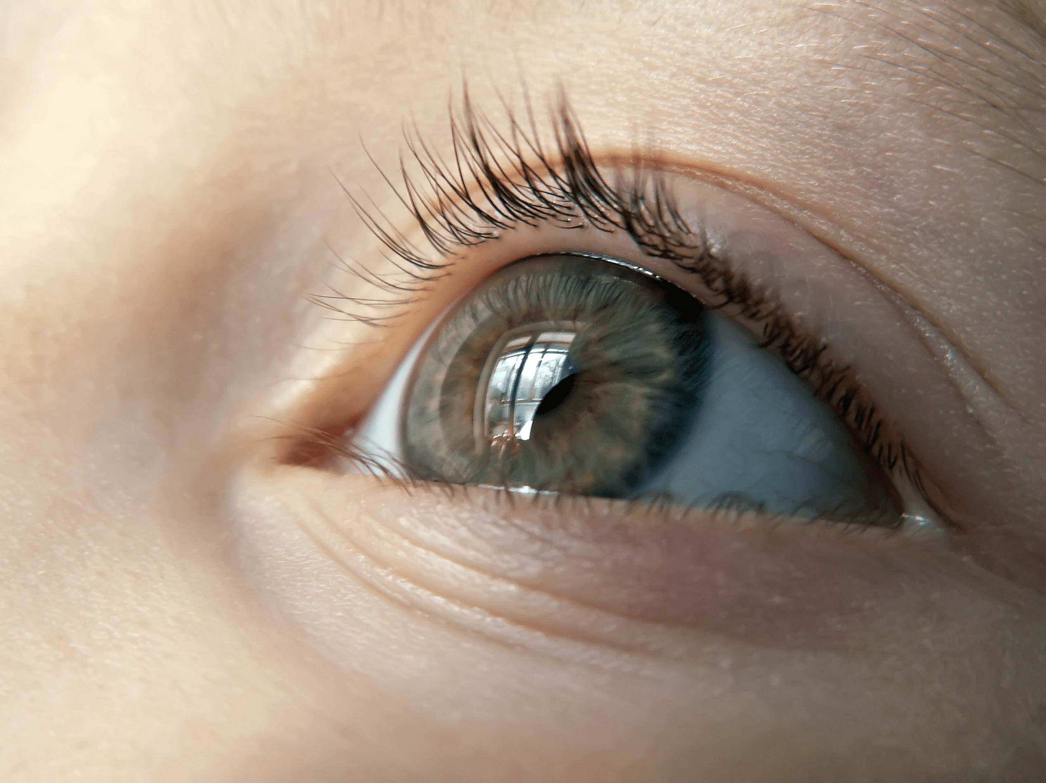
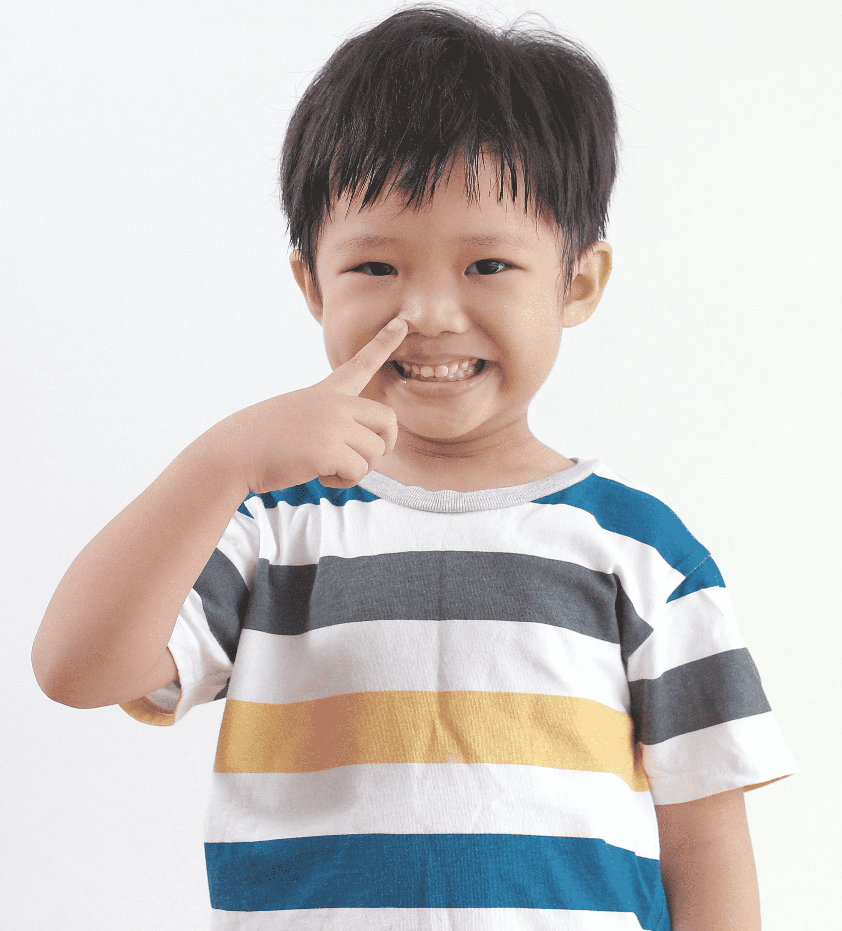
Eyes, eyes, eyes.
Open your eyes!
Open your eyes!
Nose, nose, nose.
Touch your nose!
Touch your nose!
Notes:
Game: Who is the best leader?
- Teacher can change the lyrics of the chant to other body parts.
- Then ask some pupils to do the gesture (touch/ open/ point) while the rest of the class follow along.

Slide 9
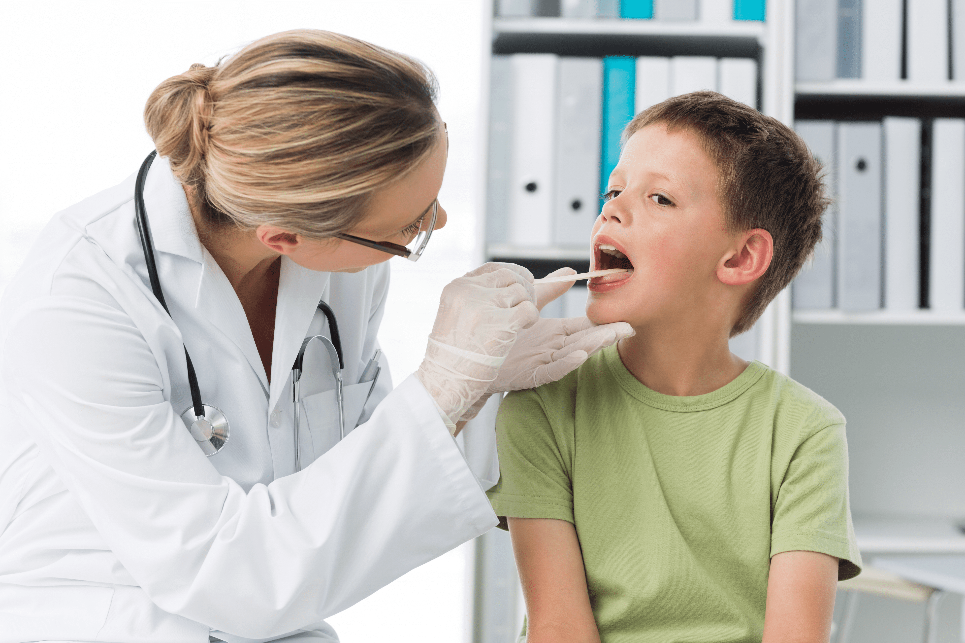
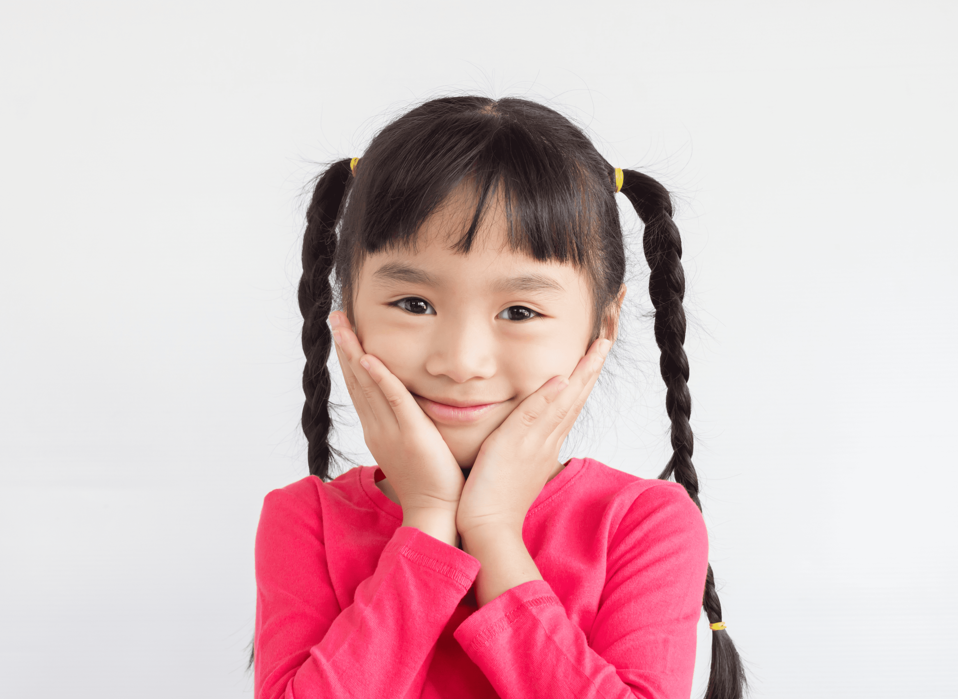
Mouth, mouth, mouth.
Open your mouth!
Open your mouth!
Face, face, face.
Touch your face!
Touch your face!

