Slide 1

Welcome !
Unit 15: At the dining table
Lesson 2: 1-2-3/ P34
Teacher :
Class : 3
Truong Tho Primary school
Happy you!

Slide 2
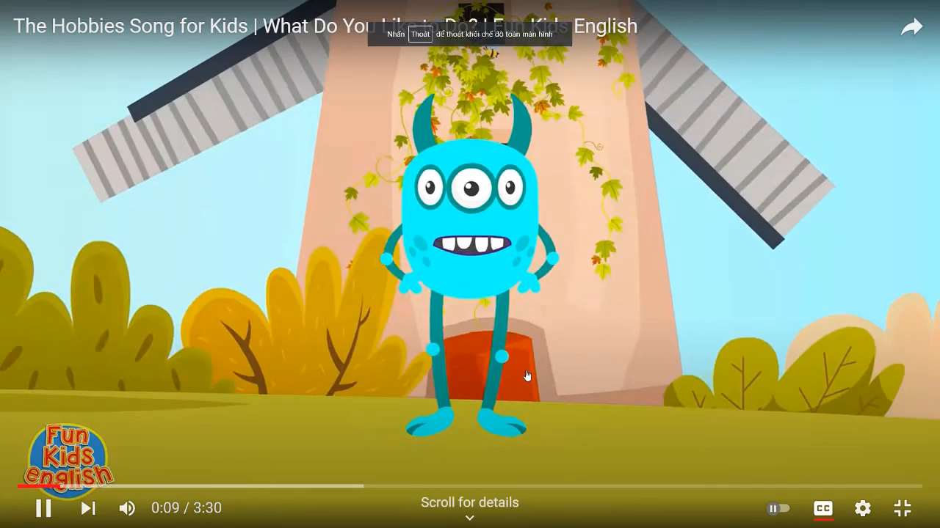

Slide 3
hobby
: sở thích

Slide 4
Unit 5 : My hobbies
Lesson 1: 1-2-3/ P34

Slide 5

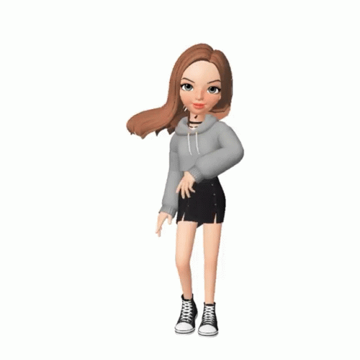
Unit 5 : My hobbies
Lesson 1: 1-2-3/ P34
1. Look, listen and repeat.
hobby
: sở thích.
singing
: hát.
dancing
: nhảy, múa.

Slide 6
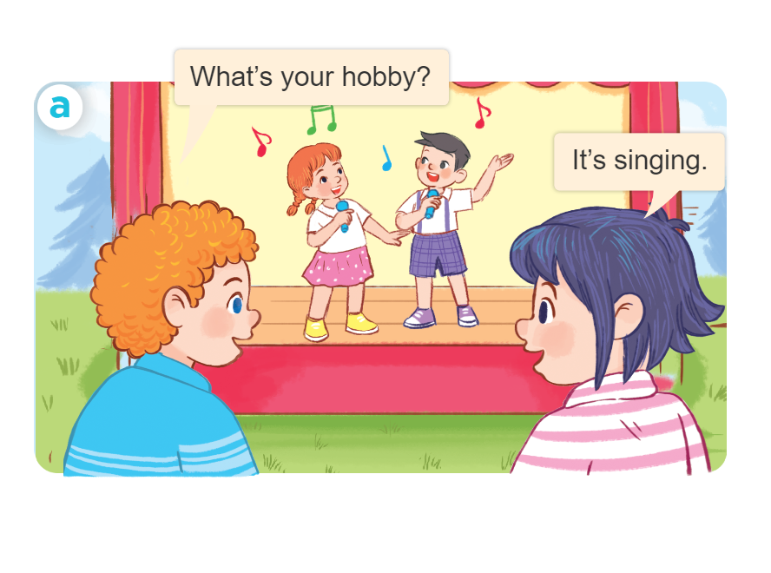
Unit 5 : My hobbies
Lesson 1: 1-2-3/ P34
1. Look, listen and repeat.
2. Listen, point and say.
*Sentence patterns:
What’s your hobby?
(It’s)
singing.

Slide 7


Unit 5 : My hobbies
Lesson 1: 1-2-3/ P34
1. Look, listen and repeat.
2. Listen, point and say.
drawing
: vẽ.
swimming
: bơi.

Slide 8
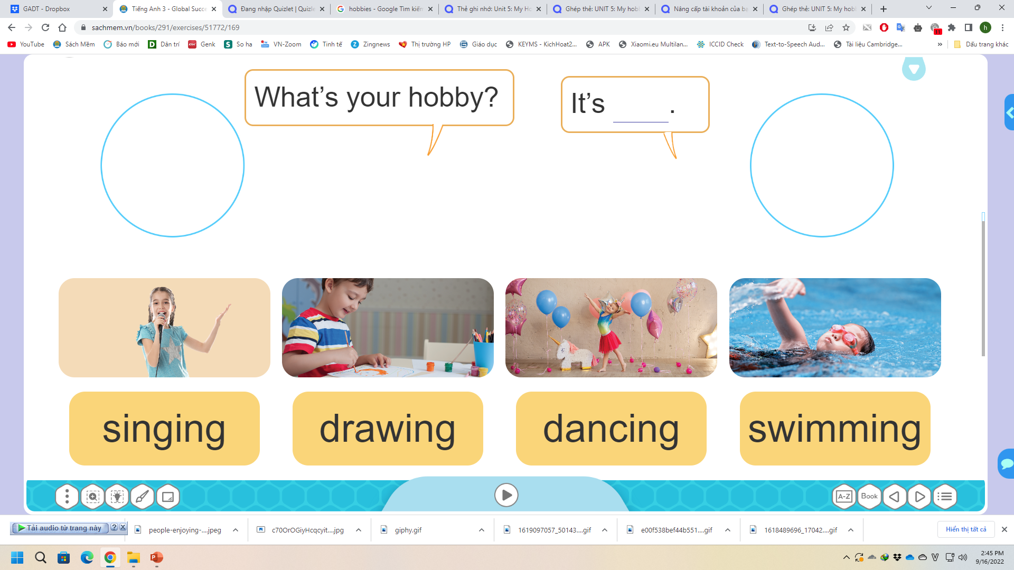
2. Listen, point and say.
What’s your hobby?
It’s_____________.
singing

Slide 9
The lucky numbers and unlucky numbers
1
2
3
4
5
6
7
8

Slide 10
Unit 5 : My hobbies
Lesson 1: 1-2-3/ P34
1. Look, listen and repeat.
2. Listen, point and say.
3. Let’s talk.
What’s your hobby?

Slide 11

What’s my hobby?

Slide 12



Thank you very much
Good bye! See you again!

Slide 13
What’s your hobby?
It’s_____________.
a

Slide 14
What’s your hobby?
It’s_____________.
b

Slide 15



Lucky number

Slide 16
Lucky number

Slide 17

Lucky number

Slide 18
What’s your hobby?
It’s_____________.
c

Slide 19
What’s your hobby?
It’s_____________.
d

Slide 20
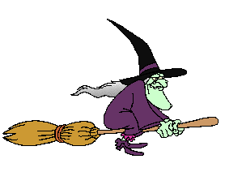

Unlucky number

