Slide 1





My foreign friends
Unit 3
Lesson 1 – Period 1

Slide 2



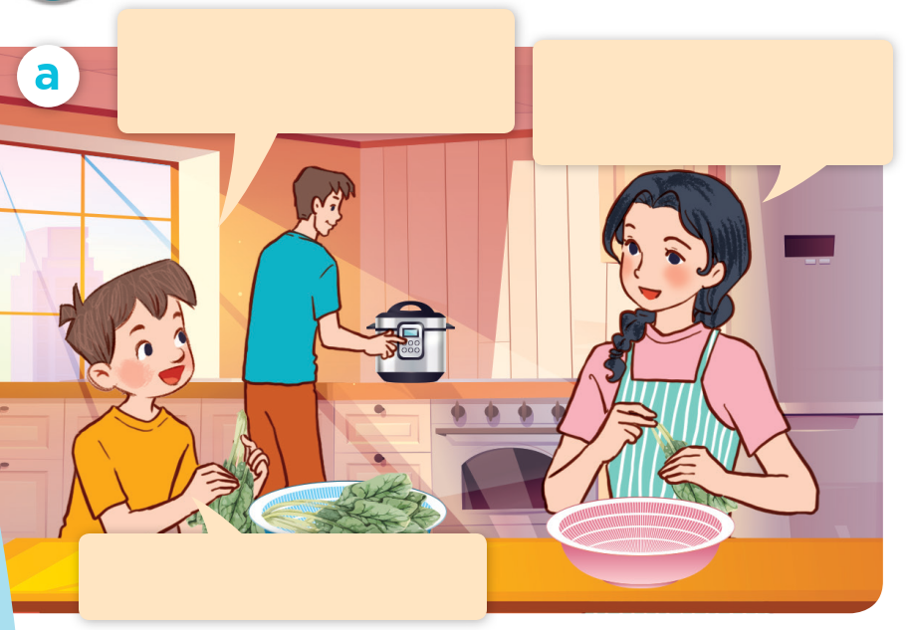


LOOK and SAY.
Mum, I have a new
foreign friend.
Do you? Where’s he from?
He’s from Australia.
Notes:
Step 1: Ask pupils to look at Pictures a and b and identify the characters and say what they can see in the pictures.
Step 2: Have pupils look at Picture a and b and guess what the characters are talking about. Pupils can use Vietnamese, then repeat their responses in English.

Slide 3



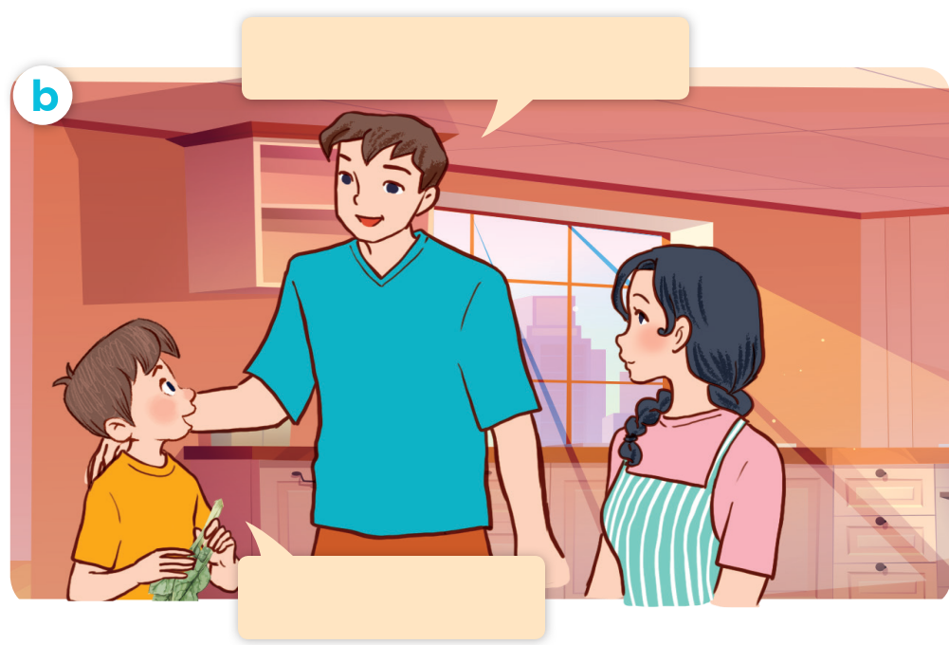


LOOK and SAY.
What nationality is he?
He’s Australian.
Notes:
Step 1: Ask pupils to look at Pictures a and b and identify the characters and say what they can see in the pictures.
Step 2: Have pupils look at Picture a and b and guess what the characters are talking about. Pupils can use Vietnamese, then repeat their responses in English.

Slide 4






LISTEN and POINT.
Mum, I have a new
foreign friend.
Do you? Where’s he from?
What nationality is he?
He’s from Australia.
He’s Australian.
Notes:
Step 3: Play the recording and encourage pupils to point at the characters while listening.

Slide 5

LISTEN, POINT and REPEAT.
Mum, I have a new
foreign friend
Do you? Where’s he from?
He’s from Australia.
Notes:
Step 4: Play the recording again, sentence by sentence, for pupils to listen, point to the sentences and repeat. Correct their pronunciation where necessary.

Slide 6
LISTEN, POINT and REPEAT.
What nationality is he?
He’s Australian.
Notes:
Step 4: Play the recording again, sentence by sentence, for pupils to listen, point to the sentences and repeat. Correct their pronunciation where necessary.

Slide 7

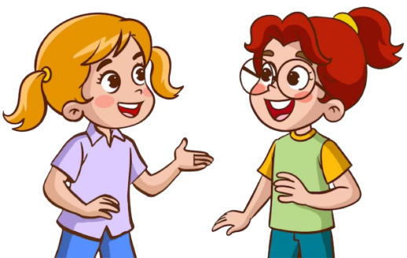
LISTEN and POINT.
What nationality is he?
He’s Australian.

Slide 8




Slide 9








LOOK and SAY.
Australian
Malaysian
American
Japanese
Notes:
Step 1: Have pupils look at the pictures, say what they can see in the pictures and identify the countries. Explain the word under each picture is not the name of the country, but it is the nationality.

Slide 10
LISTEN and REPEAT.
Australian
Notes:
Step 2: Play the first part of the recording for pupils to listen and repeat the words under the pictures in chorus and individually until they feel confident. Use the flash cards for Australian, Malaysian, American and Japanese to practise the words.

Slide 11
LISTEN and REPEAT.
Malaysian
Notes:
Step 2: Play the first part of the recording for pupils to listen and repeat the words under the pictures in chorus and individually until they feel confident. Use the flash cards for Australian, Malaysian, American and Japanese to practise the words.

Slide 12
LISTEN and REPEAT.
American
Notes:
Step 2: Play the first part of the recording for pupils to listen and repeat the words under the pictures in chorus and individually until they feel confident. Use the flash cards for Australian, Malaysian, American and Japanese to practise the words.

Slide 13
LISTEN and REPEAT.
Japanese
Notes:
Step 2: Play the first part of the recording for pupils to listen and repeat the words under the pictures in chorus and individually until they feel confident. Use the flash cards for Australian, Malaysian, American and Japanese to practise the words.

Slide 14

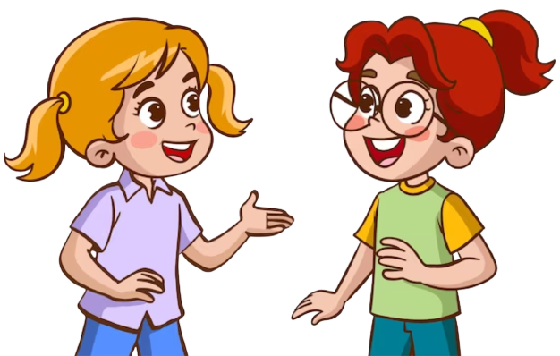
Listen, point and say.
What nationality is he?
He’s Australian.
Notes:
Step 3: Have pupils point at Picture a. Draw pupils’ attention to the speech bubbles and elicit the missing words (What nationality is he? - He’s Australian.) Play the next part of the recording a few times for pupils to repeat the sentences in both bubbles.

Slide 15

Listen, point and say.
What nationality is she?
She’s Malaysian.
Notes:
Step 4: Repeat Step 3 with Pictures b, c, and d. Then let pupils practise asking and answering questions in pairs. Go around the classroom to offer help if necessary.

Slide 16

Listen, point and say.
What nationality is she?
She’s American.
Notes:
Step 4: Repeat Step 3 with Pictures b, c, and d. Then let pupils practise asking and answering questions in pairs. Go around the classroom to offer help if necessary.

Slide 17

Listen, point and say.
What nationality is she?
She’s Japanese.
Notes:
Step 4: Repeat Step 3 with Pictures b, c, and d. Then let pupils practise asking and answering questions in pairs. Go around the classroom to offer help if necessary.

Slide 18

ASK and ANSWER.
Australian
Malaysian
American
Japanese
Notes:
Step 5: Invite a few pairs to point at the pictures and ask and answer questions about someone’s nationality.

Slide 20

04
Let’s talk.

Slide 21

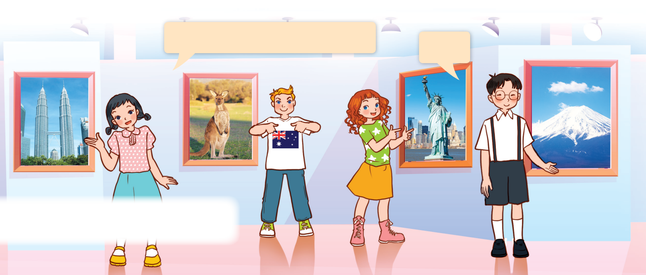
LOOK and SAY.
Notes:
Step 1: Draw pupils’ attention to the picture. Ask questions to help them identify the context (see Input).
Step 2: Point at the first character and elicit the question in the first speech bubble (e.g. What nationality is she?) and the answer in the second speech bubble (She’s Malaysian.) as an example. Then write the sentences on the board. Get pupils to say the completed sentences. Repeat the same procedure with other pictures.

Slide 22

LOOK and SAY.
What nationality is she?
She’s Malaysian.
Notes:
Step 2: Point at the first character and elicit the question in the first speech bubble (e.g. What nationality is she?) and the answer in the second speech bubble (She’s Malaysian.) as an example. Then write the sentences on the board. Get pupils to say the completed sentences. Repeat the same procedure with other pictures.

Slide 23
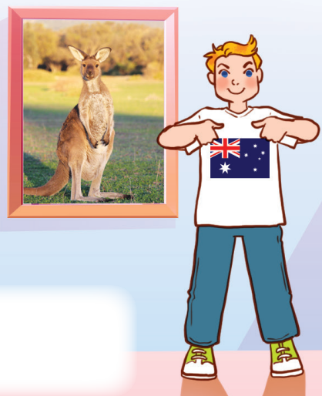
LOOK and SAY.
What nationality is he?
He’s Australian.
Notes:
Step 2: Point at the first character and elicit the question in the first speech bubble (e.g. What nationality is she?) and the answer in the second speech bubble (She’s Malaysian.) as an example. Then write the sentences on the board. Get pupils to say the completed sentences. Repeat the same procedure with other pictures.

Slide 24
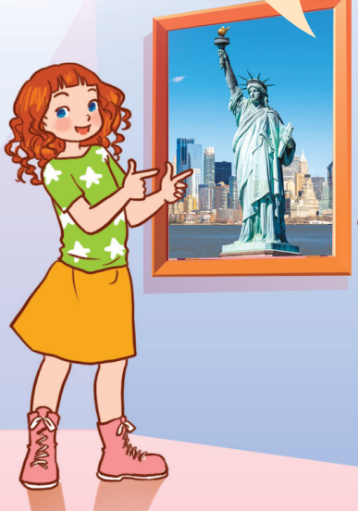
LOOK and SAY.
What nationality is she?
She’s American.
Notes:
Step 2: Point at the first character and elicit the question in the first speech bubble (e.g. What nationality is she?) and the answer in the second speech bubble (She’s Malaysian.) as an example. Then write the sentences on the board. Get pupils to say the completed sentences. Repeat the same procedure with other pictures.

Slide 25
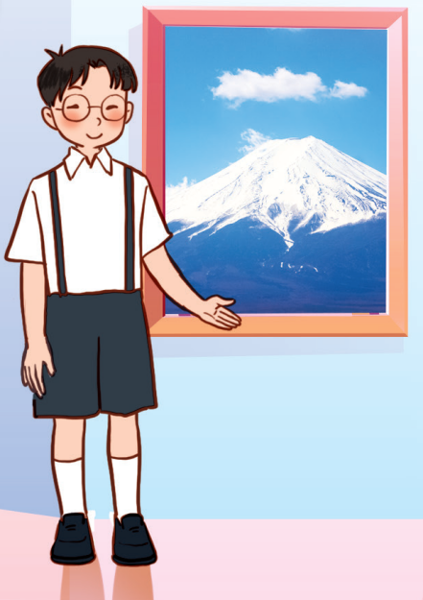
LOOK and SAY.
What nationality is he?
He’s Janpanese.
Notes:
Step 2: Point at the first character and elicit the question in the first speech bubble (e.g. What nationality is she?) and the answer in the second speech bubble (She’s Malaysian.) as an example. Then write the sentences on the board. Get pupils to say the completed sentences. Repeat the same procedure with other pictures.

Slide 26

ASK and ANSWER.
What nationality is she / he?
________.
Notes:
Step 3: Put pupils into pairs to ask and answer questions about the nationality of each character in the picture. Go around and offer support where necessary.

Slide 27
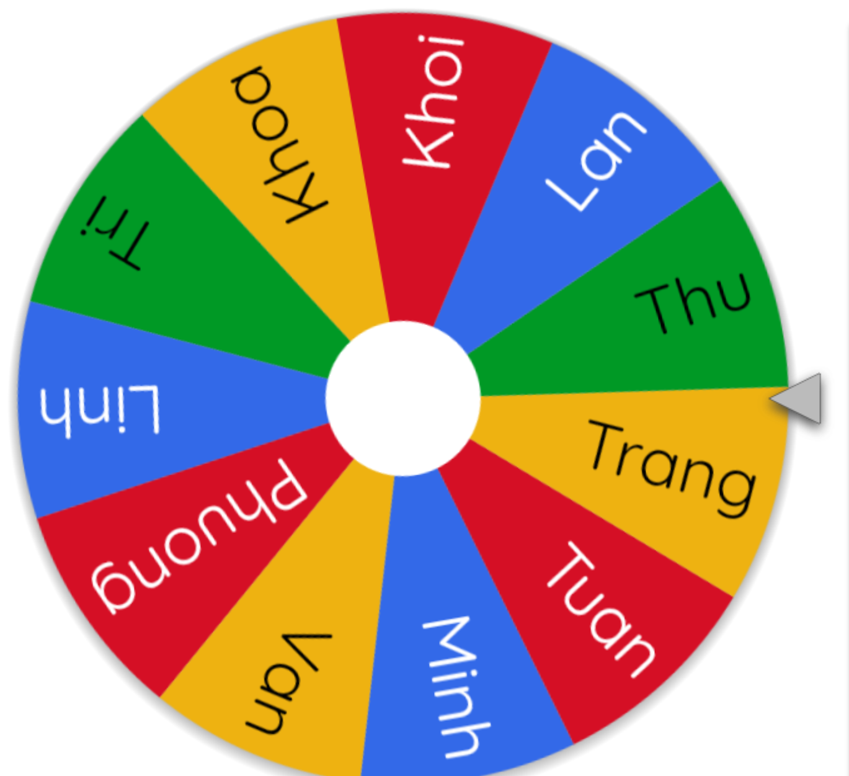
LET’S SPIN!
Notes:
Step 4: Invite a few pairs to the front of the classroom to ask and answer questions about someone’s nationality.
Use this link to choose pupils in random: https://wheelofnames.com/

Slide 29
05
Fun corner
and wrap-up

Slide 30
Sentence puzzle

Slide 31

Game
What nationality is she?
She’s American.

Slide 32

Game
What nationality is she?
She’s Japanese.
Notes:
Game: “Sentence Puzzle”
- Divide the class into groups of four.
- Show a sentence that is broken/cut into pieces.
- Pupils work in groups to arrange these words to make a complete sentence, then read it aloud.
- The group who makes it first will be the winner.

Slide 33

Game
What nationality is he?
He’s Australian.
Notes:
Game: “Sentence Puzzle”
- Divide the class into groups of four.
- Show a sentence that is broken/cut into pieces.
- Pupils work in groups to arrange these words to make a complete sentence, then read it aloud.
- The group who makes it first will be the winner.

Slide 34

Game
What nationality is she?
She’s Malaysian.
Notes:
Game: “Sentence Puzzle”
- Divide the class into groups of four.
- Show a sentence that is broken/cut into pieces.
- Pupils work in groups to arrange these words to make a complete sentence, then read it aloud.
- The group who makes it first will be the winner.

