Slide 1





My foreign friends
Unit 3
Lesson 1 – Period 2

Slide 2

















Match the flags to the countries and tell the nationalities.
Australia
Singapore
Thailand
Malaysia
Viet Nam
Britain
Japan
America

Slide 3
Match the flags to the countries and tell the nationalities.
Britain
Australia
Vietnam
Malaysia
Australia
Singapore
Thailand
Malaysia
Vietnam
Britain
Japan
America
Thailand
Singapore
America
Japan

Slide 4






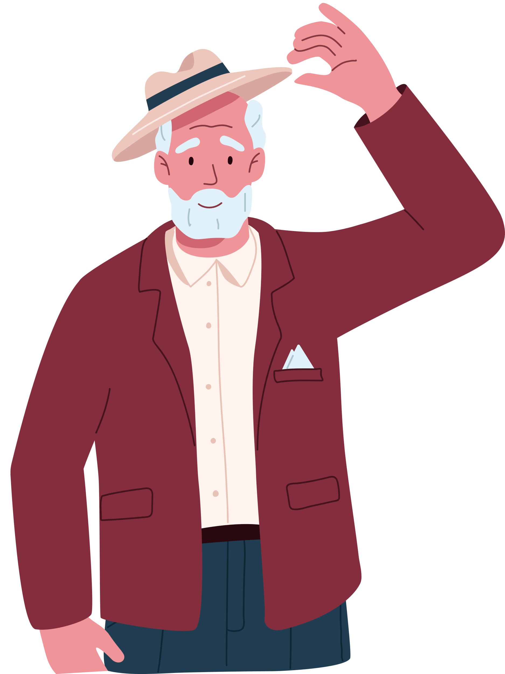


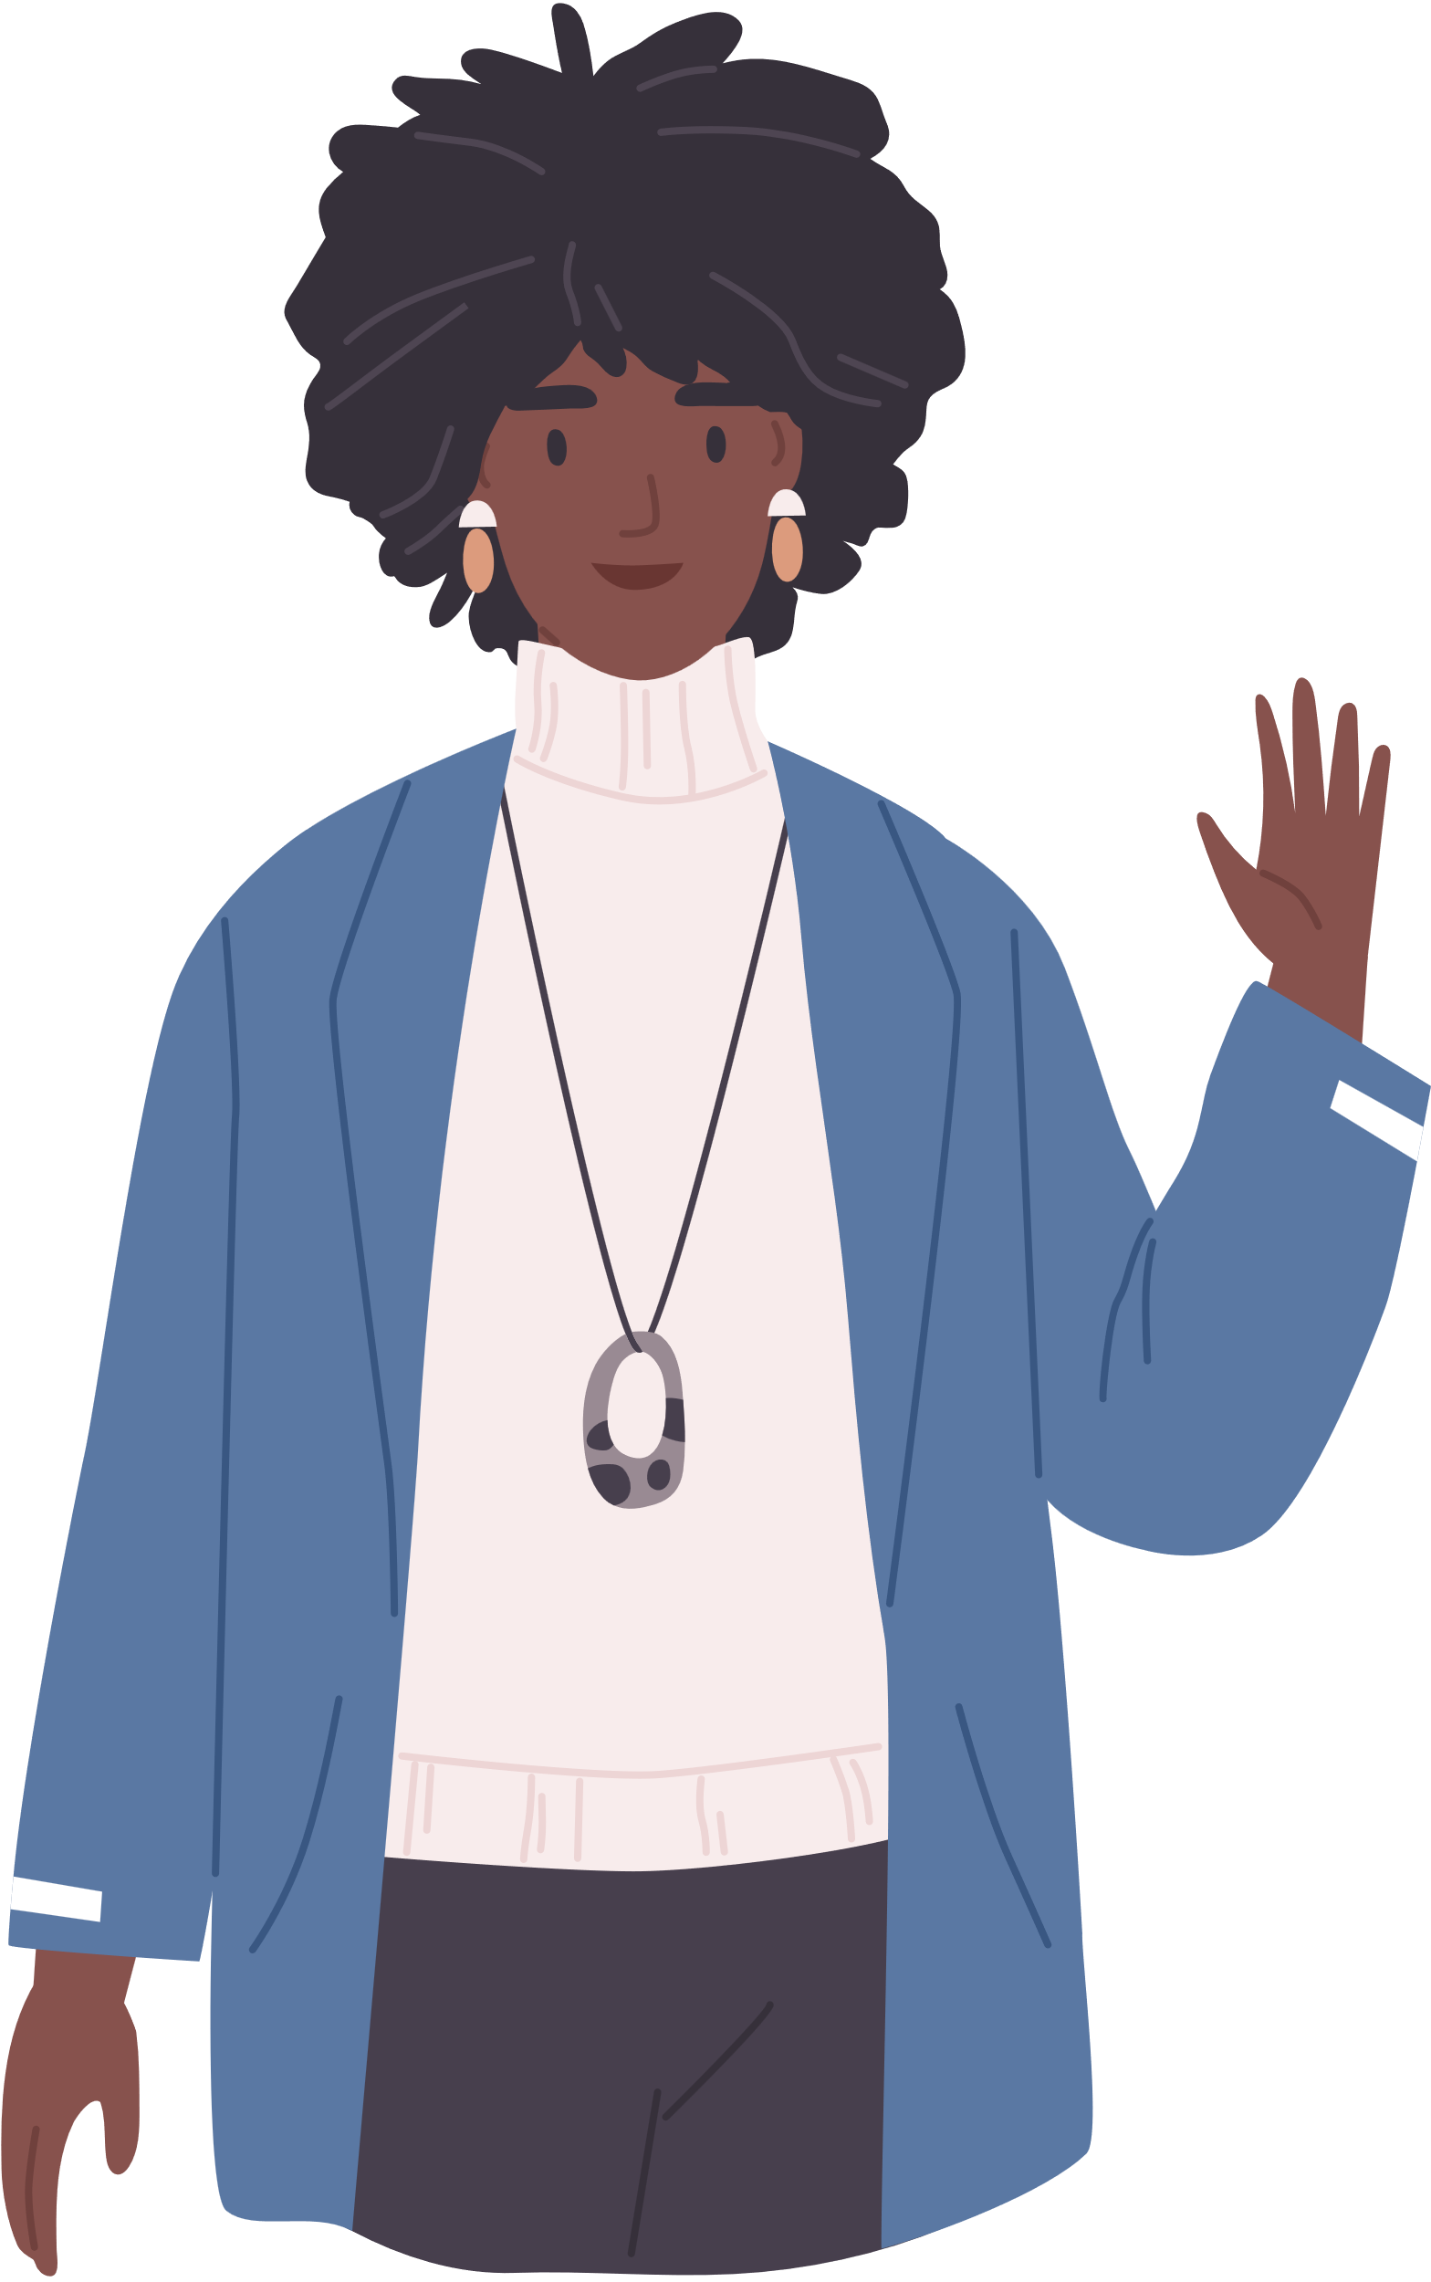


What about you?
WHERE ARE YOU FROM?

Slide 5






Slide 6







Let's play.
LUCKY STARS
GAME

Slide 7





1
2
3
4
5
6
7
8
FINISH
Notes:
Click the middle of the number to move to the Question slide.
Click the white circle to disappear the whole number card.
Click FINISH to end the game.

Slide 8









Look and Say.
He’s from Australia. He’s Australian.
Notes:
Click to show the answer sentences.
Click the sentences to show the lucky scores.
Click the yellow star to back to the Number Slide.

Slide 9


Look and Say
He’s from America. He’s American.
Notes:
Click to show the answer sentences.
Click the sentences to show the lucky scores.
Click the yellow star to back to the Number Slide.

Slide 10



Look and Say.
He’s from Britain. He’s British.
Notes:
Click to show the answer sentences.
Click the sentences to show the lucky scores.
Click the yellow star to back to the Number Slide.

Slide 11


Look and Say.
She’s from Japan. She’s Japanese.
Notes:
Click to show the answer sentences.
Click the sentences to show the lucky scores.
Click the yellow star to back to the Number Slide.

Slide 12
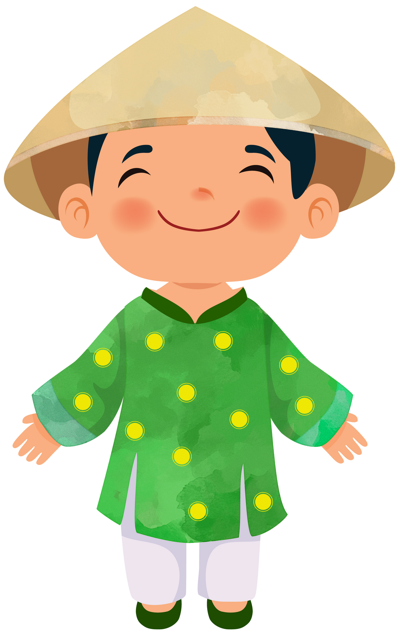

Look and Say
He’s from Viet Nam. She’s Vietnamese.
Notes:
Click to show the answer sentences.
Click the sentences to show the lucky scores.
Click the yellow star to back to the Number Slide.

Slide 13



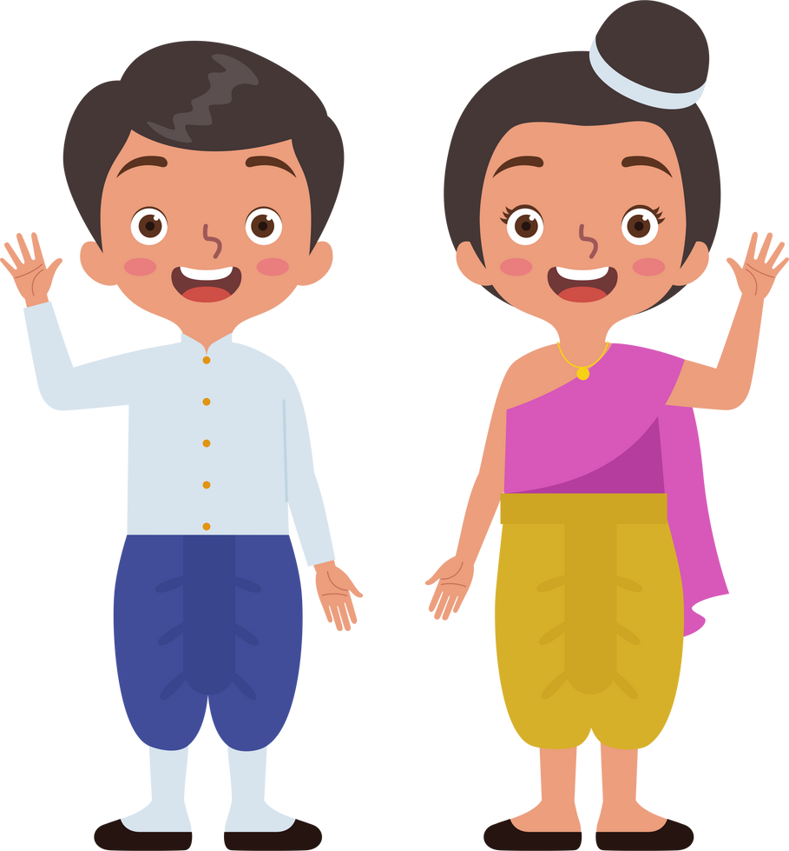
Look and Say.
They’re from Thailand. They’re Thai.
Notes:
Click to show the answer sentences.
Click the sentences to show the lucky scores.
Click the yellow star to back to the Number Slide.

Slide 14
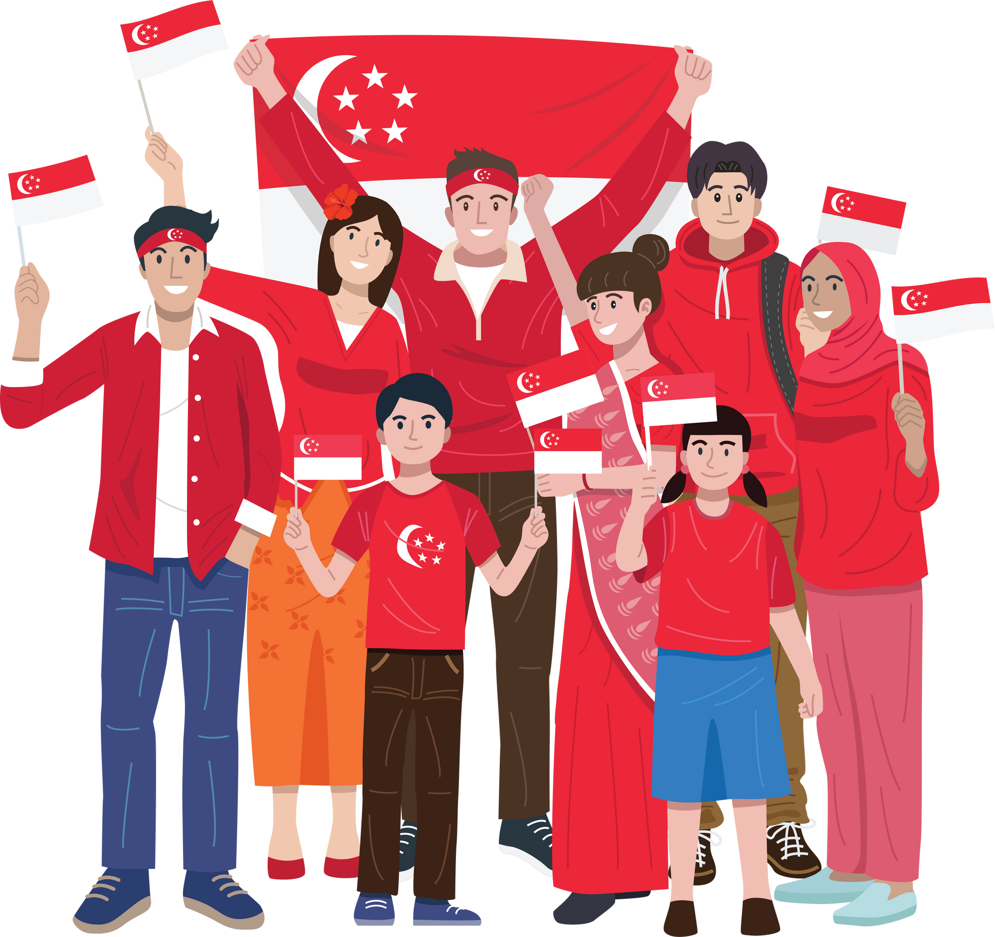
Look and Say.
They’re from Singapore. They’re Singaporean.
Notes:
Click to show the answer sentences.
Click the sentences to show the lucky scores.
Click the yellow star to back to the Number Slide.

Slide 15



Look and Say
They’re from Malaysia. They’re Malaysian.
Notes:
Click to show the answer sentences.
Click the sentences to show the lucky scores.
Click the yellow star to back to the Number Slide.

Slide 16




THANKS
FOR PLAYING!
See you next time!

Slide 17



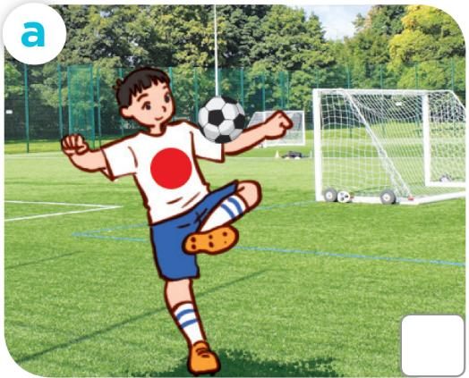
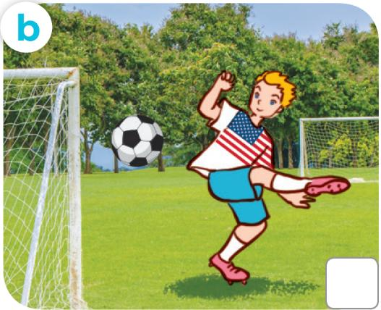
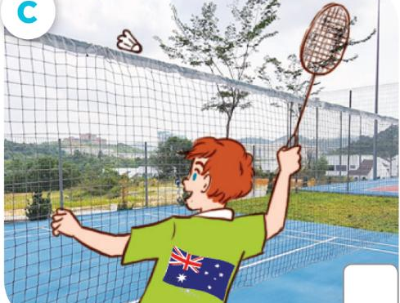


LOOK and ANSWER.
Japanese
American
Australian
Notes:
Step 1: Draw pupils’ attention to the pictures and ask questions such as What nationality is she? What’s he doing? to elicit the nationalities of the characters and the activities they are doing in the pictures. Remind them to look at the pictures a, b and c to contrast. For example, have pupils explain that the boy in picture a is playing football. He’s Japanese. The boy in picture b is playing football. He’s American. The boy in picture c is playing badminton. He’s Australian.

Slide 18


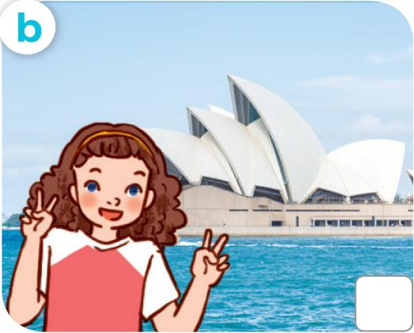
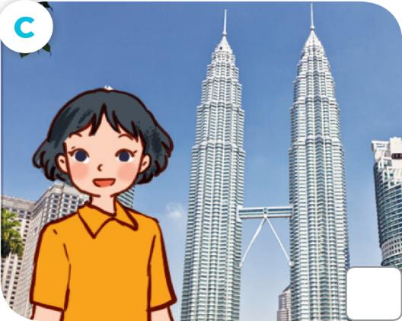
LOOK and ANSWER.
British
Australian
Malaysian
Notes:
Step 1: Draw pupils’ attention to the pictures and ask questions such as What nationality is she? What’s he doing? to elicit the nationalities of the characters and the activities they are doing in the pictures. Remind them to look at the pictures a, b and c to contrast. For example, have pupils explain that the boy in picture a is playing football. He’s Japanese. The boy in picture b is playing football. He’s American. The boy in picture c is playing badminton. He’s Australian.

Slide 19





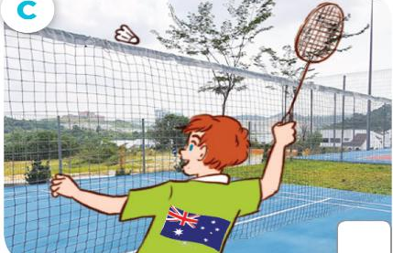




LISTEN and TICK.
Notes:
Step 2: Play the recording all the way through. Then play the recording again for pupils to listen and choose correct pictures that show the nationalities of the characters mentioned in the conversations.

Slide 20

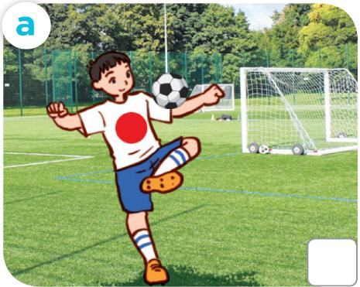





CHECK YOUR ANSWERS.
Notes:
Step 3: Get pupils to swap books with a partner and check their answers before checking as a class. Have pupils explain the answers by asking questions, for example, What’s Sam doing? What nationality is he?

Slide 21




Let's play!
sit down
Notes:
Extension (For advanced level): Read conversation 1 aloud but change specific information. For example, Look at Sam? - Who? Is he playing basketball? Have pupils stand up when the information is different. Invite a pupil to correct the information.

Slide 23

03
Read and circle.

Slide 24


READ and CIRCLE.
1. This is Sally. She’s from Britain / America.
Notes:
Step 1: Do sentences 1 together as an example. Draw pupils’ attention to the picture (A girl holding the flag of America) and elicit the words such as America and American. Have pupils read the sentences. Elicit the answer to fill in the gap (America).

Slide 25



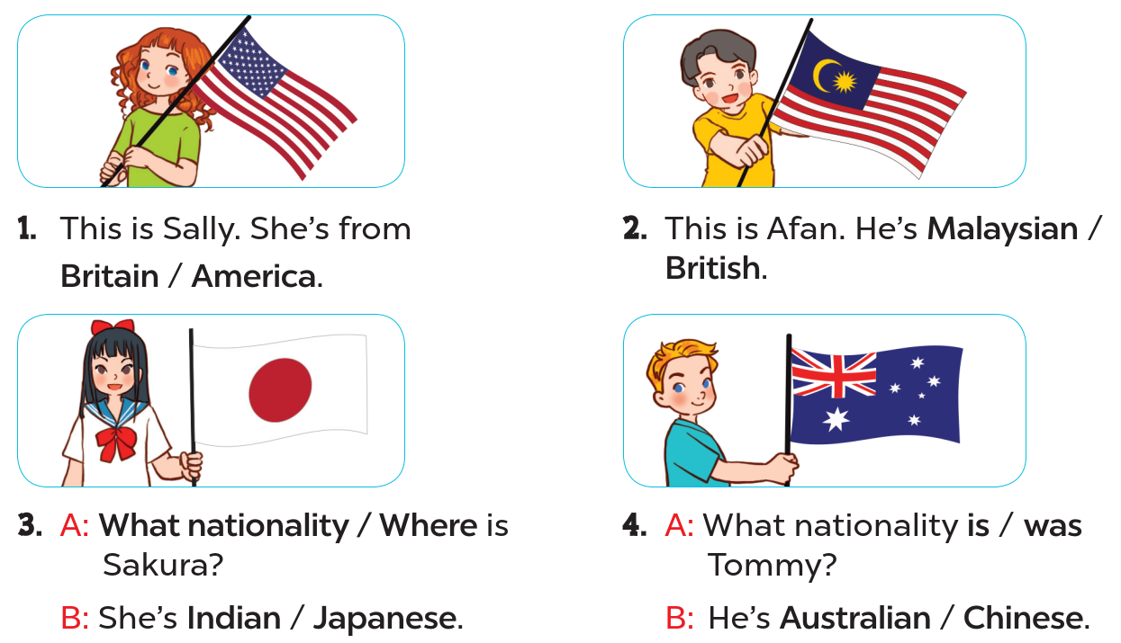

READ and CIRCLE.
Page
23
Notes:
Step 2: Give pupils time to do the task independently. Go around the classroom to offer help where necessary.

Slide 26





SWAP YOUR BOOKS
Notes:
Step 3: Get pupils to swap books with a partner and check their answers before checking as a class. Nominate some pupils to write the answers on the board. Check the answers. Ask questions to have pupils explain why they choose the options. For example, for picture B, ask why do you choose Malaysian? - Because there’s a flag of Malaysia.

Slide 27


Let’s CHECK your ANSWERS.
2. This is Afen. He’s Malaysian / British.
Notes:
Step 1: Do sentences 1 together as an example. Draw pupils’ attention to the picture (A girl holding the flag of America) and elicit the words such as America and American. Have pupils read the sentences. Elicit the answer to fill in the gap (America).

Slide 28



Let’s CHECK your ANSWERS.
3. A: What nationality / Where is Sakura?
B: She’s Indian / Japanese.
Notes:
Step 1: Do sentences 1 together as an example. Draw pupils’ attention to the picture (A girl holding the flag of America) and elicit the words such as America and American. Have pupils read the sentences. Elicit the answer to fill in the gap (America).

Slide 29


Let’s CHECK your ANSWERS.
4. A: What nationality is / was Tommy?
B: He’s Australian / Chinese.
Notes:
Step 1: Do sentences 1 together as an example. Draw pupils’ attention to the picture (A girl holding the flag of America) and elicit the words such as America and American. Have pupils read the sentences. Elicit the answer to fill in the gap (America).

Slide 30
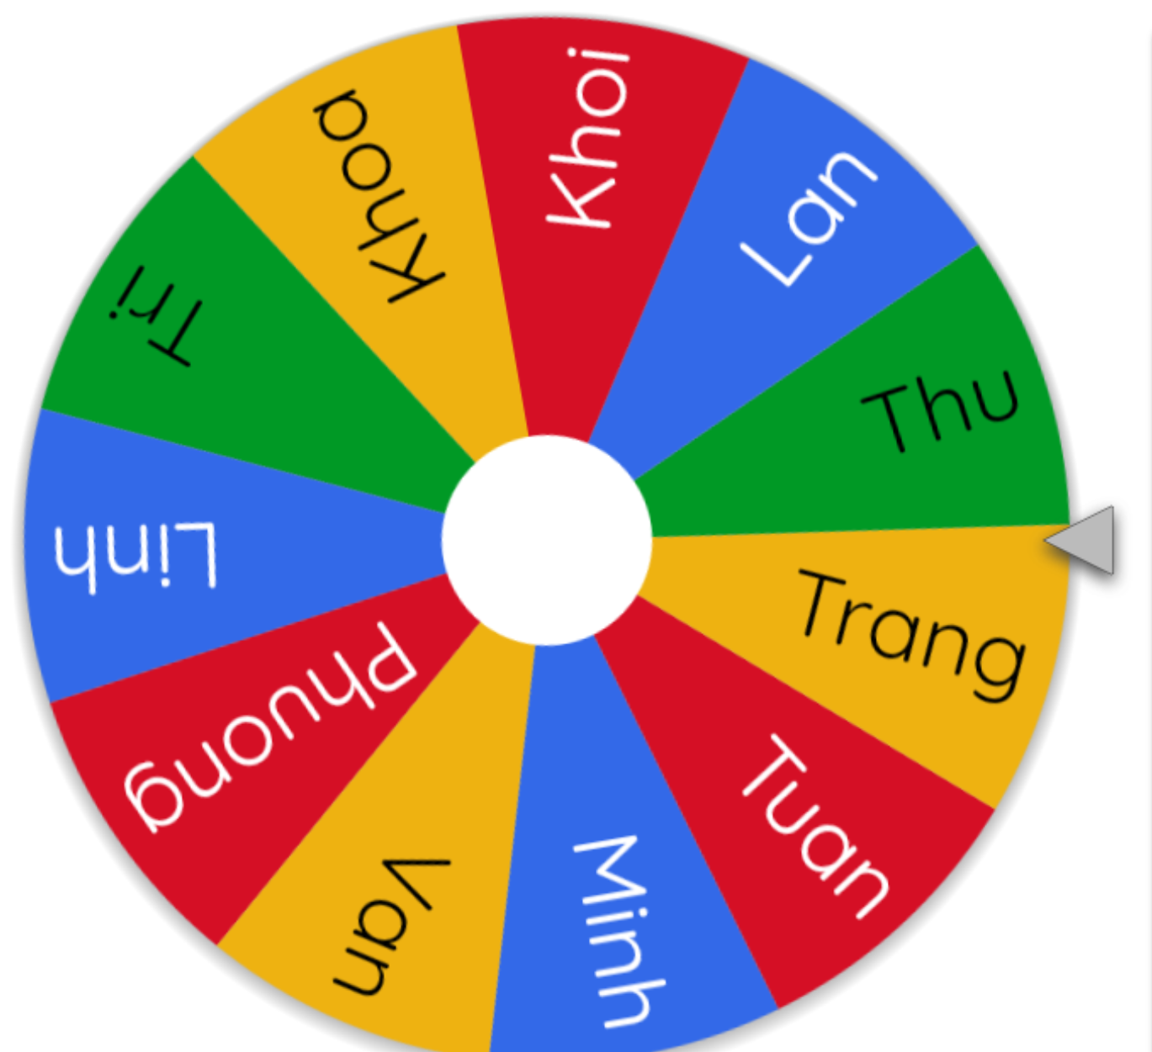
LET’S SPIN!
Notes:
Step 4: Invite four pairs of pupils to act out the completed exchanges 3 and 4 in front of the class. Correct their pronunciation where necessary.Use this link to choose pupils in random: https://wheelofnames.com/

Slide 32
04
Let’s sing.

Slide 33
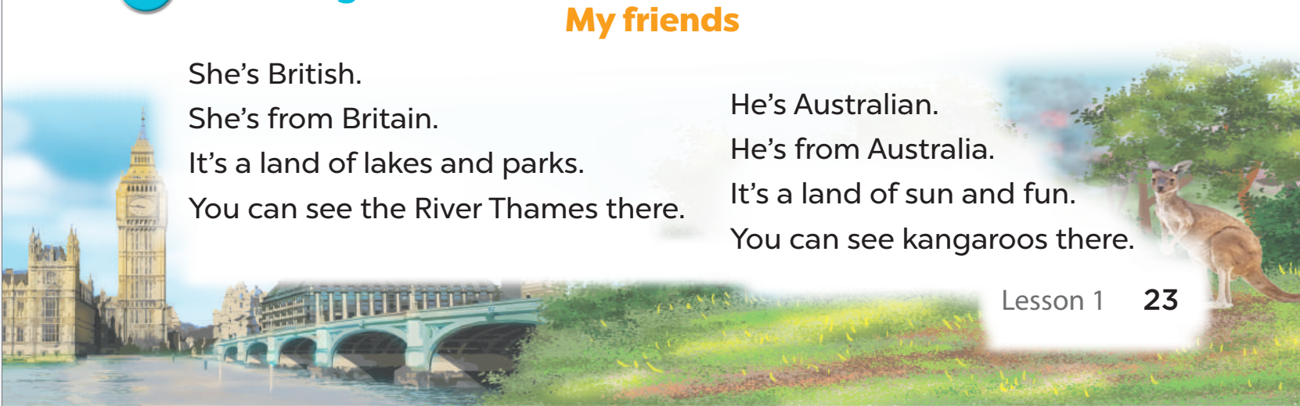

LOOK and SAY.
My friends
Notes:
Step 1: Draw pupils’ attention to the title and lyrics of the song. Encourage them to point at the pictures to say what they see.

Slide 34

LISTEN and POINT.
My friends
Notes:
Step 2: Have pupils read and listen to the song, draw their attention to the pronunciation, rhythm, and melody.

Slide 35
LISTEN and REPEAT.
My friends
She’s British.
She’s from Britain.
It’s a land of lakes and parks.
You can see the River Thames there.
Notes:
Step 3: Play the recording again and let them listen to and practise singing the song, line by line, while doing actions or clapping their hands when they hear the keywords such as British, Britain, land, see in the first verse and Australian, Australia, land, see in the second verse.

Slide 36
LISTEN and REPEAT.
My friends
He’s Australian.
He’s from Australia.
It’s a land of sun and fun.
You can see kangaroos there.
Notes:
Step 3: Play the recording again and let them listen to and practise singing the song, line by line, while doing actions or clapping their hands when they hear the keywords such as British, Britain, land, see in the first verse and Australian, Australia, land, see in the second verse.

Slide 37

SING and CLAP.
My friends
She’s British.
She’s from Britain.
It’s a land of lakes and parks.
You can see the River Thames there.
Notes:
Step 3: Play the recording again and let them listen to and practise singing the song, line by line, while doing actions or clapping their hands when they hear the keywords such as British, Britain, land, see in the first verse and Australian, Australia, land, see in the second verse.

Slide 38
LISTEN and REPEAT.
My friends
He’s Australian.
He’s from Australia.
It’s a land of sun and fun.
You can see kangaroos there.
Notes:
Step 3: Play the recording again and let them listen to and practise singing the song, line by line, while doing actions or clapping their hands when they hear the keywords such as British, Britain, land, see in the first verse and Australian, Australia, land, see in the second verse.

Slide 39
LISTEN, SING and CLAP.
My friends
Notes:
Step 4: Ask pupils to listen to and sing the whole song while doing actions or clapping their hands. Go around the classroom and offer help where necessary.

Slide 40







Let’s SING in the front.
Notes:
Step 5: Invite a few groups to the front of the class to sing the song. The class may sing along to reinforce the activity.

Slide 42
05
Fun corner
and wrap-up

Slide 43





Yes or No Game
Let’s play!

Slide 44



The
Rules
  Answer the questions within limit time.
  If the answer is correct, the player will get 1 point.
  If the answer is wrong, the player will lose 1 point.
  Have fun!

Slide 45





Question
  Is he Japanese?
You have 15 seconds.

Slide 46

Answer
Yes

Slide 47

Question
  Is she American?
You have 15 seconds.

Slide 48
Answer
No
She’s Thai.
She’s from Thailand.

Slide 49

Question
  Are they Australian?
You have 15 seconds.

Slide 50
Answer
Yes

Slide 51

Question
  Is she Malaysian?
You have 15 seconds.

Slide 52
Answer
No
She’s Singaporean.
She’s from Singapore.

Slide 53

Question
  Is he British?
You have 15 seconds.

Slide 54
Answer
No
He’s Vietnamese.
He’s from Viet Nam.

